Slide 2


Slide 3
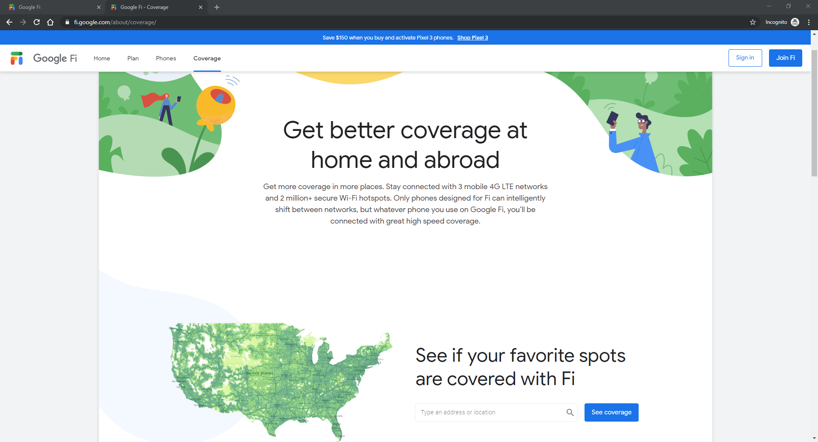

Slide 4
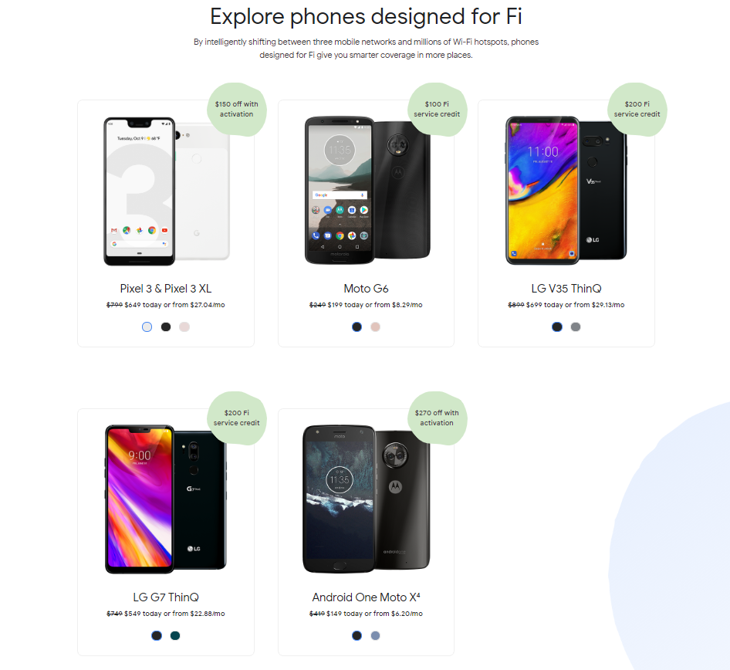
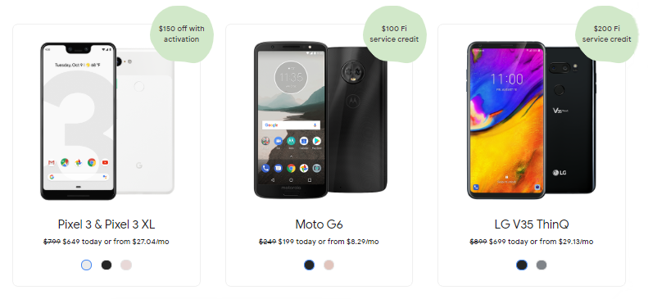

Slide 5
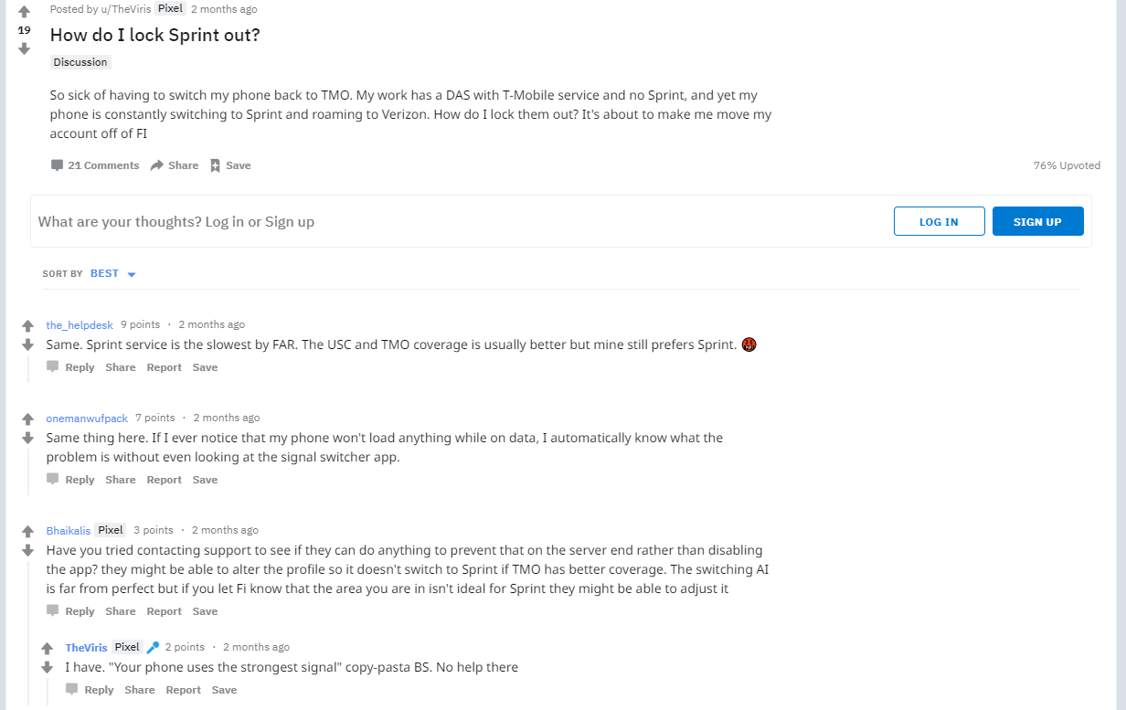
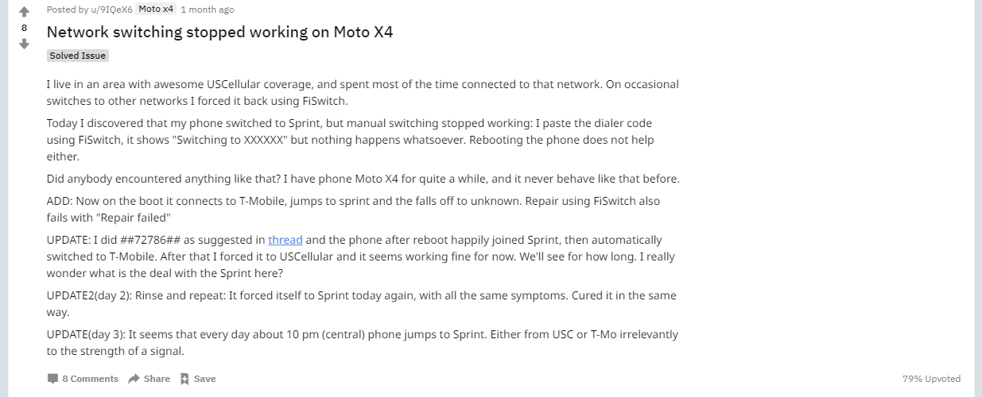

Slide 6
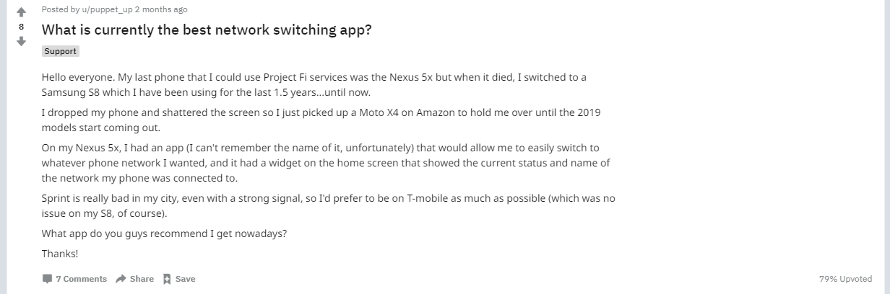

Slide 7
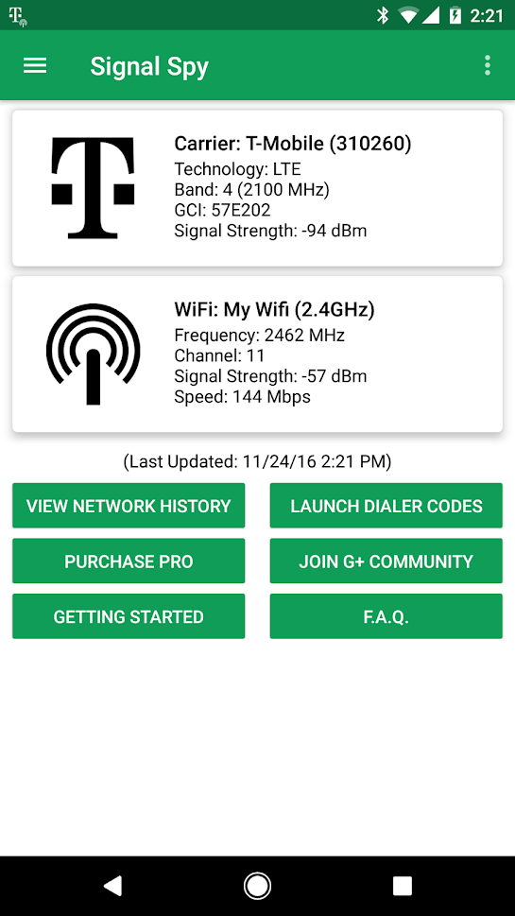
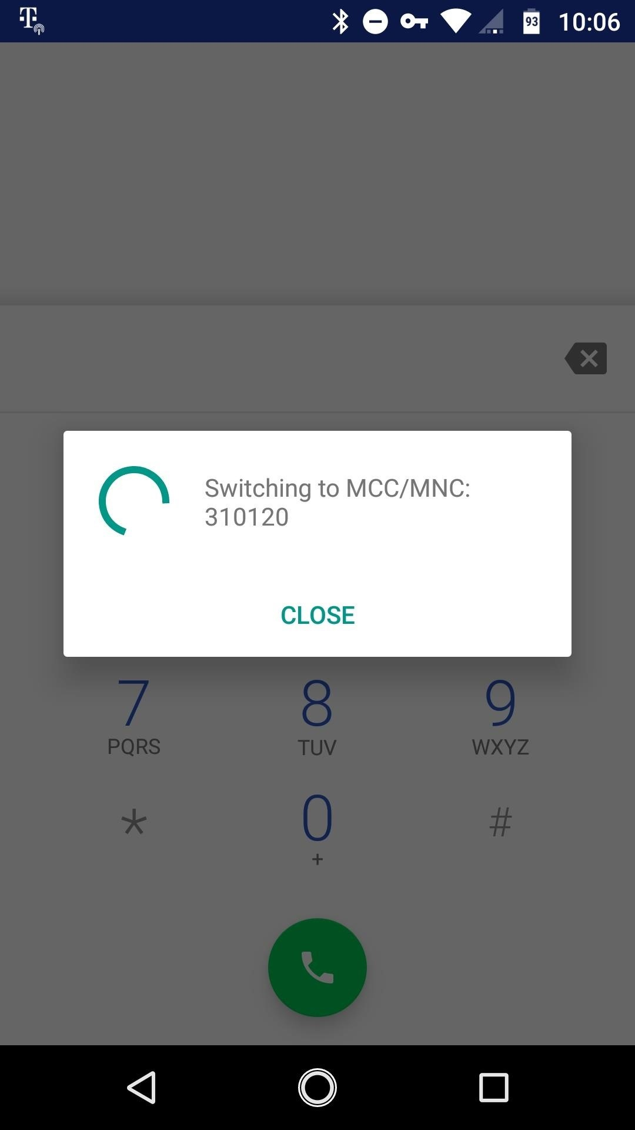
Third Party Carrier Switching Apps (SignalSpy)
Provides debugging codes to manually type into your dialer app to force a change of carrier.

Slide 8
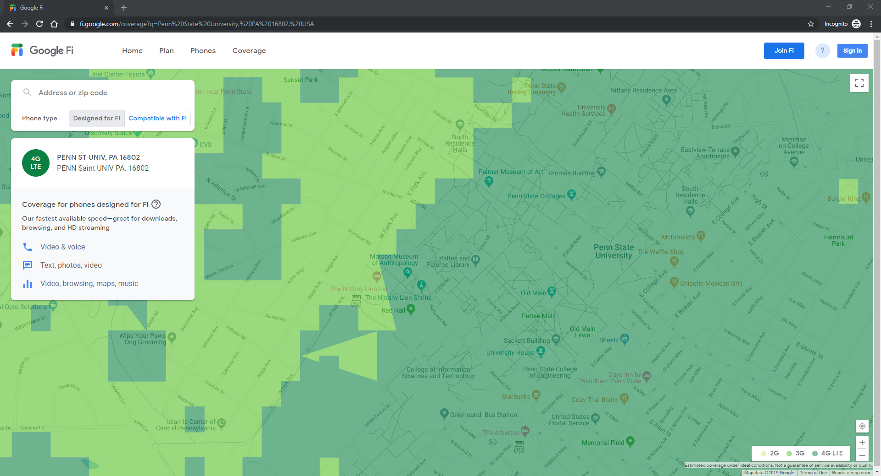
Window

Slide 9

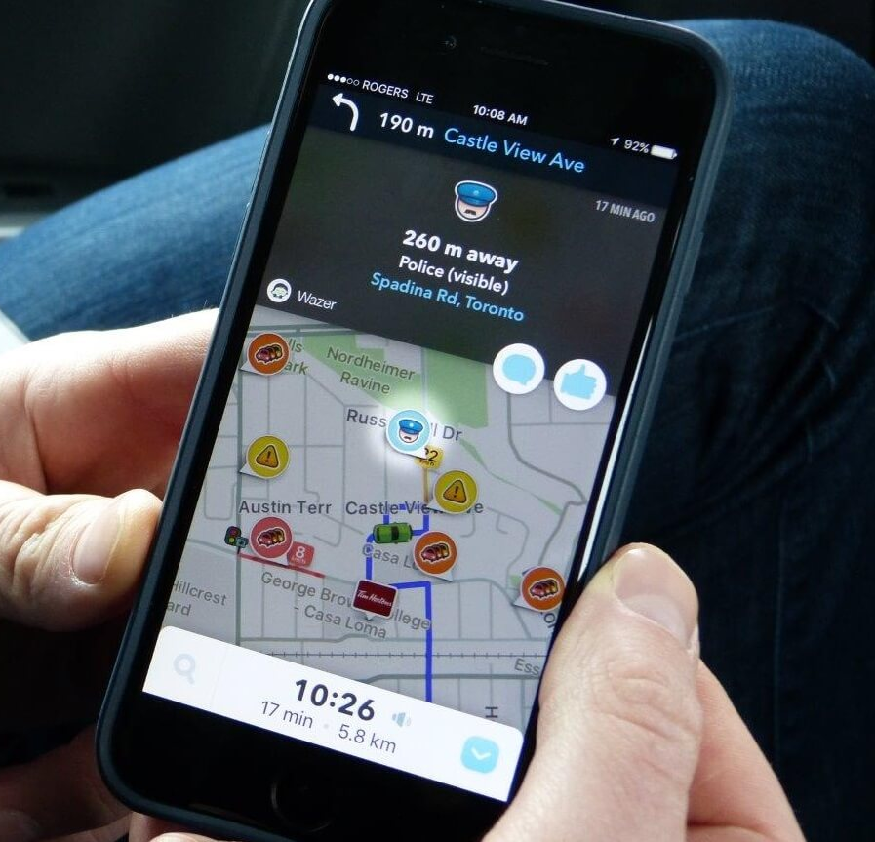

Slide 10
Window

Slide 11
Project Goals and Scope
Design a new third party app to manage the three network signals based on current location.
This will include:
A three-dimensional map of the networks
Suggesting the best signal for the area
in the form of a persistent notification
Show auto switching to the best network
without manual dialer codes

Slide 12

Evaluation of New Design
A mock-up of the potential app will be piloted in-person with up to 5 potential users

