Slide 1
Learning Software Development: ​ When Do Students Need Help?​
Master’s Thesis Presentation 3/25/2019
Author: Benjamin Eppinger
Thesis Advisor: Steve Haynes

Slide 2
Contents
Introduction
Related Literature
Psychology
Documentation Standards
Software Development
Study Introduction
IST Curriculum Background
Study Methodology
Result Analysis
Study Implications
Future Work
References

Slide 3
Introduction
Background
People turn to a variety of sources to help solve problems [1].
The term documentation has expanded to include many more resources
Documentation is now non-discriminatory of the resource’s fluidity [2].
A person can be presented with challenges which range in difficulty
very simple to very complex problems
Notes:
[1] (Illinois University Library, n.d.)
[2] (Levy, 1994)

Slide 4
Introduction (cont.)
Problem
We generally know what kinds of documentation are available, but not when people use specific resources.
When students use documentation while learning has often been overlooked [3].
Notes:
[3] (Piech, Blikstein, Cooper, Sahami, & Koller, 2012)

Slide 5
Introduction (cont.)
Objectives / Research Questions
When do students turn to external documentation?
What do students frequently use for help while participating in a programming course at a college level?
What do middle-level software development students think would aid in the rate of their learning?

Slide 6
Related Literature
Minimalistic Documentation
Types of Development Resources
Cognitive Maps
Constructivism
Bootstrapping Knowledge
Tools for Development
Error Types
---------------------------------------------------------------------- Categories of Literature --------------------------------------------------------------------
Documentation & Resources
Software Development
Psychology
{Chart of Literature Categories}

Slide 7
Related Literature in Psychology
There is still no ‘one’ completely agreed upon stance on learning and what learning entails [4].
Constructivism
Creating new knowledge by relating prior experiences [4].
Cognitive Map
A gradually created mental map of the environment (e.g. a maze) [4].
Bootstrapping Knowledge
The action of putting together the knowledge that a person already has [5]
Notes:
[4] (Olson & Hergenhahn, 2012)
[5] (Darling & Havelka, 2010)

Slide 8
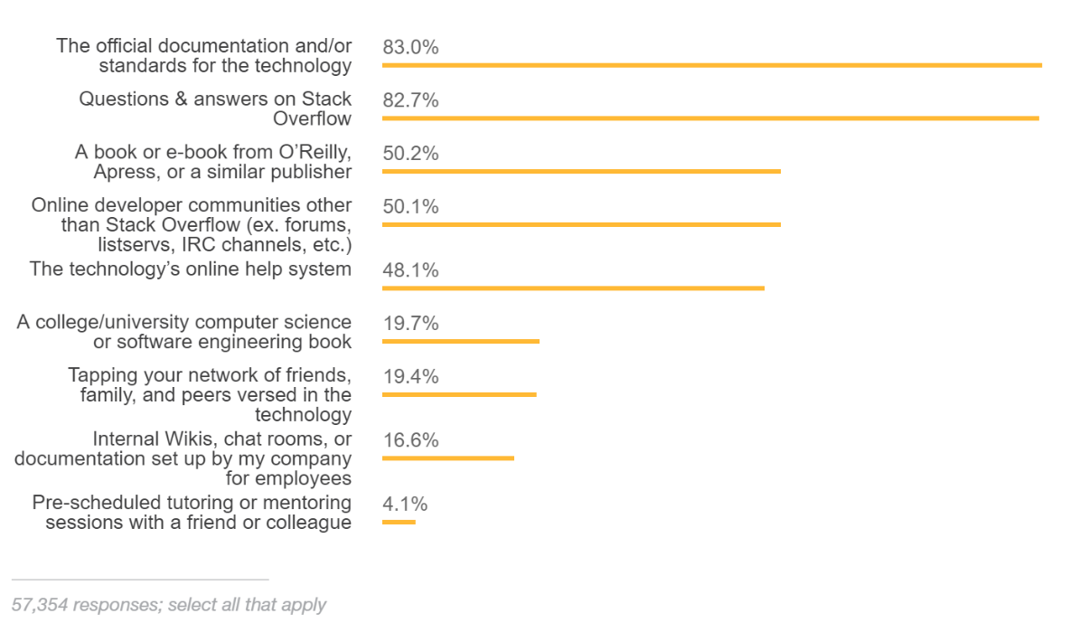
Related Literature in Documentation Standards
Minimalistic Documentation
A strategy to create training materials that people can learn from [6].
Focuses on [7]:
Action-oriented approaches
Error recognition and recovery
Self-guided exploration and guidance
The ability to have a fast start to learning
Types of Development Resources [8]:
Notes:
[6] (Farkas, 1998)
[7] (Carroll et al., 1998)
[8] (Stack Overflow, 2018)

Slide 9
Related Literature in Software Development
Tools for Development
Packages and Frameworks
Integrated Developer Environments (IDE)
Error Types (non-exhaustive)
Stylistic errors
Syntax errors
Environmental constraints
Runtime Errors

Slide 10
Study Introduction
When do students turn to external documentation?
Will students utilize a variety of information resources to assist with their course-related development problems?
What do students frequently use for help while participating in a programming course at a college level?
Do students turn to online resources more than in-person help?
Do students prefer freely-available online resources instead of using class textbooks?
What do middle-level software development students think would aid in the rate of their learning?
Do the students have a set of consistent set of problems because of their bootstrapped knowledge?

Slide 11
IST Curriculum Background
Classes, objects, inheritance, polymorphism, encapsulation, and abstractions [10]
Developing full-featured applications, Agile/scrum methodologies
IST 140
IST 242
IST 261/361
IST 311
Create basic programs in an IDE
Simple data structures
Problem-solving strategies
Application Debugging [9]
Application design,
event-driven applications, and Java core package libraries [11]
Notes:
[9] IST 140 Introduction to Application Development. (2018).
[10] IST 242 Intermediate & Object-Oriented Application Development. (2018).
[11] IST 311 Object-Oriented Design and Software Applications. (2018).

Slide 12
Study Methodology
Twenty students enrolled in a middle-level development class (i.e. IST 311) were surveyed and interviewed about when they used resources in development.
The students answered a variety of questions about past programming problems they experienced. These answers were coded into categories and concept areas.
These categories deduced recurring situations that caused them to seek help from resources.

Slide 13
Result Analysis: ‘Started, but could not continue’
Many students were able to start working on the problem, but then could not understand how the concept worked.
For example:
“We were asked to take sample FXML code and make a new window. I couldn’t find information on ‘actiontarget’ and couldn’t get it to work. I tried Googling actiontarget, but couldn’t find any info, so I went and talked to my group members. They told me to try removing actiontarget, and it worked.”

Slide 14
Result Analysis: ‘Started, but could not continue’ (cont.)
The issues were not limited to FXML (the topic currently being learned in their class).
Other students gave examples of passing control between classes, and using the model-view-controller Java class architecture.
The students could start work on the solution, but would hit an inflection point when they went beyond modeling the provided sample code.

Slide 15
Result Analysis: ‘In-person help’
Very few students said they utilized tutoring services for development help.
Even when the student reported having significant success with in-person help (conversation format) from peers and teaching staff.
“(Coding is) an activity that requires daily practice and I think tutoring can only help with foundational things and not my specific questions.”
None of the students used books (online or print).
Instead opted for instructional videos or online Q&A sites for learning concepts.

Slide 16
Study Implications
Based on the results, course content could be adapted to include more:
Instructional video content
Code walkthroughs
Debugging strategies
Additional direction for relevant online resources (applicable Q/A posts)
The students experienced repetitive issues with FXML and the model-view-controller Java class architecture.
Tutoring services provided by the school could be marketed as peer-to-peer/teaching-staff help sessions, similar to a common office hour.

Slide 17
Future Work
The scope of this study was limited to software development.
Would the resource usage change if not development focused?
The study is representative of middle-level development students in IST at Penn State.
Would there be significant differences between other college or departments?

Slide 18
References
[1] Illinois University Library, “Types of Sources and Where to Find Them: Primary Sources – History, Philosophy, and Newspaper Library – U of I Library.” [Online]. Available: https://www.library.illinois.edu/hpnl/tutorials/primary-sources/. [Accessed: 24-Feb-2019].
[2] D. M. Levy, “Fixed or Fluid? Document Stability and New Media,” 1994.
[3] C. Piech, P. Blikstein, S. Cooper, M. Sahami, and D. Koller, “Modeling how students learn to program,” ACM SIGCSE Bull., p. 153, 2012.
[4] M. H. Olson and B. R. Hergenhahn, An Introduction to Theories of Learning. Pearson Prentice Hall, 2012.
[5] S. Darling and J. Havelka, “Visuospatial bootstrapping: Evidence for binding of verbal and spatial information in working memory,” Q. J. Exp. Psychol., vol. 63, no. 2, pp. 239–245, Feb. 2010.
[6] D. Farkas, “Layering as a safety net for minimalist documentation,” 1998.
[7] J. M. Carroll, S. for T. Communication, T. Anson, R. J. Brockmann, and S. Draper, Minimalism Beyond the Nurnberg Funnel. Cambridge, Mass., 1998.
[8] Stack Overflow, “Developer Survey Results 2018,” 2018. .
[9] “IST 140 Introduction to Application Development,” 2018. .
[10] “IST 242 Intermediate & Object-Oriented Application Development,” 2018. .
[11] “IST 311 Object-Oriented Design and Software Applications,” 2018. .
Notes:
IEEE Citation Style

