Slide 1
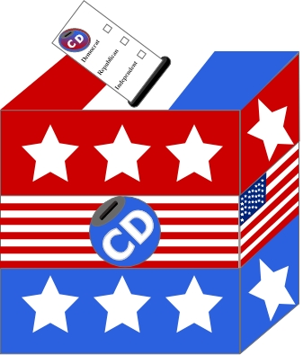
Civic Duty
24th of July, 2018
Nicholas Fuller (Product Owner)
Daniel Gaughhan
Bryan Ji
Rui Kawahara
Rob Phillips

Slide 2
Project Domain
Politic impacts our daily life
Regardless of its importance, they’re dismissed
Difficult to understand for many
Create app that everyone can use conveniently
Inform everyone what’s going on
“Foot-in-door” to politics

Slide 3
Project Goals
Allow anyone to look up the list of representatives
Provide simple description of the candidates
Color code each representatives
Pull representatives’ information from database
Show geographical location of a list of candidates
Users can input zip/address to get info on nearby candidates

Slide 4
Goals Achieved
We were able to launch our app!
Our app is compatible with both Android and iOS
We were able to pull information from our database
Take input from users
Display candidate’s information

Slide 5
Challenges (Project)
Learning backend on Django
Working around React Native’s volatile environment
Limited resources on newer technologies
Standards of UI design
Unique app testing method
Developer tools

Slide 6
Challenges (Process)
Time limit
Initial member recruitment
Communication
SCRUM process
Compatible scheduling
Productivity

Slide 7

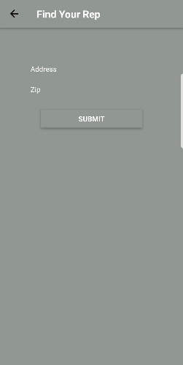
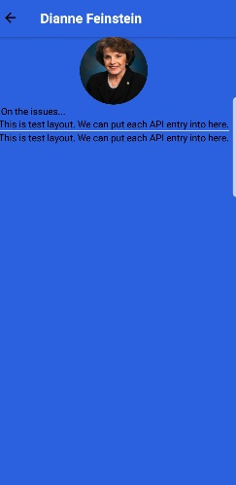
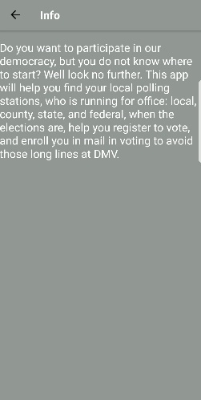
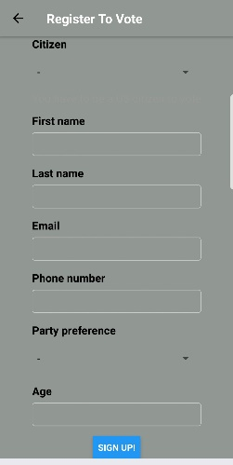
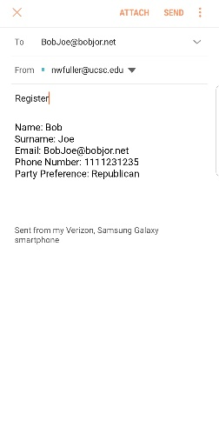
Overall Outline

Slide 8

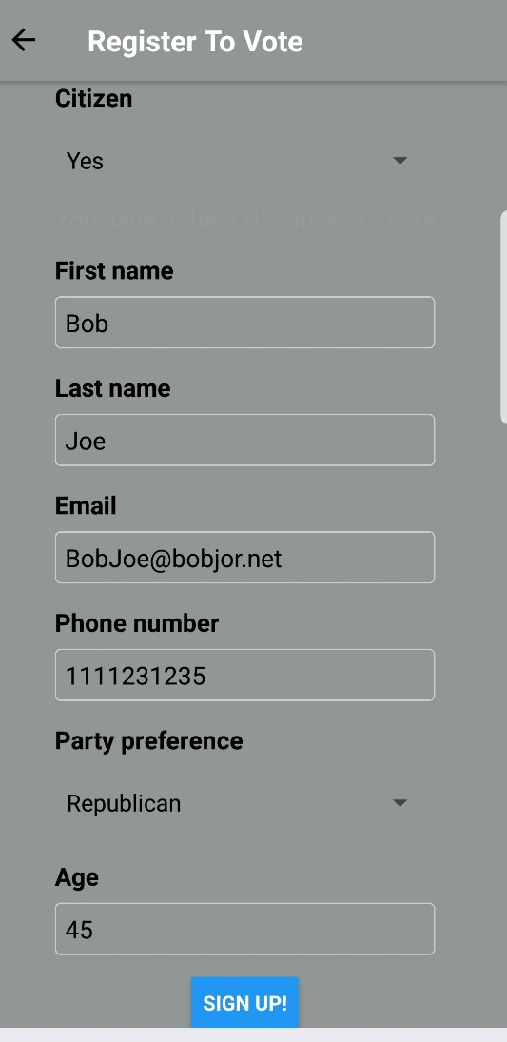

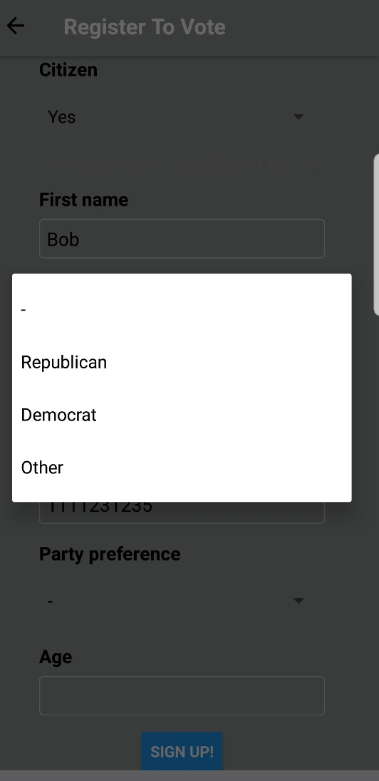
Register to Vote

Slide 9
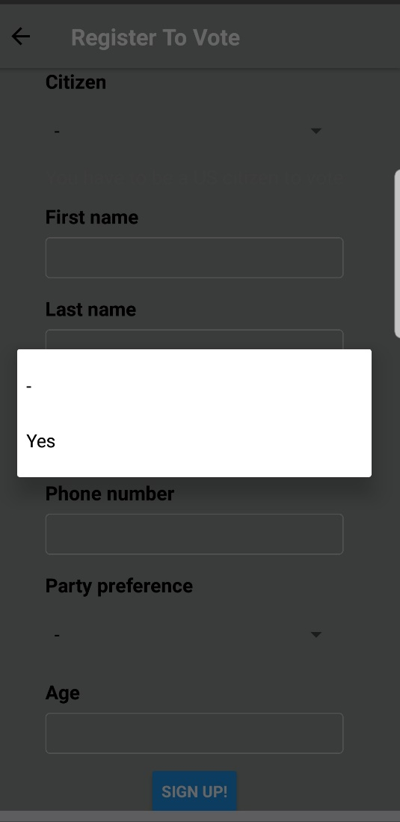
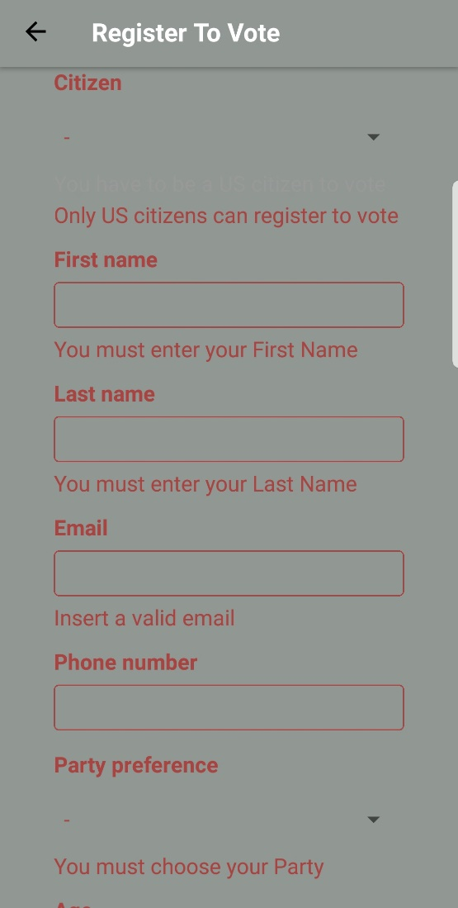
Register to Vote (cont’d)

Slide 10
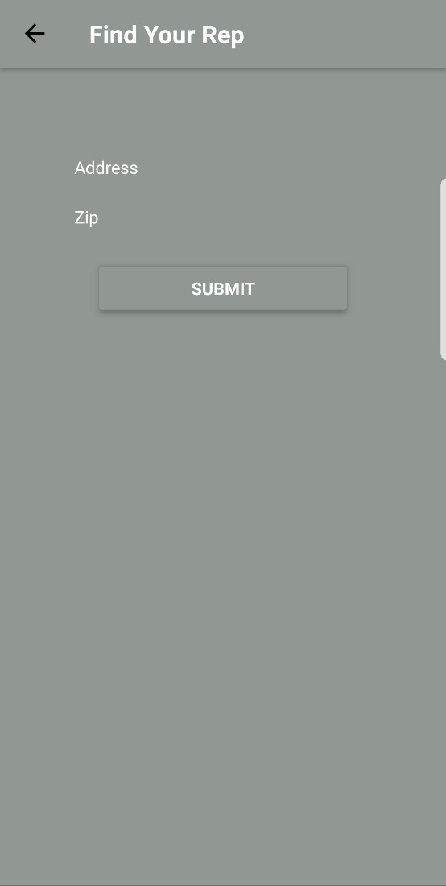
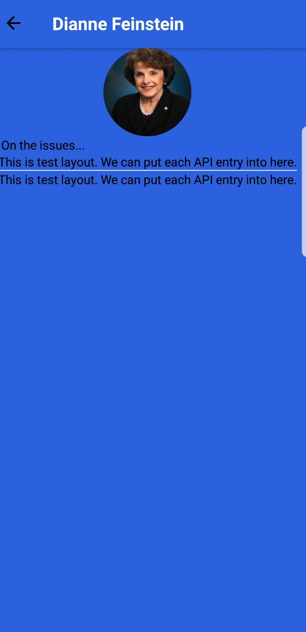
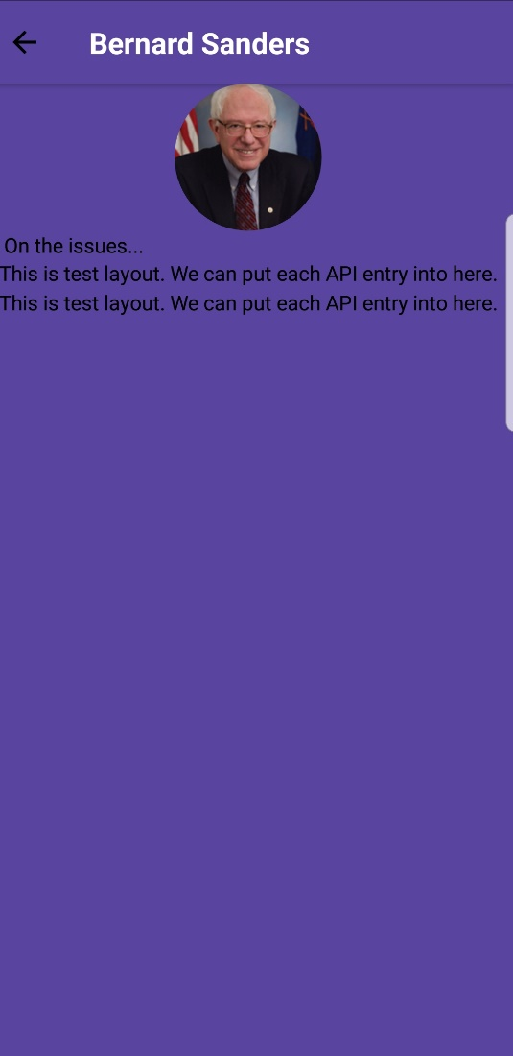
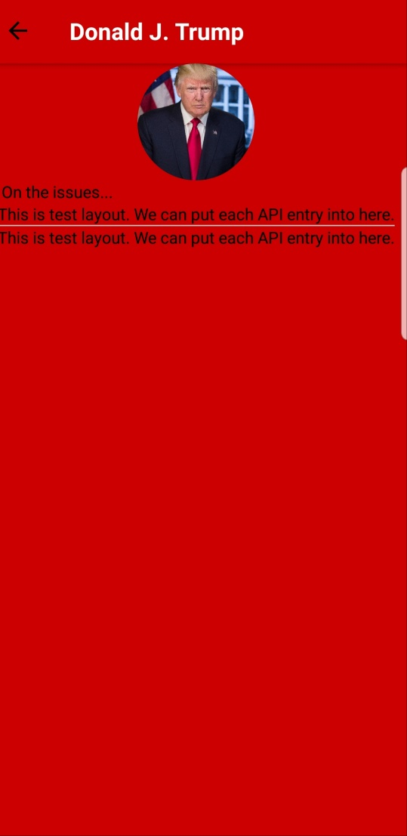
Find Representatives

Slide 11







Technology Used
Inform
Change
Display
Version
Control
Get &
Set Data
Design
Backend

Slide 12
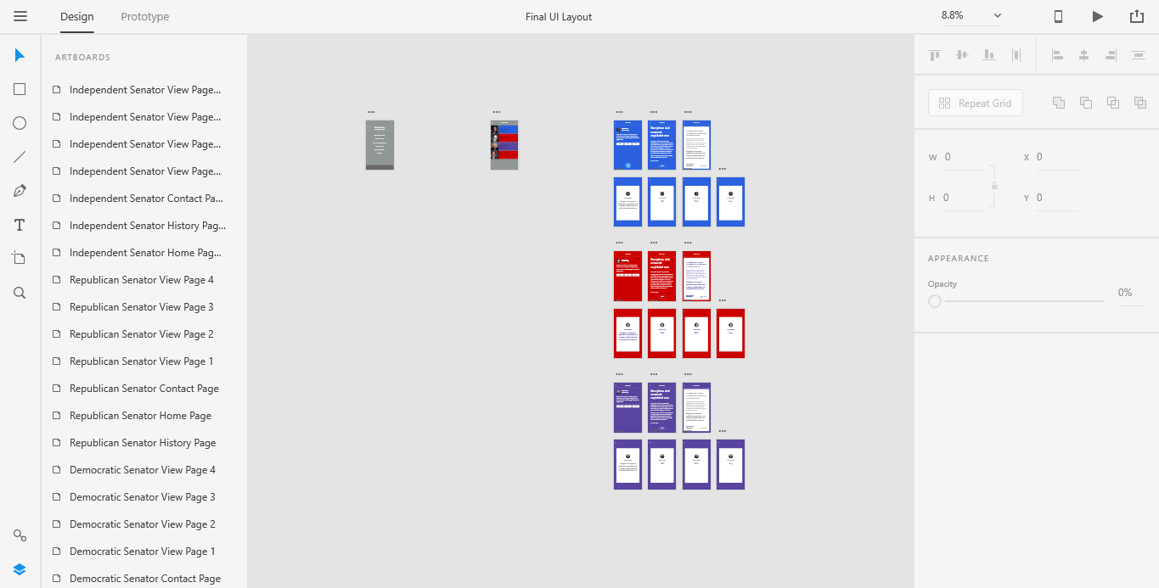
Process: Design

Slide 13
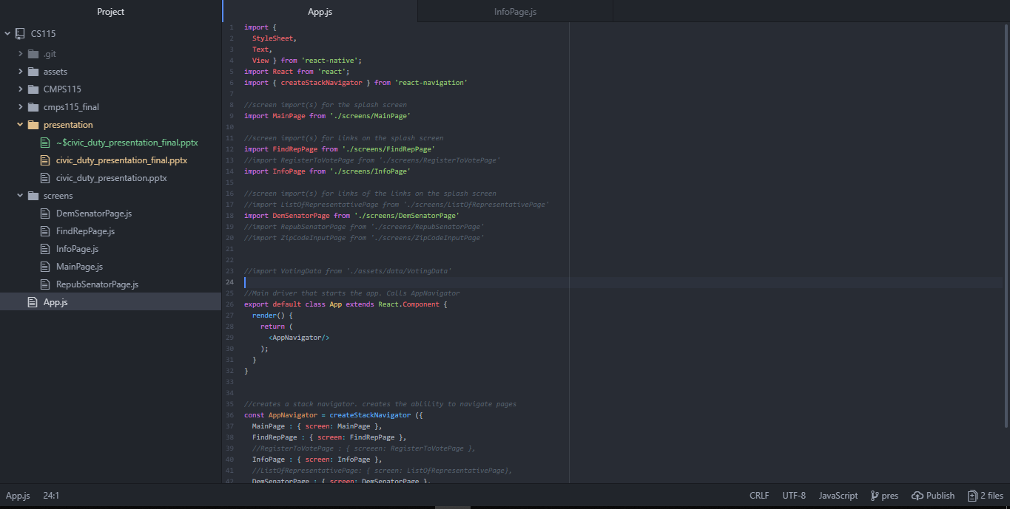
Process: React Native (Implement)

Slide 14
Process: React Native (Generate)

Slide 15
Process: Expo (Display)

Slide 16
Project Management
Engineering Method (e.g. planning poker)
Scrum Meeting
Sprint Planning
Sprint Review
Communication
Version Control

Slide 17
What We Liked
Group collaboration through Git
Watching our apps to be interactive
Encouraging environment
Professional development process
Smooth compatible schedule
Labor Distribution

Slide 18
What We Didn’t Like
Compressed deadline (5 weeks – week 1 & 5)
React Native and its volatility
Lack of documentation for React Native
Expo and debugging
Occasional miscommunication
Physical SCRUM board (inconvenience)

Slide 19
Learning Experience: Continue Doing
Frequent SCRUM meeting
Design first, then build
Setting standard convention/guideline
Documenting code through comments
Version control using Git (e.g. branching)

Slide 20
Learning Experience: Stop Doing
Stop using react native (or any unstable technology)
Meeting conflicts (e.g. missing, infrequent meeting, etc.)
Individual development
Estimating other members progress
Forgetting to document code

Slide 21
Things We Wish We Could Have Done
Used different framework/Start Over
Nationwide Search
Fix critical bugs
Info on how to register
View House of Representative members
Auto TL;DR

