Slide 1

Civic Duty
24th of July, 2018
Nicholas Fuller (Product Owner)
Daniel Gaughan
Bryan Ji
Rui Kawahara
Rob Phillips

Slide 2
Project Domain
Politics impacts our daily life
Regardless of its importance, they’re dismissed
Difficult to understand for many
Create app that everyone can use conveniently
Inform everyone what’s going on
“Foot-in-door” to politics

Slide 3
Project Goals
Allow anyone to look up their own representatives
Provide simple description of the candidates
Color code each representative
Pull representatives’ information from database
Show geographical location of a list of candidates
Users can input zip/address to get info on nearby candidates

Slide 4
Goals Achieved
We were able to launch our app!
Our app is compatible with both Android and iOS
We were able to pull information from our backend server API
Take input from users
Display candidate’s information

Slide 5
Challenges (Project)
Learning backend on Django
Working around React Native’s volatile environment
Limited resources on newer technologies
Standards of UI design
Unique app testing method
Developer tools
Notes:
Switch speakers
Rob starts here.

Slide 6
Challenges (Process)
Time limit
Initial member recruitment
Communication
SCRUM process
Compatible scheduling
Productivity

Slide 7
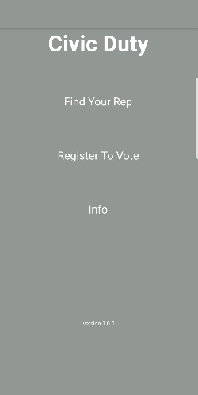
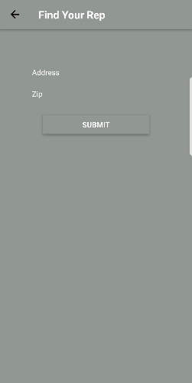
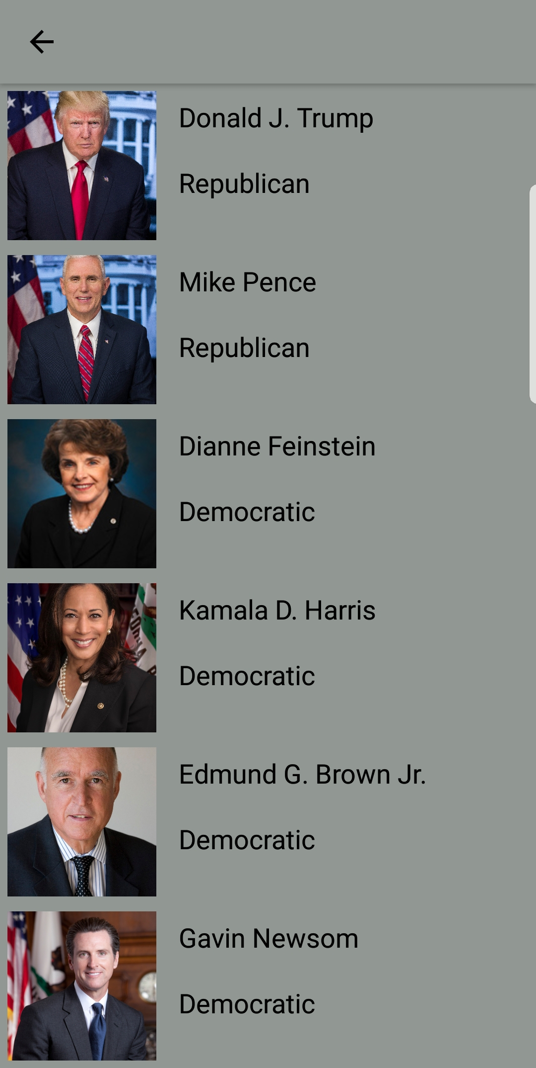
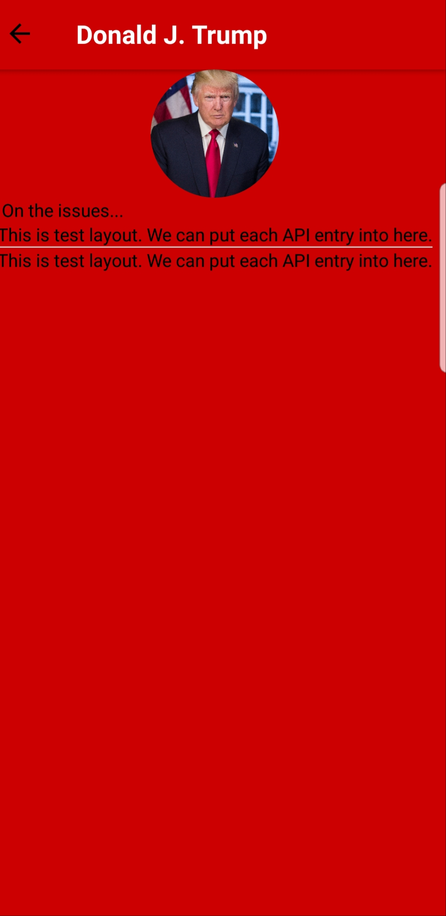
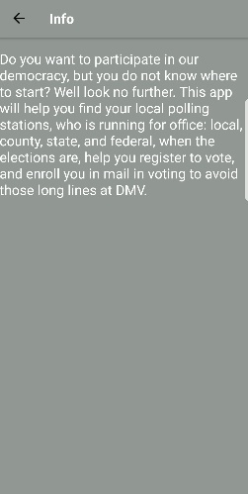
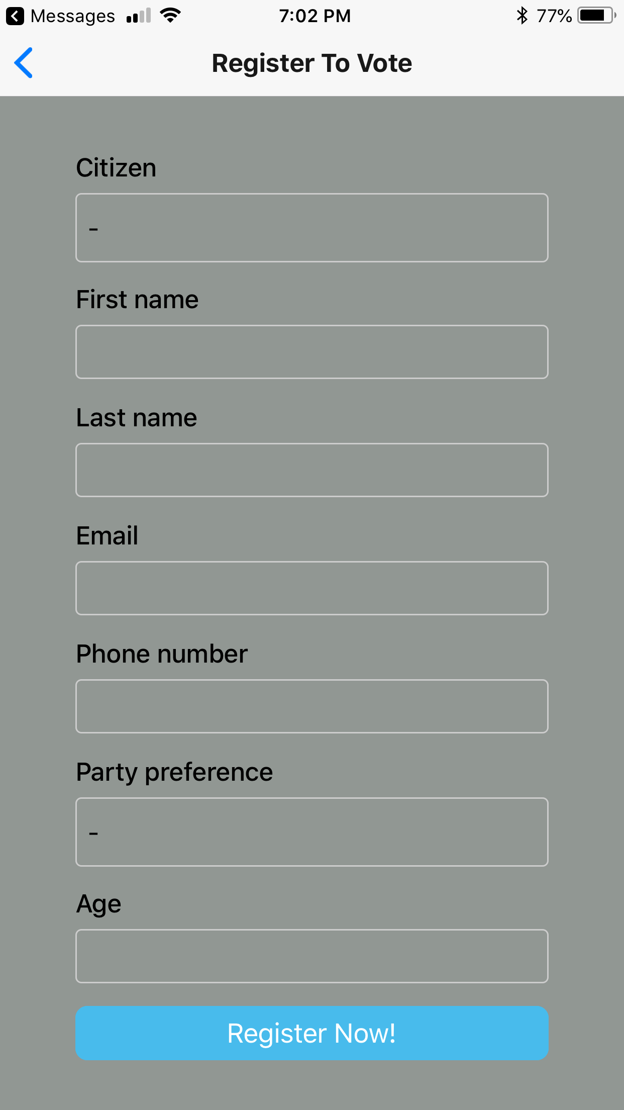
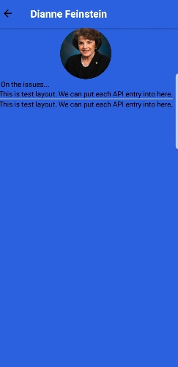
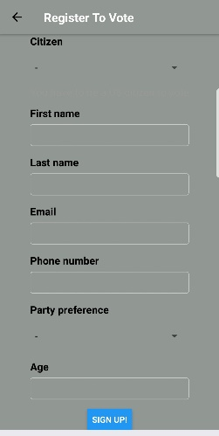
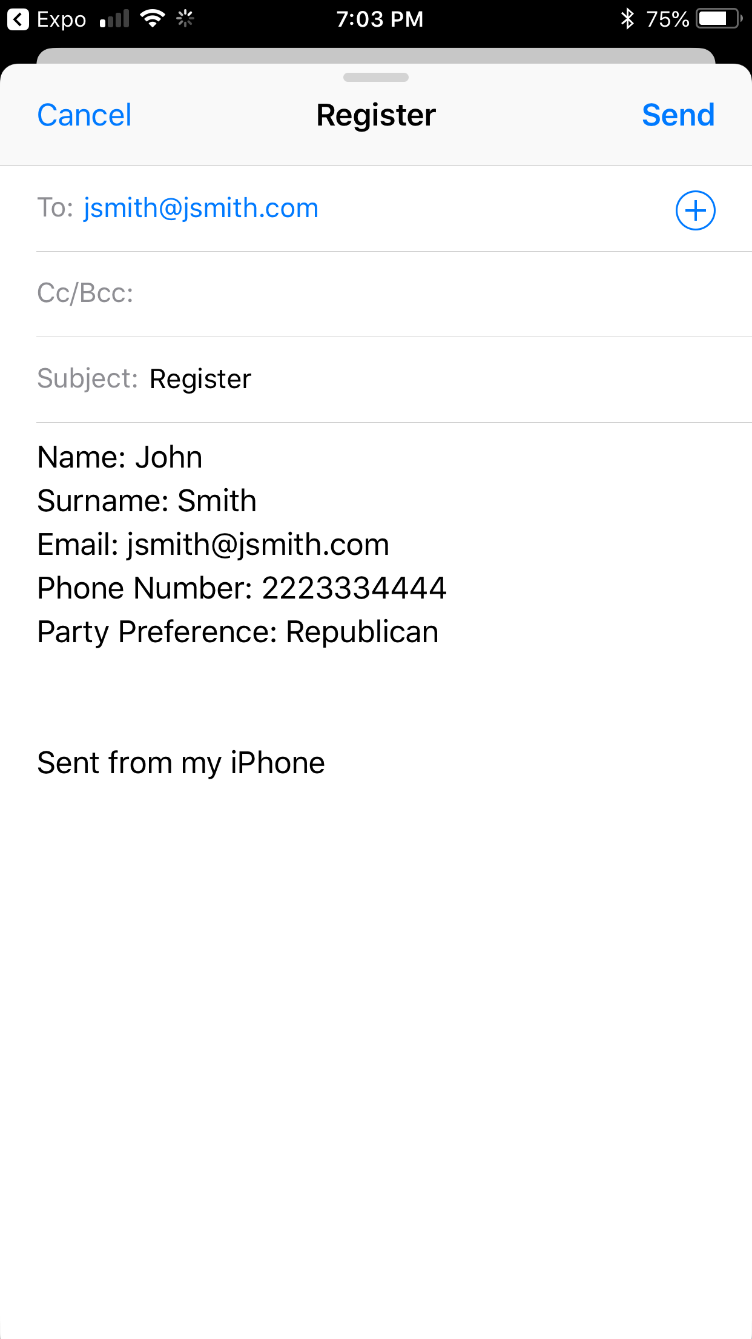
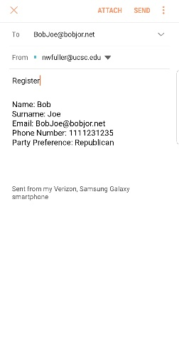
Overall Outline
Notes:
Daniel starts here

Slide 8
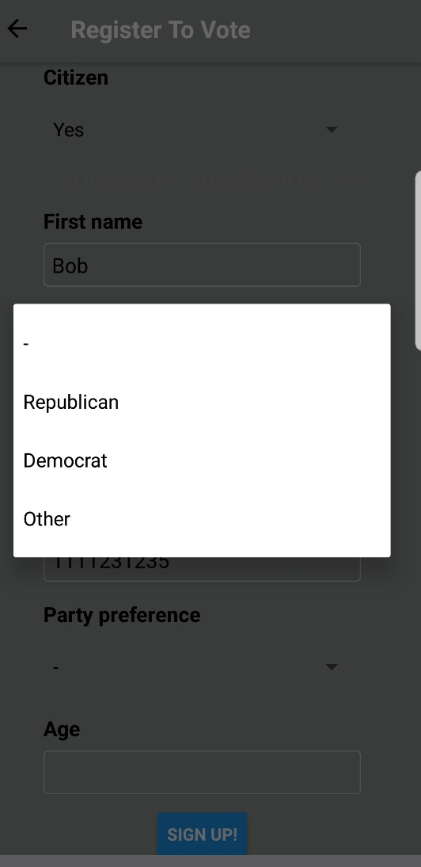

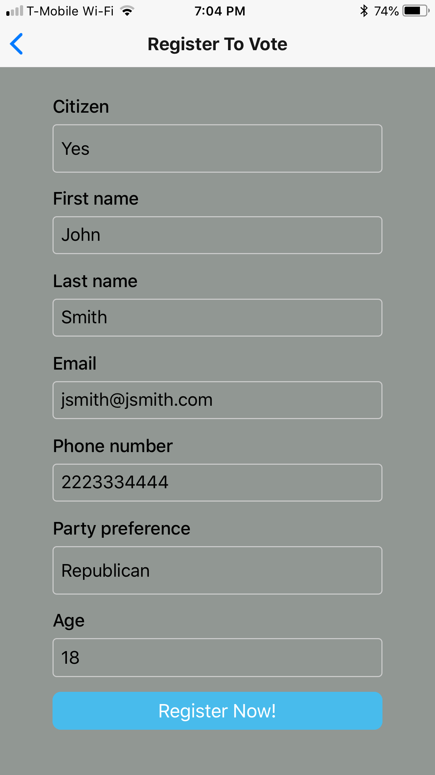
Register to Vote

Slide 9
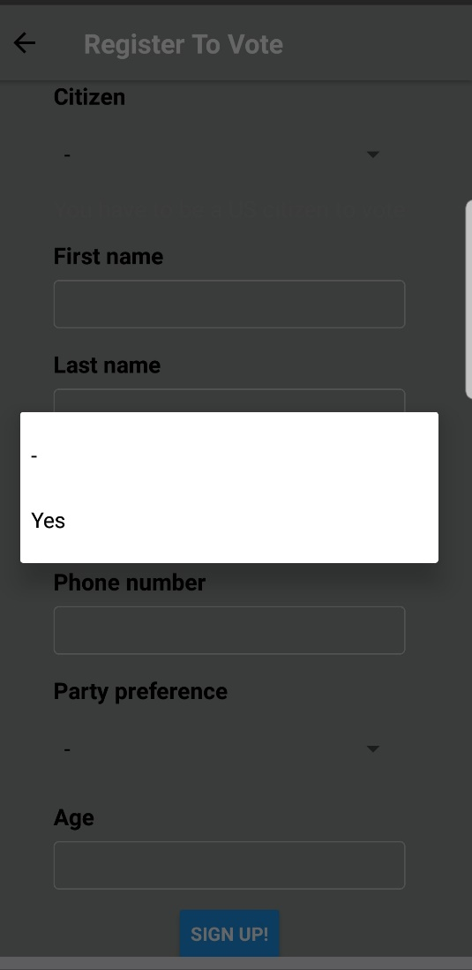
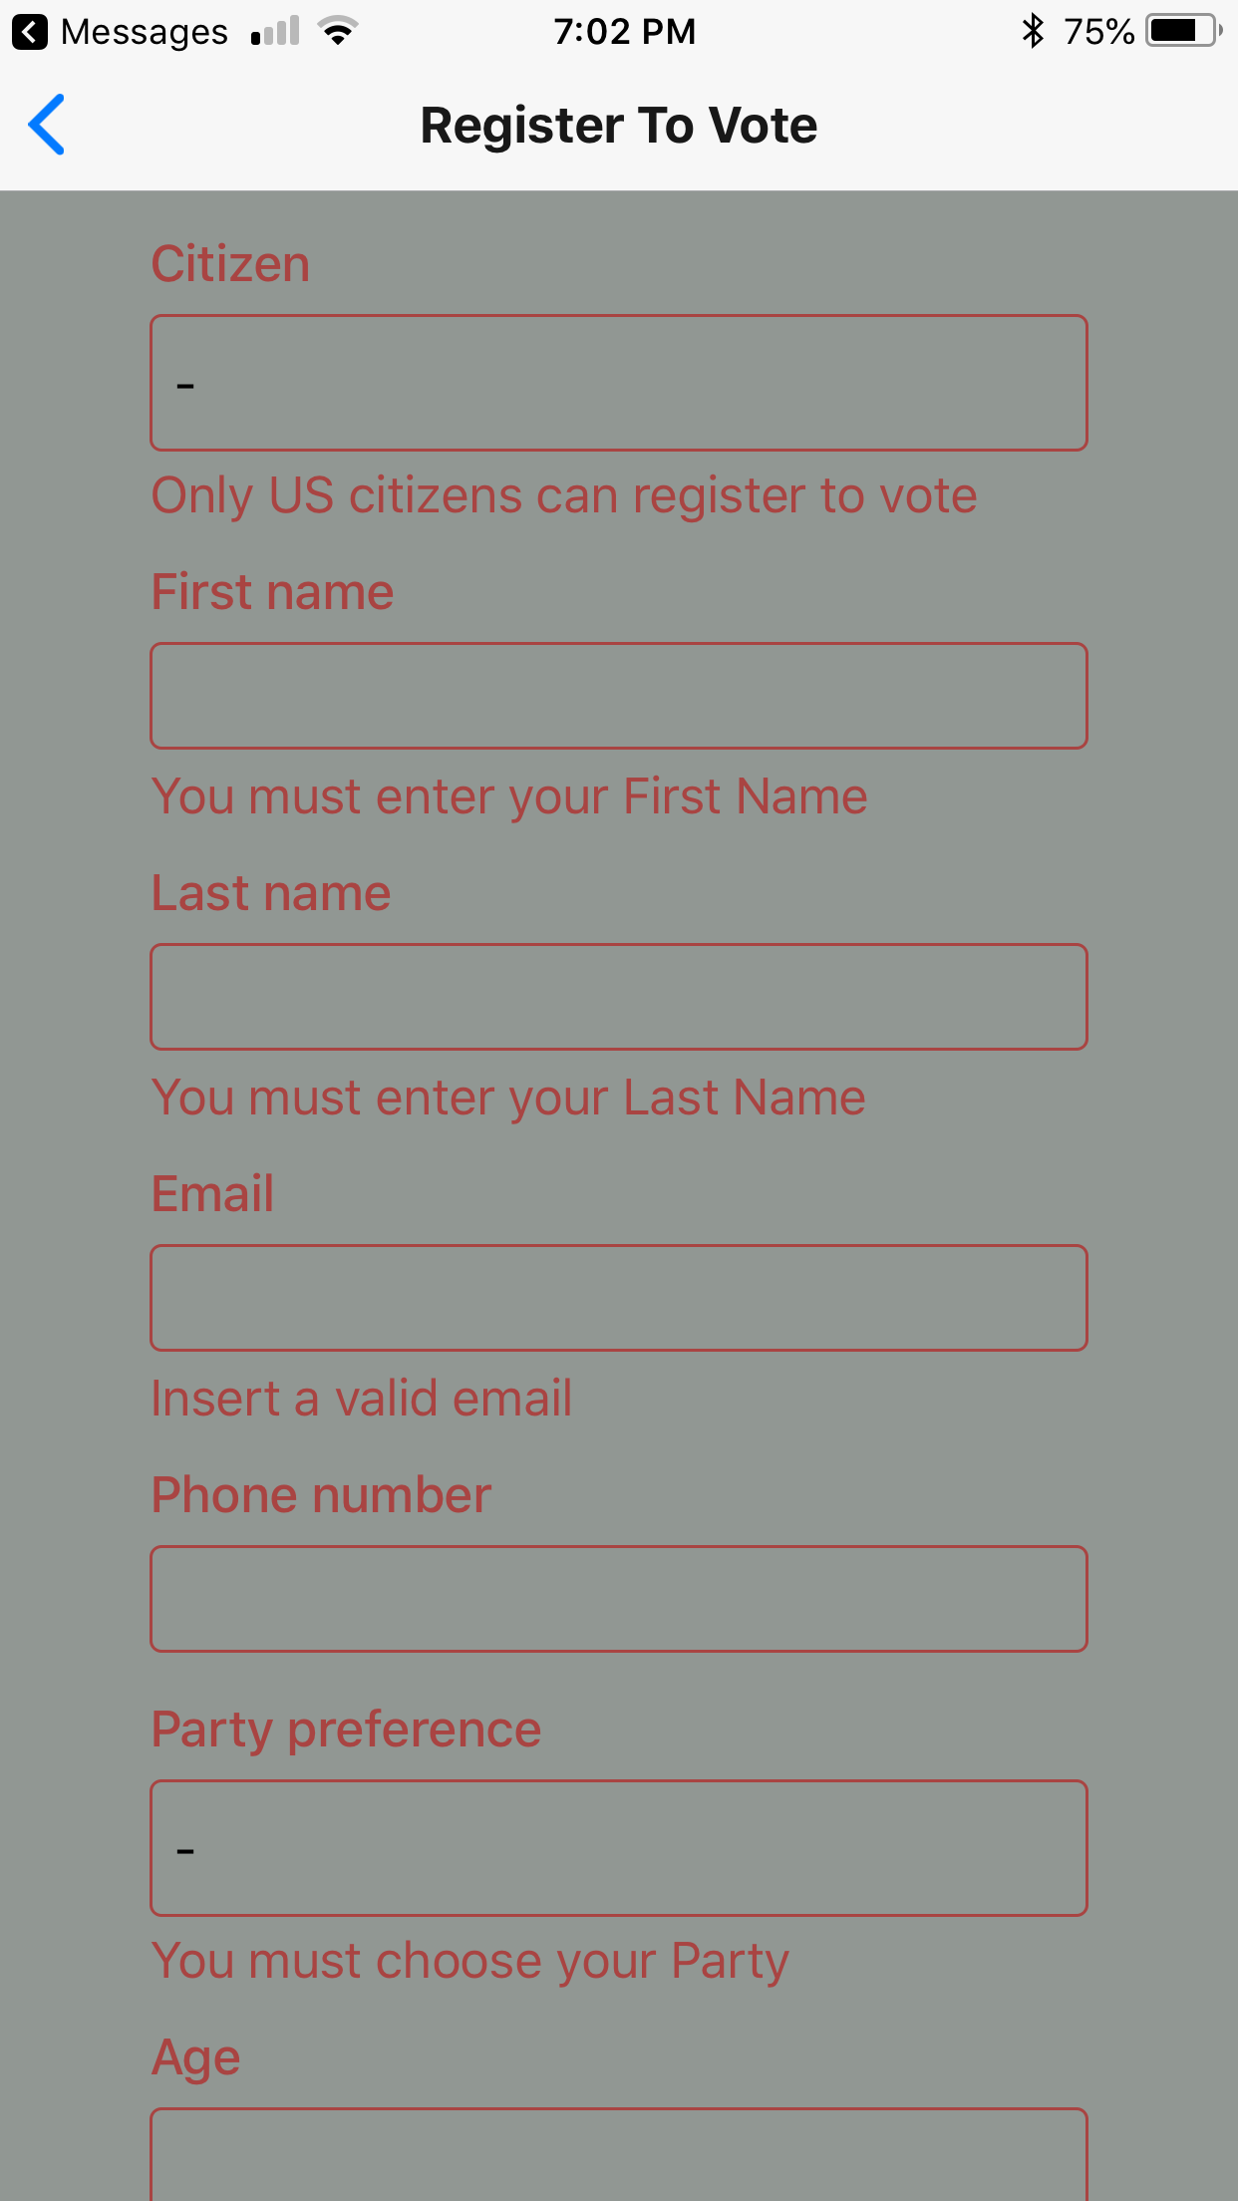
Register to Vote (cont’d)

Slide 10
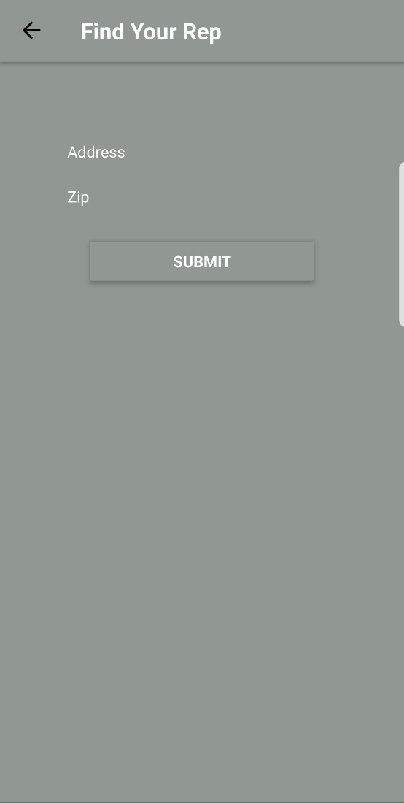
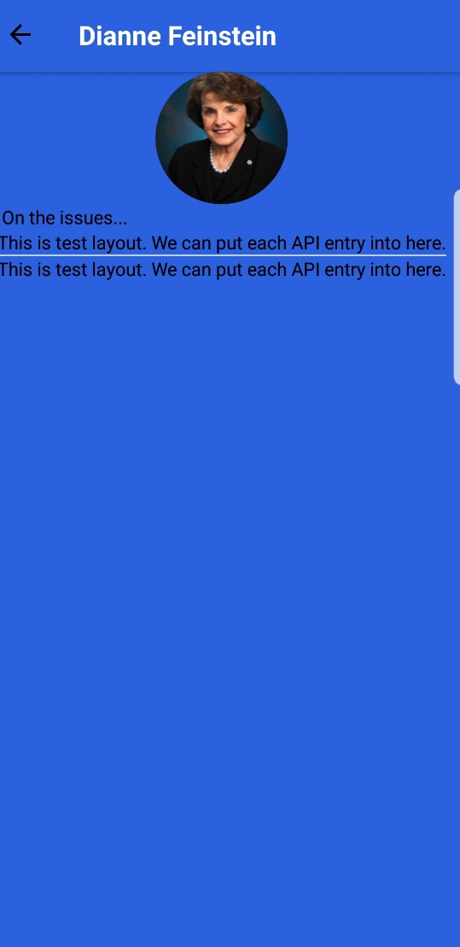
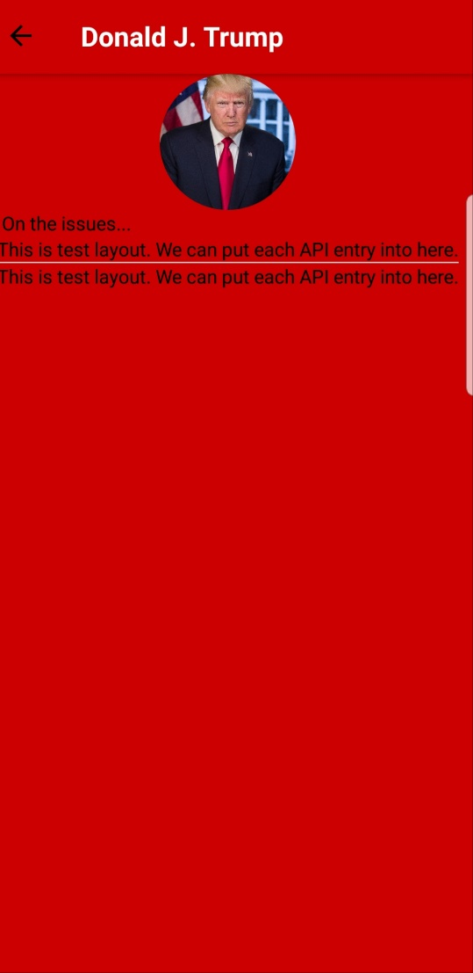
Find Representatives
Notes:
Needs user selection + animation

Slide 11







Technology Used
Inform
Change
Display
Version Control
Get &
Set Data
Design
Backend
Notes:
Bryan starts

Slide 12
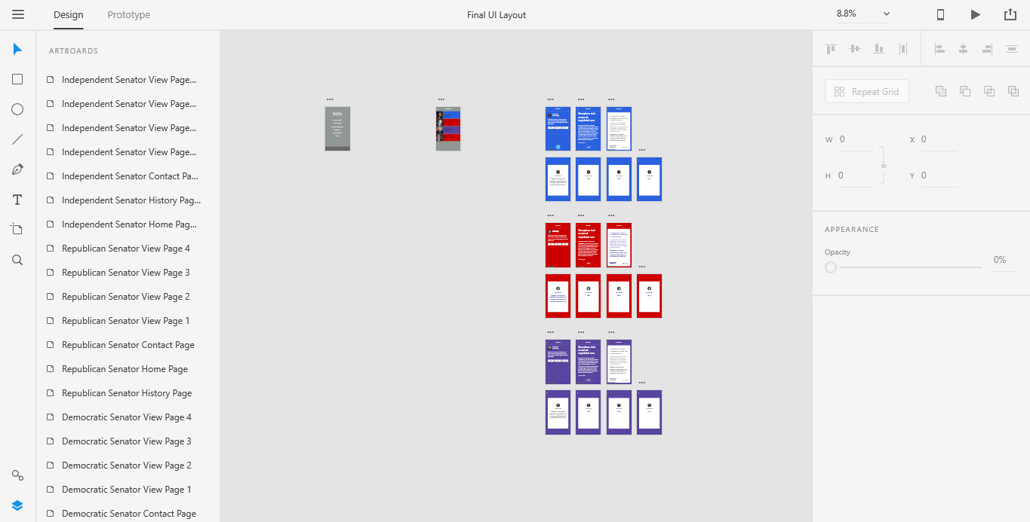
Process: Design
Notes:
Bryan

Slide 13
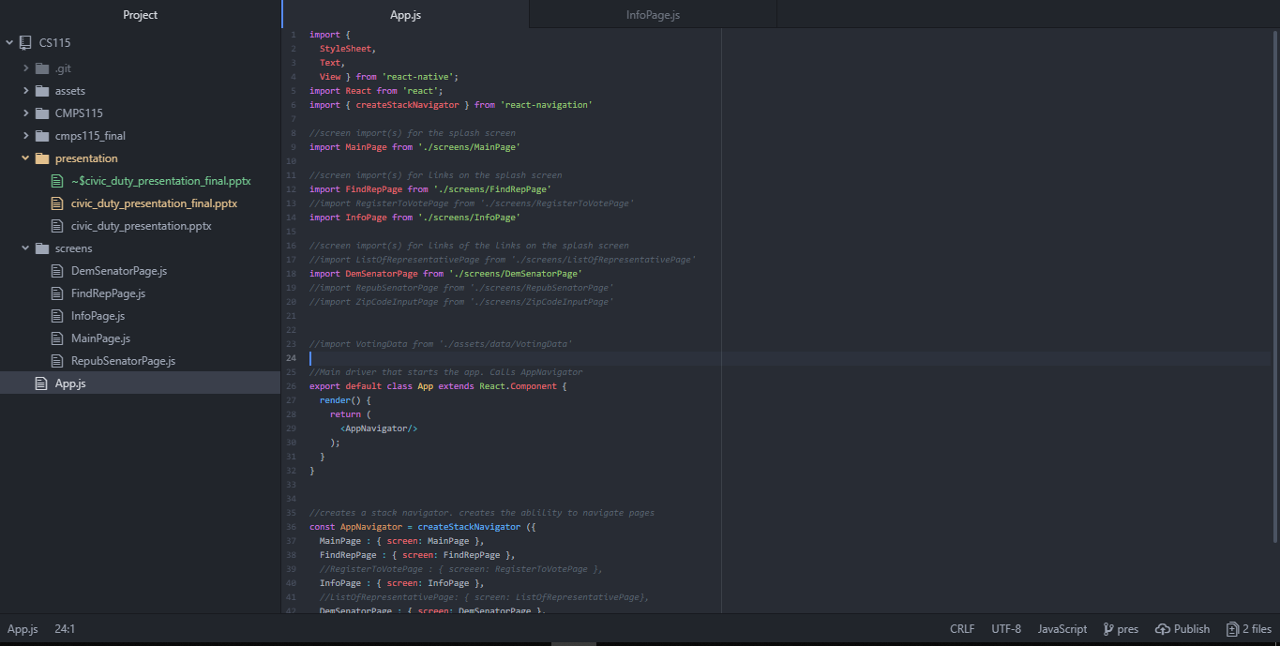
Process: React Native (Implement)
Notes:
Bryan

Slide 14
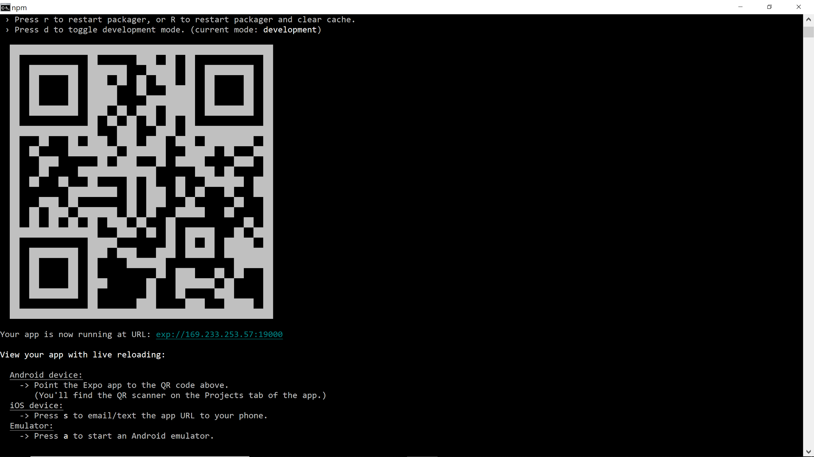
Process: React Native (Generate)
Notes:
Bryan

Slide 15
Project Management
Engineering Method (e.g. planning poker)
Scrum Meeting
Sprint Planning
Sprint Review
Communication
Version Control
Notes:
Rui starts

Slide 16
What We Liked
Group collaboration through Git
Watching our apps to be interactive
Encouraging environment
Professional development process
Smooth compatible schedule
Labor Distribution
Notes:
Ruui

Slide 17
What We Didn’t Like
Compressed deadline (5 weeks – week 1 & 5)
React Native and its volatility
Lack of documentation for React Native
Expo and debugging
Occasional miscommunication
Physical SCRUM board (inconvenience)
Notes:
Rui

Slide 18
Learning Experience: Continue Doing
Frequent SCRUM meeting
Design first, then build
Setting standard convention/guideline
Documenting code through comments
Version control using Git (e.g. branching)
Notes:
rui

Slide 19
Learning Experience: Stop Doing
Stop using react native (or any unstable technology)
Meeting conflicts (e.g. missing, infrequent meeting, etc.)
Individual development
Estimating other members progress
Forgetting to document code
Notes:
Rui

Slide 20
Things We Wish We Could Have Done
Used different framework/Start Over
Nationwide Search
Fix critical bugs
Info on how to register
View House of Representative members
Auto TL;DR

