Slide 1
  DOM
  节选自http://www.w3school.com

Slide 2
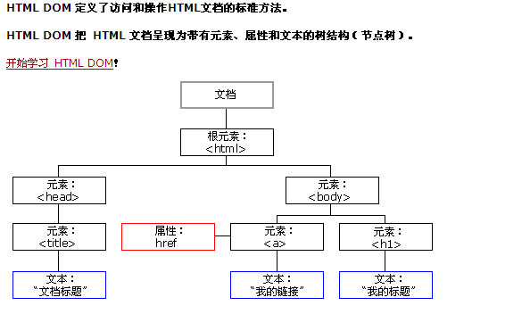

Slide 3
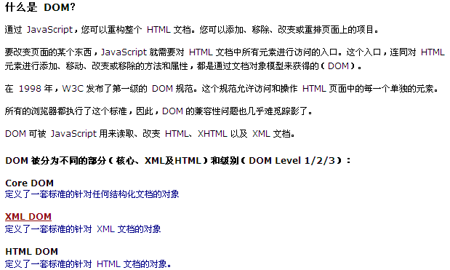
What dom

Slide 4
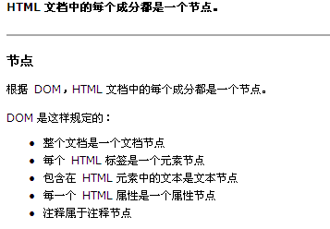
Html：node

Slide 5
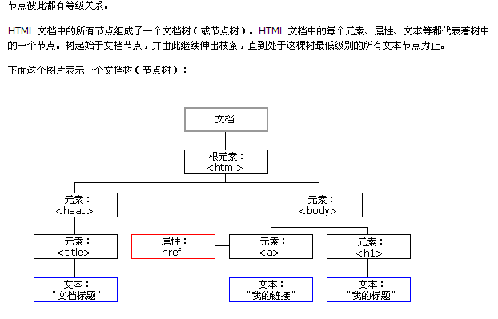
Node 层次

Slide 6
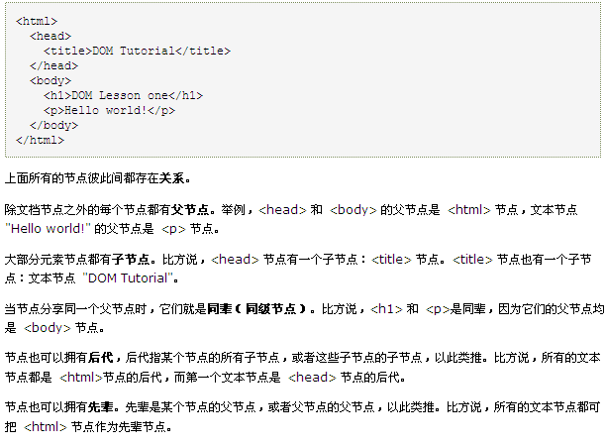
Dom tree

Slide 7
http://www.w3school.com.cn/htmldom/dom_nodes_access.asp

