Slide 1
Announcements: projects
805 students: Project proposals are due Sun 10/2. If you’d like to work with 605 students then indicate this on your proposal.
605 students: the week after 10/2 I will post the proposals on the wiki and you will have time to contact 805 students and join teams.
805 students: let me know your team by 10/9: I will approve the teams.

Slide 2
Announcements: guinea pig tips
One student reported localization problems that were fixed by setting
% export LC_ALL=C
Try this out and let me know if there are problems with it: I will make it default for next class

Slide 3
Announcements: Spark followup
ReduceByKey is a transformation
Reduce is an action
Sounds crazy but it’s not:
actions are eager, and return something (small) to the driver program
transformations are lazy, and transform a (large) RDD

Slide 4
Learning As Optimization: Motivation

Slide 5

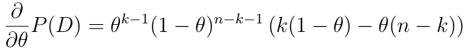
Learning as optimization: warmup
Goal: Learn the parameter θ of a binomial
Dataset: D={x₁,…,x_{n}}, x_{i} is 0 or 1, k of them are 1
➔ P(D|θ)=θ^{k}(1-θ)^{n-k}
➔ d/dθ P(D|θ) = kθ^{k-1}(1-θ)^{n-k} + θ^{k}(n-k)(1-θ)^{n-k-1}

Slide 6
Learning as optimization: warmup
Goal: Learn the parameter θ of a binomial
Dataset: D={x₁,…,x_{n}}, x_{i} is 0 or 1, k of them are 1
= 0
θ= 0
θ= 1
k- kθ – nθ + kθ = 0
nθ = k
θ = k/n

Slide 7
Learning as optimization: general procedure
Goal: Learn parameter θ (or weight vector w)
Dataset: D={(x₁,y₁)…,(x_{n} , y_{n})}
Write down loss function: how well w fits the data D as a function of w
Common choice: log Pr(D|w)
Maximize by differentiating
Then gradient descent: repeatedly take a small step in the direction of the gradient

Slide 8
Learning as optimization: general procedure for SGD (stochastic gradient descent)
Big-data problem: we don’t want to load all the data D into memory, and the gradient depends on all the data
Solution:
pick a small subset of examples B<<D
approximate the gradient using them
“on average” this is the right direction
take a step in that direction
repeat….
Math: find gradient of w for a single example, not a dataset
B = one example is a very popular choice

Slide 9
SGD vs streaming
Streaming:
pass through the data once
hold model + one example in memory
update model for each example
Stochastic gradient:
pass through the data multiple times
stream through a disk file repeatedly
hold model + B examples in memory
update model via gradient step
B = one example is a very popular choice
its simple ☺
sometimes its cheaper to evaluate 100 examples at once than one example 100 times ☹

Slide 10
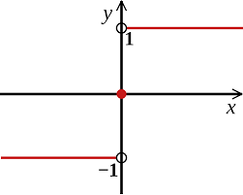
Logistic Regression vs Rocchio
Rocchio looks like:
Two classes, y=+1 or y=-1:
w = v(+1) - v(-1)
x = v(d)

Slide 11
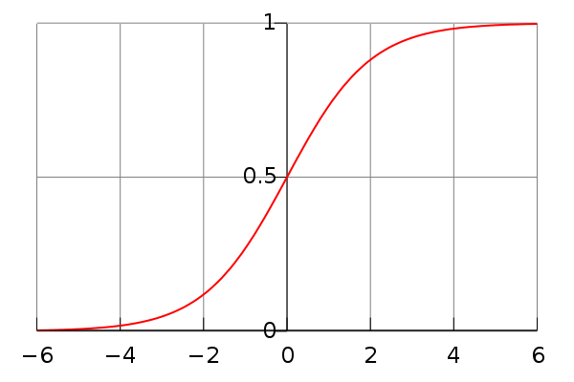
Logistic Regression vs Naïve Bayes
Naïve Bayes for two classes can also be written as:
Since we can’t differentiate sign(x), a convenient variant is a logistic function:

Slide 12
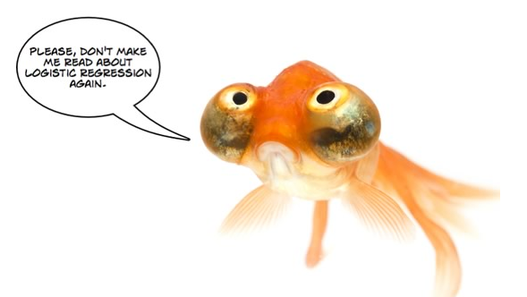
Efficient Logistic Regression with Stochastic Gradient Descent
William Cohen

Slide 13

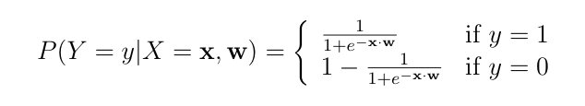
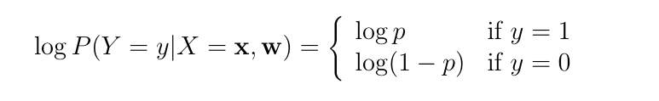
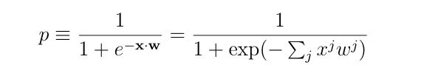
Learning as optimization for logistic regression
Goal: Learn the parameter w of the classifier
Probability of a single example P(y|x,w) would be
Or with logs:

Slide 14
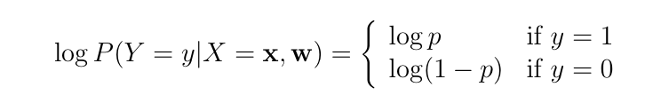
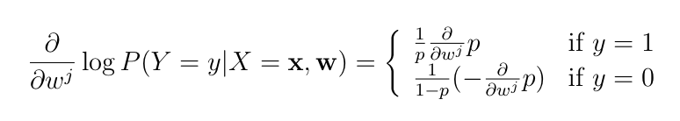


Slide 15
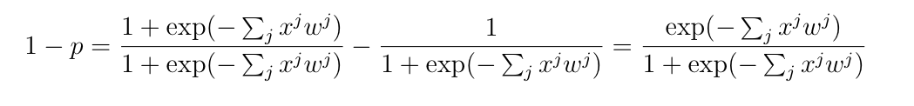
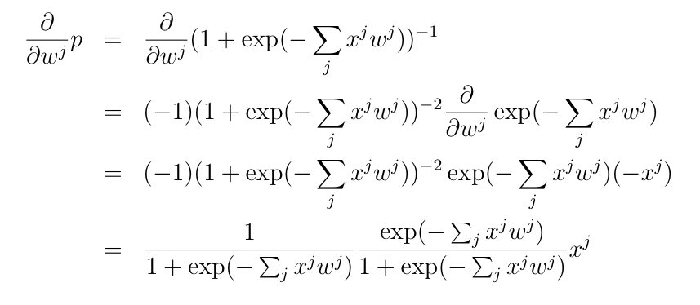

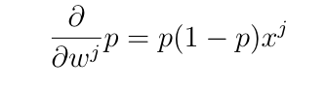
p

Slide 16
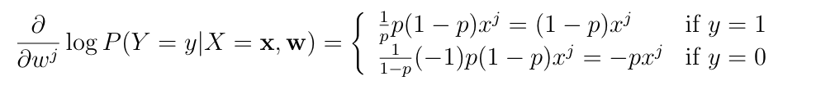
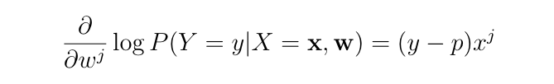


Slide 17
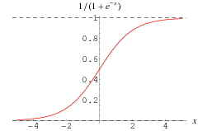
Again: Logistic regression
Start with Rocchio-like linear classifier:
Replace sign(...) with something differentiable:
Also scale from 0-1 not -1 to +1
Define a loss function:
Differentiate….

Slide 18
Magically, when we differentiate, we end up with something very simple and elegant…..
The update for gradient descent is just:

Slide 19
Logistic regression has a sparse update

Slide 20
An observation: sparsity!
Key computational point:
if x^{j}=0 then the gradient of w^{j} is zero
so when processing an example you only need to update weights for the non-zero features of an example.

Slide 21

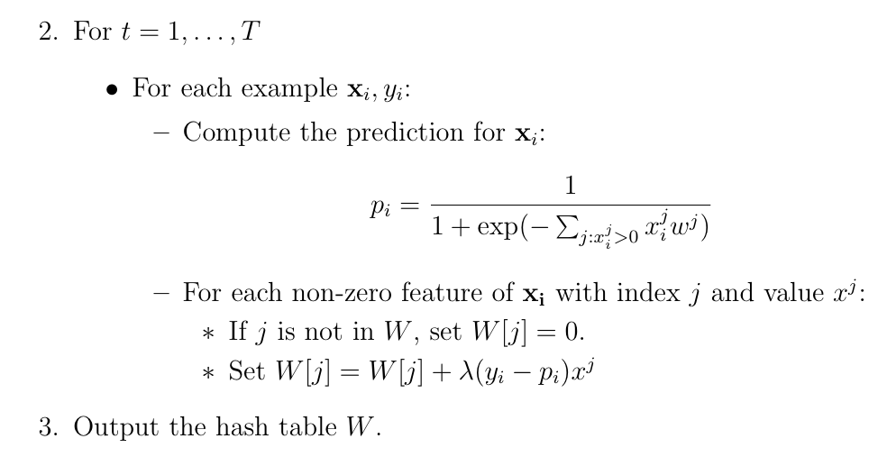
Learning as optimization for logistic regression
The algorithm:
-- do this in random order

Slide 22
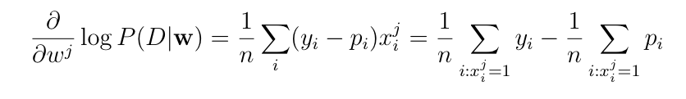
Another observation
Consider averaging the gradient over all the examples D={(x₁,y₁)…,(x_{n} , y_{n)}}
This will overfit badly with sparse features
Consider any word that appears only in positive examples!

Slide 23
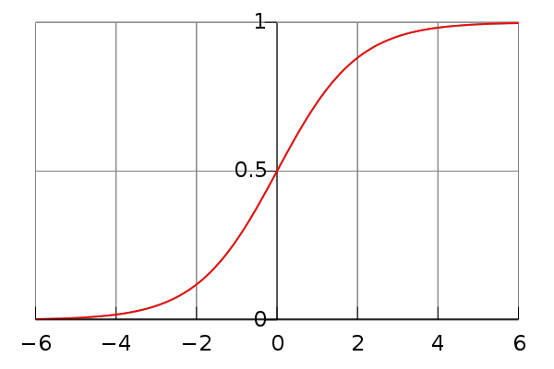
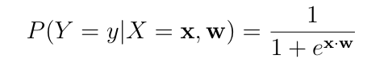
Learning as optimization for logistic regression
Goal: Learn the parameter θ of a classifier
Which classifier?
We’ve seen y = sign(x . w) but sign is not continuous…
Convenient alternative: replace sign with the logistic function
Practical problem: this overfits badly with sparse features
e.g., if w^{j} is only in positive examples, its gradient is always positive !

Slide 24
Regularized Logistic Regression

Slide 25
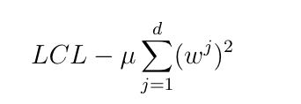
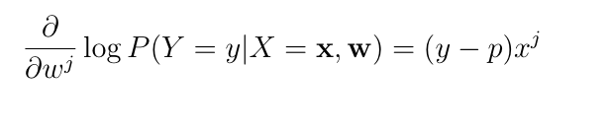
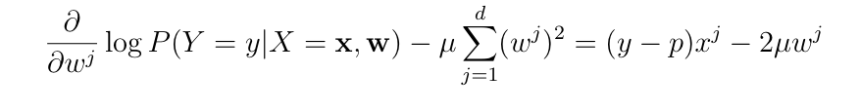
Regularized logistic regression
Replace LCL
with LCL + penalty for large weights, eg
So:
becomes:

Slide 26


Regularized logistic regression
Replace LCL
with LCL + penalty for large weights, eg
So the update for wj becomes:
Or

Slide 27
Learning as optimization for logistic regression
Algorithm:
-- do this in random order

Slide 28
Learning as optimization for regularized logistic regression
Algorithm:
Time goes from O(nT) to O(mVT) where
n = number of non-zero entries,
m = number of examples
V = number of features
T = number of passes over data

Slide 29
This change is very important for large datasets
We’ve lost the ability to do sparse updates
This makes learning much much more expensive
2*10⁶ examples
2*10⁸ non-zero entries
2*10⁶ + features
10,000x slower (!)
Time goes from O(nT) to O(mVT) where
n = number of non-zero entries,
m = number of examples
V = number of features
T = number of passes over data

Slide 30
Sparse Updates for Regularized Logistic Regression

Slide 31
Learning as optimization for regularized logistic regression
Final algorithm:
Initialize hashtable W
For each iteration t=1,…T
For each example (x_{i},y_{i})
p_{i} = …
For each feature W[j]
W[j] = W[j] - λ2μW[j]
If x_{i}^{j}>0 then
W[j] = W[j] + λ(y_{i} - p^{i})x_{j}

Slide 32
Learning as optimization for regularized logistic regression
Final algorithm:
Initialize hashtable W
For each iteration t=1,…T
For each example (x_{i},y_{i})
p_{i} = …
For each feature W[j]
W[j] *= (1 - λ2μ)
If x_{i}^{j}>0 then
W[j] = W[j] + λ(y_{i} - p^{i})x_{j}

Slide 33
Learning as optimization for regularized logistic regression
Final algorithm:
Initialize hashtable W
For each iteration t=1,…T
For each example (x_{i},y_{i})
p_{i} = …
For each feature W[j]
If x_{i}^{j}>0 then
W[j] *= (1 - λ2μ)^{A}
W[j] = W[j] + λ(y_{i} - p^{i})x_{j}
A is number of examples seen since the last time we did an x>0 update on W[j]

Slide 34
Learning as optimization for regularized logistic regression
Final algorithm:
Initialize hashtables W, A and set k=0
For each iteration t=1,…T
For each example (x_{i},y_{i})
p_{i} = … ; k++
For each feature W[j]
If x_{i}^{j}>0 then
W[j] *= (1 - λ2μ)^{k-A[j]}
W[j] = W[j] + λ(y_{i} - p^{i})x_{j}
A[j] = k
k-A[j] is number of examples seen since the last time we did an x>0 update on W[j]

Slide 35
Learning as optimization for regularized logistic regression
Final algorithm:
Initialize hashtables W, A and set k=0
For each iteration t=1,…T
For each example (x_{i},y_{i})
p_{i} = … ; k++
For each feature W[j]
If x_{i}^{j}>0 then
W[j] *= (1 - λ2μ)^{k-A[j]}
W[j] = W[j] + λ(y_{i} - p^{i})x_{j}
A[j] = k
k = “clock” reading
A[j] = clock reading last time feature j was “active”
we implement the “weight decay” update using a “lazy” strategy: weights are decayed in one shot when a feature is “active”

Slide 36
Learning as optimization for regularized logistic regression
Final algorithm:
Initialize hashtables W, A and set k=0
For each iteration t=1,…T
For each example (x_{i},y_{i})
p_{i} = … ; k++
For each feature W[j]
If x_{i}^{j}>0 then
W[j] *= (1 - λ2μ)^{k-A[j]}
W[j] = W[j] + λ(y_{i} - p^{i})x_{j}
A[j] = k
Time goes from O(nT) to O(mVT) where
n = number of non-zero entries,
m = number of examples
V = number of features
T = number of passes over data
Memory use doubles.

Slide 37
Comments
What’s happened here:
Our update involves a sparse part and a dense part
Sparse: empirical loss on this example
Dense: regularization loss – not affected by the example
We remove the dense part of the update
Old example update:
for each feature { do something example-independent}
For each active feature { do something example-dependent}
New example update:
For each active feature :
{simulate the prior example-independent updates}
{do something example-dependent}

Slide 38
Comments
Same trick can be applied in other contexts
Other regularizers (eg L1, …)
Conjugate gradient (Langford)
FTRL (Follow the regularized leader)
Voted perceptron averaging
…?

Slide 39
BOUNDED-MEMORY LOGISTIC REGRESSION

Slide 40
Question
In text classification most words are
rare
not correlated with any class
given low weights in the LR classifier
unlikely to affect classification
not very interesting

Slide 41
Question
In text classification most bigrams are
rare
not correlated with any class
given low weights in the LR classifier
unlikely to affect classification
not very interesting

Slide 42
Question
Most of the weights in a classifier are
important
not important

Slide 43
How can we exploit this?
One idea: combine uncommon words together randomly
Examples:
replace all occurrances of “humanitarianism” or “biopsy” with “humanitarianismOrBiopsy”
replace all occurrances of “schizoid” or “duchy” with “schizoidOrDuchy”
replace all occurrances of “gynecologist” or “constrictor” with “gynecologistOrConstrictor”
…
For Naïve Bayes this breaks independence assumptions
it’s not obviously a problem for logistic regression, though
I could combine
two low-weight words (won’t matter much)
a low-weight and a high-weight word (won’t matter much)
two high-weight words (not very likely to happen)
How much of this can I get away with?
certainly a little
is it enough to make a difference? how much memory does it save?

Slide 44
How can we exploit this?
Another observation:
the values in my hash table are weights
the keys in my hash table are strings for the feature names
We need them to avoid collisions
But maybe we don’t care about collisions?
Allowing “schizoid” & “duchy” to collide is equivalent to replacing all occurrences of “schizoid” or “duchy” with “schizoidOrDuchy”

Slide 45
Learning as optimization for regularized logistic regression
Algorithm:
Initialize hashtables W, A and set k=0
For each iteration t=1,…T
For each example (x_{i},y_{i})
p_{i} = … ; k++
For each feature j: x_{i}^{j}>0:
W[j] *= (1 - λ2μ)^{k-A[j]}
W[j] = W[j] + λ(y_{i} - p^{i})x_{j}
A[j] = k

Slide 46
Learning as optimization for regularized logistic regression
Algorithm:
Initialize arrays W, A of size R and set k=0
For each iteration t=1,…T
For each example (x_{i},y_{i})
Let V be hash table so that
p_{i} = … ; k++
For each hash value h: V[h]>0:
W[h] *= (1 - λ2μ)^{k-A[j]}
W[h] = W[h] + λ(y_{i} - p^{i})V[h]
A[h] = k

Slide 47
Learning as optimization for regularized logistic regression
Algorithm:
Initialize arrays W, A of size R and set k=0
For each iteration t=1,…T
For each example (x_{i},y_{i})
Let V be hash table so that
p_{i} = … ; k++
???

Slide 48
Implementation DETAILS

Slide 49
Fixes and optimizations
This is the basic idea but
we need to apply “weight decay” to features in an example before we compute the prediction
we need to apply “weight decay” before we save the learned classifier
my suggestion:
an abstraction for a logistic regression classifier

Slide 50
A possible SGD implementation
class SGDLogistic Regression {
/** Predict using current weights **/
double predict(Map features);
/** Apply weight decay to a single feature and record when in A[ ]**/
void regularize(string feature, int currentK);
/** Regularize all features then save to disk **/
void save(string fileName,int currentK);
/** Load a saved classifier **/
static SGDClassifier load(String fileName);
/** Train on one example **/
void train1(Map features, double trueLabel, int k) {
// regularize each feature
// predict and apply update
}
}
// main ‘train’ program assumes a stream of randomly-ordered examples and outputs classifier to disk; main ‘test’ program prints predictions for each test case in input.

Slide 51
A possible SGD implementation
class SGDLogistic Regression {
…
}
// main ‘train’ program assumes a stream of randomly-ordered examples and outputs classifier to disk; main ‘test’ program prints predictions for each test case in input.
<100 lines (in python)
Other mains:
A “shuffler:”
stream thru a training file T times and output instances
output is randomly ordered, as much as possible, given a buffer of size B
Something to collect predictions + true labels and produce error rates, etc.

Slide 52
A possible SGD implementation
Parameter settings:
W[j] *= (1 - λ2μ)^{k-A[j]}
W[j] = W[j] + λ(y_{i} - p^{i})x_{j}
I didn’t tune especially but used
μ=0.1
λ=η* E⁻² where E is “epoch”, η=½
epoch: number of times you’ve iterated over the dataset, starting at E=1

Slide 53
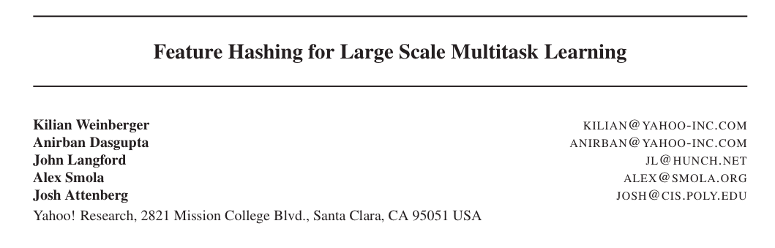
ICML 2009

Slide 54
An interesting example
Spam filtering for Yahoo mail
Lots of examples and lots of users
Two options:
one filter for everyone—but users disagree
one filter for each user—but some users are lazy and don’t label anything
Third option:
classify (msg,user) pairs
features of message i are words w_{i,1},…,w_{i,ki}
feature of user is his/her id u
features of pair are: w_{i,1},…,w_{i,ki} and u•w_{i,1},…,u•w_{i,ki}
based on an idea by Hal Daumé

Slide 55
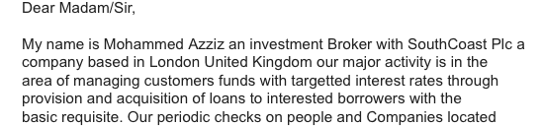
An example
E.g., this email to wcohen
features:
dear, madam, sir,…. investment, broker,…, wcohen•dear, wcohen•madam, wcohen,…,
idea: the learner will figure out how to personalize my spam filter by using the wcohen•X features

Slide 56
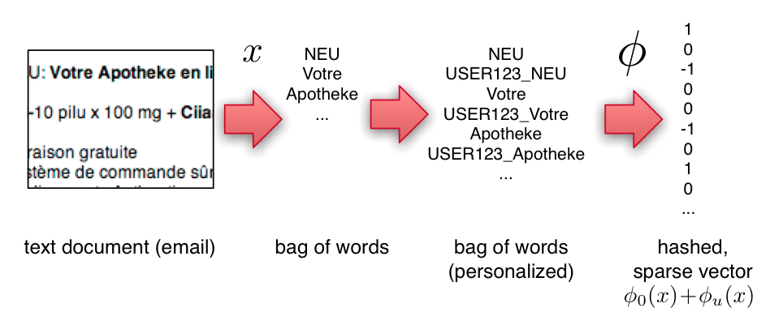
An example
Compute personalized features and multiple hashes on-the-fly:
a great opportunity to use several processors and speed up i/o

Slide 57
Experiments
3.2M emails
40M tokens
430k users
16T unique features – after personalization

Slide 58
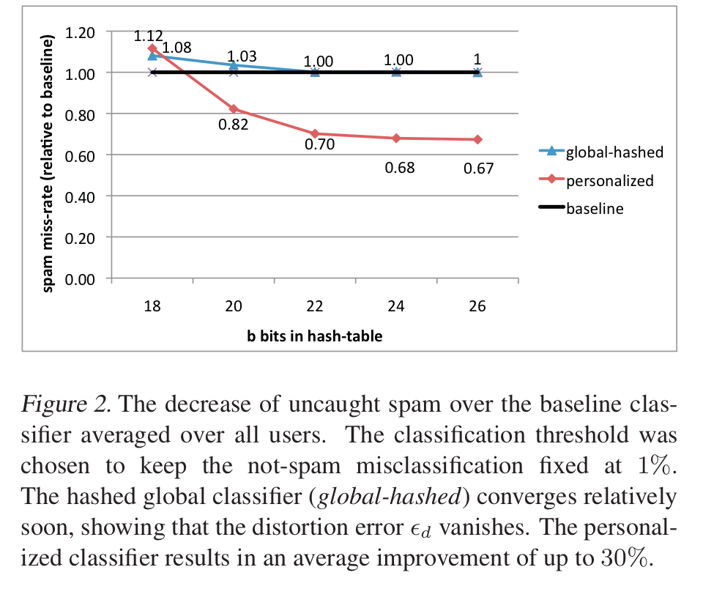
An example
2^26 entries = 1 Gb @ 8bytes/weight
Notes:
3,2M emails
400k users
40M tokens

Slide 59
