Slide 1
Electronic states of transition metal elements in
Si-Ge alloys
ICE 2017 ( May 31th, 31-3-51or, Nagoya, Japan)
First name Family name ¹ and First name Family name ¹
¹所属機関（英語）, City XXX-XXXX, Japan
口演済み（学会用参考資料）
（※ 氏名の順番は偉い人ほど最後（右）の方になります）
Notes:
Thank you, Chair. (Dr. XXXX)
Today I would like to talk you about “Electronic states of transition metal elements in Silicon Germanium alloys”.

Slide 2
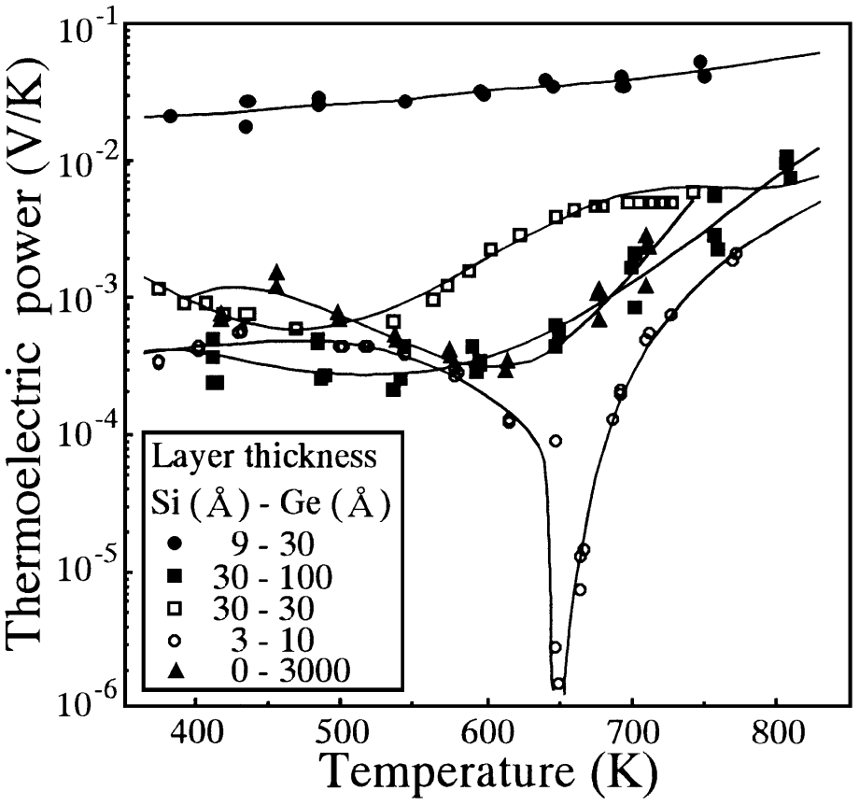
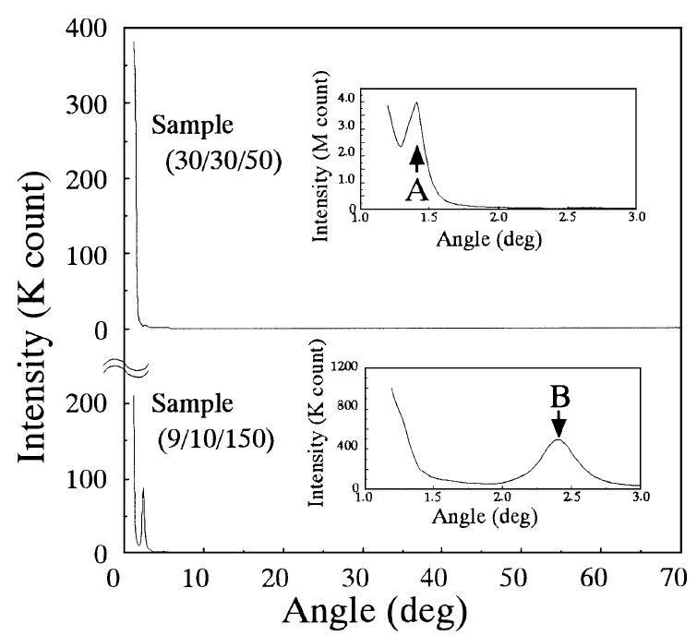
INTRODUCTION
Au-doped Si-Ge amorphous thin film
Seebeck coefficient
XRD
A and B is the artificial intervals.
High ｜S ｜
Amorphous thin film
Y. Okamoto et al., Jpn. J. Appl. Phys. 38 (1999) L945.
A huge magnitude of the Seebeck coefficient exceeding 10 mVK⁻¹ was reported for the Si-Ge thin film containing ~5 at.% of Au.
Notes:
These graph show Seebeck coefficient and XRD of the Au-doped Si-Ge amorphous thin film.
As seen in these graph, Huge magnitude of Seebeck coefficient exceeding 10 mVK^-1 were reported for the Si-Ge thin film containing -5 at.% Au and
These thin films are amorphous superlattice.

Slide 3
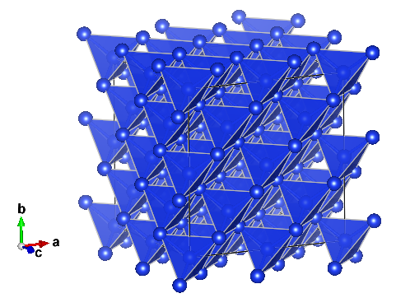
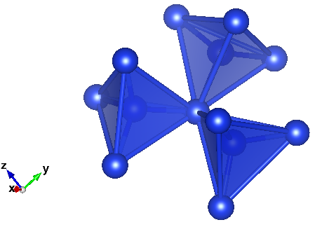
PURPOSE
We speculated that
this large Seebeck coefficient was brought by
the electronic states of Au in the Si-Ge alloy.
We tried to investigate the electronic states of Au in
Si-Ge alloy by means of first principles calculations.
To clarify the electronic structure.
Tetrahedron
Amorphous
Diamond structure
Notes:
We speculated that this large Seebeck coefficient was brought about by the electronic states of Au in the Si-Ge alloy.
We tried to investigate the electronic states of Au in Si-Ge alloy by means of first principles calculations.
We think that although amorphous is consist of local sp3 orbital, it makes tetrahedral structure.
We estimate amorphous by diamond like cluster.
Then, our purpose is to clarify the electronic structure.

Slide 4
CALCULATING PROCEDURES
Model
Si-TM(TM = transition metal) and Ge-TM.
Band calculation
FLAPW method:
The high accuracy first principles calculation.
Pseudopotential method:
This first principles calculation is suitable for structure optimization.
Cluster Calculation
DV-Xα method:
the first real-space principles MO calculation.
Easy to clarify the impurity states in
amorphous thin film.
Notes:
Model used in the present study are simple Si-TM and Ge-TM.
FLAPW(full potential linearized augmented plane-wave) calculation was employed to estimate other first principle calculation.
Theoretical optimized structure was calculated with the Pseudo-potential method.
Theoretical electronic structure ( for the cluster ) was calculated with the discrete variational Xa method.
This method is one of the real-space first principle molecular orbital calculation[ and powerful for studying the electronic structure in materials including TM without periodicity.]
It is easy to clarify the electronic structure within incoherent effect such as in amorphous thin film.

Slide 5
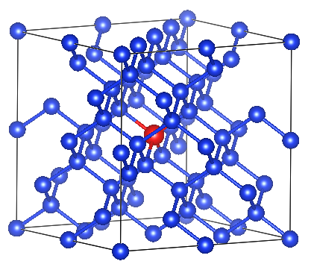
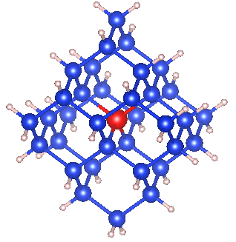
Structure model for the first principle calculation
+H
● Si or Ge
● TM
● H
Relaxed Si₆₃TM₁ structure
(Relaxed Ge₆₃TM₁ structure)
2x2x2 supercell (PWscf)
Si₃₄TM₁H₃₆ cluster
(Ge₃₄TM₁H₃₆ cluster)
(DVXα)
Notes:
Model unit clusters for the present study are based on optimized structure derived from pseudo-potential method on PWscf.
Model cluster consists of Si or Ge, TM and H. That is, blue circles stand for Si and Ge, red (circles) ones for TM and pink ones for H.
To avoid the surface effect, we have calculated the electronic structure of H-embedded clusters Si-TM-H.

Slide 6
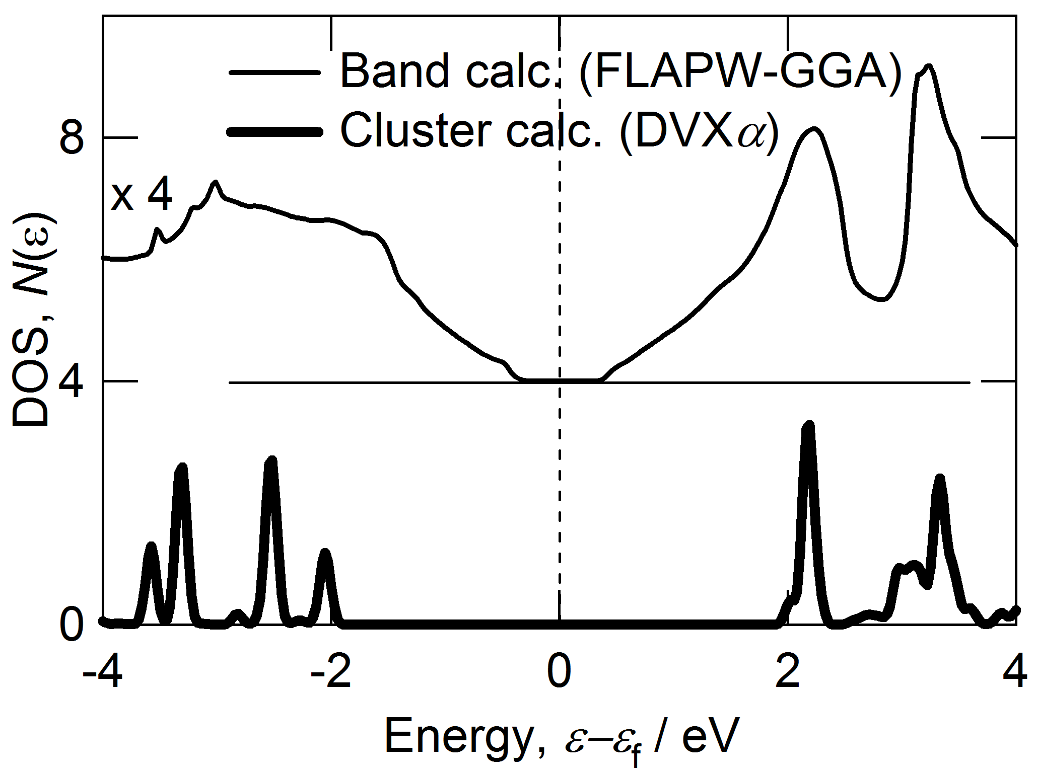
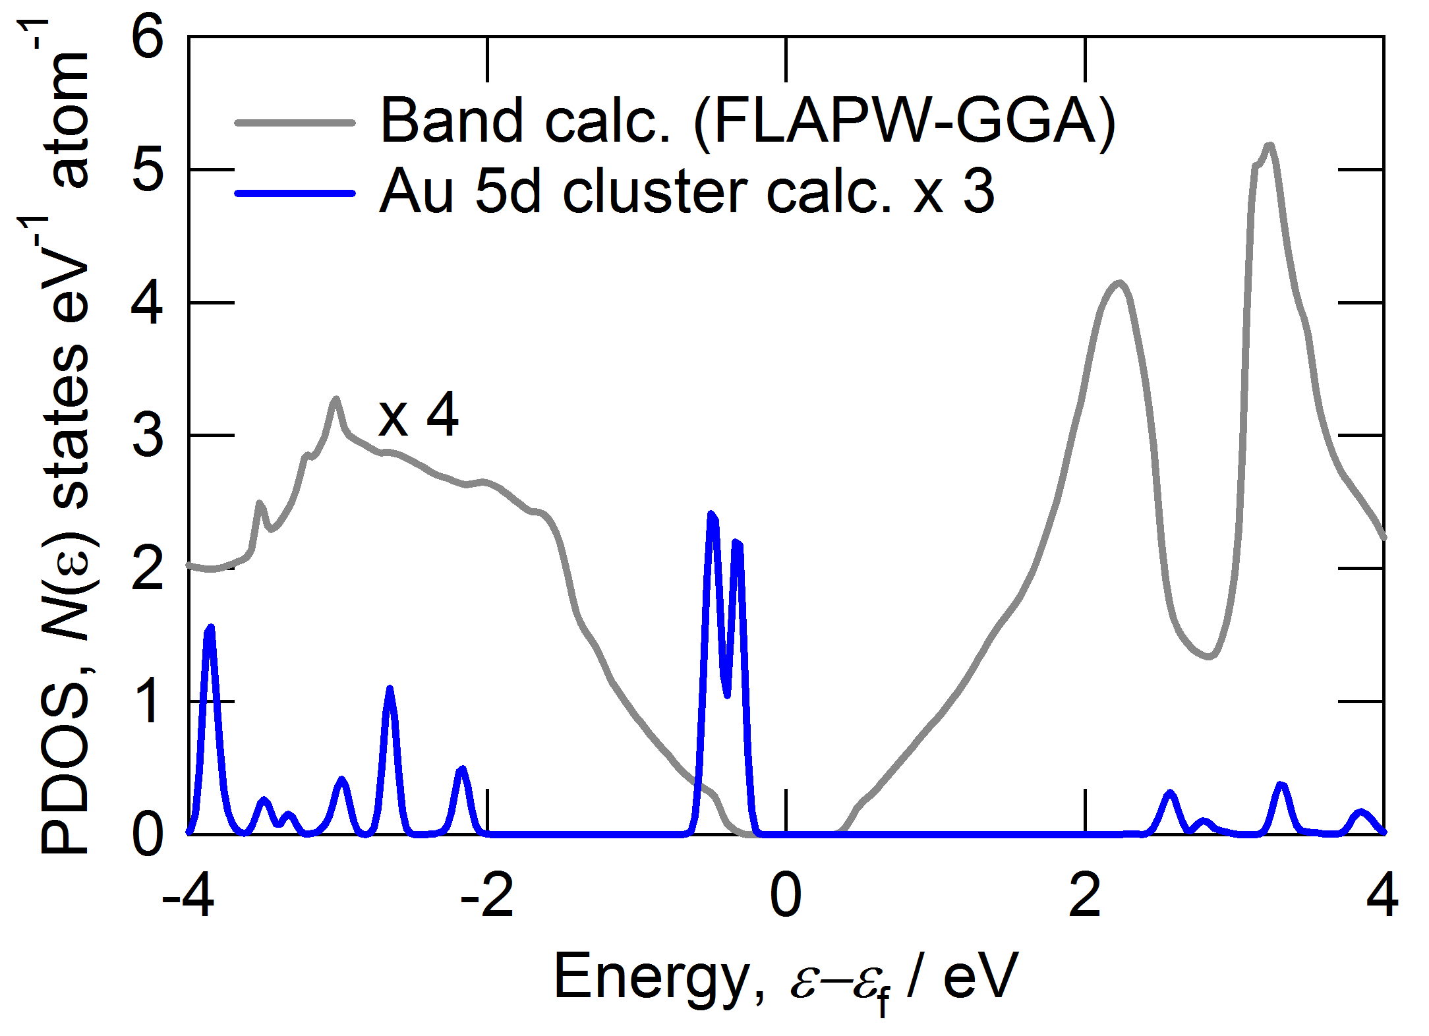
Partial density of states (PDOS)
FWHM = 0.1 eV, Shifted Energy = +0.4472 eV
Si
Au-doped Si-Ge amorphous thin film
High ｜S ｜
Y. Okamoto et al., Jpn. J. Appl. Phys. 38 (1999) L945.
The substituted Au atom produces a sharp peak slightly above
the edge of valence band, directing the contribution of the sharp peak to
the high Seebeck coefficient of the Au-doped amorphous thin film.
Notes:
Here we show Partial density of states for Si34TM1H36 cluster.
The Energy for these results was shifted in half of Si gap, to compare band calculation and cluster calculation.
The top left panel shows the results for the Si model comparing WIEN2k and DVXa method,
Indicating the good agreement between DOS for WIEN2k and for DVXa.
The bottom left panel shows the results for the Au d states.
As seen in this panels, the substituted Au atom produces a sharp peak slightly above
the edge of valence band, directing the contribution of
a sharp peak to the high Seebeck coefficient of the Au-doped amorphous thin film.

Slide 7
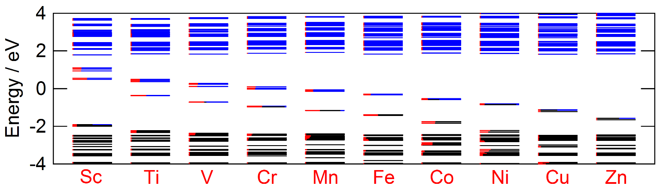
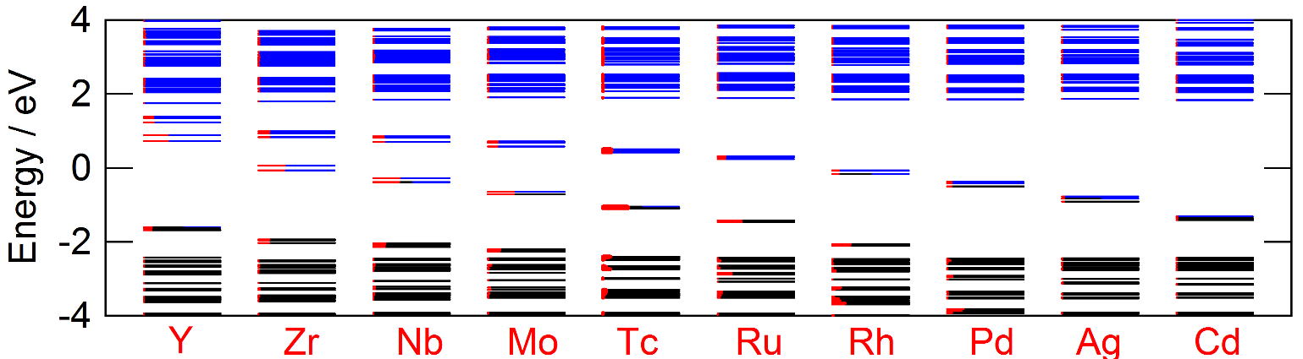
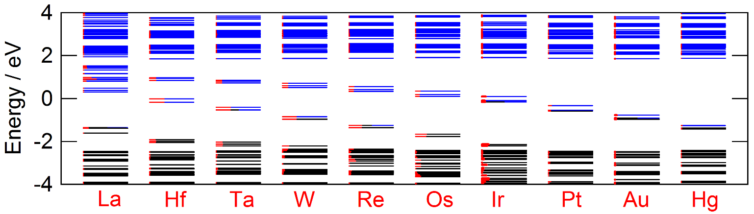
Energy level diagram of Si₃₄TM₁H₃₆ cluster
Unoccupied
states
Occupied
states
Gap in Si
The energy of impurity states decreases with
increasing atomic number.
Notes:
Here we show the energy level diagram for Si34TM1H36 cluster.
Blue line indicates unoccupied states, black line indicates occupied states and red line indicates TM.
The top panel presents the results calculated for Sc-Zn, which shows the impurity states in Gag.
The middle and bottom panels are (reveal) the results calculated for Y-Cd and La-Hg.
As seem in this viewgraph, our cluster calculation explains the energy of impurity states decreases with increasing group.
I will also point out that the energy of impurity states increase with increasing atomic weight for (Sc, Y, La), while those of (Ag, Au, Cu) showed
less significant atomic weight dependence.

Slide 8
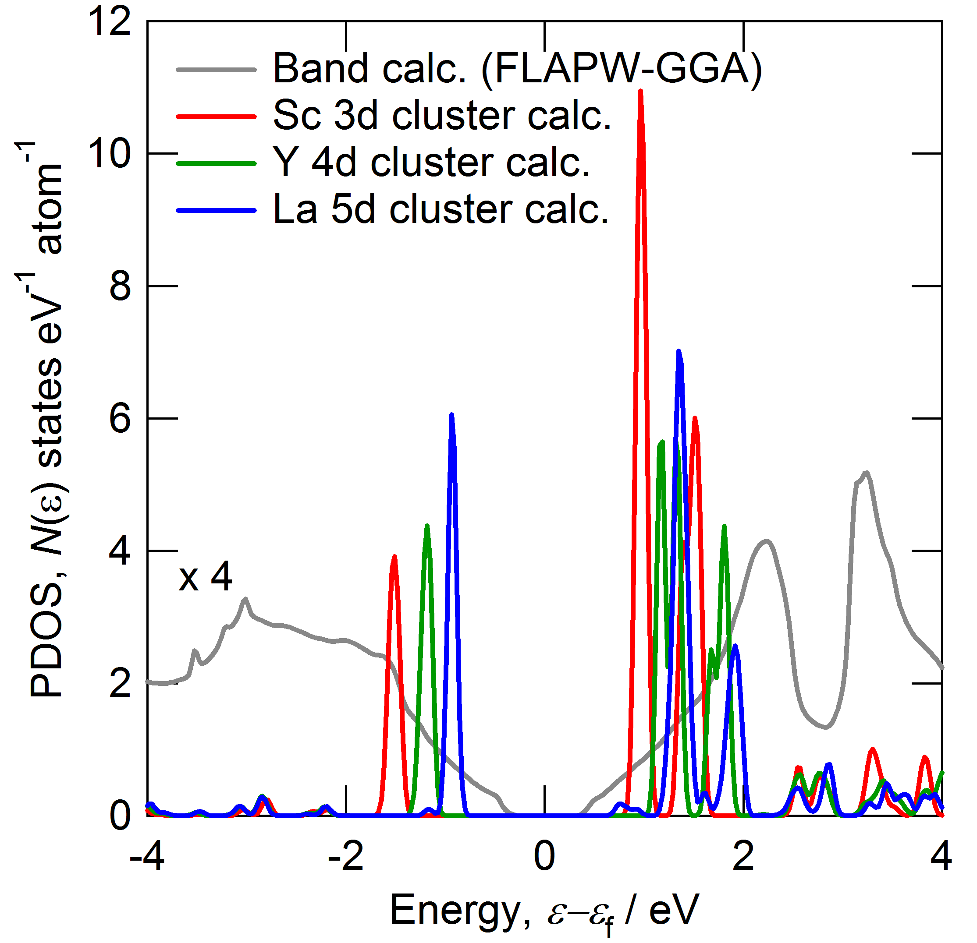
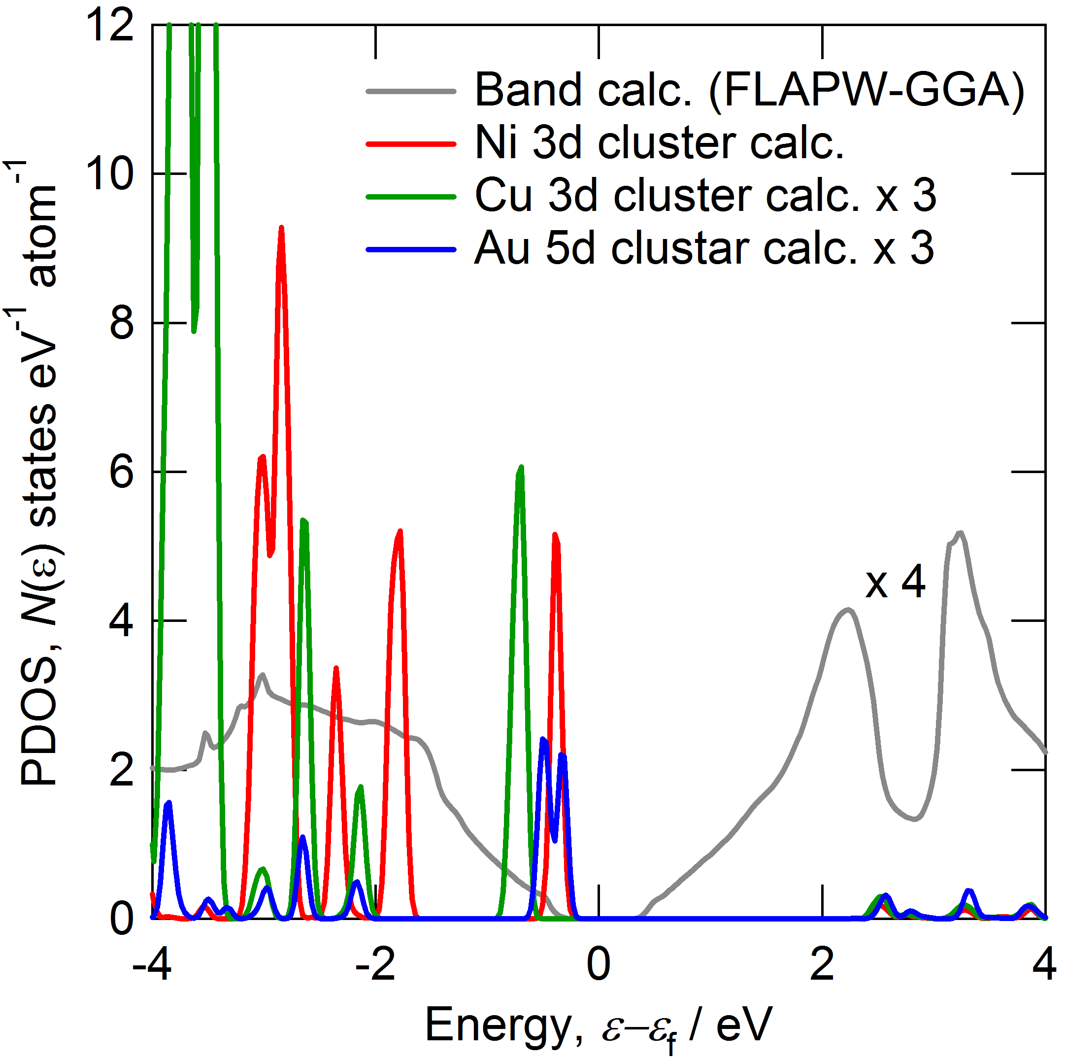
Partial density of states (PDOS)
DVXa calculation conditions: FWHM = 0.1 eV, Shifted Energy = +0.4472 eV
The substituted (Sc, Y, La) atom produces impurity states near
the band edge of conduction band, while (Cu, Ag, Au) and Ni substitutions produce impurity states slightly above the edge of valence band.
Notes:
Let’s move to the Partial DOS of TM sites.
The top left panel shows the results for the Sc, Y and La d states and the bottom right panel for the Ni, Cu and Au d states.
The right panels show these bonding and anti-bonding states.
TM d states located near Si gap are only consist of anti-bonding.
The d states of Sc, Y and La split near the edge of valence band and the edge of conduction band by Crystal field.
As seen in these panels, The substituted (Sc, Y, La) atom produces the impurity states near the band edge of conduction band,
while (Cu, Ag, Au) and Ni substitutions produce impurity states slightly above the edge of valence band.

Slide 9
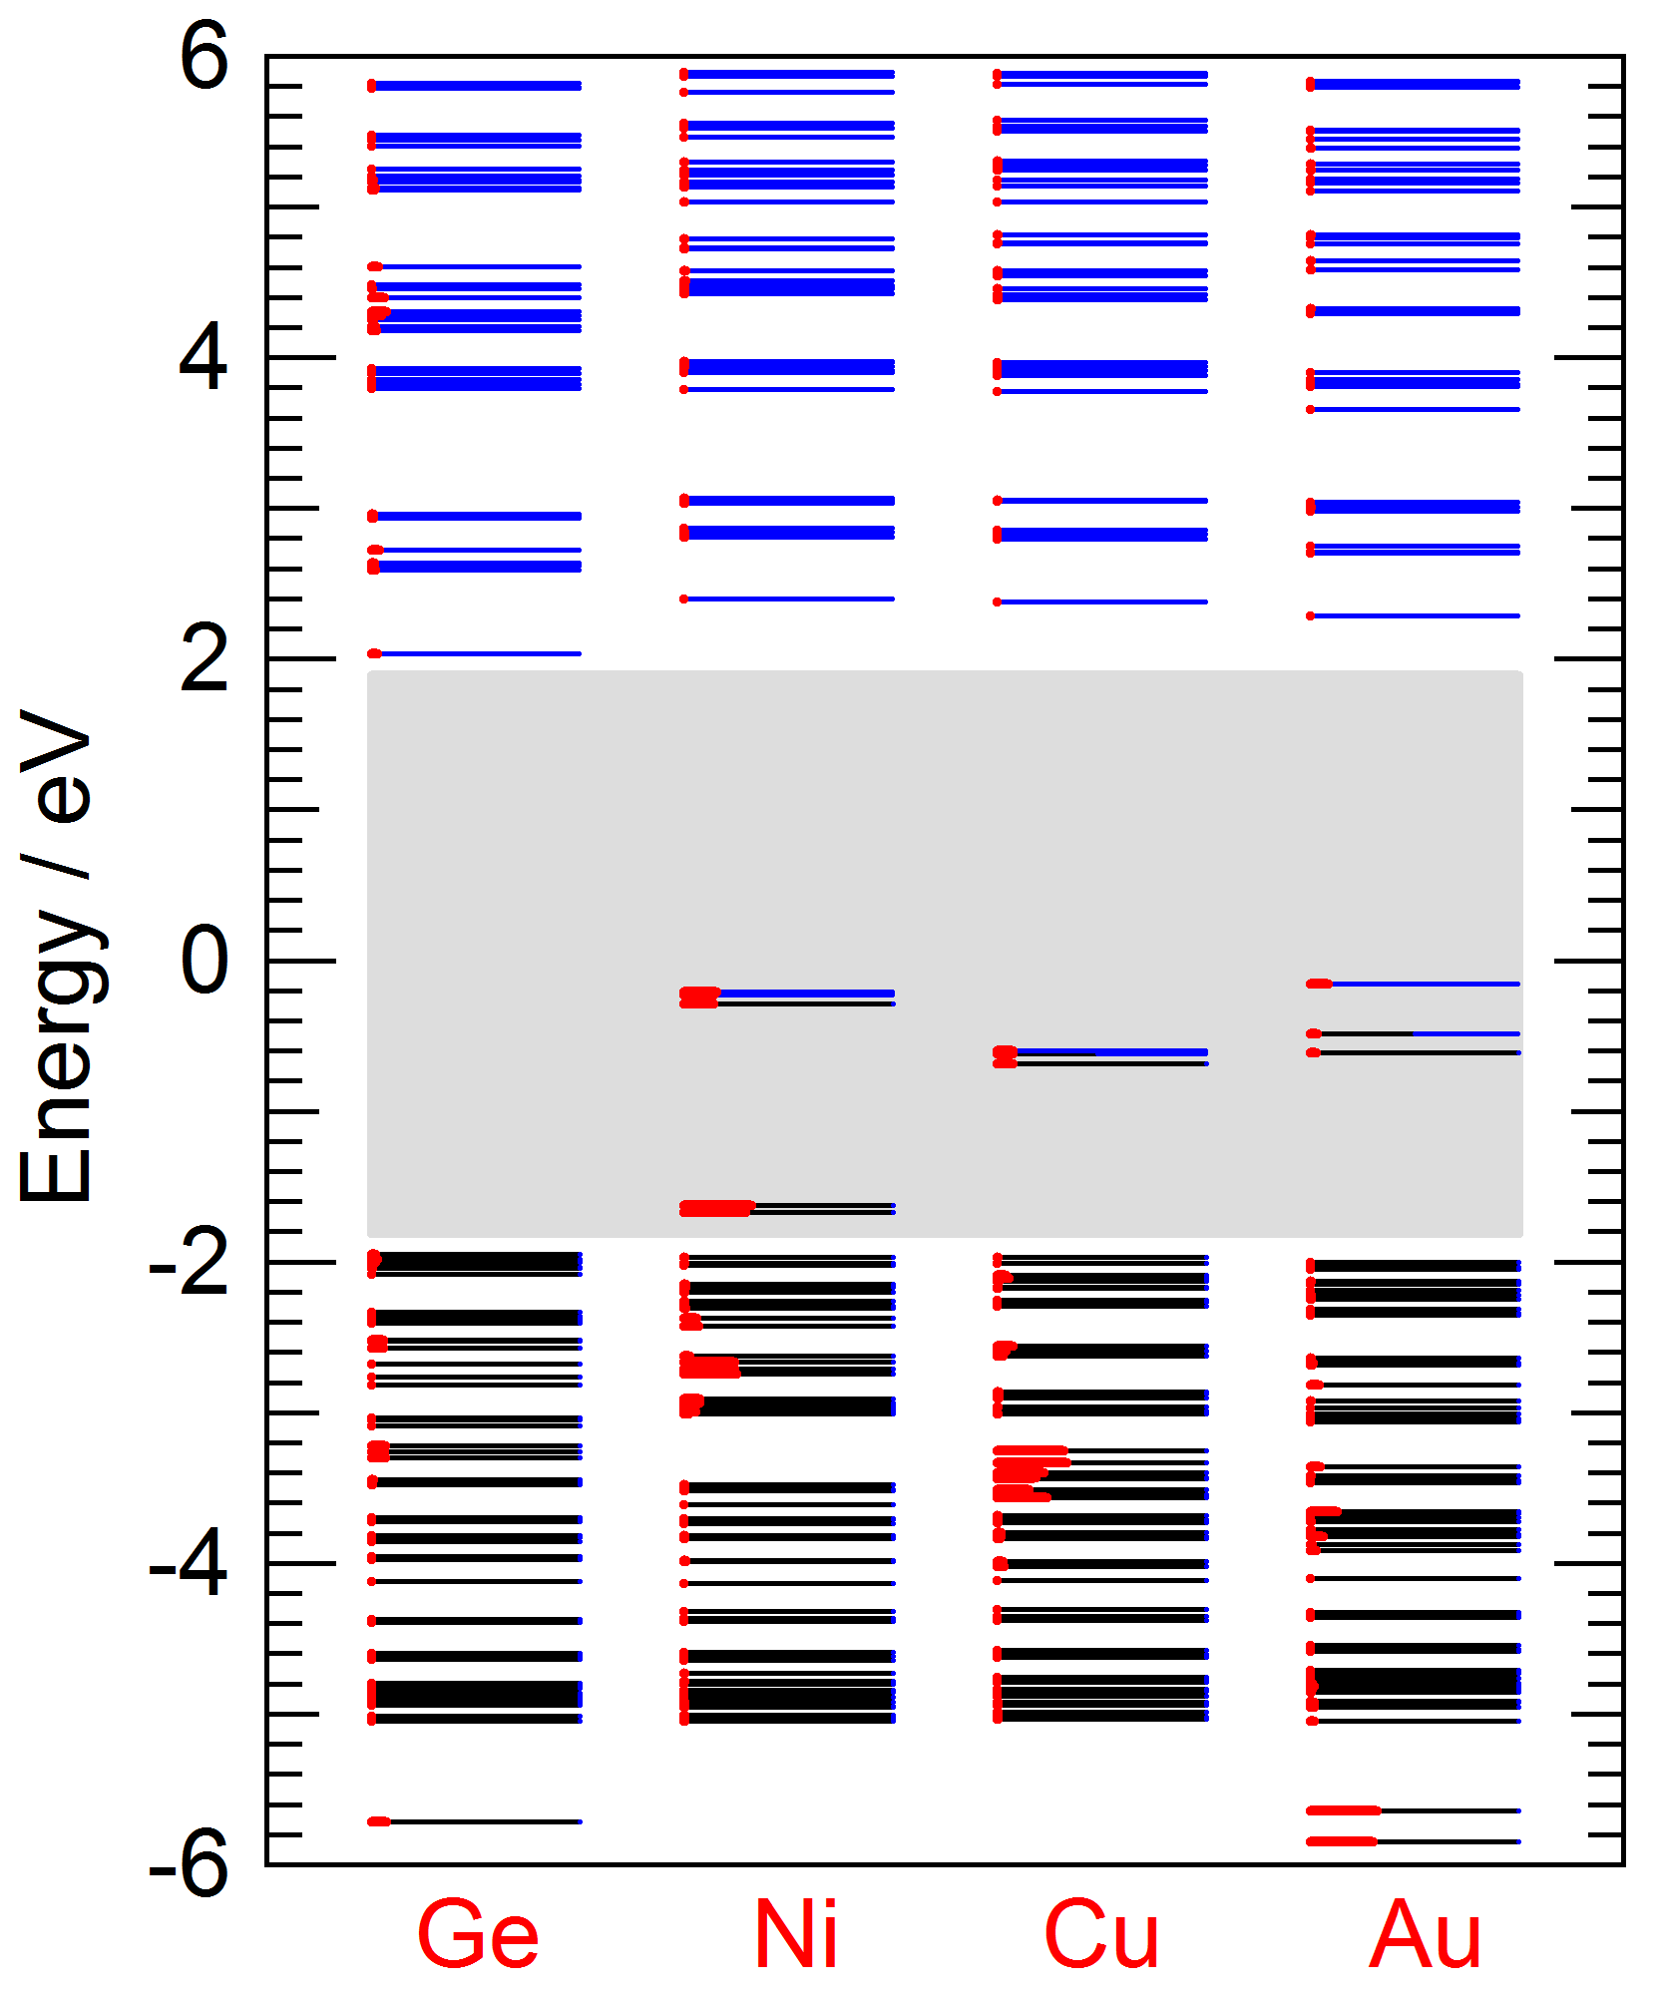
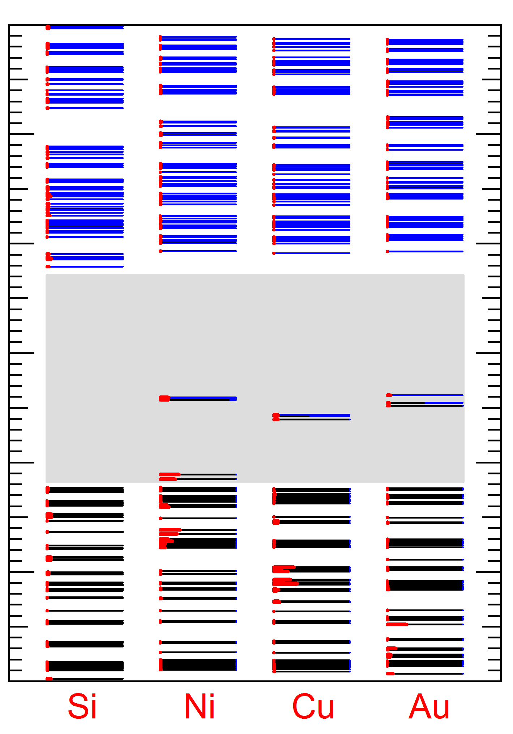
Energy level diagram
Ge₃₄TM₁H₃₆
Si₃₄TM₁H₃₆
- Occupied state, - Unoccupied state, - Center atom, - gap
The energy of impurity states increases with increasing atomic weight for
(Cu, Au) showing less significant atomic weight dependence.
Notes:
Next, we will compare the Ge-TM with Si-TM ( for energy level diagram ).
This viewgraph shows the results for Ge-TM.
Gap is smaller for Ge-TM than for Si-TM.
The Au d states are distributed over rather wide region for the Ge-TM then Si-TM, while a sharp-peaked Cu and Ni d states appears for the Ge-TM same as Si-TM.
The TM d band is located at higher energy for Ge-TM than for Si-TM.
The energy of impurity states increases with increasing atomic weight for
(Cu, Au) showing less significant atomic weight dependence.

Slide 10
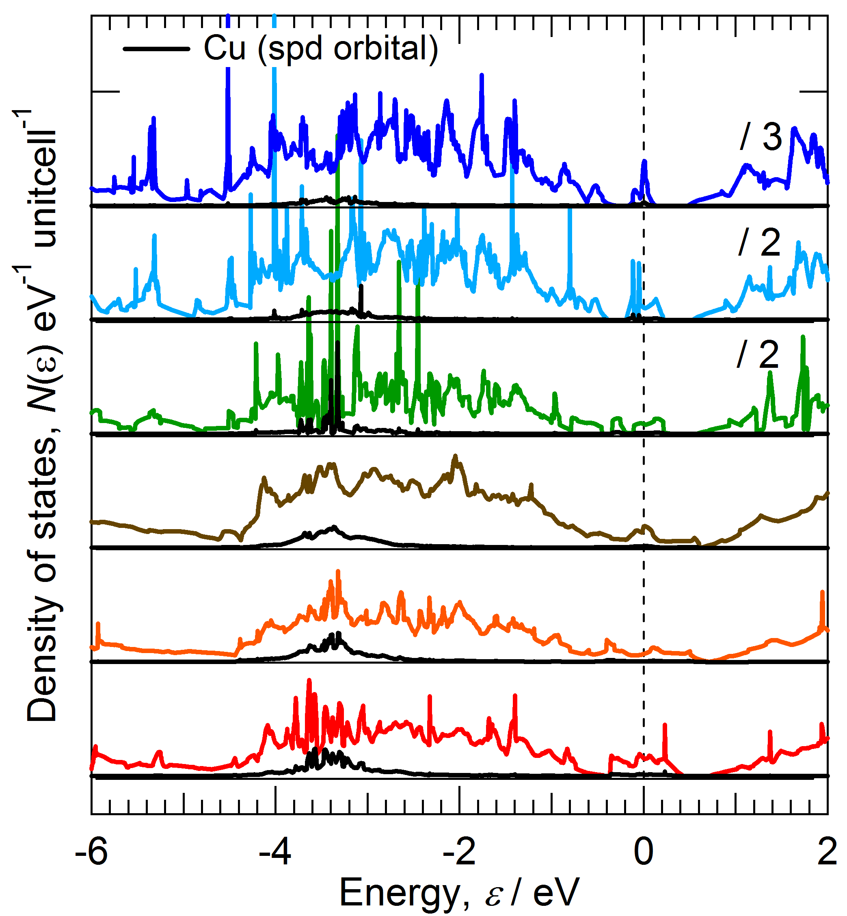
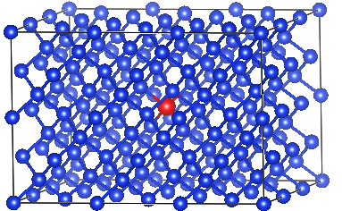
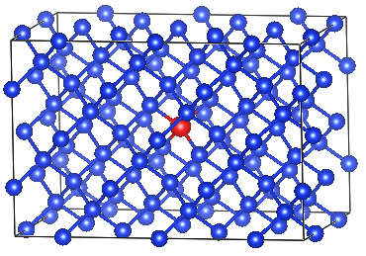
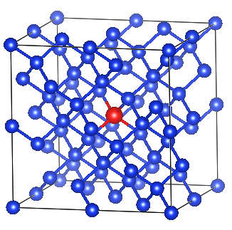
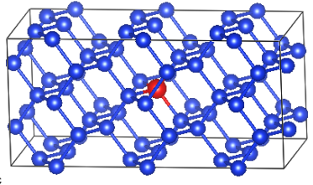
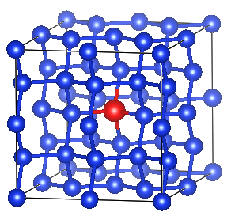
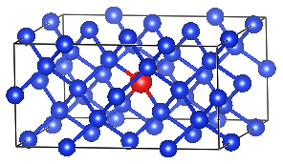
DOS for Cu concentration (VASP)
Si₁₄₃Cu₁
0.69%
Si₉₅Cu₁
1%
Si₆₃Cu₁
1.6%
Si₄₇Cu₁
2.1%
Si₃₁Cu₁
3.1%
Si₃₁Cu₁
3.1%
The Si structures containing less than 1 at.% of Cu produce
sharp peaks

Slide 11
Summary
We identified that (Sc, Y, La), (Cu, Ag, Au), and
Ni substitutions for (Ge, Si) are capable of contributing to
the increase of Seebeck coefficient.
The substituted (Sc, Y, La) atom produces
the impurity states near the band edge of conduction band,
while (Cu, Ag, Au) and Ni substitutions generate
impurity states slightly above the edge of valence band.
The energy of impurity states increases with increasing atomic weight for (Sc, Y, La), while those of (Ag, Au, Cu) showed
less significant atomic weight dependence.
The substitution of Cu was found to produce a sharp peak in electronic density of states near the edge of valence band.
This results suggest that Cu substitution can
increase the Seebeck coefficient more drastically than
the previously reported Au substitution.
Notes:
In summary,
[This is summary of my talks.]
Thank you very much for your attention kindly.
時間が無いとき（重要）
Finally, the summay we’ve obtained are like this.
Sorry to have overtime. Thank you.

Slide 12
Thank you very much for your attention.
Notes:
you very much for your kindly attention.
[ Finally, This my oral is for the first time in my life in English. I am Sorry, My English is not good, but, please, feel free to give me advise and questions.]
[This is acknowledgment]

Slide 13
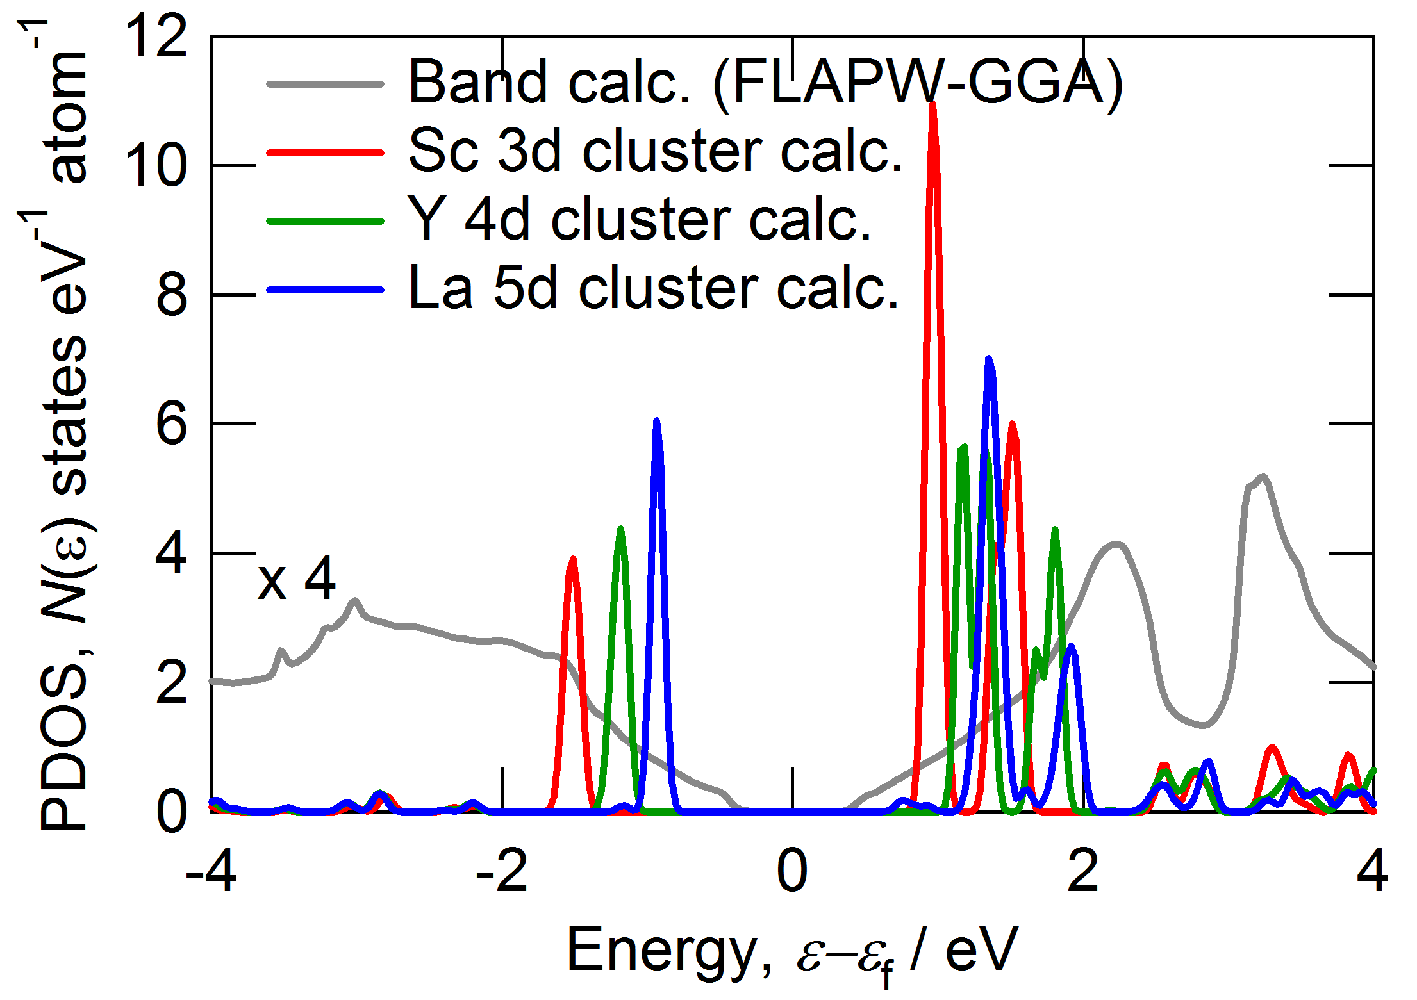
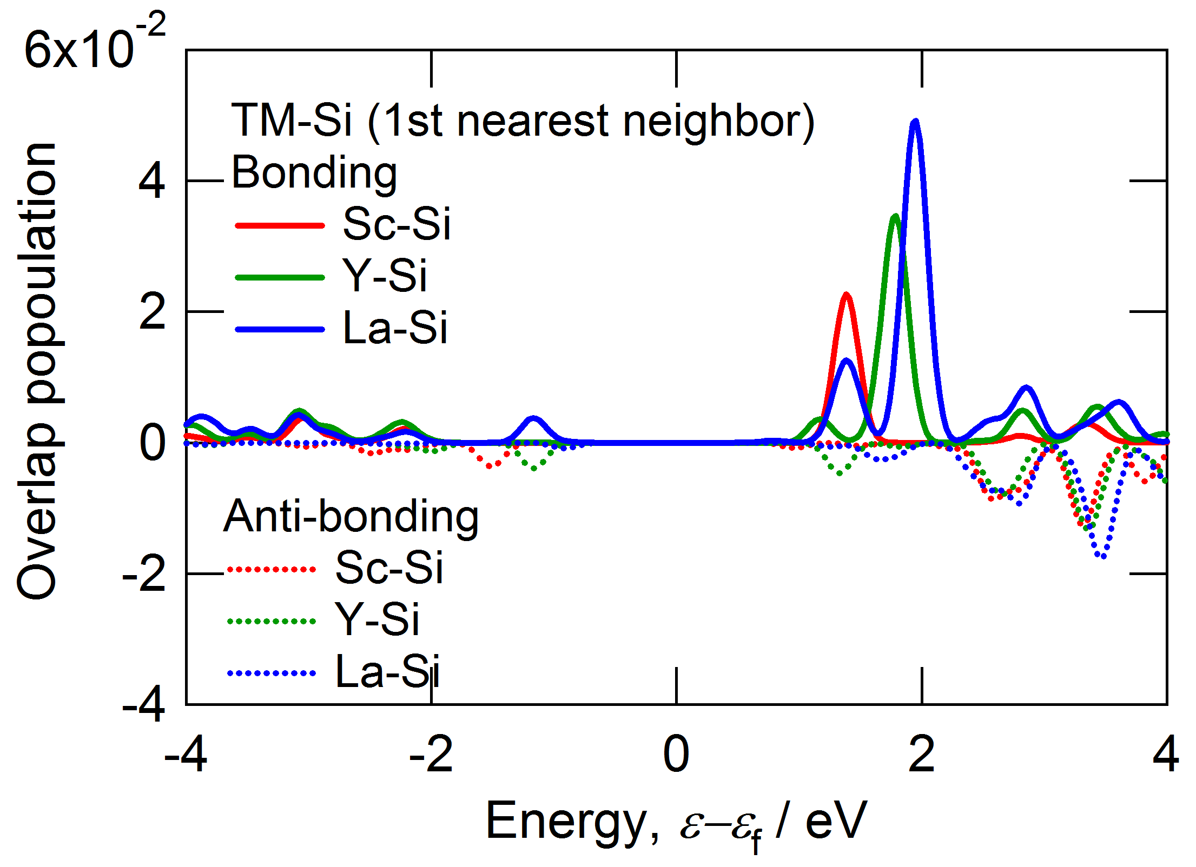
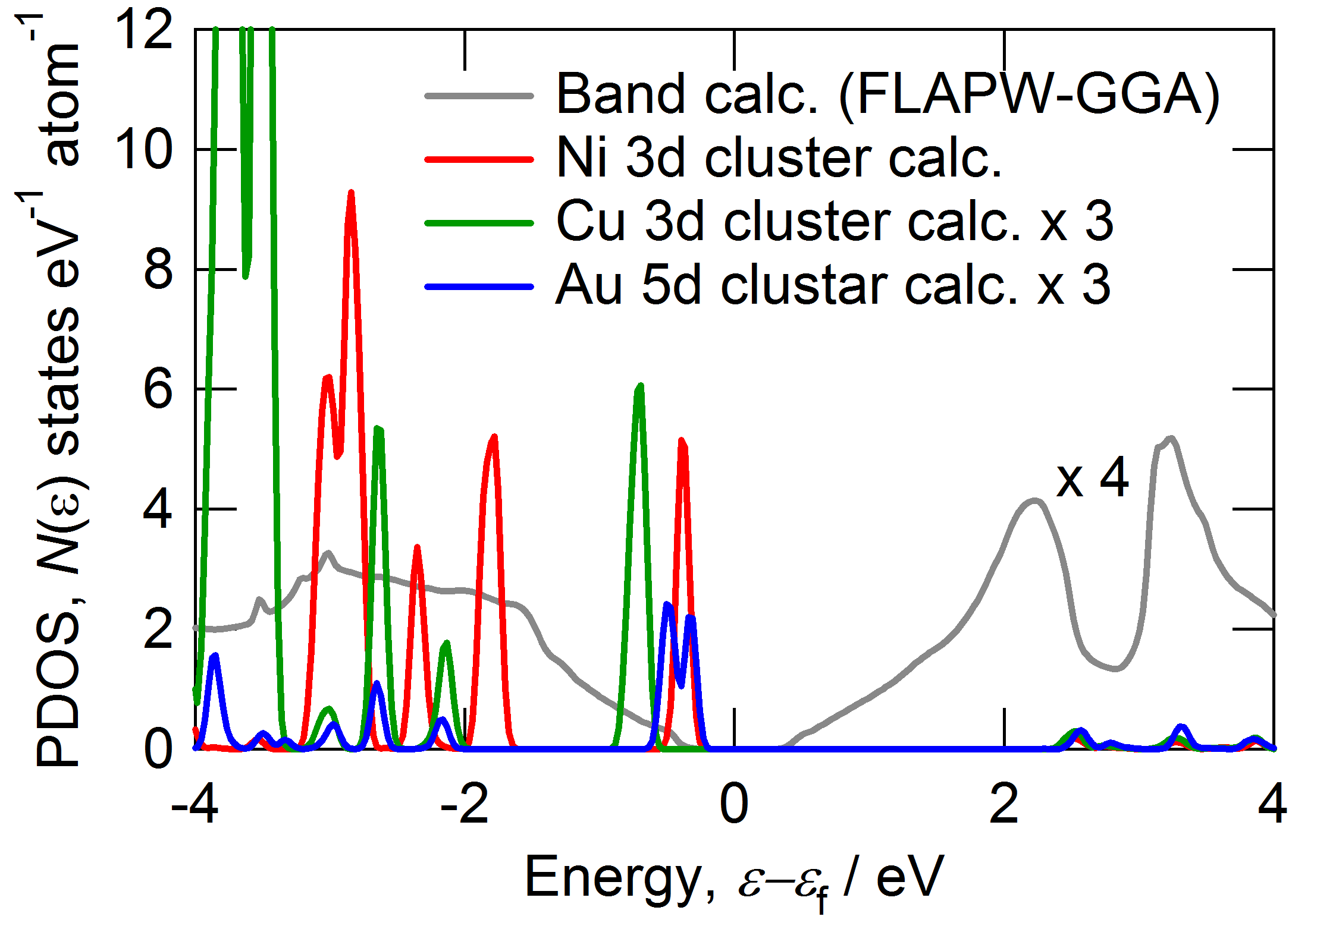
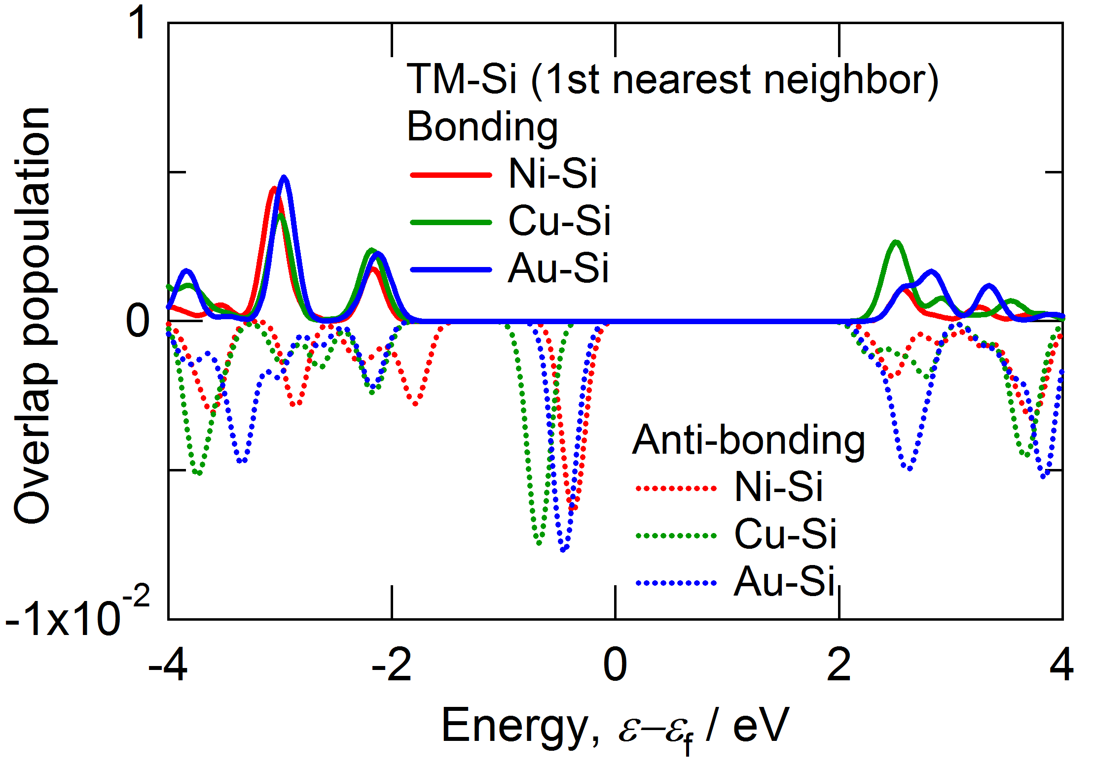
Partial density of states (PDOS)
DVXa calculation conditions: FWHM = 0.1 eV, Shifted Energy = +0.4472 eV
Bonding
Anti-bonding
Anti-bonding
The substituted (Sc, Y, La) atom produces impurity states near
the band edge of conduction band, while (Cu, Ag, Au) and Ni substitutions produce impurity states slightly above the edge of valence band.
Notes:
Let’s move to the Partial DOS of TM sites.
The top left panel shows the results for the Sc, Y and La d states and the bottom right panel for the Ni, Cu and Au d states.
The right panels show these bonding and anti-bonding states.
TM d states located near Si gap are only consist of anti-bonding.
The d states of Sc, Y and La split near the edge of valence band and the edge of conduction band by Crystal field.
As seen in these panels, The substituted (Sc, Y, La) atom produces the impurity states near the band edge of conduction band,
while (Cu, Ag, Au) and Ni substitutions produce impurity states slightly above the edge of valence band.

Slide 14
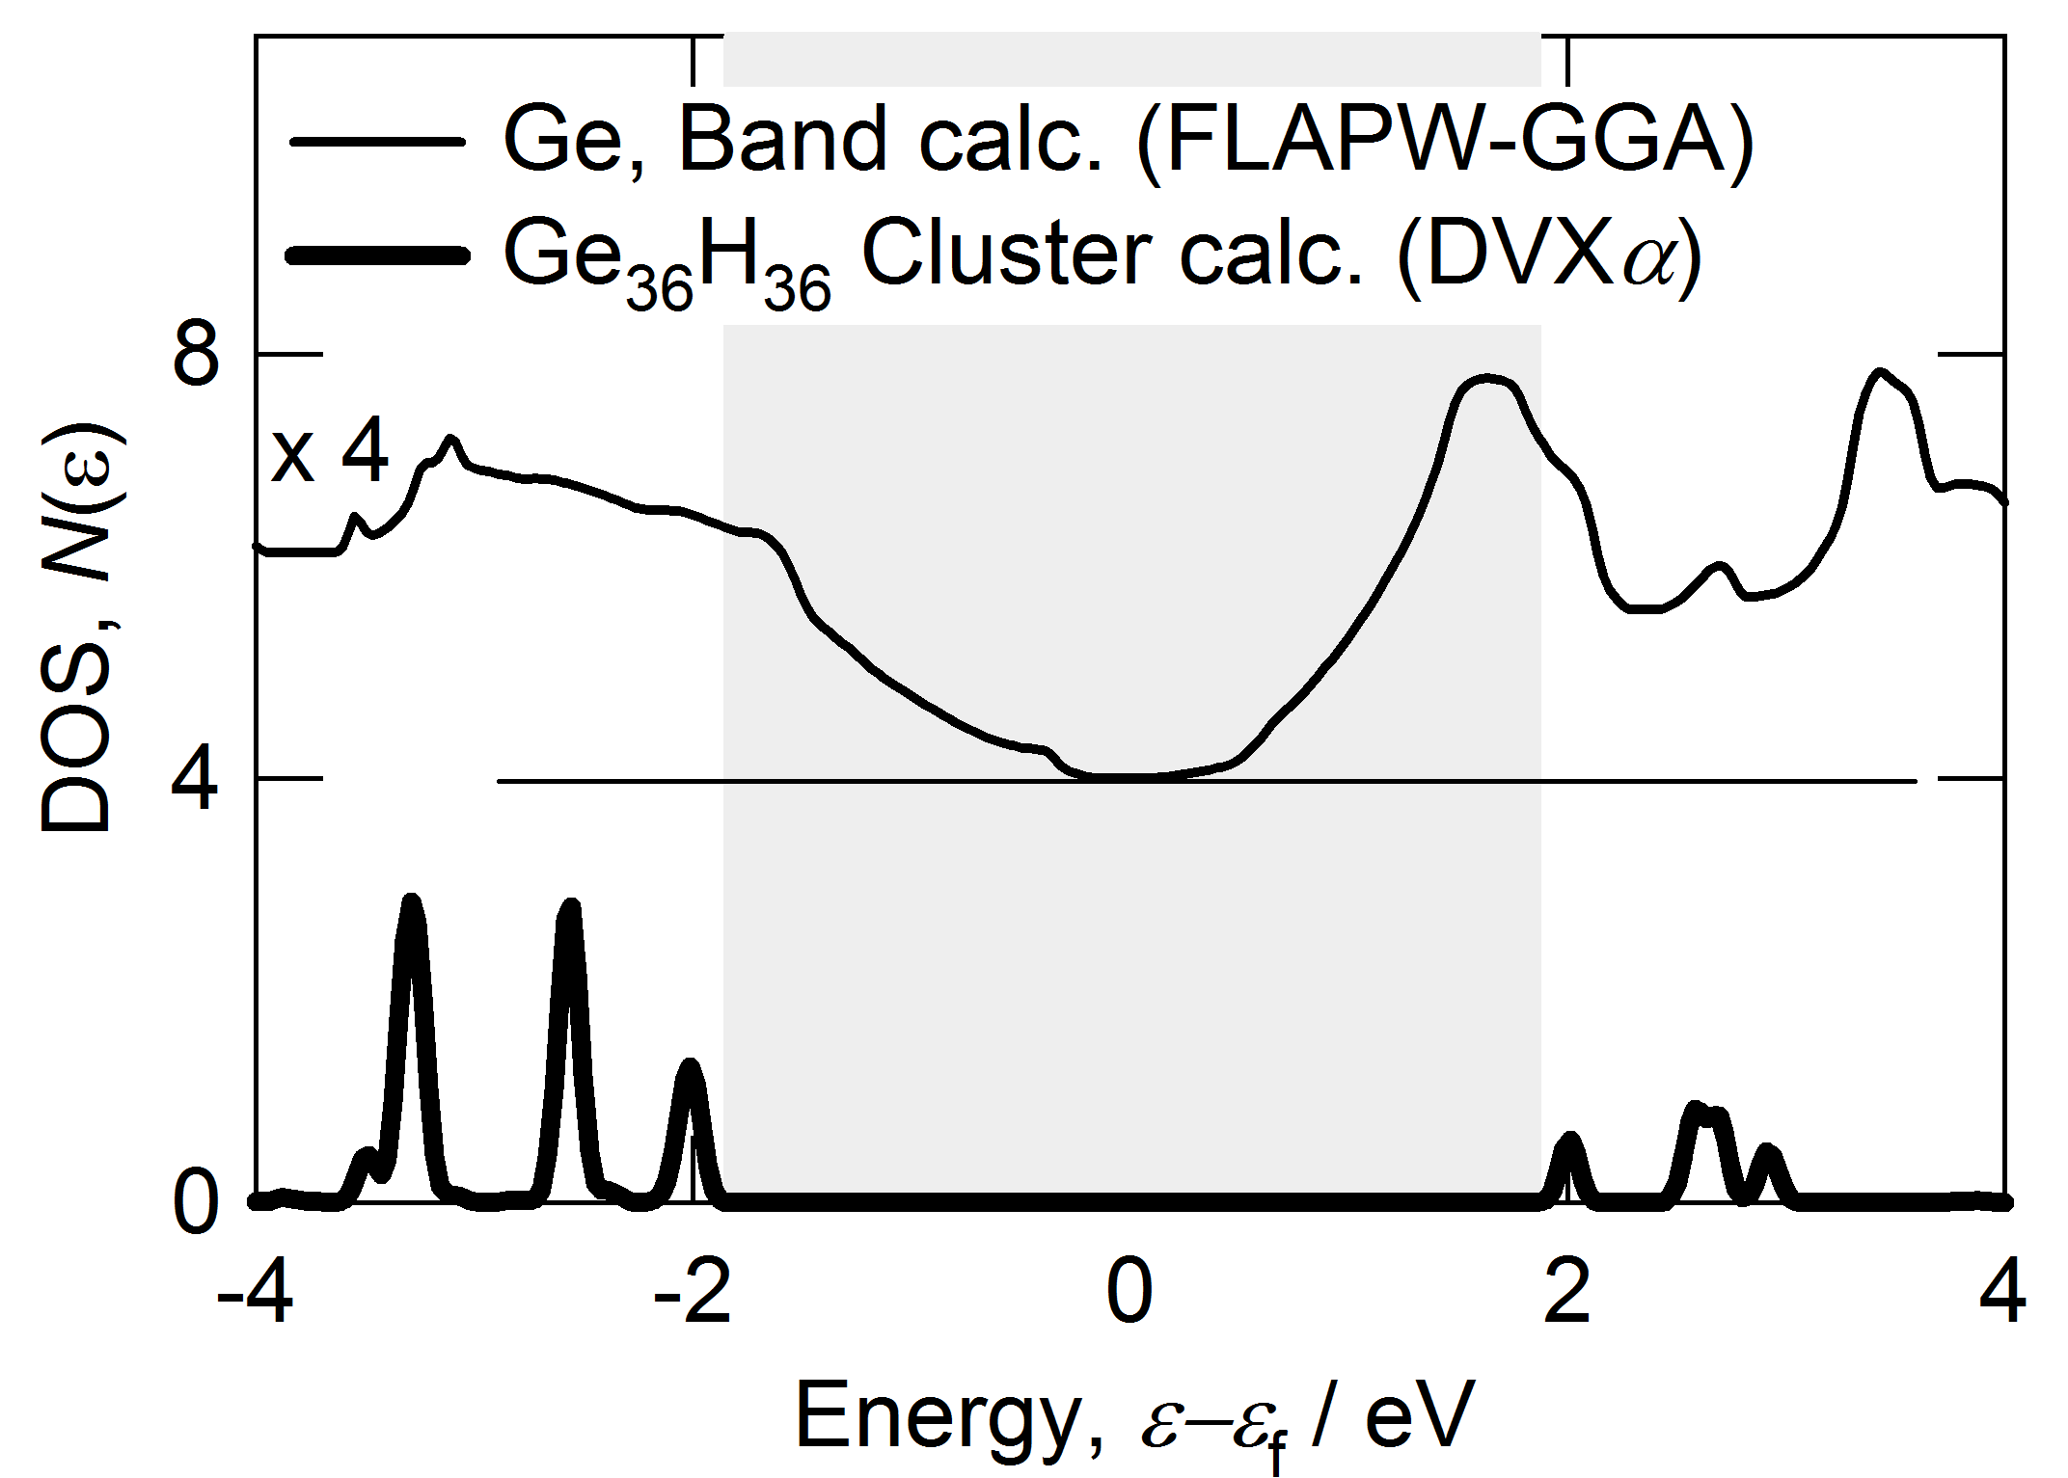
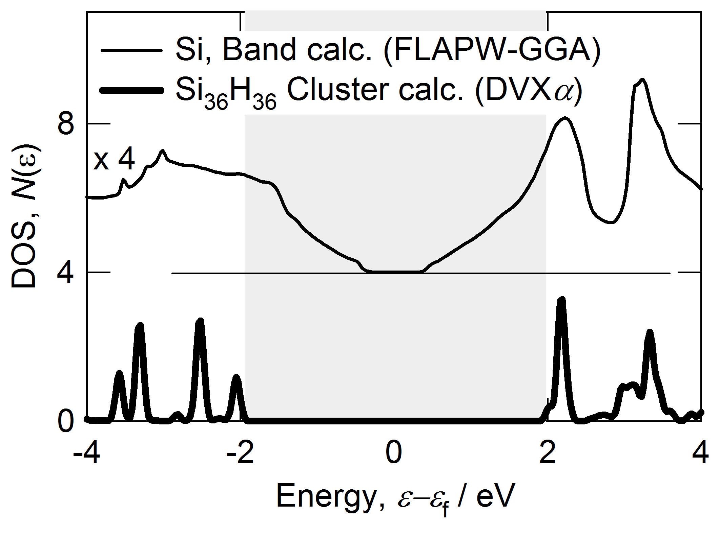
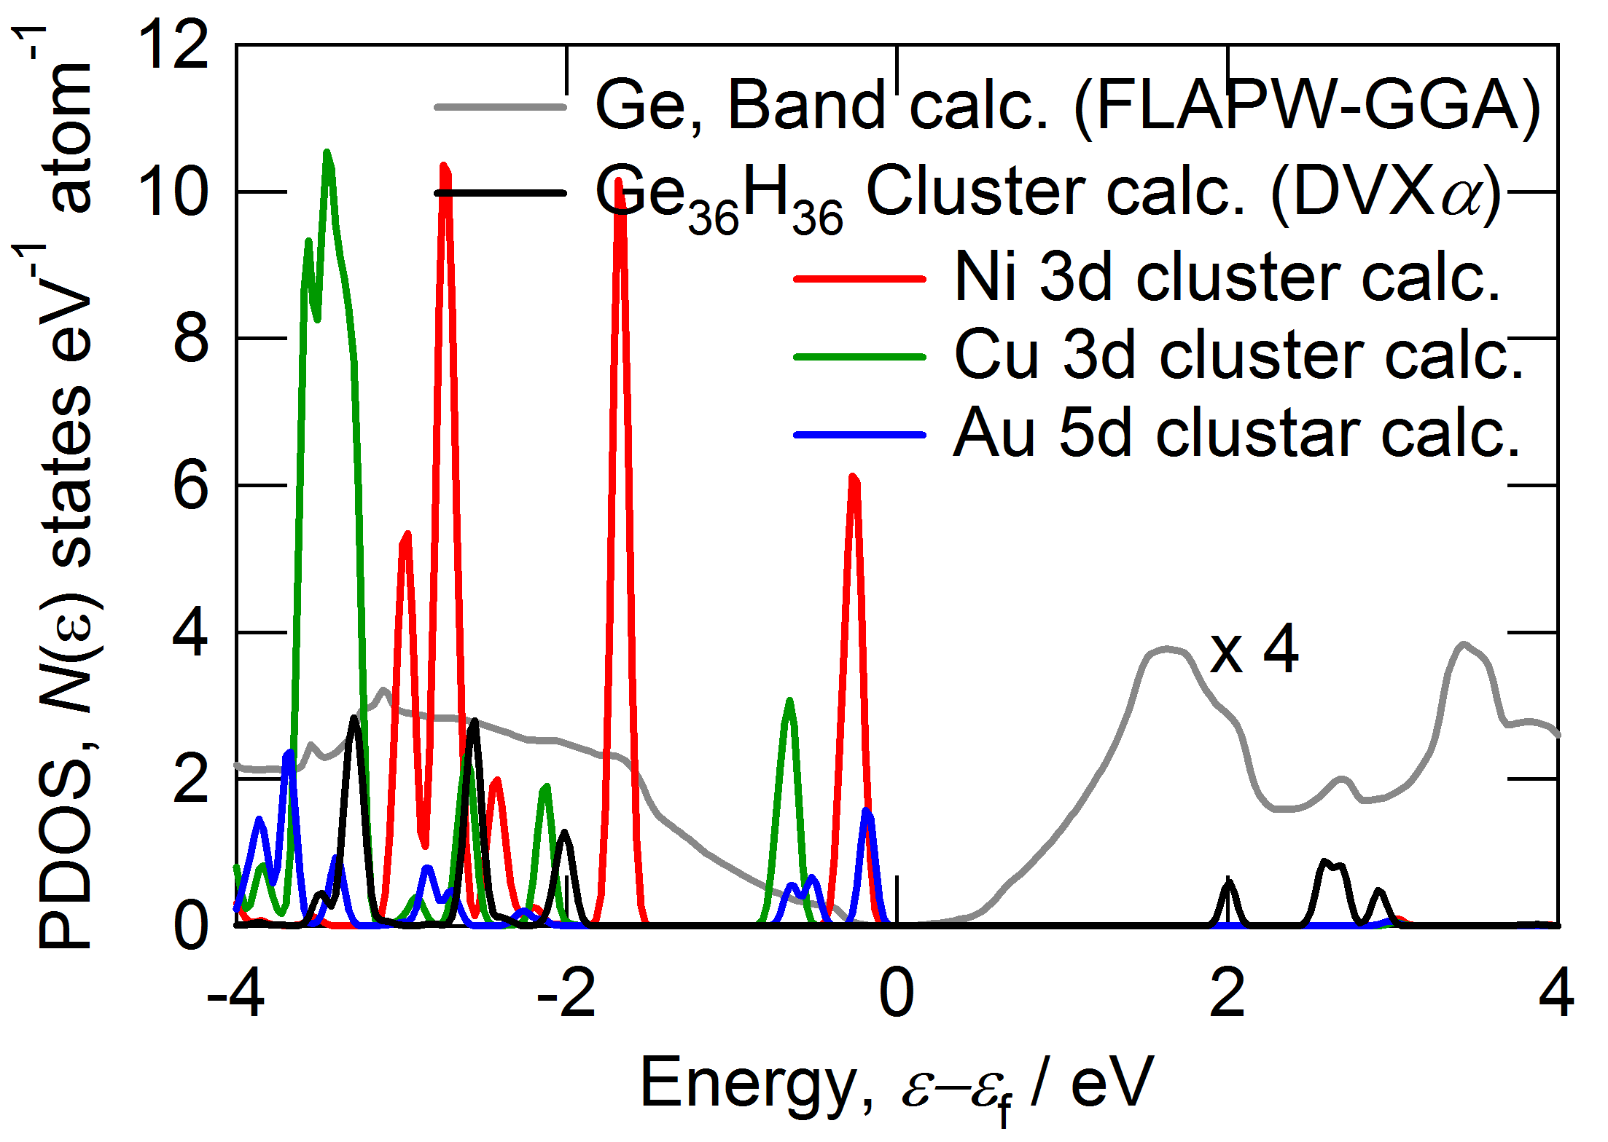
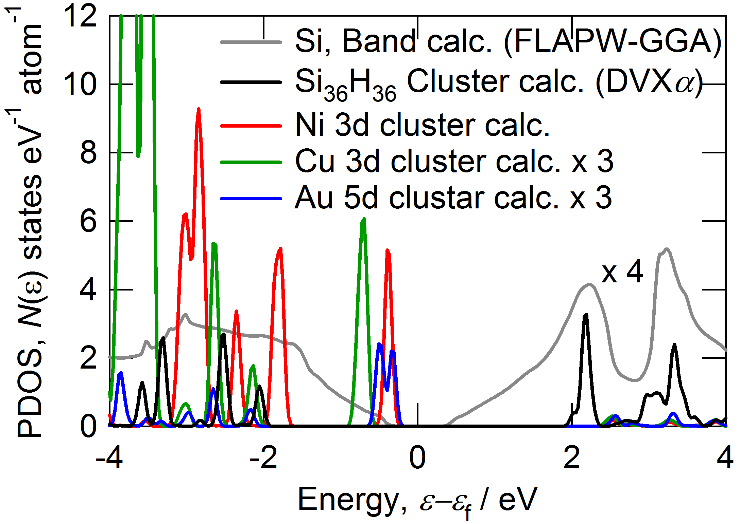
Partial density of states (PDOS)
DVXa calculation condition; FWHM = 0.1 eV
Shifted Energy = -0.029 eV
Shifted Energy = 0.4472 eV
The substitution of Cu was found to produce a sharp peak in the electronic density of states near the edge of the valence band.
Notes:
This panel shows the results for Ge-TM and Si-TM.
The substitution of Ni and Cu was found to produce a sharp peak in electronic density of states near the edge of valence band,
as a whole, the results may prefer the Ni and Cu.
This means the Ni and Cu is candidate.

Slide 15
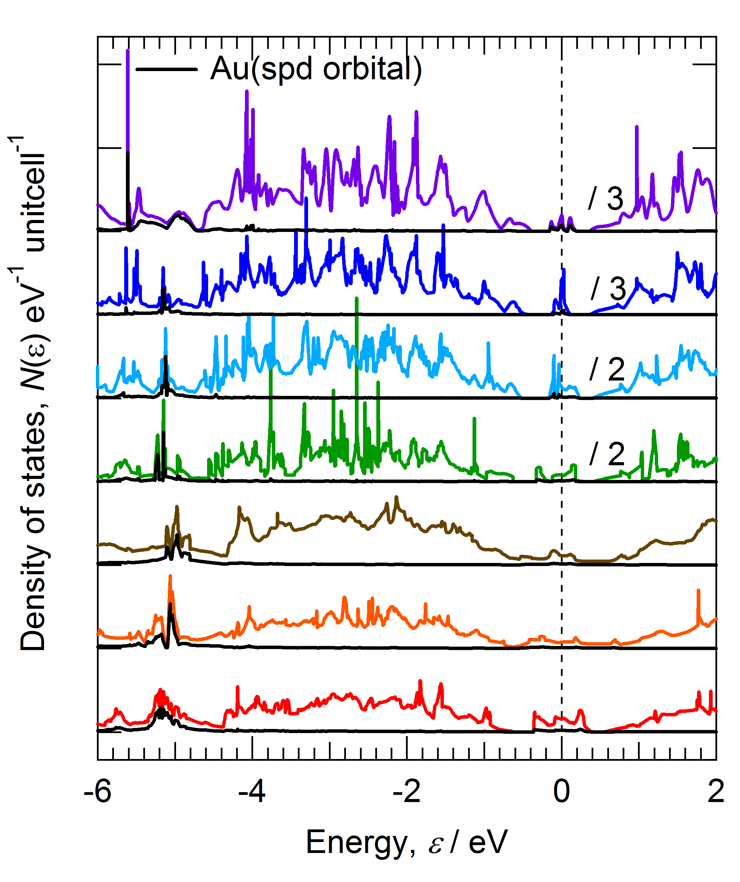
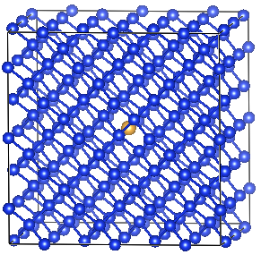
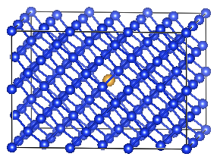
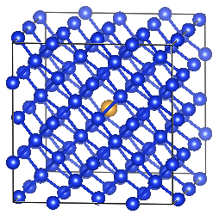
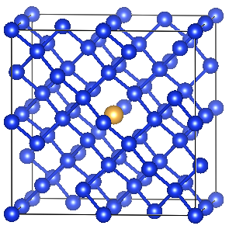
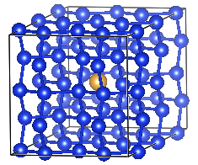
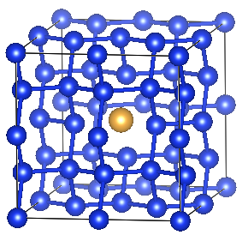
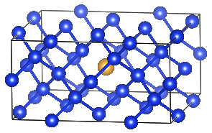
DOS for Au dependence (VASP)
Formation energy (0 K) from single crystal
1.39 eV
Si215Au1
0.46%
1.58 eV
Si143Au1
0.69%
1.53 eV
Si95Au1
1%
1.41 eV
Si63Au1
1.6%
1.26 eV
Si47Au1
2.1%
1.18 eV
Si31Au1
3.1%
1.42 eV
Si31Au1
3.1%

