Slide 1
Spectroscopic Study on
Chemical Ordering of Transition Metals in
Decagonal Al-Co-Ni and Al-Co-Cu Quasicrystals
Aperiodic’09 ( September 17th O-32, Liverpool, UK)
（※ 氏名の順番は偉い人ほど最後（右）の方になります）
（※ もう一つの順番の理由として実際に手足を動かした人を左から書きます）
A. AAAAA^{1, 2}, B. BBBB¹, C. DDDD¹, D. DDDD¹
E. EEEE³, F. FFFFF⁴ and G. GGGG⁵
¹Graduate School of Engineering, XXXX University
²Venture Business Laboratory, YYYY University
³Faculty of Science and Technology, ZZZZ University
⁴Institute of Materials Research, AAAA University
⁵Japan Synchrotron Radiation Research Institute
口演済み（学会用参考資料） ↓下にあるコメントは発表で使用した原稿（参考にしてください）
Notes:
Thank you, Chair. (Prof. XXXX)
Today I would like to talk you about the arrangement of the constituent TM (transition metal) elements in these two-dimensional QC’s (quasicrystals) studied by the spectroscopic observation and cluster calculation of their electronic structures.

Slide 2
OUTLINE
Introduction
Experimental and Calculating Procedures
Results and Discussion
・ Local TM 3d DOS
・ Bond Order & Bond Energy
・ Preferential TM Arrangement
Summary
Notes:
At the beginning, I would like to show you the outline of my presentation.
I’d like to focus on the TM 3d DOS (density of states) of the local clusters in the quasicrystals and their bond order and bond energy (of the local clusters), and discuss the preferential TM arrangement in the quasicrystals.
[Finally, I will summarize my presentation.]

Slide 3
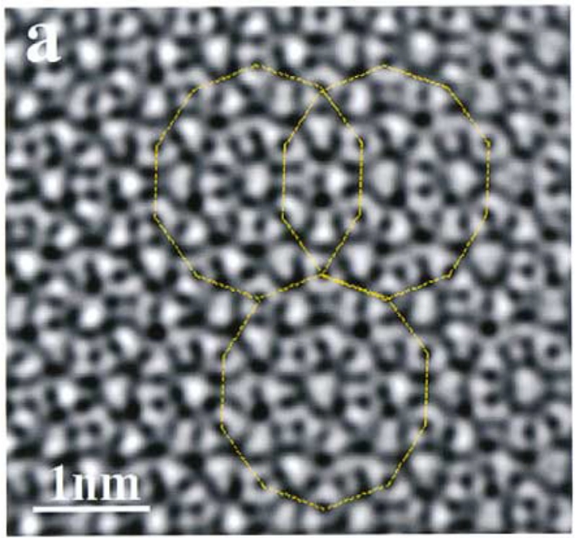
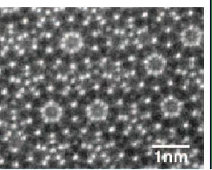
INTRODUCTION
Atomic Arrangement of 2D QC’s
Al-Co-Cu 2D QC
Z-contrast STEM
Al-Co-Ni 2D QC HRTEM
E. Abe et al., Phys. Rev. Lett. 84, 4609 (2000).
S. Taniguchi et al., Phil. Mag. 88, 1949 (2008).
Al-Co-Ni and Al-Co-Cu show a single unit 2 nm cluster.
It is difficult to distinguish constituent TM elements.
Notes:
This viewgraph shows the electron microscopic images of the 2D (two-dimensional) QC’s.
As seen in these images, 2D (two-dimensional) QC may be viewed ( or regarded) as consisting of a single unit 2 nm (decagonal columnar) cluster with overlapping rules,
but it is difficult to distinguish two kinds of TM’s from each other by these techniques.

Slide 4
PURPOSE
To specify the sites occupied by the constituent TM
consistently with
both the microscopic & spectroscopic observations
by comparing the experimental electronic structures
with those calculated
for decagonal unit columnar clusters.
To clarify the bond energy & chemical ordering
bringing the unique atomic arrangement.
Notes:
Our purpose is to specify the sites occupied by the constituent TM elements consistently with both the microscopic and spectroscopic observations by comparing the experimental electronic structures with those calculated for the decagonal unit columnar clusters
and to clarify the bond energy and chemical ordering bringing their unique atomic arrangement.

Slide 5
EXPERIMENTAL & CALCULATING PROCEDURES
Sample
Al₇₂Co₁₆Ni₁₂ and Al₆₅Co₂₀Cu₁₅ d-QC: Czochralski method
Experimental
TM 3d DOS:
TM Lα Soft X-ray Emission Spectra
@ BL-2C of Photon Factory & BL27SU of SPring-8
Soft X-ray Photoelectron Spectra
@ BL47XU & BL23SU of SPring-8
Cluster Calculation
DV-Xα method:
the real-space first principle MO calculation
Easy to clarify the bond energy & chemical ordering in local cluster.
Notes:
Specimens used in the present study are ( single-grain) decagonal Co-rich these QC’s (Al72Co16Ni12 and Al65Co20Cu15) prepared by the Czochralski method.
Experimental TM 3d DOS was obtained by measuring TM La soft X-ray emission and photoelectron spectra at these synchrotron radiation facilities,
Theoretical electronic structure ( for the decagonal unit cluster ) was calculated with the discrete variational Xa method.
This method is one of the real-space first principle molecular orbital calculation
It is easy to clarify the bond energy and chemical ordering in local cluster.
[powerful for studying the electronic structure and chemical binding in materials including many TM’s without periodicity.]

Slide 6
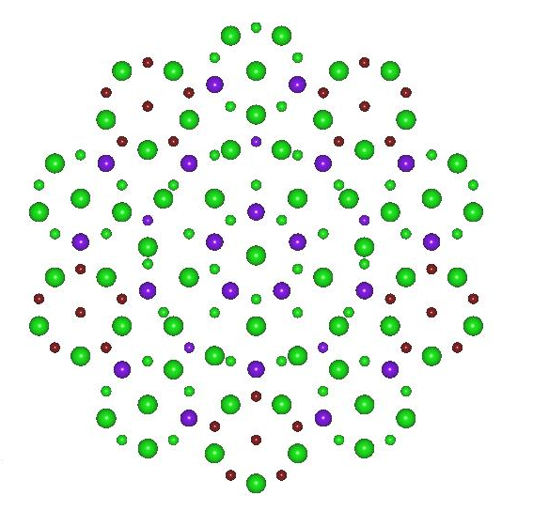
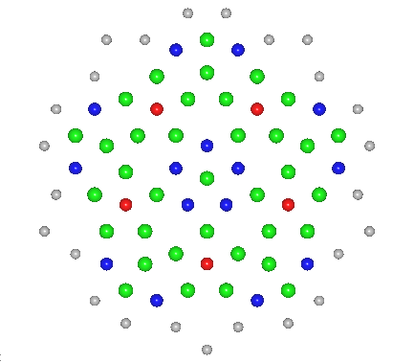
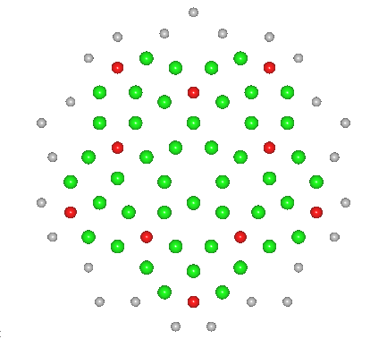
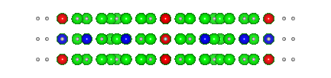

Decagonal Model Unit Cluster for DV-Xα
XRD for W-phase approximant
K. Sugiyama et al., J. Alloy Comp. 342, 65 (2002).
●Al ●TM ●Al or TM
B layer
A layer
2 nm
●Al
●TM1
●TM2
●H
＋
BAB model cluster
ABA model cluster
Summation of the local DOS’s of the central layers
DOS of AB double layered cluster
Notes:
Model unit clusters for the present study are based on the recent model proposed from the XRD( X-ray diffraction) study of the W-phase approximant by Sugiyama et al.
Model cluster consists of two quasiperiodic layers A and B with these TM arrangements. That is, blue circles stand for TM#1 and red (circles) ones for TM#2.
To avoid the surface effect, we have calculated the electronic structure of triple-layered clusters B-A-B and A-B-A.
and obtained the DOS for the model cluster by summation of the local DOS’s of the central layers in the triple-layered clusters.

Slide 7
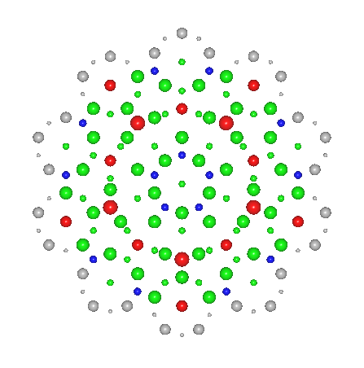
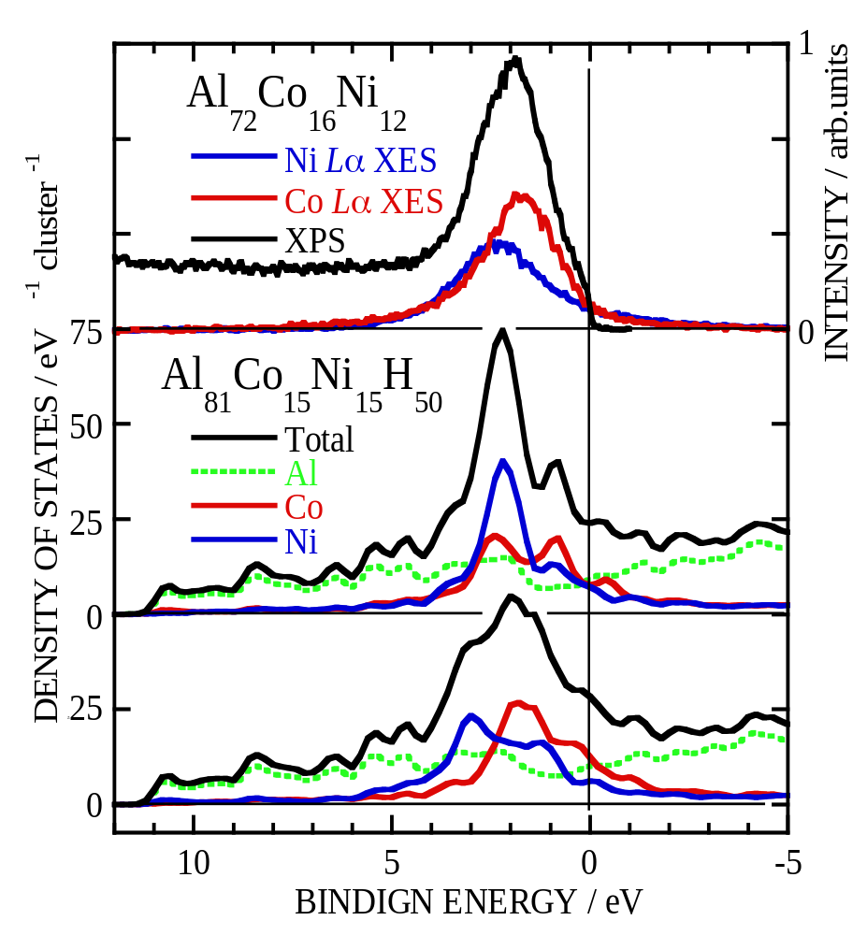
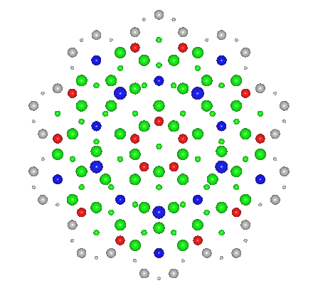
Calculated & Experimental Results
Ni Centre Model
Al₇₂Co₁₆Ni₁₂
Co Centre Model
●：Al ●：Co ●：Ni
Notes:
Here we show the experimental and calculated results.
The top panel presents the experimental XPS and XES spectra for Al-Co-Ni QC,
which shows the total DOS and Co and Ni 3d partial DOS’s, respectively.
The middle and bottom panels are (reveal) the results calculated for Ni centre model and Co centre model.
As seem in this viewgraph, our cluster calculation explains fairly well the experimental results.
I will also point out a pseudogap across the Fermi level in the Al partial DOS’s,
Indicating the contribution of the Hume-Rothery mechanism to the stabilization of the QC.

Slide 8
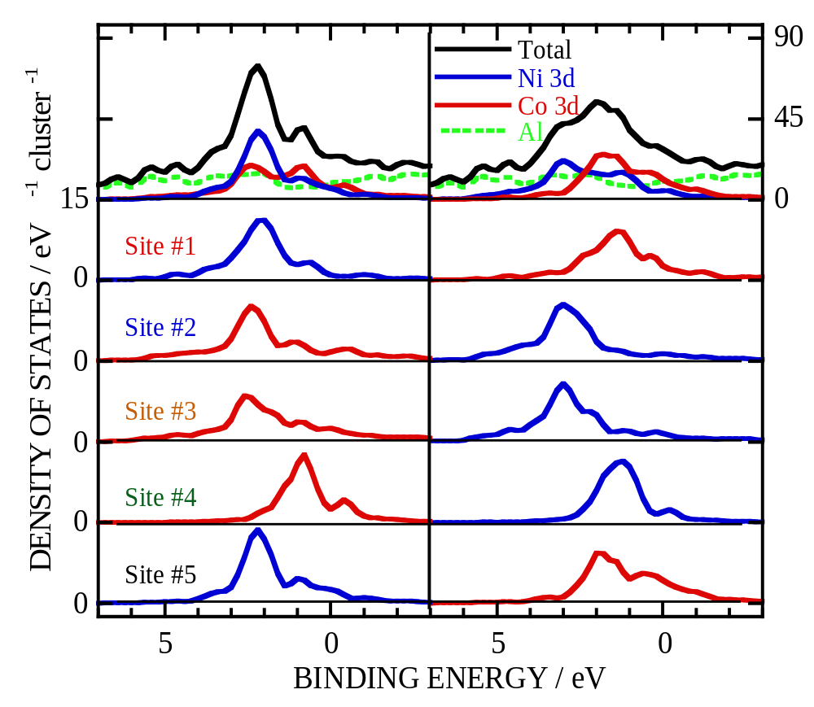
Local TM 3d DOS
Ni Centre
Model
Ni Centre
Model
Co Centre
Model
Site #1
Site #3
Site #2
Site #5
Site #4
Co Centre
Model
Site #1
Site #3
Site #2
Site #5
Site #4
●：Al ●：Co ●：Ni
Notes:
Let’s move to the local TM 3d DOS around the non-equivalent TM sites.
The left panel shows the results for the Ni centre model and the right panel for the Co centre model.
As seen in these panels,
the energy positions of the site #2 and #3 are almost the same because of the similarity in the nearest neighbor arrangement,
and they are the lowest in energy due to the large Al-TM interaction or large Al coordination.
The energy position of the site #5 is also similar to that of the site #1.
The energy position of the site #4 is the highest because of the weak Al-TM interaction.
These results indicate the important of the Al-TM interaction.
However, we will ignore the sites #4 and #5, hereafter, because they are incomplete in our calculation for the peripheral part of the cluster.
Similar results are obtained for Al-Co-Cu QC.

Slide 9
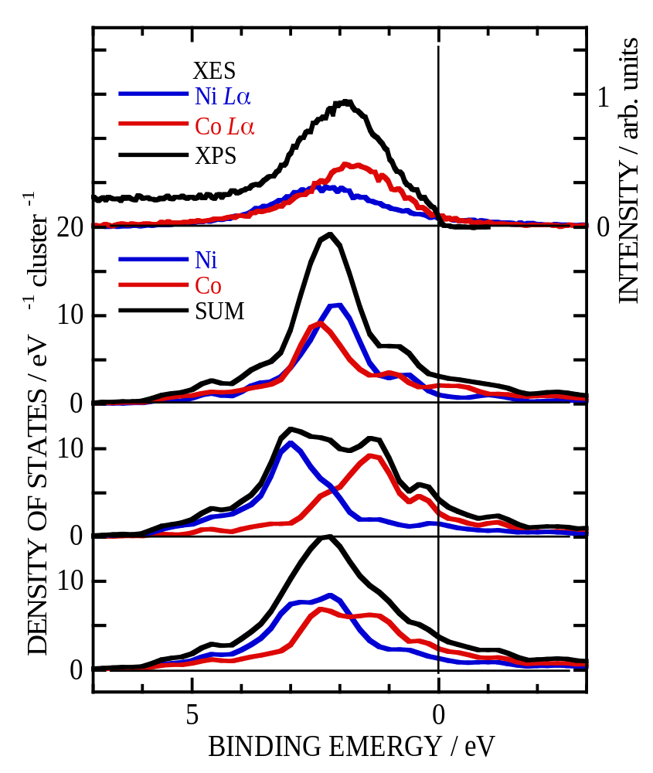
Co and Ni 3d DOS in Al-Co-Ni
Ni Centre Model
Site #1
Site #3
Ni Centre
Model
Site #2
Co Centre
Model
Co Centre
Model
Site #1
Mixed
Ni & Co
Model
Site #3
Site #2
Co and Ni may occupy the TM sites randomly.
Notes:
Next, we will compare the calculated 3d partial DOS with the experimental spectra ( for Al-Co-Ni and Al-Co-Cu QC’s ).
This viewgraph shows the results for Al-Co-Ni:
the 3rd and 2nd lower panels for the Ni and Co centre models, respectively.
The Co and Ni 3d bands are distributed over rather wide region for the Co centre model, while a single-peaked TM 3d band appears for the Ni centre model.
However, the Co 3d band is located at higher binding energy than the Ni band,
This is inconsistent with the experimental results.
As a whole, the results may prefer the Ni centre model.
Instead, as shown the bottom panel, the 3d DOS for the model with Co and Ni mixed in the site #1 and #2 agrees better with the experimental result than the others.
This means the Co and Ni may occupy the TM sites randomly .

Slide 10
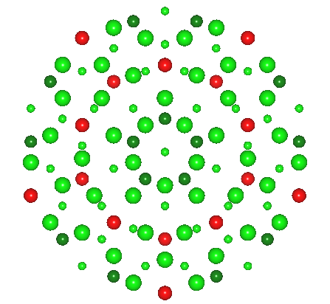
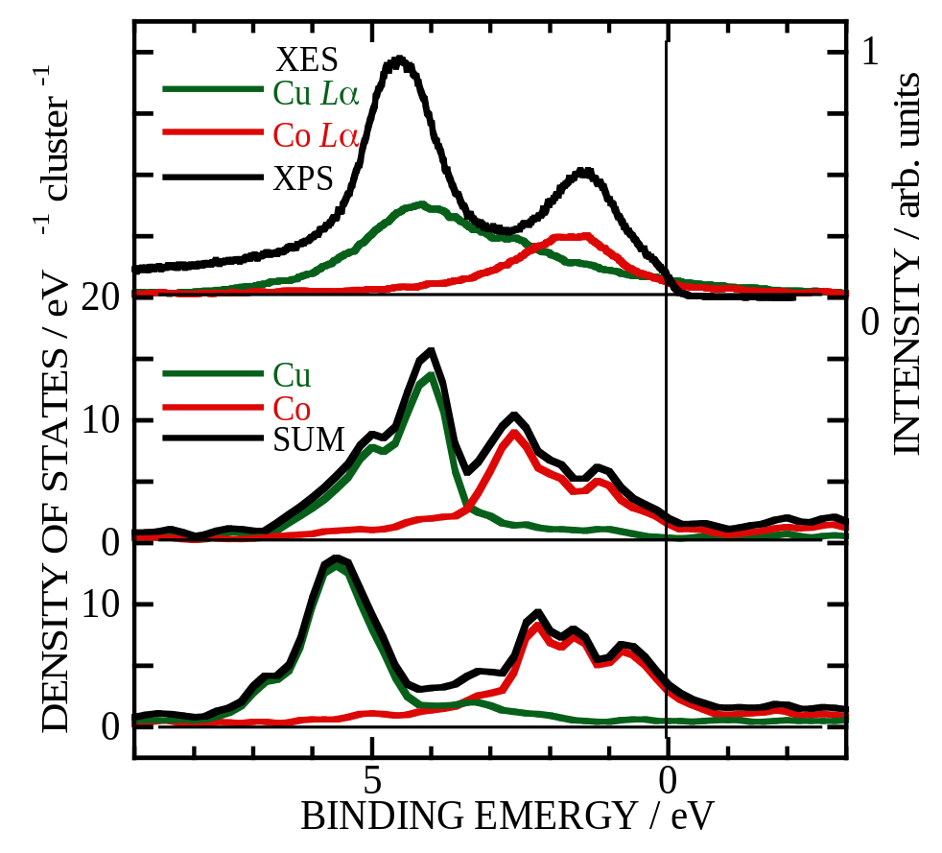
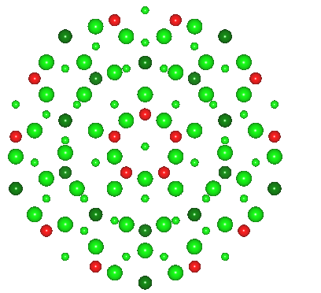
Co and Cu 3d DOS in Al-Co-Cu
Cu Centre
Model
Site #1
Site #3
Cu Centre
Model
Site #2
Co Centre
Model
Co Centre
Model
Site #1
Site #3
Site #2
Cu centre model agrees fairly with experimental results.
Notes:
This panel show the results for Al-Co-Cu.
The TM 3d DOS reveals the preferential occupation of Cu at the site #1 and Co at the site #2,
Indicating the Cu centre model agrees fairly with experimental results.

Slide 11
Stability at TM sites for Al-Co-Cu
Model Cluster | Site #1 Bond Energy (eV atom⁻¹) Bond Order |  | Site #2 Bond Energy (eV atom⁻¹) Bond Order |  | Total Bond Energy (eV atom⁻¹)
Al-Co-Cu | Co | Cu | Co | Cu | Co+Cu
Cu centre | – | 23.2 0.137 | 18.3 0.148 | – | 41.5
Co centre | 12.7 0.154 | – | – | 27.2 0.131 | 39.9
Al-Co-Ni | Co | Ni | Co | Ni | Co+Ni
Ni centre | – | 18.3 0.145 | 19.7 0.146 | – | 38.0
Co centre | 15.9 0.155 | – | – | 22.2 0.135 | 38.1
Cu preferentially occupied the site #1 and Co does the site #2,
while Co and Ni take the TM sites #1 & #2 randomly.
Notes:
In order to quantitatively compare the chemical stabilities at the TM sites 1 (the innermost TM site of the model cluster) and 2 (the second innermost one), we have calculated the local bond energy at the TM sites and bond order of the Al-TM bonds at the TM sites.
Here, the local bond energy is defined as the energy gain of the occupied TM band states at the TM site compared to the sum of the relevant occupied orbital energy of an isolated TM atom, and the bond order shows how large the bonding nature in the concerned molecular states.
In both quasicrystals, the bond energy for the site # (number) 2 is high, which indicates the large stability at site #2.
However, for the Al-Co-Cu quasicrystal, the total bond energy, clearly indicates the preferential occupation of Cu at the site 1 and Co at the site 2.
These suggest a highly chemical ordering of Cu and Co in the Al-Co-Cu quasicrystal.
For the Al-Co-Ni quasicrystal, the bond order may prefer the Ni centre model to the Co one, because of almost the same bond strength at the both TM sites.
but the bond energy is almost the same for both the models.
The very small difference in the bond energy suggest that the Co and Ni may take the TM#1 and #2 sites randomly.

Slide 12
Summary
Comparison
between the experimental & calculated TM 3d DOS’s
& Analysis
on the local bond energy & bond order at the TM sites
Al-Co-Cu QC favors
the Cu & Co occupation at the sites #1 & #2, respectively,
i.e. the high chemical ordering of Co & Cu,
while Al-Co-Ni QC may prefer the Ni centre model
but the large chemical disordering between Co & Ni.
Notes:
In summary, our comparison between the experimental and calculated TM 3d DOS’s and analysis on the local bond energy and bond order at the TM sites show that Al-Co-Cu QC favors the Cu and Co occupation at the sites #1 and #2, respectively,
that indicates the chemical order of Co and Cu,
while Al-Co-Ni QC may prefer the Ni center model to the Co one
but reveals the large chemical disorder between Co and Ni because of very small difference in the total of the local bond energy at the sites #1 and #2.
[This is summary of my talks.]

Slide 13
Acknowledgment
Financial support:
International Union of Crystallography
Venture Business Laboratory of Nagoya University
Thank you very much for your attention kindly.
Notes:
I would like to greatly appreciate financial supports by International Union of Crystallography and Venture Business Laboratory of Nagoya University.
Thank you very much for your kindly attention.
[ Finally, This my oral is for the first time in my life in English. I am Sorry, My English is not good, but, please, feel free to give me advise and questions.]
[This is acknowledgment]

