Slide 1
SnSeとCu₂Se中の遷移金属の電子構造
Electronic states of transition metal elements in SnSe or Cu₂Se alloy
TSJ 2017 ( Sep 11th, S2A8, Osaka, Japan)
○氏名*，氏名
First name Family name¹ and First name Family name ¹
所属機関，〒XXX-XXXX YY市ZZ区AA二丁目12番地1
¹所属機関（英語）, City XXX-XXXX, Japan
口演済み（学会用参考資料）
（※ 氏名の順番は偉い人ほど最後（右）の方になります）
Notes:
Thank you, Chair. (Dr. XXXX)
Today I would like to talk you about “Electronic states of transition metal elements in Silicon Germanium alloys”.

Slide 2
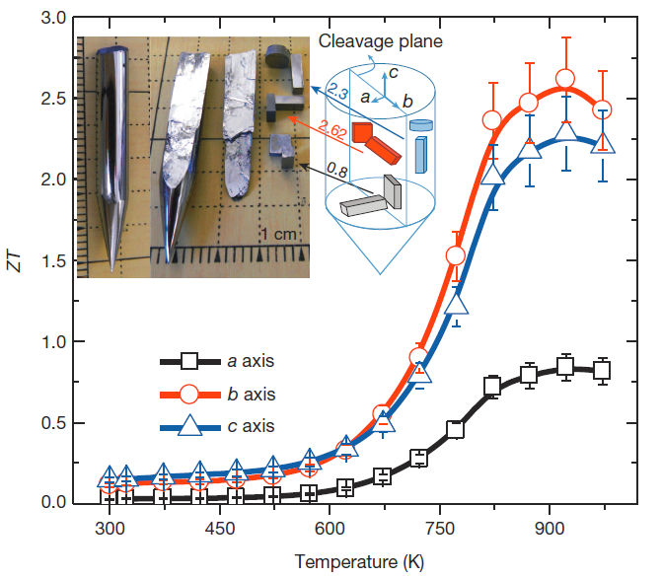
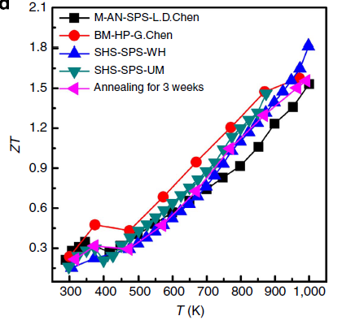
INTRODUCTION
SnSe
Cu₂Se
[1] Li-Dong Zhao et al., Nature 508 (2014) 373-377.
[2] X. Su et al., nature communications (2014)
熱伝導率は～0.5 W/mKと低く、ZT > 1.5を超える熱電性能を示す
フェルミ準位近傍の不純物準位を利用して熱電性能を向上させる
目的：遷移金属で元素置換を施したSnSeとCu₂Seの不純物準位を
第一原理計算手法を用いて明らかにする
Notes:
These graph show Seebeck coefficient and XRD of the Au-doped Si-Ge amorphous thin film.
As seen in these graph, Huge magnitude of Seebeck coefficient exceeding 10 mVK^-1 were reported for the Si-Ge thin film containing -5 at.% Au and
These thin films are amorphous superlattice.

Slide 3
CALCULATING PROCEDURES
Model
Sn_{1-x}TM_{x}Se (TM = transition metal) and Cu_{2-x}TM_{x}Se.
Band calculation
FLAPW method: WIEN2k code
高い計算精度
Pseudopotential method: PWscf code
構造最適化が容易
Cluster Calculation
DV-Xα method:
周期的（コヒーレント）な影響を除いた計算が可能
遷移金属による元素置換の影響を評価
Notes:
Model used in the present study are simple Si-TM and Ge-TM.
FLAPW(full potential linearized augmented plane-wave) calculation was employed to estimate other first principle calculation.
Theoretical optimized structure was calculated with the Pseudo-potential method.
Theoretical electronic structure ( for the cluster ) was calculated with the discrete variational Xa method.
This method is one of the real-space first principle molecular orbital calculation[ and powerful for studying the electronic structure in materials including TM without periodicity.]
It is easy to clarify the electronic structure within incoherent effect such as in amorphous thin film.

Slide 4
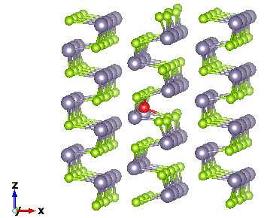
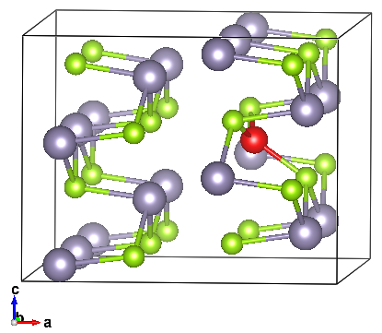
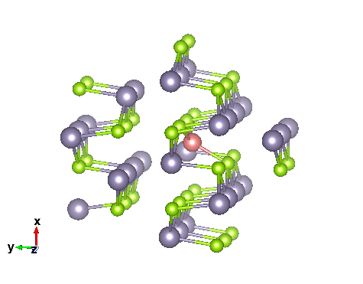
Structure model for the first principle calculation
DOS calculation of SnSe system
PWscf (1x2x2 relaxed) and DVXα (cluster)
● Sn
● TM
● Se
Cut > 7.4 Ang.
Expand periodically
About (1.5 times)
Relaxed structure (No.62, Pnma)
1x2x2 (Sn₁₅TM₁Se₁₆)
(1.5 days / 6 core), it is heavy !
Sn₂₉TM₁Se₃₁ Cluster
Cs symmetry
(XY mirror)
Notes:
Sn: tin

Slide 5
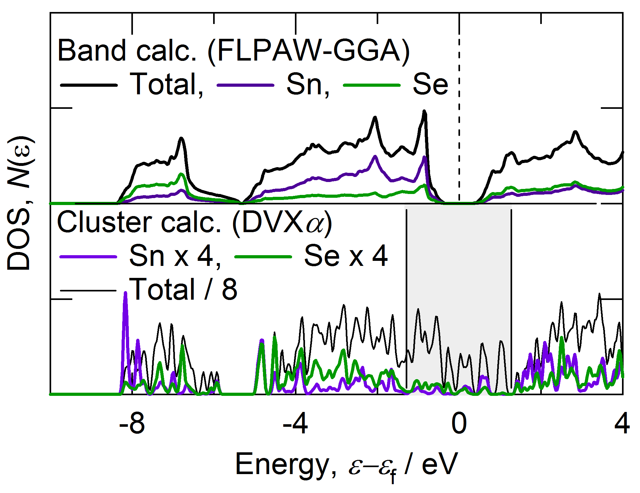
Density of states
共有結合によるダングリングボンド
ギャップが消失

Slide 6
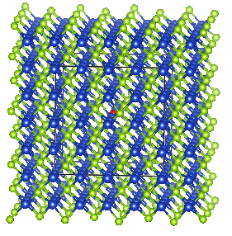
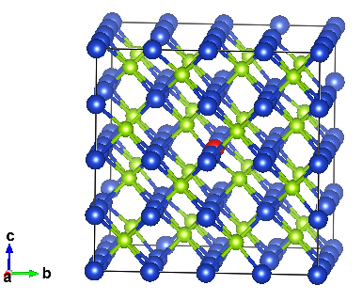
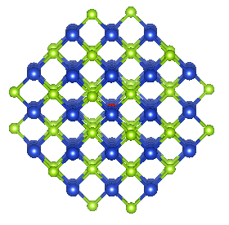
Structure model for the first principle calculation
DOS calculation of Cu₂Se system
PWscf (2x2x2 relaxed) and DVXα (cluster)
● Cu
● TM
● Se
Cut > 7.6 Ang.
1.4-fold expansion
periodically
Cut > 7.6 Ang.
Relaxed structure (high temp.)
2x2x2 (Cu₆₂TM₁Se₆₃)
(1.5 days / 6 core), it is heavy !
Cu₈₀TM₁Se₄₄ Cluster
(Td sym., order24)
Notes:
Sn: tin

Slide 7
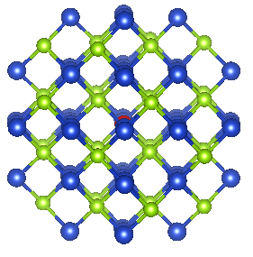
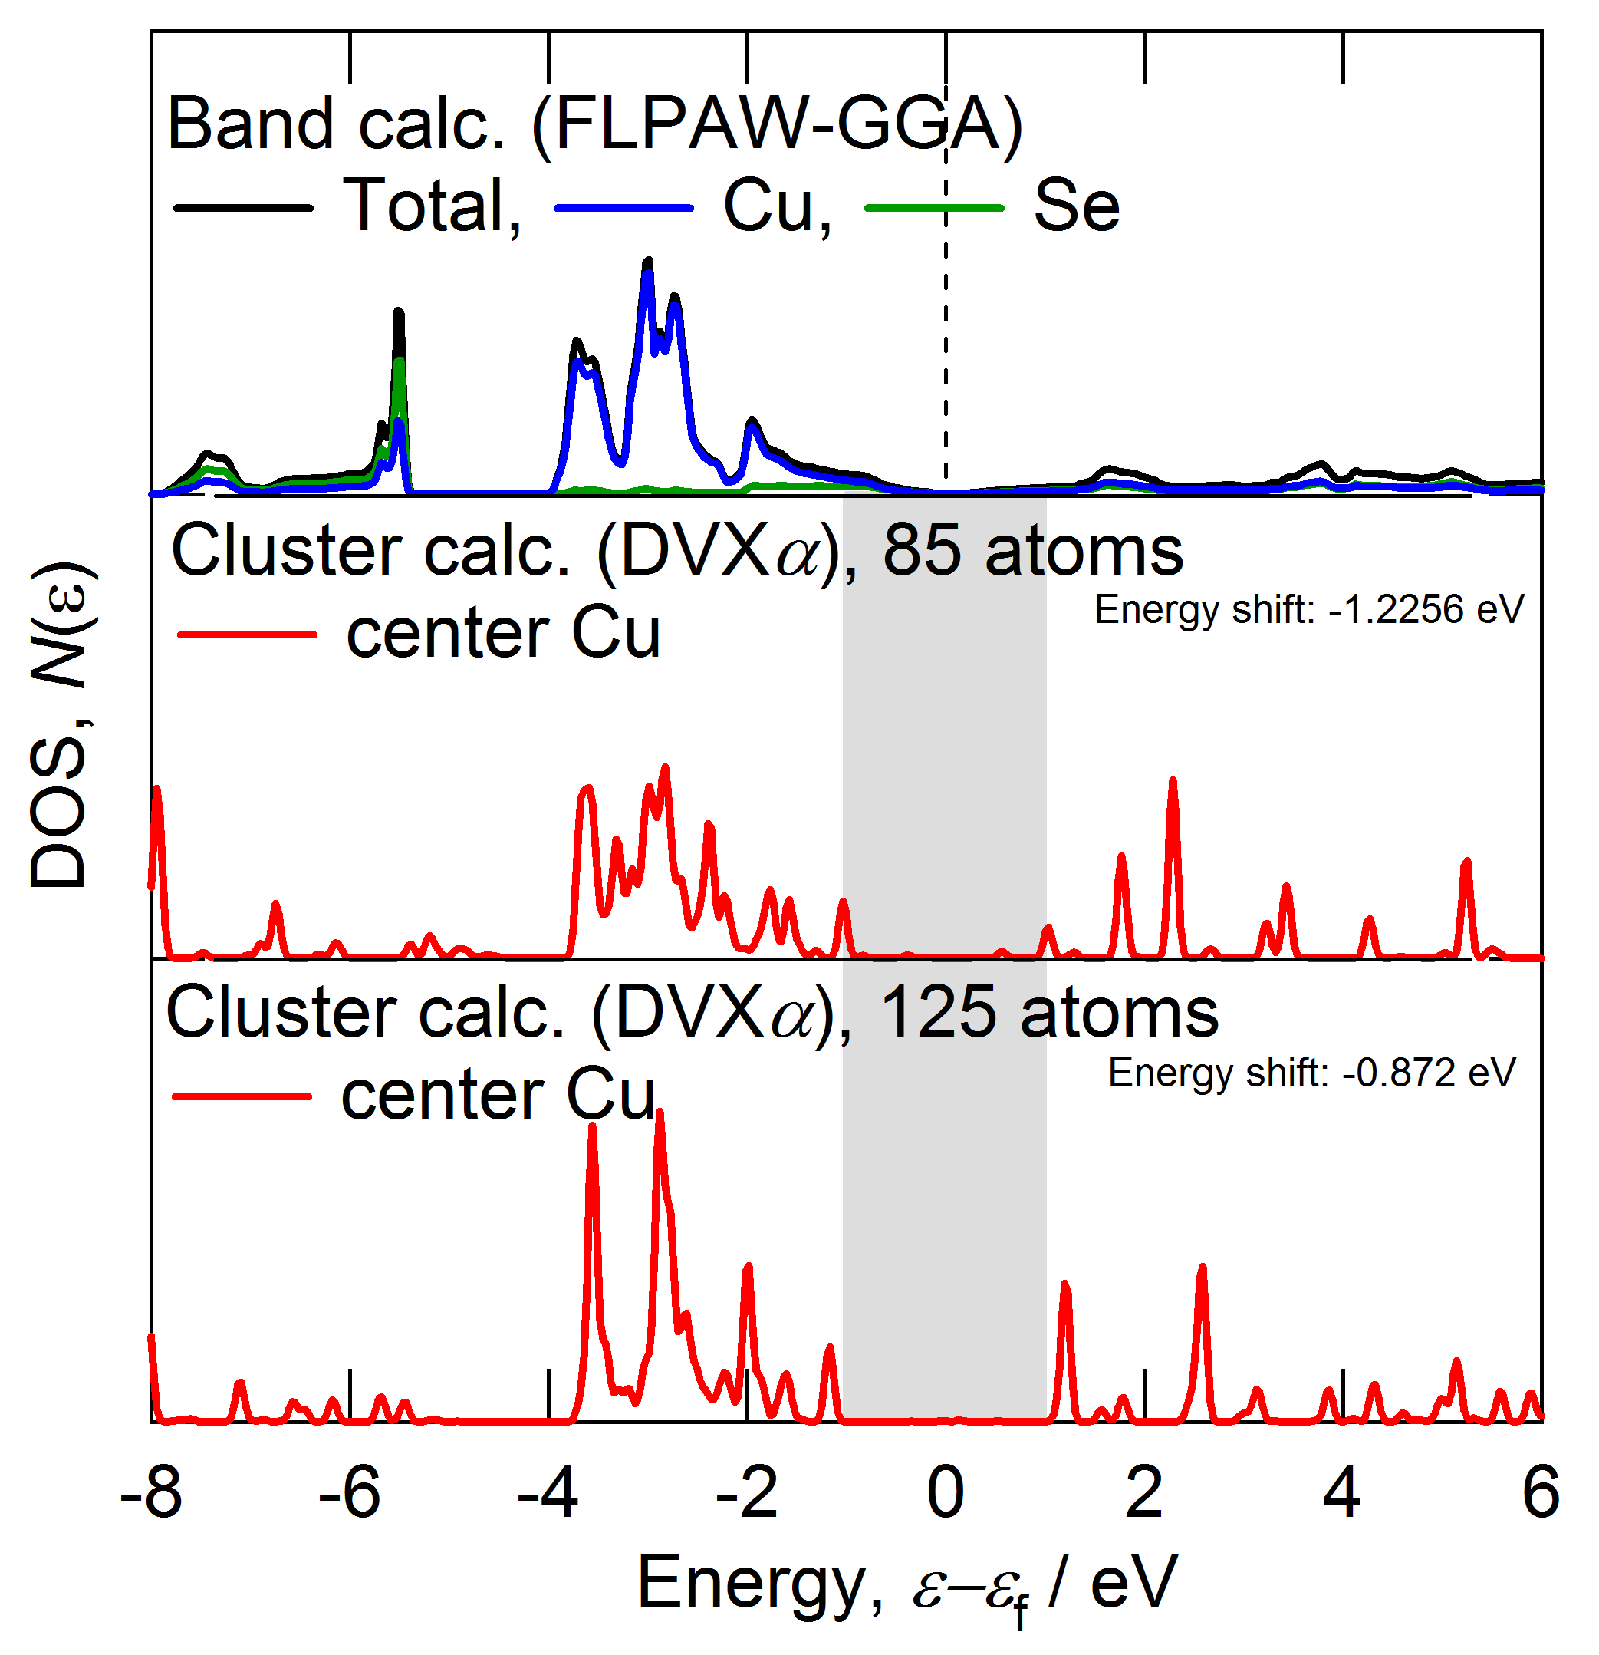
Check size dependence
TM = Cu case
Cut > 6.5 Ang.
85 atoms in cluster
Cut > 7.6 Ang.
125 atoms in cluster

Slide 8
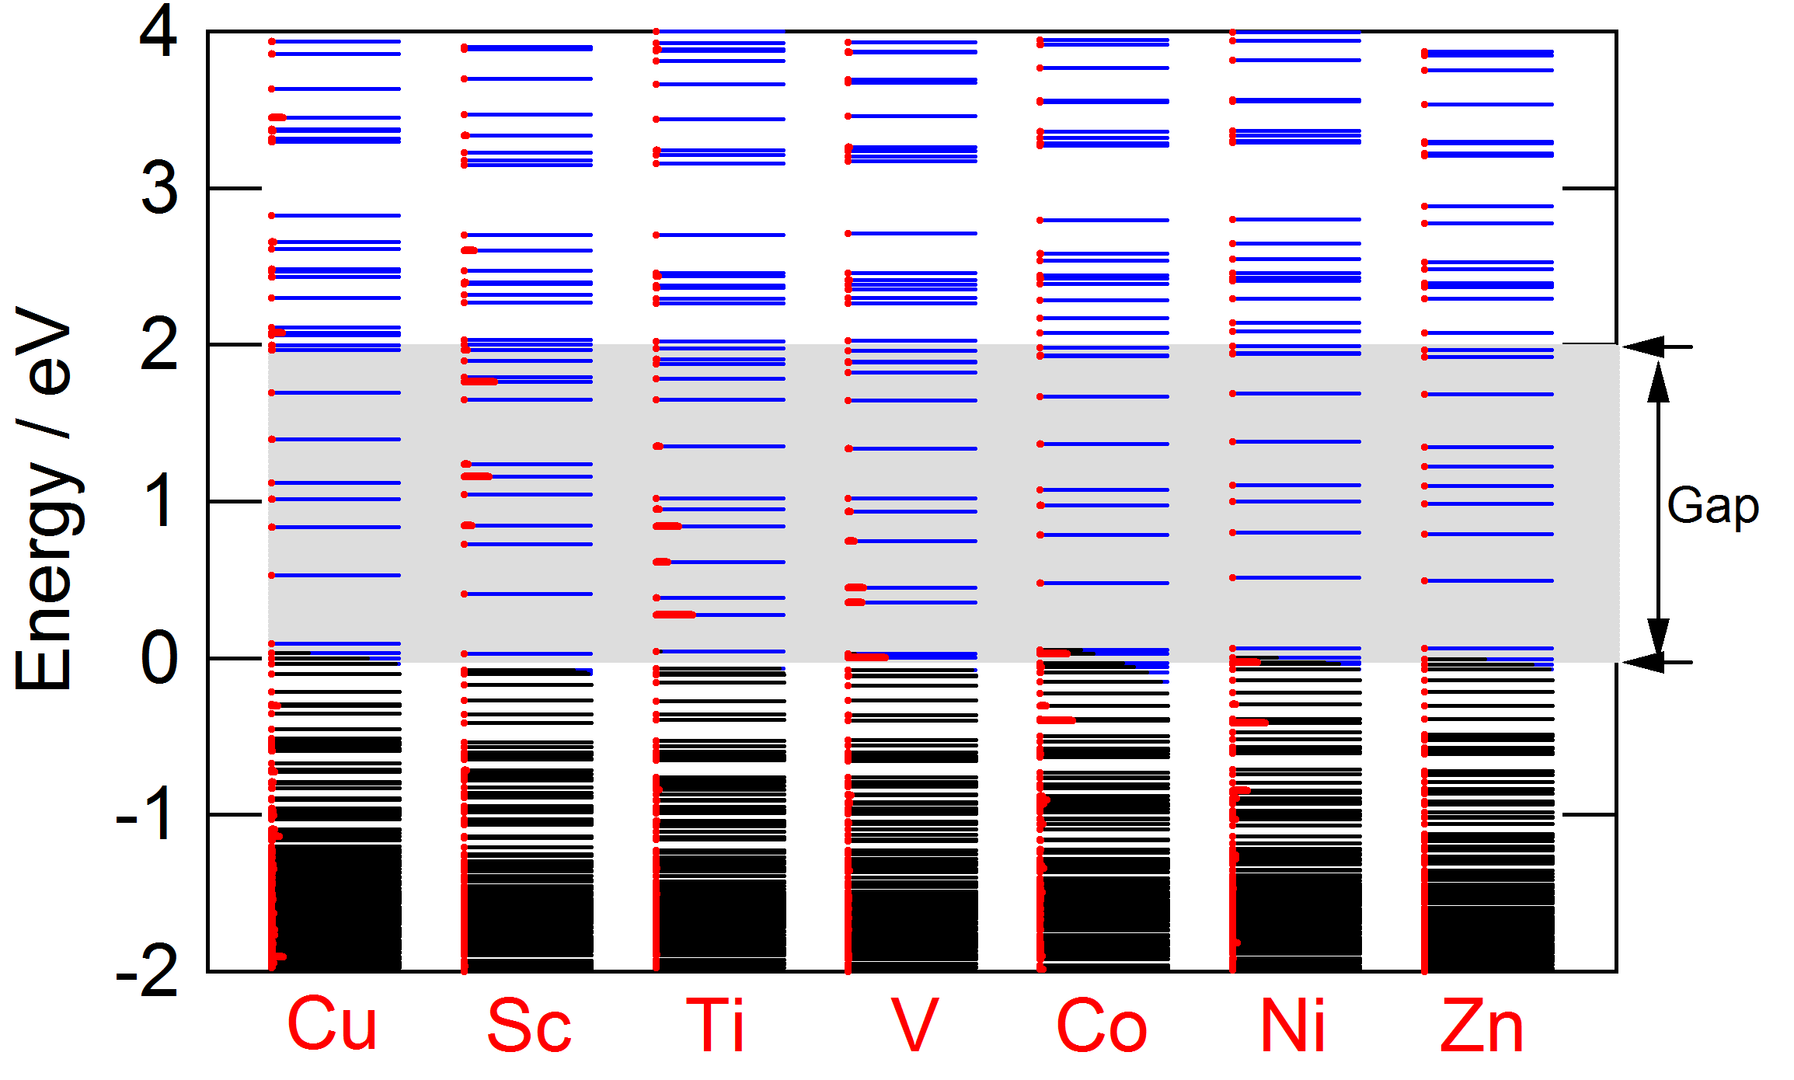
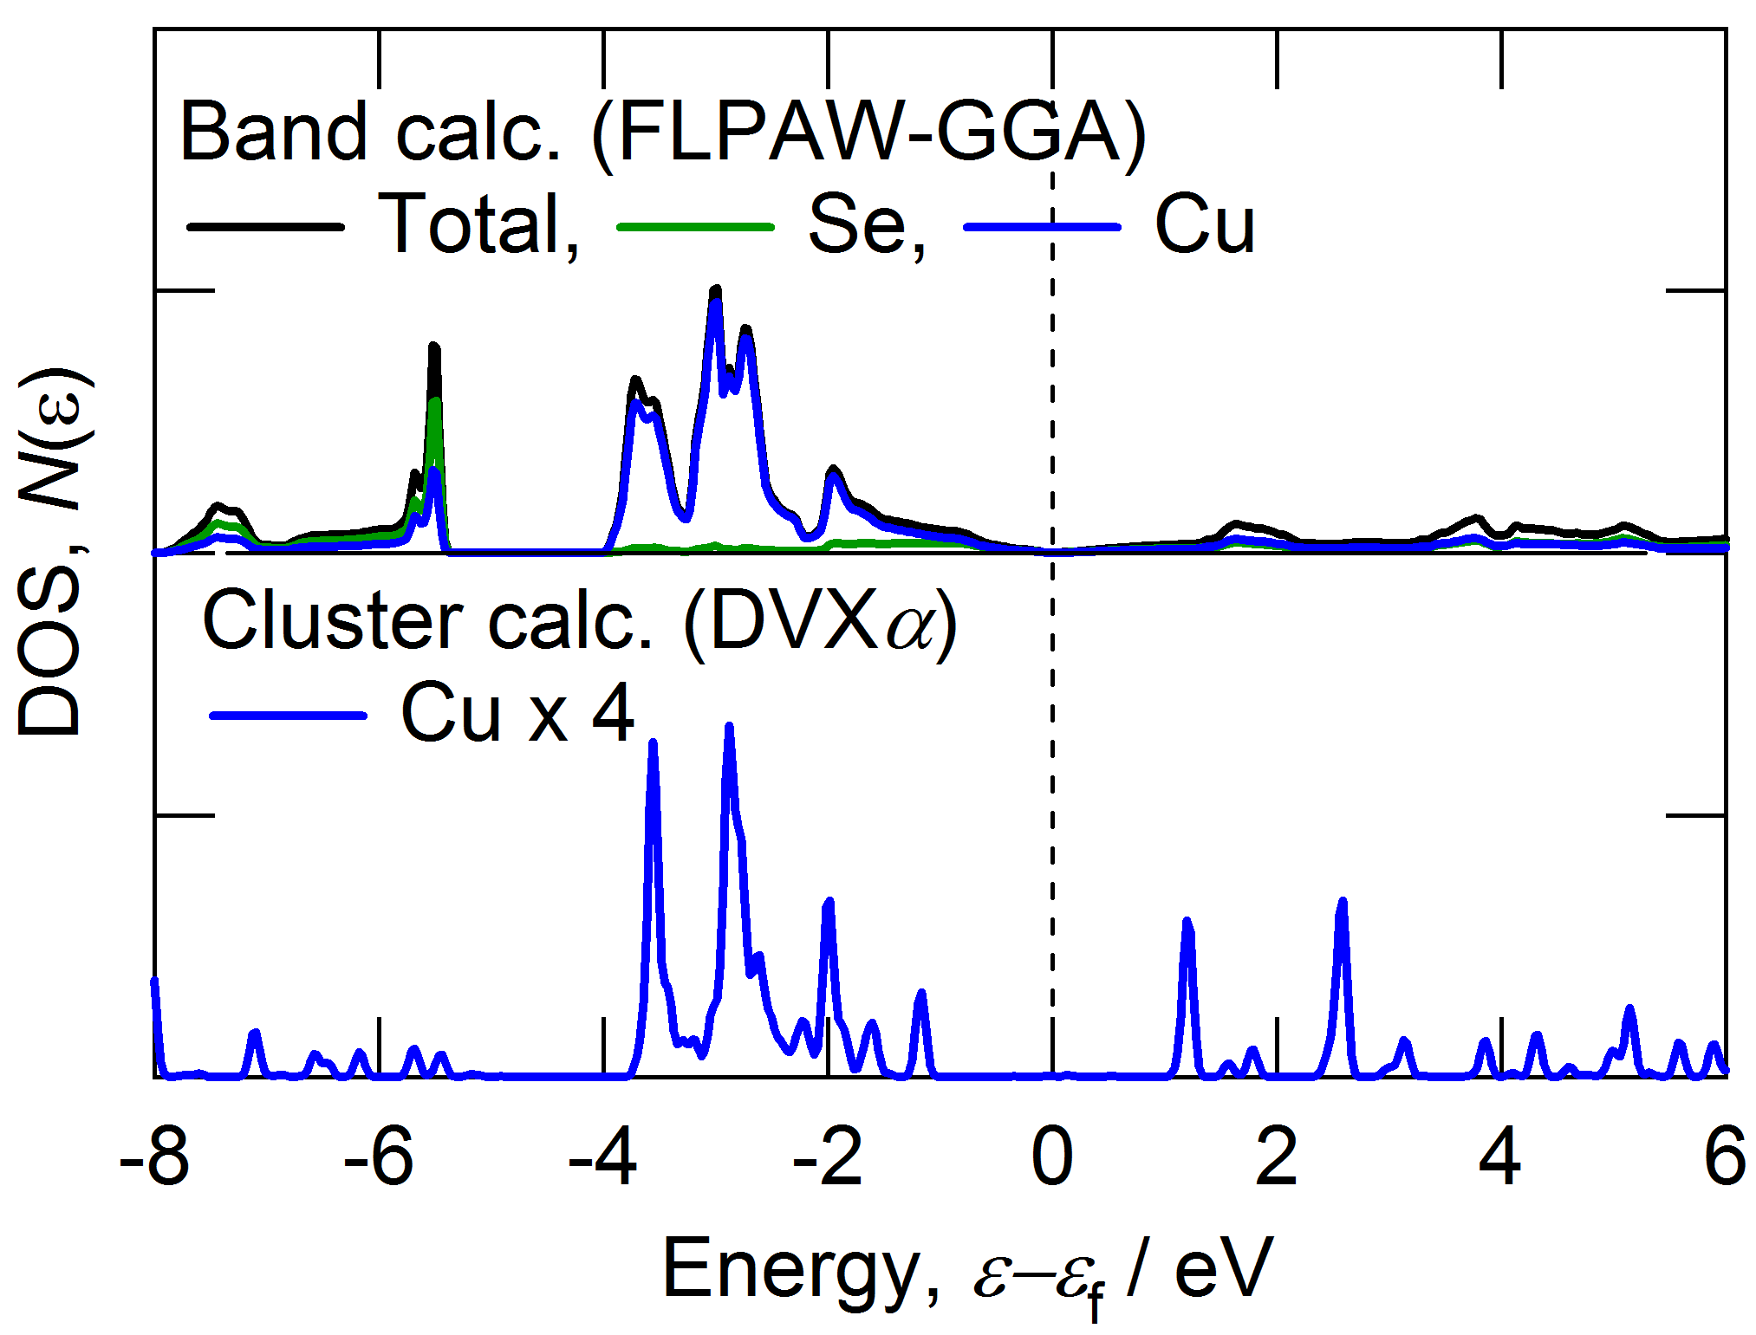
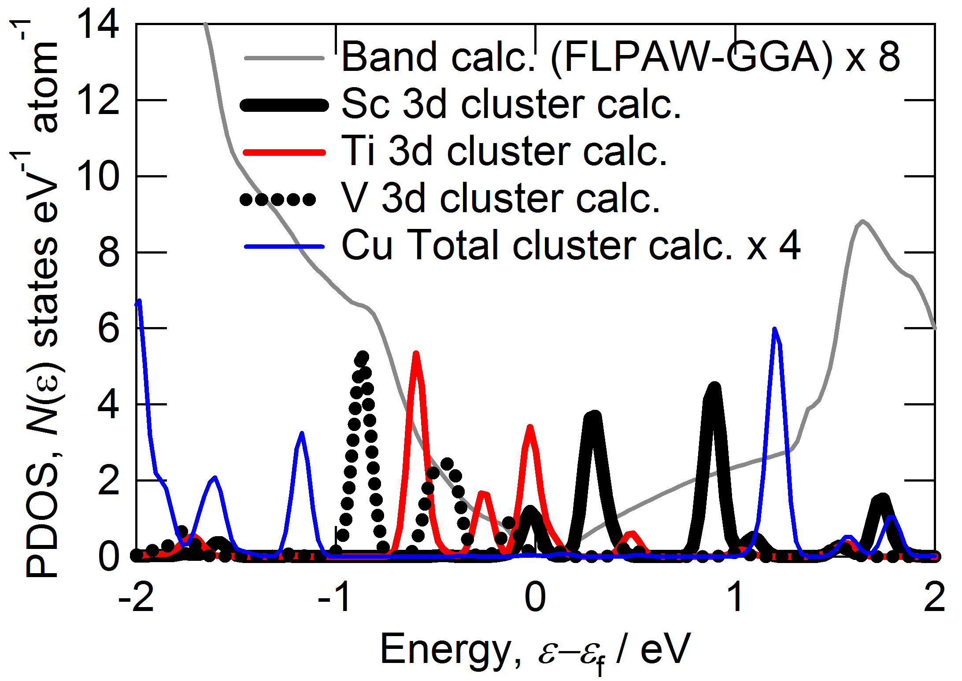
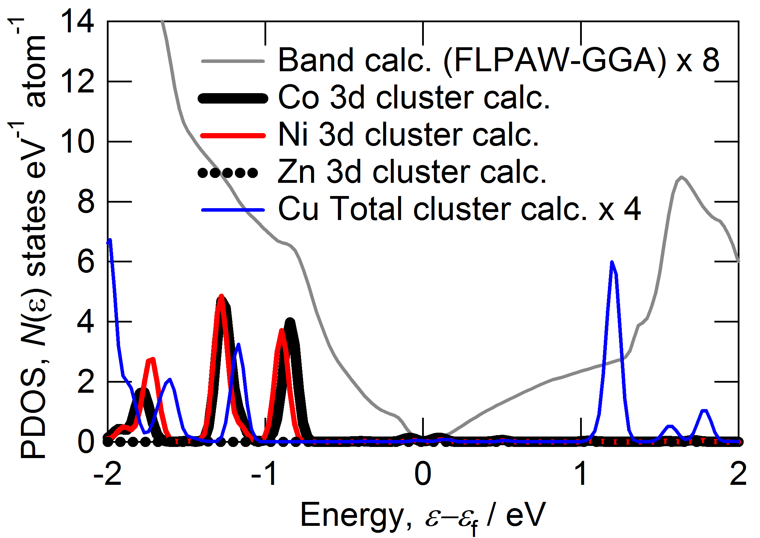
ELD and PDOS in Cu₈₀TM₁Se₄₄ cluster
DVXα calculation condition; FWHM = 0.1 eV, Energy shift = -0.87 eV for DOS
-unoccupy, -occupy, - substitution site

Slide 9
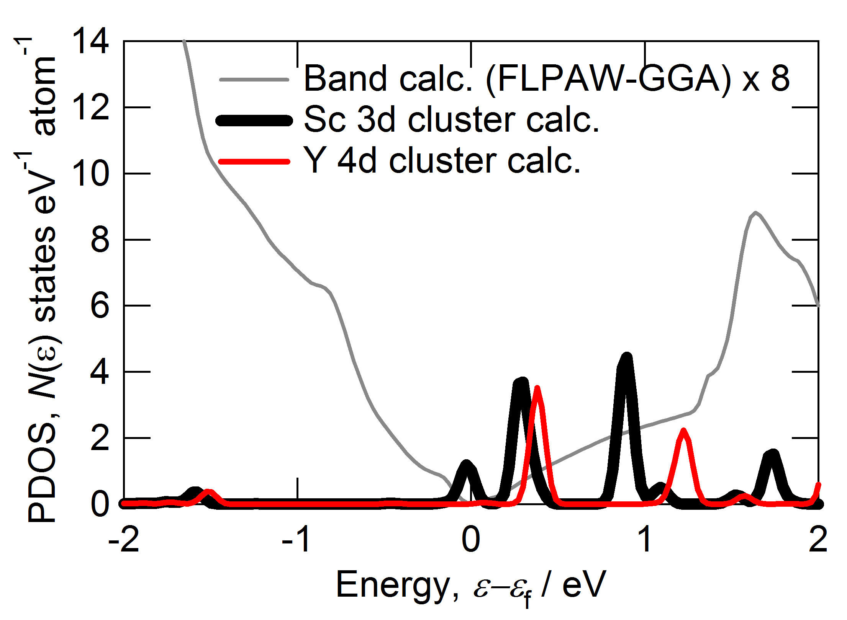
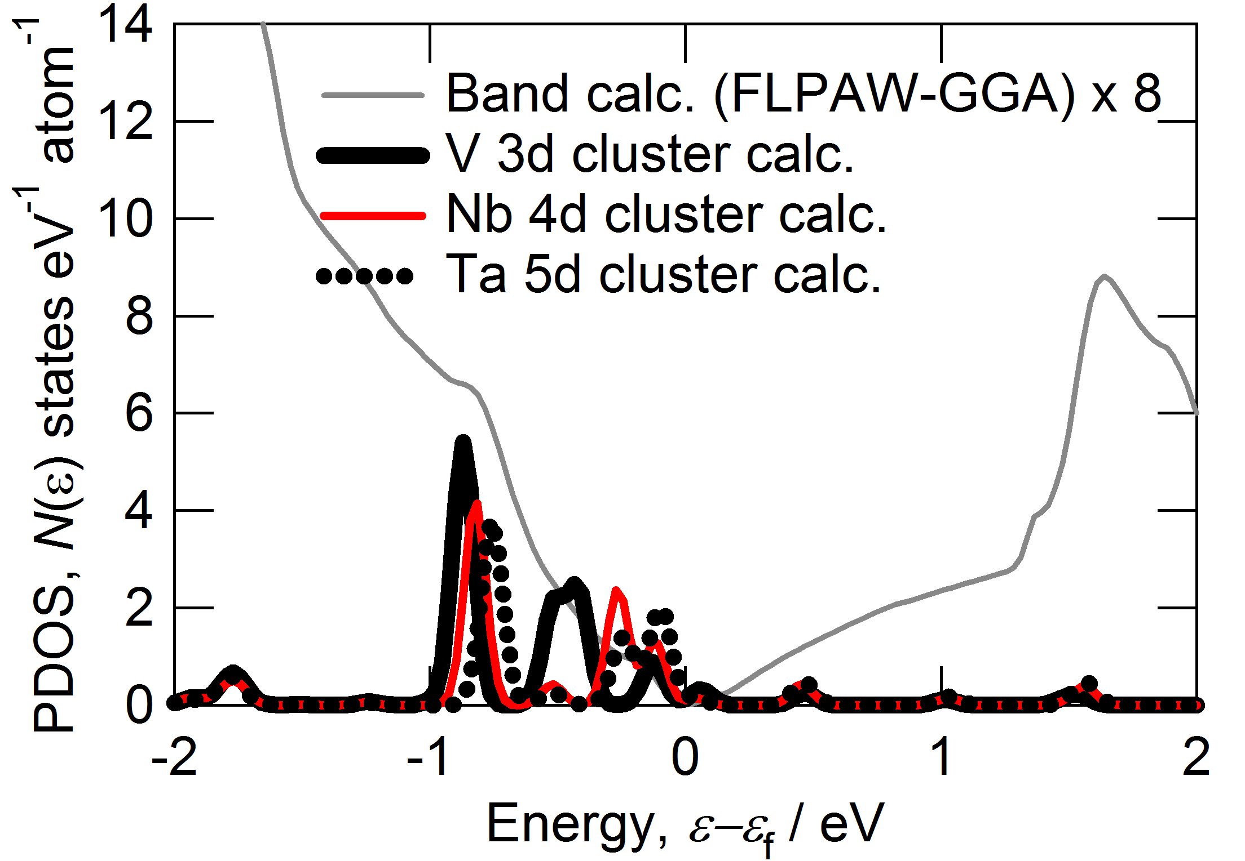
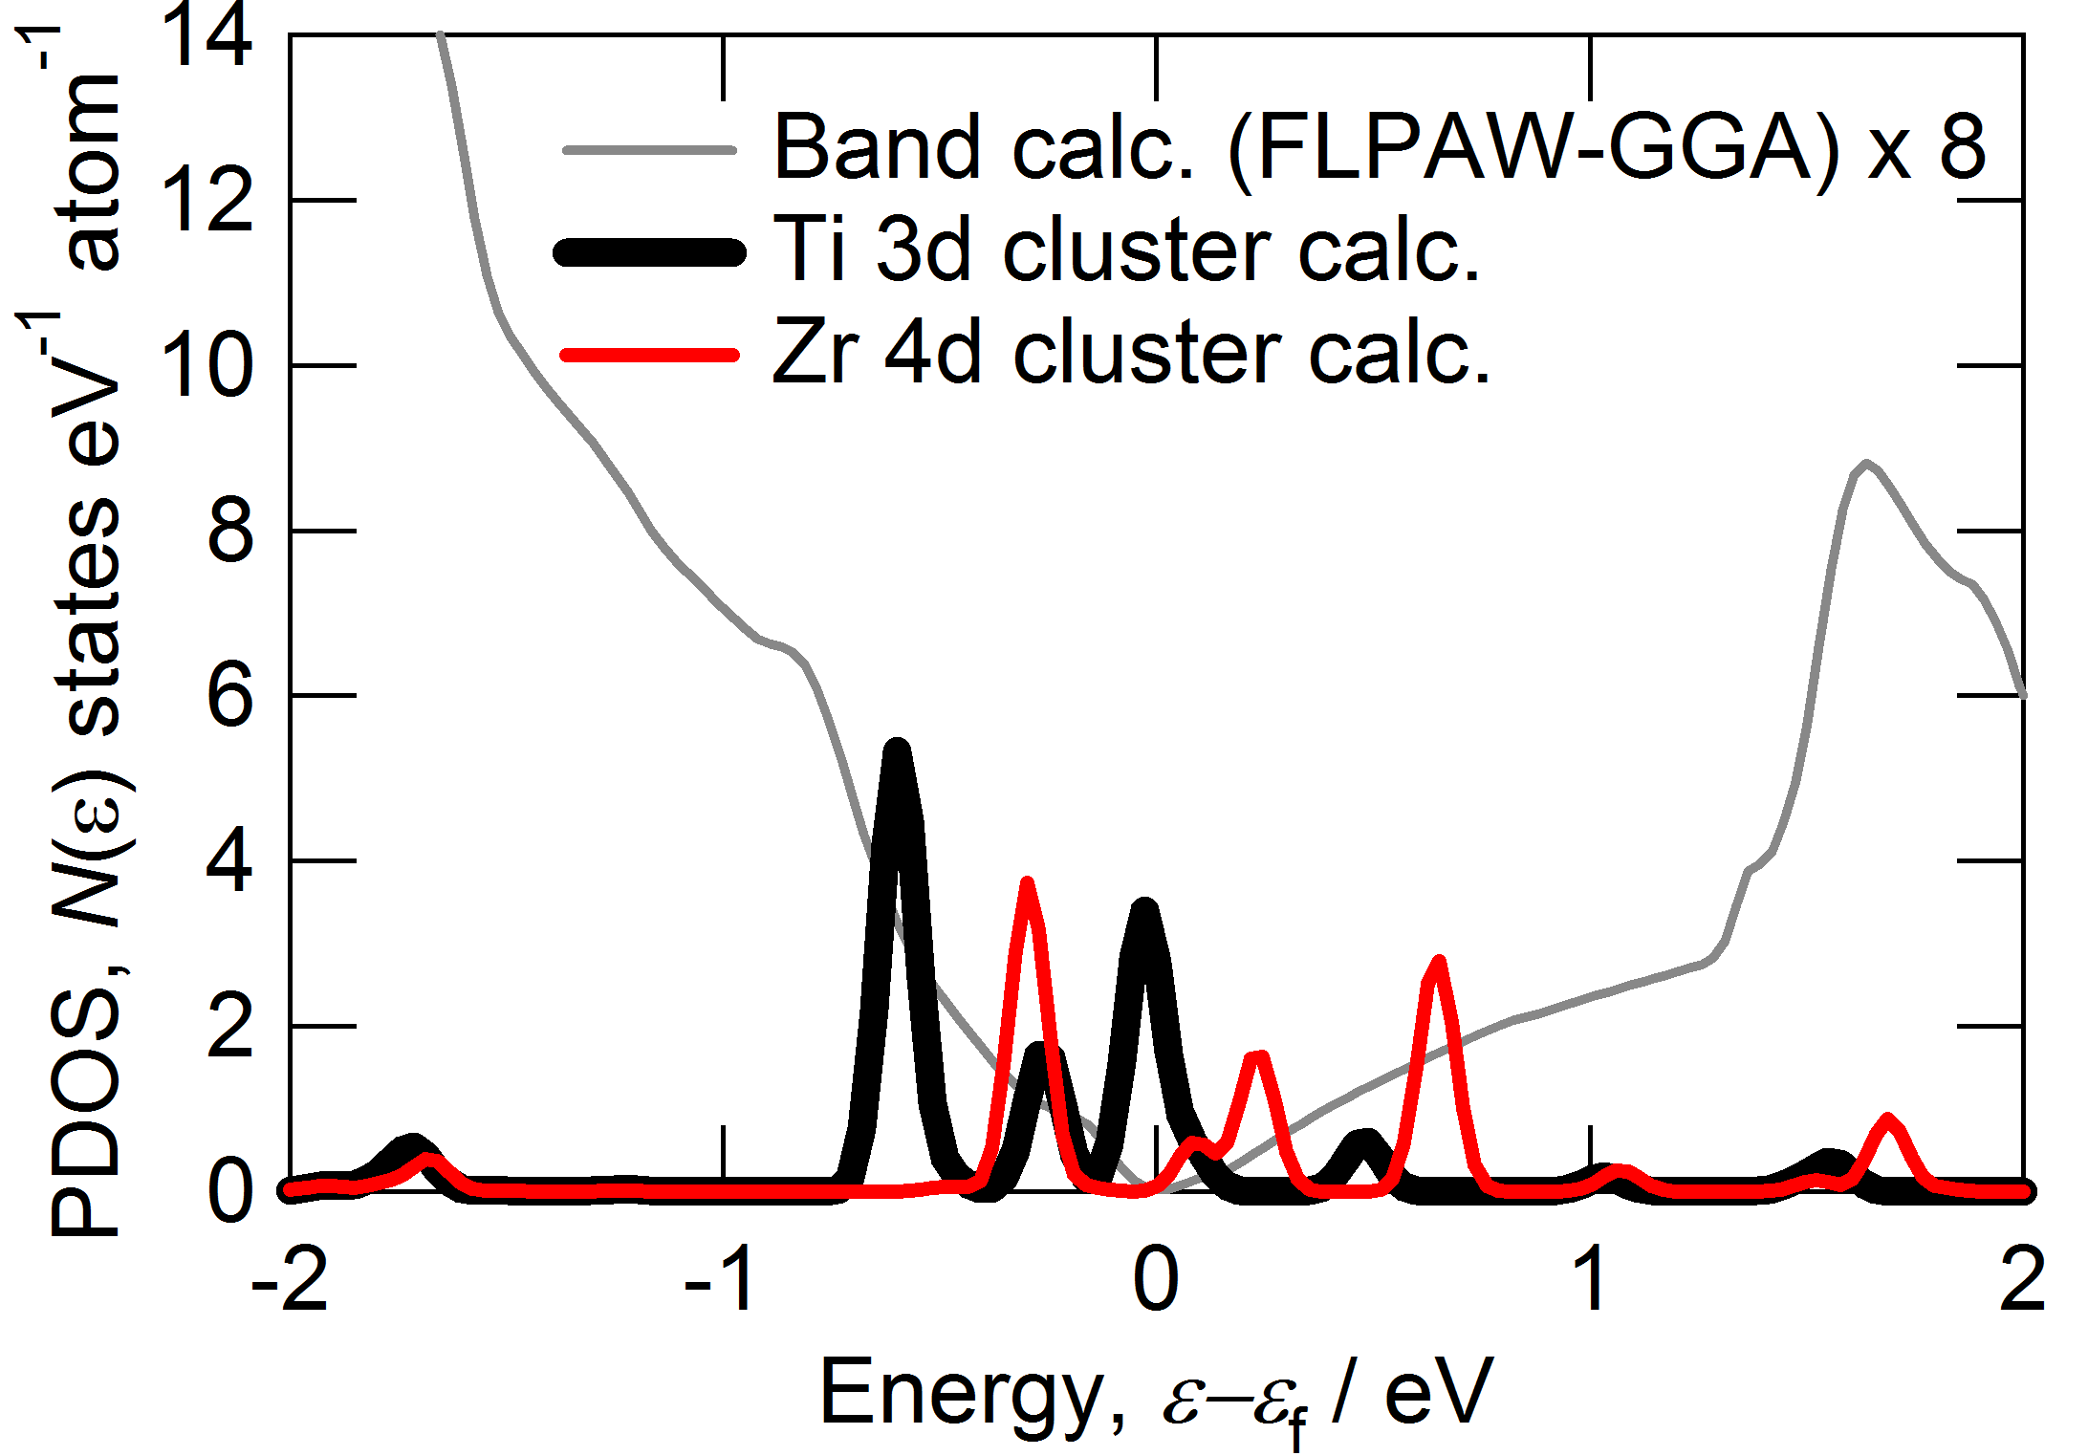
N型の候補はSc
P型の候補はVとNb, Ta Co, Ni, Zn
Notes:
No.62 (Pnma) at room temperature.
No.63 (Cmcm) at high temperature.

Slide 10
Summary
Sn_{1-x}TM_{x}Se (TM = transition metal) and Cu_{2-x}TM_{x}Seの
電子構造を第一原理計算手法を用いて明らかにした
TM 3dは原子番号が大きくなることで
低いエネルギー位置へとシフトする傾向が得られた
Sn_{1-x}TM_{x}Se
Sn₂₉TM₁Se₃₁ Cluster では
共有結合によるダングリングボンドがギャップが消失
Cu_{2-x}TM_{x}Se
N型の候補: Sc
P型の候補: VとNb, Ta Co, Ni, Zn
Notes:
In summary,
[This is summary of my talks.]
Thank you very much for your attention kindly.
時間が無いとき（重要）
Finally, the summay we’ve obtained are like this.
Sorry to have overtime. Thank you.

Slide 11
Thank you very much for your attention.
Notes:
you very much for your kindly attention.
[ Finally, This my oral is for the first time in my life in English. I am Sorry, My English is not good, but, please, feel free to give me advise and questions.]
[This is acknowledgment]

Slide 12
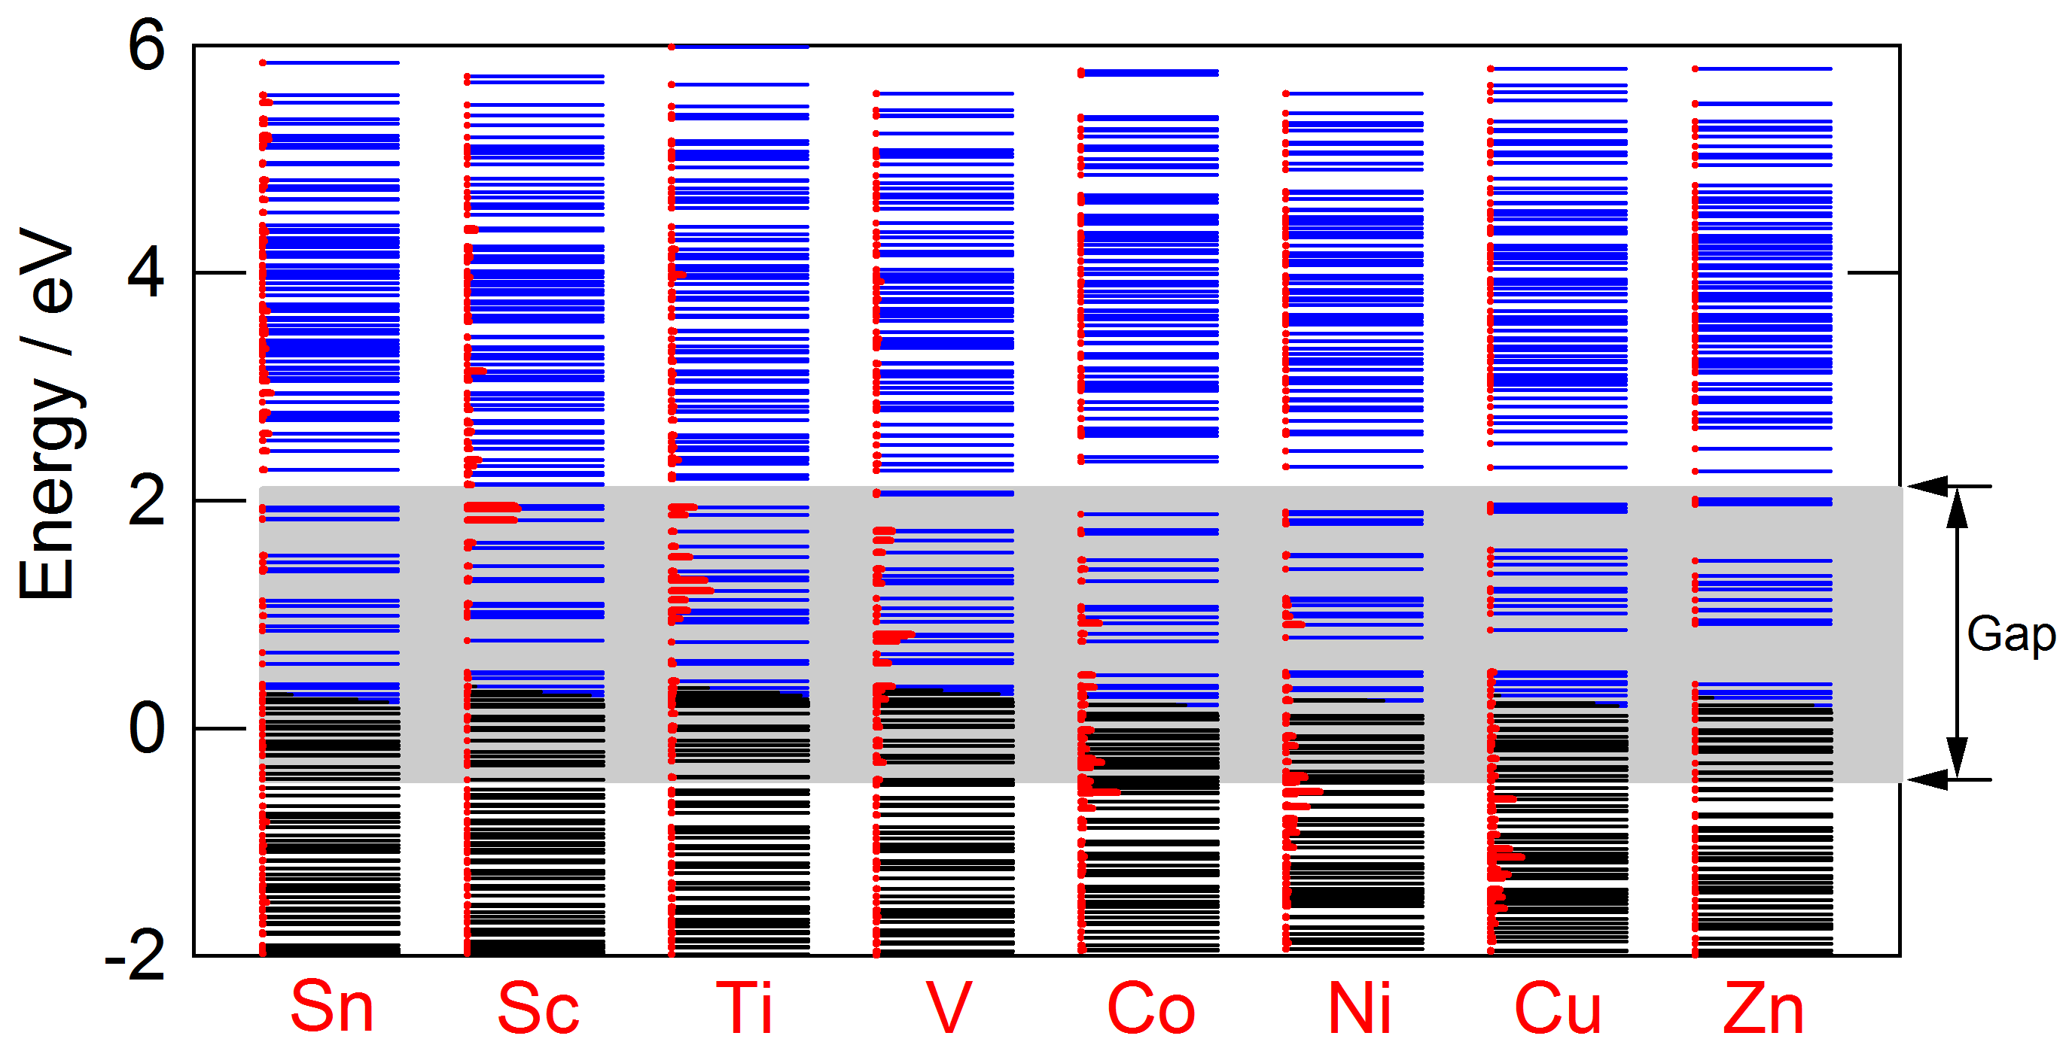
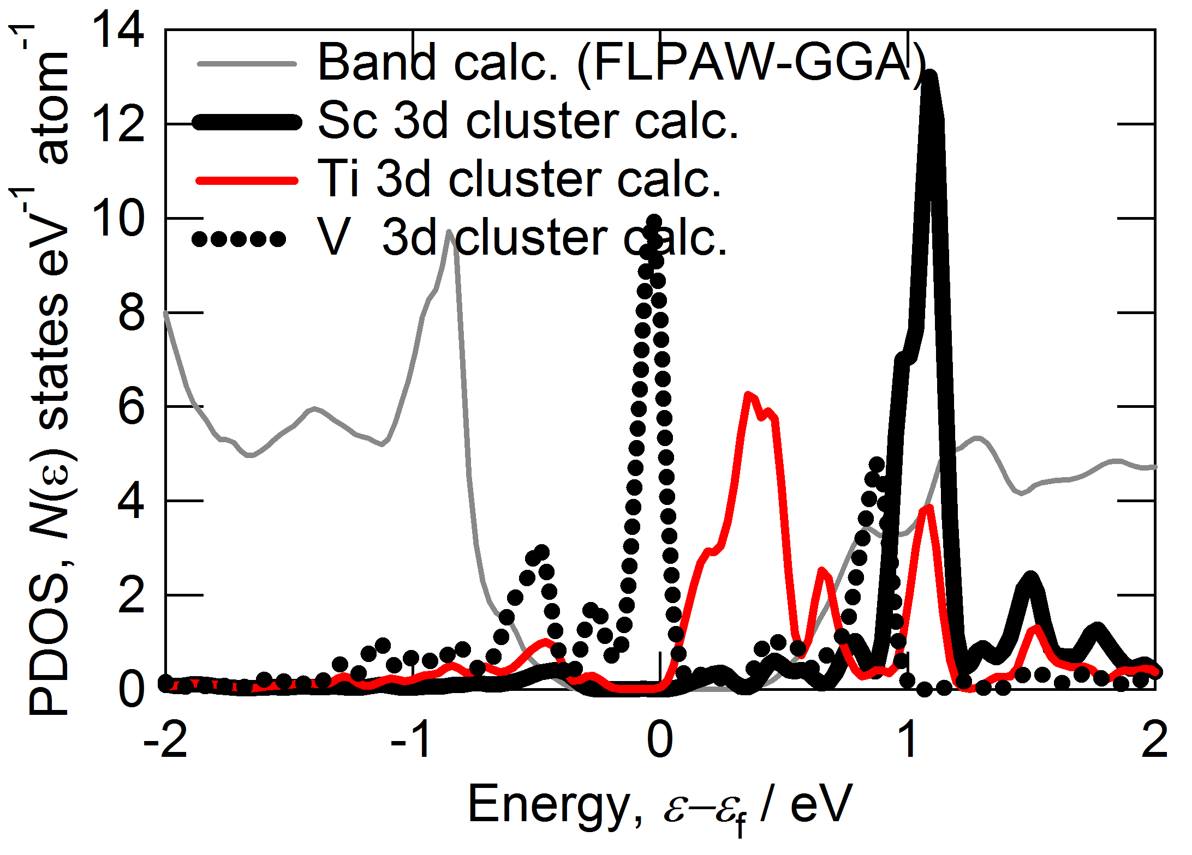
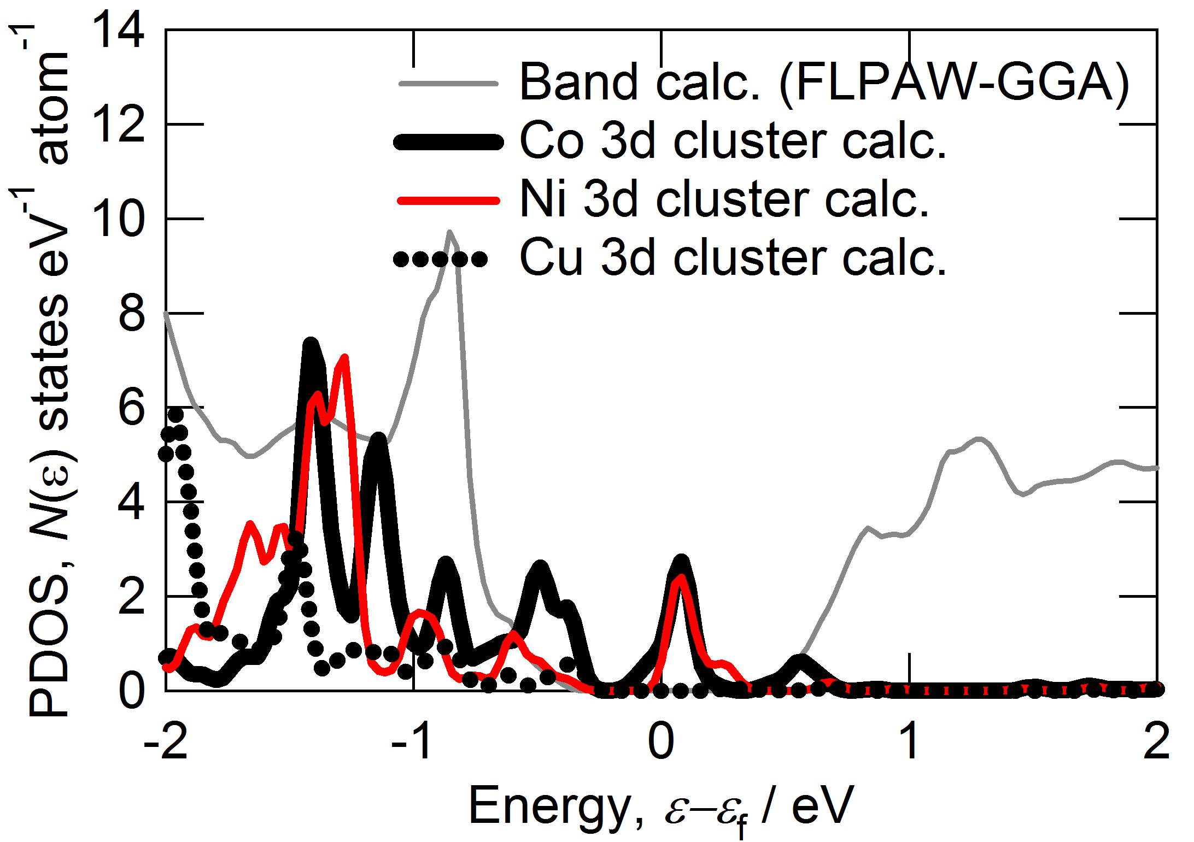
ELD and density of states (DOS)
DVXα calculation condition; FWHM = 0.1 eV, Shifted Energy = -0.84 eV for DOS
-unoccupy, -occupy, - substitution site

Slide 13
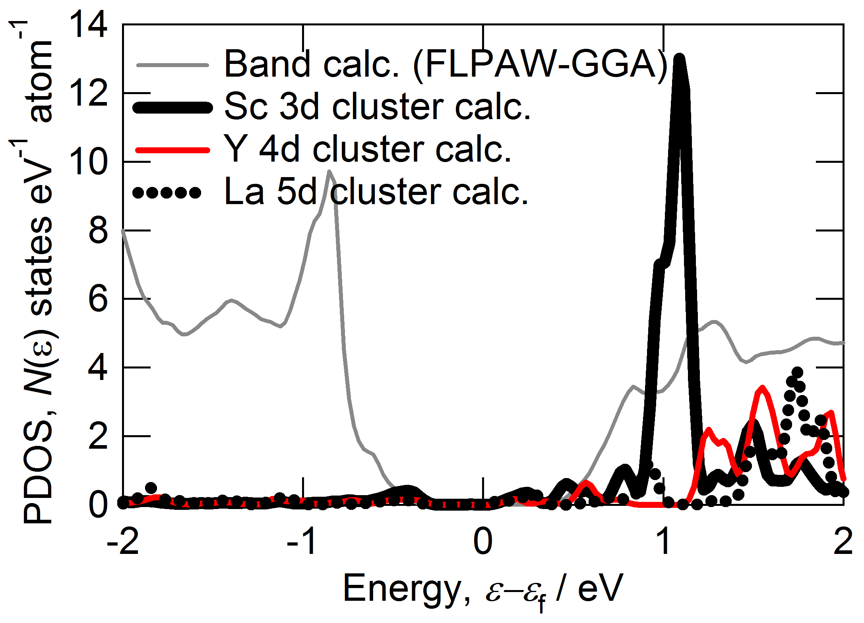
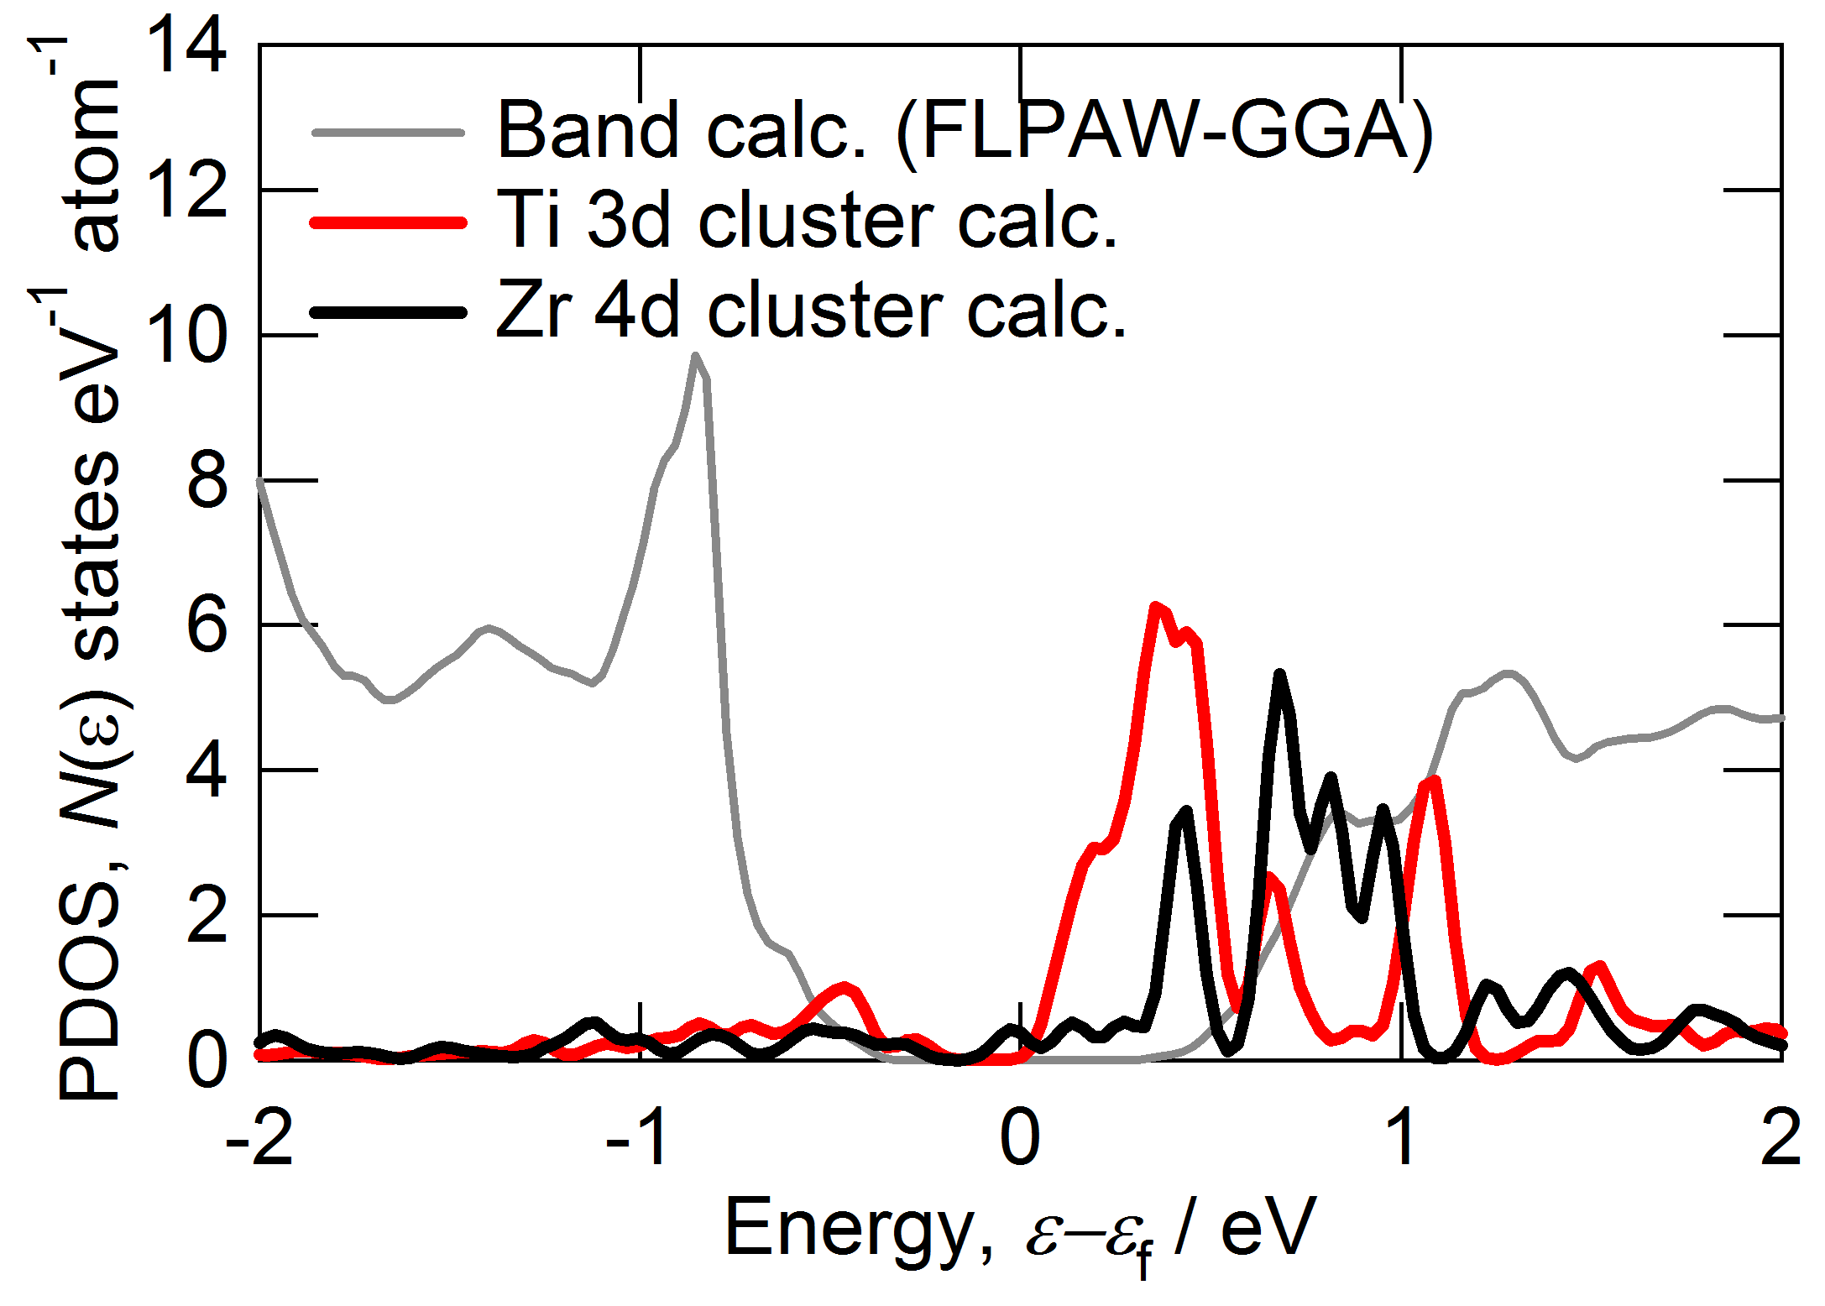
N型の候補はScとZr
P型の候補はCo-Zn
Notes:
No.62 (Pnma) at room temperature.
No.63 (Cmcm) at high temperature.

