Slide 1
OSS PULSE
How Coding Agents Reshaped
Open-Source Development
Tracking 1.46 billion GitHub events across the 2022–2026 agent era
GROUP 9 · BDAD SPRING 2026
Jhe Chen Li · Bo Yu

Slide 2
ABSTRACT & PLATFORM
What we built · how big · what it found
ABSTRACT
PLATFORM
Coding agents are fundamentally reshaping open-source development. We tracked 1.46 B GitHub events across 5 × Q1 snapshots (2022–2026) and found three shifts:
① Development got lighter — more developers, fewer contributors per repo.
② Weekends disappeared — activity hit the natural 28.9% baseline in 2026.
③ Two-phase agent adoption — 2025 explosion → 2026 normalization.
Traditional metrics like stars fail to capture this transformation.
Apache Spark 3.x
Google Cloud Dataproc (NYU HPC)
SCALE
1.46 B events
930 GB raw → 87.9 GB cleaned
10 Spark analytics jobs

Slide 3
MOTIVATION
Who needs this · what problem · why now
WHO USES IT
WHAT'S BROKEN
WHY NOW
Developers · researchers · maintainers · VCs evaluating OSS
Single signals mislead. DeepSeek-R1 ranks #2 by stars but has no PyPI library, only 5 push contributors. Hype ≠ ecosystem.
The coding-agent era (2024–2026) is reshaping open-source rhythm — and stars miss it entirely.
5-YEAR Q1 TIMELINE · AI ECOSYSTEM EVOLUTION
2022
2023
2024
2025
2026
Pre-ChatGPT baseline
ChatGPT explosion
LLM bloom GPT-4 / Claude / Gemini
Year of agents Cursor / Claude Code / Devin
Coding-agent saturation

Slide 4
GOODNESS · WHY OUR RESULTS CAN BE TRUSTED
Five-era data quality validation across 1.46 B events
0
< 0.39%
580
NULLS IN CORE FIELDS
2026 RE-VALIDATION DIFF
CORRUPT FILES TOLERATED
event_type · event_date · actor_login · repo_name across all 5 eras
Re-downloaded 2,160 raw files, re-cleaned, compared to original output
April 2026 raw .gz files rescued via spark.sql.files.ignoreCorruptFiles
DATA QUALITY · EVENT VOLUME & FIELD COMPLETENESS BY ERA
Era
Total events
Push events
PR events
null core (4 fields)
Schema
2022-Q1
206.8 M
146.4 M
35.0 M
0
✓ stable
2023-Q1
247.4 M
185.6 M
29.5 M
0
✓ stable
2024-Q1
364.4 M
307.6 M
26.4 M
0
✓ stable
2025-Q1
376.4 M
313.6 M
30.5 M
0
✓ stable
2026-Q1
265.9 M
224.6 M
23.8 M
0
⚠ schema break
2026 schema change details on Slide 9 · full quality report in backup.

Slide 5
DATA SOURCES
GITHUB ARCHIVE
HUGGING FACE HUB
PYPI / BIGQUERY
Hourly event logs
Model metadata
Monthly download counts
Watch · Fork · Push · PR · Issue events from the public GitHub event firehose, archived hourly as compressed JSON.
Snapshot of every public model on Hugging Face Hub via the huggingface_hub API, including library, downloads, and parameter counts.
Per-library install counts pulled from the public BigQuery PyPI dataset — the closest proxy we have to real engineering adoption.
FORMAT
Hourly .json.gz files
FORMAT
JSONL snapshot
FORMAT
CSV (project · month · downloads)
COVERAGE
5 × Q1 snapshots, 2022–2026
COVERAGE
All public models, April 2026
COVERAGE
46 AI / ML libraries × 12 months
VOLUME
1.46 B events · 930 GB raw · 87.9 GB cleaned
VOLUME
2,815,064 models · 229 MB
VOLUME
552 rows · 9 GB BigQuery scan

Slide 6
DATA SAMPLES · GITHUB ARCHIVE · HF HUB · PYPI
Three sources, three schemas — five-row sample of each
GH ARCHIVE
event_type event_date actor_login repo_name push pr_merged
WatchEvent 2025-03-15 user_abc huggingface/transformers — —
PushEvent 2025-03-15 dev_xyz pytorch/pytorch 3 —
PullRequestEvent 2025-03-15 contrib_1 tensorflow/tensorflow — true
ForkEvent 2025-03-15 forker_3 openai/whisper — —
schema · event_type, event_date, actor_login, repo_name, push_size, push_distinct_size, pr_merged, issue_state, pr_number, payload_action
HUGGING FACE HUB
model_id library_name pipeline_tag downloads likes
meta-llama/Llama-3-8B transformers text-generation 1,234,567 8,920
stabilityai/stable-diffusion diffusers image-generation 890,123 5,430
openai/whisper-large-v3 transformers automatic-speech 456,789 3,210
schema · model_id, author, library_name, pipeline_tag, downloads, likes, created_at, parameter_count, has_safetensors
PYPI / BIGQUERY
project month downloads
transformers 2025-01-01 12,345,678
torch 2025-01-01 45,123,456
schema · project, month (YYYY-MM-01), downloads
Total cleaned scale · 87.9 GB Parquet · 2.81 M HF rows · 552 PyPI rows.

Slide 7
DESIGN DIAGRAM · PIPELINE ARCHITECTURE
3 sources → Spark cleaning → 10 analytics jobs → CSV / Tableau
GH ARCHIVE
HUGGING FACE HUB
PyPI / BIGQUERY
hourly .json.gz
snapshot via API
monthly downloads
SPARK CLEAN & DEDUPLICATE
5 event types · unified schema · partitioned by event_date · ignoreCorruptFiles=true
Job 01-03
Job 04
Job 05-07
Job 08
Job 09-10
Daily metrics HF/GH join Health score
Top-1000 repos (billion-record shuffle)
AI vs General Star hype Contributor health
5-year era comparison
Repo deep-dive Dev rhythm (weekend gap)

Slide 8
CODE CHALLENGE · Jhe Chen Li
HDFS quota & per-era processing — surviving 5 years × Q1 in 500 GB
ROLLING INGEST · 500 GB QUOTA
PER-ERA PROCESSING · 90 GB ON 48 GB EXECUTORS
Problem · 700 GB needed > 500 GB quota
Naive cache-all spilled to disk; YARN killed it after 1.5 h. Per-era compute + intermediate saves makes the job crash-safe and resumable.
① DOWNLOAD
② SPARK CLEAN
Union-first
Per-era
Q1 raw .gz
→ Parquet, 8× smaller
Peak memory
90 GB
15-23 GB
Runtime
2-3 h (killed)
40-60 min
④ NEXT YEAR
③ DELETE RAW
Blast radius
All eras
Only failed era
loop ×5
free ~150 GB
Shuffle
90 GB / pass
15-23 GB / pass
Outcome · 5-year timeline ingested within 500 GB ✓

Slide 9
CODE CHALLENGE · 2026 SCHEMA CHANGE
Job 08 reported merged_prs = 0 for 2026-Q1 — what happened?
THE DISCOVERY
SCHEMA DIFF · 2025 vs 2026
Job 08 reported merged_prs = 0 for 2026-Q1. Investigation revealed the GitHub Archive payload schema changed.
Root cause: GitHub API simplification — announced 2025-08-08, effective 2025-10-07.
Verification: downloaded raw JSON from both eras and compared payload keys directly.
Field
2025
2026
payload.distinct_size
✓ present
✗ removed
payload.commits
✓ present
✗ removed
pr.merged
true / false
✗ NULL
payload.action
opened/closed
+ "merged"
BACKWARD-COMPATIBLE FIX · CODE
# Backward-compatible merged-PR detection ((F.col("payload_action") == "closed") & F.col("pr_merged").eqNullSafe(True)) | (F.col("payload_action") == "merged") # 2026+ schema
Validation · re-cleaned all 2,160 raw files, diff < 0.39% (corrupt-file tolerance).

Slide 10
CODE CHALLENGE · Bo Yu
Billion-record shuffle — group by repo across 334 date partitions
72 GB
83 GB
1B+
3+ h
INPUT
SHUFFLE
RECORDS
WALL CLOCK
WHAT WE DID
WHAT WE'D DO DIFFERENTLY
• Tuned spark.sql.shuffle.partitions (400 → 200) to cluster size
• .cache() on aggregated DataFrame so multi-write actions don't re-shuffle (3× redundancy gone)
• Replaced Python UDFs with native F.col().isin()
• Restructured Jobs 05–07 to read pre-aggregated Job 04 output
Bucket cleaned data by repo_name at ingest:
cleaned.write .bucketBy(256, "repo_name") .sortBy("repo_name") .saveAsTable("gharchive_cleaned")
Lesson — at billion-record scale, network I/O dominates compute. Partition strategy at ingest determines query cost.

Slide 11
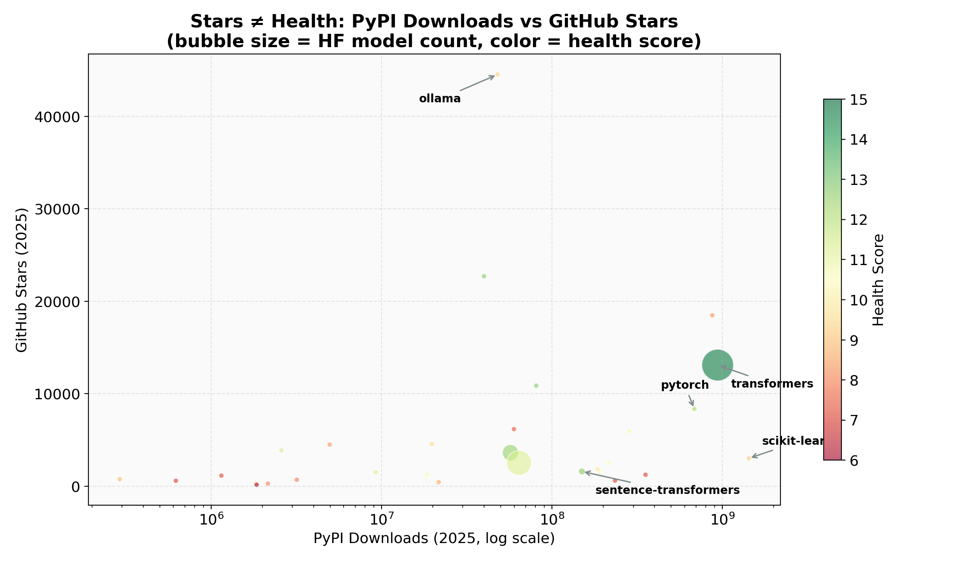
RESULT · STARS ≠ HEALTH
Bubble chart · PyPI downloads × GH stars · size = HF model count
FINDING 1
True leader · transformers 13 K stars · 938 M PyPI · 835 K HF models — wins on all three signals.
Quiet powerhouse · sentence-transformers 1.6 K stars → 519 M HF downloads — 327,014× downloads / star.
Asymmetric adoption · ollama 44.5 K stars + 47.9 M PyPI but only 241 HF downloads — it's a runtime, not a model library.
“No single signal captures every project — triangulation is the point.”

Slide 12
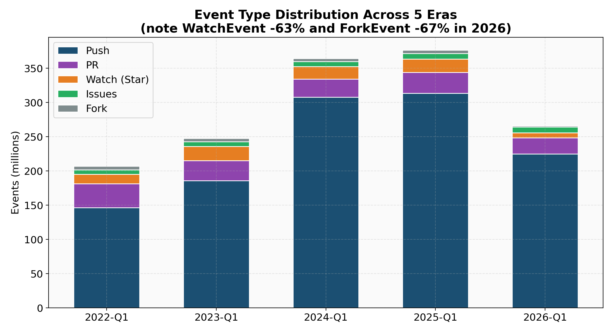
RESULT · EVENT COMPOSITION ACROSS 5 ERAS
Stacked bar · Push · PR · Watch · Issues · Fork by Q1, 2022–2026
FINDING 2
Push share grew 71% → 85% of all events
Watch (Star) collapses 19.6 M → 7.2 M (−63%)
Fork collapses 4.6 M → 1.5 M (−67%)
2026 total events fell 29% from 2025 peak — driven by GitHub's removal of inauthentic accounts.
Popularity signals were hit hardest;
push (engineering activity) fell least.

Slide 13
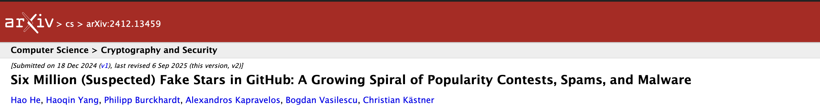
PAPER REFERENCE · EXTERNAL EVIDENCE FOR 2026
Why our 2026 WatchEvent / ForkEvent collapse is consistent with the literature
~6 M
90%
57%
FAKE STARS IDENTIFIED
FLAGGED REPOS · observed deleted
FLAGGED ACCOUNTS · observed deleted
Inauthentic stars detected by their classifier
Authors re-checked and observed deletion at 16× the normal repo rate
Same re-check on the user accounts that posted flagged stars
WHY WE CITE · HONESTY ABOUT THE 2026 ANOMALY
Our 2026 WatchEvent −63% / ForkEvent −67% aligns with their observations. The paper observes a 16× anomalous deletion rate and suggests active platform enforcement — not an official GitHub announcement.
External validation supports our era-shift caveat — we report observations, not official cleanup.

Slide 14
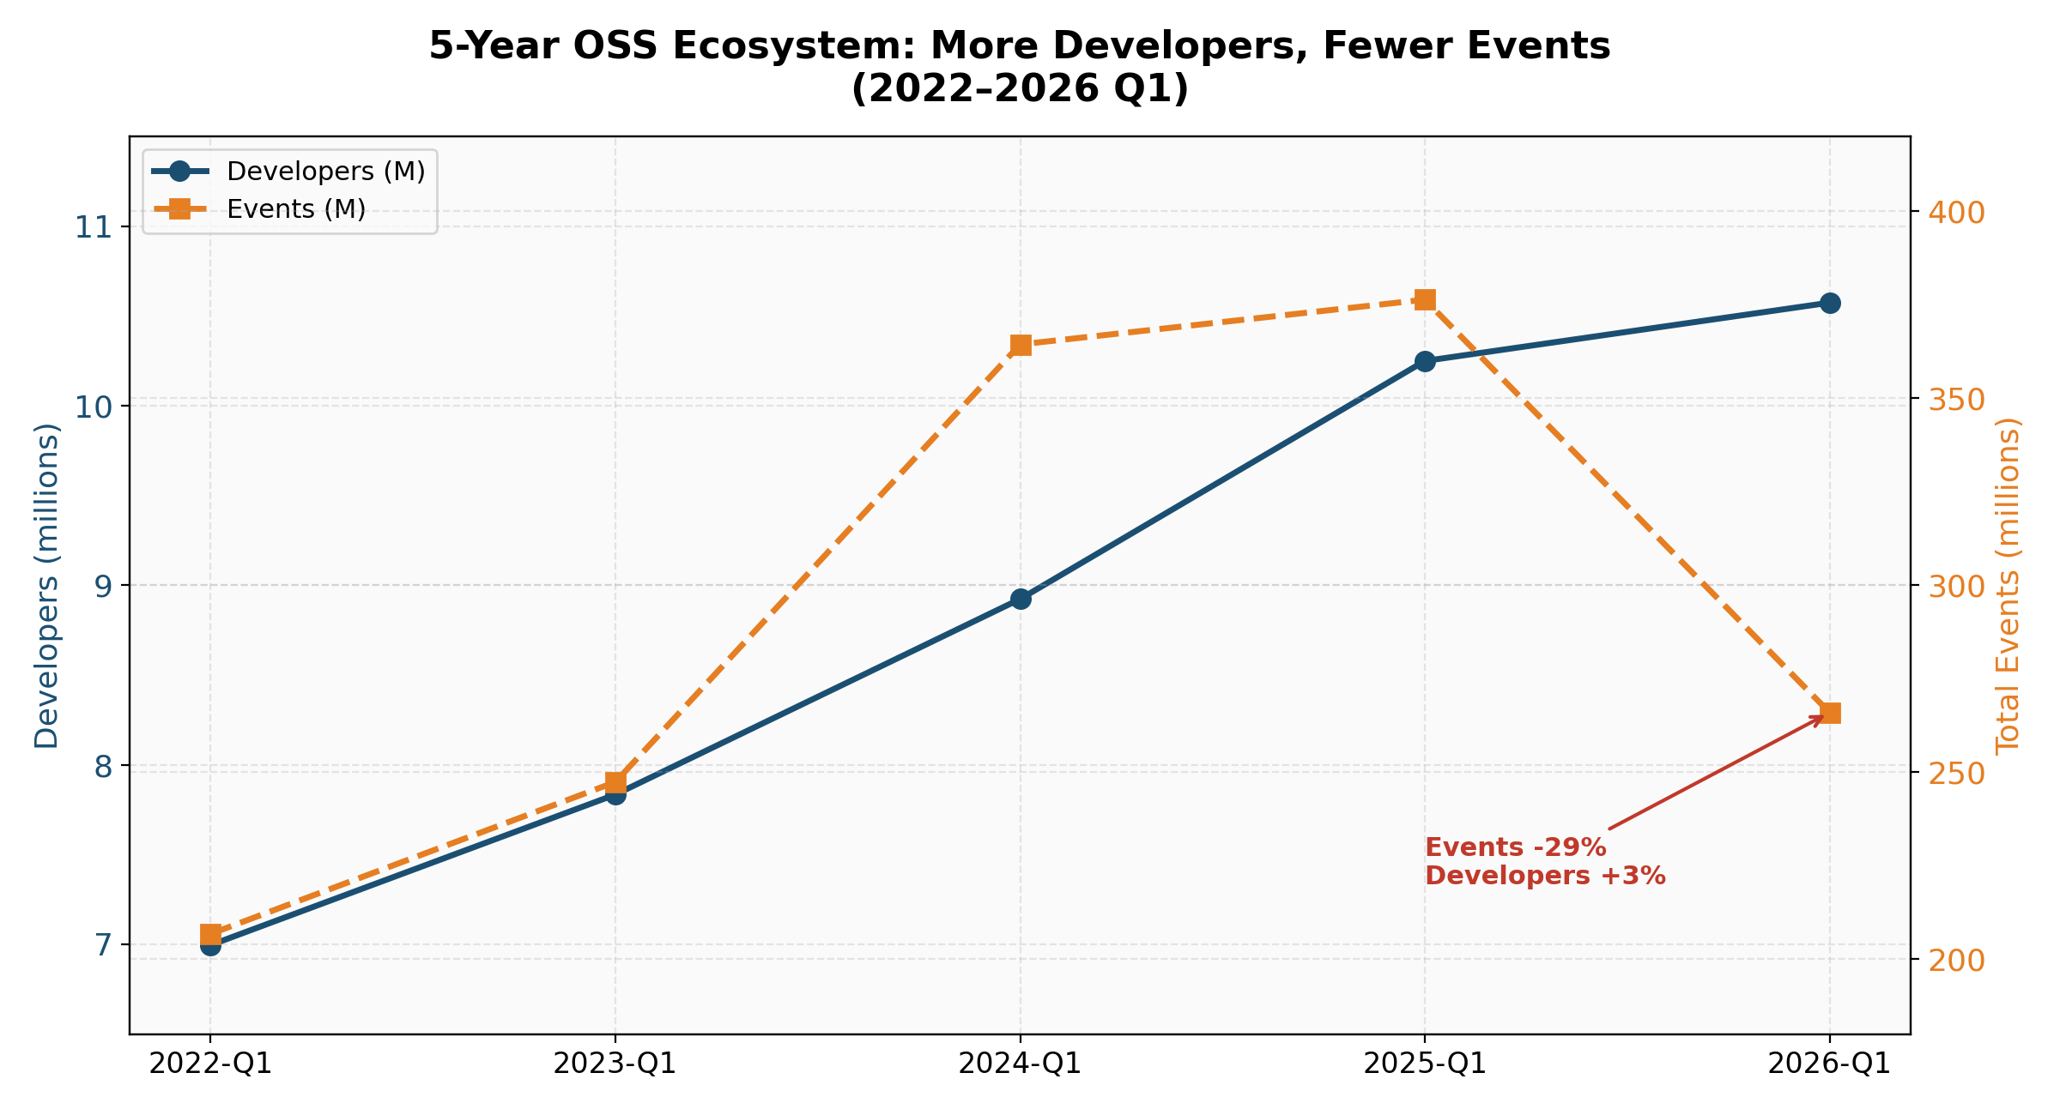
RESULT · THE 5-YEAR ECOSYSTEM SHIFT
Multi-line chart · developers (M) and total events (M) by Q1, 2022–2026
FINDING 3
Developers 7.0 M → 10.6 M (+51%)
Total events 207 M → 266 M (peaked 376 M)
Avg contributors / repo 4.88 → 2.84 (-42%)
More developers, more repos — but each repo gets less work and fewer contributors. Development is getting “lighter.”
Caveat · 2026 WatchEvent −63% / ForkEvent −67% align with Hao he. (arXiv:2412.13459): 90% of flagged repos observed deleted (16× normal rate), suggesting platform enforcement.

Slide 15
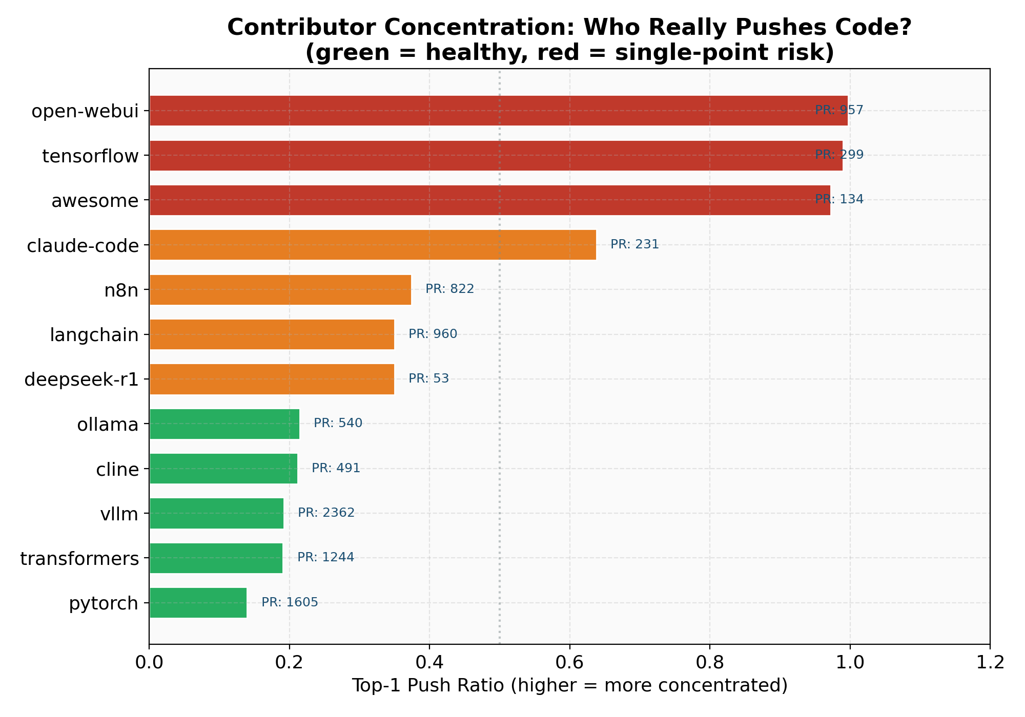
RESULT · BUS-FACTOR BY REPO
Horizontal bars · top-1 push ratio · color = single-point risk
FINDING 4
Top-1 push ratio across selected AI repos:
Red · > 0.95 open-webui · tensorflow · awesome
Orange · 0.4–0.95 claude-code · n8n · langchain · deepseek-r1
Green · < 0.4 ollama · cline · vllm · transformers · pytorch
Read together with PR contributors — tensorflow’s 0.99 is CI bot automation; metagpt’s 0.93 with only 22 PR contributors is real risk.
“Concentration alone doesn't prove fragility.”

Slide 16
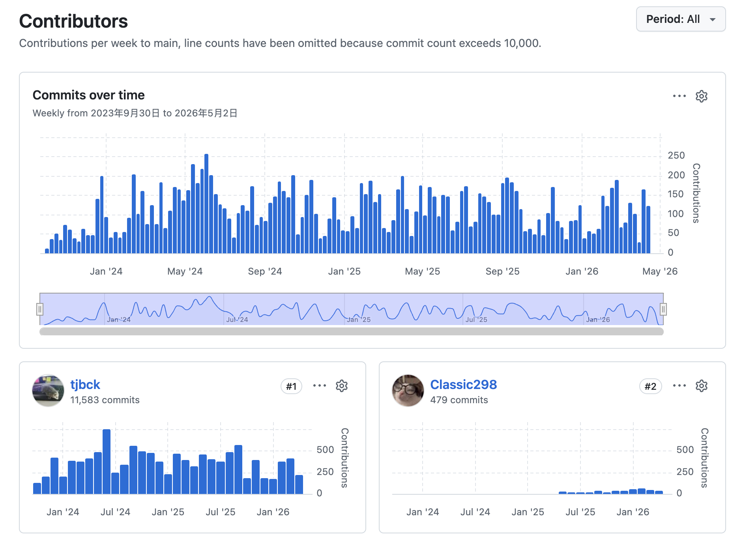
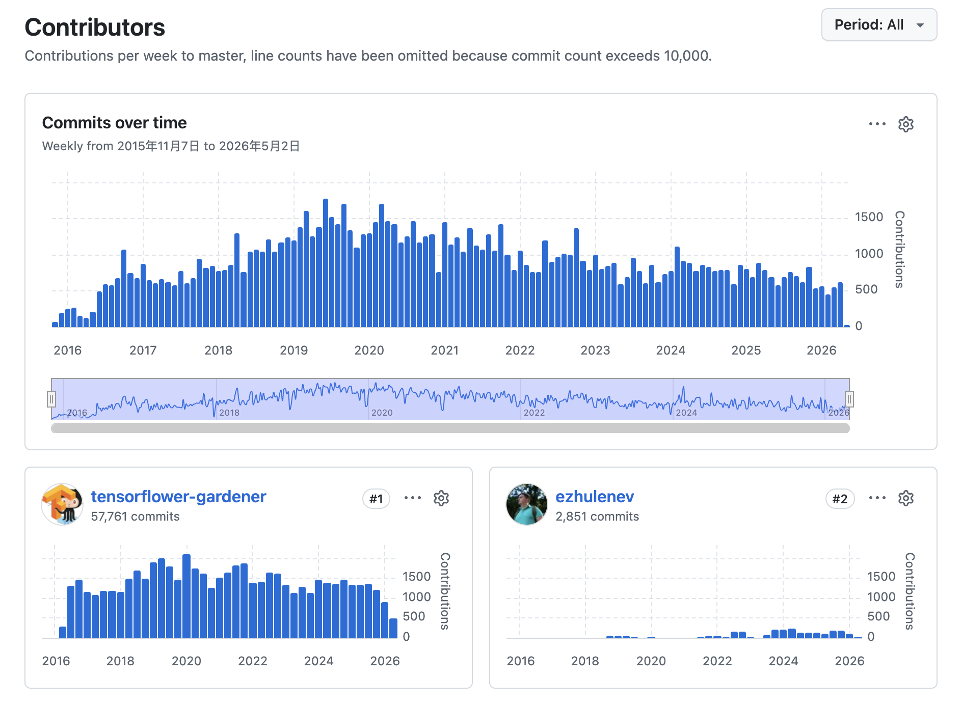
BUS-FACTOR · EVIDENCE FROM GITHUB INSIGHTS
The data behind the bars — top-1 contributor dominates these repos
open-webui · top-1 push ratio 0.957
tensorflow · top-1 push ratio 0.990
#1 tjbck 11,683 commits · vs #2 Classic298 479 commits = 24× gap
#1 tensorflower-gardener 57,761 (CI bot) · 20× #2

Slide 17
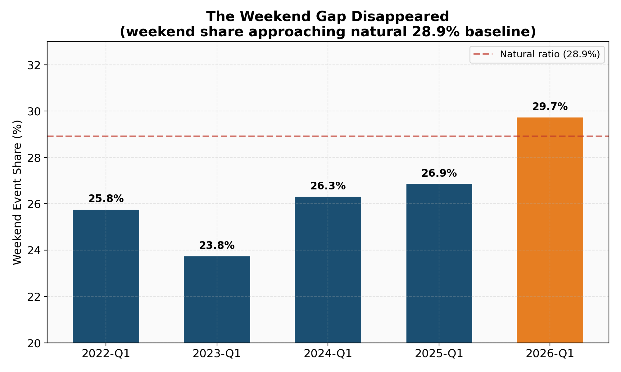
RESULT · THE WEEKEND GAP DISAPPEARED
Bar chart · weekend event share vs 28.9% natural baseline
FINDING 5
Weekend share of all events, by era:
2022 25.8% (−3.1 pp vs natural)
2024 26.3% (−2.6 pp)
2026 29.7% (+0.8 pp — gap gone)
Push-specific weekend share rose 24.8% → 29.4% — the strongest signal, since pushes mean writing code.
“In 2026, GitHub doesn't know what day of the week it is anymore.”

Slide 18
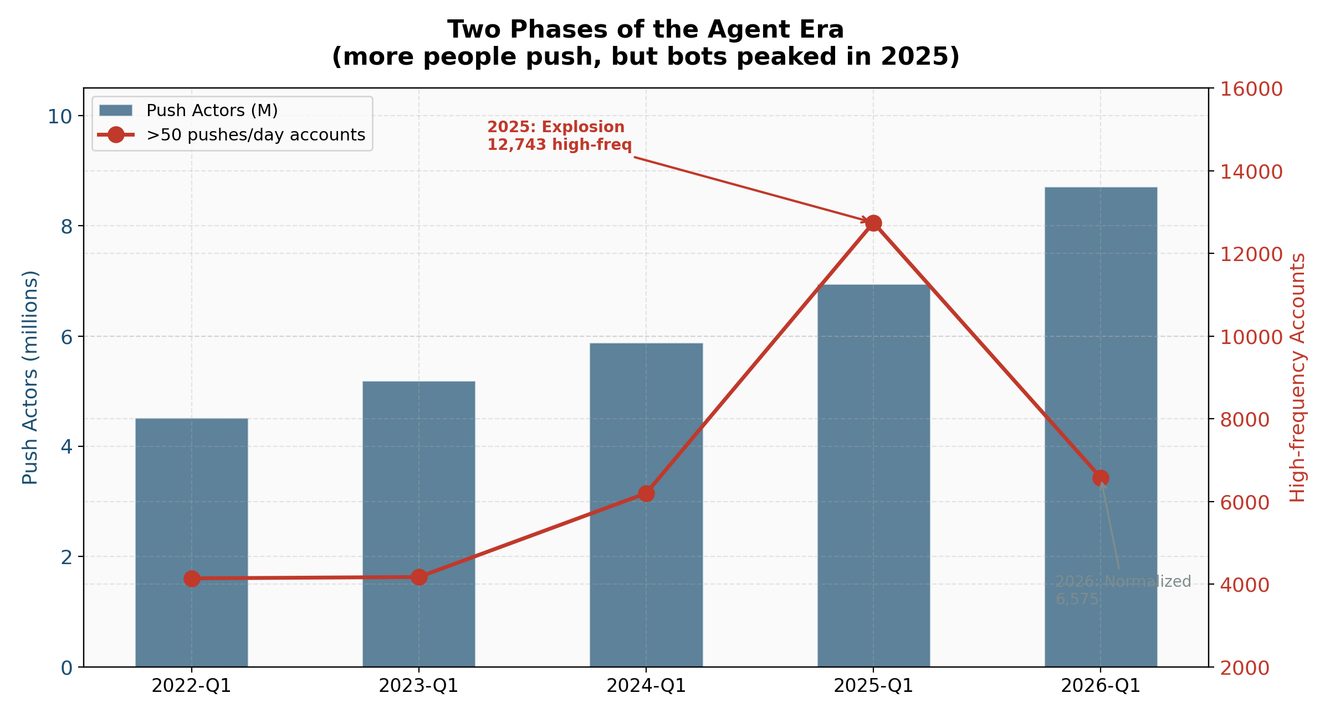
RESULT · TWO PHASES OF THE AGENT ERA
Dual-axis · push actors (M, bars) + >50 pushes/day accounts (line)
FINDING 6
Push actors vs high-frequency accounts:
Phase 1 · 2025 explosion
>50 pushes/day accounts 6,197 → 12,743 (+106%)
Phase 2 · 2026 normalization
Push actors 6.95 M → 8.71 M (+25%)
but >50 pushes/day 12,743 → 6,575 (−48%)
Bots peaked, then GitHub cleaned them. Real broadening of participation took over.

Slide 19
LESSONS LEARNED
What we'd carry forward beyond this project
01
DESIGN FOR THE CONSTRAINT, NOT AGAINST IT
HDFS quota and cross-team permission boundaries forced design decisions that ended up improving the work — rolling pipeline, per-era processing, write-own-read-union.
Carry forward · Treat infrastructure constraints as architectural input, not nuisances. The constraint-driven design was more crash-safe than a quota-free version would have been.
02
NEVER TRUST A LIVE API SCHEMA — ASSERT IT
The 2026 GitHub schema break wasn't loudly announced. Job 08 silently produced merged_prs = 0 for an entire era before we caught it.
Carry forward · Assert column counts, NULL ratios, and key value ranges explicitly. Compare era-over-era distributions. NULL ≠ zero.
03
VALIDATE THE UNEXPECTED WITH OUTSIDE SOURCES
When the 2026 WatchEvent / ForkEvent collapse looked like a bug, cross-checking with He et al. (arXiv 2412.13459) confirmed it as real platform behavior — not a pipeline error.
Carry forward · Anomalies need external corroboration. Triangulating with literature or other data sources turns suspicious numbers into trustworthy ones.

Slide 20
SUMMARY & ACKNOWLEDGEMENTS
The coding-agent era brought three fundamental shifts to OSS
①
②
③
DEVELOPMENT GOT LIGHTER
WEEKENDS DISAPPEARED
TWO-PHASE AGENT ADOPTION
+51% developers but −42% contributors per repo. Single-commit pushes rose 87% → 94%. Pushes became smaller and more frequent.
2026 weekend activity hit 29.7%, finally reaching the natural 28.9% baseline. Coding agents work 24/7.
2025 explosion (>50 pushes/day accounts +106%) → 2026 normalization (broader push base, shorter individual streaks).
IMPLICATION · Traditional metrics (stars, fork counts) are increasingly unreliable in the agent era. Multi-dimensional measurement is essential.
ACKS · NYU HPC — Google Cloud Dataproc · GH Archive · Hugging Face Hub · PyPI / BigQuery.

