Slide 1

Python基础介绍

Slide 2
Agenda
Python Introduce
Environment
Basic Syntax
Examples

Slide 3

Python
What is Python?
Python is powerful... and fast; plays well with others; runs everywhere; is friendly & easy to learn; is Open.
Why is Python?
简单
- 语法简单
- 编写简单
- 运行简单
高效效率
- 语法糖
社区活跃
- 79504 package on PyPI

Slide 4

Environment
Python 2.7
Python 2.7.3
Python 集成IDE
PyCharm 3
PyCharm 4
Pycharm 5

Slide 5
Basic Syntax
操作符
变量
基本类型
缩进
代码结构
流程控制
+ - * / % **
< <= > >= == !=
and or not
Number
String
List
Tuple
Dictionary
if
for
while
function
class
module
package

Slide 6
Indentation
什么是代码块？
T-SQL
IF (@ActionType IN (0,1))
BEGIN
IF EXISTS (SELECT TOP 1 1
FROM dbo.Newegg_SOMaster WITH (NOLOCK)
WHERE SONumber = @SONumber
AND HoldMark = 1)
BEGIN
SELECT 900022
RETURN;
END
END
代码块
代码块

Slide 7
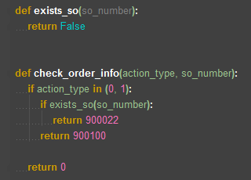
Indentation
Python’s code block.
缩进通常4个空格为单位

Slide 8
Operator
操作符
算数运算符
比较运算符
逻辑运算符
Examples:
>>> 20 + 30 *2 – 10 /5
72
>>> 10 % 3
1
>>> 3 ** 2
9
Examples:
>>> True and 100 > 5
True
>>> 100 < 10 or 10 != 20
False
Examples:
>>> 20 > 100
False
>>> 100 == 100
True

Slide 9
Variant and Type
整型
True 和 False
浮点型
Decimal
基本类型
整型
字符串
字典
元组
列表
有序,可变
[] 或 List进行声明
基于0的索引访问
包含不同类型
不可变
以双引号或者单引号为边界
有序,不可变
() 或 tuple进行声明
基于0的索引访问
包含不同类型
Key-Value键值对
{} 或 dict进行声明

Slide 10
Variant and Type
# String demo name = "Testing" name += " with Python" name = name.lower() name = name[0:7] assert name == 'testing‘
# List demo vendors = ["Intel", "Microsoft", "Samsung"] intel = vendors[0] assert intel == "Intel" microsoft = vendors[1] assert microsoft == "Microsoft" vendors.append("HP") vendors.insert(0, "IBM") assert vendors[0] == "IBM” del vendors[0]
# Dictionary demo london = {'name': 'London', 'gdp': 301, 'population': 8.539, 'regions': ["Westminster", "Chelsea", "Greenwich"]}
london["longitude"] = 0.1 name = london['name'] for key in london: print key, london[key] del london['gdp']

Slide 11
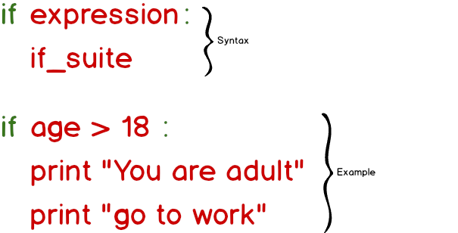
If

Slide 12
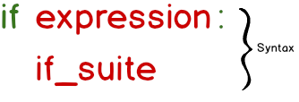
If statement
expression 会被替换为真实的逻辑表达式
冒号(:)是必须的
if_suite 必须缩进

Slide 13
If statement
语义
Expression 表达式将被求值
如果expression求值结果为True， if_suite 语句将会被执行
Expr
True
statement
statement
False
statement

Slide 14
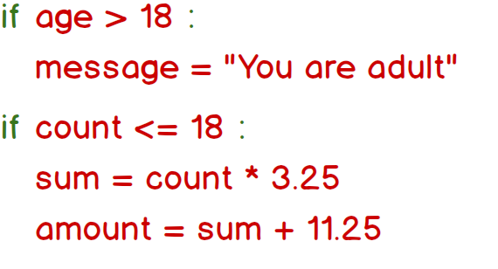
If statement examples

Slide 15
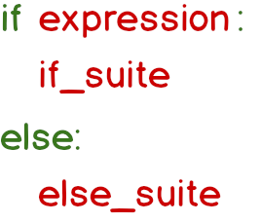
If-else statement
Expr
statement
True
False
statement
statement
statement
如果expression值为True，if_suite 会被执行
否则，else_suite被执行

Slide 16

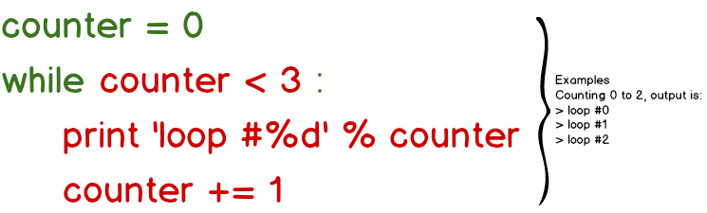
while

Slide 17

While statement
Cond
True
statement
while_suite会被不断执行，直到expression值为False
False
statement
statement

Slide 18
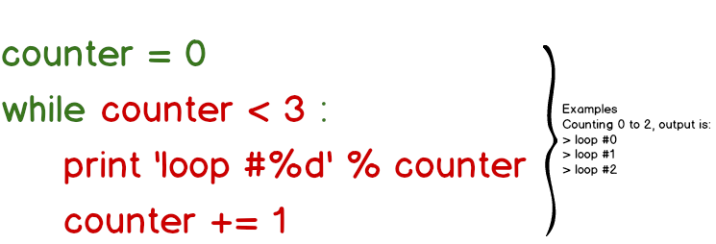
While statement examples
这里实现一个计数器，print语句会被执行三次

Slide 19
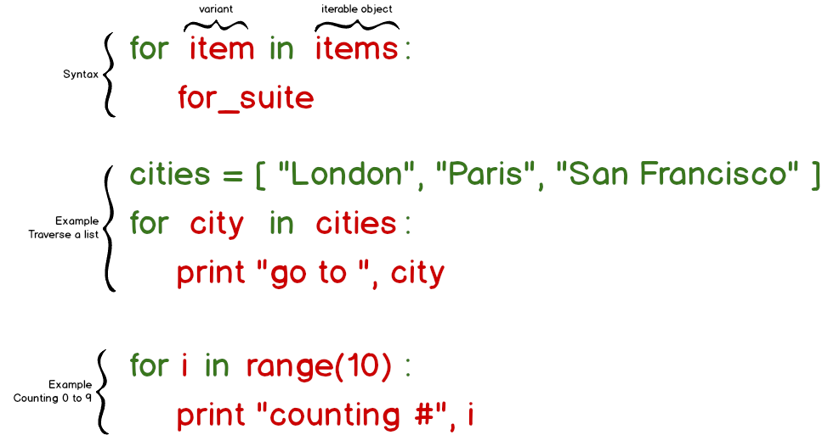
For loop

Slide 20
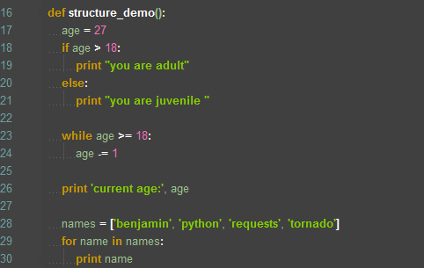
Example

Slide 21
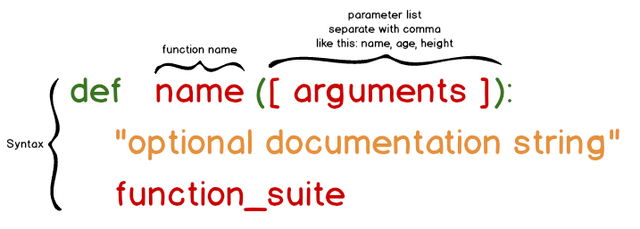
Function
Arguments可空
多个参数以逗号分隔
函数定义第一行字符串为函数文档字符串，可用于描述函数

Slide 22
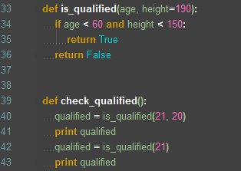
Function

Slide 23
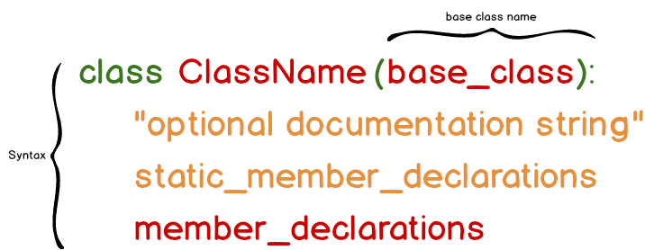
Class
面向对象编程
建模真实事物
如何定义

Slide 24
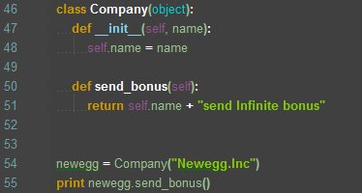
Class

Slide 25


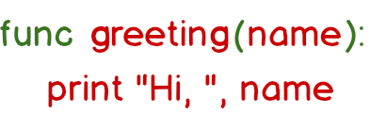
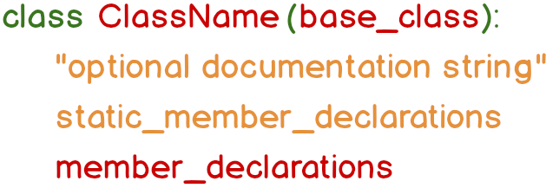
Module and Package
包含__init__.py的文件夹就是packages
.py文件就是模块
person.py
name.py
__init__.py
Notes:
Module：
Package:
1. 为平坦的名字空间加入有层次的组织结构
2. 允许程序员把有联系的模块组合到一起
3. 解决名字冲突

Slide 26
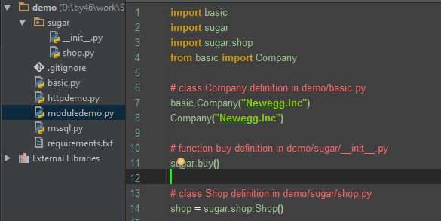
Module and Package

Slide 27
Common Third-Party libs
http client – requests
database client – pyodbc
assert – hamcrest
redis client – redis
bdd – behave
…

Slide 28
PIP
Python包管理工具
the Python Package Index
https://pypi.python.org
Python Software Foundation
PIP
Install
Dependencies
Private PyPI
http://scmesos06:3141/
私有仓库

Slide 29
Install PIP
https://bootstrap.pypa.io/get-pip.py
下载 get-pip.py
运行命令
python get-pip.py
Install packages
把C:\Python27\Scripts追加到PATH环境变量

Slide 30
Pip basic commands
pip install [--upgrade] <package>
Install a Python package or upgrades it to the latest a available version.
Examples:
pip install requests==2.8.0
pip install pyodbc==3.0.10
pip install --trusted-host scmesos06 --i http://scmesos06:3141/simple requests==2.8.0
pip install –r requirements.txt
pyodbc==3.0.10 requests==2.8.0
pip uninstall <package>
Deletes an already installed package

Slide 31
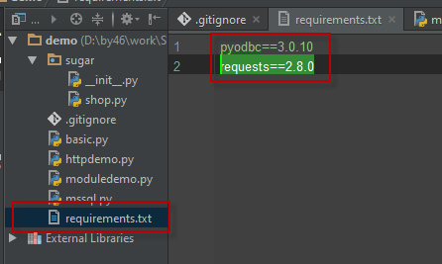
Pip basic commands

Slide 32
Examples – http
What is requests?
Requests is an elegant and simple HTTP library for Python, built for human beings. You are currently looking at the documentation of the development release.
pip install requests==2.8.0
Or,
pip install --trusted-host scmesos06 --i http://scmesos06:3141/simple requests==2.8.0

Slide 33
Examples – http
How to send request with GET method?
import requests
url = 'http://scmesos06:3141/simple/'
resp = requests.get(url)
# output the response’s status code
print resp.status_code
# output response’s body
print resp.content
# if the response’s content is JSON, you can call json function, item is a Dictionary object
item = resp.json()

Slide 34
Examples – http
How to POST json and http headers?
import requests import json url = 'http://scmesos06:3141/simple/' entity = {'TransactionNumber': 21, 'Quantity': 21, 'Items': [1, 2, 3]} body = json.dumps(entity) headers = {'X-PO-Name': 'PO', 'Content-Type': 'Application/json', 'Content-Length': str(len(body))} resp = requests.post(url, headers=headers, data=body)

Slide 35
Examples – http
How to send other method http reqeusts?
import requests
url = 'http://scmesos06:3141/simple/'
# other method resp = requests.put(url, headers={'X-PO-Name': 'PO'}, data="customer content") resp = requests.delete(url, headers={'X-PO-Name': 'PO'}) resp = requests.head(url, headers={'X-PO-Name': 'PO'}) resp = requests.request("MyMethods", url)
Customer Methods

Slide 36
Examples – Database
What is pyodbc?
pyodbc is an open source Python module that makes accessing ODBC databases simple. It implements the DB API 2.0 specification but is packed with even more Pythonic convenience.
pip install pyodbc==3.0.10
Or,
pip install --trusted-host scmesos06 --i http://scmesos06:3141/simple pyodbc==3.0.10

Slide 37
Examples – Database
How to insert row into Table MSSQL?
connection_string = 'DRIVER={SQL Server};SERVER=S1DSQL04\\EHISSQL;PORT=1433;DATABASE=CTI;UID=CTIDbo;PWD=Devdbo' # connect to MSSQL server conn = pyodbc.connect(connection_string) cursor = conn.cursor() result = cursor.execute("INSERT INTO Demo(Name, Age, Price) VALUES(?, ?,?)", ["benjamin2", 70, 21.22]) # it's important. commit new row cursor.commit() conn.close()

Slide 38
Examples – Database
How to select rows from MSSQL?
connection_string = 'DRIVER={SQL Server};SERVER=S1DSQL04\\EHISSQL;PORT=1433;DATABASE=CTI;UID=CTIDbo;PWD=pwd' # connect to MSSQL server conn = pyodbc.connect(connection_string) cursor = conn.cursor() cursor.execute('SELECT id, name, age, price FROM Demo WHERE id > ?‘, [1]) tid, name, age, price = cursor.fetchone() print 'result:', tid, name, age, price rows = cursor.fetchall() for row in rows: print 'next result :', row.id, row.name, row.age, row.price conn.close()

Slide 39
Examples – Database
How to delete and update rows from MSSQL?
connection_string = 'DRIVER={SQL Server};SERVER=S1DSQL04\\EHISSQL;PORT=1433;DATABASE=CTI;UID=CTIDbo;PWD=pwd' # connect to MSSQL server conn = pyodbc.connect(connection_string) cursor = conn.cursor()
# update one name cursor.execute('UPDATE Demo set name = ? WHERE id > ?', ['Python', 1]) cursor.commit() # delete row cursor.execute("DELETE FROM Demo WHERE NAME = ?", ['benjamin2']) cursor.commit()
conn.close()

Slide 40
Examples – Database
How to call procedure from MSSQL?
connection_string = 'DRIVER={SQL Server};SERVER=S1DSQL04\\EHISSQL;PORT=1433;DATABASE=CTI;UID=CTIDbo;PWD=pwd' # connect to MSSQL server conn = pyodbc.connect(connection_string) cursor = conn.cursor()
# update one name cursor.execute('EXEC Choice_By_Name @Name=?', ['benjamin'])
rows = cursor.fetchall() for row in rows: print "call store procedure: ", row conn.close()

Slide 41
资源
Python 百问
Requests docs
pyodbc docs
PIP
IronPython demo

Slide 42


