Slide 1
Age Estimation
using Facial Images
Byeong Jun Kim
Alibek Taizhanov
Hammad Mohiuddin
Notes:
Goal and Motivation (what & why)
Description of Overall software structure
Describe the machine learning model
Give the results of Training
Demonstration of the complete project
Key Learnings – what would you do differently?

Slide 2
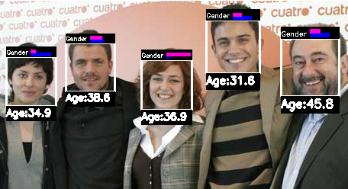
Why Age Estimation?
Goal: Determine whether machines can perform better at estimating age than humans
Applications: Security control, law enforcement and human-computer interaction
Notes:
Age estimation is an important factor in social interaction. Humans however are quite poor at guessing age because our decisions are biased by many different factors. Age estimation has recently been gaining importance with applications in security control, law enforcement and human-machine interaction etc. We hypothesized that a machine could perform better at predicting someones age as compared to a machine.

Slide 3
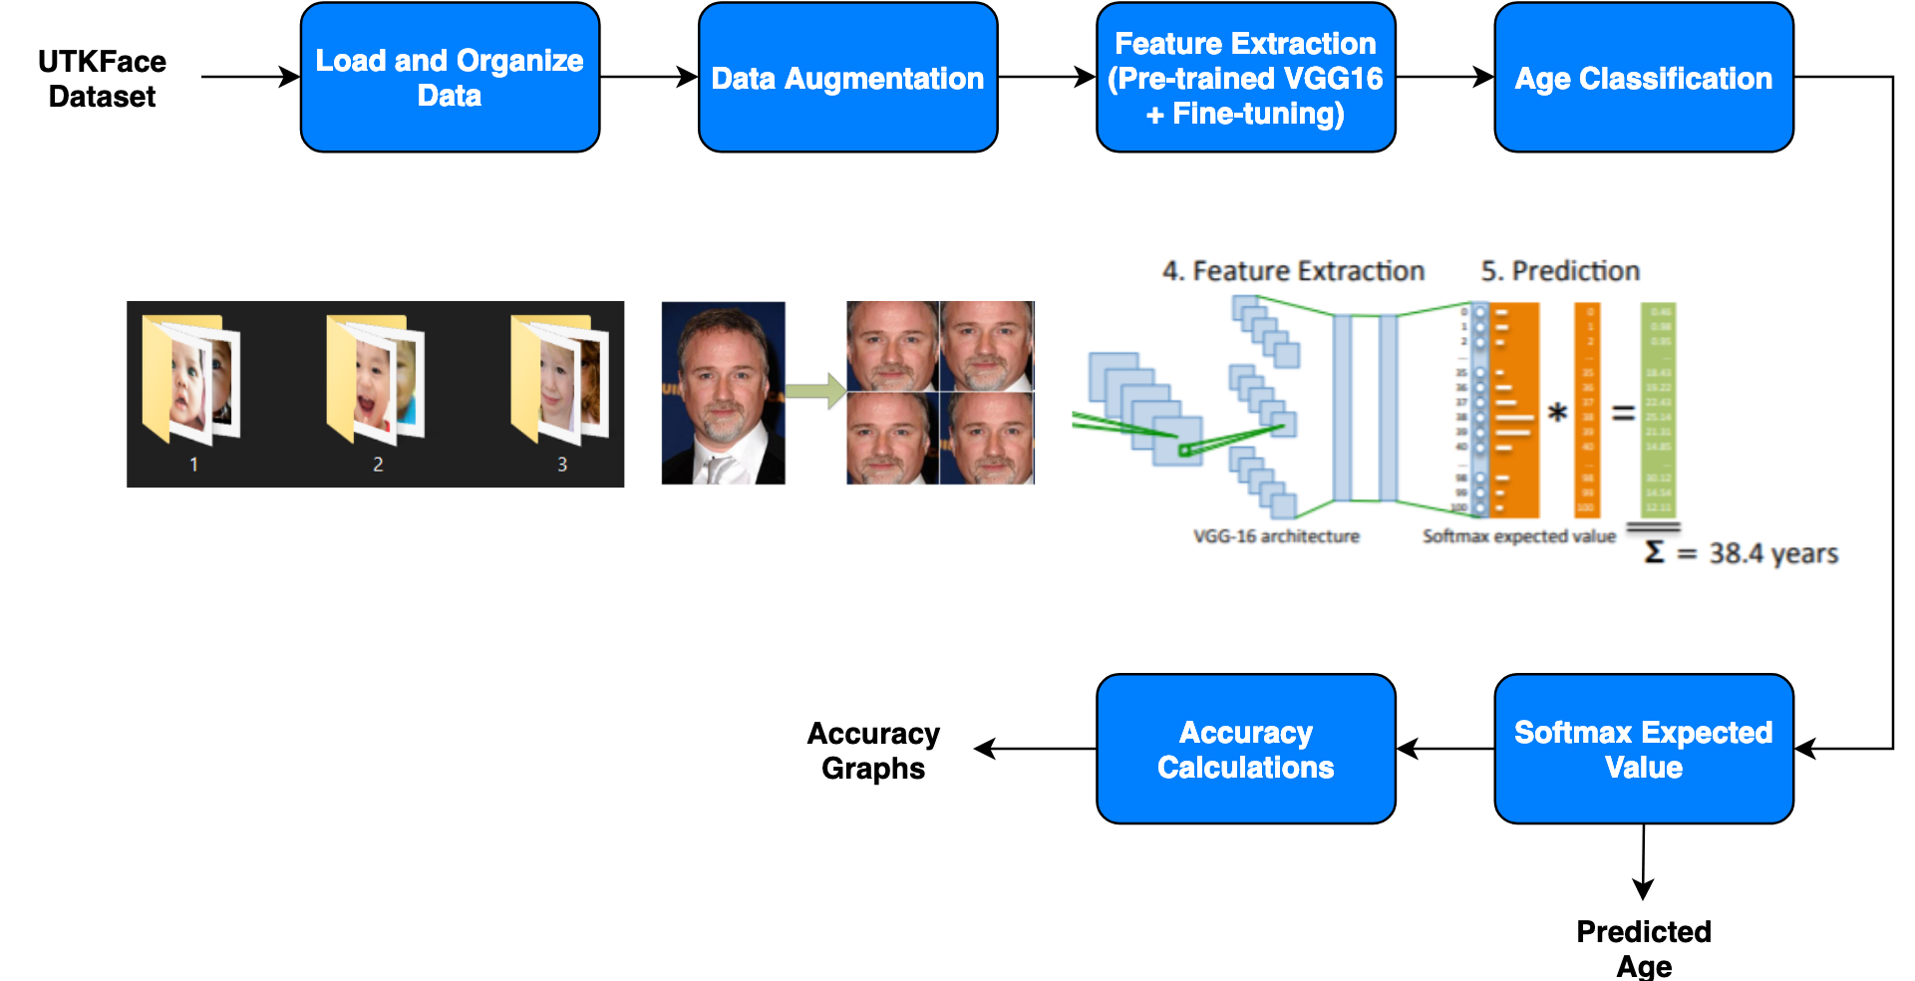
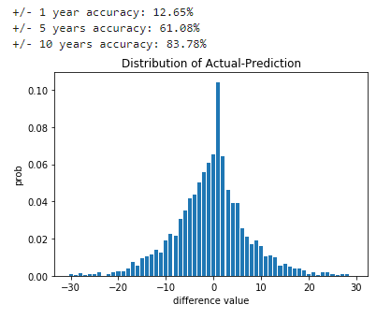
Overall Software Structure
Notes:
We designed our software to be as modular as possible. In this way the software takes in the UTKFace dataset .tar file which we extract all files from and organize into subfolders for training, validation and testing, making sure to sample equally among all subgroups. The subgroups in this case were not just categorized by age but also the race and gender. This made sure that our datasets contained a proportional amount of images from each age, gender and race. We also implemented data augmentation by randomly flipping and rotating images to complement for a lack of data in the higher age ranges.
Once we got the data, we passed it through our pretrained VGG16 model to extract the features and passed those through our age classifier which consisted of 95 classes, one for each age from 1 to 95. Passing the outputs of the classifier through a softmax layer gave us a probability distribution which we used to calculate the expected value for the predicted age. Finally, we had an accuracy module to determine our accuracies to compare our models performance on different age groups, races and gender.
Now Alibek will go in depth about the models we used.

Slide 4
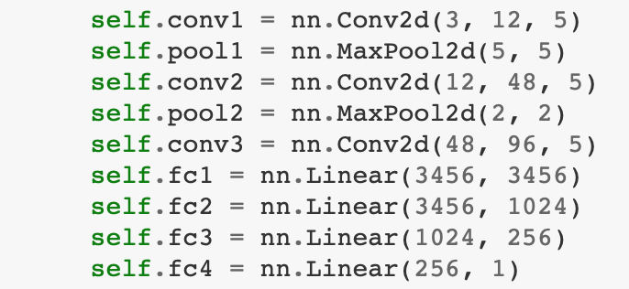
Model Description - Baseline
Establish baseline performance with a simple CNN model
11% accuracy for +/- 1 years and 60% accuracy for +/- 5 years from actual
All subsequent models would need to exceed this threshold

Slide 5
Compare Architectures
Alexnet, VGG16, VGG19, ResNet were compared
 | Exact Accuracy | +/- 1 years Accuracy | +/- 5 years Accuracy
Alexnet | 8% | 13% | 59%
VGG16 | 13% | 20% | 71%
VGG19 | 10% | 16% | 65%
ResNet | 12% | 18% | 67%
Human [4] | <10% | <15% | <50%

Slide 6
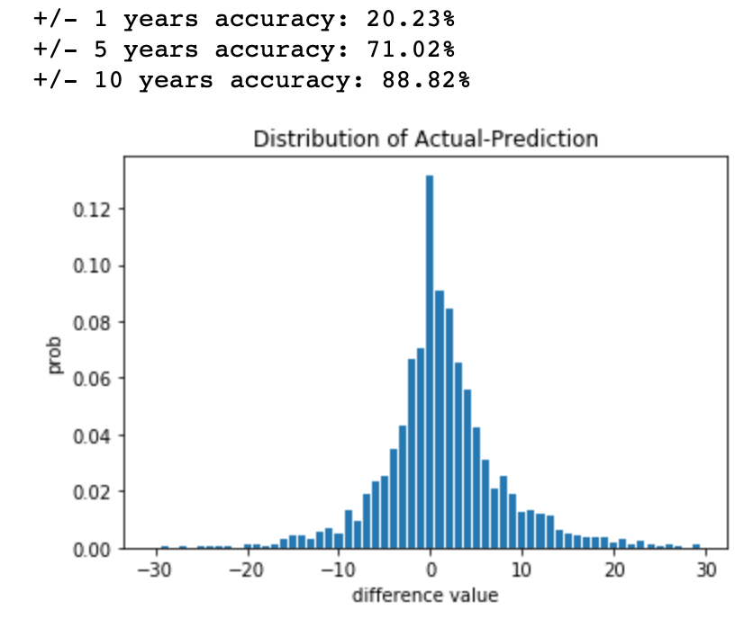
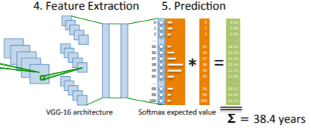
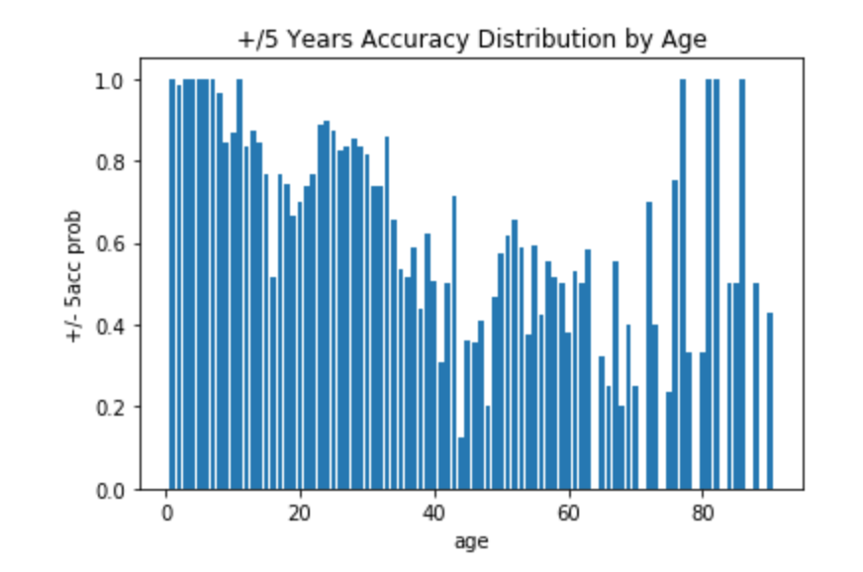
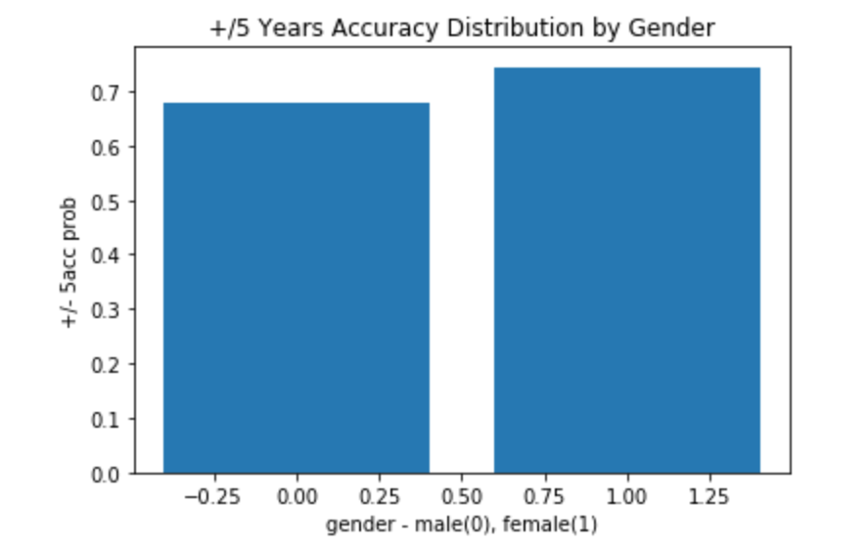
VGG16 - Model and Results
Model (VGG16 Features* + AvgPool + Custom Classifier 4 FC)
With Regression Output
With Classification Output (by age) (+2-3%)
Expected Value Output (Classification + Regression) (+3-4%)
*It is easier for the model to make comparative statements, rather than outputting a single number
Loss Functions: MSE and MAE loss functions were used with similar performance
*fine-tuned weights on our data

Slide 7
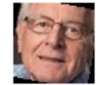

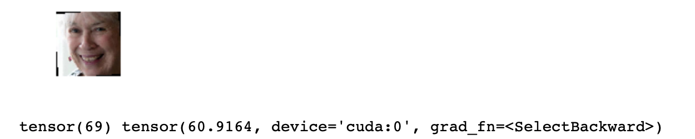


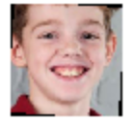

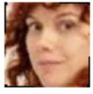



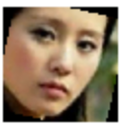

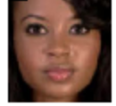



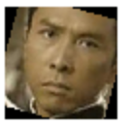

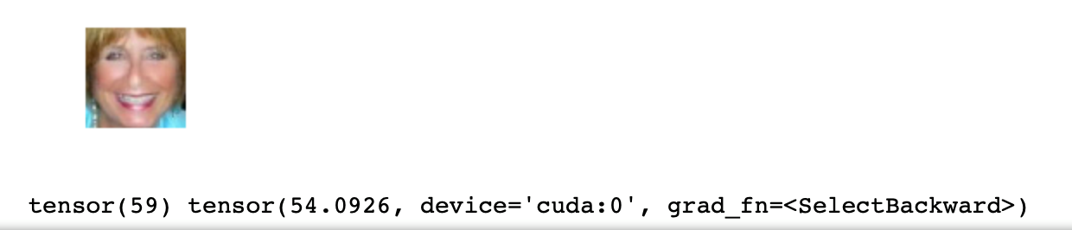



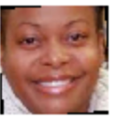

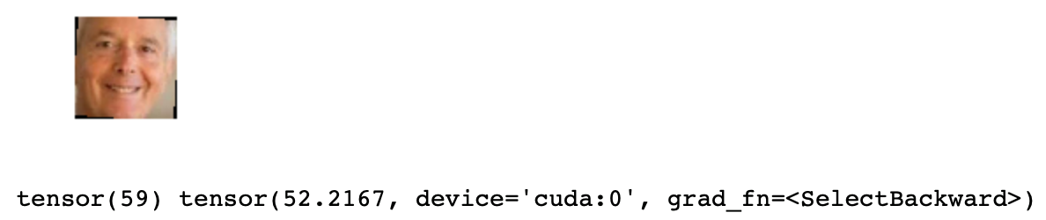



Demo - Final Model Prediction
Notes:
~52 sec?

Slide 8
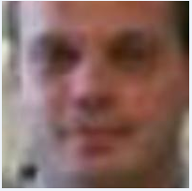

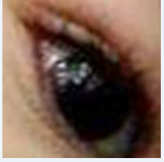

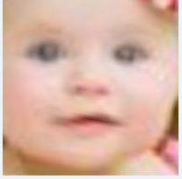
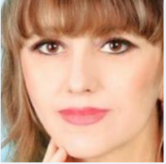
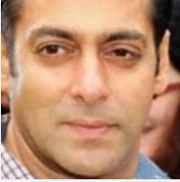
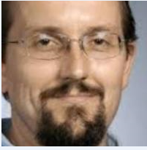
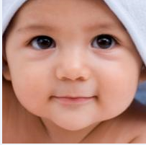
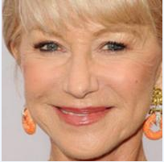
Key Learning - Data, Data, and Data
V S
Notes:
~45 sec?

Slide 9
THANK YOU

Slide 10
REFERENCES
[1] http://www.dia.fi.upm.es/~pcr/images/age_estimation.png
[2] https://ai2-s2-public.s3.amazonaws.com/figures/2017-08-08/110359824a0e3b6480102b108372793265a24a86/3-Figure3-1.png
[3] “ICCV 2015 Area Chairs,” 2015 IEEE International Conference on Computer Vision (ICCV), 2015. https://www.cv-foundation.org//openaccess/content_iccv_2015_workshops/w11/papers/Rothe_DEX_Deep_EXpectation_ICCV_2015_paper.pdf
[4] Hu Han, Charles Otto, and Anil K. Jain. Age Estimation from Face Images: Human vs. Machine Performance.
http://biometrics.cse.msu.edu/Publications/Face/HanOttoJain_AgeEstimationFaceImages_HumanvsMachinePerformance_ICB13.pdf

Slide 11
APPENDIX

Slide 12
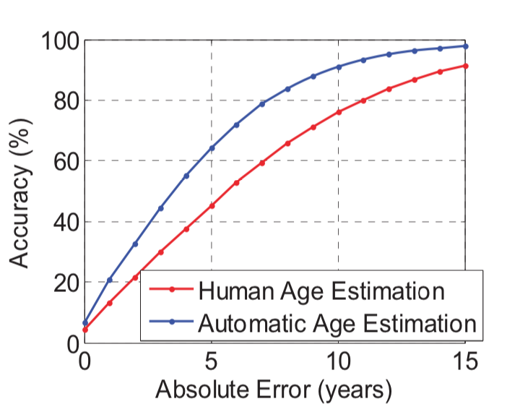
Human and Machine Performance Comparison on Age Estimation - 2200 image dataset
http://biometrics.cse.msu.edu/Publications/Face/HanOttoJain_AgeEstimationFaceImages_HumanvsMachinePerformance_ICB13.pdf

Slide 13
Regression w/ VGGFACE, bs 32, lr 1e-05

Slide 14
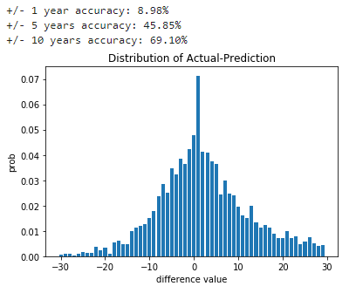
Regression w/ inception_v3 model

