Slide 1
Kosen Club CP 勉強会
Segment trees

Slide 2
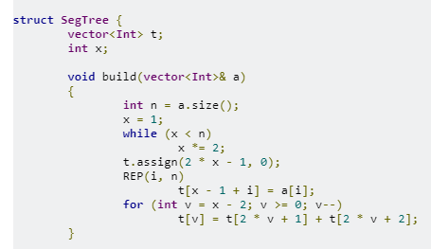
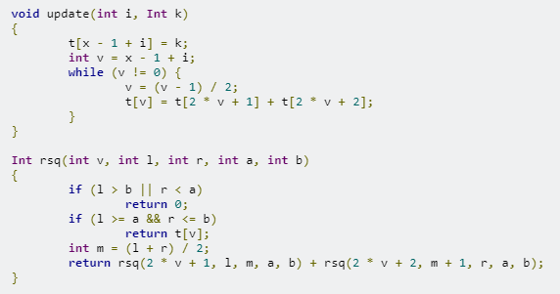
1.Point Update/Range Query
Sample Problem: Update Value/Range Sum Query A - Segment Tree, part 1 - Codeforces
Notes:
struct SegTree {
vector<Int> t;
int x;
void build(vector<Int>& a)
{
int n = a.size();
x = 1;
while (x < n)
x *= 2;
t.assign(2 * x - 1, 0);
REP(i, n)
t[x - 1 + i] = a[i];
for (int v = x - 2; v >= 0; v--)
t[v] = t[2 * v + 1] + t[2 * v + 2];
}
void update(int i, Int k)
{
t[x - 1 + i] = k;
int v = x - 1 + i;
while (v != 0) {
v = (v - 1) / 2;
t[v] = t[2 * v + 1] + t[2 * v + 2];
}
}
Int rsq(int v, int l, int r, int a, int b)
{
if (l > b || r < a)
return 0;
if (l >= a && r <= b)
return t[v];
int m = (l + r) / 2;
return rsq(2 * v + 1, l, m, a, b) + rsq(2 * v + 2, m + 1, r, a, b);
}
};
void solve()
{
int n, m;
cin >> n >> m;
vector<Int> a(n);
REP(i, n) cin >> a[i];
SegTree st;
st.build(a);
int t, i, j, v;
REP(l, m) {
cin >> t;
if (t == 1) {
cin >> i >> v;
st.update(i, v);
}
else {
cin >> i >> j;
cout << st.rsq(0, 0, st.x - 1, i, j - 1) << endl;
}
}
}

Slide 3
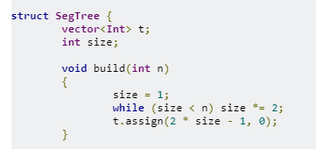
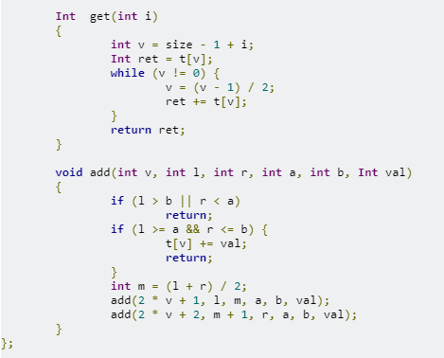
2.Range Update/Point Query
Sample Problem: Range Add Update/Point Query A - Segment Tree, part 2 - Codeforces
Notes:
struct SegTree {
vector<Int> t;
int size;
void build(int n)
{
size = 1;
while (size < n) size *= 2;
t.assign(2 * size - 1, 0);
}
Int get(int i)
{
int v = size - 1 + i;
Int ret = t[v];
while (v != 0) {
v = (v - 1) / 2;
ret += t[v];
}
return ret;
}
void add(int v, int l, int r, int a, int b, Int val)
{
if (l > b || r < a)
return;
if (l >= a && r <= b) {
t[v] += val;
return;
}
int m = (l + r) / 2;
add(2 * v + 1, l, m, a, b, val);
add(2 * v + 2, m + 1, r, a, b, val);
}
};
void solve()
{
int n, m;
cin >> n >> m;
SegTree st;
st.build(n);
REP(i, m) {
int t;
cin >> t;
if (t == 1) {
int i, j, val; cin >> i >> j >> val;
st.add(0, 0, st.size - 1, i, j - 1, val);
}
else {
int i; cin >> i;
cout << st.get(i) << endl;
}
}
}

Slide 4
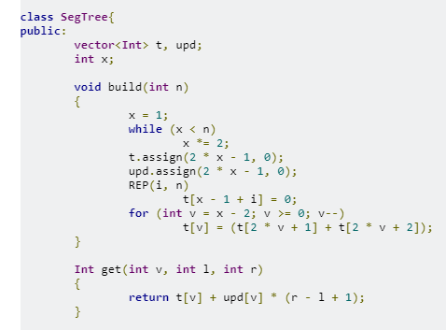
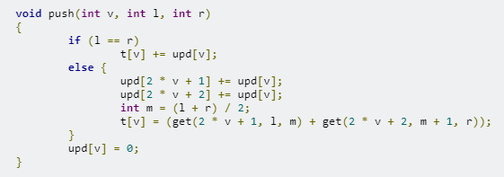
3.Range Update/Range Query (1)
Sample Problem: Range Add Update/Range Sum Query
D - Segment Tree, part 2 - Codeforces
Notes:
class SegTree{
public:
vector<Int> t, upd;
int x;
void build(int n)
{
x = 1;
while (x < n)
x *= 2;
t.assign(2 * x - 1, 0);
upd.assign(2 * x - 1, 0);
REP(i, n)
t[x - 1 + i] = 0;
for (int v = x - 2; v >= 0; v--)
t[v] = (t[2 * v + 1] + t[2 * v + 2]);
}
Int get(int v, int l, int r)
{
return t[v] + upd[v] * (r - l + 1);
}
void push(int v, int l, int r)
{
if (l == r)
t[v] += upd[v];
else {
upd[2 * v + 1] += upd[v];
upd[2 * v + 2] += upd[v];
int m = (l + r) / 2;
t[v] = (get(2 * v + 1, l, m) + get(2 * v + 2, m + 1, r));
}
upd[v] = 0;
}
void update(int v, int l, int r, int a, int b, Int add)
{
push(v, l, r);
if (l > b || r < a)
return;
if (l >= a && r <= b) {
upd[v] += add;
return;
}
int m = (l + r) / 2;
update(2 * v + 1, l, m, a, b, add);
update(2 * v + 2, m + 1, r, a, b, add);
t[v] = (get(2 * v + 1, l, m) + get(2 * v + 2, m + 1, r));
}
Int rsq(int v, int l, int r, int a, int b)
{
push(v, l, r);
if (l > b || r < a)
return 0;
if (l >= a && r <= b)
return get(v, l, r);
int m = (l + r) / 2;
return rsq(2 * v + 1, l, m, a, b) + rsq(2 * v + 2, m + 1, r, a, b);
}
};
void solve()
{
int n, m;
cin >> n >> m;
SegTree st;
st.build(n);
int T, i, j;
Int v;
REP(l, m) {
cin >> T;
if (T == 2) {
cin >> i >> j;
cout << st.rsq(0, 0, st.x - 1, i, j - 1) << endl;
}
else {
cin >> i >> j >> v;
st.update(0, 0, st.x - 1, i, j - 1, v);
}
}
}

Slide 5
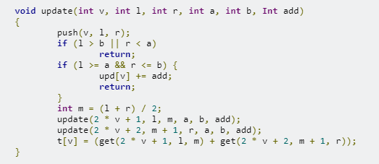
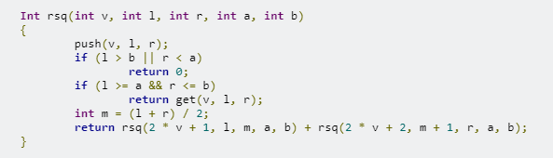
3.Range Update/Range Query (2)
Sample Problem: Range Add Update/Range Sum Query
D - Segment Tree, part 2 - Codeforces
Notes:
class SegTree{
public:
vector<Int> t, upd;
int x;
void build(int n)
{
x = 1;
while (x < n)
x *= 2;
t.assign(2 * x - 1, 0);
upd.assign(2 * x - 1, 0);
REP(i, n)
t[x - 1 + i] = 0;
for (int v = x - 2; v >= 0; v--)
t[v] = (t[2 * v + 1] + t[2 * v + 2]);
}
Int get(int v, int l, int r)
{
return t[v] + upd[v] * (r - l + 1);
}
void push(int v, int l, int r)
{
if (l == r)
t[v] += upd[v];
else {
upd[2 * v + 1] += upd[v];
upd[2 * v + 2] += upd[v];
int m = (l + r) / 2;
t[v] = (get(2 * v + 1, l, m) + get(2 * v + 2, m + 1, r));
}
upd[v] = 0;
}
void update(int v, int l, int r, int a, int b, Int add)
{
push(v, l, r);
if (l > b || r < a)
return;
if (l >= a && r <= b) {
upd[v] += add;
return;
}
int m = (l + r) / 2;
update(2 * v + 1, l, m, a, b, add);
update(2 * v + 2, m + 1, r, a, b, add);
t[v] = (get(2 * v + 1, l, m) + get(2 * v + 2, m + 1, r));
}
Int rsq(int v, int l, int r, int a, int b)
{
push(v, l, r);
if (l > b || r < a)
return 0;
if (l >= a && r <= b)
return get(v, l, r);
int m = (l + r) / 2;
return rsq(2 * v + 1, l, m, a, b) + rsq(2 * v + 2, m + 1, r, a, b);
}
};
void solve()
{
int n, m;
cin >> n >> m;
SegTree st;
st.build(n);
int T, i, j;
Int v;
REP(l, m) {
cin >> T;
if (T == 2) {
cin >> i >> j;
cout << st.rsq(0, 0, st.x - 1, i, j - 1) << endl;
}
else {
cin >> i >> j >> v;
st.update(0, 0, st.x - 1, i, j - 1, v);
}
}
}

Slide 6
Resources
ITMO Academy: pilot course – Codeforces
木マスター養成講座 – YouTube
A&DS English Course – YouTube
Lazy Propagation Segment Tree – YouTube
L06 : Lazy Propagation Introduction | Segment Tree Course – YouTube
AlgorithmsThread 3: Segment Trees – YouTube
Segment Tree - Range Queries with Lazy Updates - YouTube

