Slide 1
Kosen Club CP 勉強会
2 pointers/deque/monotone stack

Slide 2
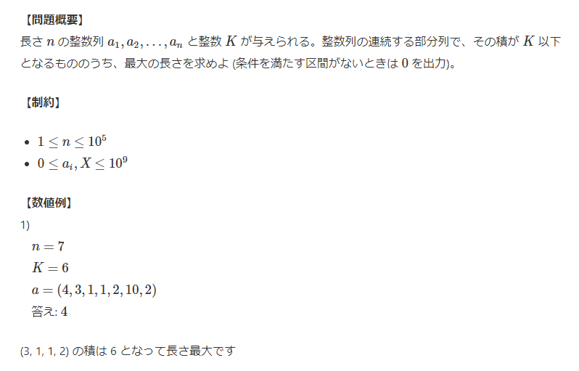
1. 2 pointers
C - 列 (atcoder.jp)

Slide 3
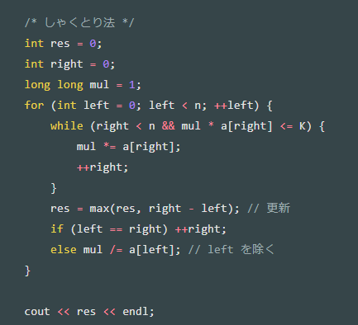
1. 2 pointers
しゃくとり法 (尺取り法) の解説と、それを用いる問題のまとめ - Qiita
N=7, K = 6, a=(4,3,1,1,2,10,2)
Start pos | 4 | 3 | 1 | 1 | 2 | 10 | 2
0 | 4 | 3 | 1 | 1 | 2 | 10 | 2
1 | 4 | 3 | 1 | 1 | 2 | 10 | 2
2 | 4 | 3 | 1 | 1 | 2 | 10 | 2
3 | 4 | 3 | 1 | 1 | 2 | 10 | 2
4 | 4 | 3 | 1 | 1 | 2 | 10 | 2
5 | 4 | 3 | 1 | 1 | 2 | 10 | 2
6 | 4 | 3 | 1 | 1 | 2 | 10 | 2
Notes:
#include <iostream> #include <vector> using namespace std; int main() { /* 入力受け取り */ int n; long long K; cin >> n >> K; vector<long long> a(n); for (int i = 0; i < n; ++i) cin >> a[i]; /* 0 があったら n をリターン */ for (int i = 0; i < n; ++i) { if (a[i] == 0) { cout << n << endl; return 0; } } /* しゃくとり法 */ int res = 0; int right = 0; long long mul = 1; for (int left = 0; left < n; ++left) { while (right < n && mul * a[right] <= K) { mul *= a[right]; ++right; } res = max(res, right - left); // 更新 if (left == right) ++right; else mul /= a[left]; // left を除く } cout << res << endl; }

Slide 4
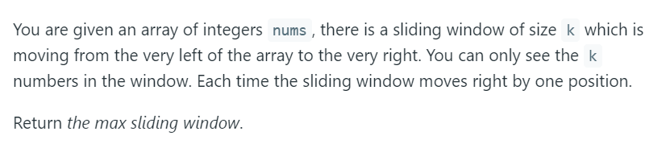
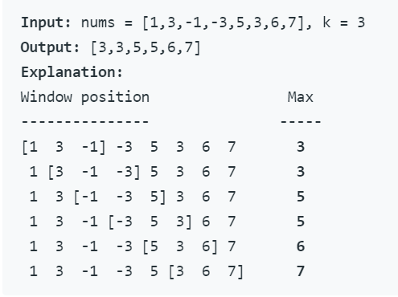
2. Deque
Sliding Window Maximum – LeetCode

Slide 5
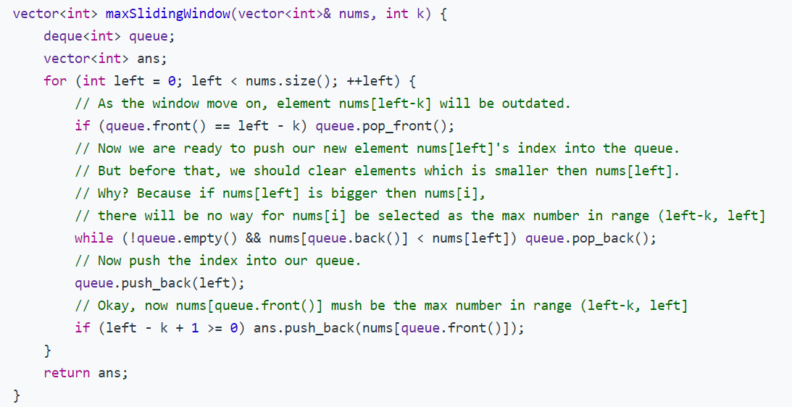
2. Deque
スライド最小値 - Algoogle (hadrori.jp)
Notes:
class Solution { public: vector<int> maxSlidingWindow(vector<int>& nums, int k) { deque<int> queue; vector<int> ans; for (int left = 0; left < nums.size(); ++left) { // As the window move on, element nums[left-k] will be outdated. if (queue.front() == left - k) queue.pop_front(); // Now we are ready to push our new element nums[left]'s index into the queue. // But before that, we should clear elements which is smaller then nums[left]. // Why? Because if nums[left] is bigger then nums[i], // there will be no way for nums[i] be selected as the max number in range (left-k, left] while (!queue.empty() && nums[queue.back()] < nums[left]) queue.pop_back(); // Now push the index into our queue. queue.push_back(left); // Okay, now nums[queue.front()] mush be the max number in range (left-k, left] if (left - k + 1 >= 0) ans.push_back(nums[queue.front()]); } return ans; } };

Slide 6
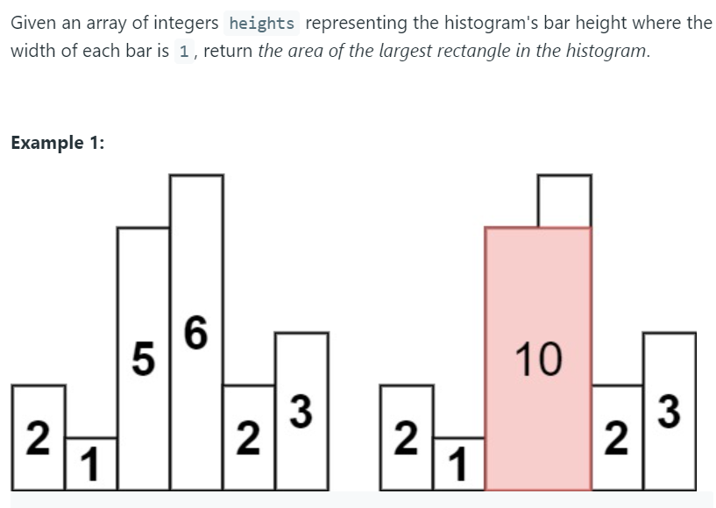
3. Monotone Stack
Largest Rectangle in Histogram – LeetCode

Slide 7
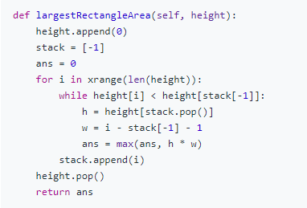
3. Monotone Stack
ALGORITHM NOTE ヒストグラム中の最大の長方形の面積 (fc2.com) LARGEST RECTANGLE IN HISTOGRAM - Leetcode 84 - Python - YouTube

