Slide 1
Project3
Data analysis of transfer investment
of top tier soccer clubs in Europe (2010-2019)
Bo Yan

Slide 2
Problem
With a combination of a dataset of transfer fee investments of top tier soccer clubs in Europe from 2010 to 2019, a data source of famous soccer players involved in these transfers, a data source of value and revenue of these clubs, and a data source of competition performance of these clubs and these players, a self-created database is implemented to perform analysis on transfer investment of these top tier soccer clubs, including normal data comparing and finding, investment return and overall performance of leagues, clubs and players, etc.

Slide 3
Software Design and Database used
MongoDB
mongo < project3.js
&
Java
java –jar project3.jar

Slide 4
Database Implementation
Different datasets or data sources from Internet are searched and gathered, from each of them, for project’s concern, a small cut down set is kept for only top tier clubs and famous players, then all kept sets of data are translated into fields or sets of fields of a document.
All MongoDB style documents and collections are manually written and inserted into a self-created MongoDB database called project3.

Slide 5
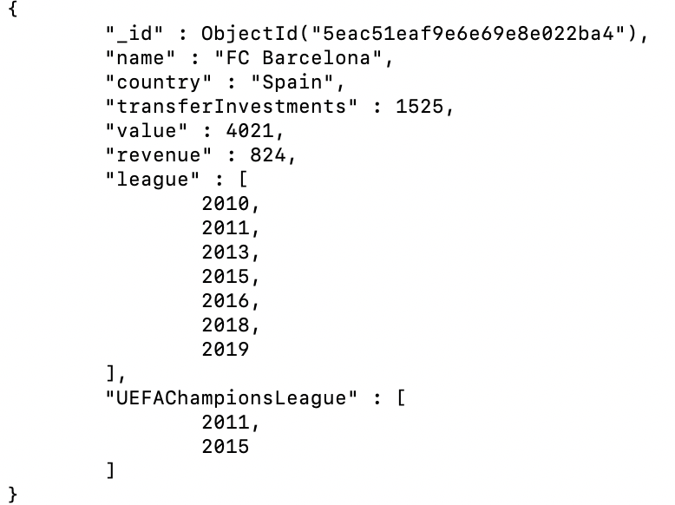
Sample Document

Slide 6
Java Implementation
The latest version of the mongo-java-driver is downloaded and installed in the Java project classpath, and packages from com.mongo are imported and used in Java code to connect to, and CRUD the MongoDB database.
A terminal style interface is implemented using Java. When the program is started, user will see from the terminal a list of all supported queries and input of choice of query can be typed by user, then the result of selected query will be output in the terminal.

Slide 7
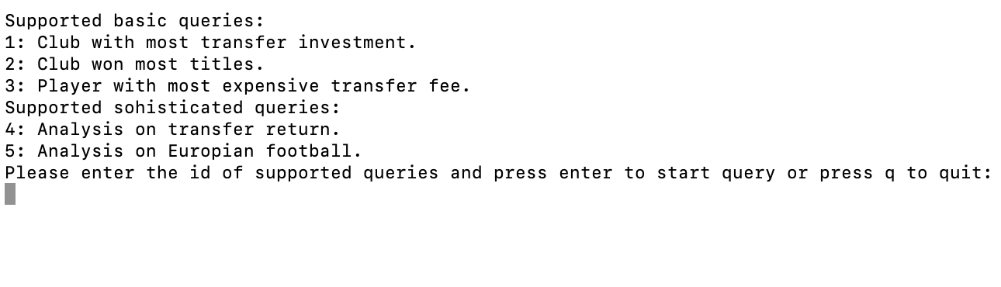
UI & Supported Queries

Slide 8
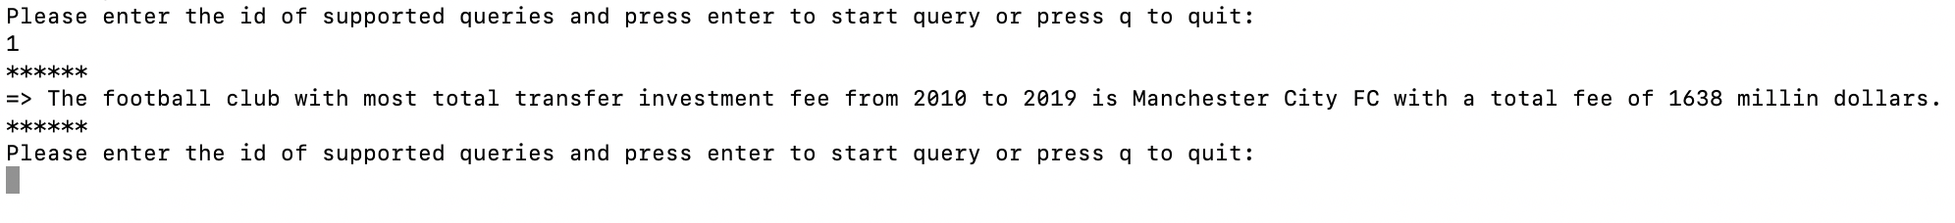
Find the club with most transfer investment fee from 2010 to 2019

Slide 9
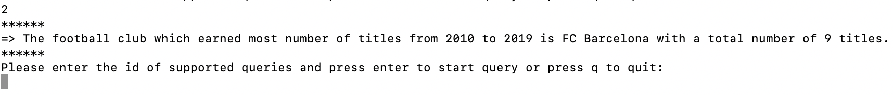
Find the club which earned most number of competitions titles from 2010 to 2019

Slide 10
Find the player who transferred with highest transfer fee from 2010 to 2019

Slide 11
Analysis on a single transfer investment return
For this query, three parts of analysis will be performed on all single transfer investment:
(1) Analyze and find the single transfer investment that gives the related club highest return at the competition level after the player joined the club. In the data model, different weights will be given for different competition results, return period of each transfer will be calculated, investment fee spent will be considered and finally the return will be computed and sorted to find the transfer with highest competition level return.
(2) Analyze and find the most successful player of the entire return period after transferred.
(3) Analyze and find the most successful player per year after transferred.

Slide 12
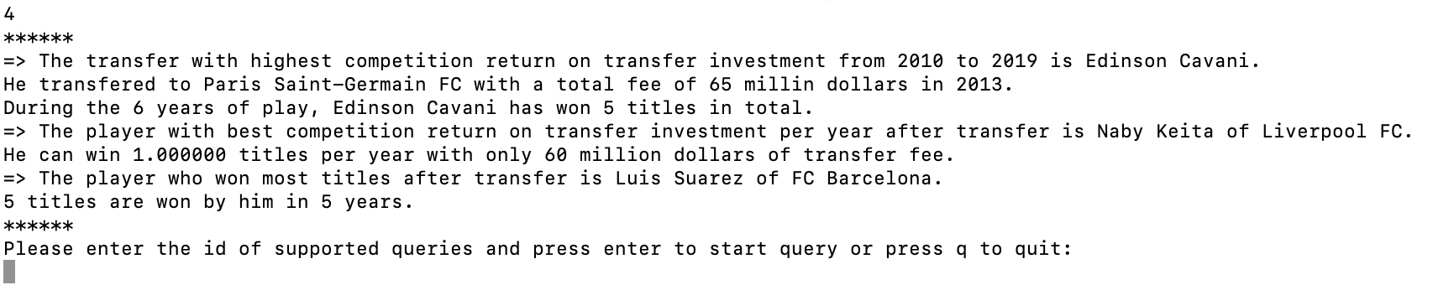
Analysis on a single transfer investment return

Slide 13
Analysis on transfer market trends and performance from 2010 to 2019
For this query, two parts of analysis will be performed on the entire transfer market:
(1) Analyze and find the most successful club from 2010 to 2019, this will consider on two levels, club value and transfer performance in the entire 10-year-window.
Club value will be calculated based on the classic asset-revenue-ratio model and transfer performance model will consider all transfer performed, all player performance after the transfer, player’s transfer fee, successful transfer ratio of all transfers, transfer investment fee, etc.
(2) Analyze and find the most successful league from 2010 to 2019, this will consider both competition results on UEFA level competitions and transfer market trend between leagues.

Slide 14
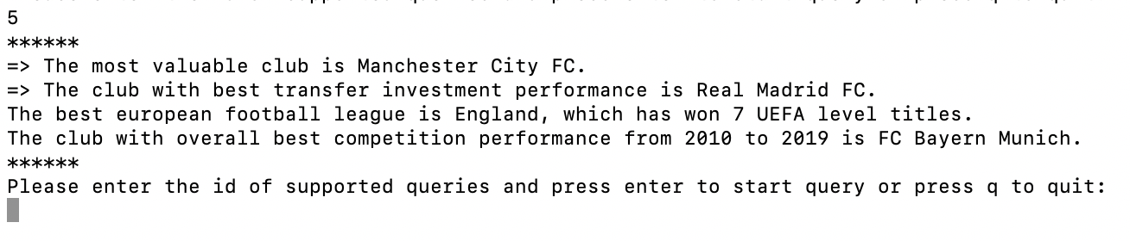
Analysis on transfer market trends and performance from 2010 to 2019

Slide 15
References
MongoDB 4.2 Manual
https://docs.mongodb.com/manual/
mongo-java-driver download and installation
https://search.maven.org/classic/#search%7Cgav%7C1%7Cg%3A%22org.mongodb%22%20AND%20a%3A%22mongo-java-driver%22

Slide 16
Thank you!

