Slide 1
SRT-211 PROJECT
P1 Private School of Education Webpage
Benjamin Yang (025538133)
&
Keith Lit (145793204)

Slide 2
Table of Content
Project Definition
Project Scope
Project Description
Objectives
Outcomes
Databases
Website

Slide 3
Project Definition
User Creation
User Login
User Profiles
Enrollment
Course Selection
Contacts
News & Articles
MySQL Workbench (Database)

Slide 4
Project Scope
A web-based educational and management system using Flask.
Synchronize data to MySQL Database
Created functions to allow students to view/modify:
Profiles
Course Selection
News & Articles
Enrollment

Slide 5
Project Description
This project creates a webpage for P1 Private School of Education.
The webpage enables centralized user management, selected courses, tuition amount, login/logout feature, news & articles, faculty contact information, as well as course information.

Slide 6
Objectives
Allowing users to have access to view educational information anytime, anywhere.
Enabling a centralized educational management system for administrative purposes.
Storing data such as article & news entries, comments, courses information, tuition, selected courses by students, as well as student's login credentials and profiles to MySQL Database

Slide 7
Outcomes
Users can view and modify news & articles, select and enroll to courses, view the profile page which displays user information such as name, address, email mobile number, selected courses and total cost, view contacts page which displays faculty contact information. Lastly, they can login/ logout, create user as well as resetting password.
User input data such as username, password, address, email, mobile number, selected courses, articles, comments and news are synchronized to MySQL workbench for administrative purposes.

Slide 8
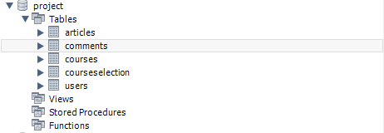
Databases

Slide 9
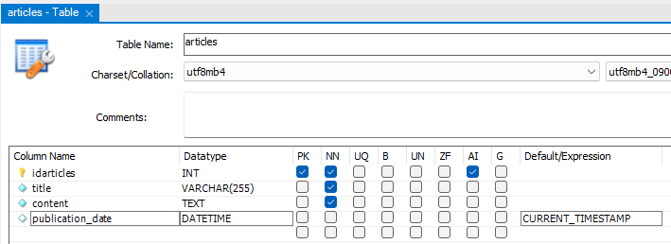
Articles

Slide 10
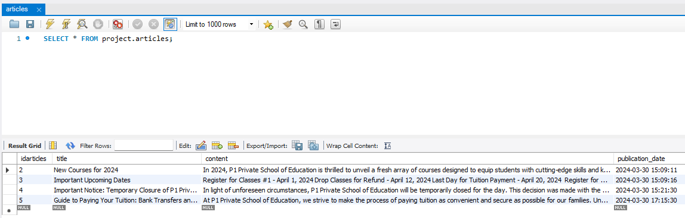
Comments

Slide 11
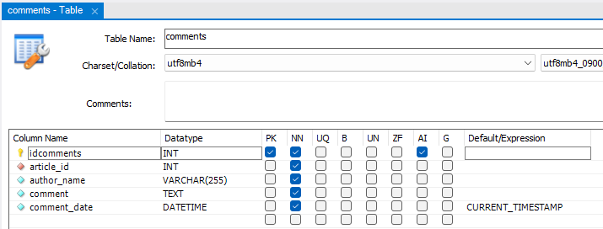
Comments

Slide 12
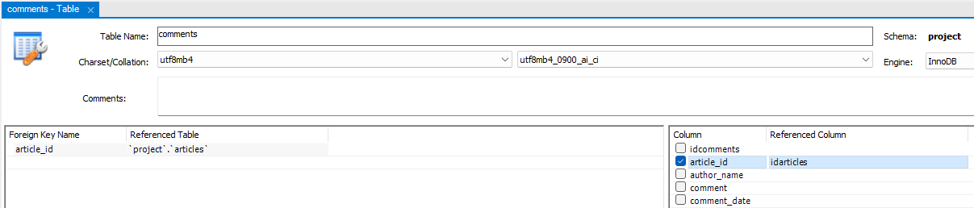
Comments

Slide 13
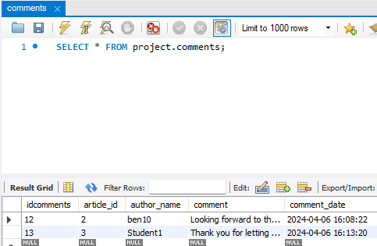
Comments

Slide 14
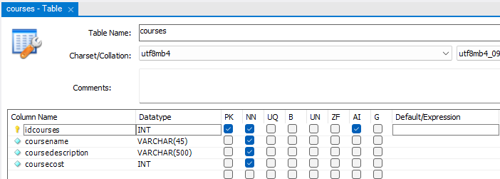
Courses

Slide 15
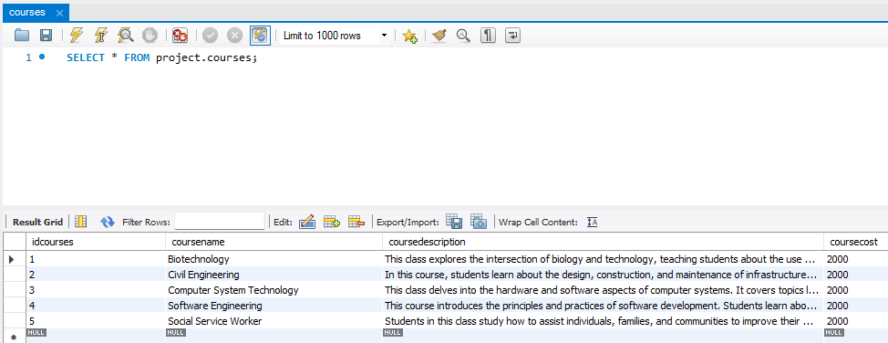
Courses

Slide 16
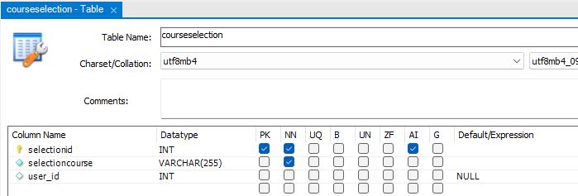
Coursesselection

Slide 17
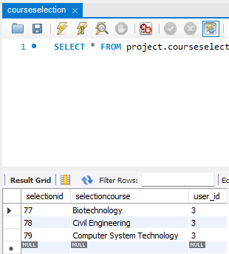
Coursesselection

Slide 18
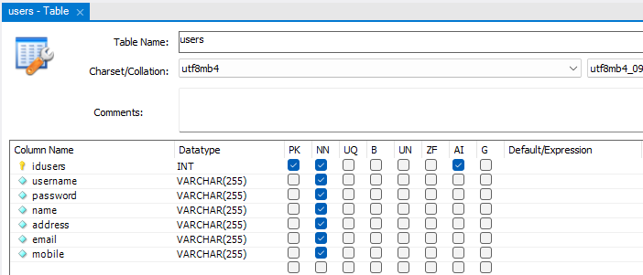
Users

Slide 19
Users

Slide 20
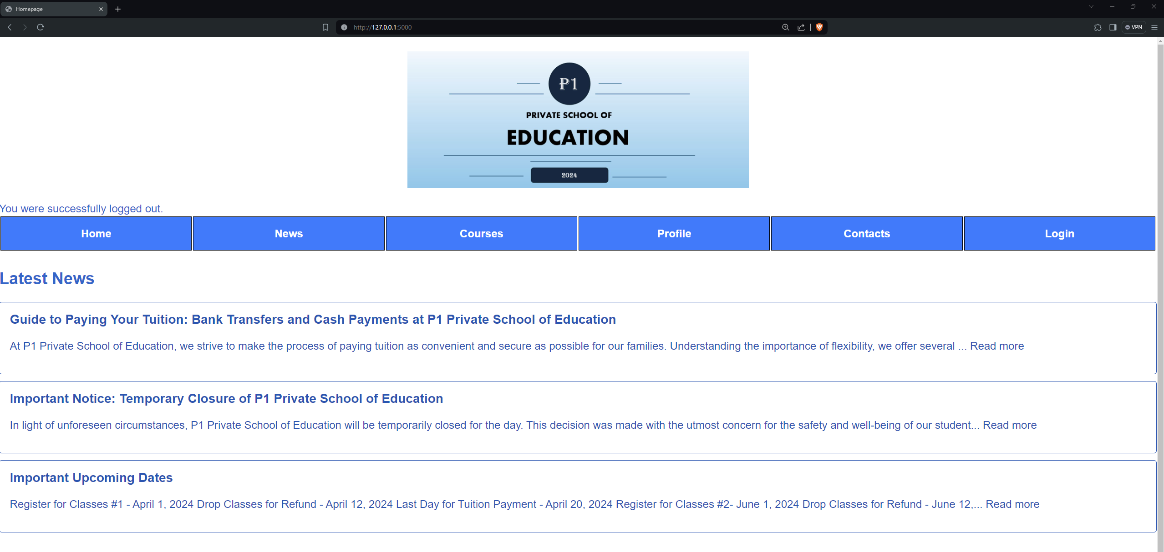
Webpage – Homepage

Slide 21
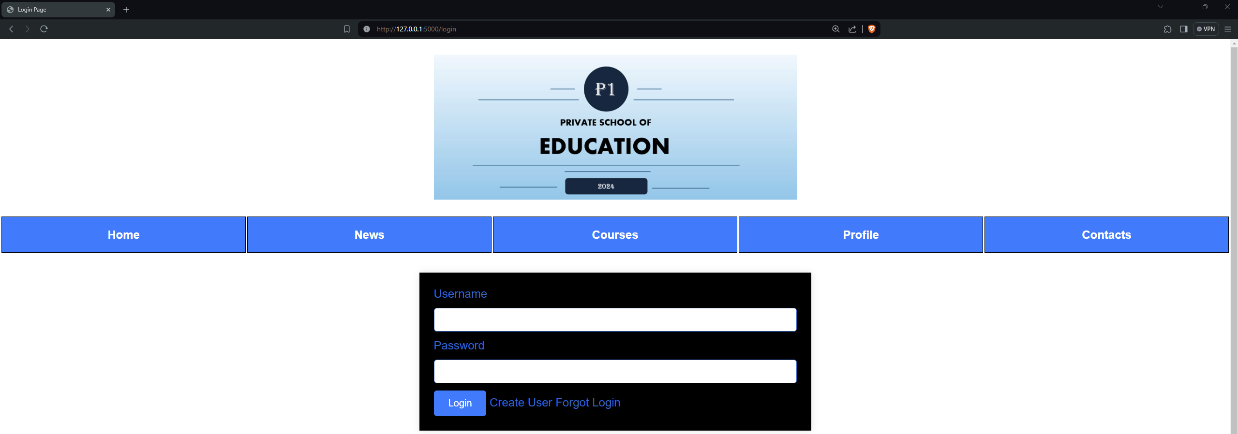
Webpage - Login

Slide 22
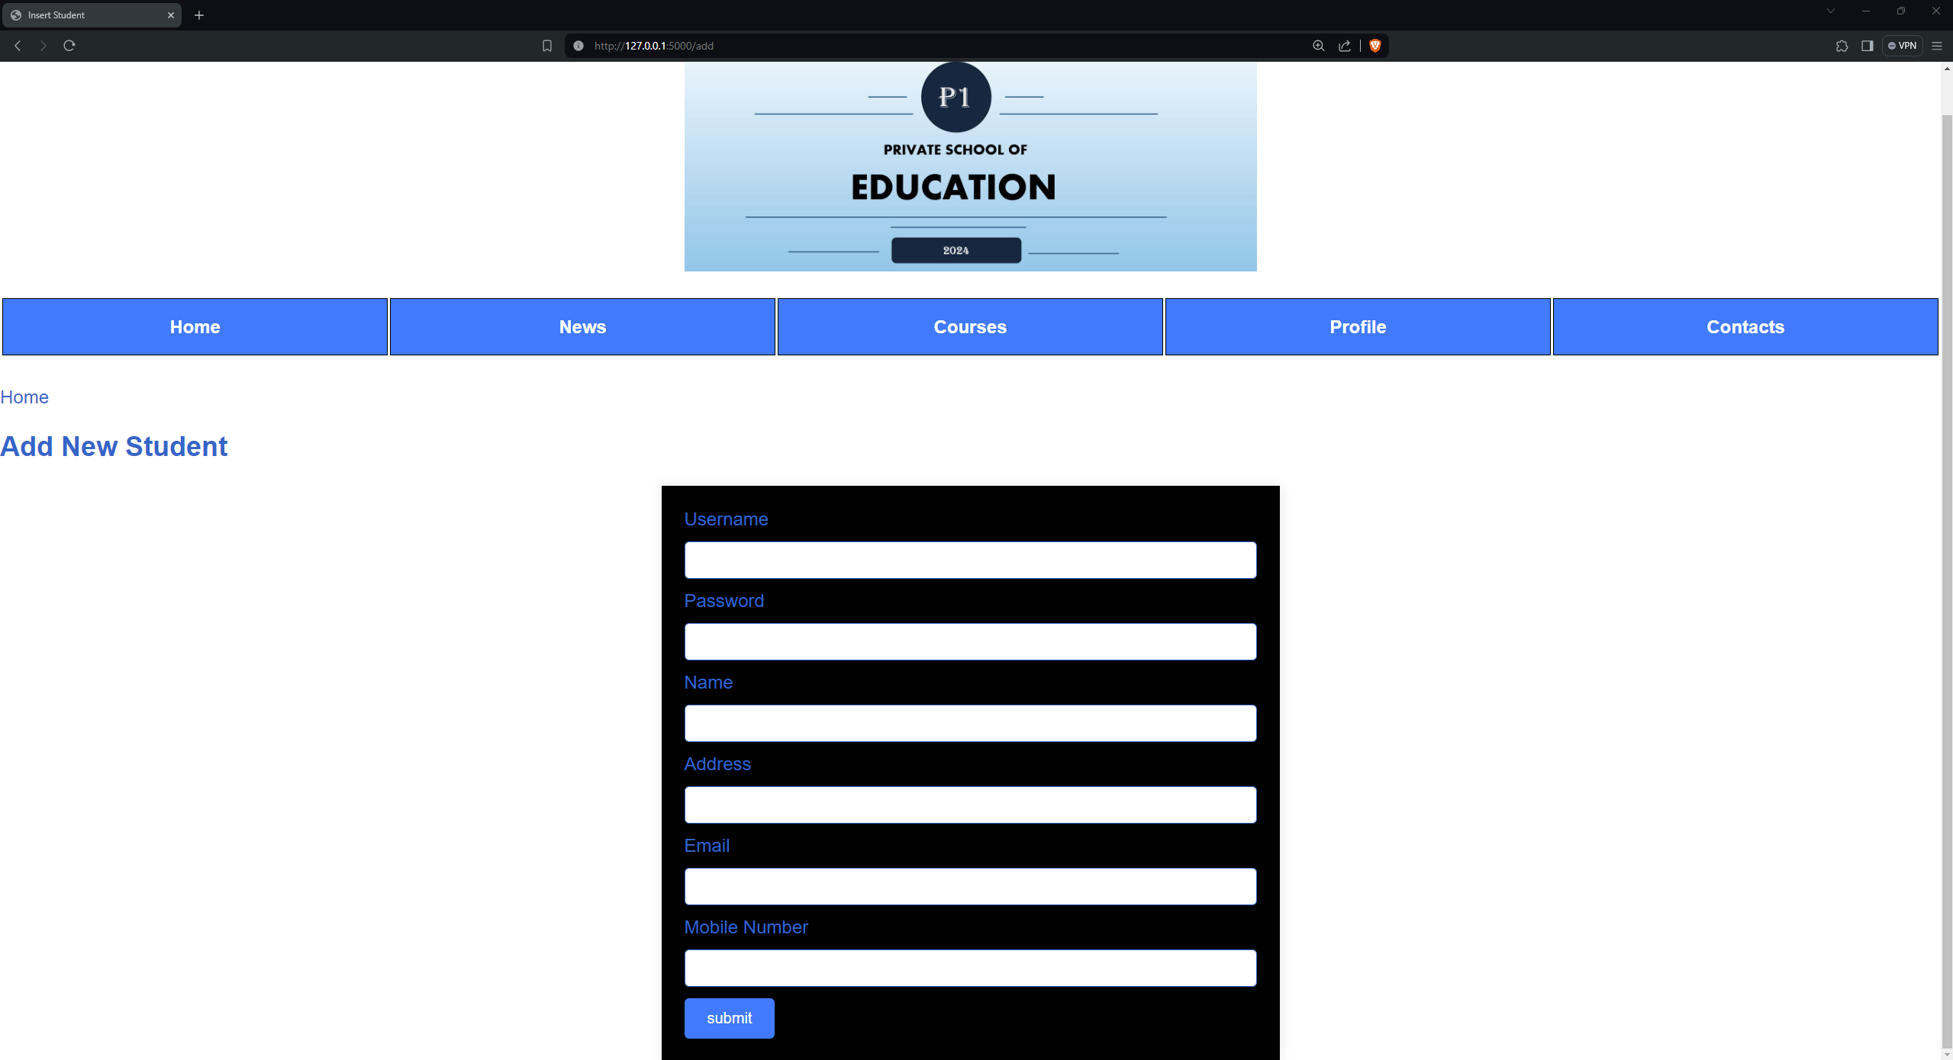
Webpage – Create User

Slide 23
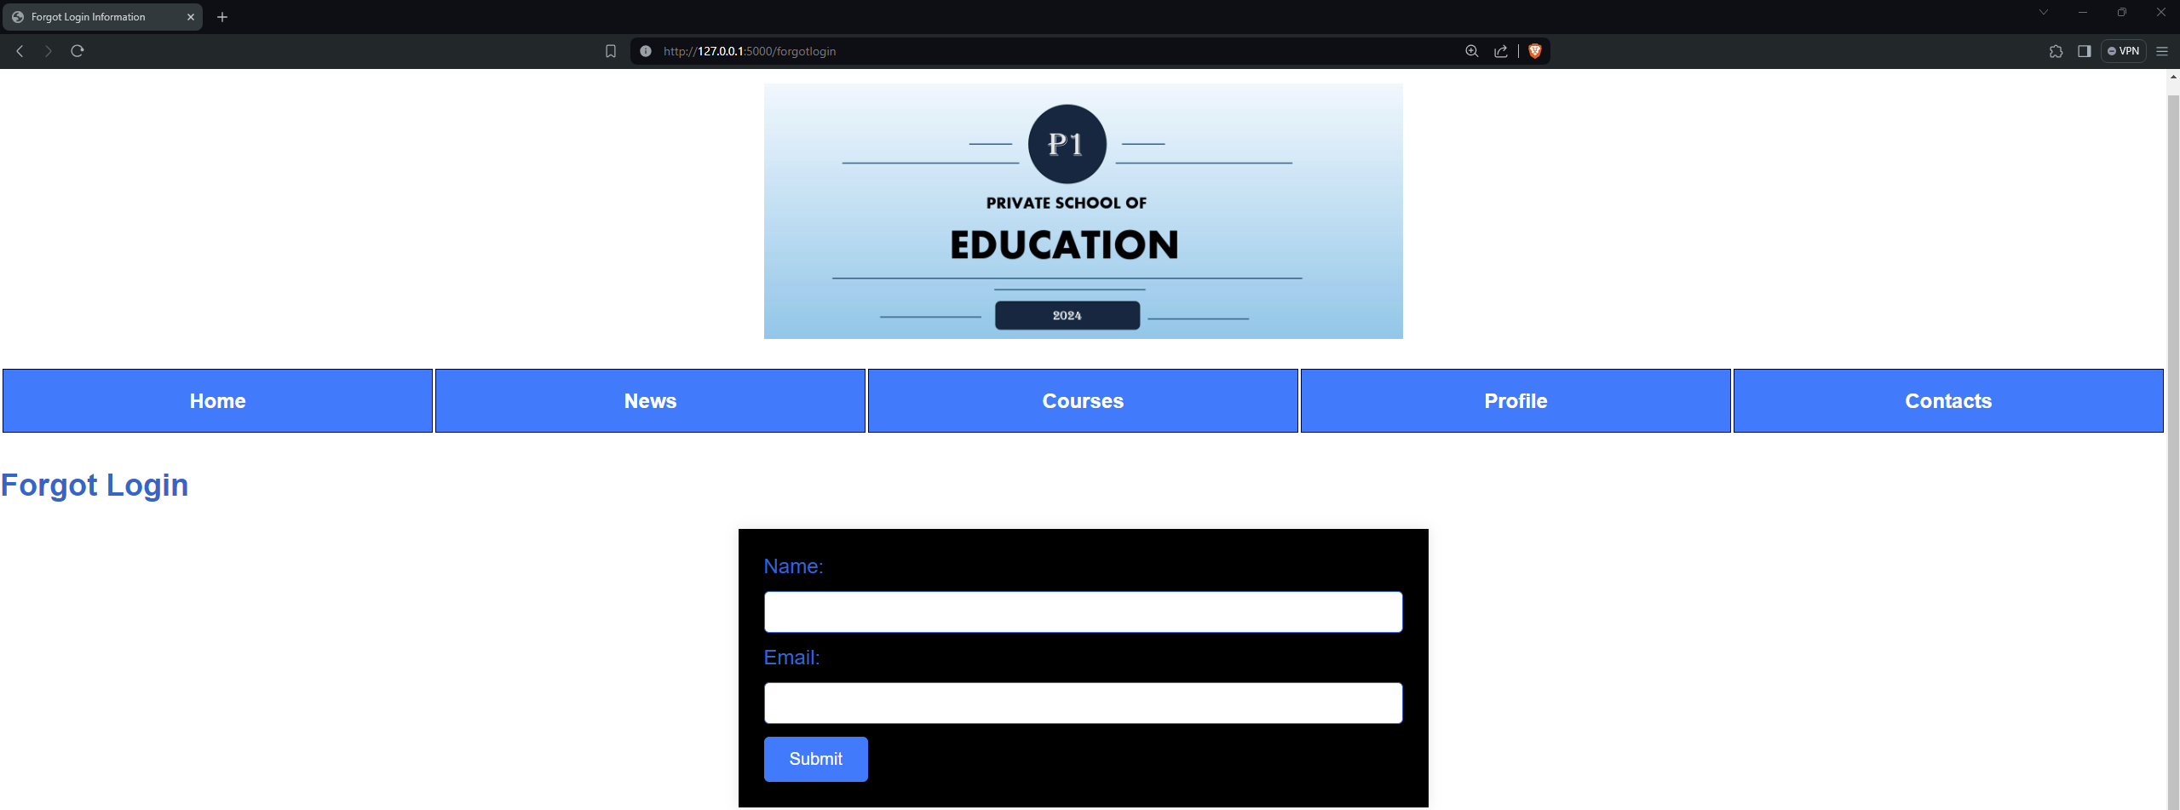
Webpage – Forgot Login

Slide 24
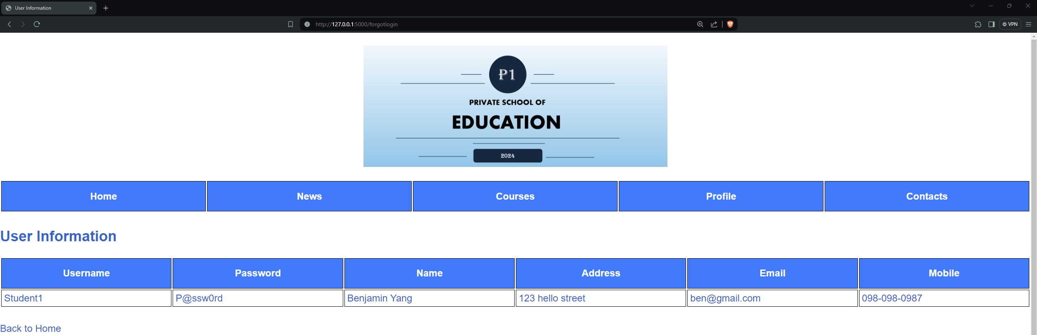
Webpage – User Information

Slide 25
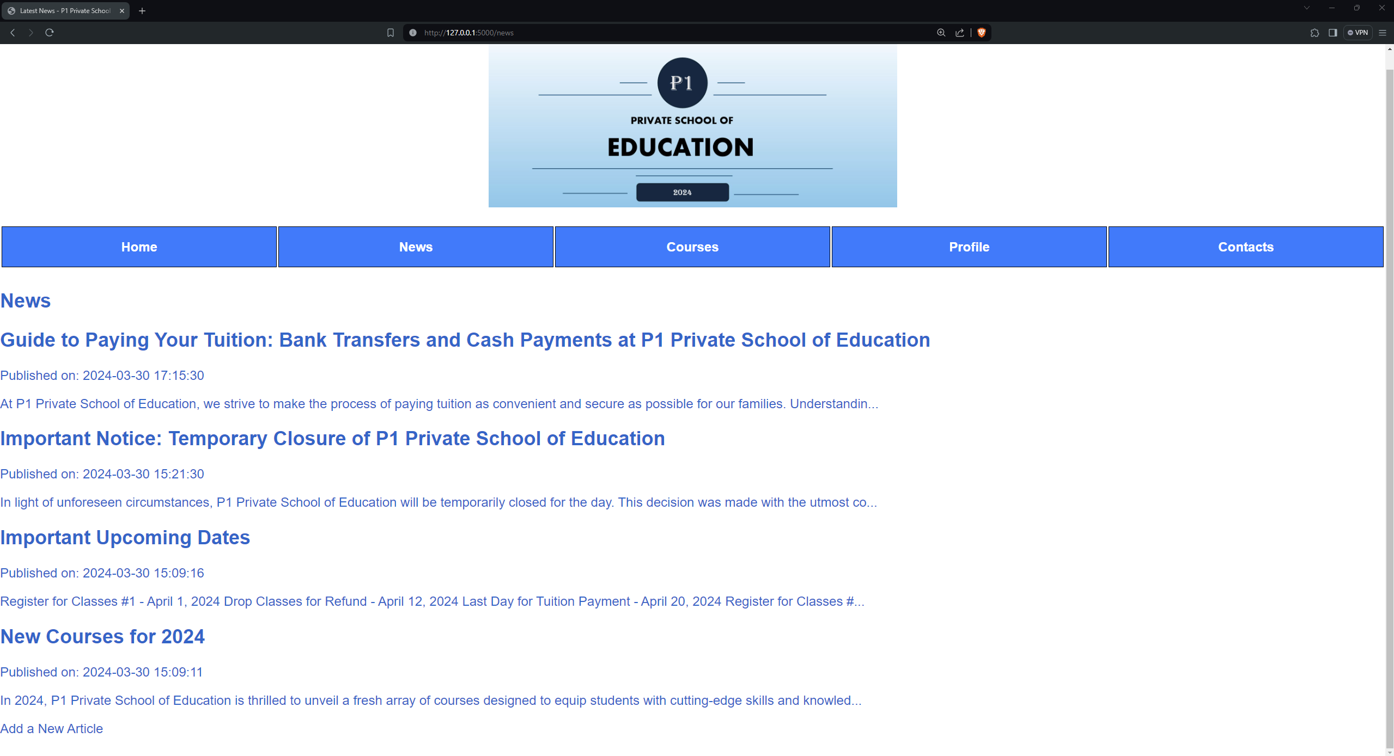
Webpage - News

Slide 26
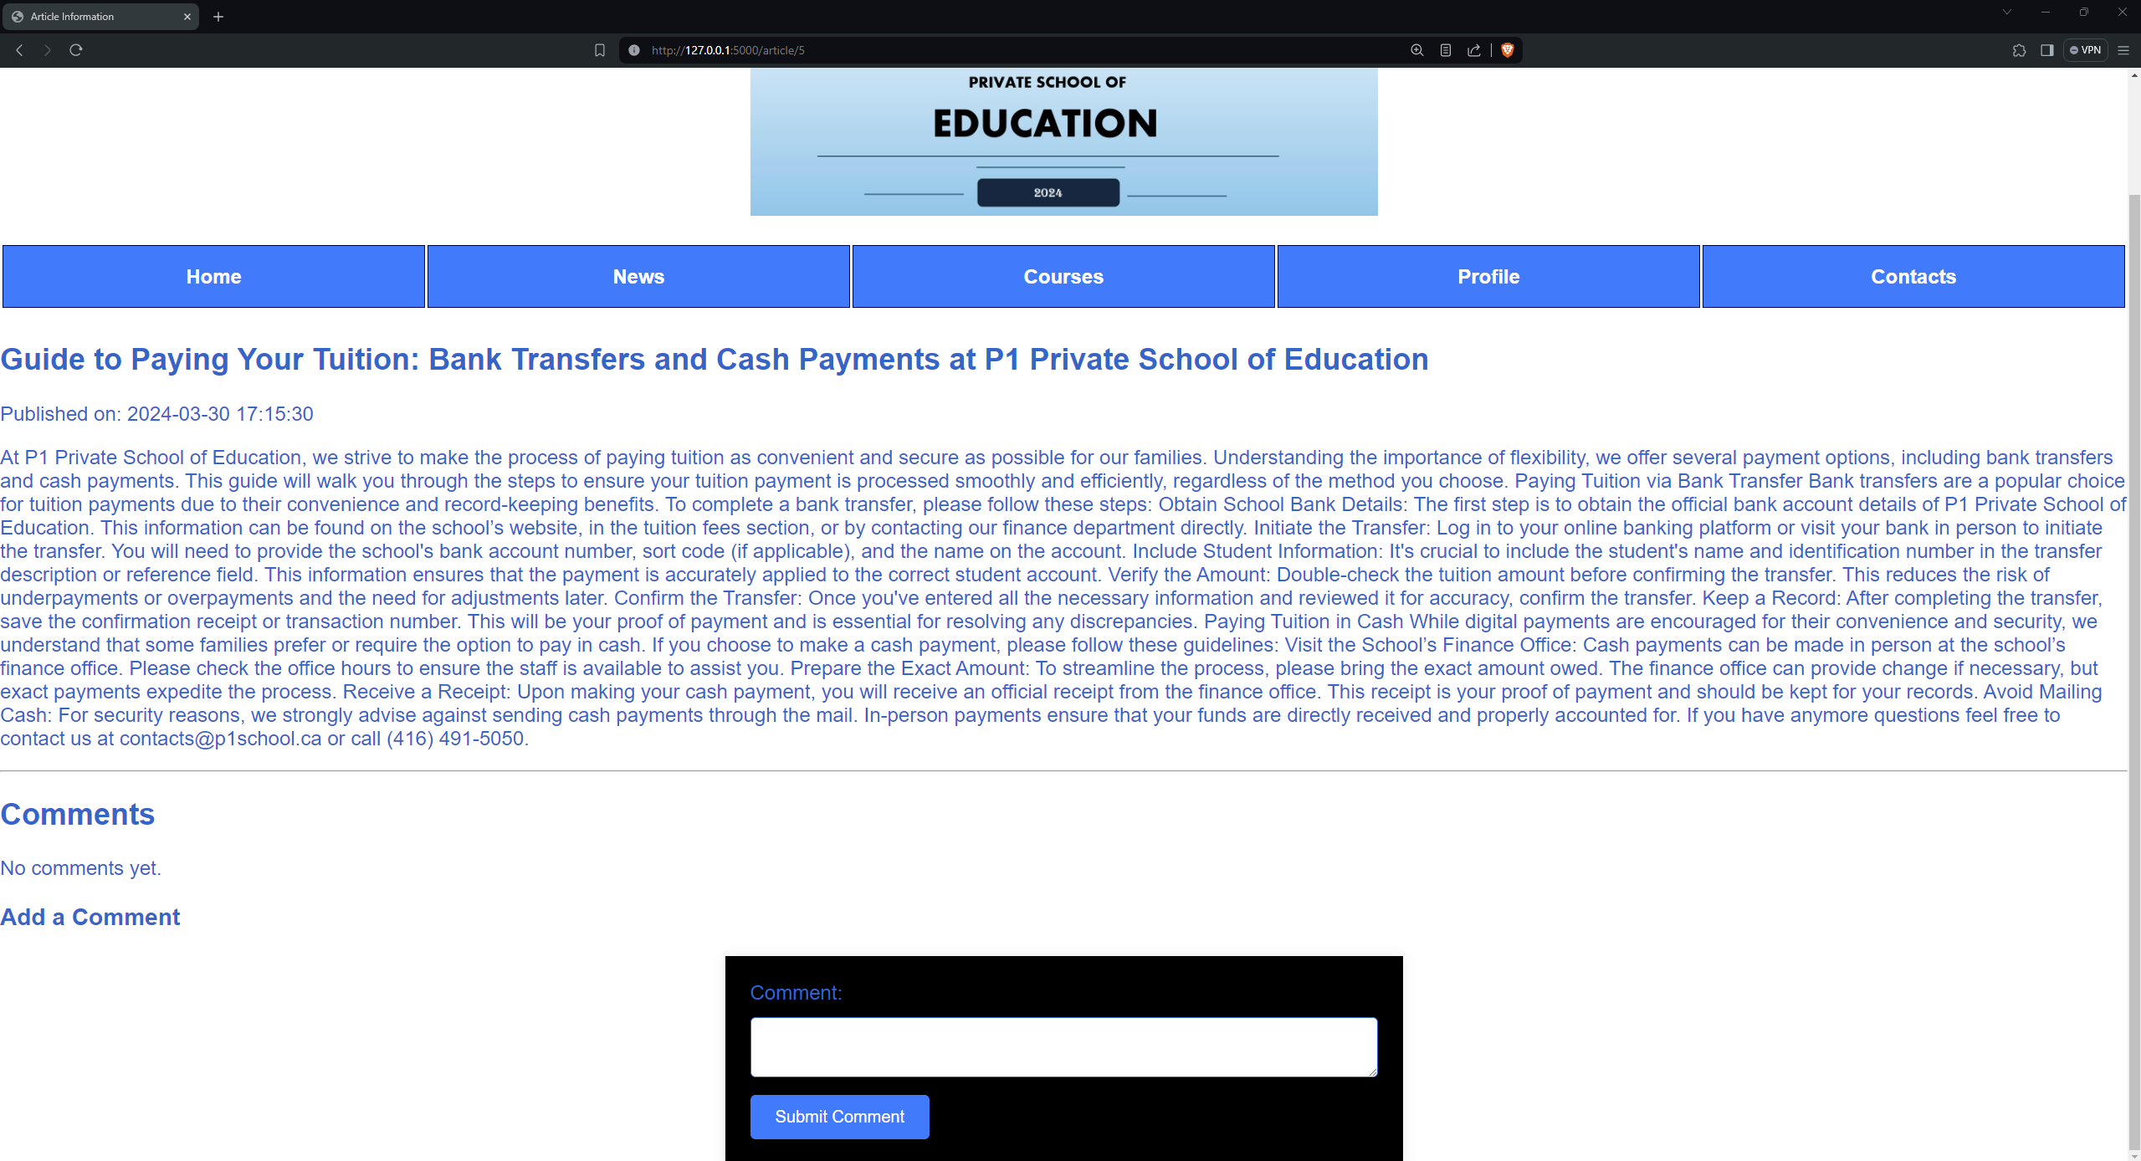
Webpage – Article Informaiton

Slide 27

Webpage - Comments

Slide 28
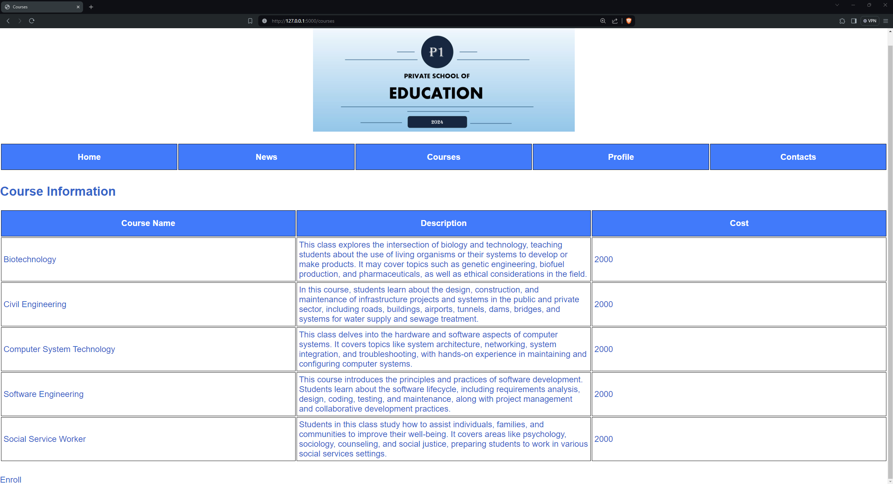
Webpage - Courses

Slide 29
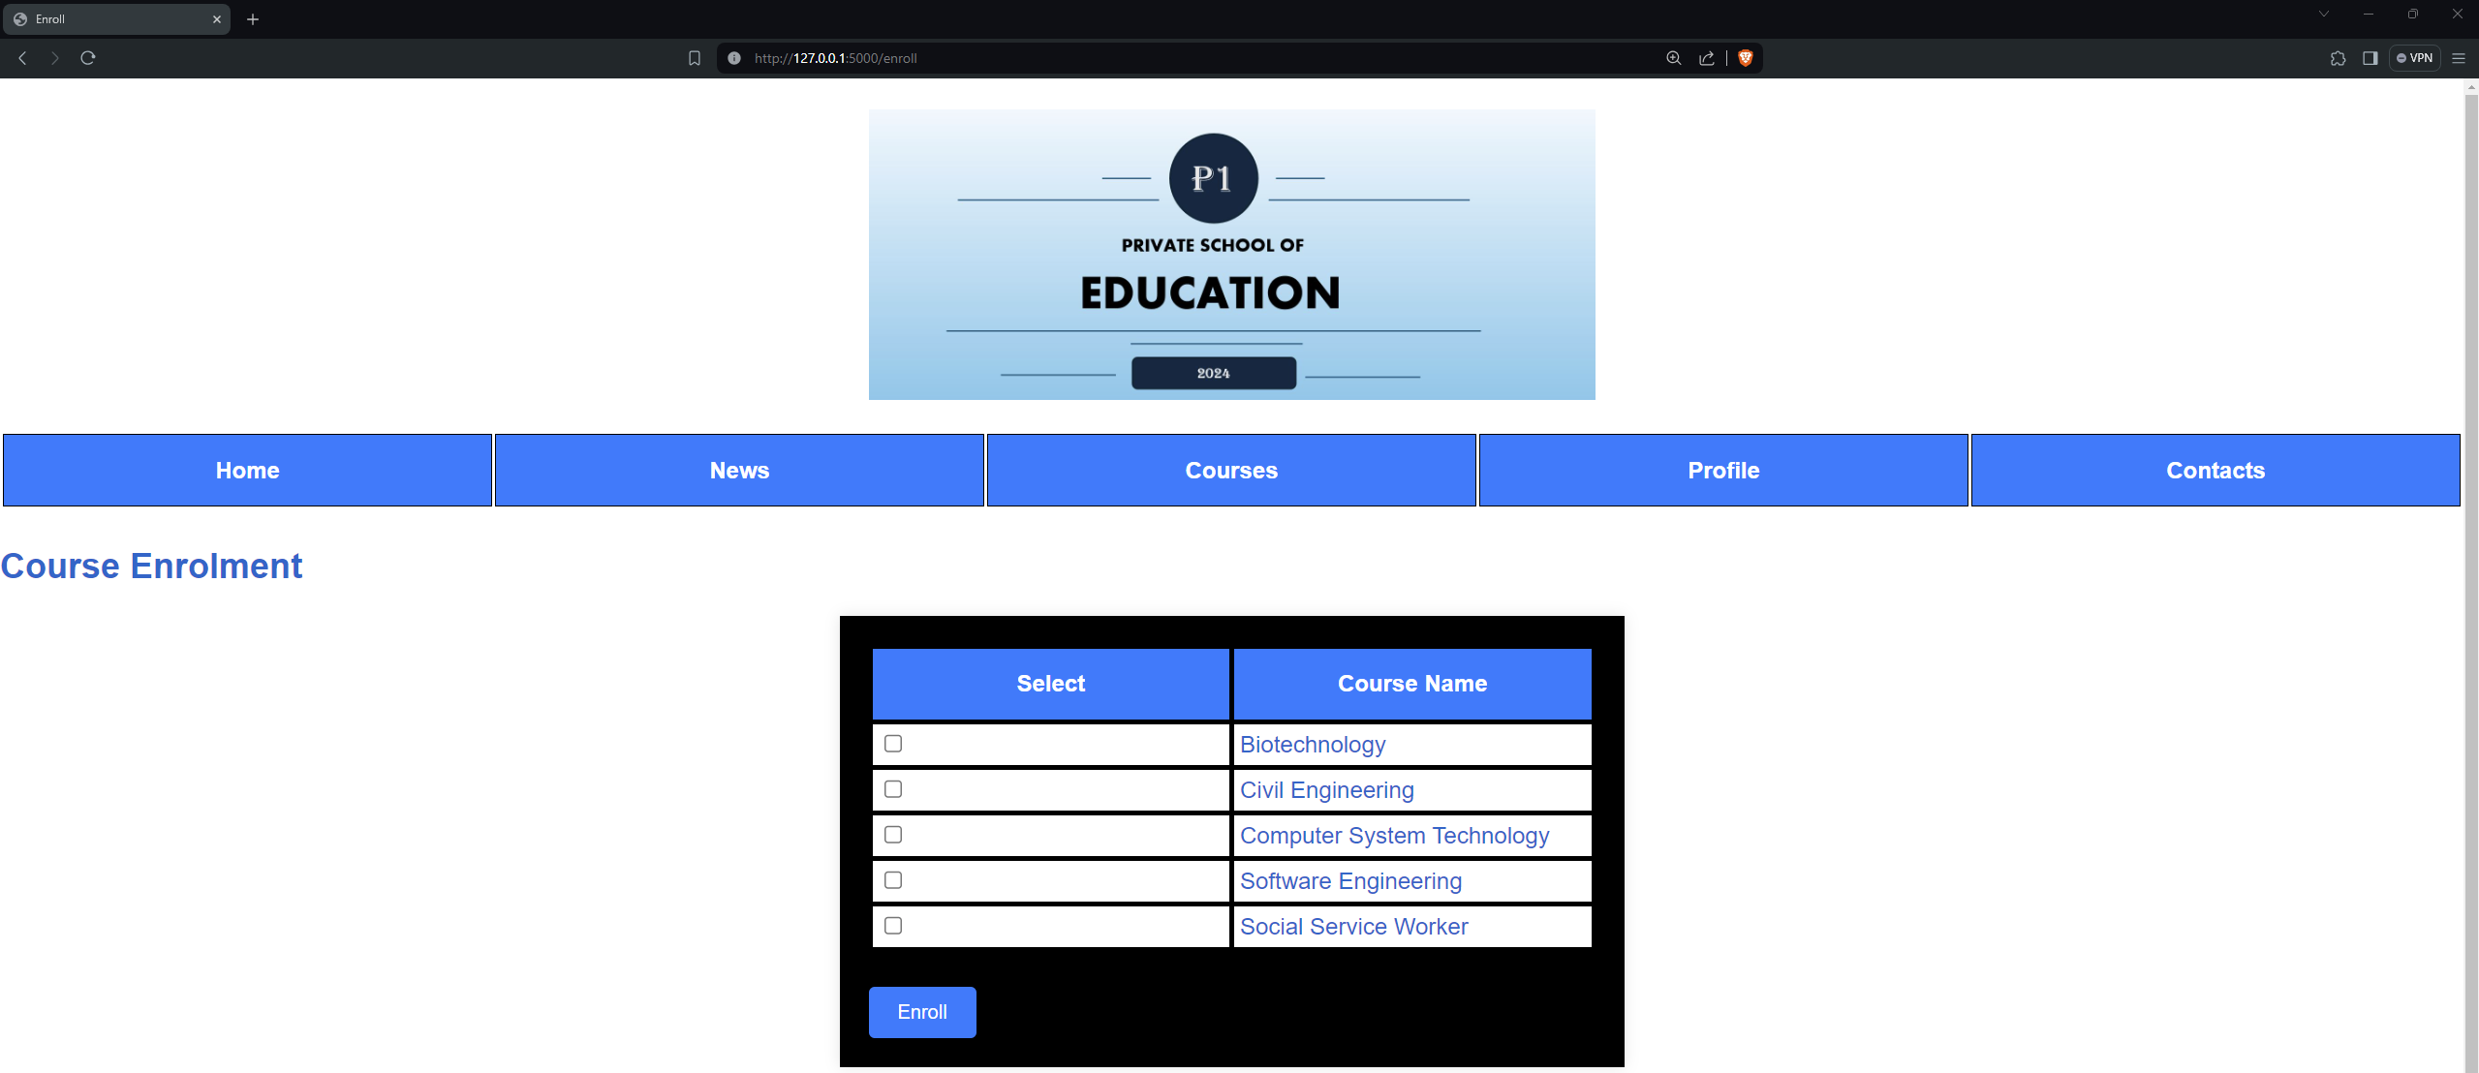
Webpage – Course Enrollment

Slide 30
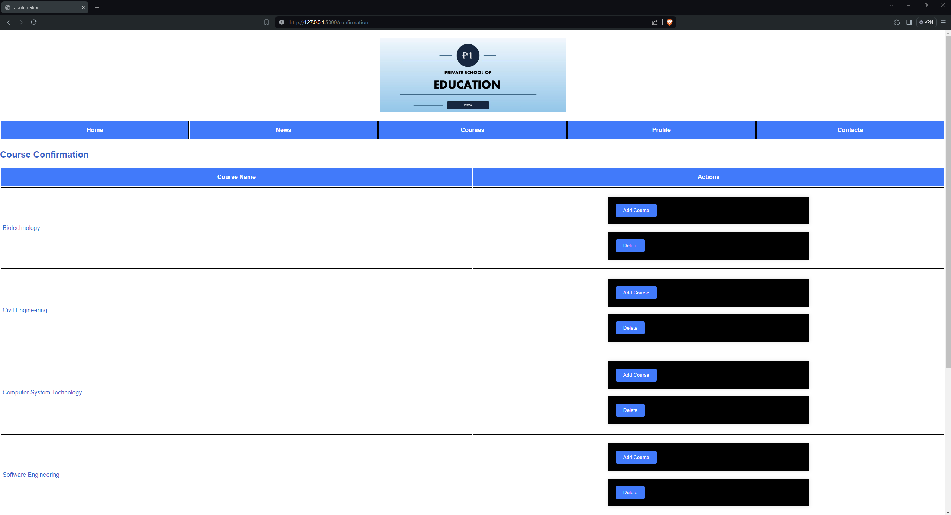
Webpage – Course Confirmation

Slide 31
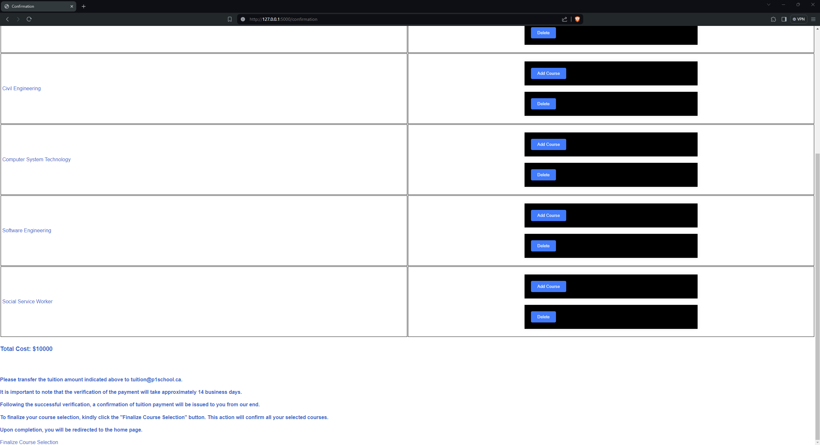
Webpage – Course Confirmation

Slide 32
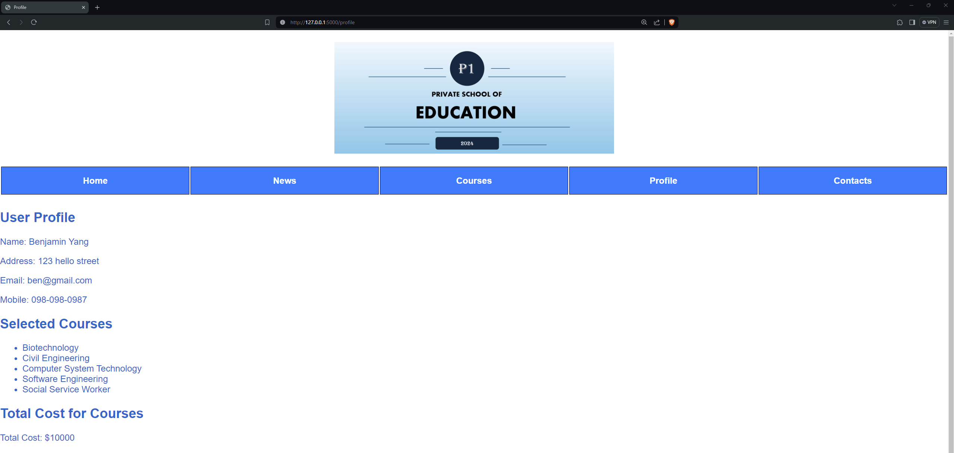
Webpage - Profile

Slide 33
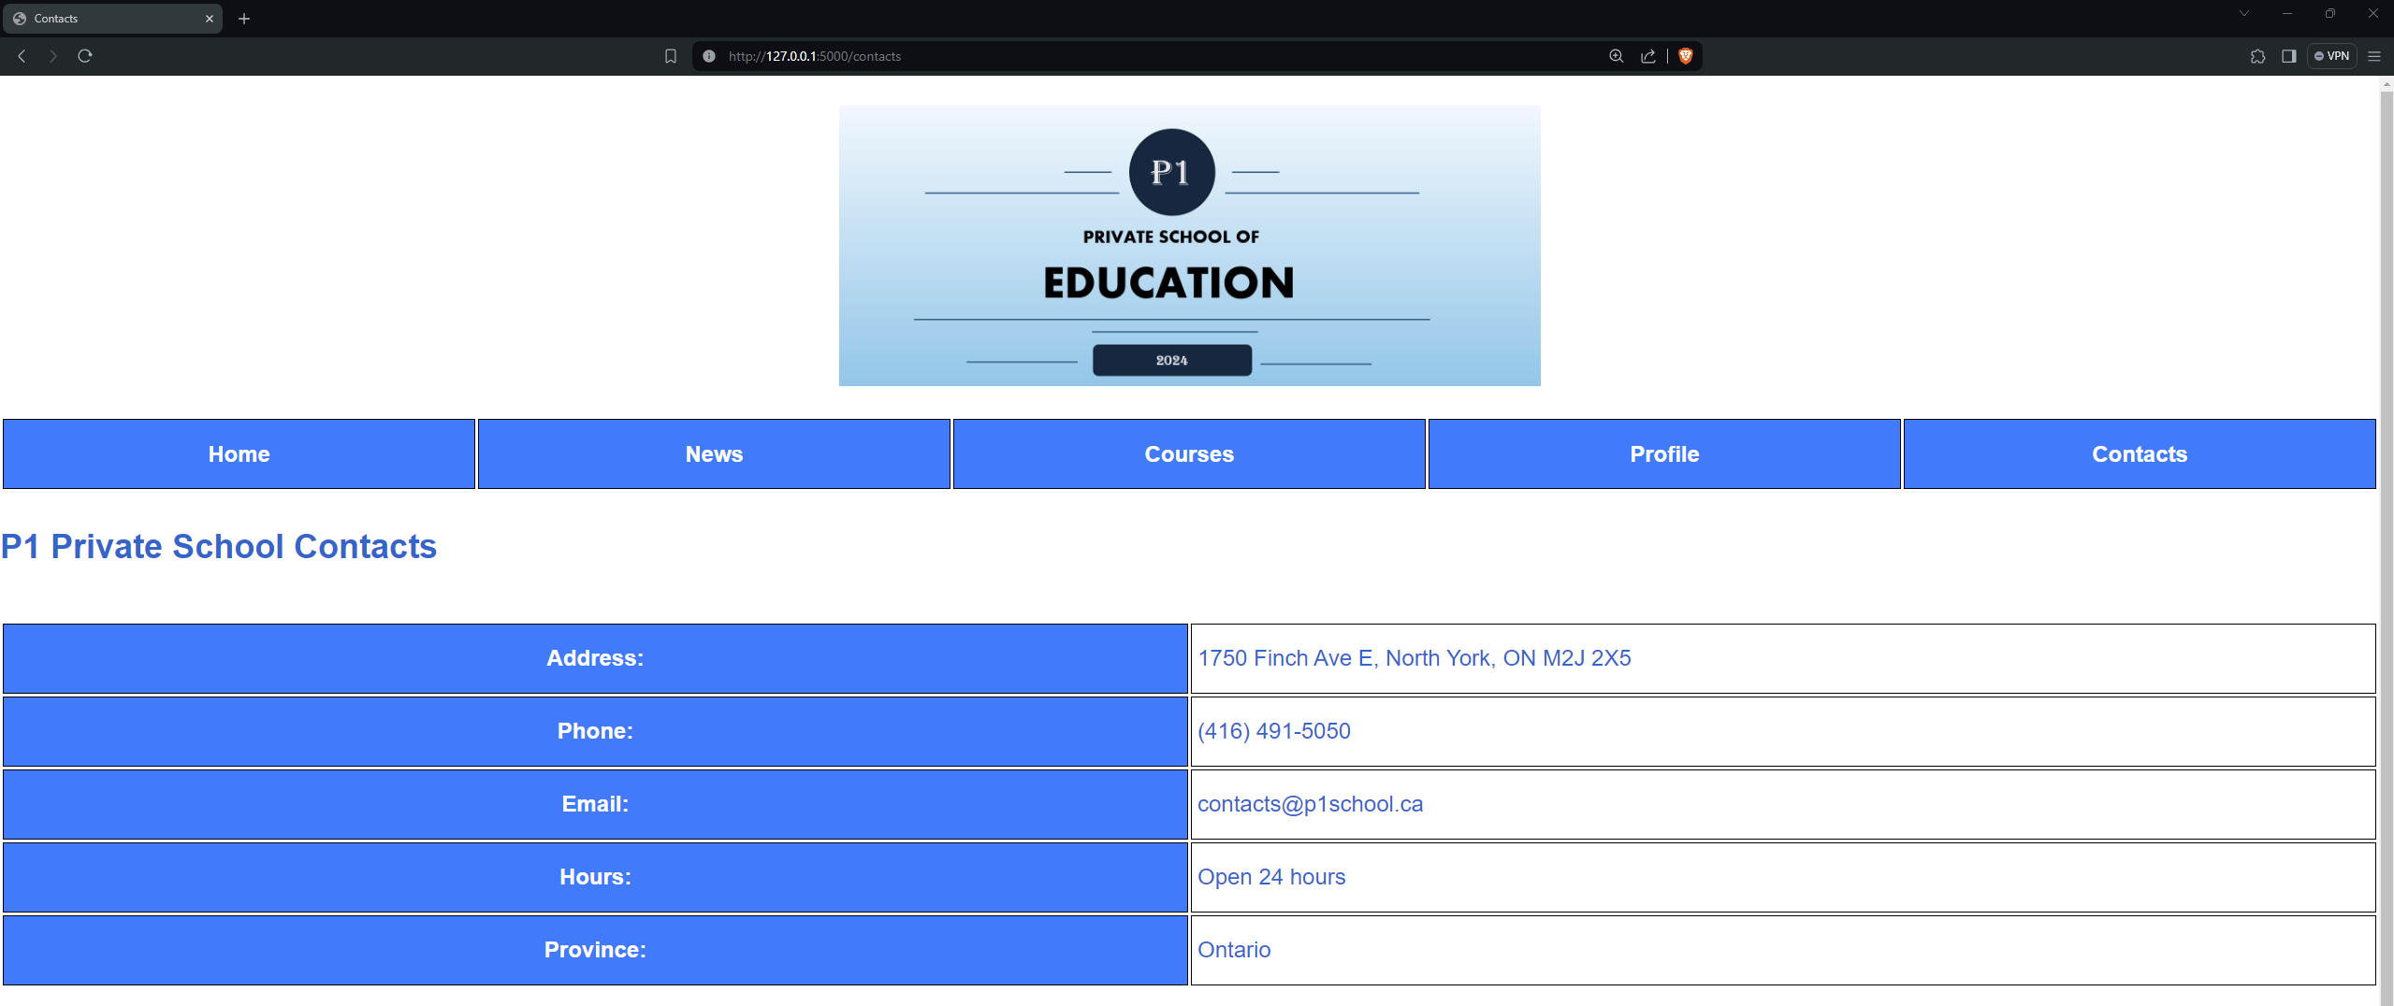
Webpage - Contacts

