Slide 1
Pipeline Patterns
Ram Bysani Ent. Architect

Slide 2


Overview
A pattern refers to a “reusable solution or design template that addresses common challenges and problems that arise when integrating various databases, applications, or services within an enterprise environment”
Patterns provide a structured and proven approach to tackle specific integration tasks and promote best practices in developing robust, scalable, and maintainable integration solutions
Patterns are not complete solutions themselves but rather pre-established templates that need to be implemented in the specific context of an integration project.
Challenge
Solution
Pipelines are an ‘asset’ and can proliferate within an organization resulting in additional maintenance overhead
Establish a pattern-based approach within the Pipeline development lifecycle, identifying common patterns for re-use across the organization
Notes:
Intended Audience - SnapLogic Developers, Architects & Community Enablers
Pipelines are at the core of data integration and workflow automation in the SnapLogic platform and enable the seamless flow of data and the execution of various tasks across different applications and systems.
While each integration scenario is unique, common requirements & patterns occur
Pipelines are at the core of data integration and workflow automation in the SnapLogic platform. They are powerful tools that enable the seamless flow of data and the execution of various tasks across different applications and systems. However, building complex Pipelines can be a daunting task, especially for those who are new to the platform or lack extensive development experience.
To address these challenges, SnapLogic encourages the adoption of a pattern-based approach within the Pipeline development lifecycle. This approach involves the identification and utilization of common patterns, best practices, and reusable components, streamlining the process of constructing Pipelines. By leveraging pre-established patterns, SnapLogic customers can significantly reduce development time and enhance the overall quality and reliability of their Pipelines.
The framework outlined in this article not only explains the importance of adopting a pattern-based approach but also provides practical guidance on how to implement it effectively. We delve into the process of identifying suitable patterns for different data & application integration scenarios, ensuring that customers can easily adapt and customize them to suit their specific needs.
Moreover, we explore the benefits of employing a pattern-based approach, such as improved maintainability, scalability, and consistency across Pipelines. Additionally, we discuss the potential for fostering collaboration and knowledge sharing within the SnapLogic developer community as they collectively contribute to a growing repository of tried and tested patterns within a customers organisation.
We will showcase real-world examples of successful Pipelines built using the proposed framework. By illustrating the versatility of the pattern-based approach, we hope to inspire SnapLogic customers to embrace this methodology and elevate their data integration and automation capabilities.

Slide 3

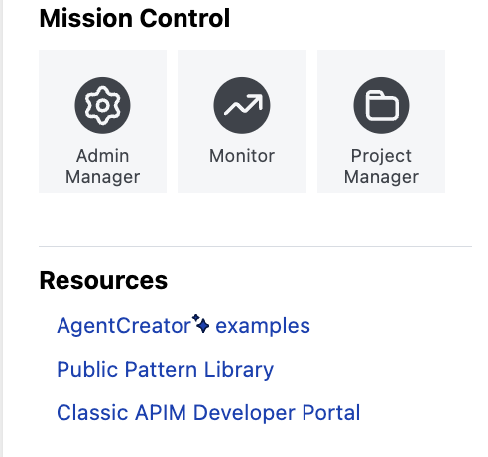
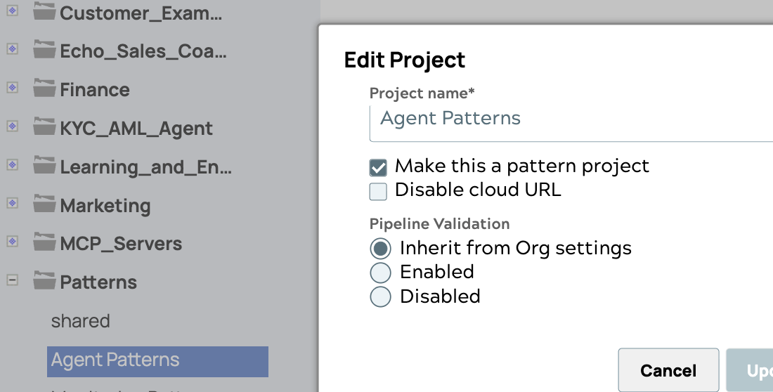

https://docs.snaplogic.com/pattern-library/pattern-library-about.html
Patterns - User defined and Public patterns
Public Pattern library
Reusable templates for common use cases.
Search, Select, and Use.
User defined patterns
Create your own patterns within Pattern projects. Pipelines appear under Patterns.

Slide 4
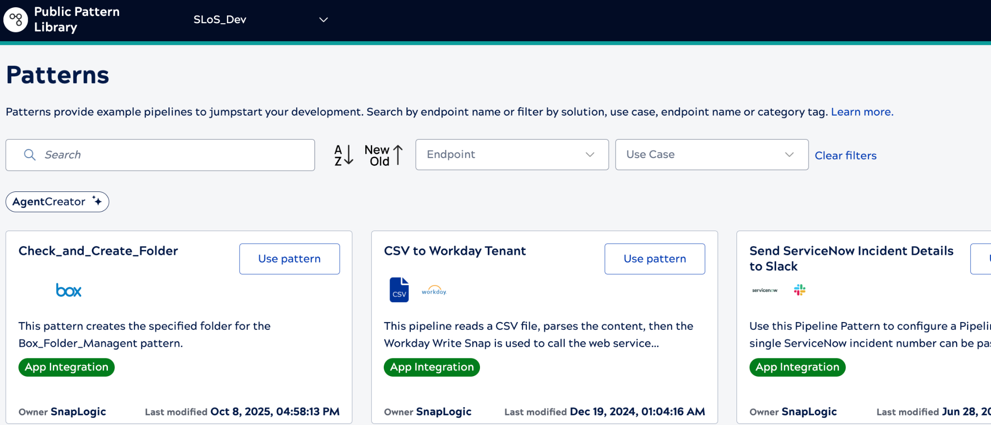
https://docs.snaplogic.com/pattern-library/pattern-library-about.html
Public Pattern library

Slide 5

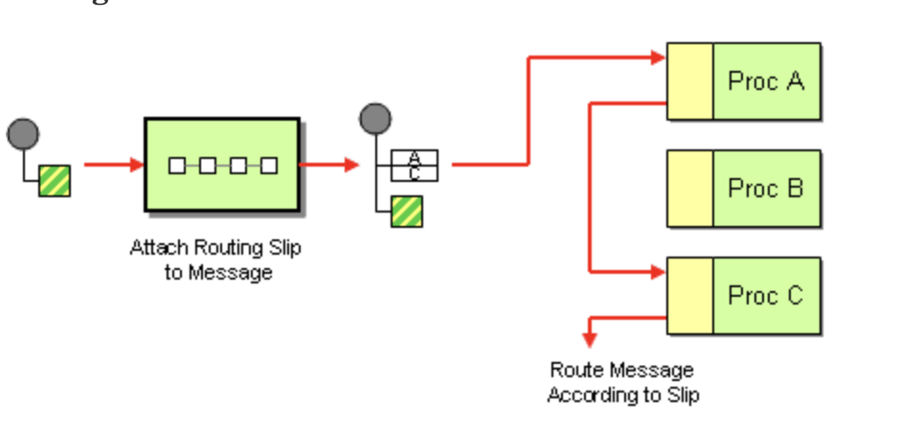
https://docs.snaplogic.com/pattern-library/pattern-library-about.html
Reference : https://www.enterpriseintegrationpatterns.com/patterns/
User Defined Patterns
Create a pattern project.
Update access permissions so that all teams can access the pattern pipelines from this project.
Configure the Snaps that will be used across the Pipelines that reference this pattern.
Maintain and validate patterns for relevance and new requirements.

Slide 6
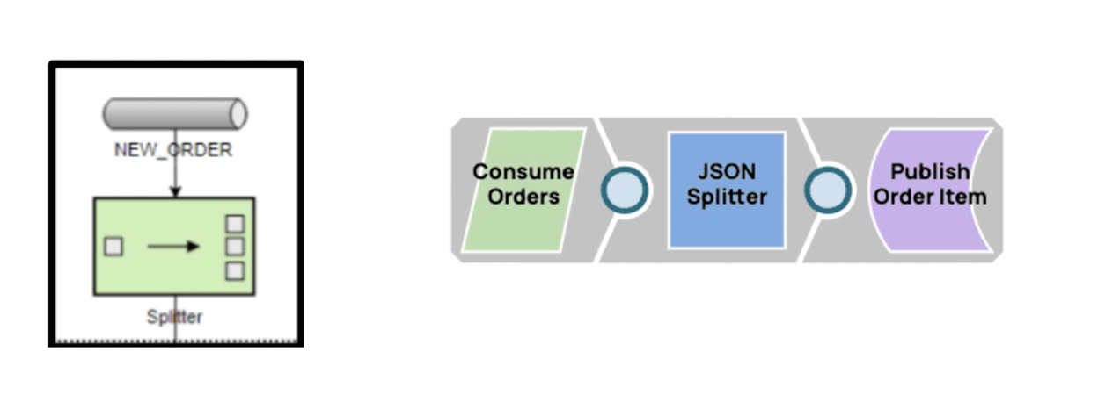
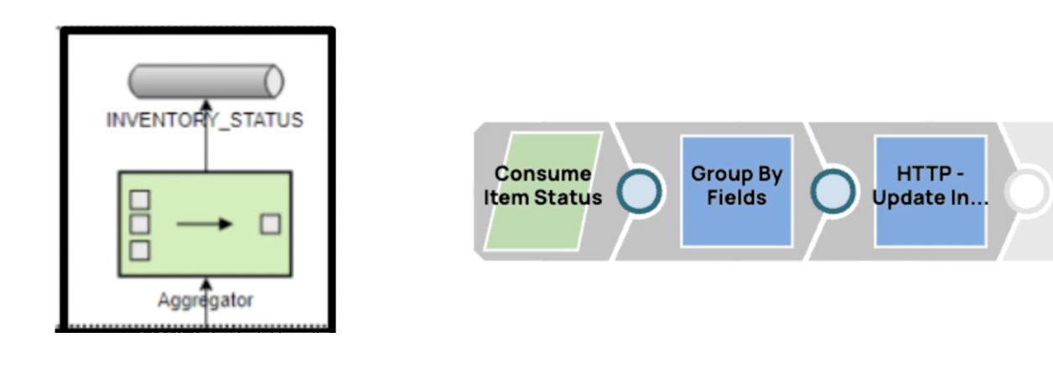
https://docs.snaplogic.com/pattern-library/pattern-library-about.html
Reference : https://www.enterpriseintegrationpatterns.com/
Mapping Integration Patterns to SnapLogic pipelines
One -> Many using a Splitter
Use the JSON Splitter Snap to split the incoming document data into separate documents based on the JSON Path
Example: Aggregator Pattern
Use the Group By Fields Snap to group input documents by field values in batches of output documents.

Slide 7
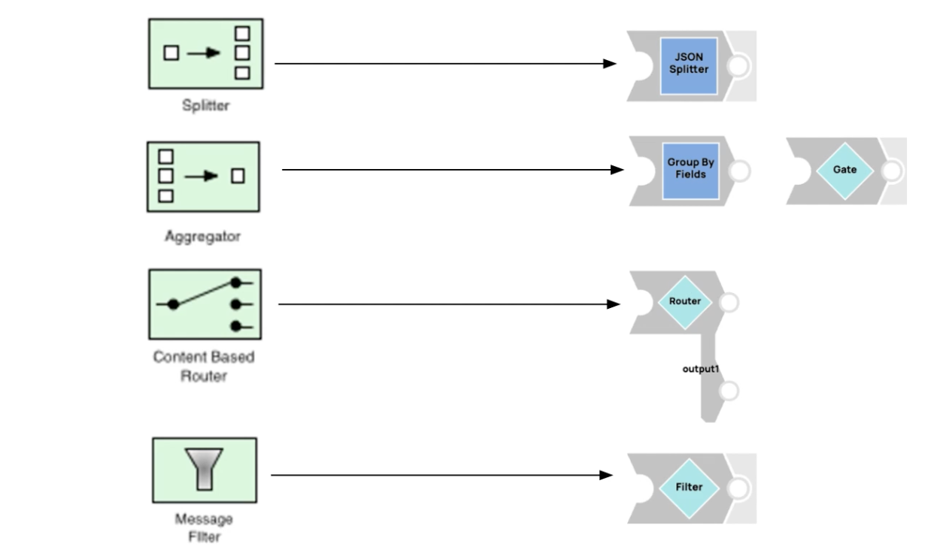
https://docs.snaplogic.com/pattern-library/pattern-library-about.html
Reference : https://www.enterpriseintegrationpatterns.com/
Mapping Integration Patterns to SnapLogic pipelines

Slide 8








Pitfalls of not using Patterns
Higher Learning Curve
for New Developers
Difficulty in Scaling
Cost of duplication
Decreased Collaboration
Inefficiency
Higher Maintenance Burden
Reduced Performance
and Optimization
Risk of Errors and Bugs

Slide 9


Approaches
Common Patterns
Error Handling
Auditing
File Polling
Bi-Directional Data Synchronization
Publish Subscribe
Fan Out
Aggregate
Streaming
Establish a Pattern Catalog within the community
Look for commonalities within existing integrations
Incorporate patterns within the development lifecycle
Notes:
Inefficiency
Without predefined patterns, SnapLogic developers may look to reinvent the wheel for every integration use case they build. This leads to redundancy and can waste time and effort, resulting in a slower development process and creates unnecessary bloat within a customers deployment of SnapLogic leading to code duplication and decreased productivity.
Lack of Consistency & Decreased Collaboration
Inconsistent pipeline structures and designs can make it challenging for team members to understand and maintain each other's work. This lack of uniformity can lead to confusion and errors which can hinder collaboration among team members. Developers might struggle to understand each other's work or work together effectively on shared projects.
Difficulty in Scaling
As the complexity of data integration tasks increases, scaling becomes more challenging without a standardized approach. A lack of patterns can hinder the ability to scale large integration project effectively & efficiently.
Higher Maintenance Burden
Without patterns, pipelines may become harder to maintain over time. When updates or modifications are needed, the absence of a consistent approach can make the process more error-prone and time-consuming.
Higher Learning Curve for New Developers
Onboarding new team members becomes more challenging when there are no established & documented patterns to follow. The absence of clear guidelines can make it difficult for newcomers to grasp the best practices and design principles used in the organization.
Reduced Performance and Optimization
Without predefined patterns for performance optimization, pipelines might not be as efficient as they could be. This can lead to increased processing times and resource usage.
Risk of Errors and Bugs
Inconsistent pipeline development can introduce more opportunities for errors and bugs to creep into integration projects. This can lead to data integrity issues and negatively impact the reliability of data across the organisation

Slide 10
Pattern Hierarchy

Slide 11
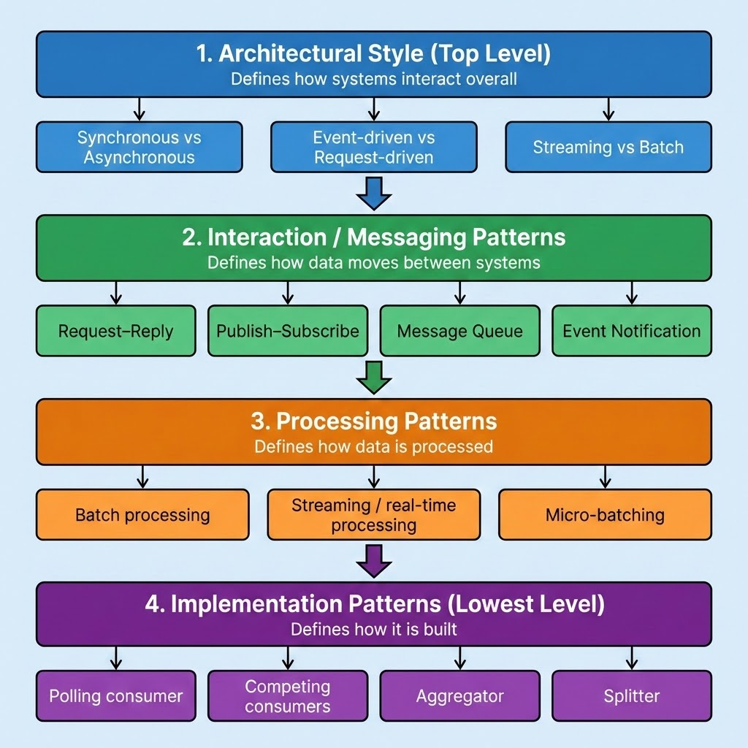
Pattern Hierarchy
Event Driven Style
⇒ Pub-Sub Pattern
⇒ Real-time Processing
=> Polling Consumer
Notes:
Inefficiency
Without predefined patterns, SnapLogic developers may look to reinvent the wheel for every integration use case they build. This leads to redundancy and can waste time and effort, resulting in a slower development process and creates unnecessary bloat within a customers deployment of SnapLogic leading to code duplication and decreased productivity.
Lack of Consistency & Decreased Collaboration
Inconsistent pipeline structures and designs can make it challenging for team members to understand and maintain each other's work. This lack of uniformity can lead to confusion and errors which can hinder collaboration among team members. Developers might struggle to understand each other's work or work together effectively on shared projects.
Difficulty in Scaling
As the complexity of data integration tasks increases, scaling becomes more challenging without a standardized approach. A lack of patterns can hinder the ability to scale large integration project effectively & efficiently.
Higher Maintenance Burden
Without patterns, pipelines may become harder to maintain over time. When updates or modifications are needed, the absence of a consistent approach can make the process more error-prone and time-consuming.
Higher Learning Curve for New Developers
Onboarding new team members becomes more challenging when there are no established & documented patterns to follow. The absence of clear guidelines can make it difficult for newcomers to grasp the best practices and design principles used in the organization.
Reduced Performance and Optimization
Without predefined patterns for performance optimization, pipelines might not be as efficient as they could be. This can lead to increased processing times and resource usage.
Risk of Errors and Bugs
Inconsistent pipeline development can introduce more opportunities for errors and bugs to creep into integration projects. This can lead to data integrity issues and negatively impact the reliability of data across the organisation

Slide 12
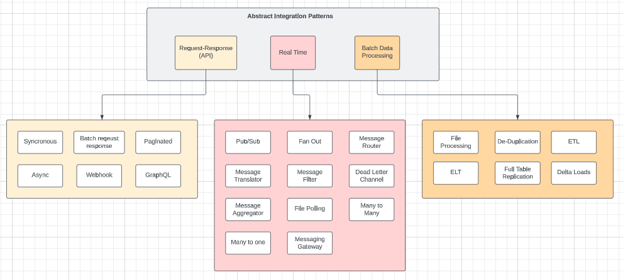
Pattern Hierarchy
Different approaches can be adopted to help with establishing a ‘pattern based mindset’ within the organization.
A common approach is to understand patterns with different levels of abstraction with each level targeting a different level of granularity.
Notes:
Inefficiency
Without predefined patterns, SnapLogic developers may look to reinvent the wheel for every integration use case they build. This leads to redundancy and can waste time and effort, resulting in a slower development process and creates unnecessary bloat within a customers deployment of SnapLogic leading to code duplication and decreased productivity.
Lack of Consistency & Decreased Collaboration
Inconsistent pipeline structures and designs can make it challenging for team members to understand and maintain each other's work. This lack of uniformity can lead to confusion and errors which can hinder collaboration among team members. Developers might struggle to understand each other's work or work together effectively on shared projects.
Difficulty in Scaling
As the complexity of data integration tasks increases, scaling becomes more challenging without a standardized approach. A lack of patterns can hinder the ability to scale large integration project effectively & efficiently.
Higher Maintenance Burden
Without patterns, pipelines may become harder to maintain over time. When updates or modifications are needed, the absence of a consistent approach can make the process more error-prone and time-consuming.
Higher Learning Curve for New Developers
Onboarding new team members becomes more challenging when there are no established & documented patterns to follow. The absence of clear guidelines can make it difficult for newcomers to grasp the best practices and design principles used in the organization.
Reduced Performance and Optimization
Without predefined patterns for performance optimization, pipelines might not be as efficient as they could be. This can lead to increased processing times and resource usage.
Risk of Errors and Bugs
Inconsistent pipeline development can introduce more opportunities for errors and bugs to creep into integration projects. This can lead to data integrity issues and negatively impact the reliability of data across the organisation

Slide 13
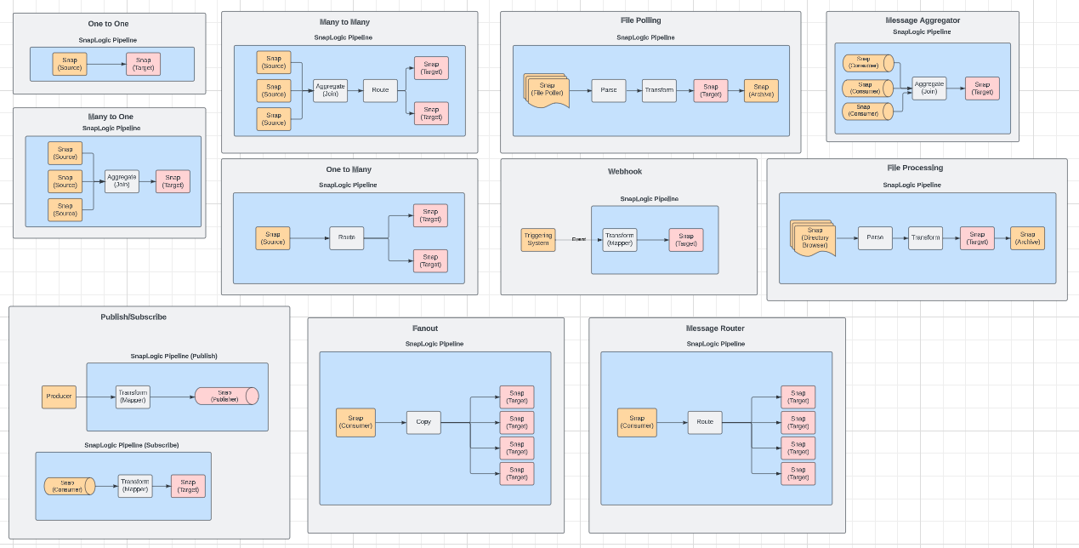
Pattern Examples
1:1, 1:N N:1, N:N
File Polling, Message Aggregation
Pub-Sub Fanout Message Router
Notes:
Inefficiency
Without predefined patterns, SnapLogic developers may look to reinvent the wheel for every integration use case they build. This leads to redundancy and can waste time and effort, resulting in a slower development process and creates unnecessary bloat within a customers deployment of SnapLogic leading to code duplication and decreased productivity.
Lack of Consistency & Decreased Collaboration
Inconsistent pipeline structures and designs can make it challenging for team members to understand and maintain each other's work. This lack of uniformity can lead to confusion and errors which can hinder collaboration among team members. Developers might struggle to understand each other's work or work together effectively on shared projects.
Difficulty in Scaling
As the complexity of data integration tasks increases, scaling becomes more challenging without a standardized approach. A lack of patterns can hinder the ability to scale large integration project effectively & efficiently.
Higher Maintenance Burden
Without patterns, pipelines may become harder to maintain over time. When updates or modifications are needed, the absence of a consistent approach can make the process more error-prone and time-consuming.
Higher Learning Curve for New Developers
Onboarding new team members becomes more challenging when there are no established & documented patterns to follow. The absence of clear guidelines can make it difficult for newcomers to grasp the best practices and design principles used in the organization.
Reduced Performance and Optimization
Without predefined patterns for performance optimization, pipelines might not be as efficient as they could be. This can lead to increased processing times and resource usage.
Risk of Errors and Bugs
Inconsistent pipeline development can introduce more opportunities for errors and bugs to creep into integration projects. This can lead to data integrity issues and negatively impact the reliability of data across the organisation

Slide 14
Pattern Template
Each documented pattern should following a consistent structure - Enables better discoverability and understanding across the developer community for the purposes of pattern selection.
Name - Unique name for the Pattern
Context - Broad context defining the scope of the pattern
Type - Defines type of integration - eg, File processing, synchronous, delta load - Pattern may span multiple types
Problem - The problem the pattern is designed to solve
Forces - What are the constraints that make the problem different to solve?
Solution - The approach encompassed by the Pattern- Documented approach
Results - What are the expected results after applying the pattern highlighting any challenges that may arise
Additional Considerations - Highlight any non functional factors that need to be considered, for example limitations of the downstream system, timeliness factors etc.
Real World Example - End to end scenarios that explains how the pattern is applied in the broader context of the integration use case
Notes:
Inefficiency
Without predefined patterns, SnapLogic developers may look to reinvent the wheel for every integration use case they build. This leads to redundancy and can waste time and effort, resulting in a slower development process and creates unnecessary bloat within a customers deployment of SnapLogic leading to code duplication and decreased productivity.
Lack of Consistency & Decreased Collaboration
Inconsistent pipeline structures and designs can make it challenging for team members to understand and maintain each other's work. This lack of uniformity can lead to confusion and errors which can hinder collaboration among team members. Developers might struggle to understand each other's work or work together effectively on shared projects.
Difficulty in Scaling
As the complexity of data integration tasks increases, scaling becomes more challenging without a standardized approach. A lack of patterns can hinder the ability to scale large integration project effectively & efficiently.
Higher Maintenance Burden
Without patterns, pipelines may become harder to maintain over time. When updates or modifications are needed, the absence of a consistent approach can make the process more error-prone and time-consuming.
Higher Learning Curve for New Developers
Onboarding new team members becomes more challenging when there are no established & documented patterns to follow. The absence of clear guidelines can make it difficult for newcomers to grasp the best practices and design principles used in the organization.
Reduced Performance and Optimization
Without predefined patterns for performance optimization, pipelines might not be as efficient as they could be. This can lead to increased processing times and resource usage.
Risk of Errors and Bugs
Inconsistent pipeline development can introduce more opportunities for errors and bugs to creep into integration projects. This can lead to data integrity issues and negatively impact the reliability of data across the organisation

Slide 15
Modularization with the Pipeline Execute Snap

Slide 16
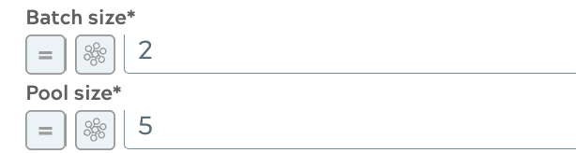
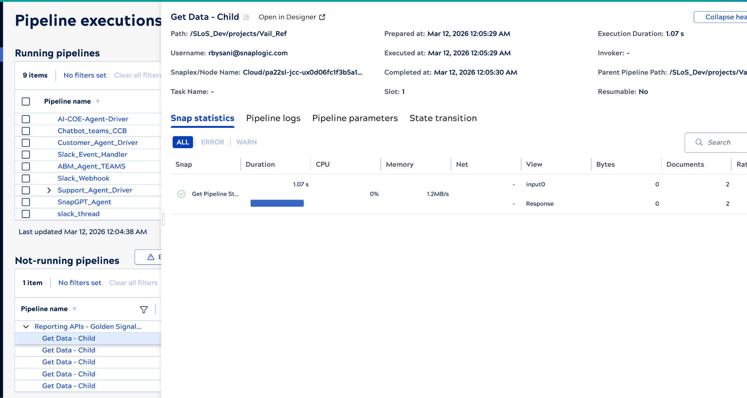
https://docs.snaplogic.com/snaps/snaps-core/sp-flow/snap-pipeline-execute.html
Modularization using Pipeline Execute Snap
LOCAL_NODE (For Ultra, and small loads) LOCAL_SNAPLEX (Distribution of intensive workloads) SNAPLEX_WITH_PATH (Workload distribution / Connectivity requirements
No. of documents per batch
Modularization based on business functions to simplify complex or monolithic pipelines
Max No. of child PL instances
With Pool size > 1, as many child PL instances are started as needed to process the input documents (each having the size specified in Batch size)
Each child PL completes once the input batch is processed.
Batching is not supported in Ultra Pipelines

Slide 17
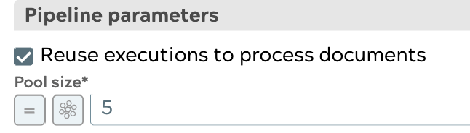
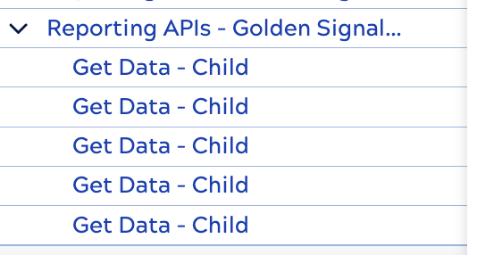
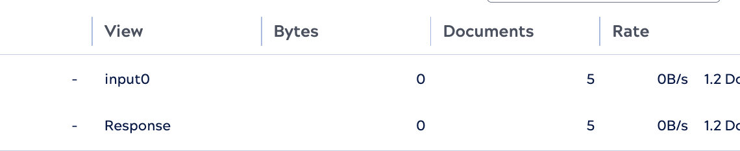
https://docs.snaplogic.com/snaps/snaps-core/sp-flow/snap-pipeline-execute.html
Modularization using Pipeline Execute Snap
Performant for applicable streaming use cases.
For Ultra tasks, LOCAL_NODE option must be selected to maintain Lineage.
Max No. of child PL instances
Child PL must have an unlinked input view, and must send the documents back to the parent Pipeline.
Child PL instances are created and remain running until the input documents are completed.
Review available node capacity.

Slide 18
Error Pipelines

Slide 19
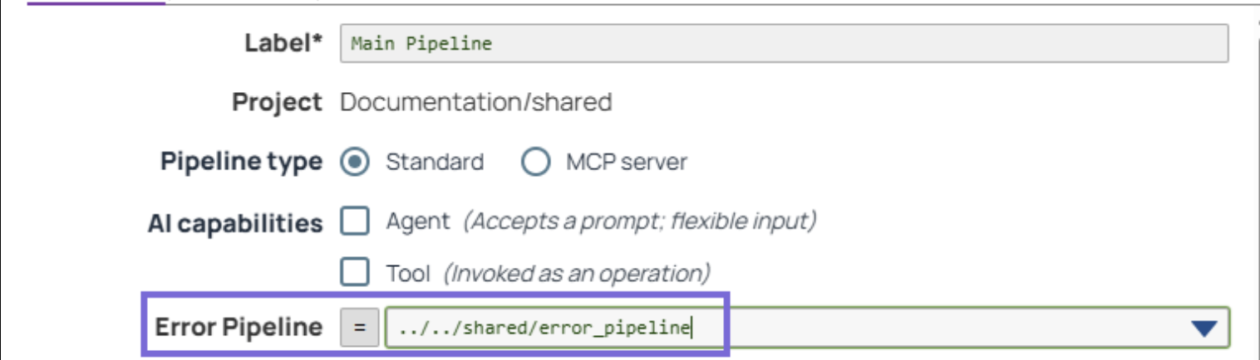
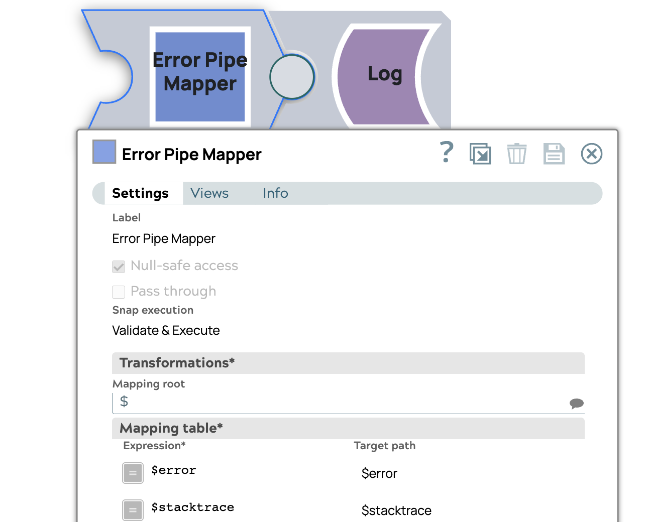
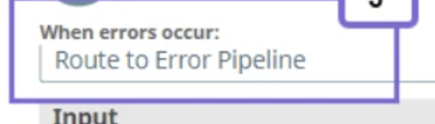
https://docs.snaplogic.com/design-integrations/working-with-error-pipelines.html
Error Pipelines
Reuse across multiple projects and Pipelines.
Single unlinked document input view to receive error documents.
Continue processing the main pipeline, propagate fields that must be processed by the Error pipeline.
Main Pipeline

Slide 20
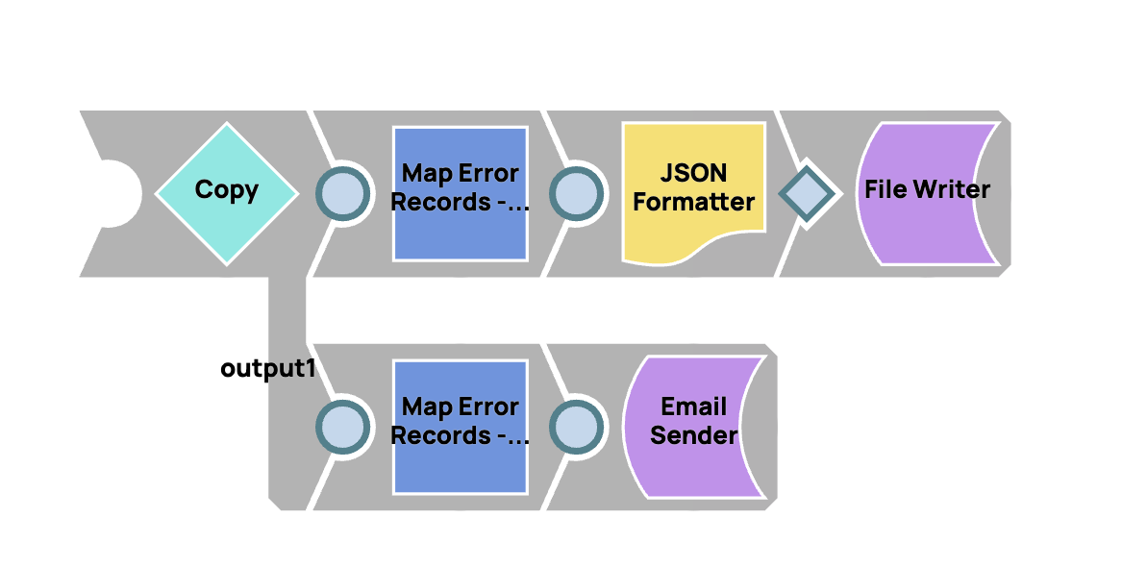
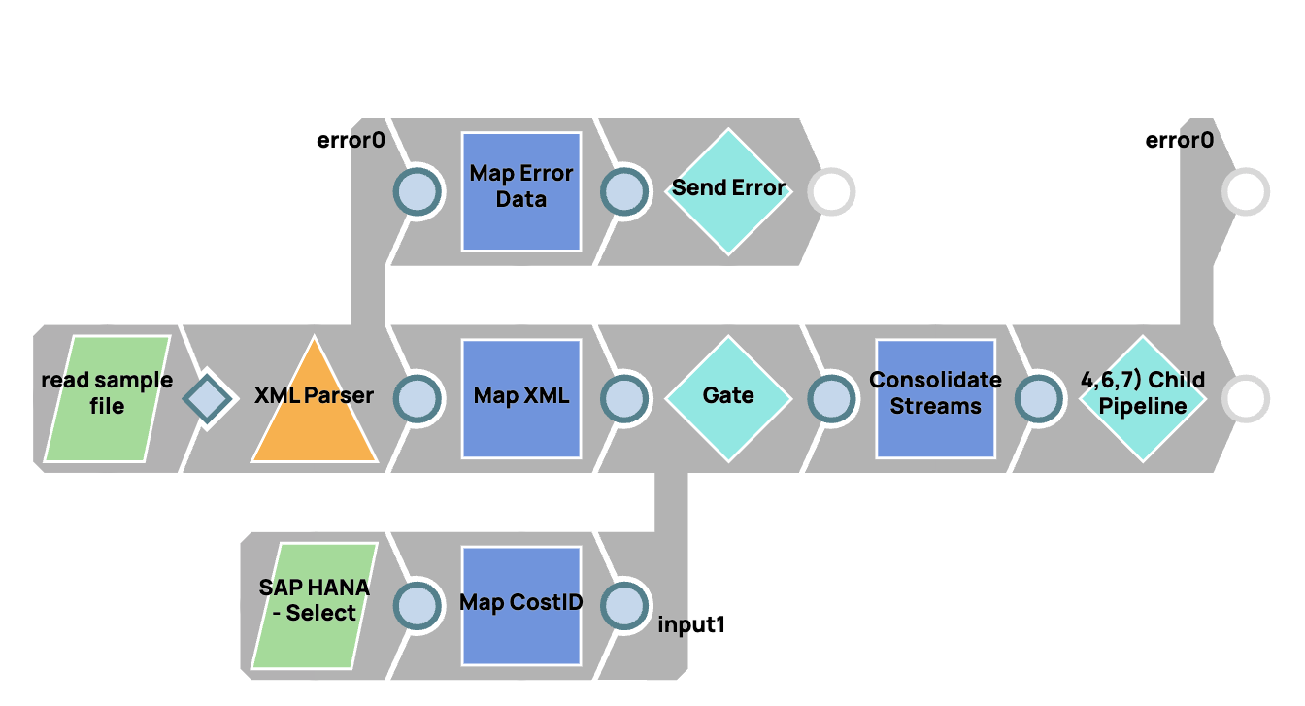
Error Handling
Dedicated “Catch” Of Errors
Child Error Handling Pipeline
Confidential and For Internal Use Only
Notes:
https://cdn.elastic.snaplogic.com/sl/designer.html?v=428742#pipe_snode=646dfb65f9b6af59e3b248bc
https://cdn.elastic.snaplogic.com/sl/designer.html?v=428742#pipe_snode=6479a0dc4985f8429bee643b

Slide 21
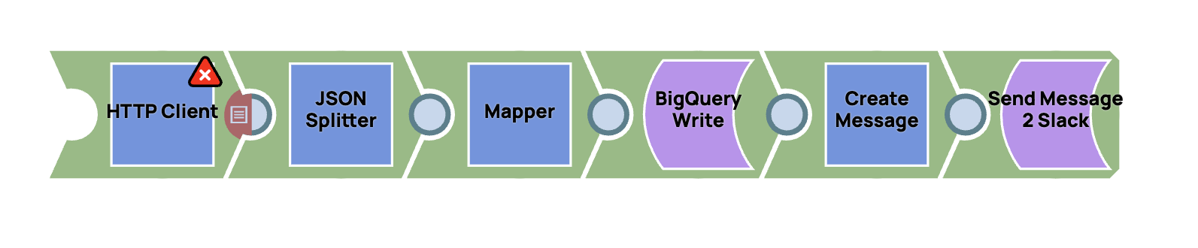
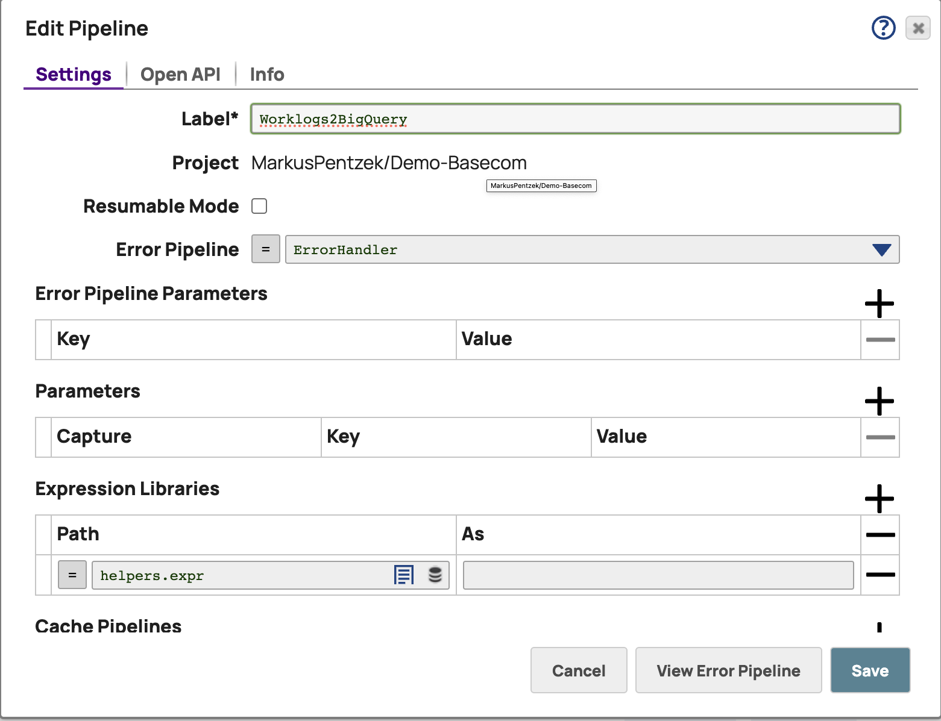
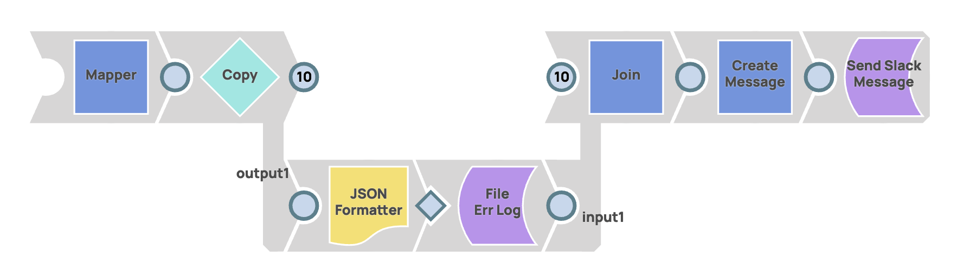
Error Handling
"Catch All” Errors
Error Handling Pipeline
Confidential and For Internal Use Only
Notes:
Error Pipeline
https://cdn.elastic.snaplogic.com/sl/designer.html#pipe_snode=6479a0dc4985f8429bee643b
Producing Error Pipeline
https://cdn.elastic.snaplogic.com/sl/designer.html#pipe_snode=646dfb65f9b6af59e3b248bc

Slide 22
Pipeline Quality

Slide 23
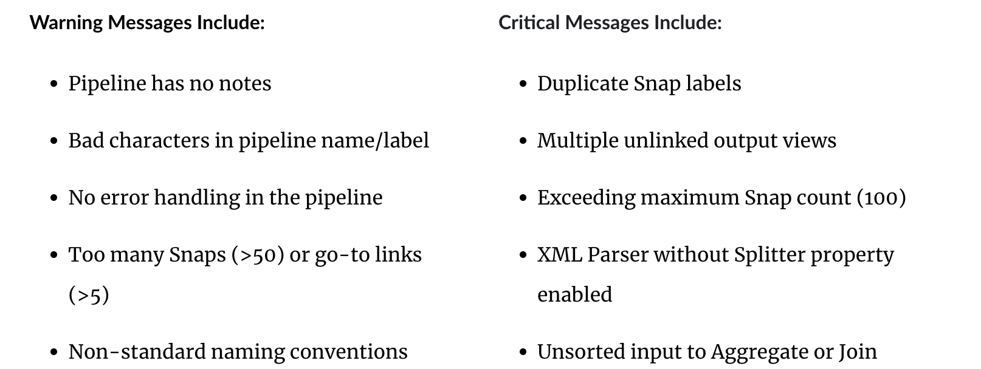
https://docs.snaplogic.com/public-apis/post-pipeline-quality.html
Pipeline quality API
Public API executed using Basic or JWT Authentication
https://{controlplane_path}/api/1/rest/public/pipeline/linter/{path}
Snapshot:
Generates a report for standard checks in various categories / levels
CRITICAL Issues that can cause Runtime failures performance issues
WARNING Best practices
INFO
Other general recommendations

Slide 24
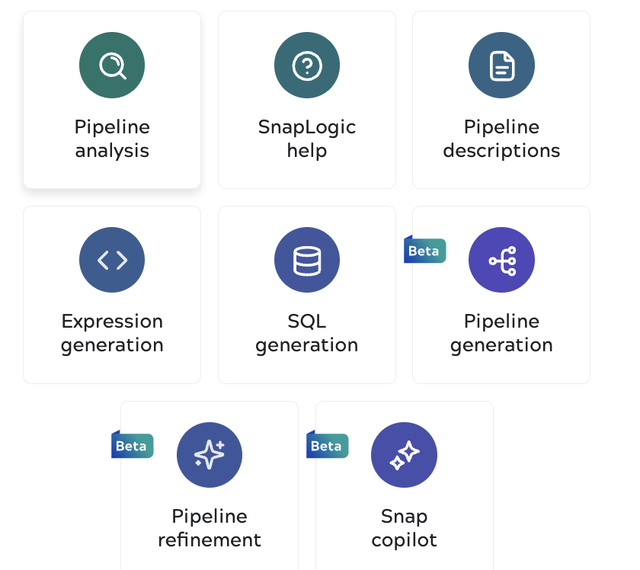
SnapGPT
Pipeline Analysis Quality report
Pipeline refinement Quality report
Pipeline generation Generates pipelines from natural language prompts. Uses patterns and can use existing pipelines for RAG.
Snap Copilot Use natural language prompting to update the configuration and properties of any Snap.
Expression generation Refine or generate new expressions in the expression editor or GPT prompt.
https://docs.snaplogic.com/snapgpt/snapgpt-about.html

Slide 25
https://docs.snaplogic.com/public-apis/post-pipeline-quality.html
Naming conventions
Asset Naming
Project Naming
Projects should follow the format <Business Domain>_<Business Group> to clarify ownership.
Example: HR_Analytics, Sales_Corporate, or Product_PartnerProgram
Pipeline Naming
Parent Pipelines <verb><BusinessFunction> to describe the action. Example: getCustomerOrder or submitPaymentAuthorization.
Child Pipelines Prepend with child_ or sub_ to distinguish dependencies.
Example: child_getAddress.
Files Referenced files to match PL name.
Example: If the pipeline is child_getAddress, the input file should be named child_getAddress.csv.
Accounts Create accounts per project following <Application/Database>_<Project Name>. Example: SFDC_HR (Salesforce account for the HR project).
Tasks Append the task type to the pipeline name.
Example: getCustomerOrder_Triggered_Task
Snaps Rename individual Snaps when placing them on the canvas. Changing "JSON Parser" to "JSON _Parser_Orders" ensures that runtime logs identify exactly which step failed, rather than listing generic Snap names.

Slide 26
Audit logging

Slide 27
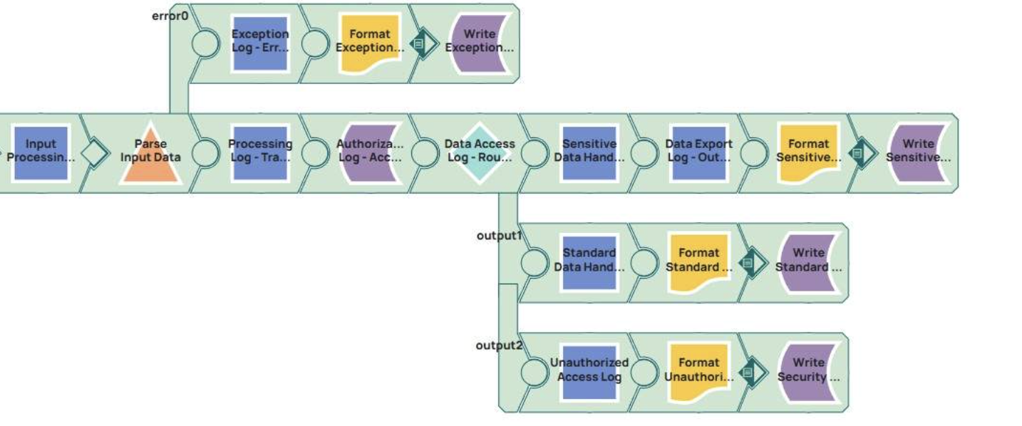
https://docs-snaplogic.atlassian.net/wiki/spaces/SD/pages/3990421701/Log https://docs.dynatrace.com/docs/ingest-from/opentelemetry/collector
https://docs.snaplogic.com/tool-integrations/observability-about.html
Logging for Audit / Compliance (Using Log Snap)
Log Snap can be used to selectively print informational messages to the jcc.json log file.
Integration with external Observability tools (Dynatrace) using OTel.
(https://docs.snaplogic.com/tool-integrations/node-metric-reference.html)
Log Snaps can be added at various stages in the Pipeline to capture logging related to Ingest, Process, Filter, Destination, and Error paths.
Log Snap

Slide 28
Guiding Principles
Identify Common Patterns: Review existing pipelines to identify common data processing patterns or transformations. This can include data cleansing, aggregation, data enrichment, or formatting tasks that are repeated across different pipelines.
Modular Design: Design pipelines in a modular fashion where each Pipeline performs a specific, reusable function. This approach allows you to easily plug in these reusable components into other pipelines.
Parameterization: Use pipeline parameters to make pipelines more flexible. Parameters can be used to pass different values such as file paths, accounts, or other configuration settings, making the pipeline adaptable to different scenarios.
Documentation and Naming Conventions: Maintain clear documentation and use consistent naming conventions. This practice helps in understanding the purpose and functionality of a pipeline, making it easier to identify when it can be reused.
Leverage SnapLogic Patterns Catalog: SnapLogic offers a patterns catalog – a repository of pre-built pipeline patterns. Explore these patterns to find reusable components that can be adapted to your needs.
Standardize Error Handling: Create a standardized approach to error handling and logging across pipelines. This makes it easier to maintain and reuse components, as the error handling logic does not need to be rewritten each time.
Evaluate Data Sources and Destinations: If multiple pipelines are interacting with the same data sources or destinations, it might be possible to create reusable components for these interactions.
Continuous Review and Refactoring: Periodically review pipelines to identify opportunities for refactoring and improving reusability. As data and processing needs evolve, so should your pipelines.
Collaboration and Sharing Best Practices: Foster a culture of collaboration where developers share their pipelines and best practices. This can lead to more reusable pipeline components being identified and utilized.

Slide 29
Appendix

Slide 30
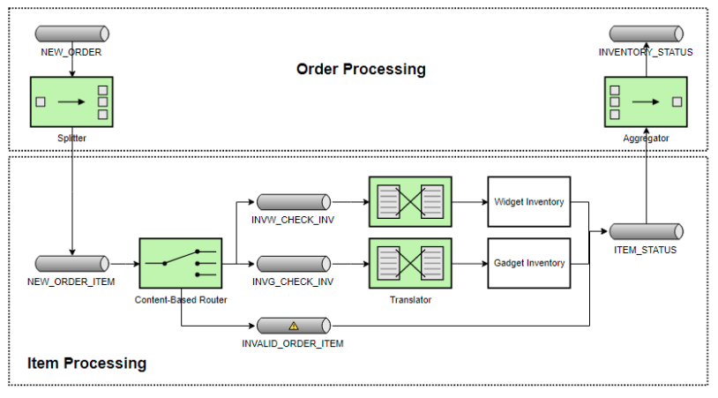
Mapping Enterprise Integration Patterns to SnapLogic Pipelines
Key Points
A composition of patterns constitutes a Pipeline or series of orchestrated Pipelines to achieve a functional business objective
Consider orchestarting an Order Processing integration workflow. The workflow may be broken down into three distinct SnapLogic Pipelines
Pipeline 1 - Message retrieval
Pipeline 2 - Message Item processing
Pipeline 3 - Message publishing
Each Pipeline assumes a distinct responsibility, and can be composed within a single orchestration pipeline, or tied together via API requests

Slide 31
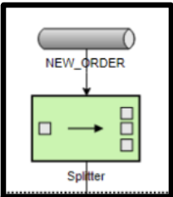
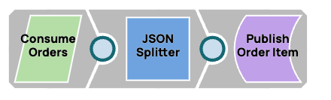
Pipeline 1 - Message Retrieval
Key Points
Consume Orders - A Order record is consumed from a Message Queue
JSON Splitter - The order contains multiple Order Line Items which require to be split into indicitval records to be processed independently
Publish Order Item - Each Order Line Item is published to a New_Order_Item message queue

Slide 32
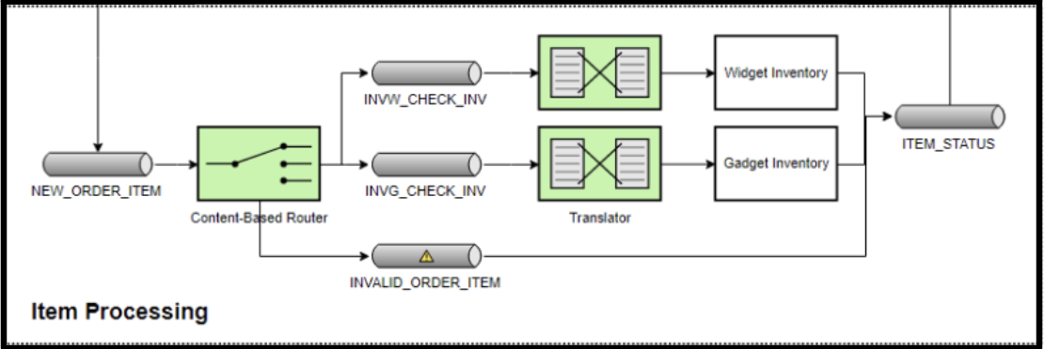
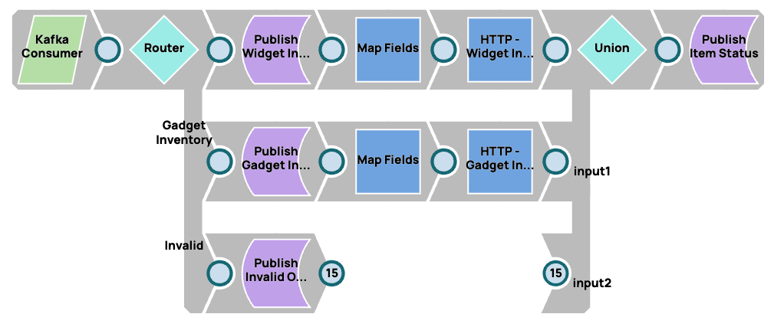
Pipeline 2 - Order Item Processing
Key Points
Kafka Consumer - Each order item is consumed from the New_Order_Item queue
Router - Depending on data stored within the Order Item, the message is routed based on the defined business logic
Publish Widget -
Publish Gadget -
Publish Invalid -
Union - The message stream is consolidated
Publish Item Status - The status of the message is published to an “Item_Status” queue

Slide 33
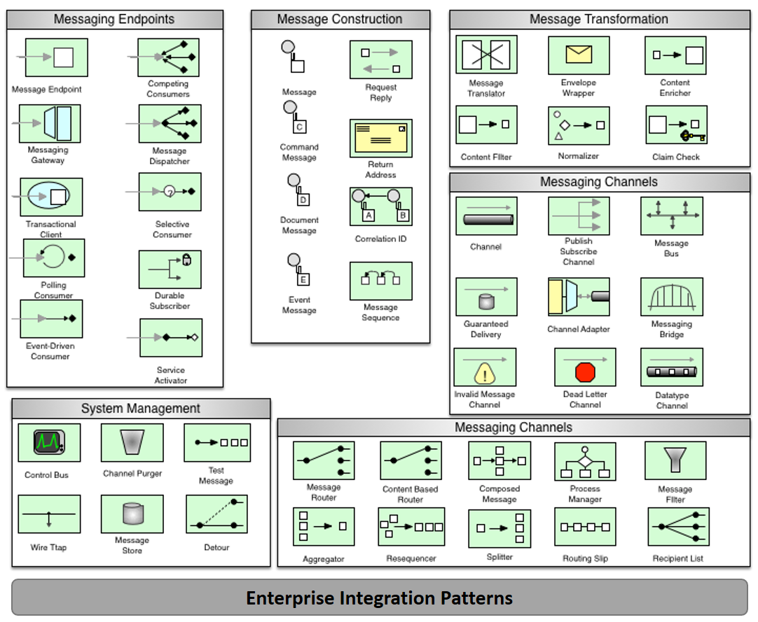

Enterprise Integration Patterns
Notes:
Technology agnostic

