Slide 1



Slide 3
manually correcting data

Slide 4
Complicated

Slide 5
Confusing

Slide 6
DataWize

Slide 7



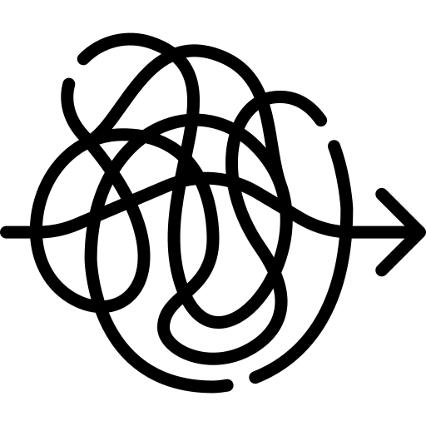
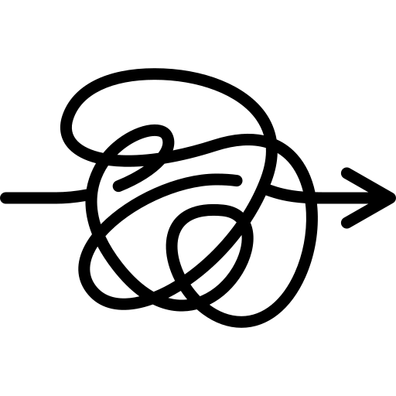

Slide 14


Slide 16
