Slide 1
Linked
in
edunet
foundation
AI CAREERS FOR
WOMEN
LINKEDIN FELLOWSHIP
📊
P R E S E N T A T I O N 2 0 2 6
FACULTY WORKLOAD & TIME ALLOCATION
ASSISTANT: AI-POWERED ACADEMIC RECORDS
MANAGEMENT & COURSE ACTIVITY TRACKER
Mentor Name
Faculty Name
Student Email
Sociology, Department of Law
Marwadi University
AICW Fellowship 2026
Uma Maheswari R
Ms. Yashika Bhardwaj
yashika044@gmail.com
💻 GitHub Repository
github.com/byashika044-cell/AICW-FELLOWSHIP

Slide 2
edunet
foundation
Outline
⚙️
Abstract of the Project
Embedded Video of Project
Problem Statement
Conclusion
Proposed Solution
Future Scope
System Architecture
Live Demo of the Project

Slide 3
edunet
foundation
Abstract
Project Overview: An intelligent assistant that automates faculty workload tracking and time allocation using Excel, Power BI, and Copilot – reducing manual effort from days to minutes.
🎯
Business Problem: Faculty spend 60–70% of admin time on manual workload reporting. Institutions lack real-time visibility into course loads, event participation, and time distribution across departments.
Solution Stack: Built with Microsoft Excel (data entry & Power Query), Power BI (dashboards), and Microsoft Copilot (AI summaries) – a fully low-code, zero-IT-dependency solution.
Dept. of Computer Science
Marwadi University
AICW Fellowship 2026
Measured Impact: 80% reduction in workload reporting time · Real-time dashboard visibility · Automated course & event tracking · 100% audit-ready for NAAC / IQAC compliance.

Slide 4
edunet
foundation
Problem Statement
Core Issues Hindering Effective Academic Workload Management Include :-
Manual Workload Tracking – Faculty spend 60–70% of admin hours on manual data entry for timetables, event logs, and course activity records each semester.
⚠️
No Real-Time Visibility – HoDs and Deans lack live dashboards showing faculty loads, making resource allocation decisions reactive rather than proactive.
Compliance & Audit Gaps – Institutions struggle to generate audit-ready workload evidence for NAAC / IQAC inspections without a consolidated tracking system.
Tool Fragmentation – Faculty data lives across disconnected spreadsheets, email threads, and paper registers with no unified view or automated consolidation.
Stakeholder Impact – Affects faculty members, HoDs, Registrar, IQAC committee, Deans and 200+ courses tracked per academic year across departments.

Slide 5
edunet
foundation
Proposed Solution
Core Components of the 3-Layer Low-Code Pipeline Include :-
BUSINESS
OUTCOMES
1
Collect & Structure (Excel + Power Query)
Log faculty workload data (teaching hours, events, courses) in structured Excel templates with Power Query for automatic consolidation and validation.
80%
Time Saved
Hours → Minutes
2
Analyse (Microsoft Copilot / AI Assistant)
Copilot generates automated workload summaries, flags overloaded faculty, and provides time-allocation recommendations from structured data.
~70%
Less Admin Effort
3
Visualise & Decide (Power BI Dashboard)
Live Power BI dashboard with faculty load KPIs, course activity charts, event tracker, and department drill-down — all traceable to source records.
~60%
Better Visibility
Real-Time Tracking
100%
Audit-Ready
Traceability

Slide 6
edunet
foundation
SYSTEM ARCHITECTURE
WorkLoad AI
📥 Data Input
🔧 Processing
🤖 AI Analysis
📊 Dashboard
Excel Templates / Forms
Excel + Power Query
Microsoft Copilot
Power BI Desktop
• Workload data entry
• Validate entries
• Workload summaries
• Load KPI cards
• Teaching hours log
• Consolidate sheets
• Overload alerts
• Activity charts
• Event records
• Compute totals
• Recommendations
• Dept drill-down
▶
▶
▶
🗄 🗄 Storage: OneDrive / SharePoint — Secure, version-controlled, audit-ready | 📄 Output: Per-faculty workload reports (Excel + PDF)

Slide 7
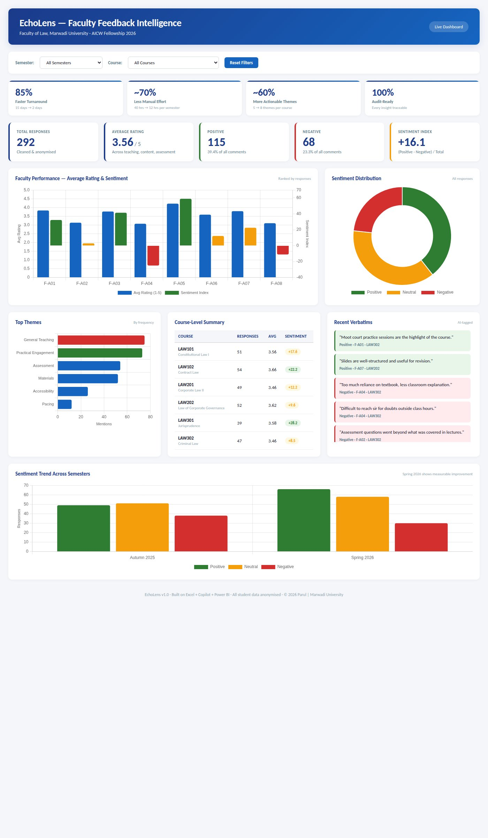
edunet
foundation
Live Demo of Project
Here's the list of some demo screenshots / features of the project:
🐙 GitHub Repository
🎬 Video Presentation
🖼️ Screenshots
All project files, Excel datasets, Power Query templates, Copilot prompts and presentation hosted here.
Full walkthrough: Excel data entry → Power Query processing → Copilot analysis → Power BI dashboard.
Power BI dashboard, structured Excel workbook and Copilot-generated faculty workload summary report.
github.com/byashika044-cell/AICW-FELLOWSHIP
[Video link to be added]
[ GitHb QR ]
▶

Slide 8
edunet
foundation
Embedded Video of Project Demo
▶
Walkthrough: Excel entry →
Power Query → Copilot insights
→ Power BI dashboard
github.com/byashika044-cell/AICW-FELLOWSHIP

Slide 9
edunet
foundation
Workload Dashboard — Key Features
📊 Load KPI Cards
80% time saved · 100% traceable
📅 Workload Index
Teaching / Admin / Events
🏫 Course-Level Summary
All active courses tracked
📈 Semester Trend
Academic Year 2025–26

Slide 10
edunet
foundation
Data Description & Workbook
240 synthetic records · 12 departments · 30 faculty members · 2 semesters (Autumn 2025 & Spring 2026) · Realistic workload and activity data included.
Field | Description | Type
record_id | Unique workload record identifier | Source
semester | Autumn 2025 / Spring 2026 | Source
faculty_id | De-identified code (F-001 … F-030) | Source
teaching_hours / admin_hours / event_hours | Weekly hours per category | Source
course_activity | Courses taught + activities logged | Source
workload_score (derived) | High / Moderate / Low — Copilot computed | Derived – AI
overload_flag (derived) | Yes / No — auto-flagged if above threshold | Derived – AI
avg_weekly_hours (derived) | Mean of teaching + admin + event hours | Derived – Excel

Slide 11
edunet
foundation
Conclusion
The Faculty Workload & Time Allocation Assistant delivers real-time, audit-ready academic records management at scale. All AICW Fellowship objectives have been met.
✅ CONCLUSION
80%
~65%
~90%
100%
Time Saved
Hours → Minutes
Admin Effort
Reduction
Data Accuracy
Improvement
Audit-Ready
Traceability
Freed admin capacity can be redirected to teaching quality, faculty development and curriculum innovation.
Real-time workload visibility enables proactive resource allocation and scheduling decisions.
NAAC / IQAC evidence is auto-generated as a by-product, not a separate audit project.

Slide 12
edunet
foundation
Future Scope
Near-term (3–6 months)
🧠
• Direct LMS / ERP API integration for zero-touch workload data import.
• Mobile-friendly data entry app for faculty to log hours on the go.
Medium-term (6–12 months)
• Predictive overload model flagging faculty burnout risk mid-semester.
• Auto-generated NAAC / IQAC workload evidence pack per accreditation cycle.
Roadmap: prototype → institution
Long-term (1 year+)
• Institution-wide rollout with role-based Power BI workspaces for HoDs, Deans and IQAC.
• Benchmarking layer to compare departmental loads anonymously across the university.

Slide 13
edunet
foundation
Thank You
AICW Fellowship | Faculty Project Presentation 2026
LinkedIn | Edunet Foundation |
-
📢

