Slide 1
The Martian

Slide 2
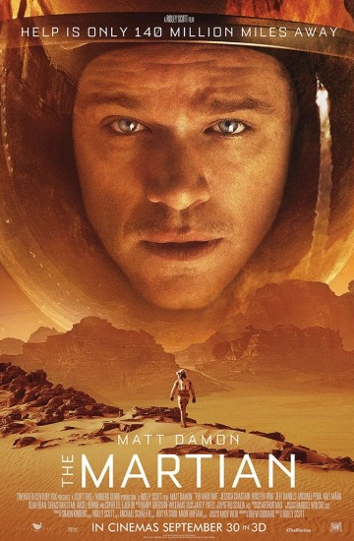
The Martian

Slide 3
The Martian
The film, adapted from the book The Martian by Andy Weir, is about an astronaut who is left alone on Mars after his team leaves after a storm and is later rescued.

Slide 4
The Martian
It all starts when astronaut named Mark, who was on the fourth of the Ares missions to the planet Mars, was thought to be dead and left behind.

Slide 5
The Martian
After the news of Mark's death came to the world, it was met with deep sadness and a funeral ceremony was held.

Slide 6
The Martian
But at satellite images NASA see Mark is alive. Now they must bring Mark. And now at Mars ,Mark is looking for a way to contact NASA.

Slide 7
The Martian
End of all Mark find way of contact with NASA .After that they start a rescue operation for Mark .This period is hard passed.But finally Mark come to World.

Slide 8
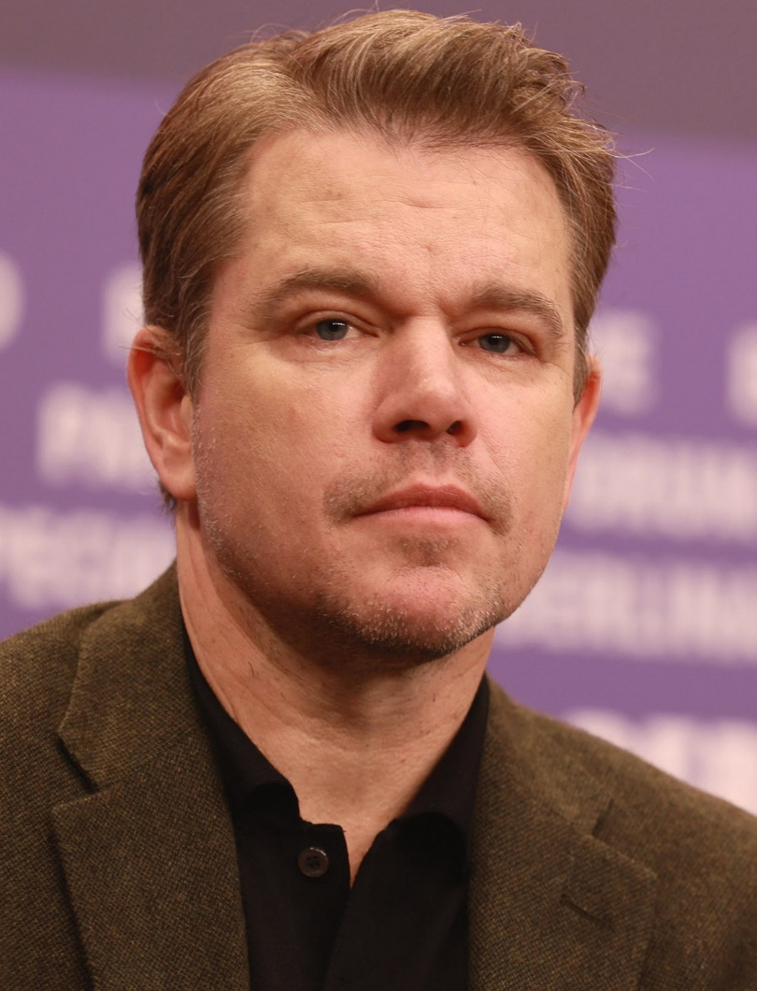
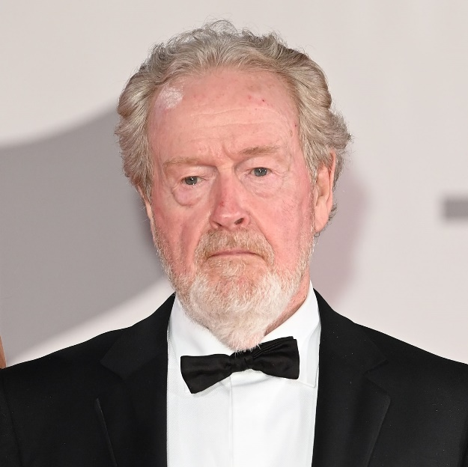
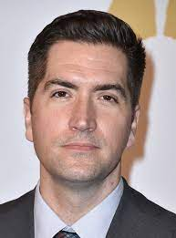
The Martian
Ridley Scott
Drew Godard
The Martian is directed by Ridley Scott and written by Drew Godard.
The Martian movie is about an astronaut who is left alone on Mars after his team leaves after a storm and is later rescued.

Slide 9
The Martian
And in the movie who plays the lead role is Matt Damon.
The Martian movie is about an astronaut who is left alone on Mars after his team leaves after a storm and is later rescued.

Slide 10
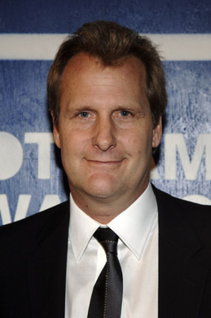
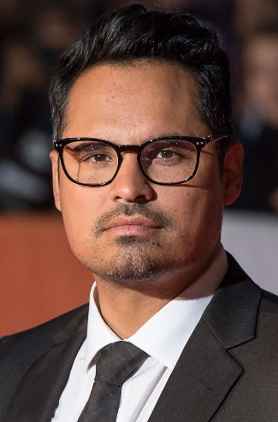

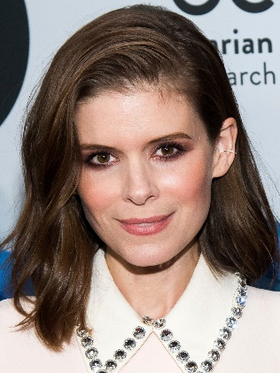

The Martian
The film also stars names such as Sean Bean, Kate Mara, Jessica Chastain, Jeff Daniels and Michael Pena.
The Martian movie is about an astronaut who is left alone on Mars after his team leaves after a storm and is later rescued.

Slide 11
Extra Informations
The Martian
The Martian movie is about an astronaut who is left alone on Mars after his team leaves after a storm and is later rescued.
All this shots takes seventy-two days.

Slide 12
The Martian
j
In the first scenes of the rescue sequence at the end of the movie, it is seen that the character 'Mark Watney' cannot hold back his tears. During filming, 'Matt Damon' was the only actor on set. The lines spoken by the other actors were recorded, and 'Matt Damon', who plays the character, started to cry as he listened to the voice of 'Commander Lewis' (Jessica Chastain) on the recording, really losing himself in his role. Director Ridley Scott was so impressed by Matt Damon's performance that he did not reshoot the scene and used it as it was in the montage.
The Martian movie is about an astronaut who is left alone on Mars after his team leaves after a storm and is later rescued.
link

Slide 13
Thanks for listening me.

