Slide 1

Exploratory Data Analysis
G2M Insight For Cab Investment Firm
John Nguyen
21 June 2024

Slide 2

Agenda
Executive Summary
Problem Statement
Approach
EDA
EDA Summary
Recommendations

Slide 3
Executive Summary
Mission Statement: Company XYZ aims to invest in the cab industry by identifying the most promising company based on market presence, revenue generation, customer loyalty, and overall usage.
Data Analysis Approach: Analyzed four datasets from January 2016 to December 2018, covering cab transaction details, customer demographics, transaction mappings, and city statistics.
Key Findings: Yellow Cab holds 55.2% of the market, generates higher revenue, has a higher proportion of repeating customers, but share the same market and follows similar usage trends with Pink Cab.
Overall Conclusion: Invest in Yellow Cab but leave room for Pink Cab’s potential

Slide 4
Problem Statement
XYZ is looking to invest in the Cab Industry due to its rapid growth in recent years.
Following their Go-to-Market(G2M) business strategy, they want to understand the market before taking the final decision.
The goal of the analysis is to provide company XYZ with actionable insight to identify the right company to make an investment.

Slide 5
Approach
Four datasets from January 31, 2016, to December 31, 2018, containing cab transaction details, customer demographics, transaction mappings, and city statistics were explored and analyzed.
The data was merged, processed, and compared, with insights visualized through various charts and graphs to aid in decision-making.

Slide 6
EDA (Exploratory Data Analysis)
Exploratory Data Analysis (EDA) refers to the process of analyzing datasets to summarize the main characteristics using visual methods.
The following slides will look at an in-depth analysis of various aspects of cab service performance.

Slide 7
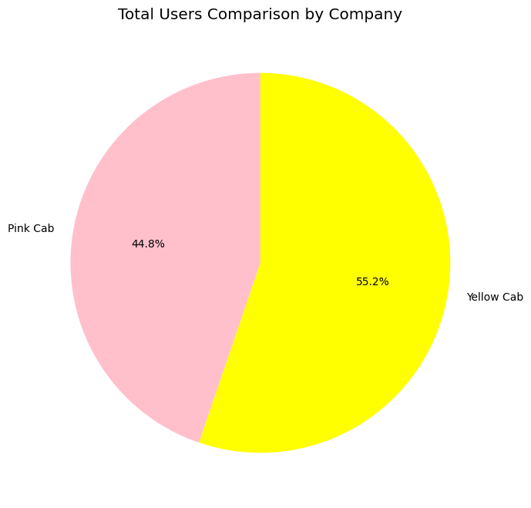
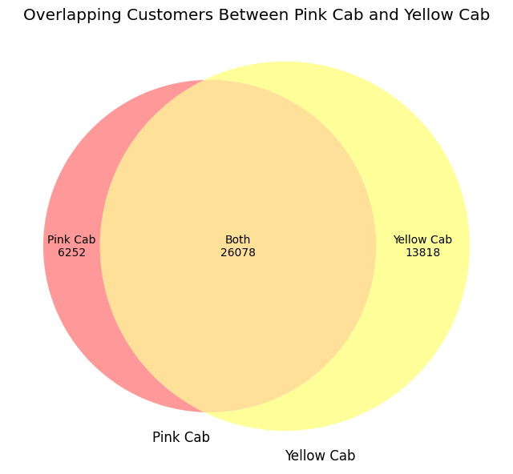
Total Users and Overlapping Users
Yellow Cab has 55.2% of the market, while Pink Cab holds 44.8%.
This indicates that Yellow Cab has a slightly larger customer base overall.

Slide 8
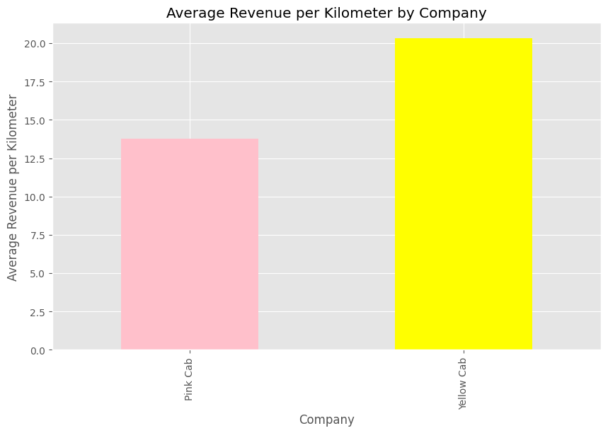
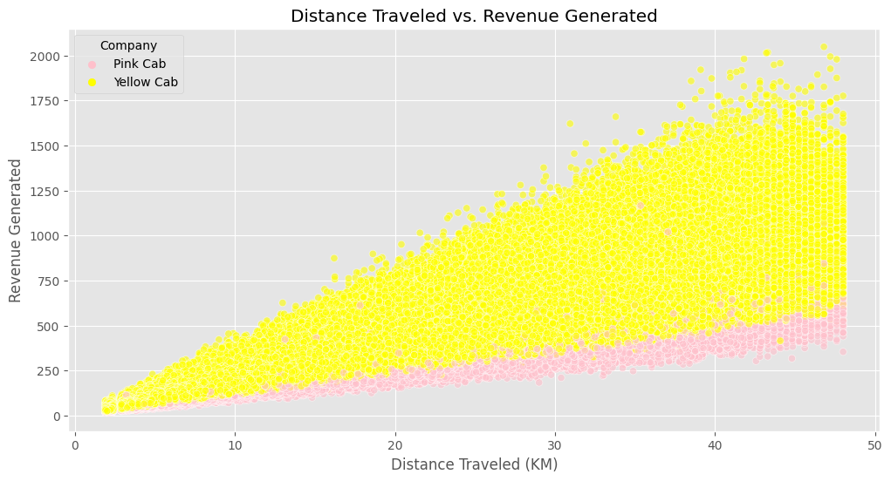
Revenue Analysis
Yellow Cab generates higher revenue per kilometer than Pink Cab, indicating more efficient pricing or higher value trips.
Both companies show a wide range of revenue for longer distances, suggesting variability in pricing or trip types.

Slide 9
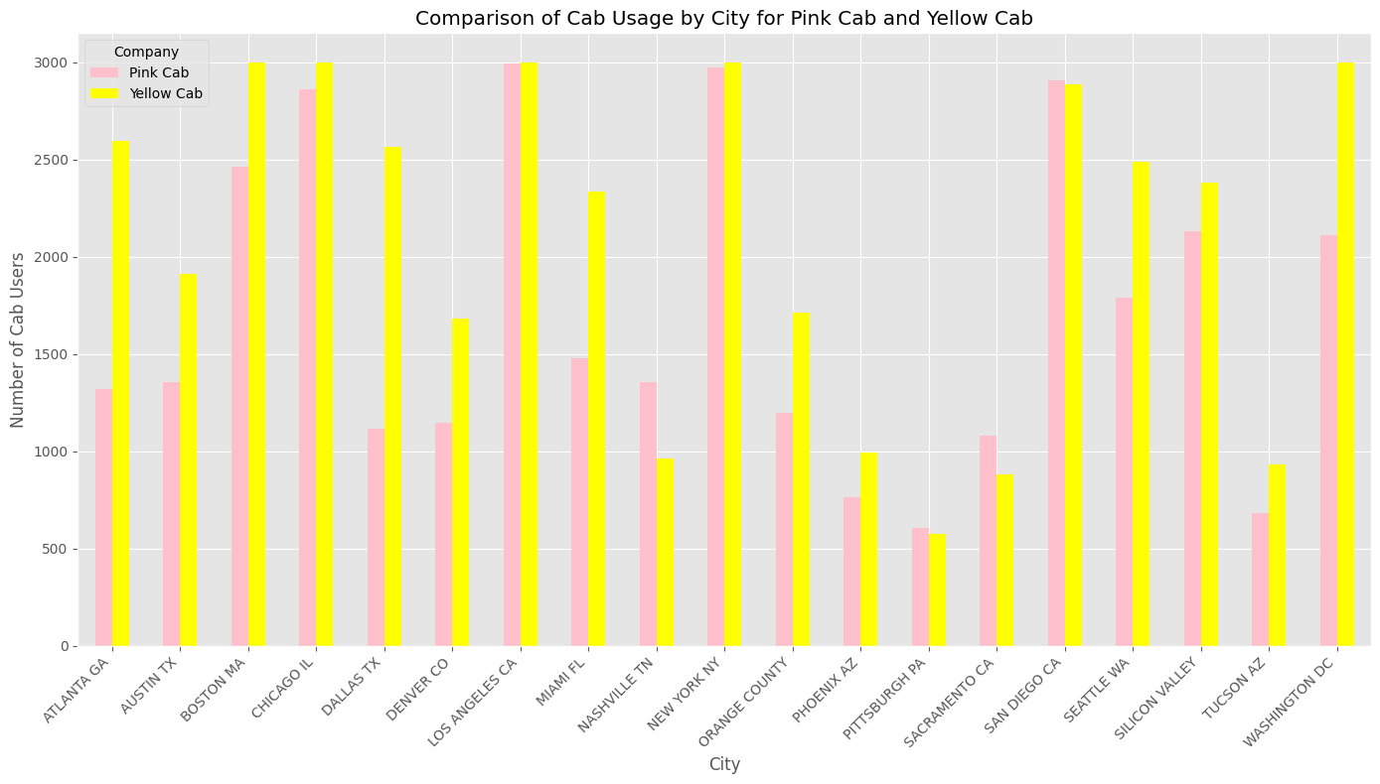
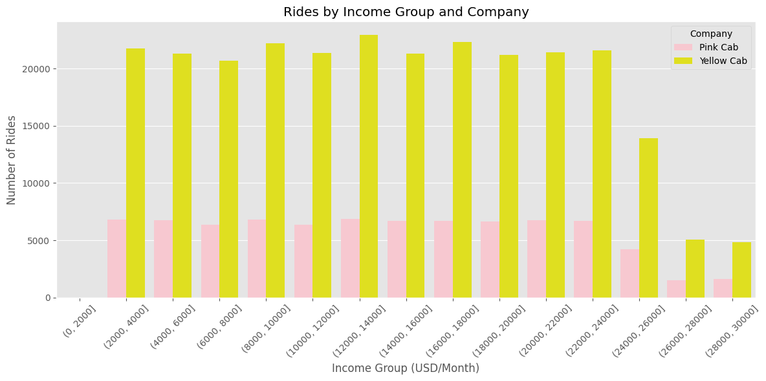
User Distribution and Demographics
No significant difference in user distribution per city between Yellow Cab and Pink Cab.
Similar income distribution for users of both Yellow Cab and Pink Cab.
Both companies have similar market penetration in urban areas and appeal to users across various income levels.

Slide 10
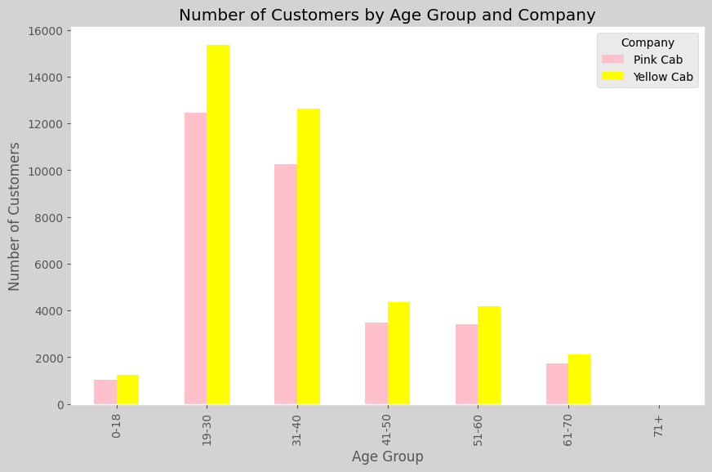
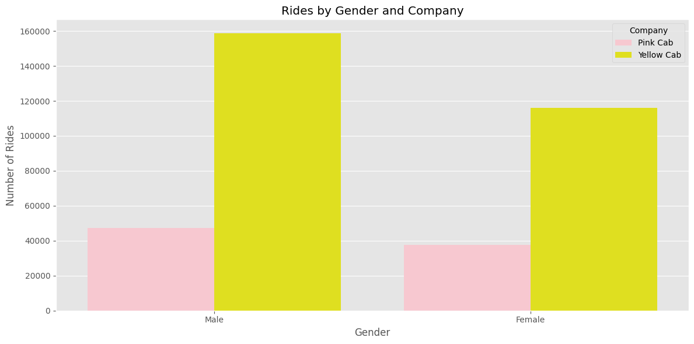
User Distribution and Demographics
No significant preference for either cab company within specific age groups.
Gender distribution is similar between Yellow Cab and Pink Cab, indicating comparable appeal across genders.
Both companies effectively serve all age groups and have a higher usage among females.

Slide 11
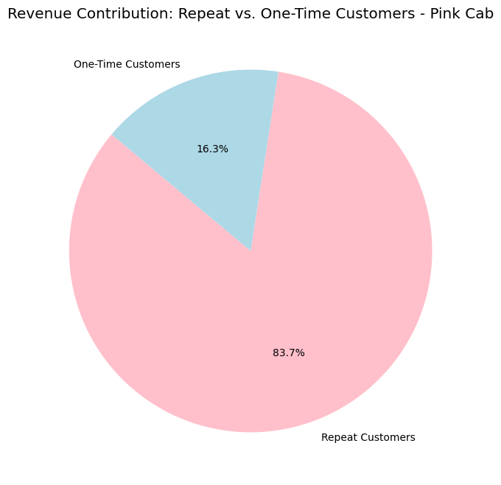
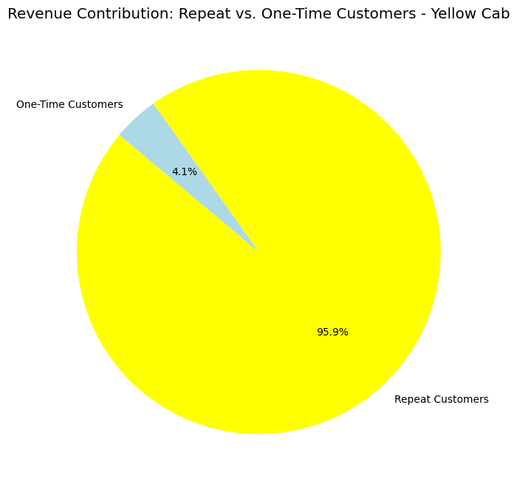
Repeated Customers to Total Revenue
Yellow Cab has a higher proportion of repeat customers contributing to its total revenue.

Slide 12
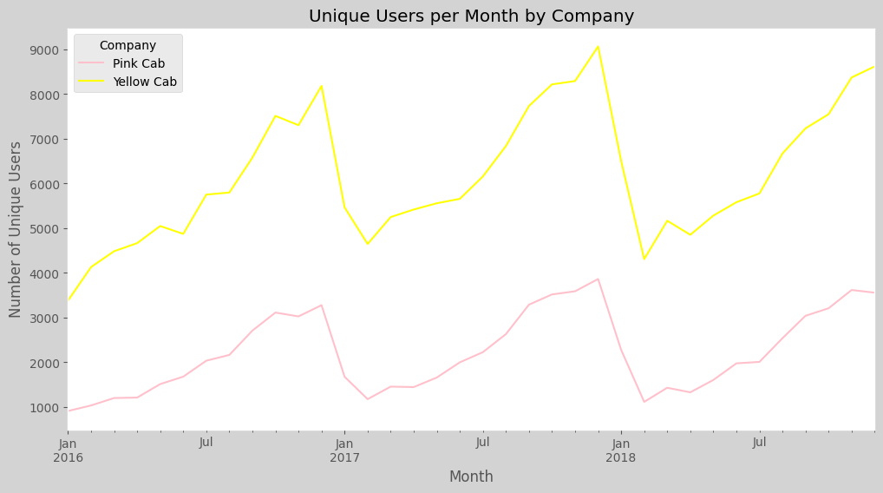
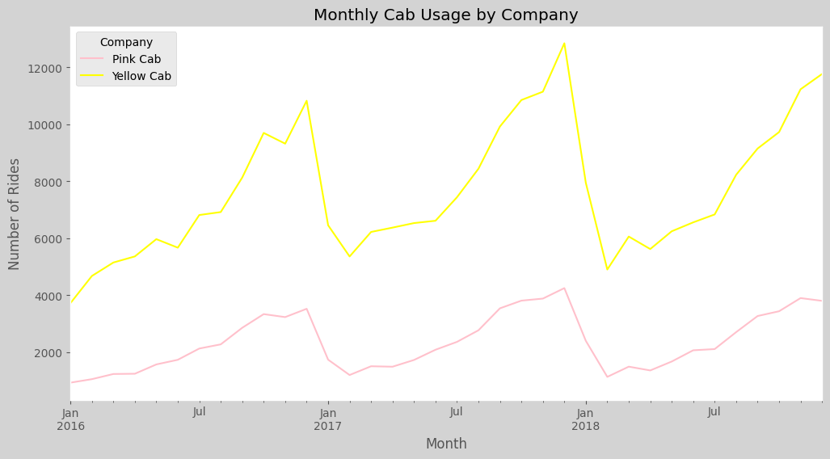
Time Series Analysis
The trends in monthly cab usage for Yellow Cab and Pink Cab are similar.
Peaks in one company’s user base are mirrored by peaks in the other’s.
The similar trends suggest that external factors (e.g., seasonality, events) impact both companies equally.

Slide 13
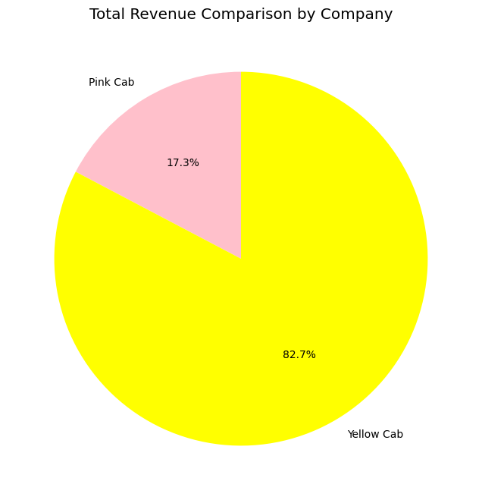

Total User vs. Total Revenue
Yellow Cab has a higher number of users compared to Pink Cab, with a ratio of approximately 0.8:1.

Slide 14
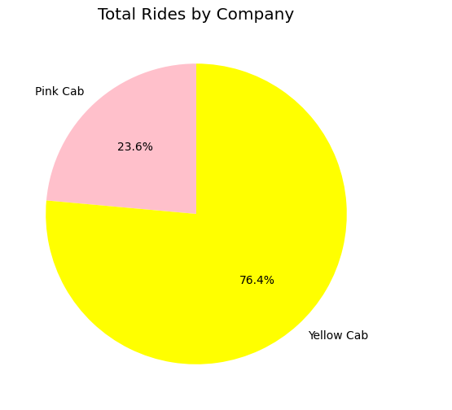
Total Revenue vs Total Rides
Yellow Cab leads in both total revenue and total rides, indicating a strong market position in terms of both volume and revenue generation.

Slide 15
Hypothesis Testing
Impact of Distance on Revenue
Cab Usage and City Population
Certain demographic groups (age, gender, income) influence on cab services usage.
Contribution of Repeat Customers to Total Revenue
Age Group Preferences for Cab Companies
Notes:
# Hypothesis 1: Impact of Distance on Revenue # H0 (Null Hypothesis): There is no difference in the average revenue per kilometer between Yellow Cab and Pink Cab. # H1 (Alternative Hypothesis): Yellow Cab has a higher average revenue per kilometer compared to Pink Cab. # Hypothesis 1: t-statistic = -320.9807762543478, p-value = 0.0 # Hypothesis 2: Cab Usage and City Population # H0 (Null Hypothesis): There is no difference in the number of users per city between Yellow Cab and Pink Cab. # H1 (Alternative Hypothesis): Yellow Cab has more users per city compared to Pink Cab in the majority of cities, # indicating stronger market penetration in larger urban areas. # Hypothesis 2: t-statistic = -1.4634295900210088, p-value = 0.1520272056721823 # Hypothesis 3: Certain demographic groups (age, gender, income) influence on cab services usage. # H0 (Null Hypothesis): There is no difference in cab usage based on demographic groups (age, gender, income) between Yellow Cab and Pink Cab. # H1 (Alternative Hypothesis): There are significant differences in cab usage based on demographic groups, with more # females using cab services compared to males, and similar income and age distributions for both companies. # Hypothesis 3 (Gender): chi2 = 107.22063897254299, p-value = 3.982674650131372e-25 # Hypothesis 3 (Age): t-statistic = -0.3777700356771092, p-value = 0.7056016582376317 # Hypothesis 3 (Income): t-statistic = 0.42711269788899975, p-value = 0.6692975005750657 # Hypothesis 4: Contribution of Repeat Customers to Total Revenue # H0 (Null Hypothesis): There is no difference in the contribution of repeat customers to total revenue between Yellow Cab and Pink Cab. # H1 (Alternative Hypothesis): Yellow Cab has a higher proportion of repeat customers contributing to its total revenue compared to Pink Cab. # Additionally, there is a notable segment of customers who use both cab services. # Hypothesis 4: z-statistic = -39.3617148837474, p-value = 0.0 # Hypothesis 5: Age Group Preferences for Cab Companies # H0 (Null Hypothesis): There is no difference in age group preferences for either cab company. # H1 (Alternative Hypothesis): The age group analysis suggests no significant preference for either cab company within # specific age groups, indicating that both Pink Cab and Yellow Cab serve customers across all age ranges fairly evenly. # Hypothesis 5: chi2 = 18.95665910841074, p-value = 0.0019581936565151313

Slide 16
Impact of Distance on Revenue
H0 (Null Hypothesis): There is no difference in the average revenue per kilometer between Yellow Cab and Pink Cab.
H1 (Alternative Hypothesis): Yellow Cab has a higher average revenue per kilometer compared to Pink Cab.
t-statistic = -320.98
p-value = 0.0
Reject the null hypothesis. Yellow Cab generates significantly higher revenue per kilometer than Pink Cab, indicating more efficient pricing or higher value trips.

Slide 17
Cab Usage and City Population
H0 (Null Hypothesis): There is no difference in the number of users per city between Yellow Cab and Pink Cab.
H1 (Alternative Hypothesis): Yellow Cab has more users per city compared to Pink Cab in the majority of cities, indicating stronger market penetration in larger urban areas.
t-statistic = -1.463
p-value = 0.152
Fail to reject the null hypothesis. There is no significant difference in the number of users per city between Yellow Cab and Pink Cab.

Slide 18
Certain demographic groups (age, gender, income) influence on cab services usage.
H0 (Null Hypothesis): There is no difference in cab usage based on demographic groups (age, gender, income) between Yellow Cab and Pink Cab.
H1 (Alternative Hypothesis): There are significant differences in cab usage based on demographic groups, with more females using cab services compared to males, and similar income and age distributions for both companies.
Gender: chi2 = 107.2, p-value = 3.98e-25
Age: t-statistic = -0.378
p-value = 0.706
Income: t-statistic = 0.427, p-value = 0.6692975005750657
Gender: Reject the null hypothesis. There are significant differences in cab usage based on gender, with more females using cab services.
Age: Fail to reject the null hypothesis. There is no significant difference in cab usage based on age.
Income: Fail to reject the null hypothesis. There is no significant difference in cab usage based on income.

Slide 19
Contribution of Repeat Customers to Total Revenue
H0 (Null Hypothesis): There is no difference in the contribution of repeat customers to total revenue between Yellow Cab and Pink Cab.
H1 (Alternative Hypothesis): Yellow Cab has a higher proportion of repeat customers contributing to its total revenue compared to Pink Cab. Additionally, there is a notable segment of customers who use both cab services.
z-statistic = -39.362
p-value = 0.0
Reject the null hypothesis. Yellow Cab has a significantly higher proportion of repeat customers contributing to its total revenue.

Slide 20
Age Group Preferences for Cab Companies
# H0 (Null Hypothesis): There is no difference in age group preferences for either cab company.
# H1 (Alternative Hypothesis): The age group analysis suggests no significant preference for either cab company within specific age groups, indicating that both Pink Cab and Yellow Cab serve customers across all age ranges fairly evenly.
chi2 = 18.957
p-value = 0.002
Reject the null hypothesis. There is no significant preference for either cab company within specific age groups, indicating that both companies serve customers across all age ranges fairly evenly

Slide 21
EDA Summary
Yellow Cab generates significantly higher revenue per kilometer.
No significant difference in the number of users per city between Yellow Cab and Pink Cab.
Significant gender-based differences in cab usage, with more females using cab services.
No significant differences in cab usage based on age or income.
Higher contribution of repeat customers to Yellow Cab's total revenue.

Slide 22

Recommendations
Invest in Yellow Cab
Market Share: 55.2% compared to 44.8%.
Revenue Generation: Higher revenue per kilometer.
Repeated Customer: Higher repeating customers.
Ride Count & Usage: Higher total revenue & total rides.
Pink Cab has potential…

Slide 23

Recommendations
Invest in Yellow Cab but leave room for Pink Cab’s potential
Significant User Base: Pink Cab still holds a significant market share with 44.8% , although less than Yellow Cab, still a significant number due to its low revenue.
Similar Demographics: Share the same market as Yellow Cab.
Repeating Customers: Although slightly behind Yellow Cab, Pink Cab has a notable proportion of repeat customers.
Overall Usage: The monthly usage trends for Pink Cab mirror those of Yellow Cab.

Slide 24
Thank You

