Slide 1


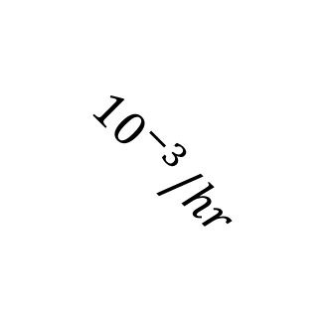
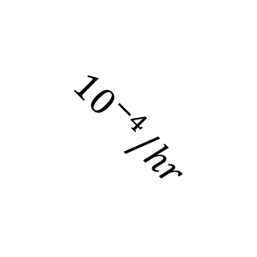
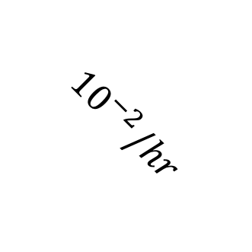
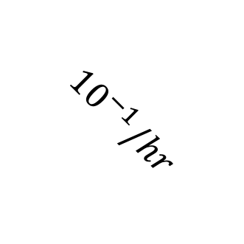
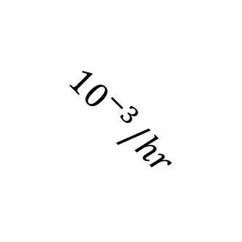
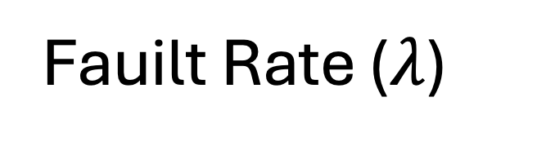
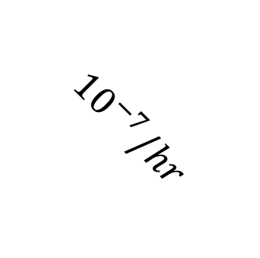
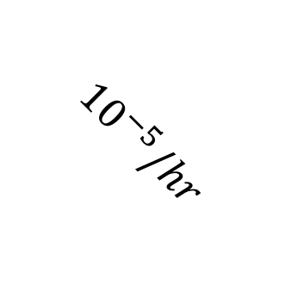
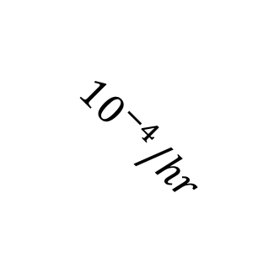
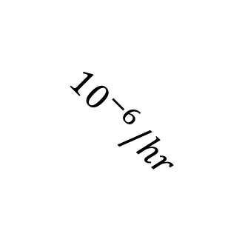
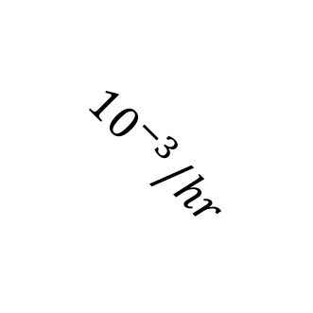
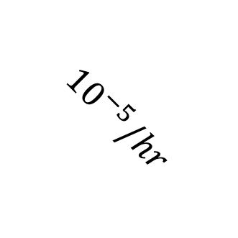
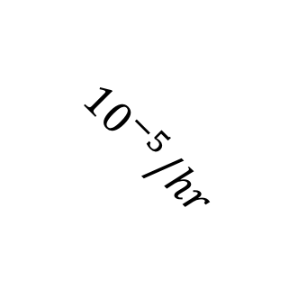
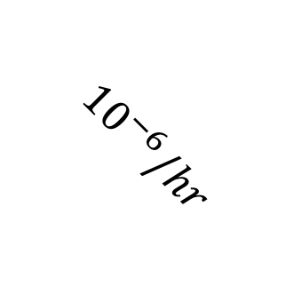
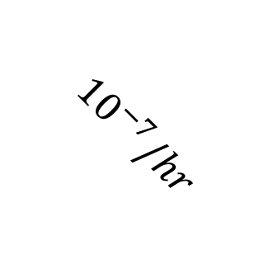
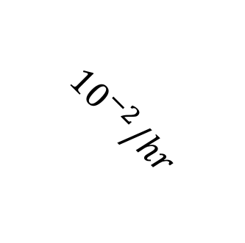
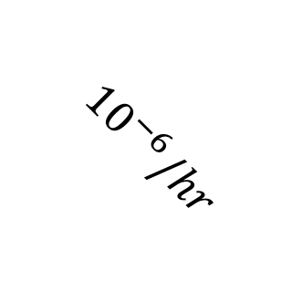
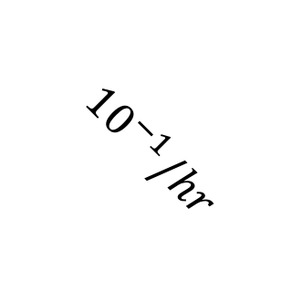
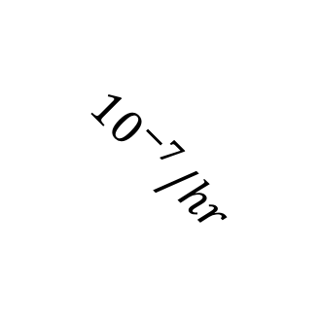
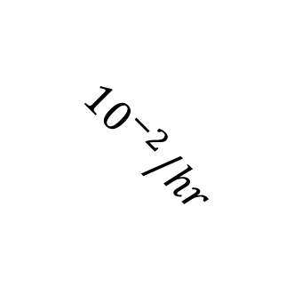
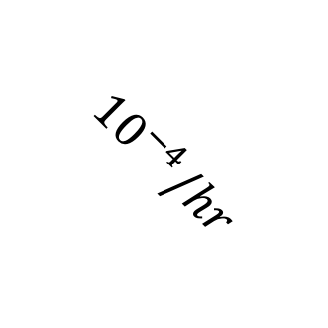
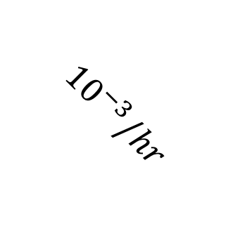
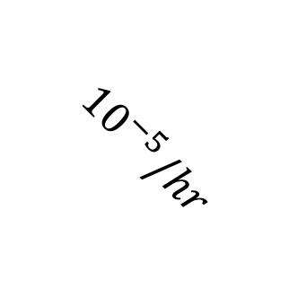
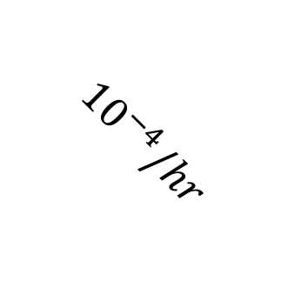
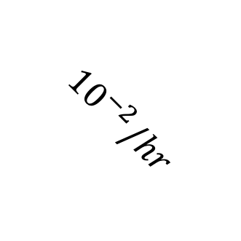
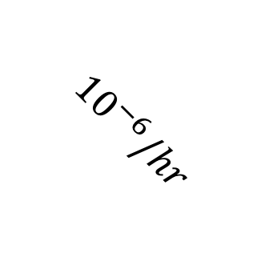
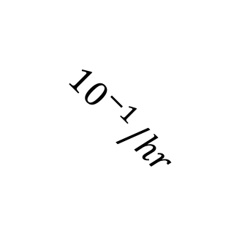
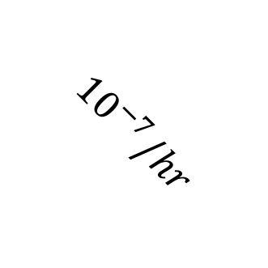
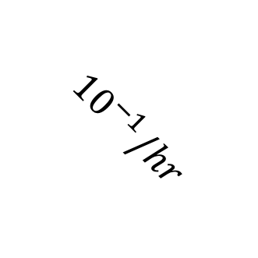
N = 5
N =10
N =25
N =50
U = 0.1
Number of Tasks that are Feasible by EDF Scheduler and Meet Required Failure Rate
U = 0.2
U = 0.3
U = 0.4
U = 0.5
$${10}^{−6}/hr$$
$${10}^{−4}/hr$$
$${10}^{−2}/hr$$
$${10}^{−4}/hr$$
$${10}^{−4}/hr$$
$${10}^{−6}/hr$$
$${10}^{−4}/hr$$
$${10}^{−2}/hr$$
$${10}^{−7}/hr$$
$${10}^{−5}/hr$$
$${10}^{−1}/hr$$
$${10}^{−6}/hr$$
$${10}^{−2}/hr$$
$${10}^{−6}/hr$$
$${10}^{−2}/hr$$
$${10}^{−5}/hr$$
$${10}^{−1}/hr$$
$${10}^{−3}/hr$$
$${10}^{−5}/hr$$
$${10}^{−1}/hr$$
$${10}^{−5}/hr$$
$${10}^{−7}/hr$$
$${10}^{−3}/hr$$
$${10}^{−7}/hr$$
$${10}^{−3}/hr$$
$${10}^{−7}/hr$$
$${10}^{−1}/hr$$
$${10}^{−3}/hr$$
Fauilt Rate ($λ$)

Slide 2
N = 5
N =10
N =25
N =50
U = 0.1
Number of Tasks that are Feasible by EDF Scheduler and Meet Required Failure Rate
U = 0.2
U = 0.3
U = 0.4
U = 0.5
$${10}^{−6}/hr$$
$${10}^{−4}/hr$$
$${10}^{−2}/hr$$
$${10}^{−4}/hr$$
$${10}^{−4}/hr$$
$${10}^{−6}/hr$$
$${10}^{−4}/hr$$
$${10}^{−2}/hr$$
$${10}^{−7}/hr$$
$${10}^{−5}/hr$$
$${10}^{−1}/hr$$
$${10}^{−6}/hr$$
$${10}^{−2}/hr$$
$${10}^{−6}/hr$$
$${10}^{−2}/hr$$
$${10}^{−5}/hr$$
$${10}^{−1}/hr$$
$${10}^{−3}/hr$$
$${10}^{−5}/hr$$
$${10}^{−1}/hr$$
$${10}^{−5}/hr$$
$${10}^{−7}/hr$$
$${10}^{−3}/hr$$
$${10}^{−7}/hr$$
$${10}^{−3}/hr$$
$${10}^{−7}/hr$$
$${10}^{−1}/hr$$
$${10}^{−3}/hr$$
Fauilt Rate ($λ$)

