Slide 1

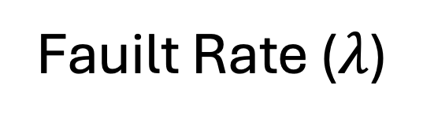

































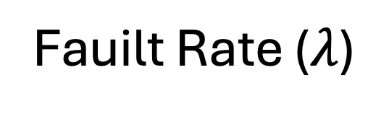









N = 5
N =10
N =25
N =50
N = 5
N =10
N =25
N =50
1
1
Utilization = 0.1
Utilization = 0.1
0.5
0.5
0
0
1
1
Ratio of Tasks that are Feasible by EDF Scheduler and Meet Required Failure Rate
Utilization = 0.2
Utilization = 0.2
0.5
0.5
0
0
1
1
Utilization = 0.3
Utilization = 0.3
0.5
0.5
0
0
1
1
0.5
Utilization = 0.4
Utilization = 0.4
0.5
0
0
1
1
Utilization = 0.5
Utilization = 0.5
0.5
0.5
0
0
$${10}^{−6}/hr$$
$${10}^{−6}/hr$$
$${10}^{−6}/hr$$
$${10}^{−7}/hr$$
$${10}^{−6}/hr$$
$${10}^{−7}/hr$$
$${10}^{−6}/hr$$
$${10}^{−7}/hr$$
$${10}^{−6}/hr$$
$${10}^{−7}/hr$$
$${10}^{−5}/hr$$
$${10}^{−7}/hr$$
$${10}^{−6}/hr$$
$${10}^{−7}/hr$$
$${10}^{−6}/hr$$
$${10}^{−5}/hr$$
$${10}^{−4}/hr$$
$${10}^{−7}/hr$$
$${10}^{−5}/hr$$
$${10}^{−7}/hr$$
$${10}^{−5}/hr$$
$${10}^{−4}/hr$$
$${10}^{−2}/hr$$
$${10}^{−5}/hr$$
$${10}^{−5}/hr$$
$${10}^{−4}/hr$$
$${10}^{−4}/hr$$
$${10}^{−2}/hr$$
$${10}^{−3}/hr$$
$${10}^{−4}/hr$$
$${10}^{−5}/hr$$
$${10}^{−4}/hr$$
$${10}^{−2}/hr$$
$${10}^{−5}/hr$$
$${10}^{−2}/hr$$
$${10}^{−3}/hr$$
$${10}^{−1}/hr$$
$${10}^{−2}/hr$$
$${10}^{−4}/hr$$
$${10}^{−2}/hr$$
$${10}^{−3}/hr$$
$${10}^{−4}/hr$$
$${10}^{−3}/hr$$
$${10}^{−1}/hr$$
$${10}^{−3}/hr$$
$${10}^{−2}/hr$$
$${10}^{−3}/hr$$
$${10}^{−1}/hr$$
$${10}^{−2}/hr$$
$${10}^{−1}/hr$$
$${10}^{−1}/hr$$
$${10}^{−3}/hr$$
$${10}^{−1}/hr$$
$${10}^{−3}/hr$$
$${10}^{−1}/hr$$
$${10}^{−1}/hr$$
Fauilt Rate ($λ$)
Fauilt Rate ($λ$)
(a) OpenRISC
(b) RISC-V

Slide 3














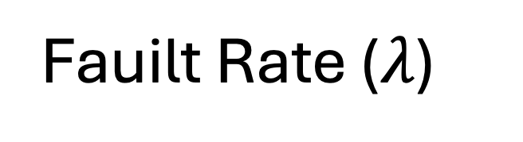















N = 5
N =10
N =25
N =50
1
0.5
Utilization = 0.1
0
1
Ratio of Tasks that are Feasible by EDF Scheduler and Meet Required Failure Rate
Utilization = 0.2
0.5
0
1
0.5
Utilization = 0.3
0
1
Utilization = 0.4
0.5
0
1
Utilization = 0.5
0.5
0
$${10}^{−4}/hr$$
$${10}^{−4}/hr$$
$${10}^{−6}/hr$$
$${10}^{−2}/hr$$
$${10}^{−4}/hr$$
$${10}^{−4}/hr$$
$${10}^{−6}/hr$$
$${10}^{−2}/hr$$
$${10}^{−7}/hr$$
$${10}^{−5}/hr$$
$${10}^{−1}/hr$$
$${10}^{−6}/hr$$
$${10}^{−2}/hr$$
$${10}^{−6}/hr$$
$${10}^{−2}/hr$$
$${10}^{−5}/hr$$
$${10}^{−1}/hr$$
$${10}^{−3}/hr$$
$${10}^{−5}/hr$$
$${10}^{−1}/hr$$
$${10}^{−5}/hr$$
$${10}^{−7}/hr$$
$${10}^{−3}/hr$$
$${10}^{−7}/hr$$
$${10}^{−3}/hr$$
$${10}^{−7}/hr$$
$${10}^{−1}/hr$$
$${10}^{−3}/hr$$
Fauilt Rate ($λ$)

Slide 5


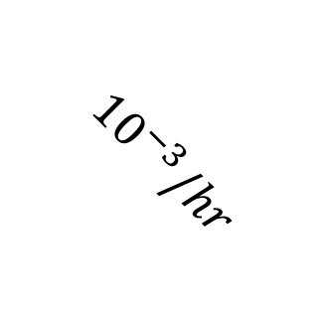
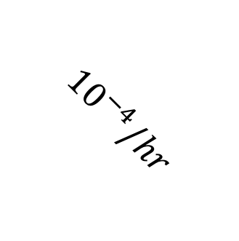
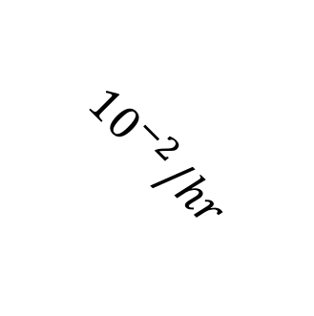
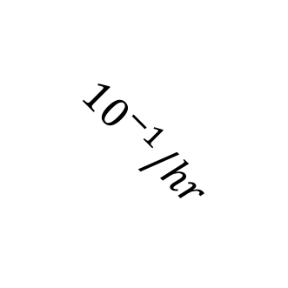
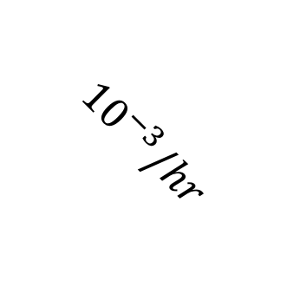
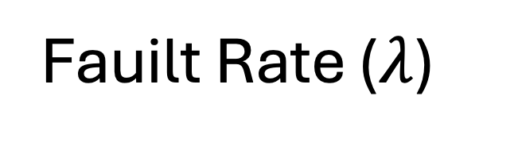
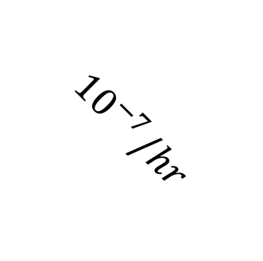
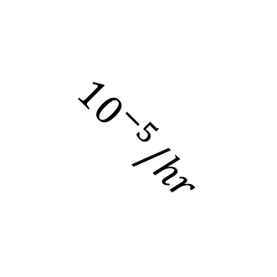
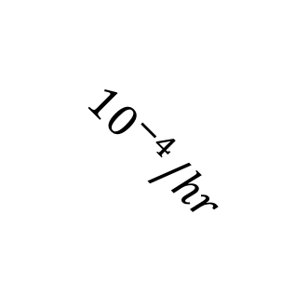
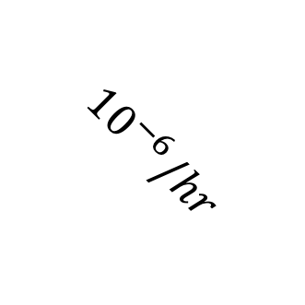
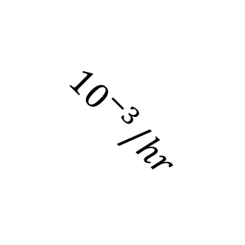
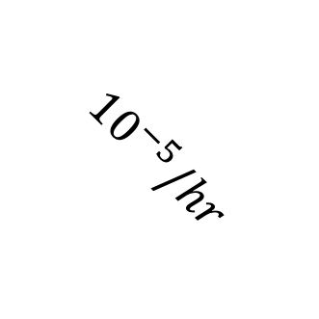
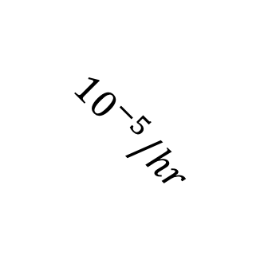
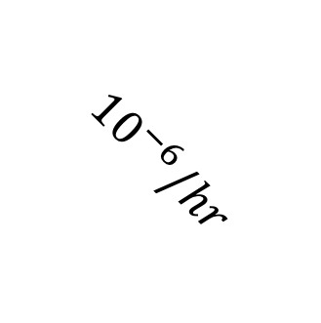
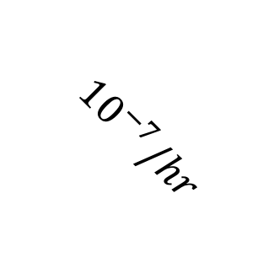
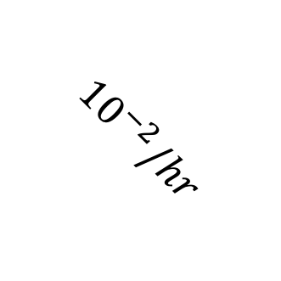
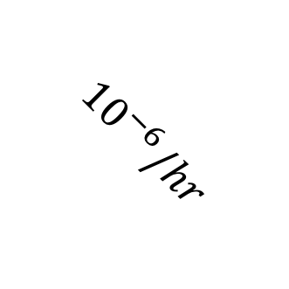
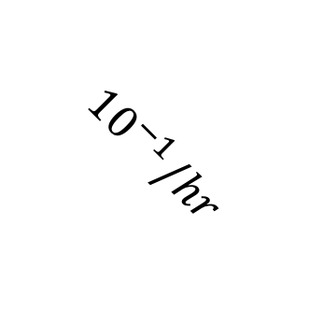
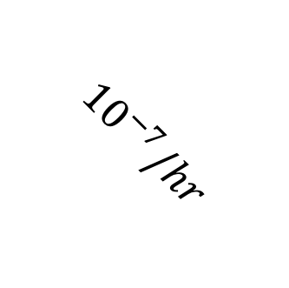
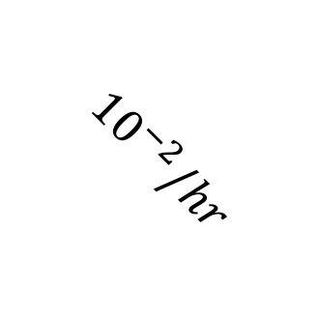
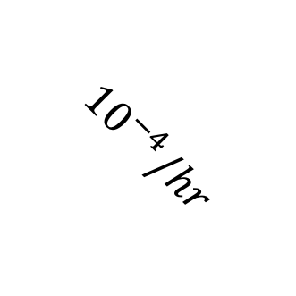
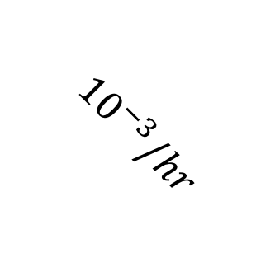
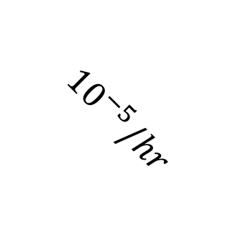
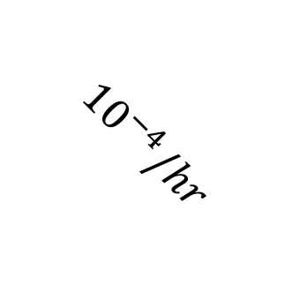
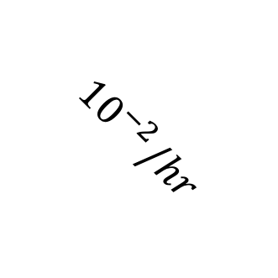
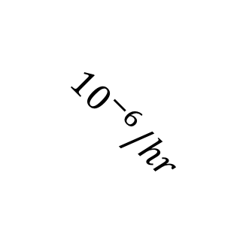
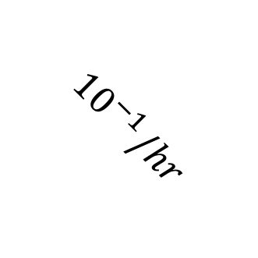
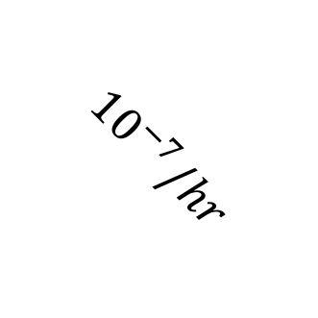
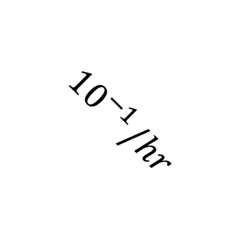
N = 5
N =10
N =25
N =50
U = 0.1
Number of Tasks that are Feasible by EDF Scheduler and Meet Required Failure Rate
U = 0.2
U = 0.3
U = 0.4
U = 0.5
$${10}^{−6}/hr$$
$${10}^{−4}/hr$$
$${10}^{−2}/hr$$
$${10}^{−4}/hr$$
$${10}^{−4}/hr$$
$${10}^{−6}/hr$$
$${10}^{−4}/hr$$
$${10}^{−2}/hr$$
$${10}^{−7}/hr$$
$${10}^{−5}/hr$$
$${10}^{−1}/hr$$
$${10}^{−6}/hr$$
$${10}^{−2}/hr$$
$${10}^{−6}/hr$$
$${10}^{−2}/hr$$
$${10}^{−5}/hr$$
$${10}^{−1}/hr$$
$${10}^{−3}/hr$$
$${10}^{−5}/hr$$
$${10}^{−1}/hr$$
$${10}^{−5}/hr$$
$${10}^{−7}/hr$$
$${10}^{−3}/hr$$
$${10}^{−7}/hr$$
$${10}^{−3}/hr$$
$${10}^{−7}/hr$$
$${10}^{−1}/hr$$
$${10}^{−3}/hr$$
Fauilt Rate ($λ$)

Slide 6
N = 5
N =10
N =25
N =50
U = 0.1
Number of Tasks that are Feasible by EDF Scheduler and Meet Required Failure Rate
U = 0.2
U = 0.3
U = 0.4
U = 0.5
$${10}^{−6}/hr$$
$${10}^{−4}/hr$$
$${10}^{−2}/hr$$
$${10}^{−4}/hr$$
$${10}^{−4}/hr$$
$${10}^{−6}/hr$$
$${10}^{−4}/hr$$
$${10}^{−2}/hr$$
$${10}^{−7}/hr$$
$${10}^{−5}/hr$$
$${10}^{−1}/hr$$
$${10}^{−6}/hr$$
$${10}^{−2}/hr$$
$${10}^{−6}/hr$$
$${10}^{−2}/hr$$
$${10}^{−5}/hr$$
$${10}^{−1}/hr$$
$${10}^{−3}/hr$$
$${10}^{−5}/hr$$
$${10}^{−1}/hr$$
$${10}^{−5}/hr$$
$${10}^{−7}/hr$$
$${10}^{−3}/hr$$
$${10}^{−7}/hr$$
$${10}^{−3}/hr$$
$${10}^{−7}/hr$$
$${10}^{−1}/hr$$
$${10}^{−3}/hr$$
Fauilt Rate ($λ$)

