Slide 1


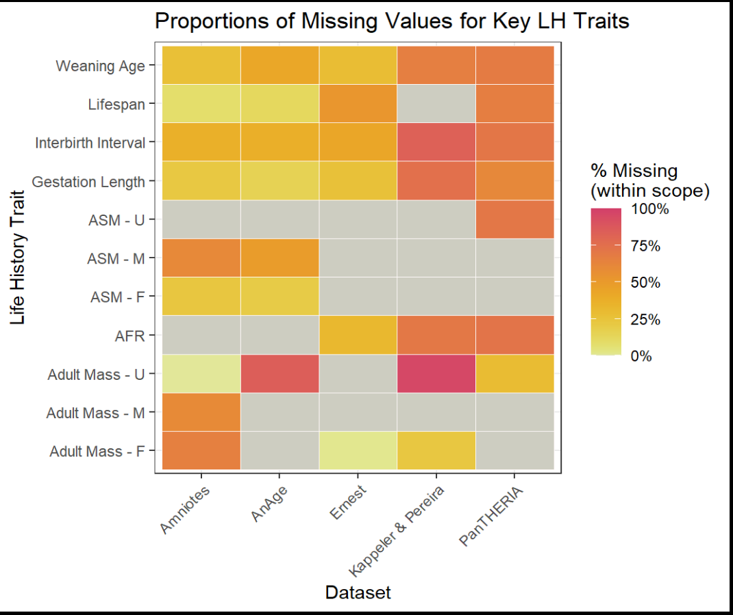
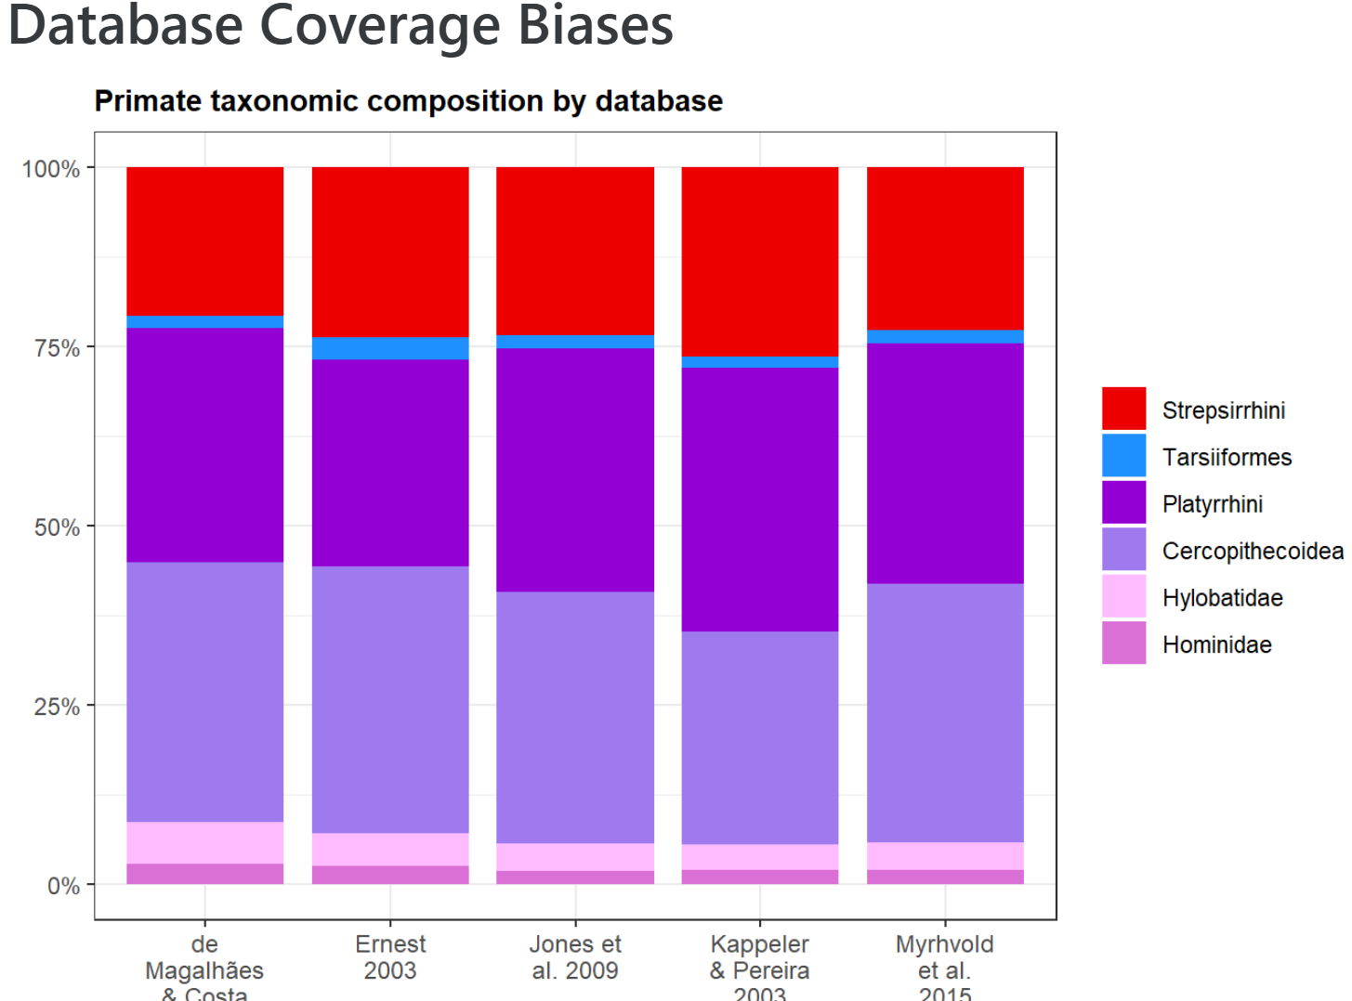
An investigation of primate life-history database quality
G. L. Gentry Miller¹, Nicole Merullo¹, Carolyn Hodges-Simeon¹, Benjamin J Finkel²
¹ Department of Anthropology, Boston University, ² <Department of Anthropology>, Dartmouth College
REFERENCES
Borries, C., Gordon, A. D., & Koenig, A. (2013). Beware of Primate Life History Data: A Plea for Data Standards and a Repository. PLOS ONE, 8(6), e67200.
Ernest, S.K.M. (2003), LIFE HISTORY CHARACTERISTICS OF PLACENTAL NONVOLANT MAMMALS. Ecology, 84: 3402-3402.
de Magalhães JP, Costa J. A database of vertebrate longevity records and their relation to other life-history traits. J Evol Biol. 2009 Aug;22(8):1770-4.
de Magalhães, J. P., Abidi, Z., Dos Santos, G. A., et al. (2024) "Human Ageing Genomic Resources: updates on key databases in ageing research." Nucleic Acids Research 52(D1):D900-D908.
Harvey, P. H., & Clutton-Brock, T. H. (1985). Life History Variation in Primates. Evolution, 39(3), 559–581.
Mittermeier, R. (2025). 2024-2025 Report of the Primate Specialist Group. In: IUCN SSC and Secretariat. Species: Annual Report of the IUCN Species Survival Commission and Secretariat 2024-2025. Gland, Switzerland: IUCN. 12 pp.
Jones, K. E., Bielby, J., Cardillo, M., et al. (2009). PanTHERIA: A species-level database of life history, ecology, and geography of extant and recently extinct mammals. Ecology, 90(9), 2648–2648.
Kappeler, P. M., Pereira, M. E., & Schaik, C. P. v. (2003). Primate life histories and socioecology. In P. M. Kappeler & M. E. Pereira (Eds.), Primate life histories and socioecology (pp. 1–20). The University of Chicago Press.
Myhrvold, N.P., Baldridge, E., Chan, B., et al. (2015), An amniote life-history database to perform comparative analyses with birds, mammals, and reptiles. Ecology, 96: 3109-3109.
Stearns, S. C. (1989). Trade-Offs in Life-History Evolution. Functional Ecology, 3(3), 259.
Stott, I., Salguero-Gómez, R., Jones, O. R., et al. (2024). Life histories are not just fast or slow. Trends in Ecology & Evolution, 39(9), 830–840.
Strier KB, Altmann J, Brockman DK, et al. (2010) The Primate Life History Database: A unique shared ecological data resource. Methods Ecol Evol., 1(2):199-211.
INTRODUCTION
Life history (LH) theory provides us with a lexicon of variables that characterize the timing and durations of growth and reproduction to maximize fitness. [5, 10]
Quantifying life history traits requires abundant, high-quality, longitudinal data to observe and infer population-level rates. [5, 11]
Life history strategies are defined by covariation [11], complicating investigations when some traits are unrecorded for a focal species.
Researchers face consistent methodological challenges in collating LH data for inter-species comparisons [1, 5, 11, 12], such as:
Access to a substantial taxonomic range
Differences in variable definitions and units
Discrepancies in data quality
Choosing appropriate variables for their study
METHODS
We selected datasets based on those used in [1] and through literature review, choosing [3,4] and [9] because they contain a large range of primary data.
We generated descriptive statistics of the data (i.e. n species, n variables, etc.) to compare their structures and find common variables.
We selected seven key LH traits commonly studied in primates and shared across all or most of our datasets.
We compared these datasets using three metrics:
The presence of values for key traits:
For each database, we quantified the proportion of values equivalent to “NA” for all available key traits for each species.
Taxonomic representation and biases:
We quantified the relative proportions of primate species at the family level and compared each database to examine biases in species coverage.
Metadata accessibility and content:
We designed a rubric to objectively score the metadata availability, accessibility, and content of each dataset.
We quantified the proportion of variables described by the authors and evaluated the detail of description based on the presence of variable units, statistic type, and citation.
Additionally, we attempted to validate the division of age of sexual maturity across species into sex classes by comparison to the dimorphism rates of body mass.
OBJECTIVES
To examine the primate LH characteristics of the Ernest [2], AnAge [3, 4], PanTHERIA [7], Kappeler & Pereira [8], and Amniotes [9] databases.
To address consistency and usage issues for researchers who want to employ life history data
To offer recommendations for best practices when using collated primate LH data
Figure 1. Heat map of missing values for key life history traits across all five databases. Low heat (yellow) signifies few missing values while high heat (red) signifies many missing values. Grey indicates that the trait was not recorded in a particular source.
Table with descriptive stats for databases
scores from table below
n primate variables
p missing values for key traits
n species
etc.
ACKNOWLEDGEMENTS
RESULTS
< Variable Definitions Table(s)>
HOW TO CONVERT THIS PAGE INTO ONE READABLE TABLE?
https://bygentry.github.io/LHDB-PCA/Variable-Definitions.html
remove notes column
include unit discrepancies (mo vs days, grams vs kg, etc.) to illustrate influence of researchers personal choices and callback borries statement
“one would assume that researchers have long since agreed upon life history definitions and are using reliable and accurate data stored in standardized repositories”
is the best way to have 7 small 5x3 tables (one for each key LH trait) with the 3 fields being source, unit, description?
highlight that no database reports both ASM and AFR
CONCLUSIONS & FUTURE RESEARCH
L
L
L
L
L
L

