Slide 1


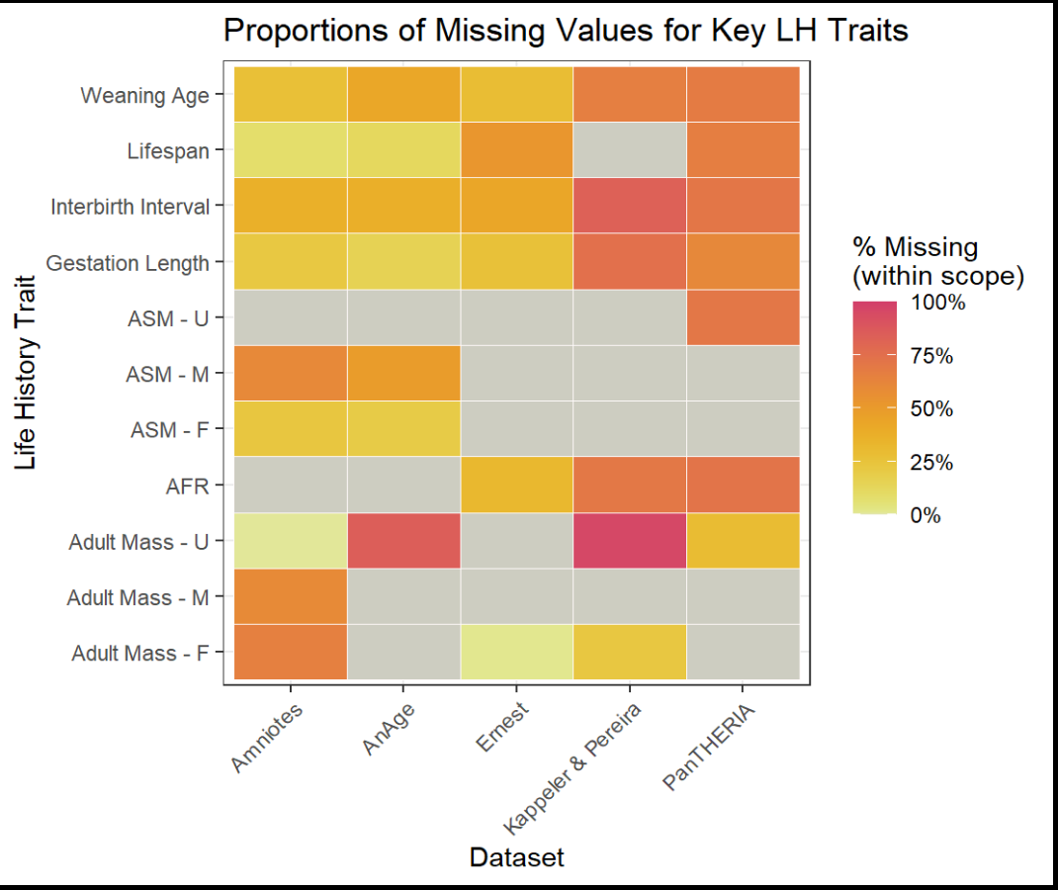
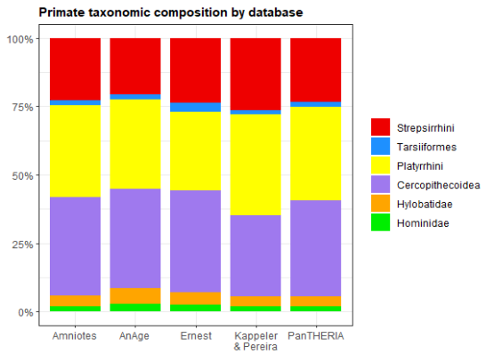
An investigation of primate life-history database quality
G. L. Gentry Miller¹, Nicole Merullo¹, Carolyn Hodges-Simeon¹, Benjamin J Finkel²
¹ Department of Anthropology, Boston University, ² Department of Anthropology, Dartmouth College
REFERENCES
Borries, C., Gordon, A. D., & Koenig, A. (2013). Beware of Primate Life History Data: A Plea for Data Standards and a Repository. PLOS ONE, 8(6), e67200. https://doi.org/10.1371/journal.pone.0067200
Ernest, S.K.M. (2003), LIFE HISTORY CHARACTERISTICS OF PLACENTAL NONVOLANT MAMMALS. Ecology, 84: 3402-3402. https://doi.org/10.1890/02-9002
de Magalhães JP, Costa J. A database of vertebrate longevity records and their relation to other life-history traits. J Evol Biol. 2009 Aug;22(8):1770-4.
de Magalhães, J. P., Abidi, Z., Dos Santos, G. A., et al. (2024) "Human Ageing Genomic Resources: updates on key databases in ageing research." Nucleic Acids Research 52(D1):D900-D908.
Harvey, P. H., & Clutton-Brock, T. H. (1985). Life History Variation in Primates. Evolution, 39(3), 559–581. https://doi.org/10.1111/j.1558-5646.1985.tb00395.x
Mittermeier, R. (2025). 2024-2025 Report of the Primate Specialist Group. In: IUCN SSC and Secretariat. Species: Annual Report of the IUCN Species Survival Commission and Secretariat 2024-2025. Gland, Switzerland: IUCN. 12 pp.
Jones, K. E., Bielby, J., Cardillo, M., et al. (2009). PanTHERIA: A species-level database of life history, ecology, and geography of extant and recently extinct mammals. Ecology, 90(9), 2648–2648. https://doi.org/10.1890/08-1494.1
Kappeler, P. M., Pereira, M. E., & Schaik, C. P. v. (2003). Primate life histories and socioecology. In P. M. Kappeler & M. E. Pereira (Eds.), Primate life histories and socioecology (pp. 1–20). The University of Chicago Press.
Myhrvold, N.P., Baldridge, E., Chan, B., et al. (2015), An amniote life-history database to perform comparative analyses with birds, mammals, and reptiles. Ecology, 96: 3109-3109. https://doi.org/10.1890/15-0846R.1
Stearns, S. C. (1989). Trade-Offs in Life-History Evolution. Functional Ecology, 3(3), 259. https://doi.org/10.2307/2389364
Stott, I., Salguero-Gómez, R., Jones, O. R., et al. (2024). Life histories are not just fast or slow. Trends in Ecology & Evolution, 39(9), 830–840. https://doi.org/10.1016/j.tree.2024.06.001
Strier KB, Altmann J, Brockman DK, et al. (2010) The Primate Life History Database: A unique shared ecological data resource. Methods Ecol Evol., 1(2):199-211. https://doi.org/10.1111/j.2041-210x.2010.00023.x
INTRODUCTION
Life history (LH) theory provides us with a lexicon of variables that characterize the timing and durations of growth and reproduction to maximize fitness. [5, 10]
Quantifying life history traits requires abundant, high-quality, longitudinal data to observe and infer population-level rates. [5, 11]
Life history strategies are defined by covariation [11], complicating investigations when some traits are unrecorded for a focal species.
Researchers face consistent methodological challenges in collating LH data for inter-species comparisons [1, 5, 11, 12], such as:
Access to a substantial taxonomic range
Differences in variable definitions and units
Discrepancies in data quality
Choosing appropriate variables for their study
METHODS
We selected datasets based on those used in [1] and through literature review, choosing [3,4] and [9] because they contain a large range of primary data.
We compared the structures of the datasets and selected seven key LH traits commonly studied in primates and shared across all or most datasets.
We compared these datasets using three metrics: The presence of values, taxonomic representation, and metadata accessibility and content.
For each database, we quantified the proportion of values equivalent to “NA” for all available key traits for each species.
We quantified the relative proportions of primate species and compared each database to examine biases in species coverage.
We designed a rubric to objectively score the metadata availability, accessibility, and content of each dataset.
We categorically scored the proportion of variables described by the authors and evaluated the detail of description based on the presence of variable units, measurement type, and citation.
We attempted to validate the division of age of sexual maturity (ASM) into sex classes by comparison to the dimorphism rates of adult body mass using Wilcoxon rank sum and signed rank tests with continuity corrections.
We evaluated the difference between ASM and age at first reproduction (AFR) when a species has data for both.
OBJECTIVES
To examine the primate LH characteristics of the Ernest [2], AnAge [3, 4], PanTHERIA [7], Kappeler & Pereira [8], and Amniotes [9] databases.
To address consistency and usage issues for researchers who want to employ life history data
To offer recommendations for best practices when using collated primate LH data
Figure 1. Heat map of missing values for key life history traits across all five databases. Low heat (yellow) signifies few missing values while high heat (red) signifies many missing values. Grey indicates that the trait was not recorded in a particular source.
Table 1. Descriptive statistics of primate life-history statistics for each database. AnAge is the only database that is continually updated, with its last update in 2023. Each database has fewer missing values for our selected key life-history traits compared to all recorded statistics.
Source | N species | P species represented | Meta-data Score (x/8) | N LH vars | P missing values (Key) | P missing values (All)
Amniotes | 365 | .68 | 8 | 23 | .34 | .54
AnAge | 174 | .33 | 3 | 19 | .37 | .46
Ernest | 156 | .29 | 8 | 9 | .31 | .32
Kappeler & Pereira | 310 | .58 | 5 | 13 | .69 | .76
PanTHERIA | 376 | .70 | 7 | 29 | .63 | .72
Table 2. Example discrepancies in how key LH traits are recorded differently between databases. IBI = Inter-birth interval.
Variable | N unit types | Description | Database Comparison
Weaning Age | 2 | Mean duration from birth to solid food transition | [2] defines as eating solid food, [7] as first solid food OR last nursing
IBI | 4 | Mean duration between successive births | [2] records litters/year, [7] specifies between successful births
Gestation Length | 2 | Mean duration between conception and birth | [2] specifies live offspring, [7] specifies “non-inactive” fetal growth
RESULTS
No dataset represented more than 70% of recognized primate species.
All datasets did not record at least two of our “key” LH traits.
Between datasets, mean proportions of missing values for key traits ranged from 30.7 to 68.8%.
[8] demonstrated the highest proportion of missing values
Of the traits recorded in multiple datasets, AFR was the least complete among pooled data with a proportion of missing values equal to .653.
Metadata content varied from complete and detailed to largely unavailable. For those with available metadata, quality and detail also ranged.
ASM was significantly less dimorphic than adult mass across primates and within species (p < .00001 & p < .001).
Despite dramatic differences in the number of species recorded, all datasets maintain relatively equal proportions of cladistic representation.
DISCUSSION
Existing datasets lack consistency in which traits are recorded, which species are included, and how traits are defined and measured.
Ex: [2], [7], and [8] report AFR while [3,4] and [9] report ASM. Of the 117 species with data for both, AFR is younger than ASM for 82%.
Ex: IBI descriptions for Amniotes & PanTHERIA specify live offspring, while KP doesn’t specify; AnAge lacks any description of IBI, and Ernest does not record data for IBI.
When designing a study, researchers should carefully consider which variables to use and how their specific source defines them.
When collating many datasets, researchers should be aware of redundant data points and inconsistent recording methods.
When compiling life history data, researchers should maintain thorough and accessible metadata to aid researchers using their dataset.
Going forward, anthropologists must come together to establish LH data collection protocols and a standardized repository filled with reliable and accurate data.
ACKNOWLEDGEMENTS
Special thanks to Dr. Finkel and Dr. Hodges-Simeon for their continued support and to Nicole Merullo for her commitment and mentorship. We are grateful to Boston University and Dartmouth College, the American Association of Biological Anthropologists (AABA), and the AABA Committee of Diversity for facilitating scientific inquiry.
Figure 2. Relative proportions of different primate clades for each database.

