Slide 1


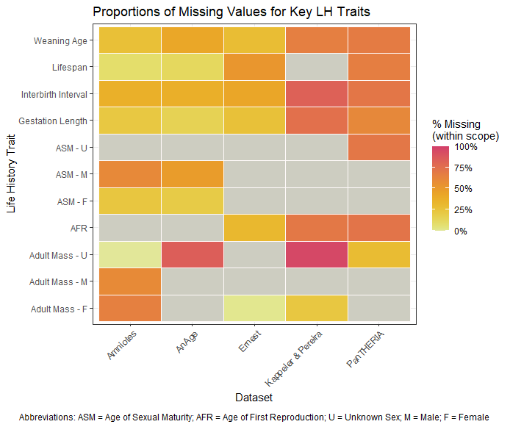
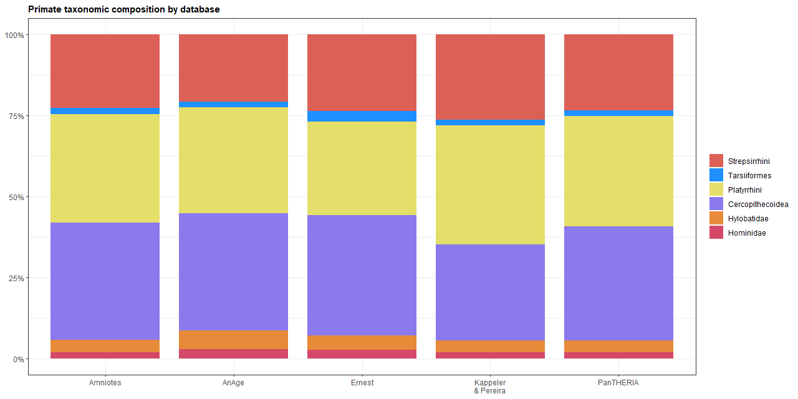
An investigation of primate life-history database quality
G. L. Gentry Miller¹, Nicole Merullo¹, Carolyn Hodges-Simeon¹, Benjamin J Finkel²
¹ Department of Anthropology, Boston University, ² Department of Anthropology, Dartmouth College
REFERENCES
Harvey, P. H., & Clutton-Brock, T. H. (1985). Life History Variation in Primates. Evolution, 39(3), 559–581. https://doi.org/10.1111/j.1558-5646.1985.tb00395.x
Stearns, S. C. (1989). Trade-Offs in Life-History Evolution. Functional Ecology, 3(3), 259. https://doi.org/10.2307/2389364
Stott, I., Salguero-Gómez, R., Jones, O. R., et al. (2024). Life histories are not just fast or slow. Trends in Ecology & Evolution, 39(9), 830–840. https://doi.org/10.1016/j.tree.2024.06.001
Strier KB, Altmann J, Brockman DK, et al. (2010) The Primate Life History Database: A unique shared ecological data resource. Methods Ecol Evol., 1(2):199-211. https://doi.org/10.1111/j.2041-210x.2010.00023.x
Borries, C., Gordon, A. D., & Koenig, A. (2013). Beware of Primate Life History Data: A Plea for Data Standards and a Repository. PLOS ONE, 8(6), e67200. https://doi.org/10.1371/journal.pone.0067200
Ernest, S.K.M. (2003), LIFE HISTORY CHARACTERISTICS OF PLACENTAL NONVOLANT MAMMALS. Ecology, 84: 3402-3402. https://doi.org/10.1890/02-9002
de Magalhães JP, Costa J. A database of vertebrate longevity records and their relation to other life-history traits. J Evol Biol. 2009 Aug;22(8):1770-4.
de Magalhães, J. P., Abidi, Z., Dos Santos, G. A., et al. (2024) "Human Ageing Genomic Resources: updates on key databases in ageing research." Nucleic Acids Research 52(D1):D900-D908.
Jones, K. E., Bielby, J., Cardillo, M., et al. (2009). PanTHERIA: A species-level database of life history, ecology, and geography of extant and recently extinct mammals. Ecology, 90(9), 2648–2648. https://doi.org/10.1890/08-1494.1
Kappeler, P. M., Pereira, M. E., & Schaik, C. P. v. (2003). Primate life histories and socioecology. In P. M. Kappeler & M. E. Pereira (Eds.), Primate life histories and socioecology (pp. 1–20). The University of Chicago Press.
Myhrvold, N.P., Baldridge, E., Chan, B., et al. (2015), An amniote life-history database to perform comparative analyses with birds, mammals, and reptiles. Ecology, 96: 3109-3109. https://doi.org/10.1890/15-0846R.1
Mittermeier, R. (2025). 2024-2025 Report of the Primate Specialist Group. In: IUCN SSC and Secretariat. Species: Annual Report of the IUCN Species Survival Commission and Secretariat 2024-2025. Gland, Switzerland: IUCN. 12 pp.
INTRODUCTION
Life history theory provides us with a lexicon of variables that characterize the timing and durations of growth and reproduction. [1, 2]
Quantifying life history traits requires abundant, high-quality, longitudinal data to observe and infer species-level rates. [1, 3, 4]
Life history strategies [3], complicating investigations when some traits are unrecorded for a focal species.
Researchers face consistent methodological challenges in collating LH data for inter-species comparisons [1, 3, 4, 5], such as:
Discrepancies in data quality & trait inclusion
Taxonomic representation
Differences in variable definitions
Choosing appropriate variables for their study
Table 1. Descriptive statistics of primate life-history characteristics for each database. AnAge is the only database that is continually updated, with its last update in 2023. Each database has fewer missing values for our selected key life-history traits compared to all recorded statistics.
RESULTS
No dataset represented >70% (376/535) of recognized primate species [12] (Table 1).
At least two of our key life history traits were not recorded for each dataset. (Figure 1)
Between datasets, mean proportions of missing values for key traits ranged from 30.7 to 68.8%. (Figure 1)
Of the traits recorded in multiple datasets, AFR was the least complete among pooled data with a proportion of missing values equal to .653.
Despite dramatic differences in the number of species recorded, all datasets maintain relatively equal proportions of cladistic representation. (Figure 2)
Metadata content varied from complete and detailed to largely unavailable. For those with available metadata, quality and detail also varied. (Table 2)
Source | N species | P species represented | Meta-data Score (x/8) | N LH vars | P missing values (Key) | P missing values (All)
Amniotes | 365 | .68 | 8 | 23 | .34 | .54
AnAge | 174 | .33 | 3 | 19 | .37 | .46
Ernest | 156 | .29 | 8 | 9 | .28 | .32
Kappeler & Pereira | 310 | .58 | 5 | 13 | .66 | .76
PanTHERIA | 376 | .70 | 7 | 29 | .63 | .72
OBJECTIVES
To examine the primate LH characteristics of the Ernest [6], AnAge [7, 8], PanTHERIA [9], Kappeler & Pereira [10], and Amniotes [11] databases.
To address consistency and usage issues for researchers who employ life history data
To offer recommendations for best practices when using collated primate LH data
DISCUSSION
Existing datasets lack consistency in which traits and species are included and how traits are defined and measured.
Ex: Amniotes [11] and AnAge [7, 8] divide ASM by sex class, but not PanTHERIA [9]. Ernest [6] and Kappeler & Pereira [12] record AFR instead.
Ex: The Amniotes [11] & PanTHERIA [9] definitions of IBI specify live offspring, while Kappeler & Pereira [12] doesn’t specify; AnAge [7, 8] lacks any description. Ernest [6] does not record data for IBI.
When collating many datasets, researchers should be aware of redundant data points and inconsistent recording methods.
When compiling life history data, researchers should maintain thorough and accessible metadata to aid researchers using their dataset.
We must establish protocols for collecting life history data and a standardized repository filled with reliable and accurate data.
Figure 1. Heat map of missing values for key life history traits across all five databases. Low heat (yellow) signifies few missing values while high heat (red) signifies many missing values. Grey indicates that the trait was not recorded in a particular source.
METHODS
We identified and selected all datasets that included wide life history trait coverage for primates [5].
We compared the structures of the datasets and selected seven key life history characteristics.
We compared these datasets using several metrics:
The presence of values to evaluate missingness
Taxonomic representation to measure bias in species coverage
Metadata accessibility and the detail and consistency of variable descriptions
ACKNOWLEDGEMENTS
Special thanks to Dr. Finkel and Dr. Hodges-Simeon for their continued support and to Nicole Merullo for her commitment and mentorship. We are grateful to Boston University and Dartmouth College, the American Association of Biological Anthropologists (AABA), and the AABA Committee of Diversity for facilitating scientific inquiry.
Figure 2. Relative proportions of different primate clades for each database.
Table 2. Example discrepancies in how key LH traits are recorded differently between databases. IBI = Inter-birth interval.
Variable | N unit types | Description | Database Comparison
Weaning Age | 2 | Mean duration from birth to solid food transition | Ernest [6] defines as eating solid food, PanTHERIA [9] as first solid food OR last nursing
IBI | 4 | Mean duration between successive births | Ernest [6] records litters/year, PanTHERIA [9] specifies between successful births
Gestation Length | 2 | Mean duration between conception and birth | Ernest [6] specifies live offspring, PanTHERIA [9] specifies “non-inactive” fetal growth

