Slide 1
Model-Free Nonstationary Reinforcement Learning
: Near-Optimal Regret and Applications in Multiagent Reinforcement Learning and Inventory Control
Dynamic Programming (Group 6)
Jihyeon Hyeong, Hyeyoon Kang, Byoungho Son*,
2025-12-09
(*presenter)
Notes:
Hello, my name is Byoungho.
Today, I am going to present a review on the paper titled [Model-Free Nonstationary Reinforcement Learning: Near-Optimal Regret and Applications in Multiagent Reinforcement Learning and Inventory Control].
This review presentation is joint work with Jihyeon and Hyeyoon.

Slide 2
CONTENTS
Introduction
  Problem
  Example
  Definition
Algorithm & Analysis
  RestartQ-UCB (Hoeffiding)
  RestartQ-UCB (Freedman)
  Double RestartQ-UCB
Conclusion
  Experiment
  Concluding Remark
Notes:
My presentation will proceed as follows:
First, I’m going to give you an overview of the problem that this paper is trying to solve, with some motivating examples and some definitions.
Next, I’m going to introduce the three main algorithms proposed by this paper, with some analysis on computational complexity.
And then, I’ll conclude my presentation with experimental results.

Slide 3




1. Introduction
Problem
Stationary MDP
Nonstationary MDP
reward: $r\left(s,a\right)$
reward: $r_{h}^{m}\left(s,a\right)$
transition kernel: $P\left(s^{′}∣s,a\right)$
transition kernel: $P_{h}^{m}\left(s^{′}∣s,a\right)$
H steps
h=1
h=2
h=3
h=H
m=1
⋯
m=2
⋯
M episodes
⁝
⁝
⁝
⁝
m=M
⋯
Mao, W., Zhang, K., Zhu, R., Simchi-Levi, D., & Başar, T. (2025). Model-Free Nonstationary Reinforcement Learning: Near-Optimal Regret and Applications in Multiagent Reinforcement Learning and Inventory Control. Management Science, 71(2), 1564-1580.
Notes:
Before I state the problem, lets recall what we have learned so far in this course:
We learned about Markov Decision Process (or MDPs), specified by some components such as rewards - denoted as r, and transition probabilities - denoted as P.
Crucially, we assumed that such rewards and transition probabilities are STATIONARY: that is, r and P does not depend on the timepoint t.
However, we are going to relax this assumption: now we are dealing with NONSTATIONARY MDPs: that is, now, r and P MAY VARY depending on the timepoint.
In this paper, we are dealing with EPISODIC Reinforcement Learning, so we have 2 dimensional timepoints: we have M episodes and H steps per each episode.
We are going refer to a particular timepoint with a tuple (m,h).
So now, the reward and the transition probability in the nonstationary version of MDP is subscripted by this tuple m and h.

Slide 4
1. Introduction
Problem
Stationary MDP
Nonstationary MDP
reward: $r\left(s,a\right)$
reward: $r_{h}^{m}\left(s,a\right)$
transition kernel: $P\left(s^{′}∣s,a\right)$
transition kernel: $P_{h}^{m}\left(s^{′}∣s,a\right)$
Problem: Can we design a near-optimal model-free learning algorithm over Nonstationary MDPs?
Mao, W., Zhang, K., Zhu, R., Simchi-Levi, D., & Başar, T. (2025). Model-Free Nonstationary Reinforcement Learning: Near-Optimal Regret and Applications in Multiagent Reinforcement Learning and Inventory Control. Management Science, 71(2), 1564-1580.
Notes:
Now, the problem that this paper is trying to tackle is the following: Can we design a near-optimal model-free learning algorithm over Nonstationary MDPs?
So we have three keywords: near-optimal, model-free, and nonstationary.
So the rest of my presentation will be mostly focused on these three keywords.

Slide 5
1. Introduction
Example - 2-player Games
(Shared) Environment
action
reward
action
reward
Agent 1
Agent 2
Mao, W., Zhang, K., Zhu, R., Simchi-Levi, D., & Başar, T. (2025). Model-Free Nonstationary Reinforcement Learning: Near-Optimal Regret and Applications in Multiagent Reinforcement Learning and Inventory Control. Management Science, 71(2), 1564-1580.
Notes:
But why do we care about this problem in the first place? What good is it about having model-free learning algorithms over nonstationary MDPs?
To motivate, let me give you an example, which is an example of a 2-player game.
As in the picture, we have a global shared environment and two agents (or two players). And each agent interacts with the shared environment independently.
Here each interaction of an agent with the environment proceeds as usual: agent takes actions, which updates the global state in the environment, and as an effect the reward is given by the environment, and so on.
The only new thing is that we have two such interactions.

Slide 6
1. Introduction
Example - 2-player Games
Environment from Agent 1’s perspective
(Shared) Environment
action
reward
action
reward
Agent 1
Agent 2
Mao, W., Zhang, K., Zhu, R., Simchi-Levi, D., & Başar, T. (2025). Model-Free Nonstationary Reinforcement Learning: Near-Optimal Regret and Applications in Multiagent Reinforcement Learning and Inventory Control. Management Science, 71(2), 1564-1580.
Notes:
Now lets think from agent 1’s perspective.
Note that agent 2 lies outside of agent 1, Agent 2 can be regarded as a part of the environment from the agent 1’s point of view.

Slide 7
1. Introduction
Example - 2-player Games
Environment from Agent 1’s perspective
⇒ NONSTATIONARY!
(Shared) Environment
action
reward
action
reward
Agent 1
Agent 2
  Consider:
    Shared environment is stationary
    Agent 2 can take arbitrary actions (uncontrollable by Agent 1)
    As the game proceeds, Agent 2 learns and updates its policy across episodes
Mao, W., Zhang, K., Zhu, R., Simchi-Levi, D., & Başar, T. (2025). Model-Free Nonstationary Reinforcement Learning: Near-Optimal Regret and Applications in Multiagent Reinforcement Learning and Inventory Control. Management Science, 71(2), 1564-1580.
Notes:
Now lets suppose that the shared environment is a stationary environment,
and agent 2 can take arbitrary actions,
and most crucially, as the game proceeds suppose the agents adaptively learn and update their policy across episodes.
In other words, the policy for the agents is not fixed before the game starts, but can change over the course of playing the game.
And that exactly gives rise to a nonstationary MDP from agent 1’s perspective.

Slide 8
1. Introduction
Example - 2-player Games
Environment from Agent 1’s perspective
(Shared) Environment
action
reward
action
reward
Agent 1
Agent 2
❌
  Decentralized: Agent 1 cannot observe the actions taken by Agent 2
  ⇒ Agent 1 has no access to the complete model of the environment
  ⇒ Agent 1 should learn the policy by simulation (Model-free Learning)
Mao, W., Zhang, K., Zhu, R., Simchi-Levi, D., & Başar, T. (2025). Model-Free Nonstationary Reinforcement Learning: Near-Optimal Regret and Applications in Multiagent Reinforcement Learning and Inventory Control. Management Science, 71(2), 1564-1580.
Notes:
Moreover, lets further assume a decentralized setting, where two agents cannot observe each other’s actions or policies.
So if agent 1 were to learn a policy or strategy to win the game (or maximize its reward) there is no way it can get access to the complete model of the environment.
Therefore, in such scenarios, the only way for agent 1 to learn the strategy along the play is to use model-free learning algorithm over nonstationary MDPs, which is exactly what this paper is providing.

Slide 9

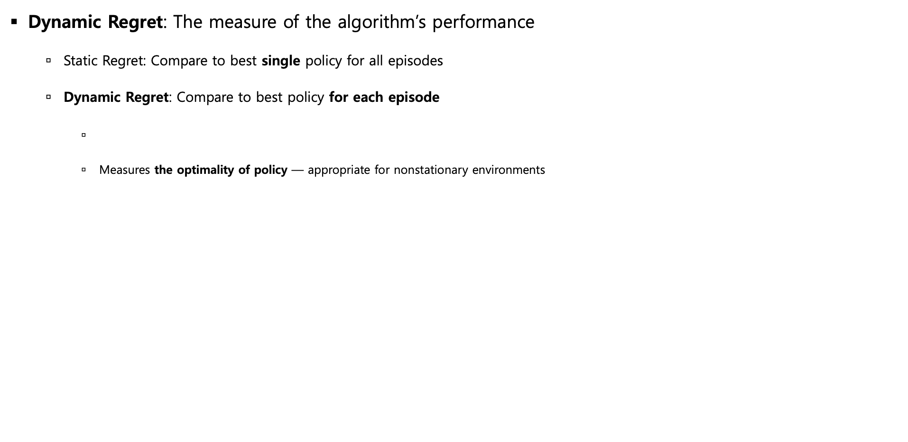
1. Introduction
Definition – Dynamic Regret, Variation Budget
Dynamic Regret: The measure of the algorithm’s performance
  Static Regret: Compare to best single policy for all episodes
  Dynamic Regret: Compare to best policy for each episode
    Measures the optimality of policy — appropriate for nonstationary environments
Mao, W., Zhang, K., Zhu, R., Simchi-Levi, D., & Başar, T. (2025). Model-Free Nonstationary Reinforcement Learning: Near-Optimal Regret and Applications in Multiagent Reinforcement Learning and Inventory Control. Management Science, 71(2), 1564-1580.
Notes:
Before I move on to the main part of this paper, let me define a few fundamental concepts: dynamic regret and variation budget.
First dynamic regret is the quantity that we are trying to minimize: so it is the quantity we’re going to use to measure the algorithm’s performance.
Given a policy pi, the Dynamic regret is defined as the summation of the gaps between the value functions of the optimal policy and pi.
So the bigger the regret is, the farther policy pi is from optimal. So we’re interested in minimizing it.
As a sidenote, in “dynamic regret”, the optimal policy is defined per episode, whereas “static regret” compares w.r.t. a global single optimal policy.
So dynamic regret is more general that static regret.

Slide 10



1. Introduction
Definition – Dynamic Regret, Variation Budget
Dynamic Regret: The measure of the algorithm’s performance
  Static Regret: Compare to best single policy for all episodes
  Dynamic Regret: Compare to best policy for each episode
    Measures the optimality of policy — appropriate for nonstationary environments
Variation Budget: The measure of the model’s non-stationarity
  $Δ=Δ_{r}+Δ_{p}$
    ≈
h=1
h=2
h=3
h=H
m=1
𝚫
𝚫
𝚫
⋯
𝚫
+
+
+
m=2
𝚫
𝚫
𝚫
⋯
𝚫
+
+
+
⁝
⁝
⁝
⁝
m=M
𝚫
+
𝚫
+
𝚫
⋯
+
𝚫
Mao, W., Zhang, K., Zhu, R., Simchi-Levi, D., & Başar, T. (2025). Model-Free Nonstationary Reinforcement Learning: Near-Optimal Regret and Applications in Multiagent Reinforcement Learning and Inventory Control. Management Science, 71(2), 1564-1580.
Notes:
The next notion is variation budget, denoted as delta.
Intuitively, it is the measure of how nonstationary a given model is.
So the bigger the variation budget is, the more nonstationary the model is.
Formally, the variation budget delta consists of variation budget for rewards and that of transition probabilities.
The variation budget for rewards is defined as the summation of the difference between a pair of rewards received in each adjacent episodes.

Slide 11
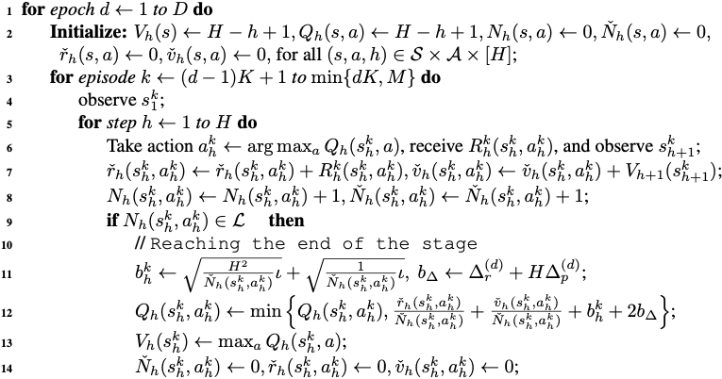
2. Algorithm & Analysis
RestartQ-UCB (Hoeffding)
RestartQ-UCB
  A familiar Q-Learning algorithm…
for each episode…
sample (s,a,r,s’)
update Q & V
Mao, W., Zhang, K., Zhu, R., Simchi-Levi, D., & Başar, T. (2025). Model-Free Nonstationary Reinforcement Learning: Near-Optimal Regret and Applications in Multiagent Reinforcement Learning and Inventory Control. Management Science, 71(2), 1564-1580.
Notes:
Now we’re ready to discuss the main algorithms proposed by the paper.
As i’ve mentioned, I’m going to introduce three versions of algorithms.
These algorithms are incrementally designed, with step-by-step improvements.
This algorithm shown in the slide is named RestartQ-UCB algorithm with Hoeffding type bonus terms.
As this algorithm is the baseline algorithm for the rest of the improved versions, I’m going to spend the most time explaining the overall structure of this algorithm,
and for the rest, I’ll be only briefly introducing the improvements.
So the RestartQ-UCB algorithm, as you can guess from the “Q” in the name, is essentially a familiar Q-Learning algorithm.
So it loops over the episodes, samples the 4-tupes of s,a,r,s’, and update the Q function.

Slide 12
2. Algorithm & Analysis
RestartQ-UCB (Hoeffding)
RestartQ-UCB
  A familiar Q-Learning algorithm… but over a nonstationary environment!
① Periodically
forget everything
(RestartQ-UCB)
② Compute UCB bonus terms
(RestartQ-UCB)
Mao, W., Zhang, K., Zhu, R., Simchi-Levi, D., & Başar, T. (2025). Model-Free Nonstationary Reinforcement Learning: Near-Optimal Regret and Applications in Multiagent Reinforcement Learning and Inventory Control. Management Science, 71(2), 1564-1580.
Notes:
The most important difference is that, it is a Q-Learning algorithm over a nonstationary environment.
And so this algorithm also involves extra computations to handle such nonstationarity.
In particular, there are two things that I am going to focus on regarding nonstationarity:
First, the algorithm has a restart step, which periodically forgets everything that it has learned so far. Hence the name Restart in RestartQ-UCB.
Second, the algorithm computes a special quantity called UCB bonus, which is used as a strategy for exploration, instead of relying on the naïve epsilon-greedy strategy.
This explains the name UCB in RestartQ-UCB.
Now I am going to elaborate on these two points in more detail.

Slide 13



2. Algorithm & Analysis
RestartQ-UCB (Hoeffding)
① Why periodically forget everything to handle nonstationarity?
  Note that, our env is as much nonstationary as variation budget $Δ$
  Env at $t$ is similar to env at $b$, but distant to env $a$
  This means, at timepoint t, $Q_{b}$ is useful but $Q_{a}$ is outdated
  So we better forget $Q_{a}$ when learning $Q_{t}$!
Q-Learning Timeline
h=1
h=2
h=3
h=H
a
(old)
m=1
⋯
𝚫
+
𝚫
+
𝚫
+
𝚫
m=2
⋯
𝚫
+
𝚫
+
𝚫
+
𝚫
b
(recent)
⁝
⁝
⁝
⁝
𝚫
+
𝚫
+
𝚫
⋯
+
𝚫
t
(current)
m=M
Mao, W., Zhang, K., Zhu, R., Simchi-Levi, D., & Başar, T. (2025). Model-Free Nonstationary Reinforcement Learning: Near-Optimal Regret and Applications in Multiagent Reinforcement Learning and Inventory Control. Management Science, 71(2), 1564-1580.
Notes:
First let’s talk about why do we have to periodically forget everything to handle nonstationarity?
This is because as Q-learning proceeds, episode by episode, the model also changes because it is nonstationary say to the amount given by Delta (the variation budget).
For example, lets say we have three timepoints a,b, and t in chronological order as depicted in the picture, where t is the current step in the middle of Q-learning procedure.
Then, by the definition of variation budgets, which is defined to be the summation of all local variations,
The environment a is much more different from the current environment at t, than the environment b is to t.
Hence, it might be the case that when learning the Q-function at timepoint t, the Q(a) is outdated, whereas Q(b) is useful.
And therefore, we have to periodically forget such outdated Q-functions to better match the most recent status of the model, when nonstationarity comes into play.

Slide 14
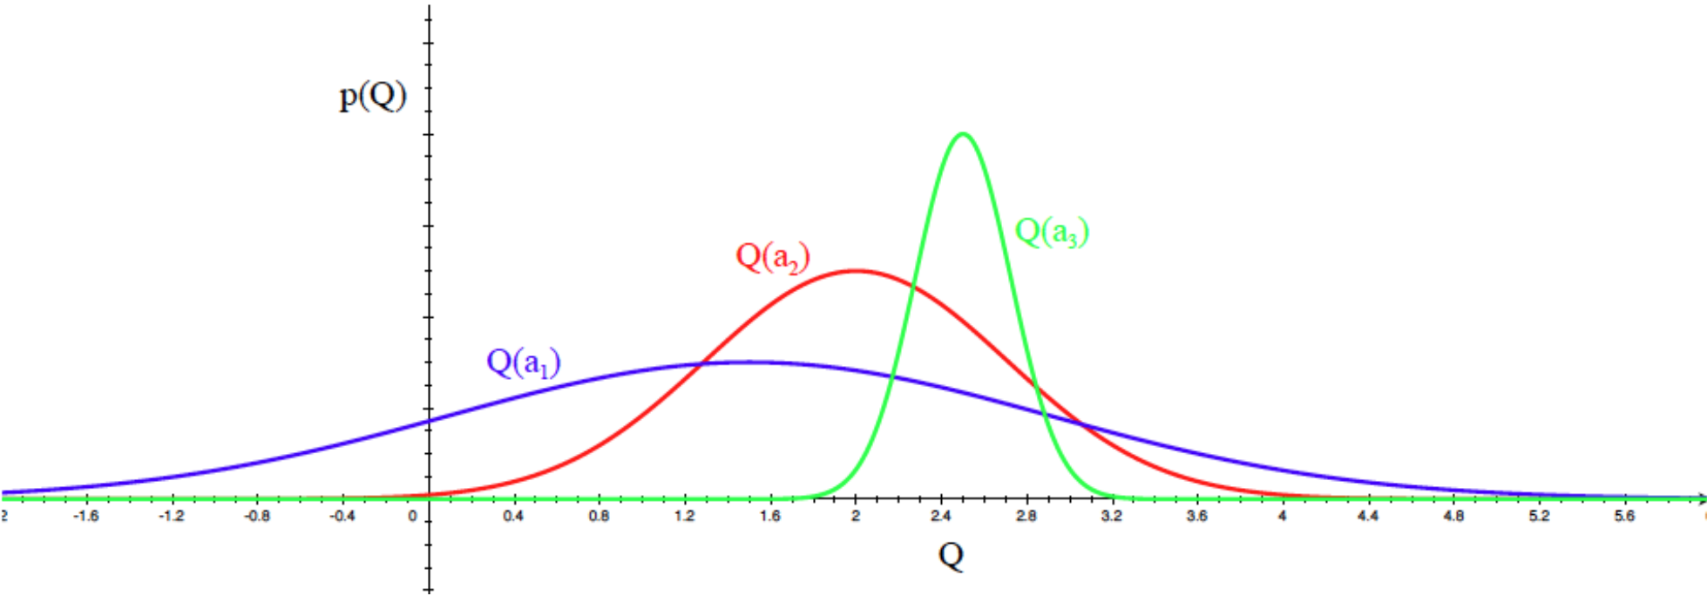

2. Algorithm & Analysis
RestartQ-UCB (Hoeffding)
② What are UCB(Upper Confidence Bound) terms for?
  Question: Suppose we want to estimate Q-values for actions $a_{1},a_{2},a_{3}$ as below.
  which action should we choose first for exploration? (width of distrib. = uncertainty)
  Principle1: “The more uncertain we are about $Q(a)$, the more important it is to explore the action”
Answer: a1
Mao, W., Zhang, K., Zhu, R., Simchi-Levi, D., & Başar, T. (2025). Model-Free Nonstationary Reinforcement Learning: Near-Optimal Regret and Applications in Multiagent Reinforcement Learning and Inventory Control. Management Science, 71(2), 1564-1580.
Notes:
Next, lets talk about what are UCB terms used for updating our Q function.
The term UCB stands for Upper Confidence Bound, which is a notion widely used to handle uncertainty in the context of bandits.
Let me briefly introduce what UCB is, with the following question:
Suppose we want to estimate Q-values for actions $a_{1},a_{2},a_{3}$ as below. which action should we choose first for exploration? (width of distrib. = uncertainty)
The most reasonable answer is to pick a1, because we have the least amount of information about it.
So here, the underlying principle is, “The more we are uncertain, the more important it is to explore”

Slide 15
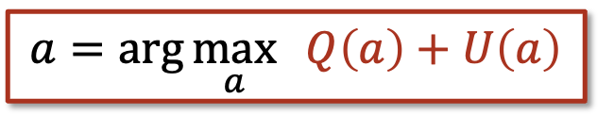
2. Algorithm & Analysis
RestartQ-UCB (Hoeffding)
② What are UCB(Upper Confidence Bound) terms for?
  UCB Algorithm: “Pick the action according to the upper bound of the confidence interval
  Principle2: “Optimism in the face of uncertainty”
uncertainty U(a)
ㅌㄴ
$$a=\arg{\max_{a}{ Q\left(a\right)+U\left(a\right)}}$$
Q(a)
Q(a)-U(a)
Q(a)+U(a)
Estimated mean
ㅌㄴ
Mao, W., Zhang, K., Zhu, R., Simchi-Levi, D., & Başar, T. (2025). Model-Free Nonstationary Reinforcement Learning: Near-Optimal Regret and Applications in Multiagent Reinforcement Learning and Inventory Control. Management Science, 71(2), 1564-1580.
Notes:
So formally, the notion of uncertainty corresponds to the length of the confidence interval centered around the estimated mean Q(a) for each action,
where the upper endpoint of the interval is given by the summation of the mean Q(a) + the uncertainty bonus U(a).
The UCB algorithm proposes a very simple strategy to pick which action to choose for exploration: pick the one with the largest upper confidence bound Q(a) + U(a).
This strategy is best expressed by the phrase “optimism in the face of uncertainty”.

Slide 16
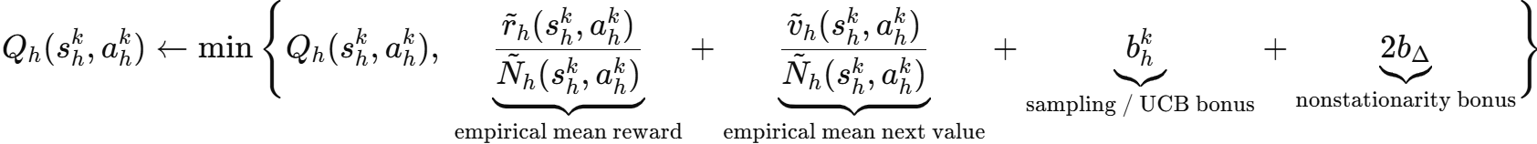
2. Algorithm & Analysis
RestartQ-UCB (Hoeffding)
② What are UCB(Upper Confidence Bound) terms for?
ㅌㄴ
empirical mean
uncertainty bonus
Mao, W., Zhang, K., Zhu, R., Simchi-Levi, D., & Başar, T. (2025). Model-Free Nonstationary Reinforcement Learning: Near-Optimal Regret and Applications in Multiagent Reinforcement Learning and Inventory Control. Management Science, 71(2), 1564-1580.
Notes:
Now lets turn back to the algorithm.
The UCB algorithm is reflected in the RestartQ-UCB algorithm, for estimating the Q-function for each pair (s,a).
Here the algorithm uses a well-known uncertainty bonus called Hoeffding-type bonus.

Slide 17
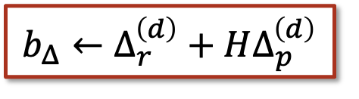
2. Algorithm & Analysis
RestartQ-UCB (Hoeffding)
② What are UCB(Upper Confidence Bound) terms for?
ㅌㄴ
empirical mean
uncertainty bonus
$$b_{Δ}←Δ_{r}^{\left(d\right)}+HΔ_{p}^{\left(d\right)}$$
Nonstationary bonus:
the bigger delta
= the more nonstationary the model is
= the more uncertain the model is
= the more important it is to explore
Mao, W., Zhang, K., Zhu, R., Simchi-Levi, D., & Başar, T. (2025). Model-Free Nonstationary Reinforcement Learning: Near-Optimal Regret and Applications in Multiagent Reinforcement Learning and Inventory Control. Management Science, 71(2), 1564-1580.
Notes:
And more importantly, it also uses an extra bonus term for nonstationarity given by delta.
So the high-level intuition is:
the bigger the delta is, the more nonstationary the model is, the more uncertainty comes into play, the more bonus we should impose for exploration.

Slide 18
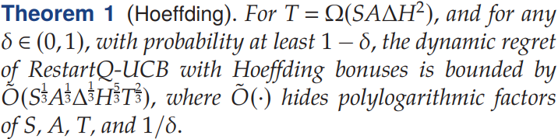







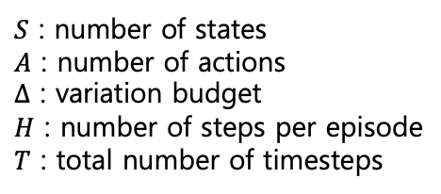

2. Algorithm & Analysis
RestartQ-UCB (Hoeffding)
$S$ : number of states
$A$ : number of actions
$Δ$ : variation budget
$H$ : number of steps per episode
$T$ : total number of timesteps
contribution
contribution
contribution
contribution
Our plan
RestartQ-UCB (Hoeffding)
Double RestartQ-UCB
RestartQ-UCB (Freedman)
Theoretical Lowerbound
$$\tilde{O}(S^{\frac{1}{3}}A^{\frac{1}{3}}Δ^{\frac{1}{3}}H^{\frac{5}{3}}T^{\frac{2}{3}})$$
$$,$$
$$\tilde{O}(S^{\frac{1}{3}}A^{\frac{1}{3}}Δ^{\frac{1}{3}}HT^{\frac{2}{3}}+H^{\frac{3}{4}}T^{\frac{3}{4}})$$
$$>$$
$$\tilde{O}(S^{\frac{1}{3}}A^{\frac{1}{3}}Δ^{\frac{1}{3}}HT^{\frac{2}{3}})$$
$$>$$
$$\tilde{O}(S^{\frac{1}{3}}A^{\frac{1}{3}}Δ^{\frac{1}{3}}H^{\frac{2}{3}}T^{\frac{2}{3}})$$
↑
Now here
Mao, W., Zhang, K., Zhu, R., Simchi-Levi, D., & Başar, T. (2025). Model-Free Nonstationary Reinforcement Learning: Near-Optimal Regret and Applications in Multiagent Reinforcement Learning and Inventory Control. Management Science, 71(2), 1564-1580.
Notes:
Now lets talk about the computation complexity of this algorithm:
It turns out that the dynamic regret of this algorithm belongs to the class O(…), where S: …, A:… …
In fact, the most important factor here is the H because the other factors are already optimal in term the theoretical lowerbound
The authors have proved that the information-theoretical lowerbound has H with its exponent 2/3.
So in the remainder, I’m going to briefly introduce two more improved algorithms that close this theoretical gap step by step.
And all these algorithms along with the lowerbound are contributions made by this paper.

Slide 19
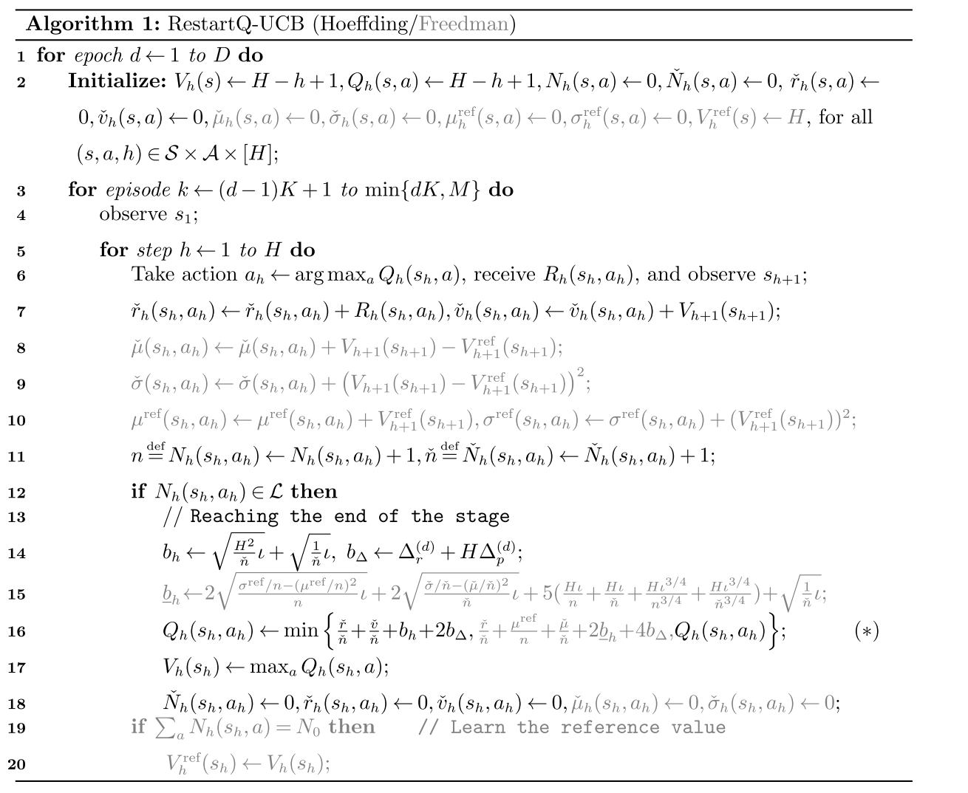
2. Algorithm & Analysis
RestartQ-UCB (Freedman)
Hoeffding type UCB is replaced
by a tighter Freedman type UCB,
which is more involved..
Mao, W., Zhang, K., Zhu, R., Simchi-Levi, D., & Başar, T. (2025). Model-Free Nonstationary Reinforcement Learning: Near-Optimal Regret and Applications in Multiagent Reinforcement Learning and Inventory Control. Management Science, 71(2), 1564-1580.
Notes:
The second algorithm is mostly the same algorithm with our baseline,
the improvement is made by using a better UCB bonus than the Hoeffding bonus.
Specifically, it uses a tighter bonus called Freedman type bonus, which involves more computations for extra statistical quantities as depicted in color red in the slide.
I’m not going to cover the details as it is out of the scope.
Anyway, the overall structure of the algorithm is identical to the previous one.

Slide 20
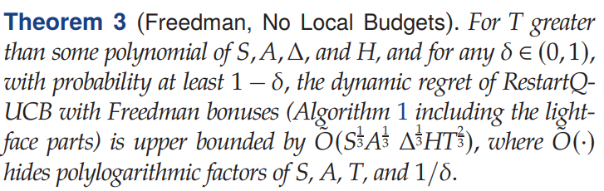
2. Algorithm & Analysis
RestartQ-UCB (Freedman)
Hoeffding type UCB is replaced
by a tighter Freedman type UCB,
which is more involved..
RestartQ-UCB (Hoeffding)
Double RestartQ-UCB
RestartQ-UCB (Freedman)
Theoretical Lowerbound
$$\tilde{O}(S^{\frac{1}{3}}A^{\frac{1}{3}}Δ^{\frac{1}{3}}H^{\frac{5}{3}}T^{\frac{2}{3}})$$
$$,$$
$$\tilde{O}(S^{\frac{1}{3}}A^{\frac{1}{3}}Δ^{\frac{1}{3}}HT^{\frac{2}{3}}+H^{\frac{3}{4}}T^{\frac{3}{4}})$$
$$>$$
$$\tilde{O}(S^{\frac{1}{3}}A^{\frac{1}{3}}Δ^{\frac{1}{3}}HT^{\frac{2}{3}})$$
$$>$$
$$\tilde{O}(S^{\frac{1}{3}}A^{\frac{1}{3}}Δ^{\frac{1}{3}}H^{\frac{2}{3}}T^{\frac{2}{3}})$$
Near-optimal!
Mao, W., Zhang, K., Zhu, R., Simchi-Levi, D., & Başar, T. (2025). Model-Free Nonstationary Reinforcement Learning: Near-Optimal Regret and Applications in Multiagent Reinforcement Learning and Inventory Control. Management Science, 71(2), 1564-1580.
Notes:
It turns out that this Freedman-type algorithm improves the complexity for the H factor to have exponent 1, which is only 1/3 away from the optimal.
This makes this algorithm near-optimal, as claimed by the authors.
The authors also mentions that closing this 1/3 gap is included in their future work.

Slide 21
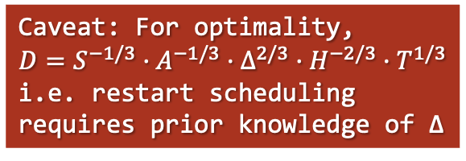
2. Algorithm & Analysis
RestartQ-UCB (Freedman)
Caveat: For optimality,
$$D=S^{−1/3}·A^{−1/3}·Δ^{2/3}·H^{−2/3}·T^{1/3}$$
i.e. restart scheduling requires prior knowledge of Δ
Can we get rid of this?
Mao, W., Zhang, K., Zhu, R., Simchi-Levi, D., & Başar, T. (2025). Model-Free Nonstationary Reinforcement Learning: Near-Optimal Regret and Applications in Multiagent Reinforcement Learning and Inventory Control. Management Science, 71(2), 1564-1580.
Notes:
But there is one caveat here.
In fact, the RestartQ-UCB algorithm schedules the periodic “restart”, by the number of epochs D, which should be set to a certain number that depends on the variation budget delta for optimality.
In short, an optimal run of the algorithm requires the prior knowledge of Delta, which constitutes a complexity parameter.
So can we get rid of this?

Slide 22
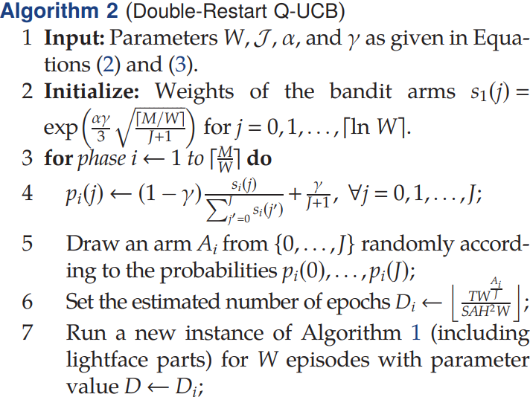
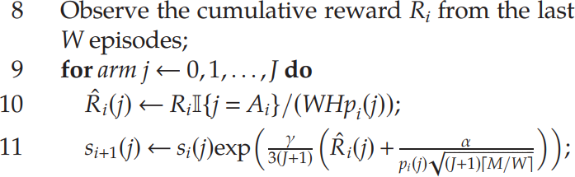





2. Algorithm & Analysis
Double-Restart Q-UCB
Here, D is “learned”
in an online manner,
rather than “given”
as a parameter
Multi-Armed Bandit Problem
$$D_{1}$$
restartQ-UCB
$$D_{2}$$
restartQ-UCB
$$⋯$$
$$⋯$$
$$D_{n}$$
restartQ-UCB
Mao, W., Zhang, K., Zhu, R., Simchi-Levi, D., & Başar, T. (2025). Model-Free Nonstationary Reinforcement Learning: Near-Optimal Regret and Applications in Multiagent Reinforcement Learning and Inventory Control. Management Science, 71(2), 1564-1580.
Notes:
The paper proposes a third version of the algorithm, called Double Restart Q-UCB, for getting rid of this parameter Delta in the scheduling parameter D.
The basic idea here is, instead of having fixed D as a parameter, the algorithm adaptively learns D by trying out different candidate values.
So for each candidate value Di, we run a new instance of restartQ-UCB algorithm, and eventually learns the best value of D.
The authors say that this algorithm is inspired by whats called “bandit-over-bandit” algorithm, by viewing each candidate D values as “arms” in the language of bandits.
This is the reason why its called “double” restart Q-UCB algorithm

Slide 23
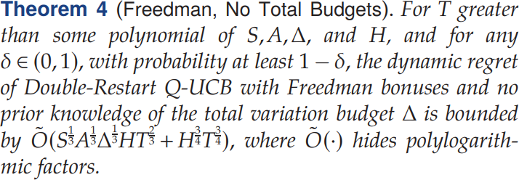
2. Algorithm & Analysis
Double-Restart Q-UCB
Compared to RestartQ-UCB (Freedman),
more overhead for learning D
but more robust to unknown, irregular,
and abrupt environment changes
RestartQ-UCB (Hoeffding)
Double RestartQ-UCB
RestartQ-UCB (Freedman)
Theoretical Lowerbound
$$\tilde{O}(S^{\frac{1}{3}}A^{\frac{1}{3}}Δ^{\frac{1}{3}}H^{\frac{5}{3}}T^{\frac{2}{3}})$$
$$,$$
$$\tilde{O}(S^{\frac{1}{3}}A^{\frac{1}{3}}Δ^{\frac{1}{3}}HT^{\frac{2}{3}}+H^{\frac{3}{4}}T^{\frac{3}{4}})$$
$$>$$
$$\tilde{O}(S^{\frac{1}{3}}A^{\frac{1}{3}}Δ^{\frac{1}{3}}HT^{\frac{2}{3}})$$
$$>$$
$$\tilde{O}(S^{\frac{1}{3}}A^{\frac{1}{3}}Δ^{\frac{1}{3}}H^{\frac{2}{3}}T^{\frac{2}{3}})$$
Still near-optimal!
Mao, W., Zhang, K., Zhu, R., Simchi-Levi, D., & Başar, T. (2025). Model-Free Nonstationary Reinforcement Learning: Near-Optimal Regret and Applications in Multiagent Reinforcement Learning and Inventory Control. Management Science, 71(2), 1564-1580.
Notes:
As a result, the Double Restart Q-UCB algorithm turns out to be slower than the previous Freedman type RestartQ-UCB algorithm because of the overhead for learning D.
However, since the algorithms requires no prior knowledge of Delta, it is more robust to unknown, irregular and abrupt environment changes.

Slide 24
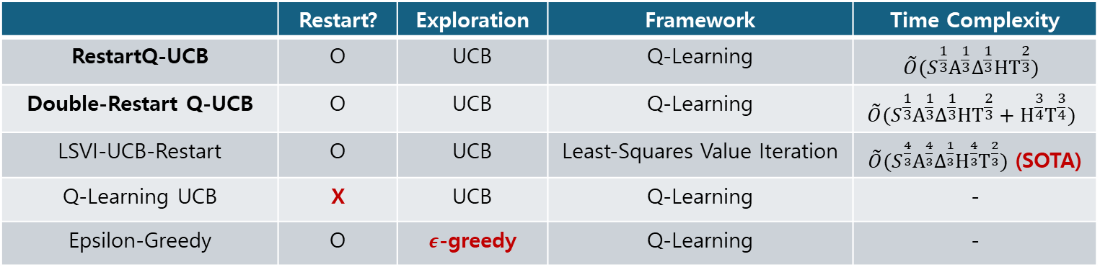
3. Conclusion
Experiment
Compared Algorithms
 | Restart? | Exploration | Framework | Time Complexity
RestartQ-UCB | O | UCB | Q-Learning | $$\tilde{O}(S^{\frac{1}{3}}A^{\frac{1}{3}}Δ^{\frac{1}{3}}HT^{\frac{2}{3}})$$
Double-Restart Q-UCB | O | UCB | Q-Learning | $$\tilde{O}(S^{\frac{1}{3}}A^{\frac{1}{3}}Δ^{\frac{1}{3}}HT^{\frac{2}{3}}+H^{\frac{3}{4}}T^{\frac{3}{4}})$$
LSVI-UCB-Restart | O | UCB | Least-Squares Value Iteration | $\tilde{O}(S^{\frac{4}{3}}A^{\frac{4}{3}}Δ^{\frac{1}{3}}H^{\frac{4}{3}}T^{\frac{2}{3}})$ (SOTA)
Q-Learning UCB | X | UCB | Q-Learning | -
Epsilon-Greedy | O | $ε$-greedy | Q-Learning | -
Baseline
Mao, W., Zhang, K., Zhu, R., Simchi-Levi, D., & Başar, T. (2025). Model-Free Nonstationary Reinforcement Learning: Near-Optimal Regret and Applications in Multiagent Reinforcement Learning and Inventory Control. Management Science, 71(2), 1564-1580.
Notes:
Now lets see if their algorithm really works well in reality.
The authors have conducted some experiments that compare their two near-optimal algorithms (…) against the baseline algorithms (…).
Three things to note here:
1) the LSVI-UCB-Restart algorithm (third row), which is based on Least-Squared Value Iteration, was the State-of-the-art before this paper got published
2) the Q-Learning UCB algorithm (fourth row) is the only one that does not have periodic restart steps
3) the Epsilon-greedy (last row) is the familiar q-learning algorithm that we learned in this course that does not use any sophisticated exploration strategy such as UCB.

Slide 25
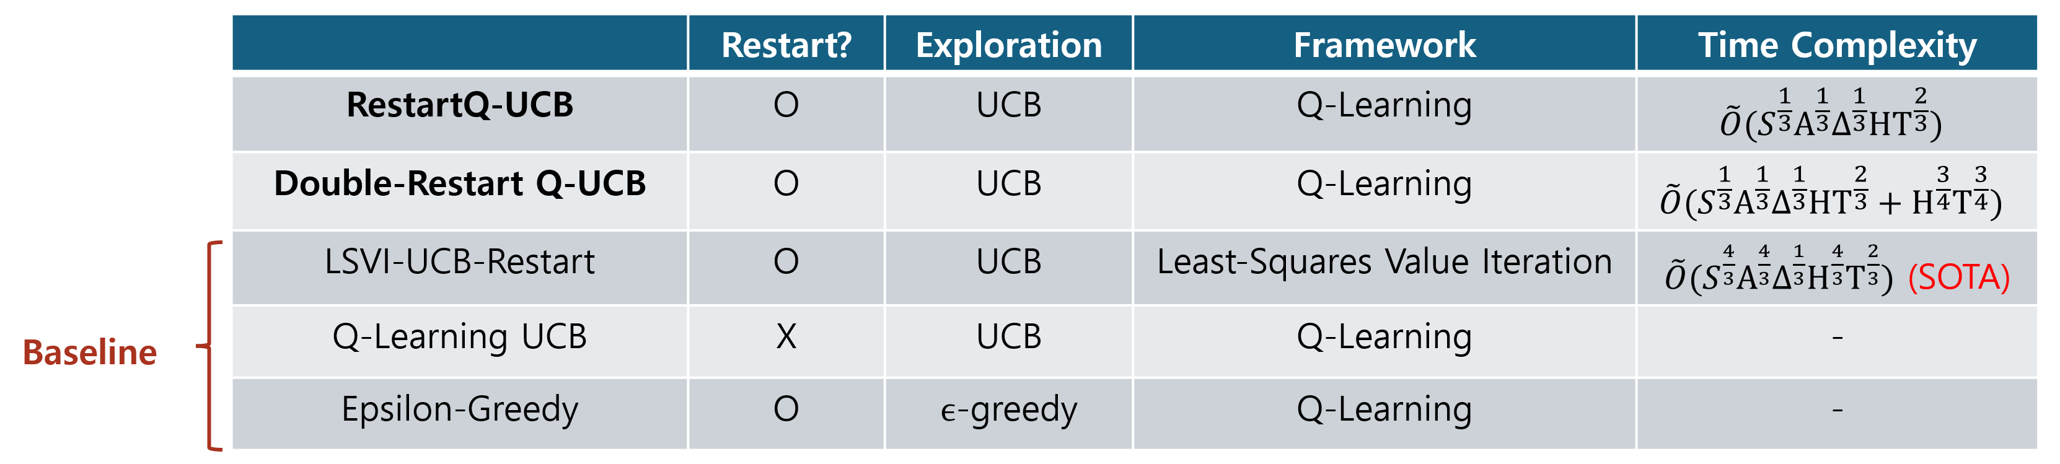
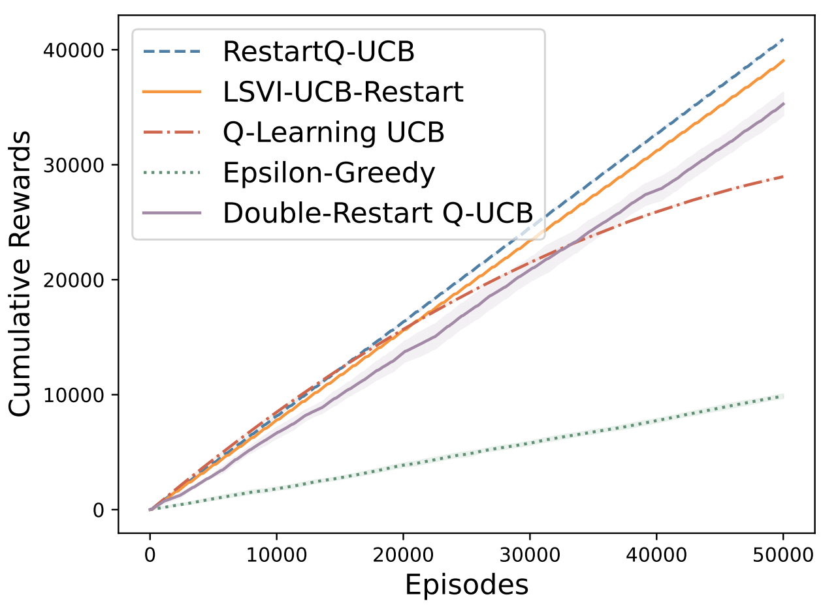
3. Conclusion
Experiment
Compared Algorithms
Simulation
  Benchmark
    Bidirectional Diabolical Combination Lock
    particularly difficult for exploration
Q-Learning UCB
: no restart
Epsilon-Greedy
: no UCB
Mao, W., Zhang, K., Zhu, R., Simchi-Levi, D., & Başar, T. (2025). Model-Free Nonstationary Reinforcement Learning: Near-Optimal Regret and Applications in Multiagent Reinforcement Learning and Inventory Control. Management Science, 71(2), 1564-1580.
Notes:
This graph here shows the result of running those 5 algorithms over a benchmark called “bidirectional diabolical combination lock”, which is designed to be particularly difficult for exploration.
The horizontal line shows the number of episodes, and the vertical line shows the cumulative rewards received by running the algorithms.
The green line at the bottom shows the result of epsilon-greedy algorithm, which turns to have the worst result. This shows that UCB is very critical for exploration.
The red line, which tilts down over the episodes, is obtained by the Q-Learning UCB algorithm. This shows that Restart steps are also critical in the long-term.
The other three algorithms, including the SOTA algorithm, showed more or less similar performances.

Slide 26
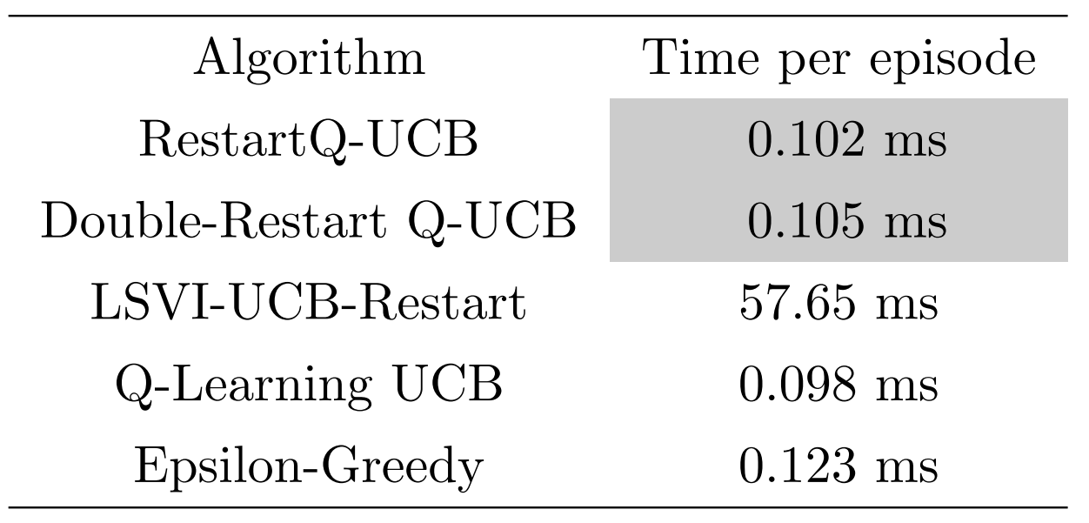
3. Conclusion
Experiment
Compared Algorithms
Simulation
only little
overhead!
very slow!
Mao, W., Zhang, K., Zhu, R., Simchi-Levi, D., & Başar, T. (2025). Model-Free Nonstationary Reinforcement Learning: Near-Optimal Regret and Applications in Multiagent Reinforcement Learning and Inventory Control. Management Science, 71(2), 1564-1580.
Notes:
Next, the table to the right shows the time usage of each algorithm.
Here, both algorithms proposed by this paper took about 0.1 milliseconds, with Double-Restart Q-UCB being slightly slower than the RestartQ-UCB, as predicted by the complexity.
Most notably, the SOTA algorithm took 57 milliseconds, which is way too much.
So these two results make the two algorithms proposed by this paper the only survivors among the five.

Slide 27

3. Conclusion
Concluding Remark
Proposed two model-free learning algorithms for nonstationary MDPs
  RestartQ-UCB : $\tilde{O}(S^{\frac{1}{3}}A^{\frac{1}{3}}Δ^{\frac{1}{3}}HT^{\frac{2}{3}})$
  Double-Restart Q-UCB : $\tilde{O}(S^{\frac{1}{3}}A^{\frac{1}{3}}Δ^{\frac{1}{3}}HT^{\frac{2}{3}}+H^{\frac{3}{4}}T^{\frac{3}{4}})$
Mao, W., Zhang, K., Zhu, R., Simchi-Levi, D., & Başar, T. (2025). Model-Free Nonstationary Reinforcement Learning: Near-Optimal Regret and Applications in Multiagent Reinforcement Learning and Inventory Control. Management Science, 71(2), 1564-1580.
Notes:
Let me wrap my presentation up with concluding remarks.
First, the paper proposes two model-free algorithms to deal with nonstationary MDPs, and those were RestartQ-UCB and Double-Restart Q-UCB algorithms.

Slide 28

3. Conclusion
Concluding Remark
Proposed two model-free learning algorithms for nonstationary MDPs
  RestartQ-UCB : $\tilde{O}(S^{\frac{1}{3}}A^{\frac{1}{3}}Δ^{\frac{1}{3}}HT^{\frac{2}{3}})$
  Double-Restart Q-UCB : $\tilde{O}(S^{\frac{1}{3}}A^{\frac{1}{3}}Δ^{\frac{1}{3}}HT^{\frac{2}{3}}+H^{\frac{3}{4}}T^{\frac{3}{4}})$
And showed that they are near-optimal
  w.r.t. the information-theoretical lowerbound $\tilde{O}(S^{\frac{1}{3}}A^{\frac{1}{3}}Δ^{\frac{1}{3}}H^{\frac{2}{3}}T^{\frac{2}{3}})$
Mao, W., Zhang, K., Zhu, R., Simchi-Levi, D., & Başar, T. (2025). Model-Free Nonstationary Reinforcement Learning: Near-Optimal Regret and Applications in Multiagent Reinforcement Learning and Inventory Control. Management Science, 71(2), 1564-1580.
Notes:
Then, they showed that their algorithms were near-optimal by showing that the time complexity of their algorithms were very close to the theoretical lowerbound.

Slide 29

3. Conclusion
Concluding Remark
Proposed two model-free learning algorithms for nonstationary MDPs
  RestartQ-UCB : $\tilde{O}(S^{\frac{1}{3}}A^{\frac{1}{3}}Δ^{\frac{1}{3}}HT^{\frac{2}{3}})$
  Double-Restart Q-UCB : $\tilde{O}(S^{\frac{1}{3}}A^{\frac{1}{3}}Δ^{\frac{1}{3}}HT^{\frac{2}{3}}+H^{\frac{3}{4}}T^{\frac{3}{4}})$
And showed that they are near-optimal
  w.r.t. the information-theoretical lowerbound $\tilde{O}(S^{\frac{1}{3}}A^{\frac{1}{3}}Δ^{\frac{1}{3}}H^{\frac{2}{3}}T^{\frac{2}{3}})$
With supporting empirical results
  competitive in both rewards & time
  justification of Restart & UCB in their design
Mao, W., Zhang, K., Zhu, R., Simchi-Levi, D., & Başar, T. (2025). Model-Free Nonstationary Reinforcement Learning: Near-Optimal Regret and Applications in Multiagent Reinforcement Learning and Inventory Control. Management Science, 71(2), 1564-1580.
Notes:
And they also gave some experimental results to support their analysis. In particular, they showed that:
Their algorithms were both competitive both in terms of rewards and time complexity
and they also justified the use of restart steps and UCB exploration in their design.

Slide 30
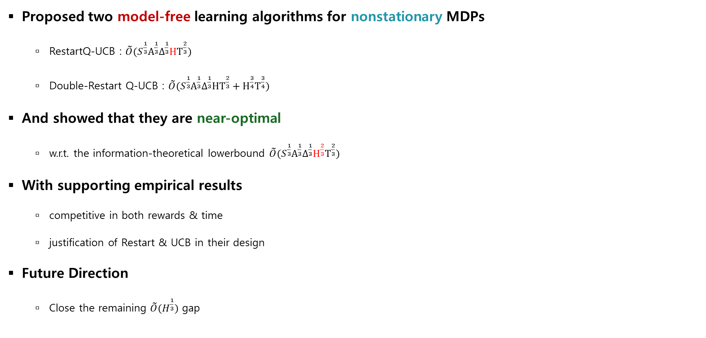
3. Conclusion
Concluding Remark
Proposed two model-free learning algorithms for nonstationary MDPs
  RestartQ-UCB : $\tilde{O}(S^{\frac{1}{3}}A^{\frac{1}{3}}Δ^{\frac{1}{3}}HT^{\frac{2}{3}})$
  Double-Restart Q-UCB : $\tilde{O}(S^{\frac{1}{3}}A^{\frac{1}{3}}Δ^{\frac{1}{3}}HT^{\frac{2}{3}}+H^{\frac{3}{4}}T^{\frac{3}{4}})$
And showed that they are near-optimal
  w.r.t. the information-theoretical lowerbound $\tilde{O}(S^{\frac{1}{3}}A^{\frac{1}{3}}Δ^{\frac{1}{3}}H^{\frac{2}{3}}T^{\frac{2}{3}})$
With supporting empirical results
  competitive in both rewards & time
  justification of Restart & UCB in their design
Future Direction
  Close the remaining $\tilde{O}(H^{\frac{1}{3}})$ gap
Mao, W., Zhang, K., Zhu, R., Simchi-Levi, D., & Başar, T. (2025). Model-Free Nonstationary Reinforcement Learning: Near-Optimal Regret and Applications in Multiagent Reinforcement Learning and Inventory Control. Management Science, 71(2), 1564-1580.
Notes:
Lastly they mention that closing the theoretical gap, which is H to the power of 1/3 would very interesting as a future work.

Slide 31
Thank You!

