Slide 1
MWERA 2026 WORKSHOP
Expressive Python
Applying Python to Educational and Scientific Data
A hands-on, beginner-friendly workshop using Google Colab
>>>
import pandas as pd
import numpy as np
from scipy import stats
import statsmodels
…..
IMPORT → INSPECT → SUMMARIZE → VISUALIZE → MODEL
Educational data • Reproducible analysis • Active learning
MWERA 2026 • Expressive Python
1

Slide 2
WORKSHOP FACILITATION
Presenter Role
PRIMARY FACILITATOR
ACADEMIC TRAJECTORY
Graduate student in Instructional Technology pursuing an M.S.Ed specializing in Assistive Technologies, alongside a Certificate of Graduate Study in Advanced Quantitative Methodology at Northern Illinois University.
Experience includes Python for data science and hands-on design/presentation of Python-focused educational workshops for student participants and field professionals.
The facilitator plans to continue toward a Ph.D. and brings together instructional technology, quantitative methodology, data science, and teaching practice.
This workshop is structured to make technical content approachable for beginner-friendly research audiences.
MWERA 2026 • Expressive Python
22

Slide 3
HANDS-ON PARTICIPATION
Anticipated Audience & Involvement
Designed for applied researchers—students or faculty, at any level—who want to use Python to understand data in interesting ways.
BRING A LAPTOP
FOLLOW ALONG
ASK QUESTIONS
Participants are encouraged to run Python syntax during the workshop rather than only watch demonstrations.
Handouts provide instructions for some of the basics of Python used to follow along as the workshop progresses.
Dedicated time at the end supports questions about Python, analysis workflows, and next steps.
No previous knowledge of Python or Google Colab is assumed.
MWERA 2026 • Expressive Python
21

Slide 4
PURPOSE & SCOPE
Workshop Abstract
Python as an expressive research toolkit
WHY COLAB?
• Python is a powerful, versatile language valued for readability, conciseness, interactivity, and statistical/data-science workflows.
• The workshop uses Google Collab to practice descriptive statistics, inferential tests, numerical operations, visualization, machine learning, and simple linear regression.
• Participants work with Pyreadstat, Pandas, NumPy, Matplotlib, SciPy, and Statsmodels, with no prior Python or Collab experience assumed.
When you run code in a Collab notebook, execution happens on virtual machines managed by Google Cloud rather than on your local computer. This shifts intensive computation to Google-managed servers and reduces demands on the participant’s machine.
BEFORE THE WORKSHOP
Python may be installed from python.org for Windows, Mac, or Linux, but Collab itself requires no local installation.
MWERA 2026 • Expressive Python
2

Slide 5
IMPORTANCE OF THE TOPIC
Why This Topic Matters
DATA-DRIVEN RESEARCH
LOWER THE BARRIER
BUILD CAPABILITY
Educational research increasingly relies on statistical analysis, visualization, reproducibility, and machine learning. Python provides one accessible, scalable language across these tasks.
Graduate students and researchers may have limited formal programming experience. A browser-based notebook reduces setup friction and supports active learning.
Python can strengthen computational thinking and problem-solving while supporting research across computer science, social science, evaluation, and education.
Workshop emphasis
• Explore student-success data.
• Connect syntax to meaningful statistical interpretation.
• Build confidence with real data, models, and visualizations.
• Encourage continued use of Python in participants’ own research.
MWERA 2026 • Expressive Python
3

Slide 6
WHAT PARTICIPANTS WILL BE ABLE TO DO
Objectives, Goals & Purposes
1 IMPORTING FROM VARIOUS FILE FORMATS
2 INSPECT / EXPLORE / CLEAN
3 SUMMARIZE OUR DATA
Identify structure, metadata, missing values, duplicates, errors, and inconsistent formats.
Use Pandas to condense larger datasets into interpretable statistics and grouped results.
Load CSV files into a Collab workflow & convert a comma-separated values (.csv) file into an SPSS (.sav) file
4 VISUALIZE OUR DATA
5 MACHINE LEARNING MODEL
Use NumPy, Matplotlib, and SciPy to explore and communicate patterns.
Run statistical tests and a simple linear regression example; connect visualization to modeling.
Handouts support each activity • The session concludes with key takeaways and participant questions.
MWERA 2026 • Expressive Python
4

Slide 7
FIVE-PART FLOW
Workshop Roadmap
01
02
03
04
05
Brief introduction to Python
Inspect / Clean Data
Summarize Data
Data Visualization
Simple Linear Regression
Google Collab + libraries
Pandas + NumPy
Pandas functions
NumPy + Matplotlib
SciPy + model visualization
The workshop moves from access and file handling to interpretation, visualization, and modeling.
MWERA 2026 • Expressive Python
5

Slide 8
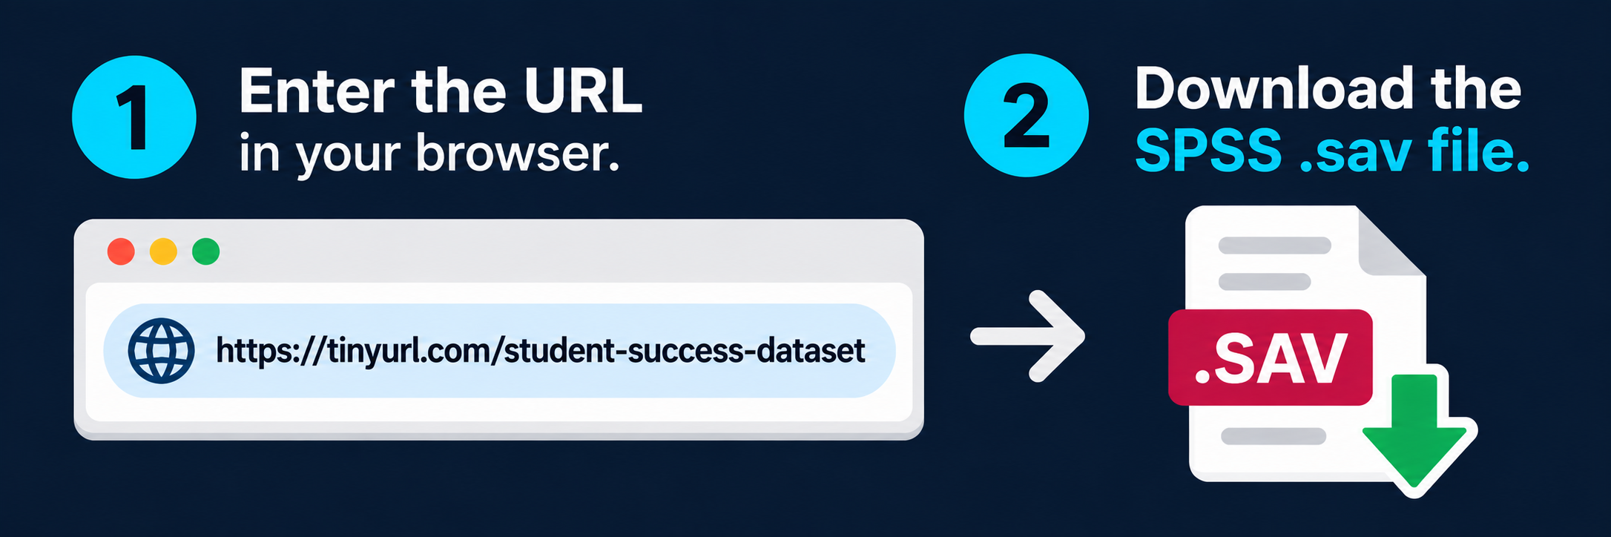
WRAP-UP
https://tinyurl.com/student-success-dataset
Enter the URL into your browser address bar.
2. Download both the .ipynb file & .sav file.
3. Open this file in your Colab Notebook.
MWERA 2026 • Expressive Python
24

Slide 9
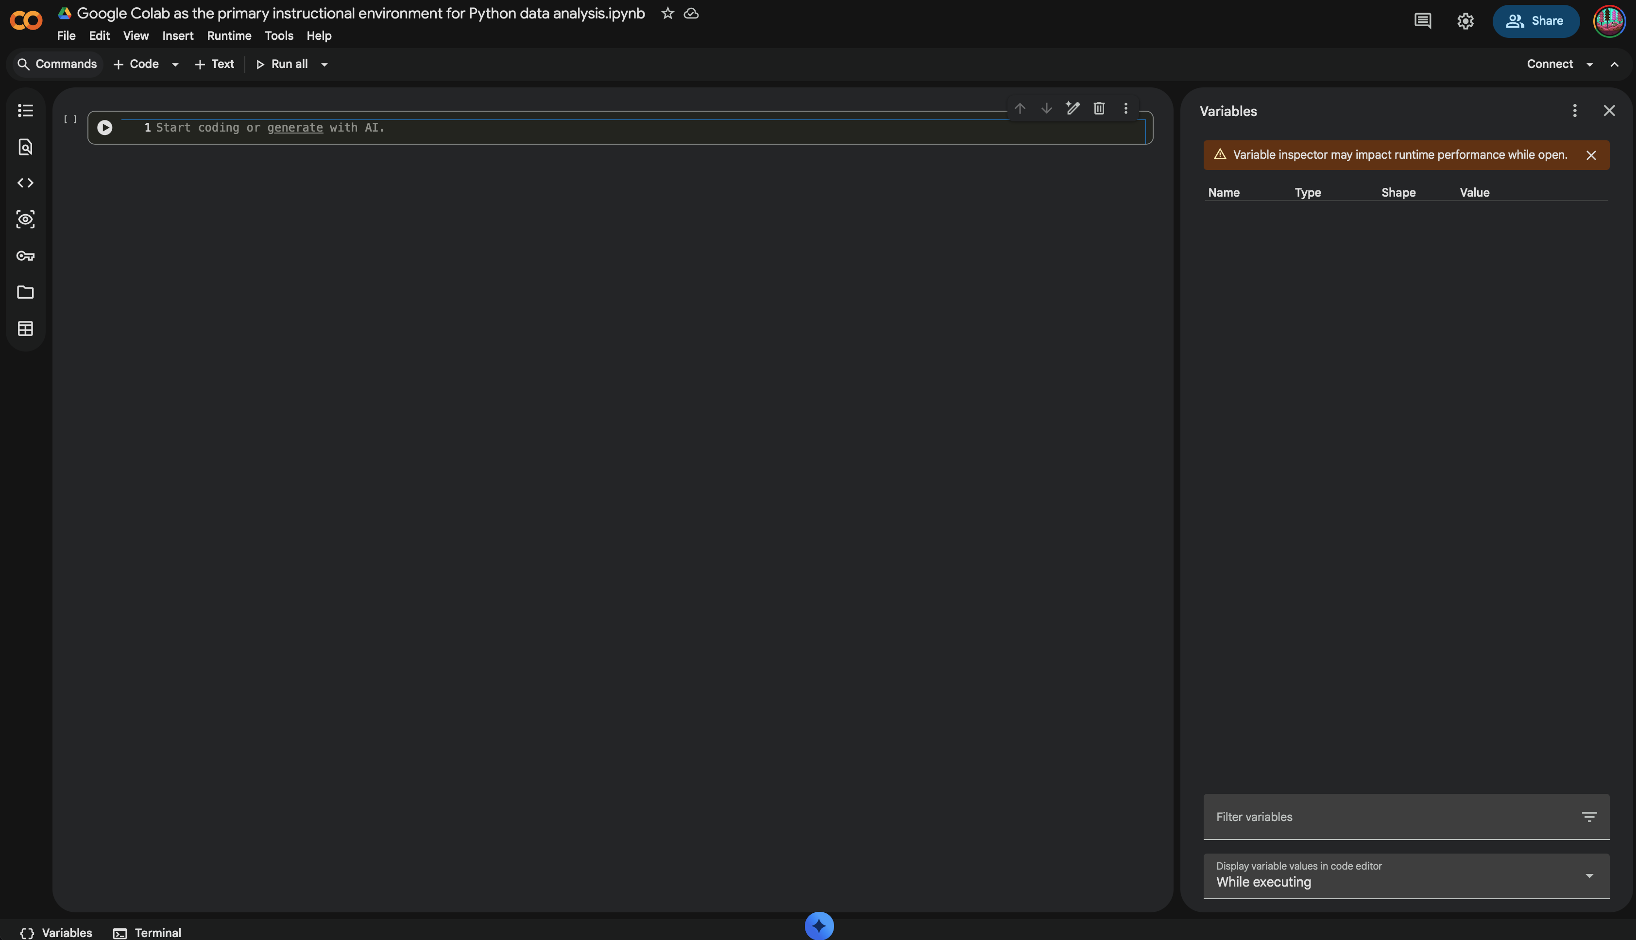
PART 1 • SETUP
Google Collab: Your Cloud-Based Workspace
BROWSER-BASED
Write, run, and share Python code without a time-consuming local environment setup.
CLOUD EXECUTION
Notebook code executes on Google-managed cloud virtual machines, freeing the local computer from much of the computational workload.
ACCESS
No Collab installation required.
Figure 1. Interactive Google Collab environment (colab.research.google.com)
MWERA 2026 • Expressive Python
6

Slide 10
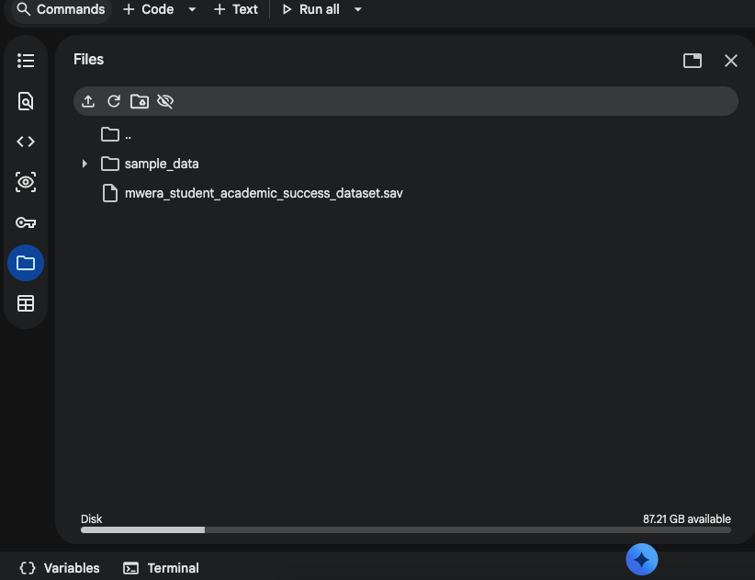
PART 1 • SETUP
Colab's Temporary Runtime File System
COLAB FILES PANEL
Temporary workspace for our notebook. When we upload the SPSS .sav dataset, it becomes available to Python within the current Colan runtime.
TEMPORARY CLOUD VM
Uploading a local file that comes right from your computer. It's being uploaded through your browser to the remote Colab virtual machine.
Figure 2. Files panel of Google Colab environment lets you upload files from your computer.
MWERA 2026 • Expressive Python
6

Slide 11
PART 1 • INTERFACE ORIENTATION
Collab Break-the-Ice Activity
Before analyzing data, participants will practice the core notebook actions:
01
Open the Variables menu
02
Create a new notebook
03
Rename a notebook
04
Open code cells and text cells
05
Open a terminal in a notebook
06
Restore notebooks using revision history
07
Manage sessions with Manage sessions
MWERA 2026 • Expressive Python
7

Slide 12
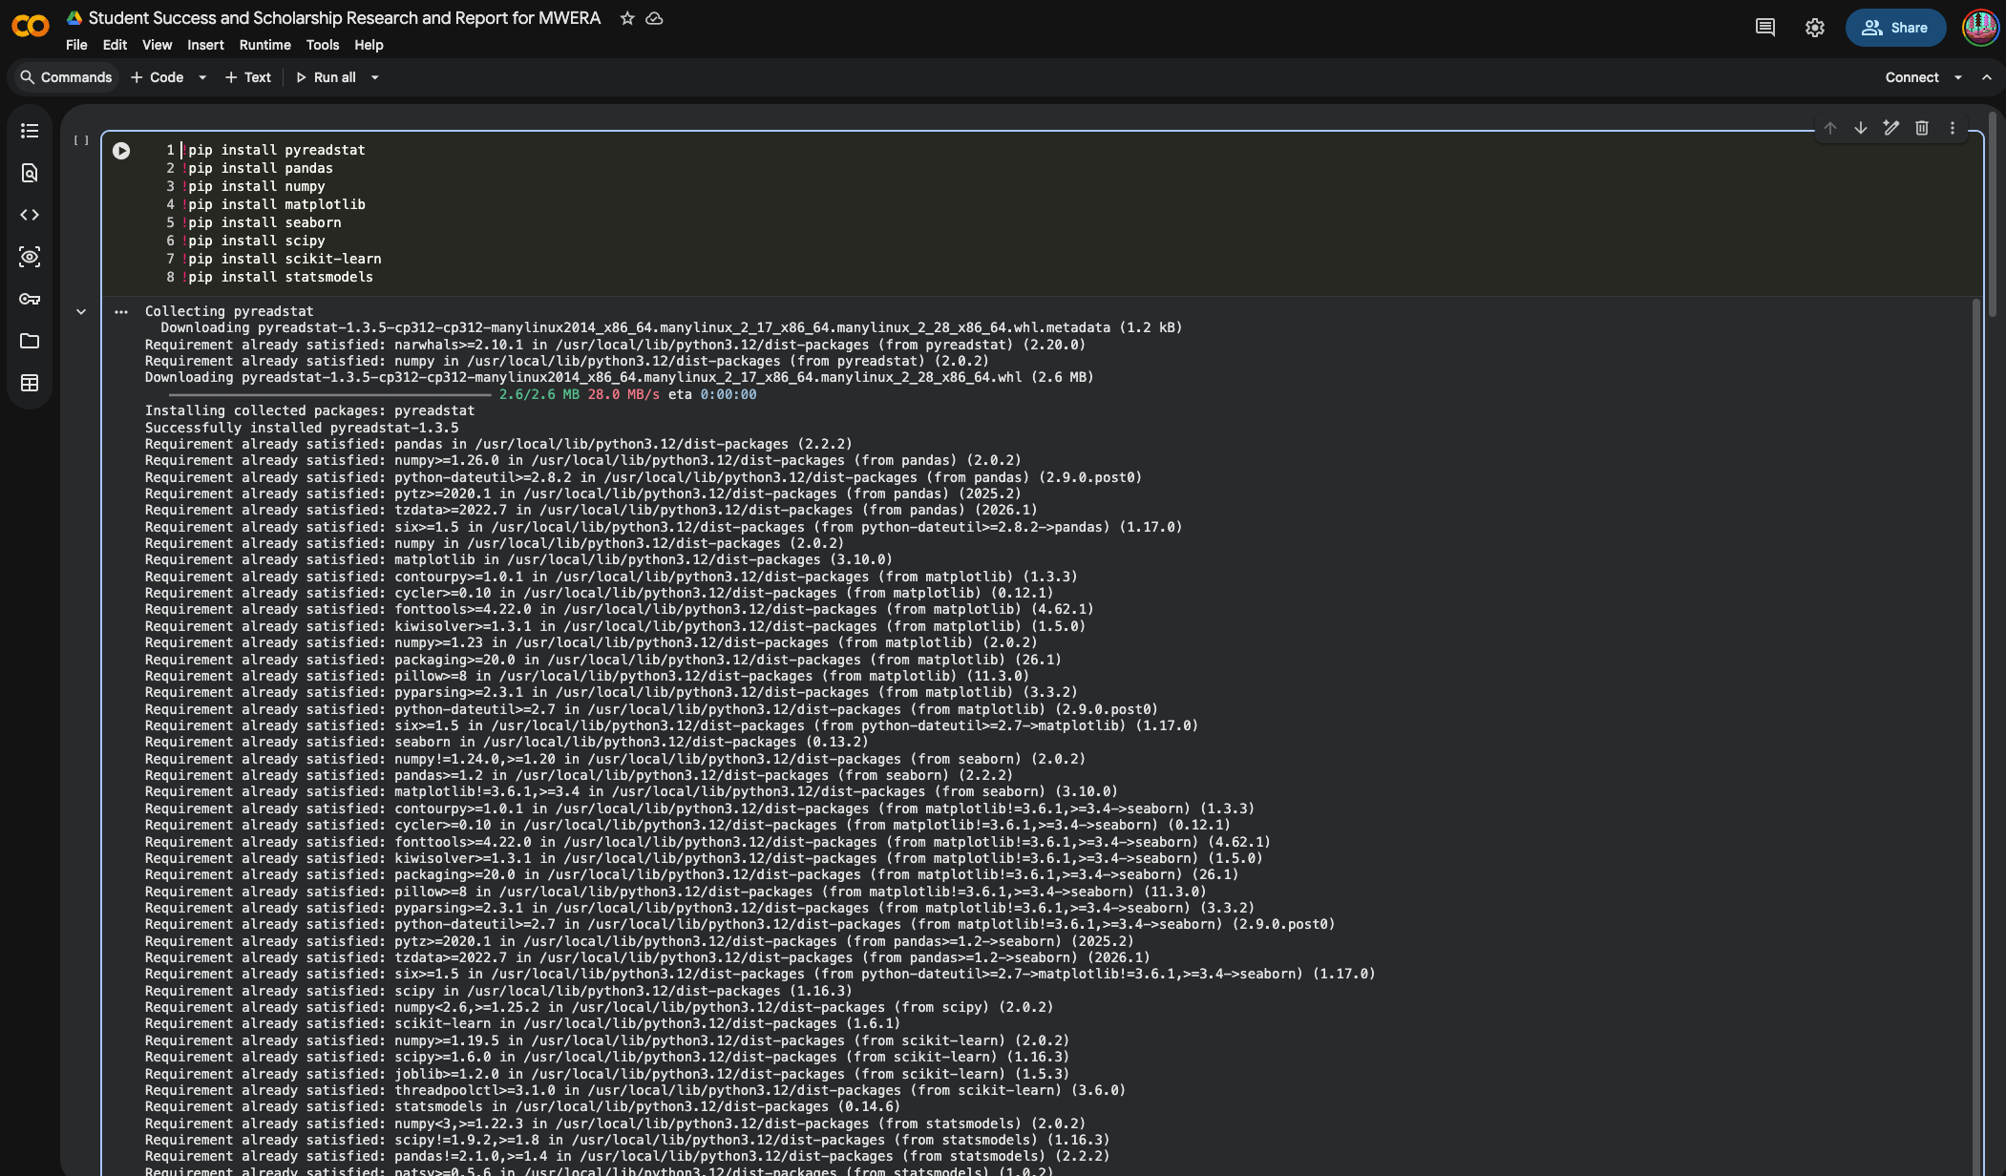
PART 1 • PYTHON ECOSYSTEM
Install the “Must-Know” Libraries
WORKSHOP LIBRARIES
Pyreadstat — SPSS file import
Pandas — data manipulation and DataFrames
NumPy — numerical/scientific computing
Matplotlib + Seaborn — visualization
SciPy — statistical tests
Statsmodels — statistical modeling
Figure 2. Installations of “must know” libraries with pip
MWERA 2026 • Expressive Python
8

Slide 13
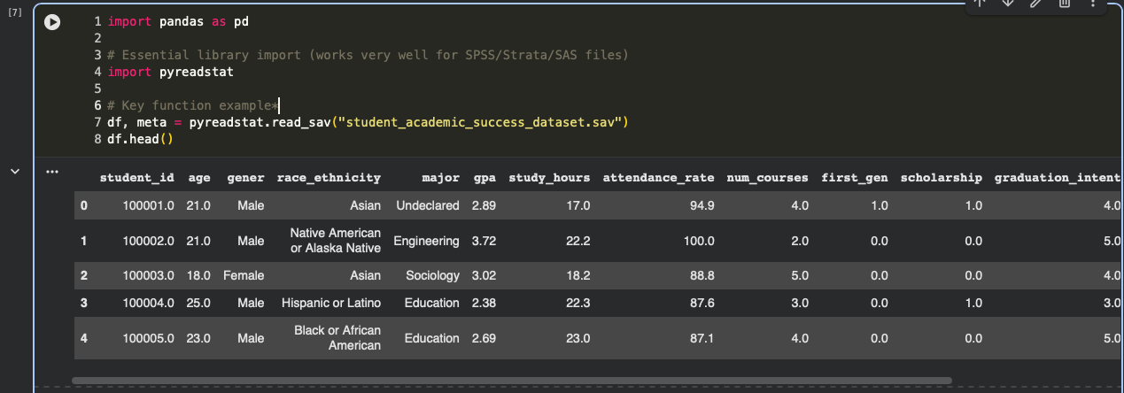
PART 1 • SPSS LOAD
Importing Research Data
Figure 3. Importing SPSS '.sav' files with pyreadstat
SPSS WORKFLOW
pyreadstat.read_sav(...) returns the data plus metadata, supporting variables and value labels common in educational datasets.
MWERA 2026 • Expressive Python
9

Slide 14
PART 2 • DATA QUALITY
Inspect & Clean Data
Pandas and NumPy help detect and correct inaccurate records so the dataset is reliable before analysis.
COMMON TASKS
DESCRIPTIVE CHECKS
WHY IT MATTERS
Handle missing values
Remove duplicate records
Correct errors
Standardize formats
Mean
Median
Mode
Distribution checks
Cleaning connects directly to later analysis. Imputation—such as mean, median, or mode replacement—can preserve records when appropriate.
Pandas DataFrame
A two-dimensional labeled data structure whose columns can contain different data types—the central structure used throughout the workshop.
MWERA 2026 • Expressive Python
10

Slide 15
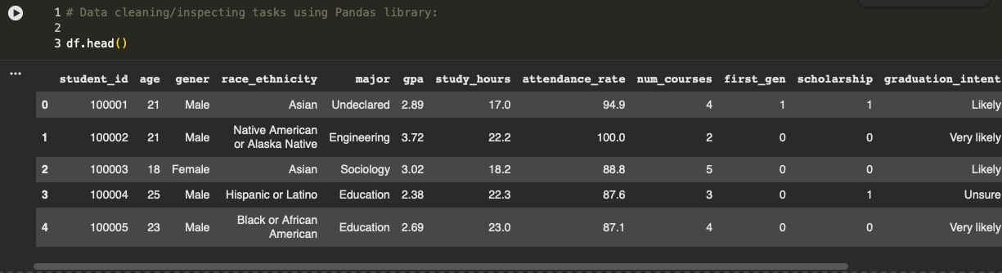
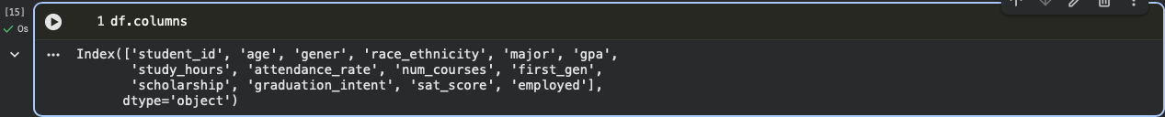
PART 2 • FIRST LOOK
Inspect the DataFrame
THREE FAST QUESTIONS
What does the data look like?
How large is it?
What variables are available?
Figure 5. Data manipulation using Pandas library (df.head())
Figure 6. Determine rows and columns (df.shape)
Figure 7. Determine column names (df.columns)
MWERA 2026 • Expressive Python
11

Slide 16
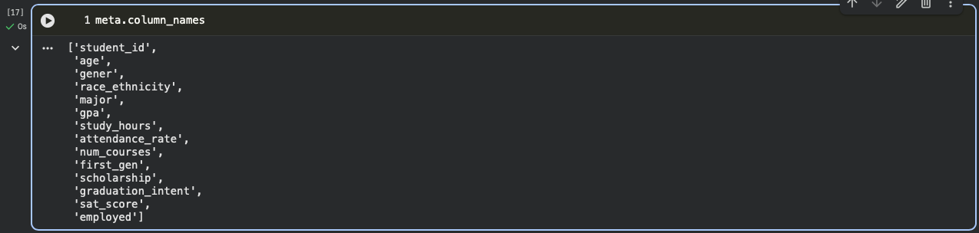
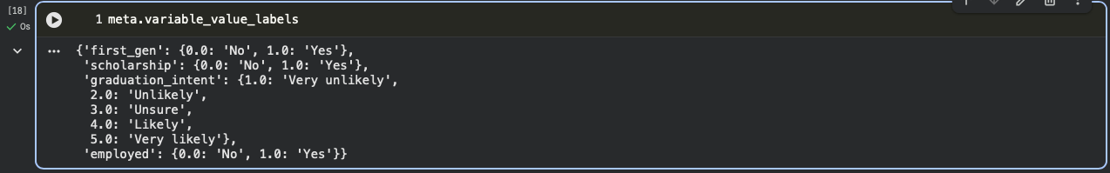
PART 2 • SPSS STRUCTURE
Read the Metadata
Figure 9. meta.variable_value_labels maps coded values to human-readable labels
Figure 8. Dataset metadata: meta.column_names
RESEARCH VALUE
Metadata preserves the meaning behind coded variables. For SPSS files, value-label dictionaries help translate numeric categories into interpretable labels before summarizing or modeling.
MWERA 2026 • Expressive Python
12

Slide 17
PART 3 • CONDENSE → INTERPRET
Summarize Data with Pandas
The goal is to turn a larger dataset into digestible representations that reveal averages, totals, counts, and trends.
df.head()
df.info()
df.describe()
df.value_counts()
preview rows
structure + types
descriptive statistics
frequency counts
df.groupby()
df.sort_values()
df.rename()
df['new_var']
grouped summaries
ordered records
clearer variable names
create/access a variable
MWERA 2026 • Expressive Python
13

Slide 18
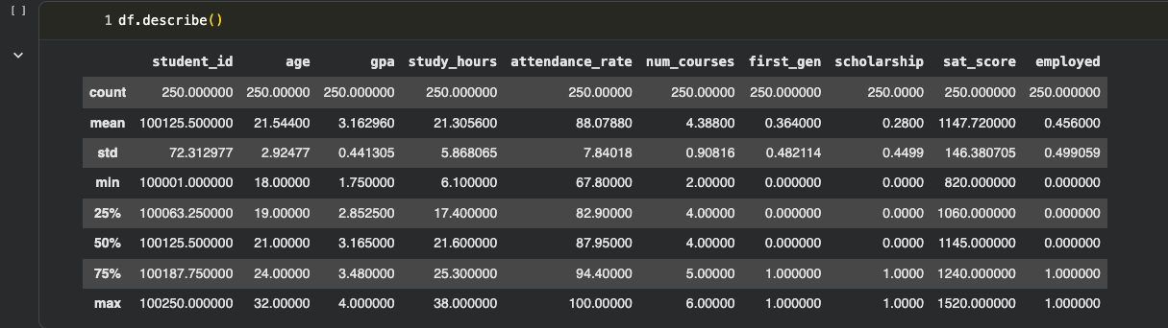
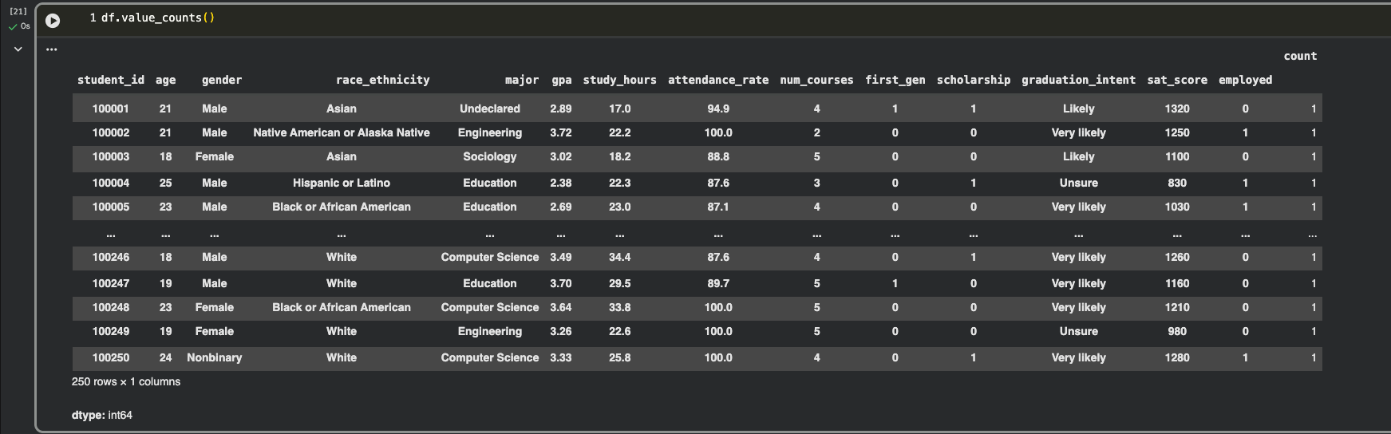
PART 3 • TWO CORE SUMMARIES
Descriptive Statistics & Frequencies
Figure 10. df.describe() displays descriptive statistics for numerical data types
Figure 11. df.value_counts() displays the frequency of unique rows
DESCRIBE
VALUE COUNTS
Quickly inspect count, mean, standard deviation, quartiles, minimum, and maximum for numerical variables.
Count repeated values or combinations to identify common categories and patterns in the DataFrame.
MWERA 2026 • Expressive Python
14

Slide 19
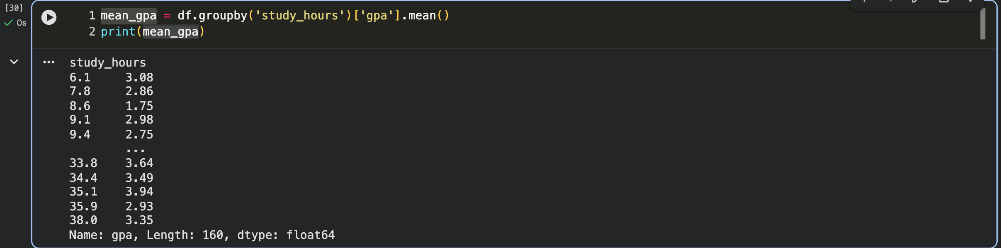
PART 3 • DF.GROUPBY()
Group, Compare, Interpret
THE QUESTION
How does mean GPA vary across different values of study_hours?
Figure 12. Displaying mean_gpa using the df.groupby() function
THE PATTERN
Grouping lets researchers summarize an outcome within meaningful categories or values before moving to visualization and modeling.
Summaries are not the endpoint—they are the bridge from raw records to research questions.
MWERA 2026 • Expressive Python
15

Slide 20
PART 4 • NUMERICAL WORKFLOWS
NumPy + Data Visualization
NUMPY
MATPLOTLIB
Core scientific-computing package for large multidimensional arrays and matrices. Workshop functions include np.where(), np.log(), np.mean(), and np.std().
Matplotlib: plt.scatter(), plt.hist(), plt.boxplot(), plt.bar()
Visualization supports interpretation, exploration, and communication of patterns in educational and scientific datasets.
NUMERICAL OPERATIONS → SUMMARY → VISUAL PATTERN → STATISTICAL MODEL
MWERA 2026 • Expressive Python
16

Slide 21
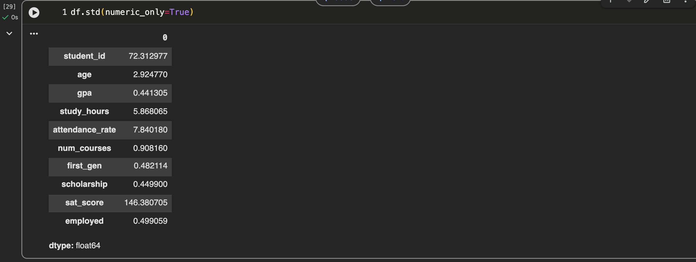
PART 4 • NUMPY
Standard Deviation in Context
WHAT IT DOES
np.std() measures dispersion: how far values tend to spread around their mean.
WORKSHOP CONNECTION
Use numerical summaries to identify scale, variability, and possible issues before visualizing or modeling.
Figure 13. np.std() demonstrating standard deviation across numeric variables
MWERA 2026 • Expressive Python
17

Slide 22
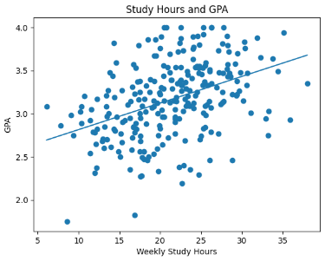
PART 4 • SCATTERPLOT
See the Relationship
X
Study hours
Y
GPA
WHY PLOT FIRST?
Visualization reveals shape, spread, outliers, and the plausibility of a relationship before formal modeling.
Figure 14. sns.scatterplot() — GPA vs. Study Hours
MWERA 2026 • Expressive Python
18

Slide 23
PART 5 • SCIPY
From Visualization to Statistical Testing
Linear regression is presented as the bridge where data visualization meets statistical modeling.
SIMPLE LINEAR REGRESSION
Participants see how Python syntax can connect a predictor and outcome, generate predictions, and visualize model performance.
Question → test/model → output → interpretation → visualization
MWERA 2026 • Expressive Python
19

Slide 24
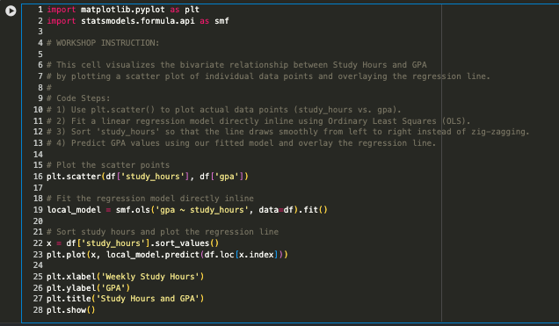
PART 5 • SIMPLE LINEAR REGRESSION
Visualize Model Performance
ACTUAL
Observed study-hours values in the dataset.
PREDICTED
Values generated by the fitted linear regression model.
INTERPRET
Compare observed and predicted values to discuss fit, residuals, and model usefulness.
Figure 15. Scatter plot visualizing the performance of a linear regression model
MWERA 2026 • Expressive Python
20

Slide 25
WHAT TO LEAVE WITH
Key Takeaways
ACCESS
STRUCTURE
NUMERACY
Colab lowers setup barriers and moves execution to cloud-based compute.
Pandas and Pyreadstat make educational data and SPSS metadata easier to inspect.
NumPy supports efficient numerical operations and foundational scientific computing.
COMMUNICATION
INFERENCE
TRANSFER
Matplotlib and Seaborn turn numerical patterns into interpretable visual evidence.
SciPy and Statsmodels extend the workflow into testing and statistical modeling.
The same workflow can be adapted to participants’ own educational and scientific research questions.
MWERA 2026 • Expressive Python
23

Slide 26

WRAP-UP
Questions + Next Steps
Scan the QR Code & Take a Survey
What will you analyze with Python next?
Suggested next step: open a Colab notebook, import a small dataset, inspect it, summarize one variable, visualize one relationship, and run one statistical test or model.
REFERENCE
Rathod, D. P. R. (2025). Python’s Potential to Enhance Learning in Higher and Distance Education. 12(3).
Thank you
MWERA 2026 • Expressive Python
24

