Slide 1


Slide 2
Name:byishimo joseph regno:25rp19781

Slide 3
Title:Machine Learning-Based Smart Cold Room Monitoring System for Food Preservation

Slide 4
Problem Statement
Cold room storage facilities face challenges in maintaining stable conditions. Inconsistent temperature and humidity monitoring often leads to food spoilage and economic losses. This project applies machine learning to predict abnormal conditions, improving food preservation.

Slide 5
Dataset Description
Source: IoT Cold Room Dataset (synthetic example)
Features: Temperature, Humidity, Timestamp
Target: Status (Normal/Abnormal)
Size: 1000 records
Goal: To Predict abnormal cold room conditions

Slide 6
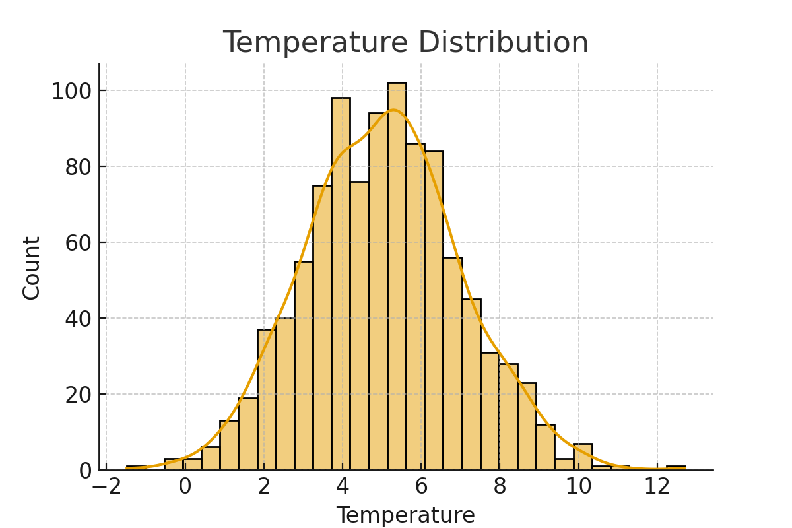
Exploratory Data Analysis – Temperature
Notes:
The histogram shows that most recorded temperatures are around 5°C, within the recommended cold room range. Some values exceed 8°C, which may cause food spoilage. This highlights the need for monitoring temperature spikes.

Slide 7
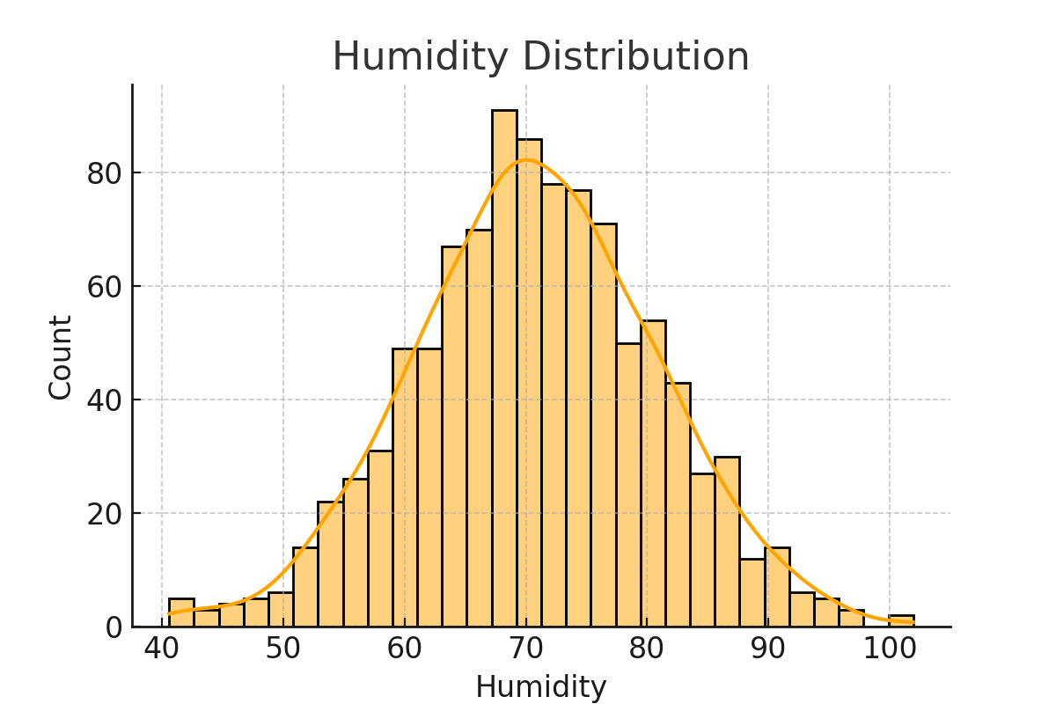
Exploratory Data Analysis – Humidity
Notes:
Humidity is mostly around 70%, which is ideal. Some records drop below 60% or rise above 85%, leading to food damage (too dry → shrinkage, too moist → mold). These anomalies are key for ML-based detection.

Slide 8
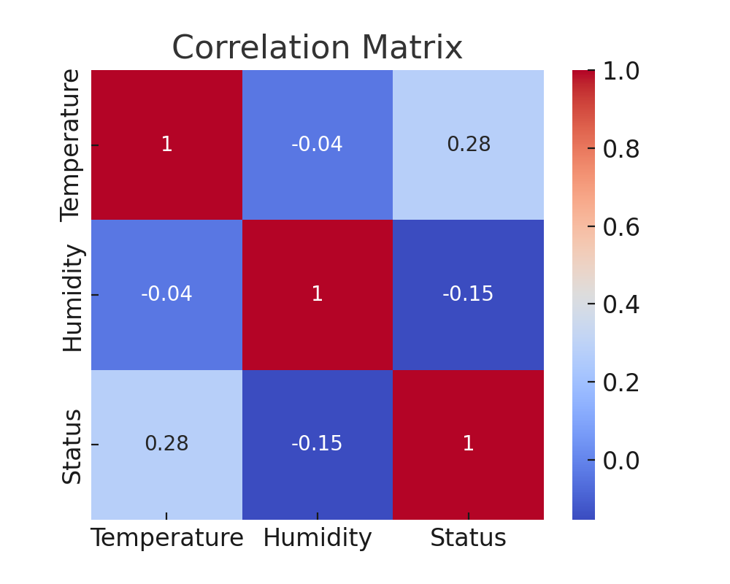
EDA – Correlation Matrix
Notes:
The heatmap shows correlations between Temperature, Humidity, and Status. Higher temperatures correlate with abnormal conditions, while extreme humidity also contributes. Both variables are important predictors for spoilage risk.

Slide 9
Feature Engineering
selected Temperature & Humidity as features
Created Status as target variable
Normalized features
using StandardScalerSplit dataset (80% training, 20% testing
Encoded target variable (Normal=0, Abnormal=1)

Slide 10
Model Building
Model: Random Forest Classifier
compared with Decision Tree & Logistic Regression
Training/Testing split: 80/20
Best model chosen based on F1-score & accuracy

Slide 11
Model Evaluation
Metrics: Accuracy, Precision, Recall, F1-score
Example result: Accuracy ~90%
Confusion matrix shows classification performance
Notes:
The confusion matrix shows how well the model predicts. Most predictions are correct, with high accuracy (~90%). Few misclassifications exist, proving the model is reliable for monitoring cold room conditions.

Slide 12
Model Deployment
Deployment using Streamlit for real-time prediction
Users can input Temperature & Humidity values
Output: Prediction (Normal ✅ or Abnormal ⚠️)

Slide 13
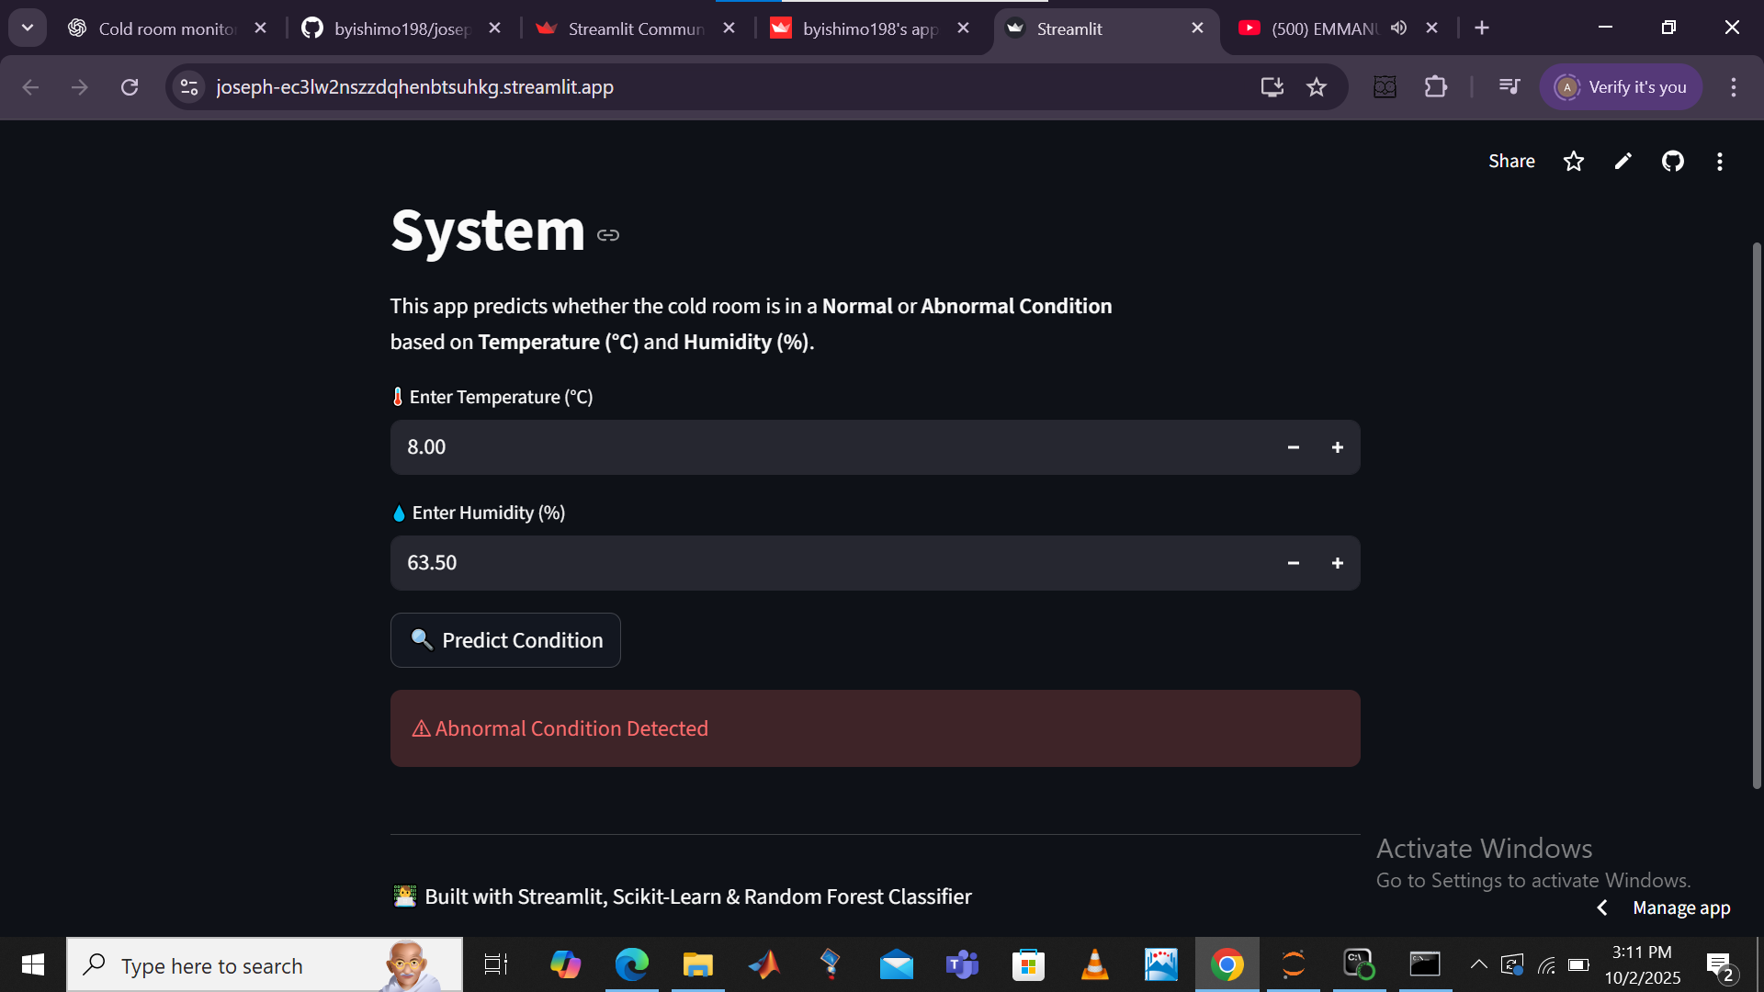
Streamlit app screenshots

Slide 14
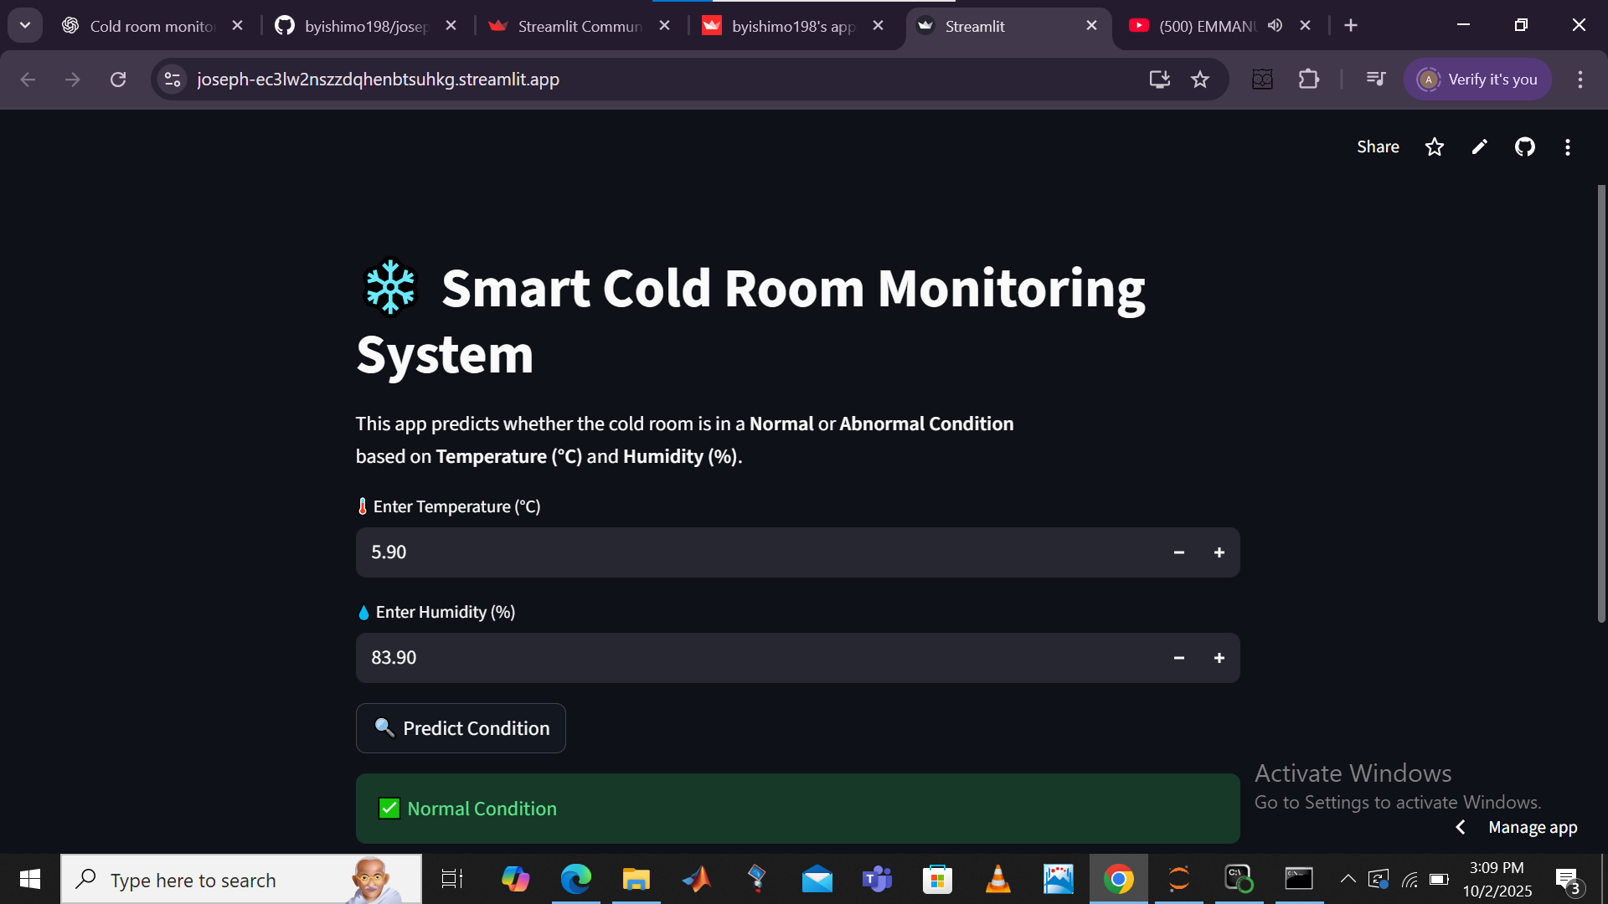

Slide 15
Conclusion
Machine learning improves cold room monitoring by predicting spoilage risks before they occur. This helps reduce food waste, increase operational efficiency, and ensure food safety by maintaining optimal storage conditions.

