Slide 1
Small Retail Inventory Management System
PL/SQL Capstone Project (Phase I - VIII)
Student Name: BYISHIMO Kevin
Student ID: 28056
Course: INSY 8311 - Database Development with PL/SQL
Institution: Adventist University of Central Africa (AUCA)
Group: Monday
Date: 6TH. December. 2025

Slide 2
The Problem (Phase I)
Issue: Manual Inefficiency
Current retail tracking relies on paper records or disconnected spreadsheets.
Pain Point: Stock updates lag behind actual sales, leading to "ghost inventory."
Risk: High frequency of stockouts for popular items and overstocking of slow items.
Lack of Control: No security restrictions; unauthorized staff can alter stock levels at any time (even on weekends).

Slide 3
The Solution (Phase I)
Objective: Centralized Oracle Database
Real-Time Tracking: Sales deduct inventory instantly via PL/SQL.
Data Integrity: Foreign Keys link Sales, Products, and Suppliers.
Security: "Time-based Access Control" blocks unauthorized edits.
Goal: Zero data latency and complete auditability.

Slide 4
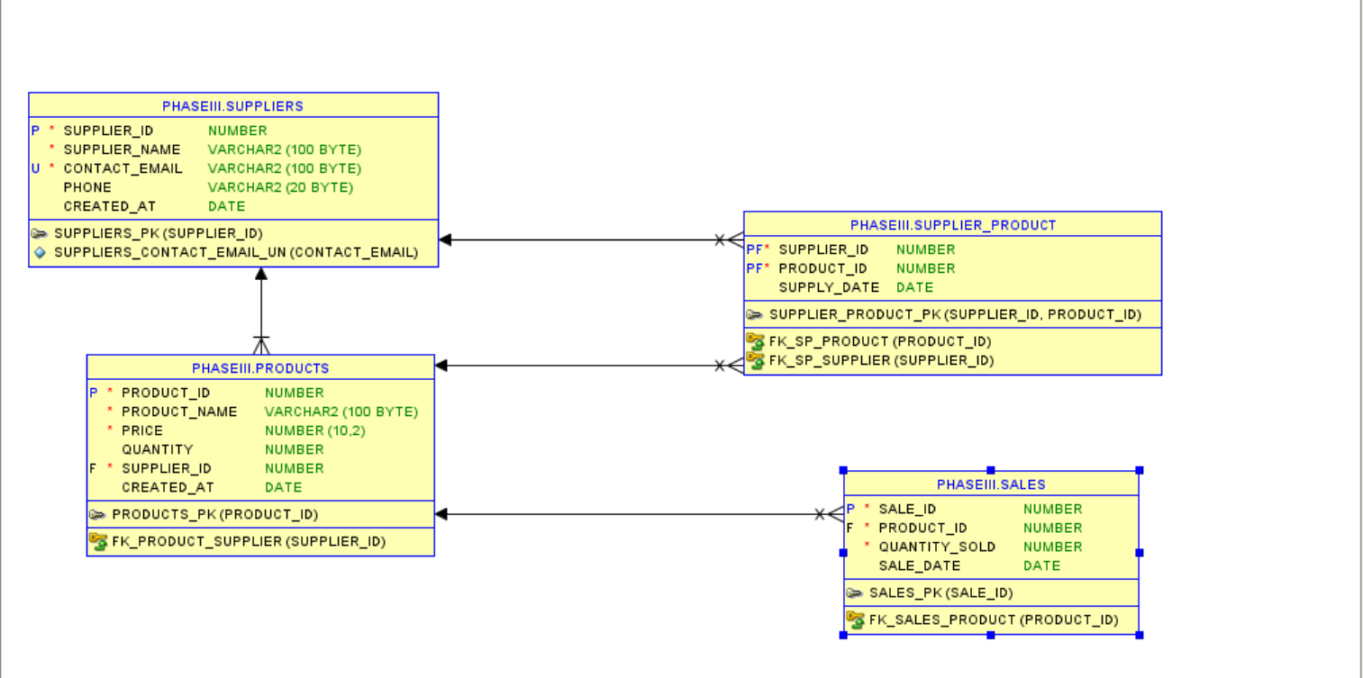
Database Design (Phase III)
Key Entities:
SUPPLIERS & PRODUCTS: Core inventory data.
SALES: Transactional history linked to customers.
AUDIT_LOG: Security table for tracking DML events.
Design: 3NF compliant with 1:Many relationships.

Slide 5
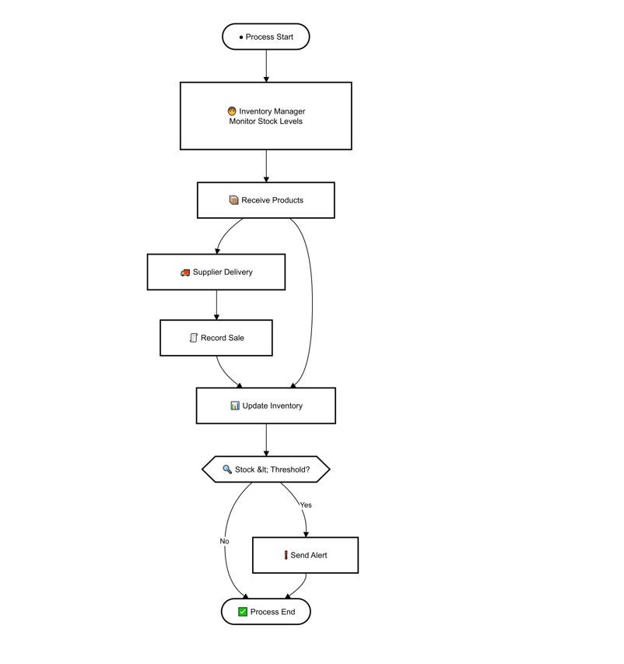
Business Process (Phase II)
Workflow:
Monitor: Inventory Manager checks levels.
Transact: Sales are recorded $\rightarrow$ System triggers auto-update.
Decision Node: System checks: Is Stock < Threshold?
Action: If Low $\rightarrow$ Alert Manager. If Normal $\rightarrow$ Complete Transaction.

Slide 6
Technical Implementation (Phase V & VI)
PL/SQL Architecture:
Procedures:
  register_sale(product, qty): Handles the transaction logic and stock deduction transactionally.
Functions:
  check_stock_status(id): Returns 'LOW_STOCK' or 'IN_STOCK'.
  get_inventory_value(): Calculates total asset value dynamically.
Data Volume: Populated with 400+ realistic rows using PL/SQL bulk generation loops.

Slide 7
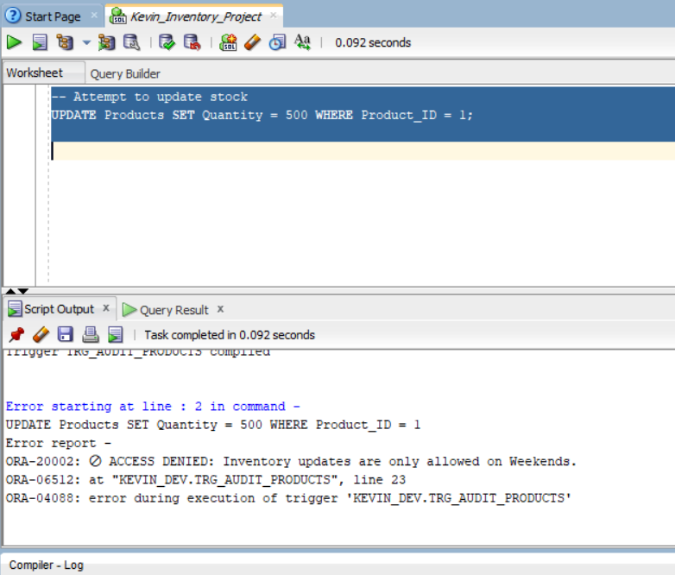
Advanced Features (Phase VII)
Security & Auditing:
Critical Requirement: Restricted DML on Weekdays/Holidays.
Trigger Implemented: trg_audit_products
  Logic: Checks SYSDATE against holiday_calendar and current Day.
  Action: If Day = Mon-Fri $\rightarrow$ Raise Error (ORA-20002: Access Denied).
Audit Package: audit_pkg captures every attempt (User, Time, Operation, Status) even if the transaction fails (Autonomous Transaction).

Slide 8
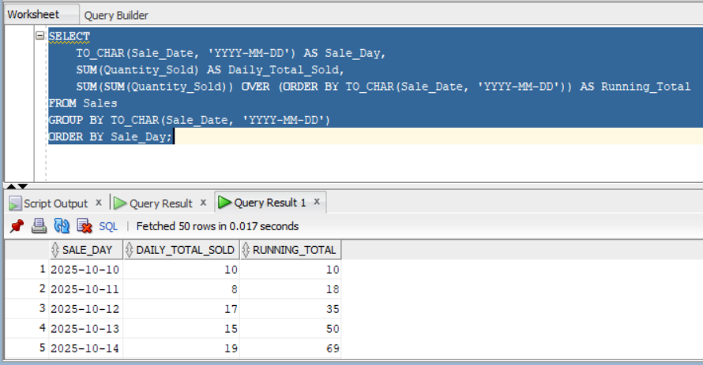
BI & Analytics (Phase VIII)
Decision Support Metrics:
Sales Trends: Window functions (LAG/LEAD) analyze daily sales growth.
Query: SELECT
TO_CHAR(Sale_Date, 'YYYY-MM-DD') AS Sale_Day,
SUM(Quantity_Sold) AS Daily_Total_Sold,
SUM(SUM(Quantity_Sold)) OVER (ORDER BY TO_CHAR(Sale_Date, 'YYYY-MM-DD')) AS Running_Total
FROM Sales
GROUP BY TO_CHAR(Sale_Date, 'YYYY-MM-DD')
ORDER BY Sale_Day;
Inventory Valuation: Real-time calculation of capital tied up in stock.
Supplier Performance: Tracking supply frequency and reliability.

Slide 9
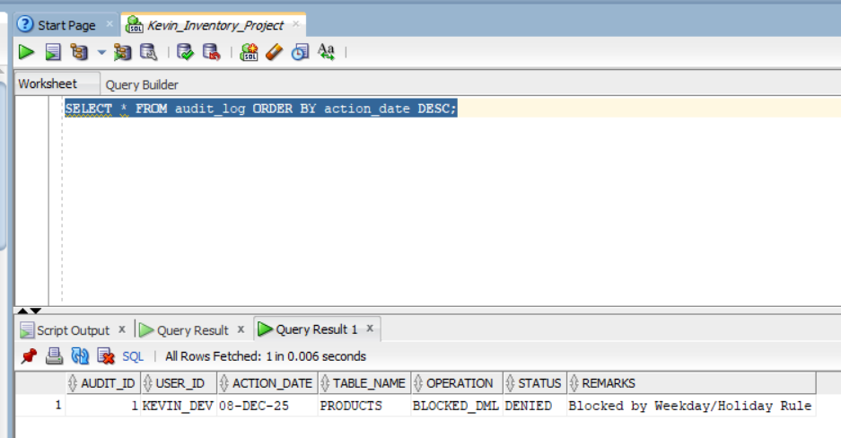
Test Results
Success: The "400 rows inserted" message from the data generator.
Restriction: The ORA-20002 error when you tried to update stock on a Monday (proving the security works).
Audit Log: A SELECT * FROM audit_log showing "DENIED" entries.

Slide 10
Conclusion
Achievements:
Successfully migrated from manual tracking to a fully automated Oracle backend.
Implemented strict business rules preventing unauthorized updates.
Delivered a scalable architecture ready for BI integration.
Future Enhancements:
Add a front-end (Oracle APEX) for cashiers.
Implement automatic email notifications for reordering.

