Slide 1
Used Car Sales Analysis Project – 2024
Power BI Data Analysis Presentation

Slide 2
Team Members
Eng. Baher
Eng. Mohamed Hassan
Mohamed Samir

Slide 3
Project Workflow
1. Raw Dataset (Flat Excel File)
The project started with a flat Excel file containing all car information in one table.
This table included:
Manufacturer
Model
Engine size
Fuel type
Year of manufacture
Mileage
Price
Although this structure is simple, it makes analysis slow and limits filtering and relationships.

Slide 4
Project Workflow
2. Data Cleaning
Promoted Headers: Converted the first row into proper column names.
Data Type Correction: Ensured text fields (Brand, Model, Fuel) and numeric fields (Engine size, Year, Mileage, Price) were correctly typed.
Removed Unnecessary Columns: Kept only relevant fields for each table during preparation.
Removed Duplicates: Cleaned each dimension column to keep unique values only.
Added Index Columns: Created surrogate keys (Model ID, Manufacturer ID, Fuel Type ID, Engine Size ID).
Validated Fact Table: Checked for empty rows, invalid records, and ensured consistent structure before modelling.

Slide 5
Project Workflow
3. Normalization:
The flat Excel file was converted into a structured model by separating repeated fields into Dimension Tables.
Created distinct Dimension Tables for:
  Dim Manufacturer
  Dim Model
  Dim Fuel Type
  Dim Engine Size
Each Dimension Table contains only unique values and an added Index Column serving as a primary key (Manufacturer ID, Model ID, Fuel Type ID, Engine Size ID).
The original dataset was transformed into a Fact Sales table containing all transaction details (brand, model, engine, fuel, year, mileage, price).
This normalization process reduced redundancy, improved performance, and prepared the data for proper modelling in a Star Schema.

Slide 6
Project Workflow
4. Data Model – Star Schema
After normalization, all tables were connected using a Star Schema to ensure efficient analysis.
Fact Sales was placed at the center, holding all transactional data.
Connected to four Dimension Tables through surrogate keys:
  Manufacturer ID
  Model ID
  Fuel Type ID
  Engine Size ID
All relationships were set to one-to-many, enabling accurate filtering and cross-analysis.
This structure improves performance and allows flexible analysis by brand, model, year, engine size, and fuel type.

Slide 7
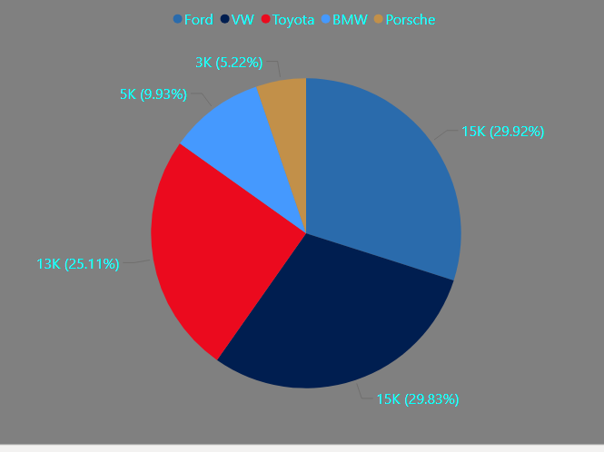
Total Cars by manufacturer
The chart shows that Ford, Volkswagen, and Toyota clearly dominate the market.
These three brands account for most available cars, which means buyers mainly prefer reliable, widely-available models.
Premium brands like BMW and Porsche appear in much smaller numbers, indicating limited supply and a more niche customer segment.

Slide 8
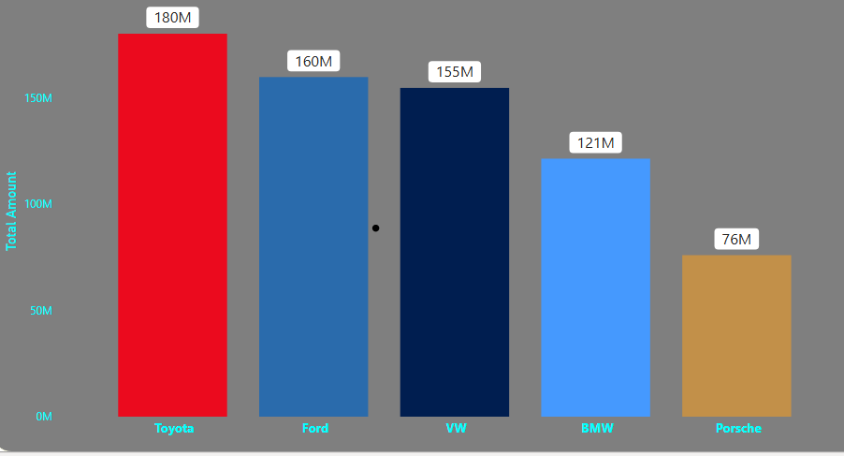
Total Amount by Manufacturer
Toyota achieves the highest total sales value (180M), showing strong demand and solid pricing.
Ford and VW follow closely, indicating both brands maintain strong market value.
BMW generates high revenue relative to its volume, confirming its premium pricing.
Porsche shows the lowest total amount, reflecting its limited market presence.

Slide 9
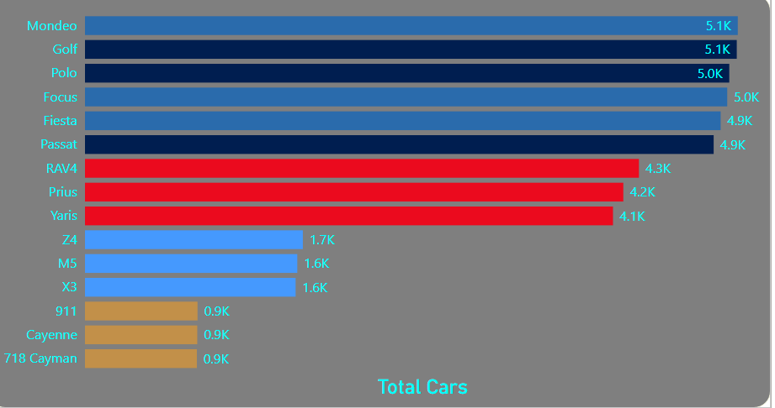
Total Cars By Model
The top-selling models are Mondeo, Golf, Polo, Focus, and Fiesta, each around 5K, showing strong demand for mass-market cars.
Toyota models (RAV4, Prius, Yaris) follow with 4K+, reflecting stable popularity.
Premium models (BMW) show moderate volumes, while Porsche models record the lowest, as expected for high-end cars.
Overall: Most sales come from affordable mid-range models.

Slide 10
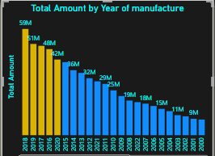
Total Amount by Year of manufacturing
The highest sales amounts come from newer models (2016–2020), reaching up to 59M, confirming that recent cars generate significantly higher revenue in the used-car market.
Sales value declines steadily for older models because older cars lose market value, even if the number of units might still be available.
The drop becomes sharper after 2010, showing that cars older than ~12–15 years contribute very little to total revenue.
Overall, the market’s revenue is driven mainly by modern cars, meaning buyers are willing to pay much more for relatively recent models, even if quantities are lower.

Slide 11
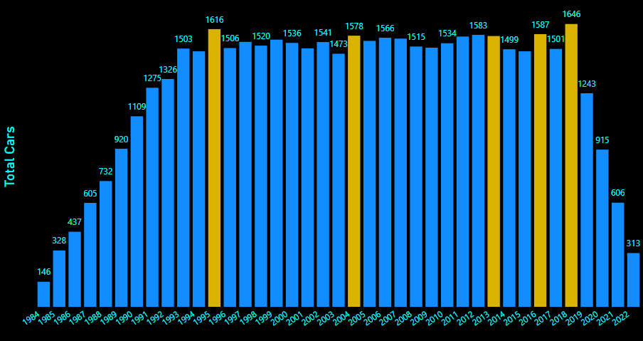
Total Sales by Year of manufacturing
The chart highlights 1995, 1996, 2005, 2019, and 2018 as the years with the highest number of cars sold, shown in yellow.
These model years simply have more cars available in the used-car market compared to the surrounding years.
Aside from these peaks, most other years show a stable and consistent sales volume across the dataset.

Slide 12
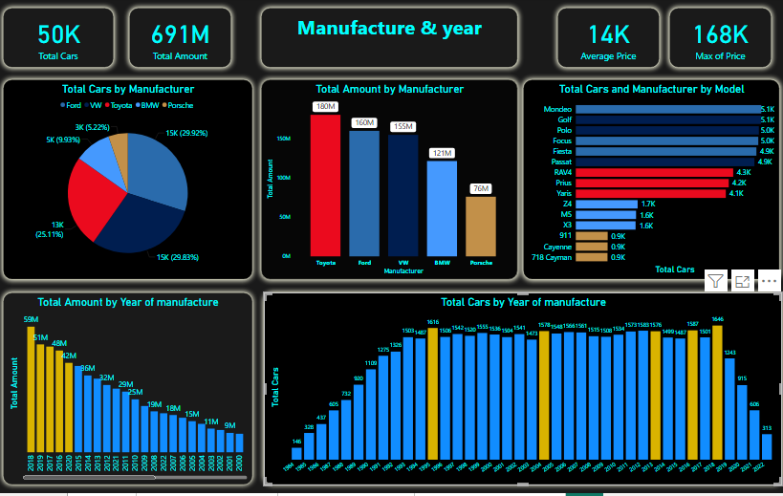

Slide 13
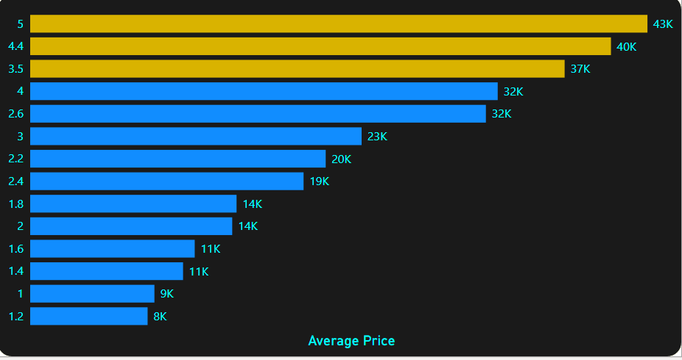
Average Price by Engine Size
The highest average prices appear in engines 5.0L, 4.4L, and 3.5L, reflecting their position in the premium and high-performance segment.
Mid-range engines between 2.6L and 3.0L show balanced pricing, indicating strong demand with moderate cost.
Smaller engines (1.2L–1.6L) have the lowest average prices, which aligns with their economy-focused design and lower overall market value.

Slide 14
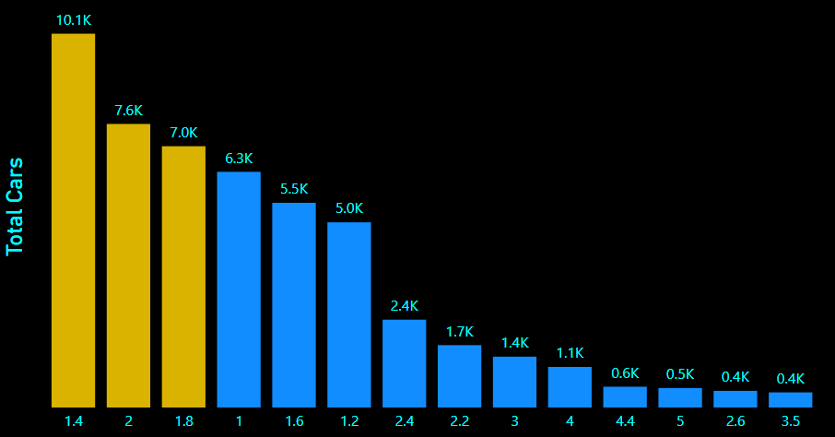
Total Cars by Engine Size
The highest volumes come from small engines (1.4L, 2.0L, 1.8L), indicating strong market demand for fuel-efficient and budget-friendly cars.
Mid-size engines (1.0L–1.6L) also show solid volumes, reinforcing the dominance of economy and compact vehicles.
Larger engines (2.2L and above) have significantly lower counts, reflecting their higher running costs and limited presence in the used-car market.

Slide 15
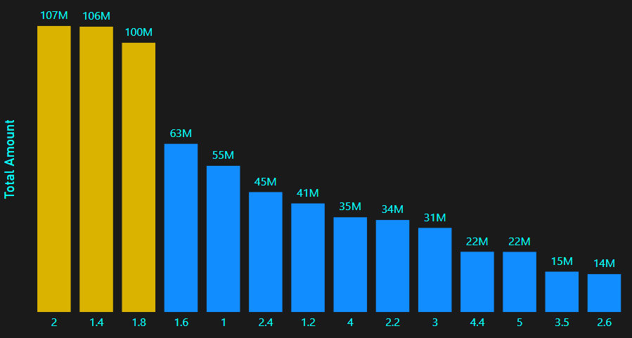
Total Amount by Engine Size
The highest total amounts come from small engines (2.0L, 1.8L, 1.4L), contributing over 100M each—showing that compact, fuel-efficient cars dominate overall market value.
Mid-range engines (1.6L and 1.0L) also generate strong totals, confirming high transaction volume in the economy segment.
Larger engines (2.4L and above) show significantly lower totals, reflecting their lower market demand and fewer transactions compared to smaller engines

Slide 16
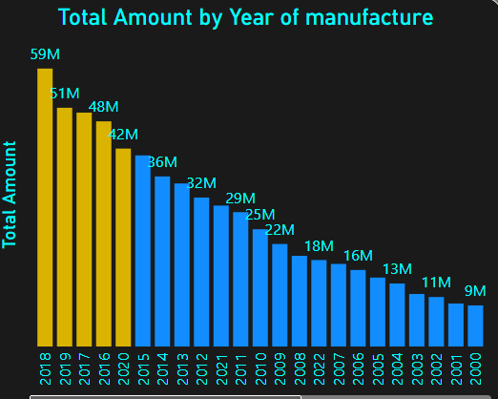
Total Amount by Year of Manufacture
Recent models generate the highest total amounts, especially 2018 (59M), 2019 (51M), 2017 (48M), and 2016 (42M).
Newer cars retain higher market value, which lifts total sales amounts.
From 2015 to 2010, there is a gradual but consistent decline, reflecting lower pricing as cars age.
Models older than 2009 show a sharp drop in total amount due to depreciation, reduced demand, and limited availability.

Slide 17
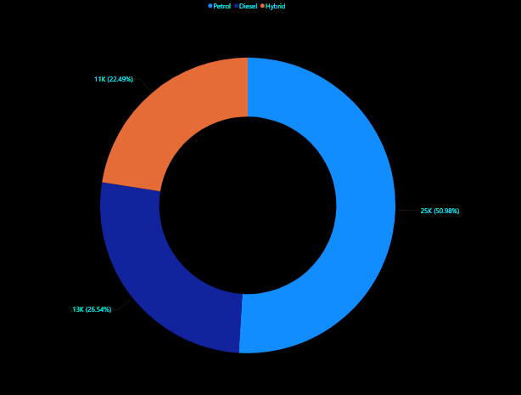
Total Cars by Fuel Type
Petrol dominates the market, representing 50.9% (25K cars) — confirming that petrol cars remain the most common and widely demanded in the used-car market.
Diesel comes next with 26.5% (13K cars), showing a solid presence but notably lower than petrol.
Hybrid cars account for 22.4% (11K cars) — a meaningful share that reflects growing adoption of fuel-efficient and environmentally friendly options, but still behind traditional fuel types.

Slide 18
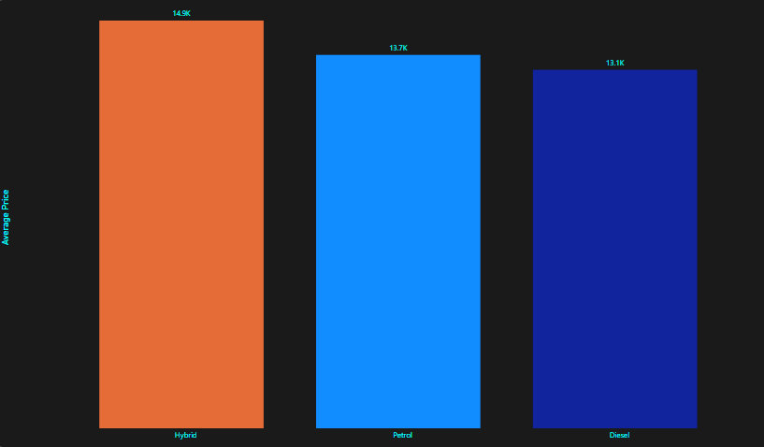
Average Price by Fuel Type
Hybrid cars have the highest average price (14.9K), reflecting their newer technology and stronger market demand.
Petrol cars come next (13.7K), maintaining a solid price point due to wide availability and lower maintenance costs.
Diesel cars show the lowest average price (13.1K), consistent with their reduced popularity and long-term ownership concern

Slide 19
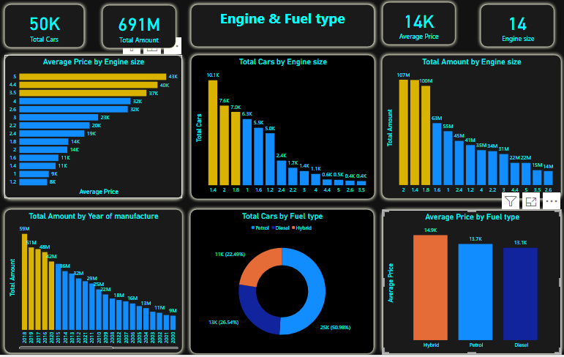

Slide 20
Key Findings Summary
Toyota, Ford, and VW represent the highest share of total cars, making them the dominant manufacturers in the used-car market.
Peak availability appears clearly in 1995, 1996, 2005, and 2019, where the number of cars is significantly higher than surrounding years.
Engine sizes 1.4L, 2.0L, and 1.8L are the most common, showing the highest adoption among buyers.
Larger engines (4.4L and 5.0L) have the highest average prices despite low market availability.
Petrol is the most widely available fuel type, while Hybrid has the highest average price.
Total sale values decrease consistently for older manufacturing years, reflecting lower demand for aging models.

Slide 21
Recomendations
Focus Inventory on High-Demand Brands
Toyota, Ford, and VW represent the largest share of used-car demand. Increasing stock from these manufacturers will maximize turnover and sales volume.
2) Prioritize Engine Sizes Between 1.4L and 2.0L
These engines account for the majority of sold units and generate steady revenue. They should remain the core of inventory planning.
3) Leverage Hybrid Models as Premium Offerings
Hybrid cars show the highest average price, making them strong candidates for premium positioning and higher-margin sales.
4) Monitor Older Model Years Carefully
Cars older than 2005 show a sharp decline in demand. Limit purchasing of very old models to reduce slow-moving inventory.
5) Adjust Pricing Strategies Based on Engine Size & Fuel Type
Higher engine sizes (3.5L–5.0L) yield the highest prices but lower sales volumes; they should be priced competitively and targeted toward niche buyers.

