Slide 1

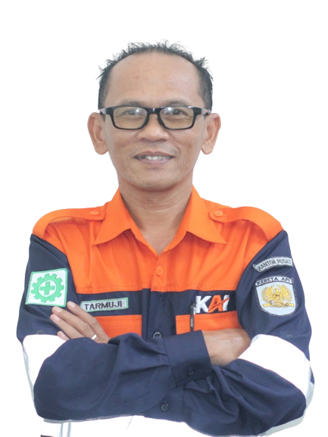

MANAGER BALAIYASA MEKANIK CIREBON PRUJAKAN (TJJC)
TARMUJI
44729
MANAGER BALAIYASA MEKANIK CIREBON PRUJAKAN (TJJC)
TARMUJI
44729
MANAGER BALAIYASA MEKANIK CIREBON PRUJAKAN (TJJC)
TARMUJI
44729
MANAGER BALAIYASA MEKANIK CIREBON PRUJAKAN (TJJC)
TARMUJI
44729
MANAGER BALAIYASA MEKANIK CIREBON PRUJAKAN (TJJC)
TARMUJI
44729
MANAGER BALAIYASA MEKANIK CIREBON PRUJAKAN (TJJC)
TARMUJI
44729
MANAGER BALAIYASA MEKANIK CIREBON PRUJAKAN (TJJC)
TARMUJI
44729

