Slide 1


Chapter 1
Ethical Hacking Overview

Slide 2

Describe the role of an ethical hacker
Describe what you can do legally as an ethical hacker
Describe what you cannot do as an ethical hacker
Hands-On Ethical Hacking and Network Defense

Slide 3

Ethical hackers
  Employed by companies to perform penetration tests
Penetration test
  Legal attempt to break into a company’s network to find its weakest link
  Tester only reports findings, does not solve problems
Security test
  More than an attempt to break in; also includes analyzing company’s security policy and procedures
  Tester offers solutions to secure or protect the network
Hands-On Ethical Hacking and Network Defense

Slide 4

Hackers
  Access computer system or network without authorization
  Breaks the law; can go to prison
Crackers
  Break into systems to steal or destroy data
  U.S. Department of Justice calls both hackers
Ethical hacker
  Performs most of the same activities but with owner’s permission
Hands-On Ethical Hacking and Network Defense

Slide 5

Script kiddies or packet monkeys
  Young inexperienced hackers
  Copy codes and techniques from knowledgeable hackers
Experienced penetration testers write programs or scripts using these languages
  Practical Extraction and Report Language (Perl), C, C++, Python, JavaScript, Visual Basic, SQL, and many others
Script
  Set of instructions that runs in sequence
Hands-On Ethical Hacking and Network Defense

Slide 6

This class alone won’t make you a hacker, or an expert
  It might make you a script kiddie
It usually takes years of study and experience to earn respect in the hacker community
It’s a hobby, a lifestyle, and an attitude
  A drive to figure out how things work
Hands-On Ethical Hacking and Network Defense

Slide 7
Tiger box
  Collection of OSs and hacking tools
  Usually on a laptop
  Helps penetration testers and security testers conduct vulnerabilities assessments and attacks
Hands-On Ethical Hacking and Network Defense

Slide 8

White box model
  Tester is told everything about the network topology and technology
    Network diagram
  Tester is authorized to interview IT personnel and company employees
  Makes tester’s job a little easier
Hands-On Ethical Hacking and Network Defense

Slide 9

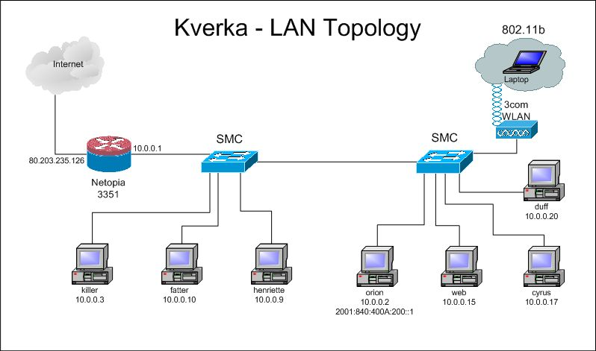
From ratemynetworkdiagram.com (Link Ch 1g)
Hands-On Ethical Hacking and Network Defense

Slide 10

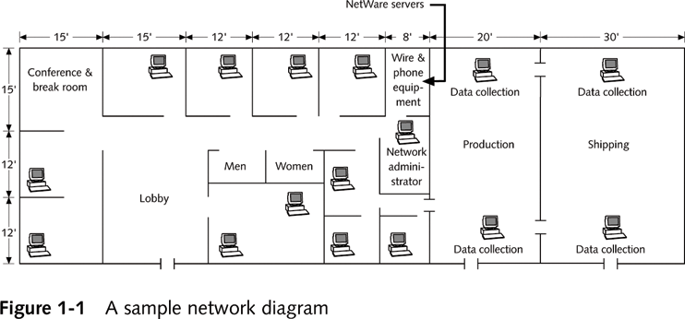
Hands-On Ethical Hacking and Network Defense

Slide 11
Black box model
  Company staff does not know about the test
  Tester is not given details about the network
    Burden is on the tester to find these details
  Tests if security personnel are able to detect an attack
Hands-On Ethical Hacking and Network Defense

Slide 12

Gray box model
  Hybrid of the white and black box models
  Company gives tester partial information
Hands-On Ethical Hacking and Network Defense

Slide 13

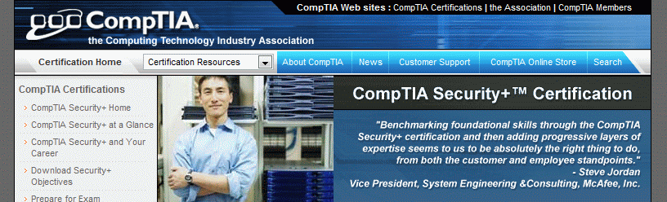
Certification programs available in almost every area of network security
Basics:
  CompTIA Security+ (CNIT 120)
  Network+ (CNIT 106 or 201)
Hands-On Ethical Hacking and Network Defense

Slide 14

CNIT is a Prometric Vue testing center
  Certification tests are given in S214
  CompTIA and Microsoft
  The next tests will be in the second week of April, right after Spring Break
  Email sbowne@ccsf.edu if you want to take a test
Hands-On Ethical Hacking and Network Defense

Slide 15

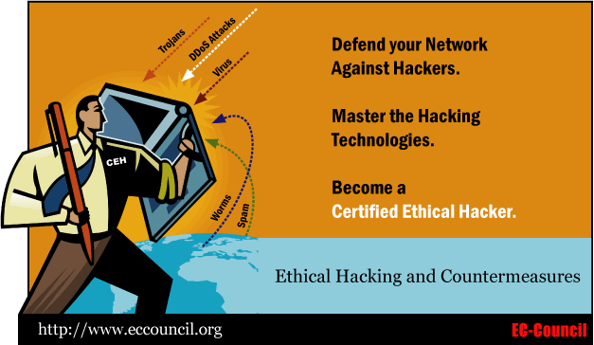
But see Run Away From The CEH Certification
  Link Ch 1e on my Web page

Slide 16

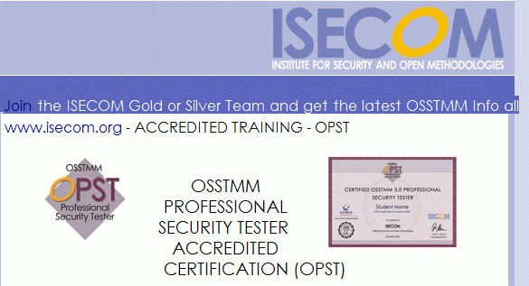
Designated by the Institute for Security and Open Methodologies (ISECOM)
  Uses the Open Source Security Testing Methodology Manual (OSSTMM)
  Test is only offered in Connecticut and outside the USA, as far as I can tell
    See links Ch 1f and Ch 1h on my Web page

Slide 17


Issued by the International Information Systems Security Certifications Consortium (ISC²)
Usually more concerned with policies and procedures than technical details
Web site
  www.isc2.org

Slide 18

SysAdmin, Audit, Network, Security (SANS)
Offers certifications through Global Information Assurance Certification (GIAC)
Top 20 list
  One of the most popular SANS Institute documents
  Details the most common network exploits
  Suggests ways of correcting vulnerabilities
Web site
  www.sans.org (links Ch 1i & Ch 1j)
Hands-On Ethical Hacking and Network Defense

Slide 19

Laws involving technology change as rapidly as technology itself
Find what is legal for you locally
  Laws change from place to place
Be aware of what is allowed and what is not allowed
Hands-On Ethical Hacking and Network Defense

Slide 20

Tools on your computer might be illegal to possess
Contact local law enforcement agencies before installing hacking tools
Written words are open to interpretation
Governments are getting more serious about punishment for cybercrimes
Hands-On Ethical Hacking and Network Defense

Slide 21

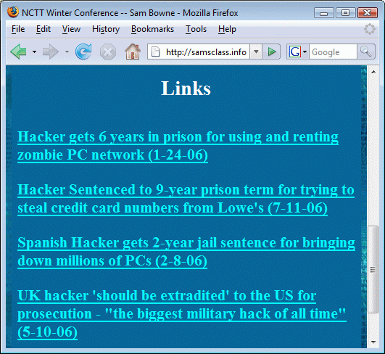
Hands-On Ethical Hacking and Network Defense

Slide 22

Some states deem it legal
Not always the case
Federal Government does not see it as a violation
  Allows each state to address it separately
Read your ISP’s “Acceptable Use Policy”
  IRC “bots” may be forbidden
    Program that sends automatic responses to users
    Gives the appearance of a person being present
Hands-On Ethical Hacking and Network Defense

Slide 23

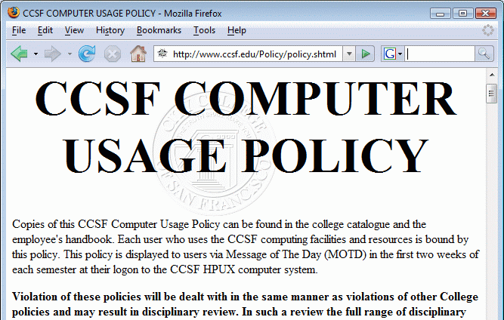
www.ccsf.edu/Policy/policy.shtml (link Ch 1k)
Hands-On Ethical Hacking and Network Defense

Slide 24

Federal computer crime laws are getting more specific
  Cover cybercrimes and intellectual property issues
Computer Hacking and Intellectual Property (CHIP)
  New government branch to address cybercrimes and intellectual property issues
Hands-On Ethical Hacking and Network Defense

Slide 25
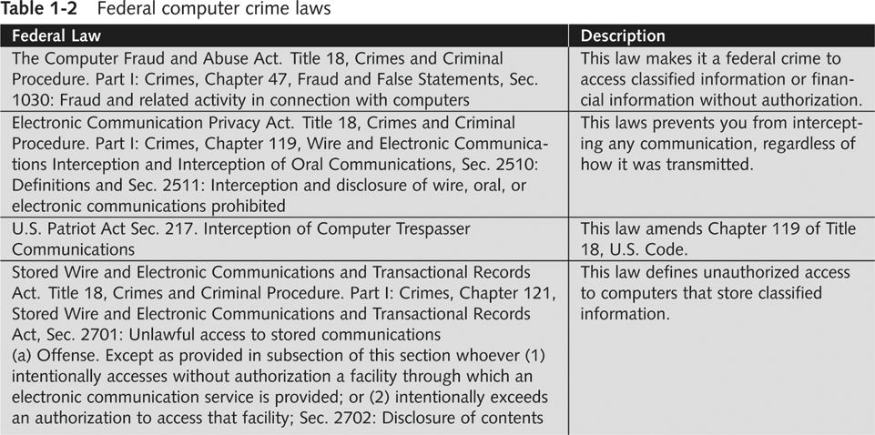
Hands-On Ethical Hacking and Network Defense

Slide 26

Accessing a computer without permission is illegal
Other illegal actions
  Installing worms or viruses
  Denial of Service attacks
  Denying users access to network resources
Be careful your actions do not prevent customers from doing their jobs
Hands-On Ethical Hacking and Network Defense

Slide 27

Ch 1l1: Lycos starts anti-spam screensaver plan: Dec 2, 2004
Ch 1l2: Lycos Pulls Anti-Spam 'Vigilante' Campaign -- Dec 3, 2004
Ch 1l3: Lycos's Spam Attack Network Dismantled -- Spammers sent the DOS packets back to Lycos -- Dec 6, 2004
Hands-On Ethical Hacking and Network Defense

Slide 28

Ch 1m: Blue Frog begins its "vigilante approach" to fight spam -- July, 2005
Ch 1n: Russian spammer fights back, claims to have stolen Blue Frog's database, sends threating email -- DOS attack in progress -- May 2, 2006
Ch 1o: Blue Frog compromised and destroyed by attacks, urgent instructions to uninstall it, the owners have lost control -- May 17, 2006
Hands-On Ethical Hacking and Network Defense

Slide 29

Ch 1p: Call for help creating distributed, open-source Blue Frog replacement -- May 17, 2006
  Not in textbook, see links on my page (samsclass.info)
Hands-On Ethical Hacking and Network Defense

Slide 30

Using a contract is just good business
Contracts may be useful in court
Books on working as an independent contractor
  The Computer Consultant’s Guide by Janet Ruhl
  Getting Started in Computer Consulting by Peter Meyer
Internet can also be a useful resource
Have an attorney read over your contract before sending or signing it
Hands-On Ethical Hacking and Network Defense

Slide 31

What it takes to be a security tester
  Knowledge of network and computer technology
  Ability to communicate with management and IT personnel
  Understanding of the laws
  Ability to use necessary tools
Hands-On Ethical Hacking and Network Defense

