Slide 1
Introduction to SQL
Presenter
Ambili P K

Slide 2
SQL Statements
SELECT
INSERT
UPDATE
DELETE
MERGE
CREATE
ALTER
DROP
RENAME
TRUNCATE
COMMIT
ROLLBACK
SAVEPOINT
GRANT
REVOKE
Data retrieval
Data Manipulation Language (DML)
Data Definition Language (DDL)
Transaction control
Data Control Language (DCL)
Notes:
SQL Statements
Oracle SQL complies with industry-accepted standards. Oracle Corporation ensures future compliance with evolving standards by actively involving key personnel in SQL standards committees. Industry-accepted committees are the American National Standards Institute (ANSI) and the International Standards Organization (ISO). Both ANSI and ISO have accepted SQL as the standard language for relational databases.

Slide 3
SQL is used for:
Data Manipulation
Data Definition
Data Administration
All are expressed as an SQL statement or command.
Notes:
If you have several points, steps, or key ideas use multiple slides. Determine if your audience is to understand a new idea, learn a process, or receive greater depth to a familiar concept. Back up each point with adequate explanation. As appropriate, supplement your presentation with technical support data in hard copy or on disc, e-mail, or the Internet. Develop each point adequately to communicate with your audience.

Slide 4
SQL Requirements
SQL is a free form language so there is no limit to the number of words per line or fixed line break.
Syntax statements, words or phrases are always in lower case; keywords are in uppercase.
Notes:
In your opening, establish the relevancy of the topic to the audience. Give a brief preview of the presentation and establish value for the listeners. Take into account your audience’s interest and expertise in the topic when choosing your vocabulary, examples, and illustrations. Focus on the importance of the topic to your audience, and you will have more attentive listeners.

Slide 5
Design
SQL represents all information in the form of tables
Supports three relational operations: selection, projection, and join. These are for specifying exactly what data you want to display or use
SQL is used for data manipulation, definition and administration
Notes:
If you have several points, steps, or key ideas use multiple slides. Determine if your audience is to understand a new idea, learn a process, or receive greater depth to a familiar concept. Back up each point with adequate explanation. As appropriate, supplement your presentation with technical support data in hard copy or on disc, e-mail, or the Internet. Develop each point adequately to communicate with your audience.

Slide 6
Capabilities of SQL SELECT Statements
Projection
Selection
Table 1
Table 1
Join
Table 1
Table 2
Notes:
Capabilities of SQL SELECT Statements
A SELECT statement retrieves information from the database. Using a SELECT statement, you can do the following:
Projection: You can use the projection capability in SQL to choose the columns in a table that you want returned by your query. You can choose as few or as many columns of the table as you require.
Selection: You can use the selection capability in SQL to choose the rows in a table that you want returned by a query. You can use various criteria to restrict the rows that you see.
Joining: You can use the join capability in SQL to bring together data that is stored in different tables by creating a link between them. You learn more about joins in a later lesson.
Instructor Note
Inform students that selection and projection are often considered horizontal and vertical partitioning.

Slide 7
Table Design
Columns describe one characteristic of the entity
Rows describe the Occurrence of an Entity
Name | Address
Jane Doe | 123 Main Street
John Smith | 456 Second Street
Mary Poe | 789 Third Ave
Notes:
If you have several points, steps, or key ideas use multiple slides. Determine if your audience is to understand a new idea, learn a process, or receive greater depth to a familiar concept. Back up each point with adequate explanation. As appropriate, supplement your presentation with technical support data in hard copy or on disc, e-mail, or the Internet. Develop each point adequately to communicate with your audience.

Slide 8
Basic SELECT Statement
SELECT *|{[DISTINCT] column|expression [alias],...}
FROM table;
SELECT identifies what columns
FROM identifies which table
Notes:
Basic SELECT Statement
In its simplest form, a SELECT statement must include the following:
A SELECT clause, which specifies the columns to be displayed
A FROM clause, which specifies the table containing the columns listed in the SELECT clause
In the syntax:
SELECT is a list of one or more columns
* selects all columns
DISTINCT suppresses duplicates
column|expression selects the named column or the expression
alias gives selected columns different headings
FROM table specifies the table containing the columns
Note: Throughout this course, the words keyword, clause, and statement are used as follows:
A keyword refers to an individual SQL element. For example, SELECT and FROM are keywords.
A clause is a part of a SQL statement. For example, SELECT employee_id, last_name, ... is a clause.
A statement is a combination of two or more clauses. For example, SELECT * FROM employees is a SQL statement.

Slide 9
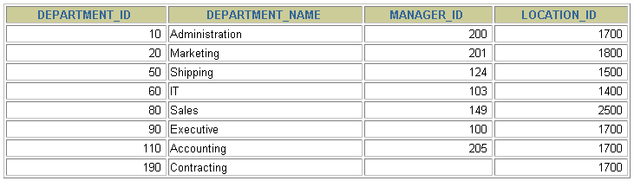
Selecting All Columns
SELECT *
FROM departments;
Notes:
Selecting All Columns of All Rows
You can display all columns of data in a table by following the SELECT keyword with an asterisk (*). In the example on the slide, the department table contains four columns: DEPARTMENT_ID, DEPARTMENT_NAME, MANAGER_ID, and LOCATION_ID. The table contains seven rows, one for each department.
You can also display all columns in the table by listing all the columns after the SELECT keyword. For example, the following SQL statement, like the example on the slide, displays all columns and all rows of the DEPARTMENTS table:
SELECT department_id, department_name, manager_id, location_id
FROM departments;
Instructor Note
Let the students know that details of all the tables are given in Appendix B.

Slide 10
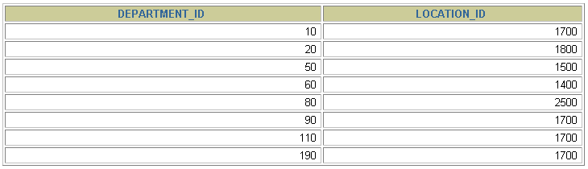
Selecting Specific Columns
SELECT department_id, location_id
FROM departments;
Notes:
Selecting Specific Columns of All Rows
You can use the SELECT statement to display specific columns of the table by specifying the column names, separated by commas. The example on the slide displays all the department numbers and location numbers from the DEPARTMENTS table.
In the SELECT clause, specify the columns that you want, in the order in which you want them to appear in the output. For example, to display location before department number going from left to right, you use the following statement:
SELECT location_id, department_id
FROM departments;
Instructor Note
You can also select from pseudocolumns. A pseudocolumn behaves like a table column but is not actually stored in the table. You cannot insert or delete values of the pseudocolumns. Some available pseudocolumns are CURRVAL, NEXTVAL, LEVEL, ROWID, and ROWNUM.
…

Slide 11
Writing SQL Statements
SQL statements are not case sensitive.
SQL statements can be on one or more lines.
Keywords cannot be abbreviated or split across lines.
Clauses are usually placed on separate lines.
Indents are used to enhance readability.
Notes:
Writing SQL Statements
Using the following simple rules and guidelines, you can construct valid statements that are both easy to read and easy to edit:
• SQL statements are not case sensitive, unless indicated.
SQL statements can be entered on one or many lines.
• Keywords cannot be split across lines or abbreviated.
Clauses are usually placed on separate lines for readability and ease of editing.
• Indents should be used to make code more readable.
Keywords typically are entered in uppercase; all other words, such as table names and columns, are entered in lowercase.
Executing SQL Statements
Using iSQL*Plus, click the Execute button to run the command or commands in the editing
window.
Instructor Note
Although not required in iSQL*Plus, placing a semicolon (;) at the end of the last clause is recommended. Other environments, such as PL/SQL programs, require that the end of each statement contains a semicolon.

Slide 12
Column Heading Defaults
Default heading justification: Center
Default heading display: Uppercase
Character and Date column headings are left- justified
Number column headings are right-justified
Notes:
Column Heading Defaults
In iSQL*Plus, column headings are displayed in uppercase and centered.
SELECT last_name, hire_date, salary
FROM employees;
You can override the column heading display with an alias. Column aliases are covered later in this lesson.
…

Slide 13
Defining a Null Value
A null is a value that is unavailable, unassigned, unknown, or inapplicable.
A null is not the same as zero or a blank space.
Notes:
Null Values
If a row lacks the data value for a particular column, that value is said to be null, or to contain a null.
A null is a value that is unavailable, unassigned, unknown, or inapplicable. A null is not the same as zero or a space. Zero is a number, and a space is a character.
Columns of any data type can contain nulls. However, some constraints, NOT NULL and PRIMARY KEY, prevent nulls from being used in the column.
In the COMMISSION_PCT column in the EMPLOYEES table, notice that only a sales manager or sales representative can earn a commission. Other employees are not entitled to earn commissions. A null represents that fact.
Instructor Note
Demo: 1_null.sql
Purpose: To illustrate calculating with null values.

Slide 14
Defining a Null Value
SELECT last_name, job_id, salary, commission_pct
FROM employees;
…
…
Notes:
Null Values
If a row lacks the data value for a particular column, that value is said to be null, or to contain a null.
A null is a value that is unavailable, unassigned, unknown, or inapplicable. A null is not the same as zero or a space. Zero is a number, and a space is a character.
Columns of any data type can contain nulls. However, some constraints, NOT NULL and PRIMARY KEY, prevent nulls from being used in the column.
In the COMMISSION_PCT column in the EMPLOYEES table, notice that only a sales manager or sales representative can earn a commission. Other employees are not entitled to earn commissions. A null represents that fact.
Instructor Note
Demo: 1_null.sql
Purpose: To illustrate calculating with null values.

Slide 15


Using Column Aliases
SELECT last_name AS name, commission_pct AS comm
FROM employees;
…
SELECT last_name "Name", salary*12 "Annual Salary"
FROM employees;
…
Notes:
Column Aliases (continued)
The first example displays the names and the commission percentages of all the employees. Notice that the optional AS keyword has been used before the column alias name. The result of the query is the same whether the AS keyword is used or not. Also notice that the SQL statement has the column aliases, name and comm, in lowercase, whereas the result of the query displays the column headings in uppercase. As mentioned in a previous slide, column headings appear in uppercase by default.
The second example displays the last names and annual salaries of all the employees. Because Annual Salary contain a space, it has been enclosed in double quotation marks. Notice that the column heading in the output is exactly the same as the column alias.
Instructor Note
Point out the optional AS keyword in the first example and the double quotation marks in the second example. Also show that the aliases always appear in uppercase, unless enclosed within double quotation marks.

Slide 16
Concatenation Operator
A concatenation operator:
Concatenates columns or character strings to other columns
Is represented by two vertical bars (||)
Creates a resultant column that is a character expression
Notes:
Concatenation Operator
You can link columns to other columns, arithmetic expressions, or constant values to create a character expression by using the concatenation operator (||). Columns on either side of the operator are combined to make a single output column.

Slide 17
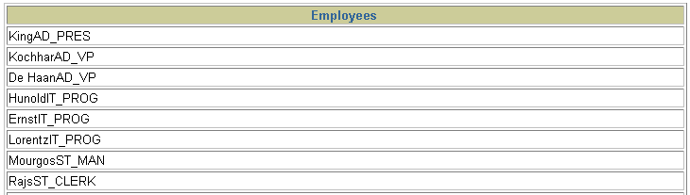
Using the Concatenation Operator
SELECT last_name|| “ “ ||job_id "Employees"
FROM employees;
…
Notes:
Concatenation Operator (continued)
In the example, LAST_NAME and JOB_ID are concatenated, and they are given the alias Employees. Notice that the employee last name and job code are combined to make a single output column.
The AS keyword before the alias name makes the SELECT clause easier to read.

Slide 18
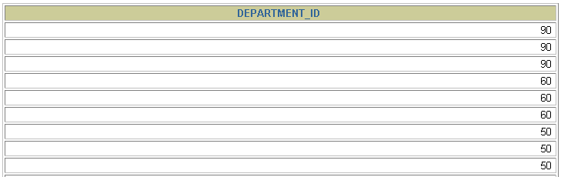
Duplicate Rows
The default display of queries is all rows, including
duplicate rows.
SELECT department_id
FROM employees;
…
Notes:
Duplicate Rows
Unless you indicate otherwise, iSQL*Plus displays the results of a query without eliminating duplicate rows. The example on the slide displays all the department numbers from the EMPLOYEES table. Notice that the department numbers are repeated.

Slide 19
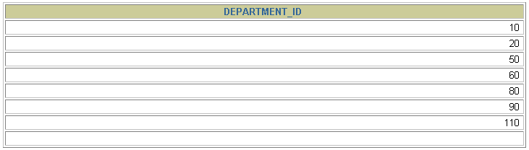
Eliminating Duplicate Rows
Eliminate duplicate rows by using the DISTINCT keyword in the SELECT clause.
SELECT DISTINCT department_id
FROM employees;
Notes:
Duplicate Rows (continued)
To eliminate duplicate rows in the result, include the DISTINCT keyword in the SELECT clause immediately after the SELECT keyword. In the example on the slide, the EMPLOYEES table actually contains 20 rows but there are only seven unique department numbers in the table.
You can specify multiple columns after the DISTINCT qualifier. The DISTINCT qualifier affects all the selected columns, and the result is every distinct combination of the columns.
SELECT DISTINCT department_id, job_id
FROM employees;
…

Slide 20
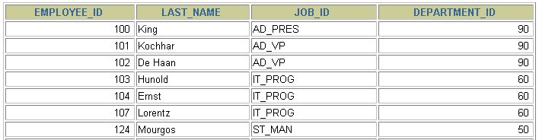

Limiting Rows Using a Selection
EMPLOYEES
…
“retrieve all employees in department 90”
Notes:
Limiting Rows Using a Selection
In the example on the slide, assume that you want to display all the employees in department 90. The rows with a value of 90 in the DEPARTMENT_ID column are the only ones returned. This method of restriction is the basis of the WHERE clause in SQL.

Slide 21
Limiting the Rows Selected
Restrict the rows returned by using the WHERE clause.
The WHERE clause follows the FROM clause.
SELECT *|{[DISTINCT] column|expression [alias],...}
FROM table
[WHERE condition(s)];
Notes:
Limiting the Rows Selected
You can restrict the rows returned from the query by using the WHERE clause. A WHERE clause contains a condition that must be met, and it directly follows the FROM clause. If the condition is true, the row meeting the condition is returned.
In the syntax:
WHERE restricts the query to rows that meet a condition
condition is composed of column names, expressions, constants, and a comparison operator
The WHERE clause can compare values in columns, literal values, arithmetic expressions, or functions. It consists of three elements:
Column name
Comparison condition
Column name, constant, or list of values

Slide 22

Using the WHERE Clause
SELECT employee_id, last_name, job_id, department_id
FROM employees
WHERE department_id = 90 ;
Notes:
Using the WHERE Clause
In the example, the SELECT statement retrieves the name, job ID, and department number of all employees whose job ID is SA_REP.
Note that the job title SA_REP has been specified in uppercase to ensure that it matches the job ID column in the EMPLOYEES table. Character strings are case sensitive.

Slide 23
Character Strings and Dates
Character strings and date values are enclosed in single quotation marks.
Character values are case sensitive, and date values are format sensitive.
SELECT last_name, job_id, department_id
FROM employees
WHERE last_name = 'Whalen';
Notes:
Character Strings and Dates
Character strings and dates in the WHERE clause must be enclosed in single quotation marks (''). Number constants, however, should not be enclosed in single quotation marks.
All character searches are case sensitive. In the following example, no rows are returned because the EMPLOYEES table stores all the last names in mixed case:
SELECT last_name, job_id, department_id
FROM employees
WHERE last_name = 'WHALEN';
Oracle databases store dates in an internal numeric format, representing the century, year, month, day, hours, minutes, and seconds. The default date display is DD-MON-RR.
Note: Changing the default date format is covered in a subsequent lesson.
Instructor Note
Some students may ask how to override the case sensitivity. Later in the course, we cover the use of single-row functions such as UPPER and LOWER to override the case sensitivity.

Slide 24
Comparison Conditions
Operator
=
>
>=
<
<=
<>
Meaning
Equal to
Greater than
Greater than or equal to
Less than
Less than or equal to
Not equal to
Notes:
Comparison Conditions
Comparison conditions are used in conditions that compare one expression to another value or expression. They are used in the WHERE clause in the following format:
Syntax
... WHERE expr operator value
For Example
... WHERE hire_date='01-JAN-95'
... WHERE salary>=6000
... WHERE last_name='Smith'
An alias cannot be used in the WHERE clause.
Note: The symbol != and ^= can also represent the not equal to condition.

Slide 25

Using Comparison Conditions
SELECT last_name, salary
FROM employees
WHERE salary <= 3000;
Notes:
Using the Comparison Conditions
In the example, the SELECT statement retrieves the last name and salary from the EMPLOYEES table, where the employee salary is less than or equal to 3000. Note that there is an explicit value supplied to the WHERE clause. The explicit value of 3000 is compared to the salary value in the SALARY column of the EMPLOYEES table.

Slide 26
Other Comparison Conditions
Operator
BETWEEN ...AND...
IN(set)
LIKE
IS NULL
Meaning
Between two values (inclusive),
Match any of a list of values
Match a character pattern
Is a null value

Slide 27
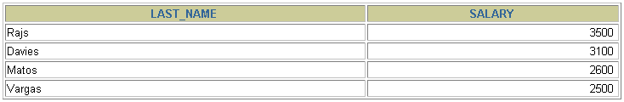
Using the BETWEEN Condition
Use the BETWEEN condition to display rows based on a range of values.
SELECT last_name, salary
FROM employees
WHERE salary BETWEEN 2500 AND 3500;
Lower limit
Upper limit
Notes:
The BETWEEN Condition
You can display rows based on a range of values using the BETWEEN range condition. The range that you specify contains a lower limit and an upper limit.
The SELECT statement on the slide returns rows from the EMPLOYEES table for any employee whose salary is between $2,500 and $3,500.
Values specified with the BETWEEN condition are inclusive. You must specify the lower limit first.
Instructor Note
Emphasize that the values specified with the BETWEEN operator in the example are inclusive. Explain that BETWEEN … AND … is actually translated by Oracle server to a pair of AND conditions: (a >= lower limit) AND (a <= higher limit). So using BETWEEN … AND … has no performance benefits, and it is used for logical simplicity.
Demo: 2_betw.sql
Purpose: To illustrate using the BETWEEN operator.

Slide 28
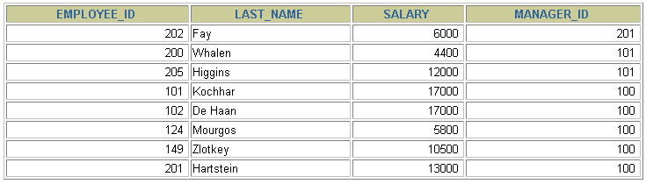
Using the IN Condition
Use the IN membership condition to test for
values in a list.
SELECT employee_id, last_name, salary, manager_id
FROM employees
WHERE manager_id IN (100, 101, 201);
Notes:
The IN Condition
To test for values in a specified set of values, use the IN condition. The IN condition is also known as the membership condition.
The slide example displays employee numbers, last names, salaries, and manager’s employee numbers for all the employees whose manager’s employee number is 100, 101, or 201.
The IN condition can be used with any data type. The following example returns a row from the EMPLOYEES table for any employee whose last name is included in the list of names in the WHERE clause:
SELECT employee_id, manager_id, department_id
FROM employees
WHERE last_name IN ('Hartstein', 'Vargas');
If characters or dates are used in the list, they must be enclosed in single quotation marks ('').
Instructor Note
Explain that IN ( ... ) is actually translated by Oracle server to a set of OR conditions: a = value1 OR a = value2 OR a = value3. So using IN ( ... ) has no performance benefits, and it is used for logical simplicity.
Demo: 2_in.sql
Purpose: To illustrate using the IN operator.

Slide 29
Using the LIKE Condition
Use the LIKE condition to perform wildcard searches of valid search string values.
Search conditions can contain either literal characters or numbers:
% denotes zero or many characters.
_ denotes one character.`
SELECT first_name
FROM employees
WHERE first_name LIKE 'S%';
Notes:
The LIKE Condition
You may not always know the exact value to search for. You can select rows that match a character pattern by using the LIKE condition. The character pattern-matching operation is referred to as a wildcard search. Two symbols can be used to construct the search string.
The SELECT statement on the slide returns the employee first name from the EMPLOYEES table for any employee whose first name begins with an S. Note the uppercase S. Names beginning with an s are not returned.
The LIKE condition can be used as a shortcut for some BETWEEN comparisons. The following example displays the last names and hire dates of all employees who joined between January 1995 and December 1995:
SELECT last_name, hire_date
FROM employees
WHERE hire_date LIKE '%95';

Slide 30

Using the LIKE Condition
You can combine pattern-matching characters.
SELECT last_name
FROM employees
WHERE last_name LIKE '_o%';
Notes:
Combining Wildcard Characters
The % and _ symbols can be used in any combination with literal characters. The example on the slide displays the names of all employees whose last names have an o as the second character.
The ESCAPE Option
When you need to have an exact match for the actual % and _ characters, use the ESCAPE option. This option specifies what the escape character is. If you want to search for strings that contain ‘SA_’, you can use the following SQL statement:
SELECT employee_id, last_name, job_id
FROM employees
WHERE job_id LIKE '%SA\_%' ESCAPE '\';
The ESCAPE option identifies the backslash (\) as the escape character. In the pattern, the escape character precedes the underscore (_). This causes the Oracle Server to interpret the underscore literally.

Slide 31
Using the NULL Conditions
Test for nulls with the IS NULL operator.
SELECT last_name, manager_id
FROM employees
WHERE manager_id IS NULL;
Notes:
The NULL Conditions
The NULL conditions include the IS NULL condition and the IS NOT NULL condition.
The IS NULL condition tests for nulls. A null value means the value is unavailable, unassigned, unknown, or inapplicable. Therefore, you cannot test with = because a null cannot be equal or unequal to any value. The slide example retrieves the last names and managers of all employees who do not have a manager.
For another example, to display last name, job ID, and commission for all employees who are NOT entitled to get a commission, use the following SQL statement:
SELECT last_name, job_id, commission_pct
FROM employees
WHERE commission_pct IS NULL;
…

Slide 32
Logical Conditions
Operator
AND OR
NOT
Meaning
Returns TRUE if both component conditions are true
Returns TRUE if either component condition is true
Returns TRUE if the following condition is false
Notes:
Logical Conditions
A logical condition combines the result of two component conditions to produce a single result based on them or inverts the result of a single condition. A row is returned only if the overall result of the condition is true. Three logical operators are available in SQL:
AND
OR
NOT
All the examples so far have specified only one condition in the WHERE clause. You can use several conditions in one WHERE clause using the AND and OR operators.

Slide 33

Using the AND Operator
AND requires both conditions to be true.
SELECT employee_id, last_name, job_id, salary
FROM employees
WHERE salary >=10000
AND job_id LIKE '%MAN%';
Notes:
The AND Operator
In the example, both conditions must be true for any record to be selected. Therefore, only employees who have a job title that contains the string MAN and earn $10,000 or more are selected.
All character searches are case sensitive. No rows are returned if MAN is not in uppercase. Character strings must be enclosed in quotation marks.
AND Truth Table
The following table shows the results of combining two expressions with AND:
Instructor Note
Demo: 2_and.sql
Purpose: To illustrate using the AND operator.

Slide 34
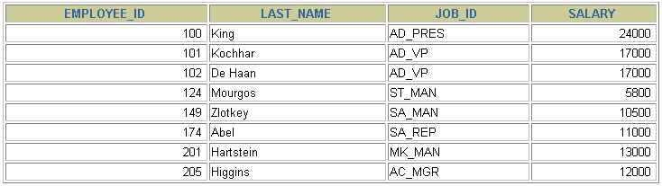
Using the OR Operator
OR requires either condition to be true.
SELECT employee_id, last_name, job_id, salary
FROM employees
WHERE salary >= 10000
OR job_id LIKE '%MAN%';
Notes:
The OR Operator
In the example, either condition can be true for any record to be selected. Therefore, any employee who has a job ID containing MAN or earns $10,000 or more is selected.
The OR Truth Table
The following table shows the results of combining two expressions with OR:
Instructor Note
Demo: 2_or.sql
Purpose: To illustrate using the OR operator.

Slide 35
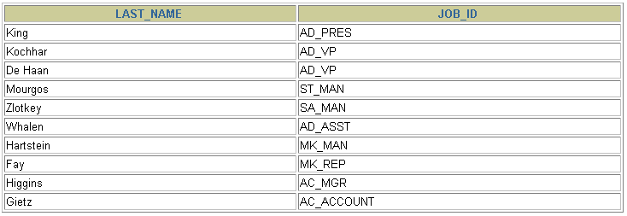
Using the NOT Operator
SELECT last_name, job_id
FROM employees
WHERE job_id
NOT IN ('IT_PROG', 'ST_CLERK', 'SA_REP');
Notes:
The NOT Operator
The slide example displays the last name and job ID of all employees whose job ID is not IT_PROG, ST_CLERK, or SA_REP.
The NOT Truth Table
The following table shows the result of applying the NOT operator to a condition:
Note: The NOT operator can also be used with other SQL operators, such as BETWEEN, LIKE, and NULL.
... WHERE job_id NOT IN ('AC_ACCOUNT', 'AD_VP')
... WHERE salary NOT BETWEEN 10000 AND 15000
... WHERE last_name NOT LIKE '%A%'
... WHERE commission_pct IS NOT NULL

Slide 36
Data Input
Putting data into a table is accomplished using the keyword
INSERT
Variable
INSERT INTO publishers VALUES (‘0010’, ‘pragmatics’, ‘4 4th Ln’, ‘chicago’, ‘il’)
Keyword
pub_id | pub_name | address | state
0736 | New Age Books | 1 1st Street | MA
0987 | Binnet & Hardley | 2 2nd Street | DC
1120 | Algodata Infosys | 3 3rd Street | CA
pub_id | pub_name | address | state
0010 | Pragmatics | 4 4th Ln | IL
0736 | New Age Books | 1 1st Street | MA
0987 | Binnet & Hardley | 2 2nd Street | DC
1120 | Algodata Infosys | 3 3rd Street | CA
Table is updated with new information
Notes:
If you have several points, steps, or key ideas use multiple slides. Determine if your audience is to understand a new idea, learn a process, or receive greater depth to a familiar concept. Back up each point with adequate explanation. As appropriate, supplement your presentation with technical support data in hard copy or on disc, e-mail, or the Internet. Develop each point adequately to communicate with your audience.

Slide 37
Types of Tables
There are two types of tables which make up a relational database in SQL
User Tables: contain information that is the database management system
System Tables: contain the database description, kept up to date by DBMS itself
Relation | Table
Tuple | Row
Attribute | Column
Notes:
If you have several points, steps, or key ideas use multiple slides. Determine if your audience is to understand a new idea, learn a process, or receive greater depth to a familiar concept. Back up each point with adequate explanation. As appropriate, supplement your presentation with technical support data in hard copy or on disc, e-mail, or the Internet. Develop each point adequately to communicate with your audience.

Slide 38
Using SQL
To begin, you must first CREATE a database using the following SQL statement:
CREATE DATABASE database_name
Depending on the version of SQL being used the following statement is needed to begin using the database:
USE database_name
Notes:
If you have several points, steps, or key ideas use multiple slides. Determine if your audience is to understand a new idea, learn a process, or receive greater depth to a familiar concept. Back up each point with adequate explanation. As appropriate, supplement your presentation with technical support data in hard copy or on disc, e-mail, or the Internet. Develop each point adequately to communicate with your audience.

Slide 39
Using SQL
To create a table in the current database, use the CREATE TABLE keyword
CREATE TABLE authors (
auth_id int(9) PRIMARY KEY not null, auth_name char(40) not null)
auth_id | auth_name
(9 digit int) | (40 char string)

Slide 40
Using SQL
To insert data in the current table, use the keyword INSERT INTO
INSERT INTO authors values(‘000000001’, ‘John Smith’)
Then issue the statement
SELECT * FROM authors
auth_id | auth_name
000000001
John Smith

Slide 41
Using SQL
If you only want to display the author’s name and city from the following table:
auth_id | auth_name | auth_city | auth_state
123456789 | Jane Doe | Dearborn | MI
000000001 | John Smith | Taylor | MI
SELECT auth_name, auth_city FROM publishers
auth_name | auth_city
Jane Doe | Dearborn
John Smith | Taylor

Slide 42
Using SQL
To delete data from a table, use the DELETE statement:
DELETE from authors WHERE auth_name=‘John Smith’
auth_id | auth_name | auth_city | auth_state
123456789 | Jane Doe | Dearborn | MI
000000001 | John Smith | Taylor | MI

Slide 43
Using SQL
To Update information in a database use the UPDATE keyword
UPDATE authors SET auth_name=‘hello’
auth_id | auth_name | auth_city | auth_state
123456789 | Jane Doe | Dearborn | MI
000000001 | John Smith | Taylor | MI
Hello
Hello
Sets all auth_name fields to hello

Slide 44
Using SQL
To change a table in a database use ALTER TABLE. ADD adds a characteristic.
ALTER TABLE authors ADD birth_date datetime null
Type
Initializer
auth_id | auth_name | auth_city | auth_state
123456789 | Jane Doe | Dearborn | MI
000000001 | John Smith | Taylor | MI
birth_date
.
.
ADD puts a new column in the table called birth_date

Slide 45
Using SQL
To delete a colummn, use the keyword DROP
ALTER TABLE authors DROP birth_date
auth_id | auth_name | auth_city | auth_state
123456789 | Jane Doe | Dearborn | MI
000000001 | John Smith | Taylor | MI
auth_state
.
.
DROP removed the birth_date characteristic from the table

Slide 46
Using SQL
The DROP statement is also used to delete an entire database.
DROP DATABASE authors
auth_id | auth_name | auth_city | auth_state
123456789 | Jane Doe | Dearborn | MI
000000001 | John Smith | Taylor | MI
DROP removed the database and returned the memory to system

Slide 47
What is a Subquery?
A subquery is a SELECT statement embedded in a clause of another SQL statement.
Main
query
SELECT ...
FROM ...
WHERE ...
(SELECT ...
FROM ...
WHERE ...)
Subquery

Slide 48
Subquery
SELECT select_list
FROM table
WHERE expr operator (SELECT select_list
FROM table);
The subquery (inner query) executes once before the main query.
The result of the subquery is used by the main query (outer query).

Slide 49
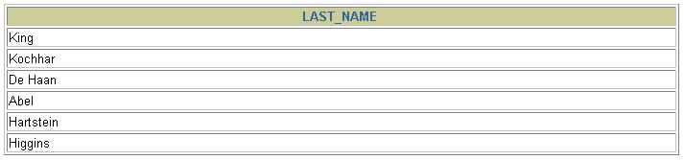
Subquery
SELECT last_name
FROM employees
WHERE salary >
(SELECT salary
FROM employees
WHERE employee_id = 149) ;
10500

Slide 50
Difference between DELETE, TRUNCATE and DROP
DELETE: When you are using DELETE command in oracle the data will be deleted in the table. After that if you are using ROLLBACK the data in the table will be retrieved.
TRUNCATE: When you are using TRUNCATE command what ever data in the table, it will be deleted. After that if you are using ROLLBACK the data in the table will not be retrieved, but the structure of the table is available.
DROP: When you are using DROP the ROLLBACK command is not working and structure and data in the table also deleted. Nothing will be available about that table.

Slide 51
Example
DELETE * FROM emp;
TRUNCATE TABLE emp;
DROP TABLE emp;

Slide 52
Conclusion
SQL simplifies data manipulation by reducing the amount of code required.
More reliable than creating a database using files with linked-list implementation
Notes:
Determine the best close for your audience and your presentation. Close with a summary; offer options; recommend a strategy; suggest a plan; set a goal. Keep your focus throughout your presentation, and you will more likely achieve your purpose.

Slide 53
Thank You....

