Slide 1
Quality Factors

Slide 2
Question
To know that quality has improved, it would be helpful to be able to measure quality.
How can we measure quality?

Slide 3
ISO 9126 Software Quality Factors
Functionality
Reliability
Usability
Efficiency
Maintainability
Portability

Slide 4
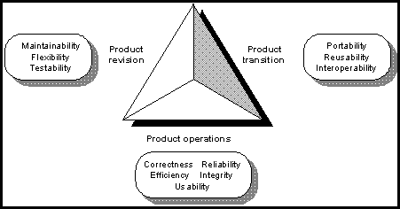
McCall's Quality Factors (1977)

Slide 5
Define and give example of each
Usability
Integrity
Efficiency
Correctness
Reliability
Maintainability
Testability
Flexibility
Reusability
Portability
Interoperability

Slide 6
Operability
Training
Communicativeness
Input/Output volume
Input/Output gate
Access Control
Access Audit
Storage efficiency
Execution Efficiency
Traceability
Completeness
Accuracy
Error Tolerance
Consistency
Simplicity
Conciseness
Instrumentation
Expandability
Generality
Self-Descriptiveness
Modularity
Machine Independence
Software System Independence
Communications Commonality
Data Commonality
Usability
Integrity
Efficiency
Correctness
Reliability
Maintainability
Testability
Flexibility
Reusability
Portability
Interoperability

Slide 7
Reality Check…
Q: So, how does that long list help us with SQA?
A: Most, if not all, of those factors should be covered explicitly in the software requirements document.
A: Measuring those factors tell us where we need improvement.
SQA : Software Quality Assurance

Slide 8
IEEE 982
" Reliability is an estimation of system failure-freeness. … A constructive approach to reliable software seeks to remove the root causes of this class of system failure through software development and support processes that promote fault avoidance, early fault detection, appropriately prompt removal, and system-designed fault tolerance.
The analysis of the errors, faults, and failures from previous development and support processes can lead to improved future processes. While the exact functional relationships are not proven, it is through experience that the majority of failures are related to their origins. Examples include the following:
Incompletely defined user needs and requirements
Omissions in the design and coding process
Improper usage of the system
Excessive change activity

Slide 9
IEEE 982
Nine Classes of Measures
Product Measures
  errors, faults, failures
  mean-time-to-failure
  realibility growth and projection
  remaining products faults
  completeness and consistency
  complexity
Process Measures
  management control
  coverage
  risk, benefit, cost evaluation

Slide 10
More Info on Quality Metrics
Links to
  IEEE 982
    particularly interesting
      section 4
      appendices
  National Institute for Standards and Technology
  NASA Quality Factors

