Slide 1
A Introduction to Configuration Management
Naveen Kumar K.S

Slide 2
What is Configuration Management
“SCM is the control of the evolution of complex systems,…, for the purpose to contribute to satisfying quality and delay constraints.”
– Jacky Estublier
“SCM provides the capabilities of identification, control, status accounting, audit and review, manufacture, process management, and teamwork.”
– Susan Dart

Slide 3
What is CM (cont.)
CM is a key process in Capability Maturity Model (recently updated to CMMI)
  Level 1-Initial: ad hoc/chaotic
  Level 2-Repeatable: basic project management and documentation
  Level 3-Defined: standard and complete process control and procedures
  Level 4-Managed: predictable process performance and precise measurements
  Level 5-Optimizing: continuous and recursive improvement to performance
CM operates through the software life cycle

Slide 4
What is CM not
Not just version control
Not just for source code management
Not only for development phase
Selecting and using tools are important, but design and management of CM process are more crucial for project success

Slide 5
Some Simple CM Scenarios
Developer A wants to see latest version of foo.c and its change history since last week
B needs to revert foo-design.doc to its version two days ago
B makes a release of the project and he needs to know what items to include and which version

Slide 6
Some Simple CM Scenarios (cont.)
A lives in New Dehli, India and B lives in Boston, US, they want to work on HelloWorld.java together
In the latest release, a serious bug is found and manager C wants to track what changes caused the bug, who made those changes and when
C wants to get reports about current project progress to decide if she needs to hire more programmers and delay the alpha release

Slide 7
SCM Terminology
Configuration Item (CI)
Version, Variant, and Revision
Configuration
Baseline
Workspace

Slide 8
Configuration Item (CI)
An approved and accepted deliverable, changes have to be made through formal procedure
Examples:
  Management plan
  Requirement
  Design specification
  Source code and executable code
  Test specification, data, and records
  Log information
  User documentation
  Library and supporting software
  Bug reports, etc.

Slide 9
Version, Variant, and Revision
Version: a CI at one point in its development, includes revision and variant
Revision: a CI linked to another via revision-of relationship, and ordered in time
Variant: functionally equivalent versions, but designed for different settings, e.g. hardware and software
Branch: a sequence of versions in the time line
1.2
1.3
1.4
Win32 on x86
1.3.1.1
1.3.1.2
Solaris on SPARC
1.2
1.3
1.4

Slide 10
How Versions are Stored
Full copy of each version
Delta (differences between two versions)
Forward delta
Reverse delta
Mixed delta
1.2
1.3
1.4
1.1
1.1
1.2
1.3
1.4

Slide 11
Configuration
An arrangement of functional CIs according to their nature, version and other characteristics
Guaranteed to recreate configurations with quality and functional assurance
Sometimes, configuration needs to record environment details, e.g. compiler version, library version, hardware platform, etc.
Simple examples
  Ant buildfile, Makefile

Slide 12
Baseline
A collection of item versions that have been formally reviewed and agreed on, a version of configuration
Marks milestones and serves as basis for further development
Can only be changed via formal change management process
Baseline + change sets to create new baselines

Slide 13
Workspace
An isolated environment where a developer can work (edit, change, compile, test) without interfering other developers
Examples
  Local directory under version control
  Private workspace on the server
Common Operations
  Import: put resources into version control in repository
  Update: get latest version on the default branch
  Checkout: get a version into workspace
  Checkin: commit changes to the repository

Slide 14
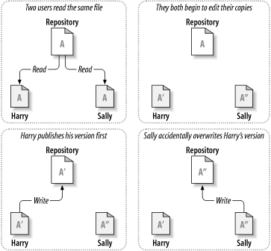
Version Control Models (1/3)
Basic problem of collaborative work
Figure from svn-book

Slide 15
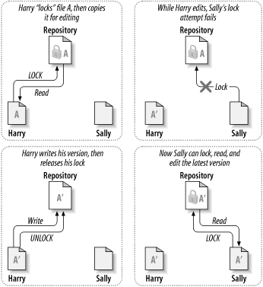
Version Control Models (2/3)
Model 1-Pessimistic: lock-modify-unlock
Problems:
Forget to unlock
Parallel work not possible
Deadlock
Figure from svn-book

Slide 16
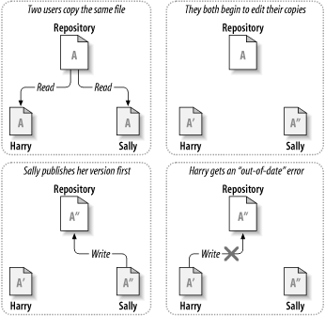
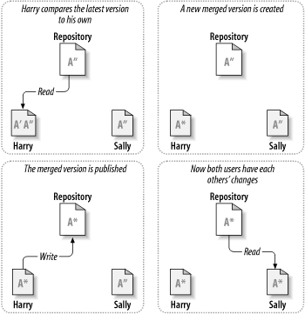
Version Control Models (3/3)
Model 2-Optimistic: copy-modify-merge
Figure from svn-book

Slide 17
SCM Processes
Change control process
Status accounting
Configuration audit
Release management
CM planning

Slide 18
Change Control Process
Submission of Change Request (CR)
Technical and business evaluation and impact analysis
Approval by Change Control Board (CCB)
Engineering Change Order (ECO) is generated stating
  changes to be made
  criteria for reviewing the changed CI
CI’s checked out
Changes made and reviewed
CI’s checked in

Slide 19
Status Accounting
Administrative tracking and reporting of CIs in CM system
Examples
  Status of proposed changes
  Status of approved changes
  Progress of current version, on or behind schedule
  Estimate of resources to finish one task
  bugs identified by configuration audit

Slide 20
Configuration Audit
Independent review or examination to assess if a product or process is in compliance with specification, standards, contractual agreement, or other criteria
Examples
  Verifies that CIs are tested to satisfy functional requirements
  Verifies that baseline contains necessary and correct CI versions
  Ensures that changes made to a baseline comply with the configuration status reports

Slide 21
Release Management
Creation and availability of a new version of software to the public
Release format
  Source code + build script + instructions
  Executables packaged for specific platforms
  Other portable formats: Java Web Start, plugins
  Patches and updates: automatic, manual
Release content
  Source and/or binary, data files, installation scripts, libraries, user and/or developer documentation, feedback programs, etc.

Slide 22
Make a CM Plan
Standards
  IEEE Std 828 (SCM Plans), ANSI-IEEE Std 1042 (SCM), etc.
CM plan components
  What will be managed (list and organize CIs)
  Who will be responsible for what activities (roles and tasks)
  How to make it happen (design processes for change requests, task dispatching, monitoring, testing, release, etc.)
  What records to keep (logs, notes, configurations, changes, etc.)
  What resources and how many (tools, money, manpower, etc.)
  What metrics to measure progress and success

Slide 23
CM Tools
Version control
  RCS, CVS, Subversion, Visual Source Safe, Rational ClearCase
Bug tracking
  Bugzilla, Mantis Bugtracker, Rational ClearQuest
Build
  GNU Make and many variants, Ant
Project management
  Sourceforge.net, freshmeat.net, GForge, DForge

Slide 24
Reference and Further Reading
Reference
Introduction to Configuration Management, lecture slides for COMP3100/3500, Ian Barnes, the Australian National University.
Software Configuration Management, Center for Development of Advanced Computing, Mumbai at Juhu, India.
Concepts in Configuration Management Systems, Susan Dart, CMU.
Software Configuration Management: A Roadmap, Jacky Estublier, CNRS, France.
Further Reading
Software Engineering, a Practitioner’s Approach (6th), part 4, Roger Pressman.
Code Complete (2nd), Steve McConnel.
http://cmcrossroads.com/
Implementing and Integrating PDM and SCM, Ivica Crnkovic et al.
Version Control with Subversion, Ben Collins-Sussman et al.

