Slide 1
Agile Development

Slide 2
Agenda
Introduction
Why do we need Agile anyway?
  The traditional way of building software doesn’t work.
  The change conflict
Agile Software Development – embracing change
  Six Principles of Agile Development
  Five Benefits of Agile Development
  Five reasons why agile development more efficient
Turning your development team into a Money Machine
Next steps

Slide 3
Agenda
Introduction
Why do we need Agile anyway?
  The traditional way of building software doesn’t work.
  The change conflict
Agile Software Development – embraces change
  Six Principles of Agile Development
  Five Benefits of Agile Development
  Five reasons why agile development more efficient
Turning your development team into a Money Machine
Next steps

Slide 4
Introduction - why are we here?
Provide outline answers to the following:
How and why does Agile work?
How can I use Agile to turn my development team into a “Money Machine”?
Objective:
‘I can see the potential, what next?’
Notes:
There has been a growing sense of dissatisfaction with the more traditional form of software delivery since the late 90’s.
Given the 45 mins we can only give an overview of why agile is different from more traditional methodologies.
Agile is based on issues I believe we would all recognise, founded on research including empirical process control (processes are too complex to be managed by defined process control) – but we wont go into the detail on this one, and is totally focused on delivering maximum value to the customer.
We have assumed that you the audience know nothing about agile.
Success is that you finish the session and think yes this is something I can see what do I do next?
There are a number of principles that the agile alliance have agreed:
Individuals and interactions over processes and tools
Working software over comprehensive documentation
Customer collaboration over contract negotiation
Responding to change over following a plan
Today we will talk primarily about the last one.

Slide 5
Why do we need Agile anyway?
IT Projects have a history of failure
30 - 40% of systems projects fail prior to completion ¹
Half of all systems projects overrun their budgets and schedules by 200% or more ¹
Failed systems projects cost more than US$100 billion per year in the USA alone ²
67% of customer-relationship-management projects fail ³
1 B.P. Lientz and K.P. Rea, Breakthrough Technology Project Management
2 Computerworld
3 The Economist
Notes:
I’m sure everyone of you can put up a slide that is similar to this one. Would anyone disagree with this?
Something is rotten in the state of Denmark to quote the Bard

Slide 6
Why do we need Agile anyway?
The
traditional way
of
building software
simply does not
work.
IT Projects have a history of failure
30 - 40% of systems projects fail prior to completion ¹
Half of all systems projects overrun their budgets and schedules by 200% or more ¹
Failed systems projects cost more than US$100 billion per year in the USA alone ²
67% of customer-relationship-management projects fail ³
1 B.P. Lientz and K.P. Rea, Breakthrough Technology Project Management
2 Computerworld
3 The Economist
Notes:
I’m sure everyone of you can put up a slide that is similar to this one. Would anyone disagree with this?
Something is rotten in the state of Denmark to quote the Bard

Slide 7
The change conflict : A true story* …
NHS IT project
£6.2 Billion
Already 1 year late
GP’s don’t like it
* The Sunday Times, November 13, 2005
Notes:
I’m sure you recognise these.
More mean agile addresses some of the key reasons projects fail or are successful… they address customer involvement…they deal with the fact that software is complex head-on…they deal with some of the people issues and by default trust

Slide 8
NHS chaos exposed by new e-mails
A COMPUTER project costing £6.2 billion that is central to Tony Blair’s National Health Service reforms is in “grave” danger of being “derailed”, leaked Whitehall e-mails reveal.
The warning has been issued by Richard Granger, the £250,000-a-year civil servant in charge of what has been billed as the world’s biggest civil information technology project.
The scheme is central to the government’s plans to give patients wider choice by allowing GPs to book hospital appointments online with consultants throughout the country.
The problems have already caused a year-long delay in the booking system and now threaten to add millions to the cost of the project.
To date the system has made only about 20,000 appointments for patients. It was supposed to have made 250,000 by December 2004.
When it is fully operational the system is meant to be capable of making up to 9.5m first hospital appointments a year.
In the e-mail exchanges in September, Granger blames a senior civil servant in the Department of Health for the fiasco, criticising her repeated last-minute changes and failure to heed his advice.
Granger censures Margaret Edwards, the department’s director for access and patient choice, for adding numerous new specifications to the booking programme, known as Choose and Book. Granger writes: “Choose and Book’s £20m IT build contract is now in grave danger of derailing (not just destabilising) a £6.2 billion programme.” He concludes: “Unfortunately, your consistently late requests will not enable us to rescue the missed opportunities and targets.”
Sir Nigel Crisp, the NHS chief executive, was forced to admit to the Commons health select committee two weeks ago that the booking system was at least a year behind schedule. However, he failed to mention that the delay was having a serious impact on the entire project.
The National Audit Office has identified changes to specifications after the award of IT contracts as a key reason for regular delays and overspends on government projects.
Granger’s comments were triggered by an e-mail on September 9 from Edwards marked “Restricted — Policy” which begins: “We have a problem!” The e-mail reveals that patients and their GPs still cannot book treatment at any of the country’s 32 foundation trust hospitals by computer because they are not on its “choice menu”.
The 10 private sector treatment centres, set up by the government to reduce waiting lists, are also absent from the official list on the computer.
Edwards warns that the treatment centres and foundation trusts will not be on the “choice menu” until next summer.
The delay places hospitals at a financial disadvantage. Under the government’s payment-by-results regime, they are supposed to compete with other NHS hospitals for patients.
Edwards admits: “We haven’t yet told ministers that there is a problem.”
Granger was incensed by the implied criticism of the booking system and fired off a trenchant 11-point reply. Although Edwards’s original e-mail was encrypted and her password protected, Granger decrypted it, sent it out with his reply and widened the distribution.
Granger complains that the project has been allowed to change beyond recognition from the original specification. “The original request from your predecessor and yourself was for an Electronic Booking System. The change of this to Choose and Book occurred in (the second quarter of) 2003. This was the first of what are now recurrent major changes in your requirements.”
The booking system has been dogged with difficulties since its inception. GPs have refused to use it and early pilot schemes identified fundamental software design flaws.
Last week Granger, who insists that the booking system now works, broke civil service protocol and publicly blamed policy officials in the Department of Health for failing to get GPs to use the system. In an interview with Computing Magazine, he said: “Low usage is not something I can do anything about.”
Both the health department and Granger’s spokesman refused to comment on the leaked e-mails.
Jonathon Carr-Brown, The Sunday Times, November 13, 2005
http://www.timesonline.co.uk/article/0,,2087-1869851,00.html

Slide 9
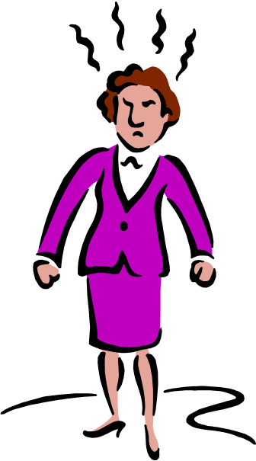
No Change!
We are already running late.
I need to meet my date.
We worked hard to prevent change at the start.
Cost of change
Granger – big cheese
Edwards - Customer
Promised
date

Slide 10
No Change!
We are already running late.
I need to meet my date.
We worked hard to prevent change at the start.
Change & Rework happens at the most expensive time
Cost of change
Granger – big cheese
Edwards - Customer
Promised
date
Spec signed off here

Slide 11
Change!
Our spec was a guess
We learn by doing the project
We need the best product
Learning Curve
Granger – big cheese
Edwards - Customer
Promised
date
Spec signed off here

Slide 12
Out of hundreds of projects, there is no case in which requirements remained stable throughout the design - Reinertson (1998) on Product Development
Change!
Our spec was a guess
We learn by doing the project
We need the best product
A typical software project experiences a 25% change in requirements
- Boehm and Papaccio (1988)
on Software Development
Learning Curve
This learning causes change
Granger – big cheese
Edwards - Customer
Medium to Large projects (1000+ function points) experience 25 – 35% requirements change - Jones (1997) on Software Development
Promised
date
Spec signed off here
Conclusion: We can’t successfully prevent change

Slide 13
The Project Managers Conflict:
Successful Project
Meet Schedule
Best Product
No Change!
Change!
Granger – big cheese
Edwards - Customer
Conflict*
* See my MBA dissertation “The Project Managers Conflict”
http://www.clarkeching.com/2004/04/my_mba_disserta.html

Slide 14
The Project Managers Conflict:
Who’s to blame?
The customer? ✗
The project manger? ✗
The way we build software? ✓
Successful Project
Meet Schedule
Best Product
No Change!
Change!
Granger – big cheese
Edwards - Customer
Conflict*

Slide 15
Agenda
Introduction
Why do we need Agile anyway?
  The traditional way of building software doesn’t work.
  The change conflict
Agile Software Development – embracing change
  Six Principles of Agile Development
  Five Benefits of Agile Development
  Five reasons why agile development more efficient
Turning your development team into a Money Machine
Next steps

Slide 16
Agile Methodologies – such as XP, DSDM and Scrum …
… are specifically designed to efficiently cope with change.
They do this by building software iteratively and incrementally.

Slide 17
Six principles of Agile Development
1: Customer lists known requirements (to a high level), then prioritises them.
2: Frequently deliver time-boxed increments of high-value Working software
All
features
3: The Customer can release the software at any time they want.
Promised
Shipping
Date
4: The Customer can add, delete or reprioritise features at any time. i.e. this is how we “embrace change”
5: We protect schedule commitments, despite change
6. Stop at any time and still use what has been built.
££££££££££££££
learn from the market
Working Software = Potentially shippable
RELEASE
prioritised
Backlog
Scrum 30 days
XP 1 week
time
NOT MINI-WATERFALL

Slide 18
Making more money: Six Benefits of Agile development
1. Customer gets the best product – learning is incorporated. More money!
2. Cash flow starts earlier, profits are higher, the customer learns by using the product in the market, can react to changes in the market. More money!
All
features
3. Projects are faster – early to market, faster product evolution. More Money!
4. Best use of budget – finish early More money!
5. IT keeps commitments – trust up, contractual overheads down. More Money!
6.. IT is more productive and efficient. More Money!
££££££££££££££
Working Software = Potentially shippable
RELEASE
prioritised
Backlog
time
Notes:
Trust is increased - demonstrable functionality is the most tangible measure of progress.
Within a 30 day sprint the customer knows that they will have another chance to review whats important to them … even if they can’t change it for the 30 days.
Forces customers and IT to sit down and talk to each other…
Practices are in place to enable collaboration to mutual benefit
Under waterfall no-one really has a sense of the problem until much later in the project… not deliberate… it’s the way its set up!

Slide 19
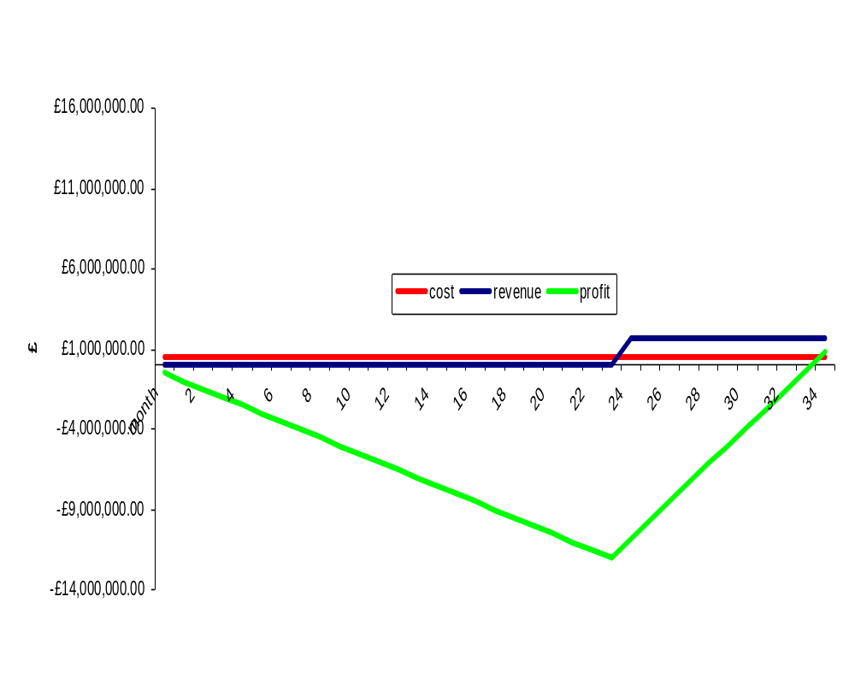
Compare Cash-flow of single release waterfall …
Revenue, starts month 24, £1,666,666 / month
(£20m / year}
Dev cost = 500,000 / month
Break-
even
after
34
months

Slide 20
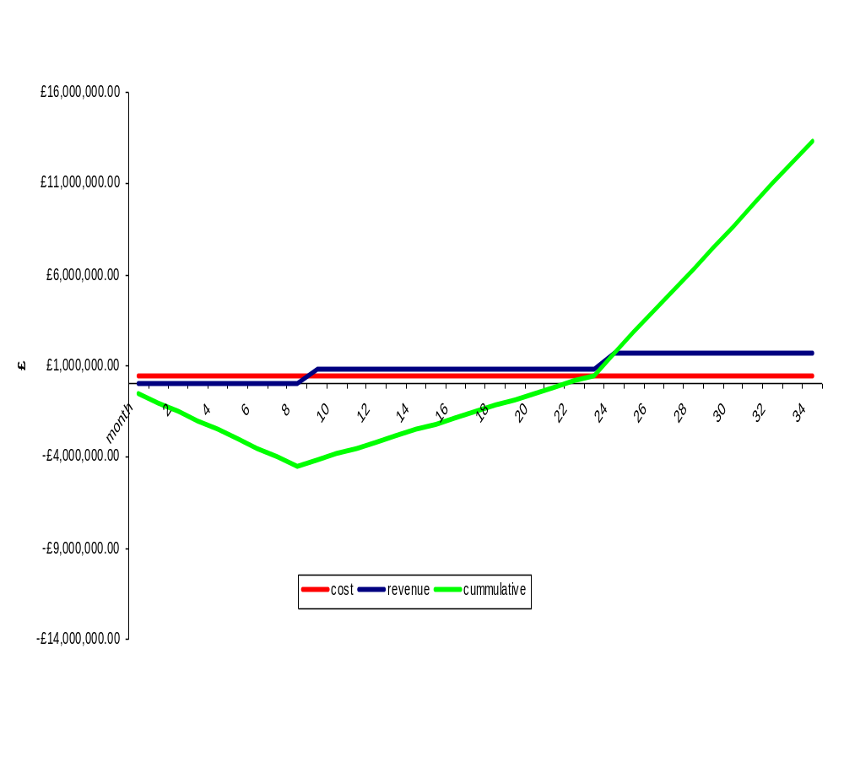
… With Cash-flow with early release
Revenue, starts month 9 at £833,333 / month
(£10m / year},
Dev cost = 500,000 / month
Revenue, increases month 24 to £1,666,666 / month
(£20m / year}
Break-even
after 25 months

Slide 21
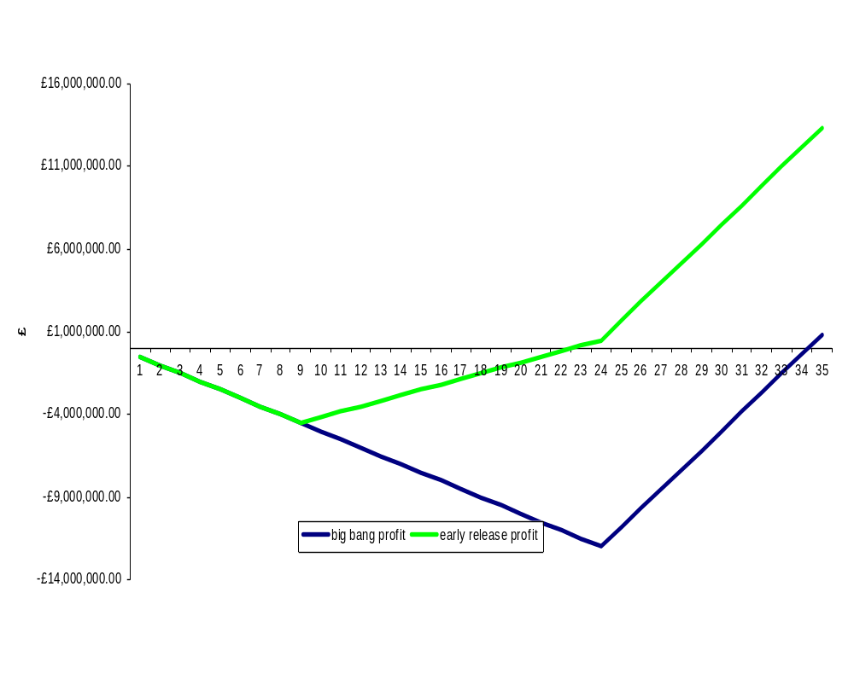
Single big-bang release is loosing your company a fortune

Slide 22
Five reason why Agile is more efficient
Summary
  Waterfall is designed to prevent change, but fails, making it a very, very inefficient
  Agile is designed to cope with changing requirements. It is efficient because it builds quality into it’s processes.

Slide 23
Five reason why Agile is more efficient
Summary
  Waterfall is designed to prevent change, but fails, making it a very, very inefficient
  Agile is designed to cope with changing requirements. It is efficient because it builds quality into it’s processes.

Slide 24
Waterfall – in theory prevents change and defects
1. Preventing rework (from
change and defects) by
“getting things right” upfront
2. Starting build with a perfect spec – just like manufacturing
3. Testing very quickly, because there are v. few changes & defects
Boehm’s Cost of change
Requirements | Analysis | Design | Build | Test
4. Not testing, but proving – in theory.
Notes:
Most change happens at the end of the project

Slide 25
Waterfall fails – in practice does much, expensive rework
1. We try to Prevent rework
2. We make mistakes & learn as we do the project
3. Rework happens at the most expensive time
6. Not testing,
REWORK, in practice
4. Testing duration unpredictable &
50%+ of total
Boehm’s Cost of change
Requirements | Analysis | Design | Build | Test
5. We often de-scope or run-late
Notes:
Most change happens at the end of the project

Slide 26
5 reasons why Agile is more efficient
Summary
  Waterfall is designed to prevent change, but fails, making it a very, very inefficient
  Agile is designed to cope with changing requirements. It is efficient because it builds quality into it’s processes.

Slide 27
Efficient Agile 1: Many changes are free
All
features
If we are working on this increment then …
… you can change any of these for FREE
prioritised
Backlog

Slide 28
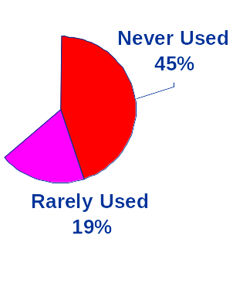
Efficient Agile 2: Avoids over-production
The traditional “requirements document” is a guess … it’s wrong
  Many features aren’t wanted, but they’re still built.
  These “low” or “no” value features are at the bottom of the backlog … but they still get built in Waterfall
  Agile builds the best product
YAGNI
  Build for now, not later
Features and Function usage
Source: Jim Johnson, Standish Group, xp2003.org/xp2002/talksinfo/johnson.pdf

Slide 29
Efficient Agile 3: Killer changes don’t always kill
Agile forces “architecture killers” to the start of the project
Better to fail early, not late - when all the money has been spent
Most changes have low cost of change
Very few “killer” changes
Barry Boehm’s original paper on CoC described 3 curves
Average Cost of change
Most changes
Increment 1 | Increment 2 | Increment 3 | Increment 4 | Increment 5
Notes:
Most change happens at the end of the project

Slide 30
Efficient Agile 4: Prevents & Speeds Rework
Prevention is best & cheapest
The sooner a defect is detected, the easier and cheaper it is to fix
but …
All
features
Customer almost always available
Write & automate UAT and Unit tests before coding
Automated tests find regression defects earlier.
Continuous integration finds defects earlier
Pair Programming finds defects much sooner earlier
prioritised
Backlog

Slide 31
Efficient Agile 5: design is easy to change
Agile builds working software on top of working software, on top of working software, …
Each increment is
  Defect free – potentially shippable
  Well Designed
Refactoring keeps designs clean
Automated tests act as safety net
All
features
Good Design
= easy to change
= low cost of change
prioritised
Backlog

Slide 32
Making more money: Agile is more efficient
1. Many changes are free
2. Avoids over-production
All
features
3. Killer changes don’t always kill
4. Prevents & Speeds Rework
5. design is easy to change
But, what do we do with all this new-found efficiency & productivity?
££££££££££££££
Working Software = Potentially shippable
RELEASE
prioritised
Backlog
time
Notes:
Trust is increased - demonstrable functionality is the most tangible measure of progress.
Within a 30 day sprint the customer knows that they will have another chance to review whats important to them … even if they can’t change it for the 30 days.
Forces customers and IT to sit down and talk to each other…
Practices are in place to enable collaboration to mutual benefit
Under waterfall no-one really has a sense of the problem until much later in the project… not deliberate… it’s the way its set up!

Slide 33
Agenda
Introduction
Why do we need Agile anyway?
  The traditional way of building software doesn’t work.
  The change conflict
Agile Software Development – embracing change
  Six Principles of Agile Development
  Five Benefits of Agile Development
  Five reasons why agile development more efficient
Turning your development team into a Money Machine
Next steps

Slide 34

The purpose of software development is to … develop a product, process or service … that makes (or saves) money
1. “The business” can produce new ideas much faster than IT can
deliver
£
Project
Backlog
£
£
£
£
Software
development
“The Business”
£
£
£
£
£
£
£
£
£
£
£
£
£
£
£
£
2. There is a large backlog of unfinished and unstarted projects
3. Software Development
is THE BOTTLENECK
to future income, for MOST organisations
£
Goldratt’s Theory of constraints:
If you want to increase output of a system first identify then speed up it’s bottleneck.

Slide 35
1. Each queuing project is unrealised value
– i.e. profit on-hold.
£
2. Agile increases bottleneck capacity
Project
Backlog
£
£
£
£
Software
development
£
“The Business”
£
£
£
£
£
£
£
£
£
£
£
£
£
£
£
£
£
£
£
£
£
£
Shrinks the backlog
Releases lots of cash into the organisation
New projects queue less, start far sooner
£
6. Agile turns software development into a Money Machine

Slide 36
Agenda
Introduction
Why do we need Agile anyway?
  The traditional way of building software doesn’t work.
  The change conflict
Agile Software Development – embracing change
  Six Principles of Agile Development
  Five Benefits of Agile Development
  Five reasons why agile development more efficient
Turning your development team into a Money Machine
Next steps

Slide 37
Next steps
Applying some of the principles brings some of the benefits
  Smaller projects – highest priority first
  Customer on site always – you know you should do it
  Get your team involved with the financials
  Do your testing incrementally – in highest priority/value order
Don’t under-estimate the cultural impact it can have
It’s hard to scale agile when started from bottom up
Agile is hard work but it does work…

Slide 38
Thank You…
Naveen Kumar K.S
Adith.naveen@gmail.com

