Slide 1
Kano Model

Slide 2
Objectives
Origins
Purpose
Process Model
Key Elements
Methodology
Application
Examples

Slide 3

Origins of the Kano Model
Noriaki Kano
  Professor at Tokyo Rika University
  International Consultant
  Received individual Demming Prize in 1997
Notes:
Know the Voice of the Customer
Translate the V
Kano Model concept first published in an article by Kano, N., Takahshi, F & Tsuji, S. (1984). Attractive quality and must-be quality. The Journal of the Japanese Society for Quality Control, April, pp. 39-48.

Slide 4
Origins of the Kano Model
Noriaki Kano
  Developed foundation for an approach on “Attractive Quality Creation” commonly referred to as the “Kano Model”
  Challenged traditional Customer Satisfaction Models that More is better, i.e. the more you perform on each service attribute the more satisfied the customers will be.
  Proposed new Customer Satisfaction model (Kano Model)
    Performance on product and service attributes is not equal in the eyes of the customers
    Performance on certain categories attributes produces higher levels of satisfaction than others.

Slide 5
When to use the Kano Model
Project Selection
  Lean Six Sigma
  Design for Six Sigma
New Product Development
New Service Development
Determine Market Strategies

Slide 6
Key Elements
Identify the Voice of the Customer
Translate Voice of the Customer into Critical to Quality Characteristics (CTQs)
Rank the CTQs into three categories:
  Dissatisfier - Must be’s – Cost of Entry
  Satisfier – More is better – Competitive
  Delighter – Latent Need – Differentiator
Evaluate Current Performance
Notes:
Surveys
Interviews
Focus Groups
Observations
Customer Complaints

Slide 7
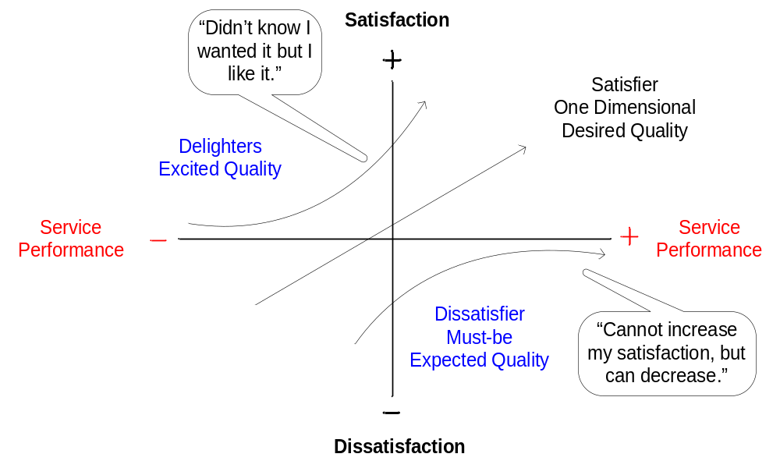
Kano Model
Notes:
The Kano Model is a tool that can be used to prioritize the Critical to Quality characteristics, as defined by the Voice of the Customer and the three categories identified by the model are:
Must Be: Whatever the quality characteristic is, it must be present, such that if it is not, the customer will go elsewhere!
Performance: The better we are at meeting these needs, the happier the customer is.
Delighter: Those qualities that the customer was not expecting, but received as a bonus.
Link to Six Sigma:
Lean
Six Sigma
Design for Six Sigma
Model Structure
The model is represented in an (x, y) graph
The x-axis represents how good we are at achieving the customer’s outcome (s), or CTQ’s.
The y-axis records the customer’s level of satisfaction the customer should have, as a result of our level of achievement.

Slide 8
Kano Model Process
Research
Analyze &
Brainstorm
Plot &
Diagram
Strategize
Research available data sources
Determine data collection strategy
Design data collection instruments
Collect and summarize data
Analyze results from data collection
Brainstorm list of features and functionality
Develop Functional and Dysfunctional Questionnaire
Distribute Questionnaire
Develop Customer Requirement Matrix
Record Questionnaire results in Matrix and Summarize
Plot results on Kano Model
Determine Project selection
Product Development
Service Development
Identify Marketing Strategy

Slide 9
Research
Must Be’s - Focus Groups, Lawsuits and Regulations, Buzz on Internet
Satisfiers - Competitive Analysis, Interviews, Surveys, Search Logs, Usablity Testing, Customer Forums
Delighters - Field Research, Marketing/Branding Vision, Industrial Design, Packaging, Call Center Data, Site Logs

Slide 10
Analyze & Brainstorm
Analyze data from available sources
Brainstorm list of features and functionality
Determine type of requirements:
  Output Requirements
  Service Requirements
Kano Model Requirements Survey
  User Survey
    “Functional form” vs. “Dysfunctional Form”
      “How would you feel if the product had feature X?”
      “How would you feel if the product didn’t have feature X?”
  Kano Questionnaire Answers:
    I like it.
    I expect it.
    I’m neutral.
    I can tolerate it.
    I dislike it.
Notes:
Output Requirement – Features of the final product and service delivered to the customer at the end of the process
Service Requirements – More subjective ways in which customer expects to be treated and served during the process itself
- How should we interact with and treat customers?

Slide 11
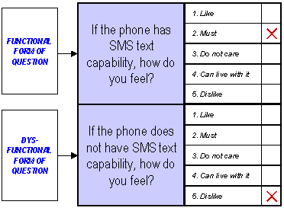
Example: Requirements Survey

Slide 12
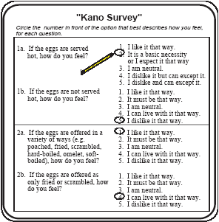
Example: Requirements Questionnaire

Slide 13
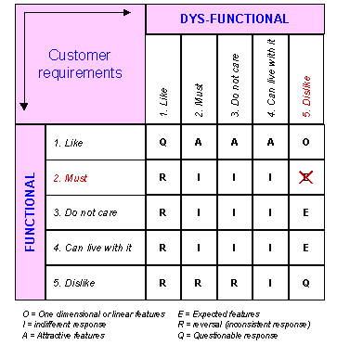
Functional vs. Dysfunctional Comparison

Slide 14
Evaluation Customer Requirements
C.R. | A | E | O | R | Q | I | Total | Grade
1 | 3 | 6 | 14 |  |  |  | 23 | O
2 | 5 | 6 | 11 |  |  | 1 | 23 | O
3 | 6 | 1 | 4 | 1 |  | 11 | 23 | I
4 |  | 13 | 10 |  |  |  | 23 | E
5 | 11 | 1 | 2 |  |  | 9 | 23 | A
Customer Requirement is:
A: Attractive R: Reverse Q: Questionable Result
E: Expected O: One Dimensional I: Indifferent
Notes:
All CR are not created equal. Improving performance on a Must-be CR that is already at a satisfactory level is not productive compared with improving performance on a one dimensional or attractive CR. Insight into which CRs fall into which quality dimensions can improve one’s focus on the vital few. In general, must-be requirements must be adequately covered, the set of one dimensional requirements must be competitive, and some attractive requirements are needed for competitive differentiation.

Slide 15
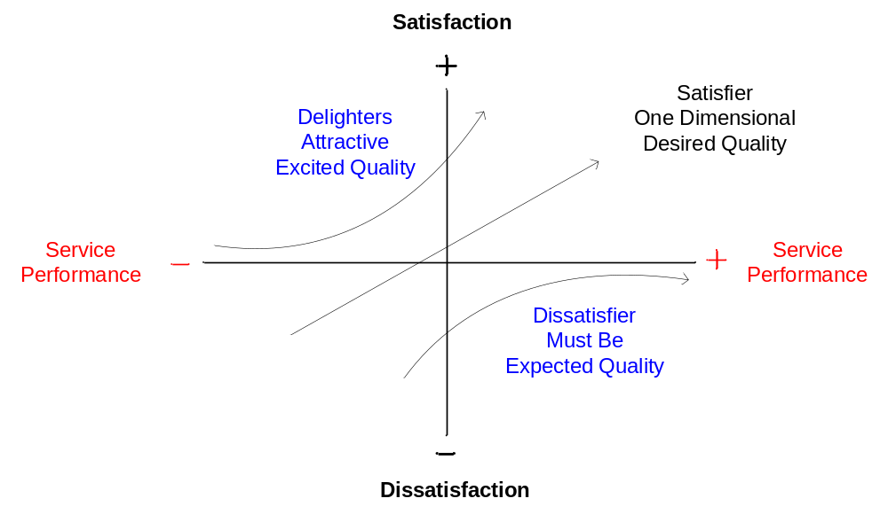
Plot & Diagram
Notes:
Plot Attributes
Lean - Waste
Six Sigma – Defects, Variability
DFSS – New Product/Service Development

Slide 16
Strategize
Project Selection
  Lean Six Sigma
  Design for Six Sigma
Organizational Strategy
  Dissatisfier – Must be’s – Cost of Entry
  Satisfier – More is better – Competitive
  Delighter – Latent Need – Differentiator

Slide 17
Application
Break into Teams
Select Team Leader
Select Scribe
Select Presenter
Scenario – You work for a Hotel chain and your company is trying to identify Voice of the Customer information to improve Hotel performance.
Instructions:
  Brainstorm important characteristics you expect when staying at a Hotel
  Identify whether they are a Must be, Expected or a Delighter from a Business Client perspective and from a vacationer perspective
  Add in what the current performance is for the Hotel

Slide 18
Summary of Kano Model
Analyze and rank the voice of the customer data
Develop into Categories
  Dissatisfier – Must be’s – Cost of Entry
  Satisfier – More is better – Competitive
  Delighter – Latent Need – Differentiator
Identify and implement strategy

Slide 19
Questions
?

