Slide 1

Struts an Overview

Slide 2
What is Struts?
Struts is a framework to develop web application easily. Using Struts, makes easier to develop web application and maintain them.
Struts is an open source framework which makes building web applications easier, based on Java Servlets and JSP technologies.
The Struts framework was created by Craig R. McClanahan and was donated to the Apache software foundation in 2000. Since then it is a open source software.

Slide 3
Why struts? What’s wrong with jsp/servlet coding?
Using only Servlets – difficult to output a html and needs lot of out.printlns – hard to read and clumsy
Using only JSP – added scriptlets and implicit objects into jsp - awkward to see java inside html– hard to read and maintain – useful if very small application
Using JSP+ Java beans – Code inside bean and jsp to display . Good choice for small applications. But what if there is need of multiple type of views? Eg: if there is need of different language display depending on client location? - making request to a general servlet, which outputs data according to the client locale, for same url request, will be good choice – Model 2 architecture evolved.
Using JSP+Servlets+JavaBeans → Model 2 architecture
Request made to servlet, servlet does business calculation using simple java POJO gets the result. Also decides the view and give back the response using the view to the client.
Here servlet called – Controller, Business calculation POJO called – Model and JSP called - View
Uses : the business logic is separated from JSPs and JSP gets displayed depending upon the result of model (the business function). → similar behavior like all applications above, but the code is more structured now. Changing business logic will not affect view and vice versa.
Struts 2.0 also uses Model 2 MVC pattern
Still the question remains: Why struts?

Slide 4
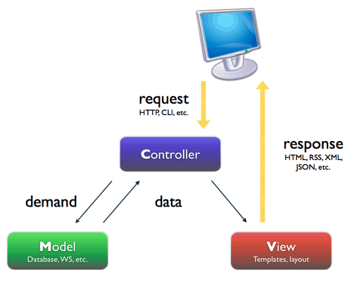
Stucture of JSP+Servlets+JavaBeans :Model 2 architecture
Servlet
JSP File
Java function

Slide 5
Why do we need Web Application Frameworks like Struts when we have good solution like Model 2 pattern?
Struts will be obviously complicated than Model 2 even though it uses same MVC.
Why do we make our application complicated using struts?
Before answering this lets check what is a framework

Slide 6
What is a Web framework?
Web framework is a basic readymade underlying structure, where you have to just add components related to your business.
  For example, if you take struts, it comes with all jars you might need to develop basic request response cycle, and with basic configuration. It provides the controller servlet or filter which will read your request and convert it to integer or float etc according to your business requirements. If there is any exception while converting, you don’t have to deal with that. Framework deals with the problem and displays you exact message.
  After all conversion, the framework automatically populate all your data needed from form to the java object.
  You don’t have to write much code to validate all your form data. Frame work provides some basic automatic validations.
  After you write business logic, you don’t have to write code to dispatch request to another page. Etc
It forces the team to implement their code in a standard way. (helps debugging, fewer bugs etc).
  For Example, in struts immediate backend logic should be in action classes’s method. Action class functions intern can call other components to finish business logic.
Framework might also help you develop complex User Interface easily like iterating tables, the menu etc (provide some tag libraries )
Using frameworks like struts 2.0, one need not have to have deep knowledge of Http protocol and its request and responses interfaces to write business logic.

Slide 7
Why Application Frameworks?
Most Model 2 architecture based web applications share a common set of functionality. For example, they all do receive and dispatch HTTP requests, invoking model methods, selecting and assembling views.
If everybody is doing the same thing over and over every time - Spending less time on business logic.
Its good idea to have a common framework that support these set of functionalities
only thing developer have to do is basically using or extending the frameworks using common interface and classes and can concentrate on business logic.
Provides rich set of features

Slide 8
Conclusion
If your application is very small and have only few pages, implementing Model 2 pattern by coding servlets / JSP / and java beans would be easier and simpler.
If Application is large have got complicated flow and business logic, need to be maintained for long terms, using frameworks would save time and resource.
Using frameworks like struts make its easy to maintain and develop and application will be more structured.

Slide 9
Why struts?
Free to develop & deploy –open source
Stable & Mature
Many supported third-party tools
Feature-rich
Flexible & Extendable
Large User Community, Expert Developers and Committers
Rich tag library (html, bean tags etc)
Easy to test and debug

Slide 10
Struts Framework Features
Model 2 -MVC Implementation
Internationalization(I18N) Support
Rich JSP Tag Libraries
Annotation and XML configuration options
POJO-based actions that are easy to test
Based on JSP, Servlet, XML, and Java
Less xml configuration
Easy to test and debug with new features
Supports Java’s Write Once, Run Anywhere Philosophy
Supports different model implementations (JavaBeans, EJB, etc.)
Supports different presentation implementations( JSP, XML/XSLT, etc)

Slide 11
What are the pieces of struts?
The filter dispatcher, by which all the requests to the applications gets filtered. - Controller
The interceptors which called after filters, before action methods, apply common functionalities like validation, conversion etc
Action classes with execute methods, usually storing and/or retrieving information from a database the view,i.e the jsp files
Result will be figured out and the jsp file will be rendered.

Slide 12
Lets look at sample Hello World application of struts

Slide 13
Struts cons
Bigger Learning Curve
Less Transparent
For struts 2 there is less documentation

Slide 14
      Thank You!!!!!!

