Slide 1
DTD

Slide 2
Document Type Definitions
Document Type Definitions allow you to constrain the content of your XML documents
Specify what kinds of content is allowed, where it is allowed to appear, and how many instances of certain types of content can appear
Can be declared directly inside the XML document or attached via an external file
Relatively simple to write, but not particularly powerful or flexible

Slide 3
DTD Syntax and Content
DTDs consist of a set of markup declarations that define the document’s elements, attributes, and other information
DTDs can contain declarations for:
  Elements
  Attributes
  Entities
  Notations
  etc

Slide 4
Format of a DTD
A Document Type Declaration has the following format:
<!DOCTYPE Name
Document Type Definition
>
Where name is the name of the root node of the document and the Document Type Definition defines the content rules

Slide 5
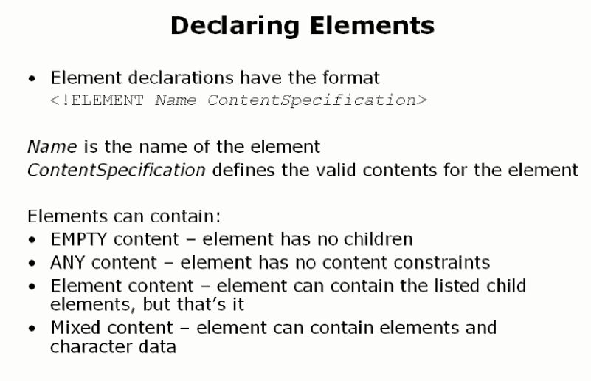

Slide 6
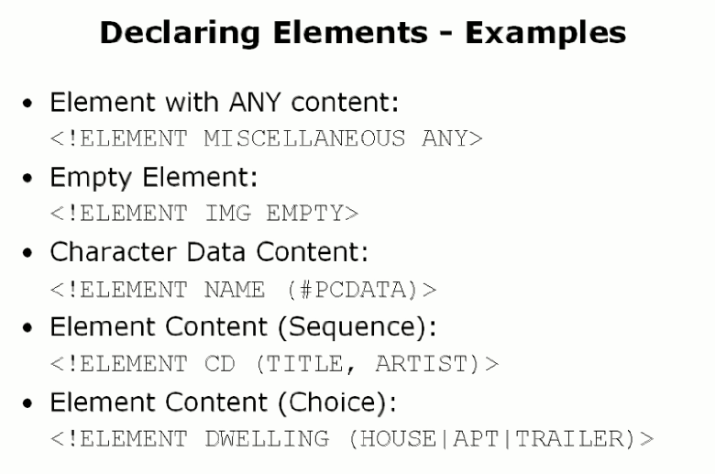

Slide 7
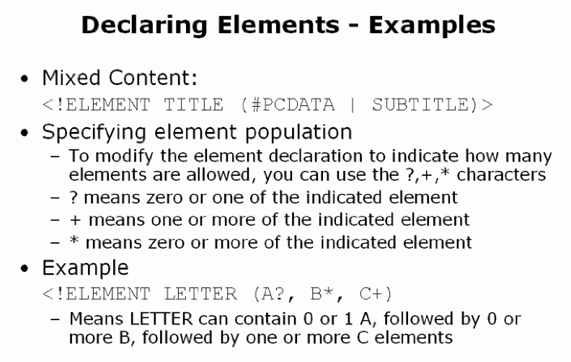

Slide 8
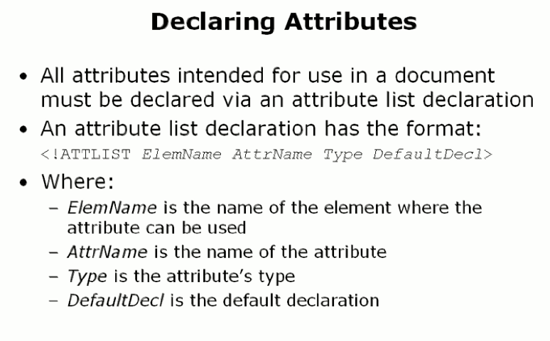

Slide 9
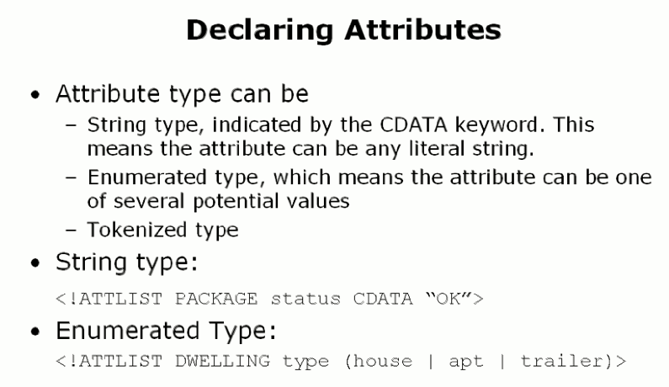

Slide 10
