Slide 1
IBM® WebSphere® Application Server V6.1
J2SE 5, J9 and Performance
Notes:
This presentation focuses on the IBM Java™ Runtime changes for WebSphere Application Server V6.1.

Slide 2
Agenda
Changes to the Java language include:
  Generics, Autoboxing, Enhanced For Loop
  Enumerations
  Annotations (Metadata)
  Many other Java language and API enhancements
Changes to the IBM Java runtime environment include:
  New Java Virtual Machine implementation
  New Garbage Collector implementation
  New Just In Time Compiler Implementation
  Shared classes on all platforms
  Native Async IO support
Performance
Notes:
The entire underlying Java Virtual Machine implementation is new for WebSphere Application Server V6.1.
This new Java Virtual Machine supports J2SE 5.0, a major Java release from Sun that includes many powerful new features and APIs.

Slide 3
Section
Changes to the Java Language
Notes:
The next section focuses on the changes to the Java language and APIs for J2SE 5.0.

Slide 4
Generics
Generics allow abstracting over types, getting rid of a lot of typecasting
  This is particularly useful on container classes, like those in Java’s Collection hierarchy
    java.lang.Class has also been generified in JDK 5.0
  The compiler can verify type-correctness at compile-time
    This offers run-time protection, reduces ClassCastExceptions
People often compare generics to C++ templates, however, there are subtle differences
Use generics wherever you can to add robustness and readability, especially in large programs
Notes:
There are a lot of subtleties associated with the use of generics, and further study and investigation beyond the information given here is needed to be able to use generics to their full potential. References for further study are provided later in the presentation, and additional examples of using generics are provided in the appendix.

Slide 5
Generics
Example: Using a Collection in JDK 1.4.2
Example: Using a Collection in JDK 5.0
  Notice that the element coming out of the array does not require a cast
  This example also illustrates autoboxing and auto-unboxing
LinkedList intList = new LinkedList();
intList.add( new Integer(1) );
Integer iObj = (Integer) intList.getFirst();
int iPrim = iObj.intValue();
LinkedList<Integer> intList =
new LinkedList<Integer>();
intList.add( 1 );
int iPrim = intList.getFirst();
Notes:
Note that, while the examples above highlight using generics with Collections, generics are not only for use with Collections. The class java.lang.class, for example, has also been generified in Java™ 5.0.

Slide 6
Autoboxing and Enhanced For Loop Syntax
Autoboxing and auto-unboxing automatically wraps primitives in their Object-based counterparts for certain method calls
  Very useful for working with Collections
  Produces code that is more concise and easier to follow
New for loop syntax provides a mechanism for sequential navigation
  Like a for each loop
  Step through a Collection without using an Iterator
  Step through arrays without using an index
Notes:
While autoboxing is very useful in conjunction with Collections, it can also be used in other circumstances, such as:
Integer two = new Integer( 2 );
int four = two + two;

Slide 7
Autoboxing and Enhanced For Loop Syntax
Example: Navigating a Collection in JDK 1.4
Example: Navigating a Collection in JDK 5.0
ArrayList list = new ArrayList();
// Fill the ArrayList with values here...
int sum = 0;
for(Iterator i = list.iterator(); i.hasNext(); ){
Integer value = (Integer)i.next();
sum += value.intValue();
}
ArrayList<Integer> list = new ArrayList<Integer>();
// Fill the ArrayList with values here...
int sum = 0;
for(Integer i : list )
sum += i;
Notes:
When combined into a single example, the power of these new language features becomes more apparent. Using generics, in conjunction with autoboxing and the enhanced for loop syntax, greatly simplifies the code and makes it much cleaner and more straightforward. This is where one can really see the benefits of the new constructs.

Slide 8
Enumerations
Java now natively supports enumerated types that:
  Are typesafe and robust
  Offer namespace support
  Provide meaningful printed values
  Can have associated fields and methods, implement interfaces, and more
Example: Using a simple enum
enum Day { SUNDAY, MONDAY, TUESDAY, WEDNESDAY,
THURSDAY, FRIDAY, SATURDAY }
System.out.println( “That goodness it’s ” + Day.FRIDAY );
Notes:
Java 5.0 is the first Java release to have built in support for enumerated types. Enumerated types in Java are more powerful and rich than in other languages such as C/C++.

Slide 9
Enumerations
If you’ve previously used the identifier enum, you will need to adjust your source
Use enums whenever you need a fixed set of constants
Still need to access static fields in legacy code? Now you can use static import
  Refer to static constants in a class without needing to inherit from it
  Example:
import static java.awt.BorderLayout.*;
getContentPane().add( new JPanel(), CENTER );
Notes:
The identifier enum has now become a registered Java keyword. This change will require source code changes for applications that have previously used the identifier enum in other capacities.

Slide 10
Annotations
A new metadata facility – embed data into Java code
  This embedded data can be read by the javac compiler or other tools
  Depending on configuration, annotated information can be stored in the class file and accessed at runtime through the reflection APIs
Why annotate?
  Code level documentation – indicate dependencies, aspects required for completeness, and other features
  Compiler checking – the Java compiler will guarantee that the behavior you specify is actually happening (Override), will process deprecation information, and more
  Code analysis – tools can create accurate code catalogs, automatically generate configuration files, analyze dependencies, or anything else you fancy
Notes:
A code generator (XDoclet, for example) can use annotation data in an EJB implementation class to generate EJB interfaces and deployment descriptors for you, reducing both your effort and the error rate. The average developer will probably not be writing code-generation tools, so these annotation types are likely to be used out-of-the-box rather than authored anew.
Annotations can be useful at runtime as well. Using annotations you could mark code to behave in a particular way whenever it is called. For example, you could mark some methods with a @prelog annotation. Then at runtime, you could analyze the methods that you're calling and print a particular log message before you begin running code for that method. One way to achieve this would be through the use of the updated Java 1.5 reflection API. The reflection API now provides access to runtime-accessible annotation data.
Another way to use annotations at runtime is to use Aspect-Oriented Programming (AOP). AOP uses pointcuts—sets of points configured to processed aspects. You could define a pointcut that will run an aspect for an annotated method. My guess is that developers would be more likely to write their own runtime annotation types than they would annotation types used for code generation and compile-time checking. Still, writing and understanding the code that accesses the annotations (the annotation consumer) at runtime is fairly advanced.
For the annotations support that RapidDeployment and RAD developed prior to J2SE 5, it does not conflict with what J2SE 5 implements for annotations. J2SE 5 treats it as class built in metadata, whereas Rapid Deployment/RAD are javadoc tags which are parsed by their annotations processor.

Slide 11
Annotations
Anything in Java can be annotated
  Package, class, interface, field, method, constructor, parameter, enum, local variable – even another annotation
The JDK provides three built-in annotation types
  Override: the annotated method overrides a method in a superclass
  Deprecated: the annotated field or method should not be used anymore
  SuppressWarnings: suppress the specified type(s) of compile-time warnings
You can also create your own custom annotation types
Notes:
Confused about what's an annotation versus an annotation type? The easiest way to get this straight is to think in terms of Java language concepts you're already familiar with. You can define a single class (for example, Person), and you will always have only one version of the class in the JVM (assuming you aren't doing nasty class path things). However, you might have 10 or 20 instances of that class in use at any given time. There's still only a single Person class, but it's used multiple times, in varying ways. The same is true of annotation types and annotations. An annotation type is analogous to the class, and an annotation is analogous to an instance of that class.
In addition to the three built-in annotation types mentioned above, there are also four built-in meta-annotation types (such as annotations for annotations):
Documented: annotated types are added to documentation
Inherited: indicates that a class inherits annotations from its superclass (not used by interfaces)
Retention: indicates how the compiler should handle annotation information
Target: shows what types of elements the annotation can be used on

Slide 12
Annotations
There are three major categories of annotation types
  Marker annotations have no variables – they simply appear, identified by name, with no other information supplied
    Example:
  Single-value annotations are like markers, but they only have one value, so a special syntax can be used
    Example:
  Full annotations have multiple data members
    Example:
@Deprecated public void deprecatedMethod() {…}
@SuppressWarnings(value={“unchecked”})
public void nonGenericsMethod() {
List stringList = new ArrayList();
stringList.add(“foo”); // causes warning
}
@FullAnnotation( var1=“data value 1”,
var2=“data value 2”,
var3=“data value 3” )
Notes:
Note that the full annotations example could be (and normally would be) on a single line in the Java source.

Slide 13
Other Ease of Development Changes
Formatted Input and Output
  Use printf-type functionality to generate formatted output
    Example:
  The scanner API provides basic input functionality for reading from a data stream
    Example:
Variable Arguments
  A variable number of arguments can be passed as parameters to a method
    Example:
Concurrency Utilities
  A set of powerful, high-level thread constructs, contained in the java.util.concurrent package
System.out.printf(“%s %5d%n”, user, total);
Scanner s = new Scanner(System.in);
int value = s.nextInt();
s.close();
void argtest(Object ... args) {
for(int i=0; i < args.length; i++) {...}
}
Notes:
The concurrency package contains things like a thread task framework, thread safe queues, timers, locks (including semaphores), and other synchronization primitives

Slide 14
Compatibility Issues
Code can no longer use enum as a variable name
Some commonly used class names, such as Proxy and Queue are now included in the Java API
  Use fully qualified class names on imports to avoid naming conflicts
Don’t want to bother with these updates?
  Compile your source with option ‘-source 1.4’
  The new 5.0 JVM is backwards compatible – code compiled for previous JDK versions will run, but it cannot take advantage of any new 5.0 features
Note: The J2EE 1.4 specification does not take into account the new 5.0 language features!
  Don’t use new interfaces or features with public J2EE interfaces
  JMX has been added to the base JDK for 5.0. WebSphere still uses existing JMX.
Notes:
Customers who use the new Java 5.0 language features and J2SE will need to be restricted to deploying their applications to V6.1 nodes (or higher) only, as earlier releases of WebSphere Application Server (V5, V6.0), do not support the J2SE 5.0 features.
Other possible migration issues include compatibility issues with JDBC using the java.sql.Timestamp and java.util.Data classes, possible ordering changes when using a JList or a JTree with a Swing JTable, and SAX API changes.

Slide 15
Section
Changes to the IBM Java Runtime
Notes:
The next section focuses on the changes to the IBM Java runtime environment for WebSphere Application Server V6.1.

Slide 16
The New IBM Java Virtual Machine
Across IBM, Java technology is converging to a clean room Java Virtual Machine implementation
Contains no Sun intellectual property
Designed from the ground up to be small and fast
  Based on a J2ME implementation
The underlying JVM change should be transparent to WebSphere users
  Except that you’ll still get all of the stability and performance benefits!
Notes:
The new IBM Java Virtual Machine is the standard for Java across IBM. The new JVM leverages the Java expertise of people all across IBM and has been developed entirely in house. It’s slated to be available on all platforms where IBM supports Java. Operating system specific JVM implementations will be phased out and replaced by this new Java technology.
The JVM switch should be relatively transparent to users. Pure Java applications, targeted at the proper JDK level, will function unchanged. There are, however, a variety of new JVM options and several serviceability differences in the new Java Virtual Machine.

Slide 17
The New Garbage Collector
New memory management framework for allocating and freeing objects
A variety of garbage collection policies are available:
  Stop-the-world policies that can be tuned to reduce pause time or processing time
  A new generational collection policy that focuses on collecting new objects
  A subpooling policy that helps reduce contention in intensely multi-threaded applications
All collection policies include a compactor and support fragmented allocation
Notes:
The default garbage collection policy is the optthruput, one of the stop-the-world (STW) policies. This option trades pause times for processing speed and should be used when occasional pauses are acceptable. Pauses can range from milliseconds to seconds.
The second STW policy, optavgpause, performs some GC work while the mutator is running to reduce STW pause time (but usually takes more processing time overall).
If you’re having problems with freelist contention, which is common in in intensely multi-threaded applications, try the subpooling policy.
The generational collection policy aims to balance optthruput and optavgpause, in other words, it aims to both avoid long pauses and minimize processing time.

Slide 18
Memory Management / Garbage Collection
How the IBM J9 Generational and Sun/HP Garbage Collectors Work
JVM Heap
Nursery/Young Generation
Old Generation
Permanent Space
IBM J9:
-Xmn (-Xmns/-Xmnx)
Sun:
-XX:NewSize=nn
-XX:MaxNewSize=nn
-Xmn<size>
IBM J9:
-Xmo (-Xmos/-Xmox)
Sun:
-XX:NewRatio=n
Sun JVM Only:
-XX:MaxPermSize=nn
Minor Collection – takes place only in the young generation, normally
done through direct copying → very efficient
Major Collection – takes place in the old generation and uses the
normal mark and sweep algorithm
Notes:
The young generation consists of eden plus two survivor spaces . Objects are initially allocated in eden. One survivor space is empty at any time, and serves as a destination of the next, copying collection of any live objects in eden and the other survivor space. Objects are copied between survivor spaces in this way until they are old enough to be tenured, or copied to the tenured generation.
Other virtual machines, including the production virtual machine for the J2SE Platform version 1.2 for the Solaris Operating System, used two equally sized spaces for copying rather than one large eden plus two small spaces. This means the options for sizing the young generation are not directly comparable; see the Performance FAQ for an example.
A third generation closely related to the tenured generation is the permanent generation. The permanent generation is special because it holds data needed by the virtual machine to describe objects that do not have an equivalence at the Java language level. For example objects describing classes and methods are stored in the permanent generation.

Slide 19
Memory Management / Garbage Collection
Fragmentation
Java Objects in the heap are in most cases moveable
  In other words they are not tied to a single space in memory
Some objects in the heap however cannot be moved either permanently or temporarily
  Known as “pinned objects”
What does J9 do to prevent fragmentation
  With the addition of new garbage collection strategies as well as a new runtime memory management unit, pinned objects can be moved during compaction and accounted for in a much better manner with JDK 5.0 thus nearly eliminating the fragmentation problem seen in JDK 1.4.2 for the most part.

Slide 20
Runtime Performance Tuning
What GC Policy should I choose for the J9 JVM?
I want my application to run to completion as quickly as possible.
  -Xgcpolicy:optthruput
My application requires good response time to unpredictable events.
  -Xgcpolicy:optavgpause
My application has a high allocation and death rate.
  -Xgcpolicy:gencon
My application is running on big metal and has high allocation rates on many threads.
  -Xgcpolicy:subpool

Slide 21
Memory usage increases on Solaris and HP-UX
Solaris JVM settings:
-client -XX:MaxPermSize=256m -XX:-UseLargePages -XX:+UseSerialGC
HP-UX JVM settings:
-XX:-UseParallelGC -XX:-UseAdaptiveSizePolicy
If memory utilization is not an issue for you, do not make these adjustments to your JVM.
Flash Alert at:
http://www-1.ibm.com/support/docview.wss?rs=180&context=SSEQTP&dc=D600&uid=swg21240768&loc=en_US&cs=UTF-8&lang=en

Slide 22
Memory Management / Garbage Collection
Fragmentation
Java Objects in the heap are in most cases moveable
  In other words they are not tied to a single space in memory
Some objects in the heap however cannot be moved either permanently or temporarily
  Known as “pinned objects”
What does J9 do to prevent fragmentation
  With the addition of new garbage collection strategies as well as a new runtime memory management unit, pinned objects can be moved during compaction and accounted for in a much better manner with JDK 5.0 thus nearly eliminating the fragmentation problem seen in JDK 1.4.2 for the most part.

Slide 23
The New Just In Time Compiler
IBM JIT Features – 1.4.2
  Compiles on the Java threads
  Methods are compiled on demand
  Uses the native stack for Java
  Uses only one optimization strategy
  Asynchronously suspended for GC
  JIT is disabled with -Xdebug
IBM JIT Features – 5.0
  Uses a separate thread for compiling
  Methods are queued for compile
  Maintains a separate stack for Java
  Can recompile methods at 5 opt levels
  Cooperatively suspended for GC
  JIT compiles as no-opt with -Xdebug
JIT behavior can be changed using JIT options
  Specify optimization levels, view a compile listing, exclude certain methods from compilation, limit methods eligible to be compiled
Allows for full speed debug – very powerful in combination with hot code replace
  Run in debug mode with the JIT enabled and replace class definitions on the fly without having to restart the server
Notes:
A variety of behaviors of the IBM JIT have changed in the move to the new Java Virtual Machine technology. These behaviors can still be changed using JIT options.
One of the most powerful new JIT features is full speed debug in conjunction with hot code replace. This allows users to run with the JIT enabled in debug mode and to replace class definitions on the fly, with no need to restart the application. These capabilities eliminate the need to constantly stop and start the Application Server for debugging.

Slide 24
Shared Classes
Static class data is cached in an area of shared OS memory and is shared between JVMs
The cache is persistent beyond the lifetime of any JVM, but it is lost on shutdown/reboot. Can also be flushed explicitly.
Cache dynamically keeps itself up to date
Overhead to populate a cache is minimal
Two major benefits:
  Dramatic improvement in JVM startup time with a populated cache; classes are loaded directly from memory
  Significant virtual memory savings when more than one JVM shares a cache
Notes:
All application and bootstrap classes are shared in the class cache. Any JVM can create a cache and any JVM can connect to the cache; there is no defined direction of control. Except for runtime bytecode modification, there are no restrictions on JVMs sharing a cache.
The class cache offers significant startup speed improvements, because all of the JVM bootstrap classes are essentially pre-loaded into the Java Virtual Machine. Tests running Eclipse 3.1 on Linux® showed a 36% improvement in startup speed.
Class sharing is aimed at products that use multiple JVMs concurrently or start JVMs frequently and can offer significant virtual memory savings. Some tests with WebSphere Application Server, with no applications running, have shown memory savings of approximately 50MB of class data.
There is a small about of overhead to populate and maintain the shared class cache, around 0-5% depending on the application and platform.

Slide 25
Section
Performance

Slide 26
Warning
All v6.1 data provided in this presentation is preliminary. Released versions results may change.
Cross platform comparisons are not to be made from this data as hardware is not directly comparable in size, power, and price.
These are preliminary results. Please wait for performance report that will be available at the following link some time after GA:
https://w3quickplace.lotus.com/QuickPlace/wasperf/Main.nsf/h_Toc/e600a81c8a82722085256efb000b5116/?OpenDocument

Slide 27
WAS 6.1 Asynchronous I/O (AIO)
WAS 6.1 includes significant enhancements in network layer I/O technologies for the application server
  Leverage true native asynchronous IO capabilities of many platforms including AIX, Z-series, Linux and Windows, HP and Solaris
  Native IO platform capabilities far exceed Java NIO in performance and scalability
    IBM designed native libraries are included with WAS for supported platforms to take advantage of platform specific, high performance native IO capabilities
AIX – pollset
Linux – sys/epoll
Z-Series – asyncio
Windows – IOCP (IO completion ports)
Solaris – dev/poll
HP – dev/poll
Notes:
Not a JDK enhancement this is introduced by WAS

Slide 28
WAS 6.1 Asynchronous I/O (AIO)
Incoming HTTP connections
from Web clients and/or Web Server plugin
IBM WebSphere high performance AIO capabilities
  Client connections are managed by native high performance I/O capabilities
  HTTP I/O events are processed by the WebSphere Web container threads which are registered with the platform kernel for event handling
  I/O Events can be managed in batch by the IBM WebSphere Native I/O Library
Platform Kernel Native AIO Driver
(IOCP, /dev/poll, /dev/epoll, etc.)
TCP Device Drivers
IBM WebSphere Native AIO Library ( .so , .DLL)
TCP Channel
Web Container Thread Pool
The I/O Ready Request Queue is maintained by the native kernel
I/O Events can be batch processed between the kernel layer and IBM Native library
I/O Events are processed directly by the WebSphere Web Container thread pool greatly reducing context switches and associated overhead
WebSphere Process
Platform

Slide 29

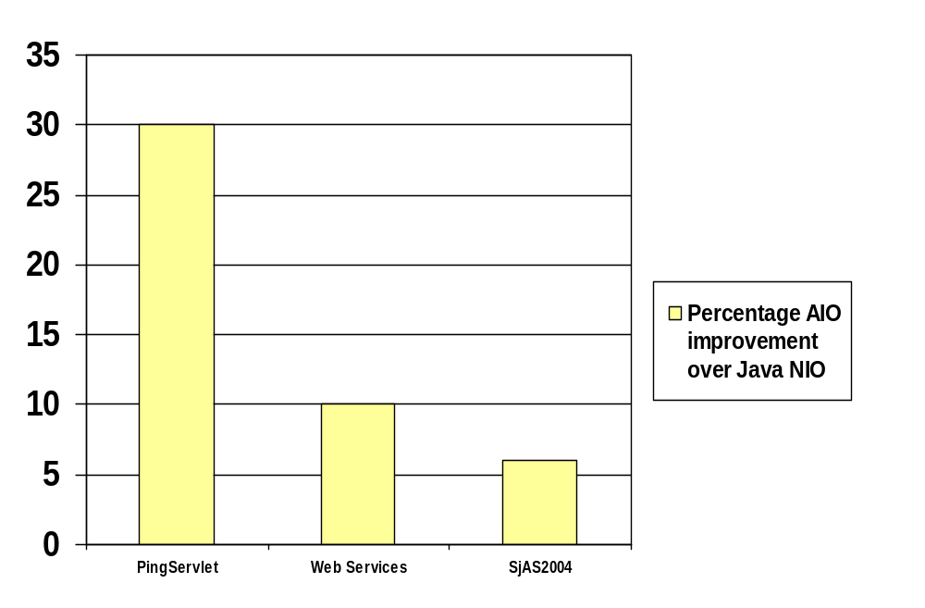

WAS 6.1 AIO performance
Load Driver
WSWS engine
Percent Improvement
SUT
WebSphere
Performance gains of 30%+ for heavy IO benchmarks as well as significant improvements for full end to end workloads
Scalability to 1000’s of concurrent client connections on appropriate systems.

Slide 30
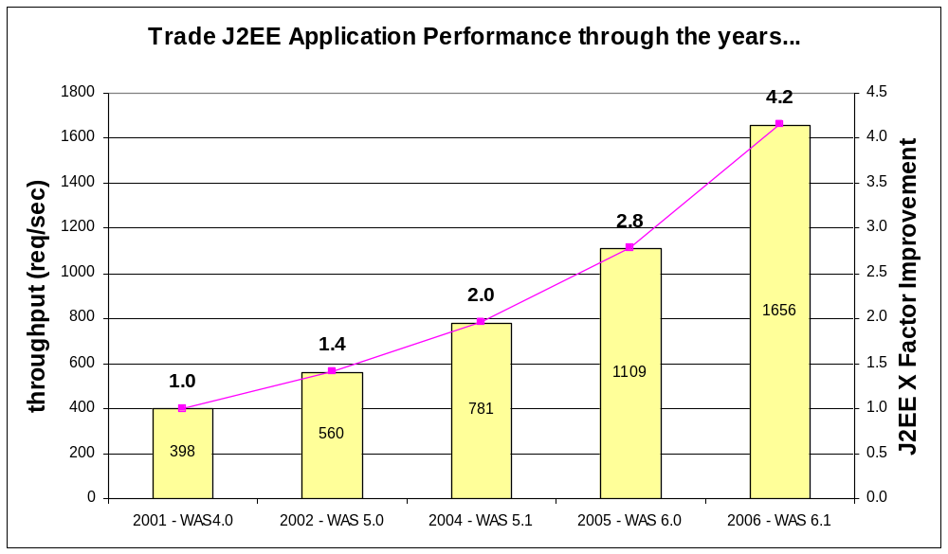
J2EE Performance History
J2EE Performance (JSP, Servlets, and EJBs) has steadily improved with each WebSphere release.
WAS 5.0
  Moved from J2EE 1.2
  to J2EE 1.3
WAS 5.1
  Internal optimizations
  and JDK 1.4.X
WAS 6.0
  Moved from J2EE 1.3
  to J2EE 1.4
WAS 6.1
  Internal optimizations
  and JDK 1.5
In five years throughput on the exact same hardware has gone up over 4x!

Slide 31
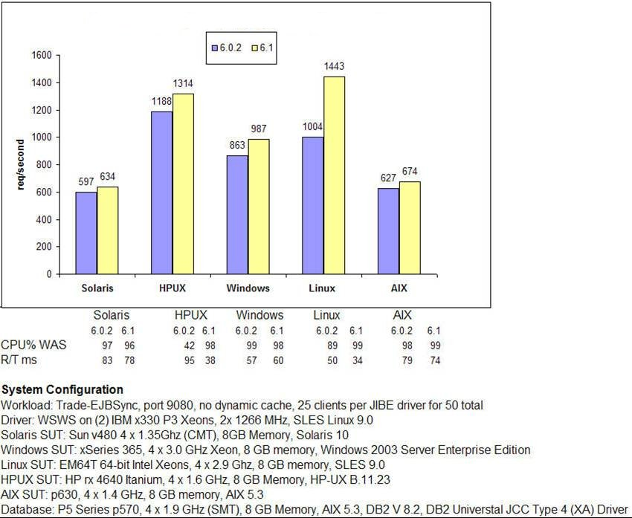
WAS v6.1 J2EE Performance Improvements Preliminary Results
Load Driver
(2) WSWS engines
Trade6 EJB Throughput Improvements
SUT
WebSphere
V6.1 Trade6 EJB performance is significantly improved over V6.02 across all platforms
  Current data shows 10% or more improvement on all platforms including z/OS and iSeries.
Improvements in the JDK, EJB container, PM and connection management provide better throughput in v6.1

Slide 32
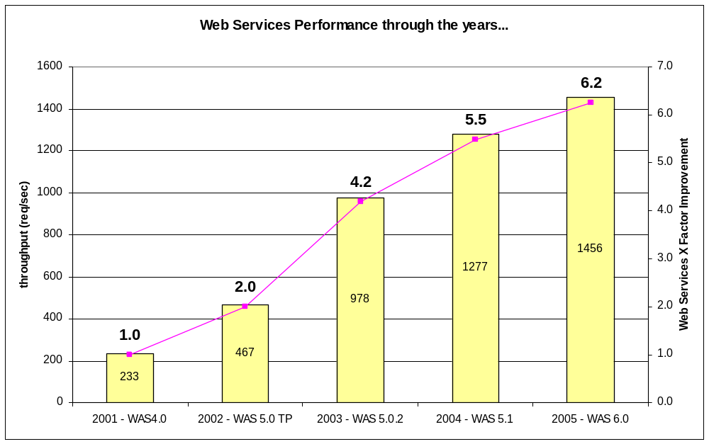
Web Services Performance History
Web Services Performance has steadily improved with each WebSphere release
WAS 5.0
  Moved from AXIS to IBM
  Web Services Engine
WAS 5.0.2
  Moved from Xerces to
  IBM Parser
WAS 5.1
  Internal optimizations
WAS 6.0
  Compiled (de)serializers
Once again what a difference four years can make! Since v4.0 WebServices performance on benchmarks has improved over 6x.

Slide 33
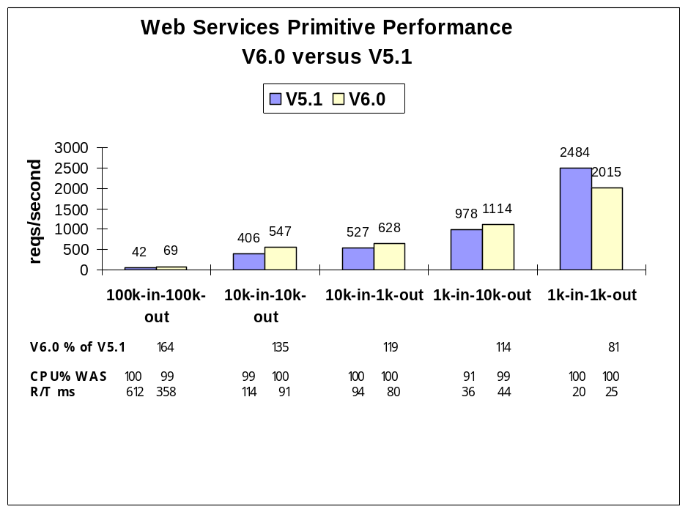
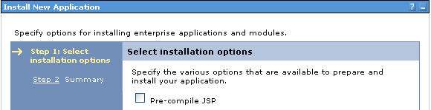
Web Services Primitive Performance, V6.0 versus V5.1
Load Driver
JIBE
SUT
WebSphere
Compiled (de)serialization helper classes
  14% to 65% Improvements
RPC encoded to DOC literal wrapped
  More to parse, but better interoperability
Small payload performance decreased
  Due to addition of scalable I/O handling
Notes:
Web Services Primitive Performance, V6.0 versus V5.1
The chart shows a performance comparison between V5.1 and V6.0 for scenarios in the wsbench suite of Web services primitives. The scenarios vary SOAP payload request and response sizes from 1k to 100k, driving a Web service implemented as a Java Bean. The chart shows the throughput in terms of requests per second.
A larger chart tower number indicates better throughput (requests-per-second handled by the application server). The CPU utilization below the chart indicates how efficient the application server process was in using the CPUs available. 100% is the maximum use of a processor, and a value in the high 90’s is considered very efficient. The R/T (response time) information below the chart indicates the response time in milliseconds, where a lower value is better. Response times typically correspond to the number of clients divided by requests-per-second.
Conclusions
WebSphere Application Server V6.0 provides significant performance improvements for Web services.
V6.0 outperforms V5.1 driving Web services to JavaBeans primitives, except for very small payloads. Web services performance decreased in the very small and atypical 1k payload test case, due to:
Scalability improvements in WebSphere HTTP I/O processing. WebSphere enhancements to the internal transport mechanism benefit larger-scope scaling in general but come at the expense of smaller, more primitive operations.
Other enhancements in the Web services engine also benefit typical workloads but provide a small setup penalty for very small workloads.
The typical performance improvement expected in Web services primitive performance in WebSphere Application Server V6.0 is 30%.
High CPU utilization indicates efficient use of the processor and a lack of bottlenecks.

Slide 34
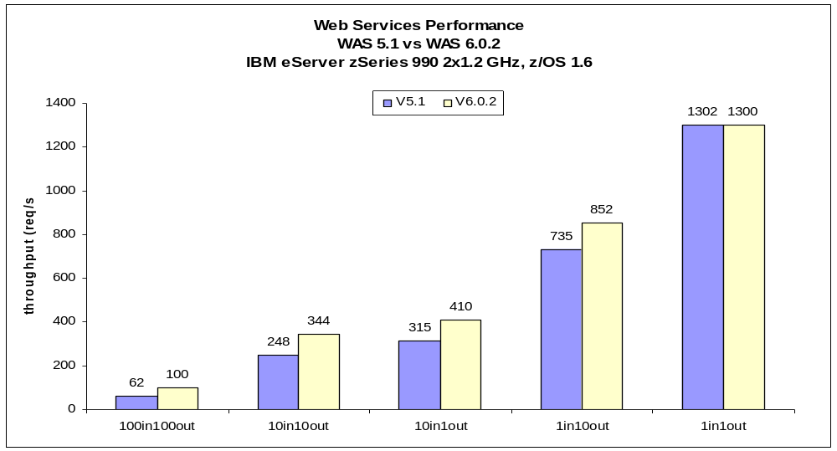
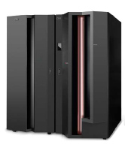
zSeries Web Services Primitive Performance, V5.1 versus V6.0.2
Load Driver
JIBE
SUT
WebSphere
Improvements for distributed are also applicable to zSeries (16% to 62%)
Specific focus on zSeries Web Services performance given architectural differences
Java functions of Web Services can be run on zAAPs, thus reducing cost

Slide 35
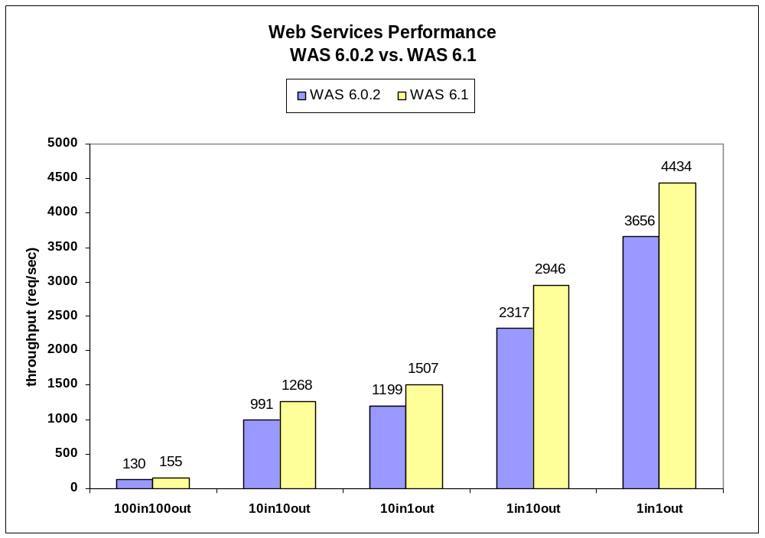
WAS V6.1 Web Services Performance Improvements Preliminary Results
Load Driver
JIBE
SUT
WebSphere
Improvements range from 19% to 28% on all platforms including z/OS
Due to newer JDK, newer XML parser, AIO, and internal optimizations

Slide 36
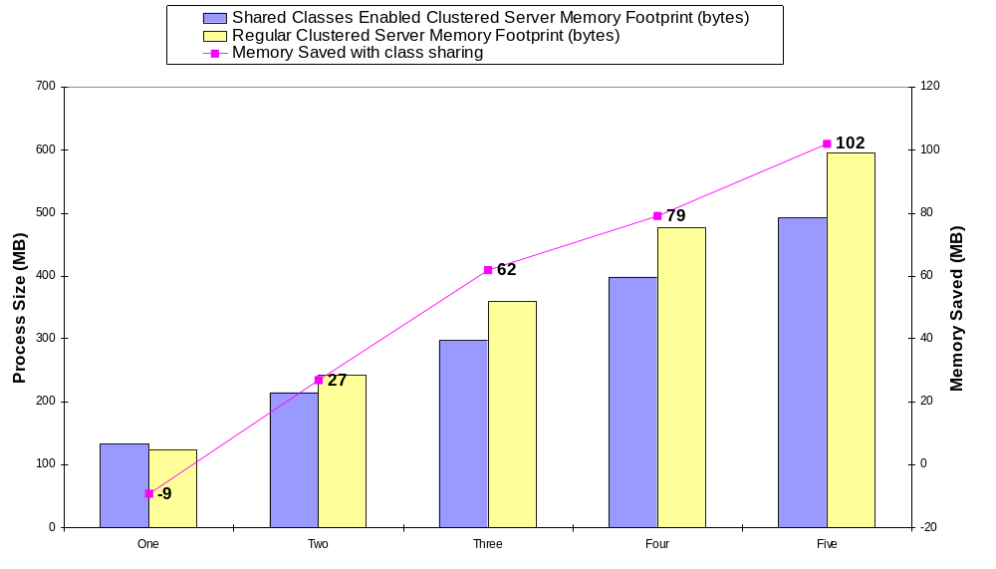
Cluster Server Startup Time for v6.1
With the addition of the Shared Classes feature to the IBM JDK WebSphere JVM’s are able to share non-changing class files amongst each other limiting the memory overhead of each JVM.
Typically for a base WebSphere install each JVM uses about 30MB less memory with Shared Classes on its process size.

Slide 37
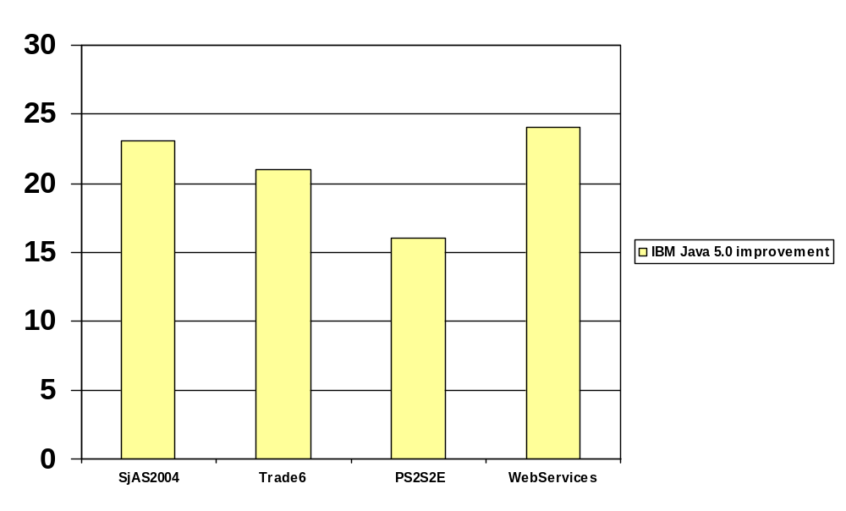
IBM Java 5.0 - Key highlights for WAS (continued)
  The graph below shows measured improvements across various WebSphere benchmarks using IBM Java 5.0
    Results show improvements from Java 5.0 compared to Java 1.4.2
    Results were gathered using WAS 6.02, but are reflective of improvements in WAS 6.1

Slide 38

Q&A

Slide 39









Thank You
Hindi
English
Thai
Gracias
Russian
Spanish
Obrigado
Traditional Chinese
Arabic
Brazilian Portuguese
Danke
Grazie
German
Simplified Chinese
Merci
Italian
French
Japanese
Tamil
Korean

