Slide 1
What’s New in WebSphere Security
WAS V6.1

Slide 2
Agenda
Security Enabled by Default and WebSphere Member Registry
SSL, KeyStore, Certificate, and Key Management Enhancements
Windows Single Sign-On (SSO) using the SPNEGO TAI
Fine-Grained Admin Security
Portlet URL Security
Security Integration Options

Slide 3
WebSphere v6.1 Security Features (Enablement)
Security Enabled By Default
  Enabled during install and profile creation to protect administrative resources.
    Option to disable.
  File-based repository used by default.
    Stores primary administrative identity and password as the initial user.
    Specified during install/profile creation or security enablement (if not enabled during install).
  Administrative security is split from application security enablement.
    Must have administrative security enabled before enabling application security.
    Application security enables J2EE container authentication and authorization.
    Administrative security protects other resources including Naming, MBeans, System Applications, etc.
  LTPA keys, self-signed certificate, keystores, server default identity are all generated automatically during profile creation.
Notes:
DRS is used to distribute file based registry in WAS-ND

Slide 4
WebSphere v6.1 Security Features (Enablement)
Consumability Improvements
  Redesigned security console to improve usability.
  Security Configuration Wizard for simplifying enablement for new users.
  Security Configuration Report for showing security configuration overview
Notes:
DRS is used to distribute file based registry in WAS-ND

Slide 5
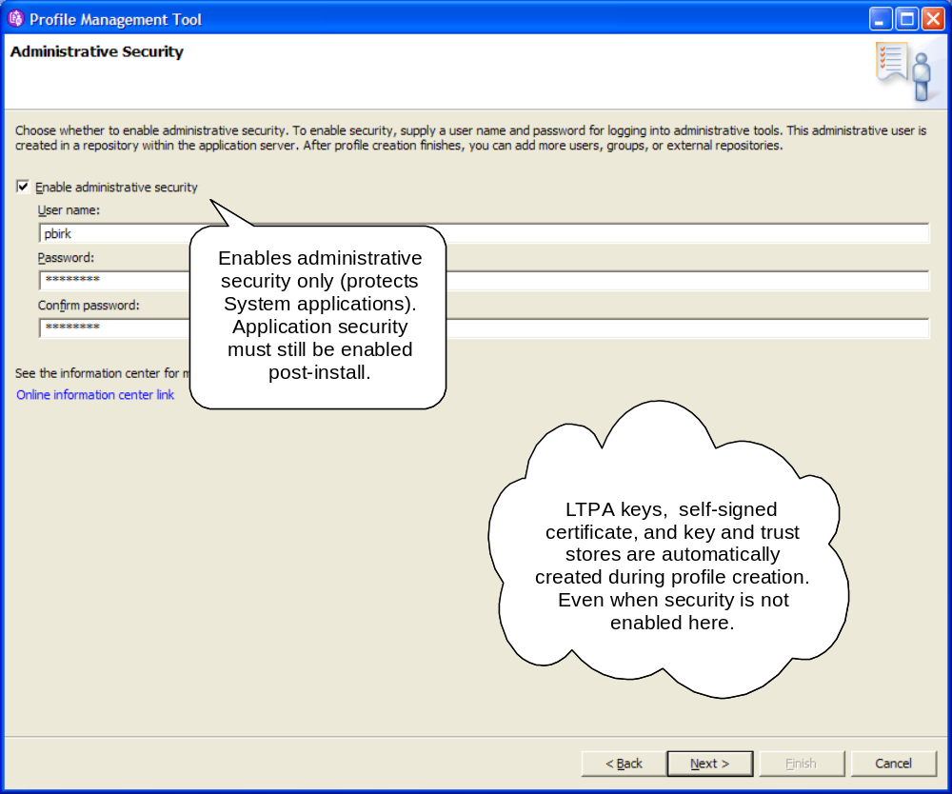
Security Enablement in Profile Tool
Notes:
Creates the primary administrative user in the built-in File-Based repository.
Administrative security is enabled.
Administrative security represents protection of system applications such as MBeans, scripting, AdminConsole, FileTransferServlet, Naming, etc. Other resources may still have some protection requirements to keep the WebSphere infrastructure protected. Application security is left disabled.
Application security represents security for the J2EE containers (EJB and Web). The authorization of these containers for non-system applications is disabled when application security is disabled.
LTPA keys, self-signed certificate (one for the entire profile), default key and trust stores, and server identity will be automatically created.
Migration will preserve the state of security from the previous configuration. If security was enabled before, both administrative and application security will be enabled after migration to preserve behavior.
Creates the primary administrative user in the built-in File-Based repository.
Administrative security is enabled.
Administrative security represents protection of system applications such as MBeans, scripting, AdminConsole, FileTransferServlet, Naming, etc. Other resources may still have some protection requirements to keep the WebSphere infrastructure protected. Application security is left disabled.
Application security represents security for the J2EE containers (EJB and Web). The authorization of these containers for non-system applications is disabled when application security is disabled.
LTPA keys, self-signed certificate (one for the entire profile), default key and trust stores, and server identity will be automatically created.
Migration will preserve the state of security from the previous configuration. If security was enabled before, both administrative and application security will be enabled after migration to preserve behavior.

Slide 6
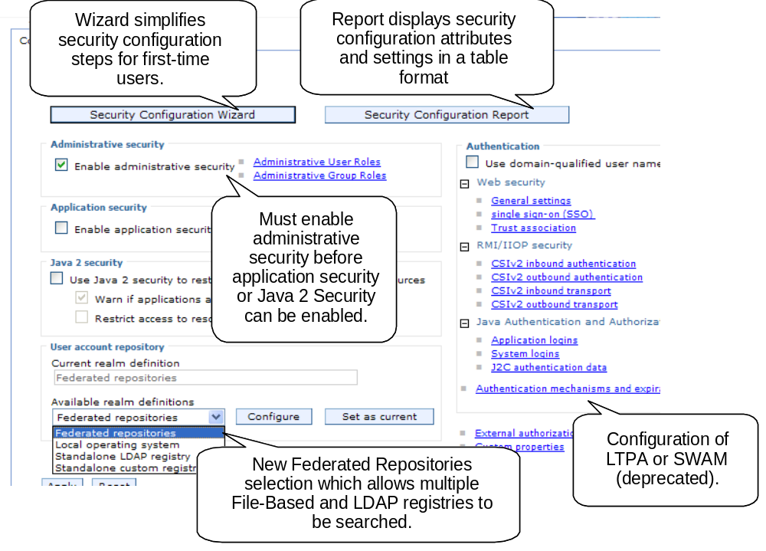
Secure administration, applications, and infrastructure

Slide 7
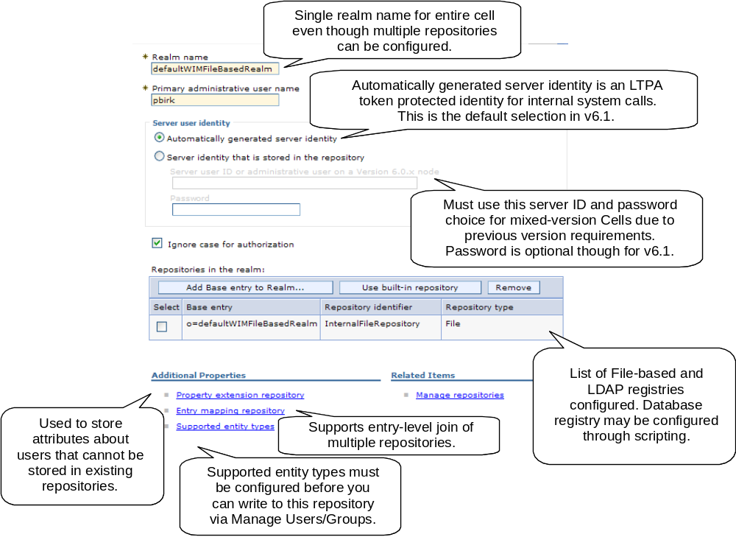
Virtual Member Manager - Federated Repositories Configuration
Notes:
Federated repositories is a logical view of users from multiple registries (LDAP and built-in File-Based configurable through AdminConsole or scripting. A database registry is configurable only via scripting).
WebSphere Application Server Version 6.1 distinguishes between the user identities for administrators who manage the environment and server identities for authenticating server to server communications. In most cases, server identities are automatically generated and are not stored in a repository. Mixed-version cells require server identity and password be defined.
Configure connection properties for LDAP server separately from base DN subtrees.
Supports a “look-aside” repository of additional attributes for users that cannot be added to existing repositories.
Supports an entry-level join of multiple repositories. An entry-level join means that the federated repository configuration uses multiple repositories simultaneously and recognizes the entries in the different repositories as entries representing distinct entities. By configuring an entry mapping repository, a federated repository configuration can use both the LDAP and the database at the same time.
You must configure the supported entity types before you can manage this account with Users and Groups in the administrative console. The supported entity types are Group, OrgContainer, and PersonAccount.

Slide 8
Agenda
Security Enabled by Default and WebSphere Member Registry
SSL, KeyStore, Certificate, and Key Management Enhancements
Windows Single Sign-On (SSO) using the SPNEGO TAI
Fine-Grained Admin Security
Portlet URL Security
Security Integration Options

Slide 9
WebSphere v6.1 Security Features (Crypto)
SSL Configuration Management
  Dynamic SSL configuration updates (all outbound, CFW inbound)
  Pluggable key and trust manager support
  Support for CRL checking using PKIX trust manager
  Multiple SSL configuration selection types with precedence rules:
    Programmatic selection (thread-based)
    Dynamic outbound selection (outbound protocol, target host and port)
    Direct selection (for backwards compatibility)
    Scoped selection (centrally managed)
KeyStore and Certificate Management
  No longer shipping the dummy certificate
  Self-signed certificate created per profile (properties to define values).
  Advanced IKeyMan-like certificate management capabilities built into AdminConsole via AdminTasks.
  WebSphere SSL socket factory removes system property requirements for SOAP and URL connections
  More detailed error messages for SSL handshake failures

Slide 10
WebSphere v6.1 Security Features (Crypto)
KeyStore and Certificate Management (server-side)
  Keystores can be remotely managed
  Federation of Base AppServer exchanges signer with Deployment Manager
  Common TrustStore used by default in Cell
  Java-based CMS keystore provider used to automate creation of CMS keystores (w/password stash) for WebServer plugins.
  Expiration monitoring with notification (email and logs) and auto-replacement of expiring self-signed certificates (based on threshold)
  SSL and KeyStore configurations hierarchically scoped to a WAS management resource (e.g., endpoint, server, cluster, node, nodegroup, cell)
KeyStore and Certificate Management (client-side)
  Signer exchange prompt for easy exchange (browser-like, can disable prompt)
  RetrieveSigners script for downloading and uploading (protected) signers
  By default, same self-signed certificate as server of the same profile
  New SSL configuration properties file, ssl.client.props, supports multiple SSL configurations
  Same SSL configuration support as server-side, including pluggable trust/key managers

Slide 11
WebSphere v6.1 Security Features (Crypto)
Key Lifecycle Management
  Generic key and key pair generator interfaces
  Automatically deletes old keys when new key generated and maximum number of managed keys reached
  LTPA implements key set and key set groups to manage auto-generation of LTPA keys
  Keys stored in keystores (can be hardware keystore)

Slide 12
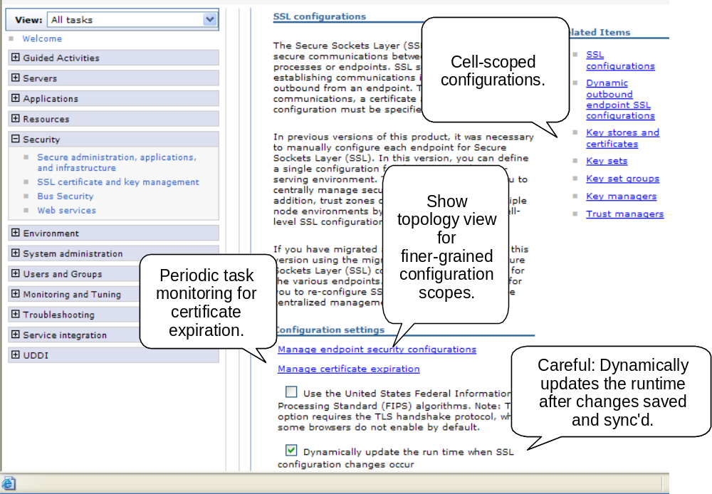
SSL, KeyStore, and Certificate Management
Notes:
New configuration model for SSL. Centrally managed option instead of specifying SSL alias all over the place. Integration of SSL runtime with SSL configuration for everything SSL (including URLs, Admin SOAP, Bus, IIOP, HTTP, etc). com.ibm.websphere.ssl.JSSEHelper API for used to link configuration with runtime.
Ability to determine visibility of configuration by management scope. By default, Cell scope. If you want to create configurations below the Cell scope, you have to go into “Manage endpoint security configurations” and pick a link from the topology view.
Certificate expiration monitoring capabilities. Can replace self-signed certificates once they reach threshold of expiration. Replace function will replace signers that exist in keystores throughout the entire Cell configuration.
Warning: Be care with changes made when “dynamic” updates are enabled. This can cause immediate outages if not careful, should test changes in test environment before making them in production.
Note: Admin SOAP inbound and IIOP inbound (on distributed) do not accept dynamic changes. This is due to their use of socket factories instead of the channel framework (which can dynamically change SSL settings for inbound without affecting existing connections).

Slide 13
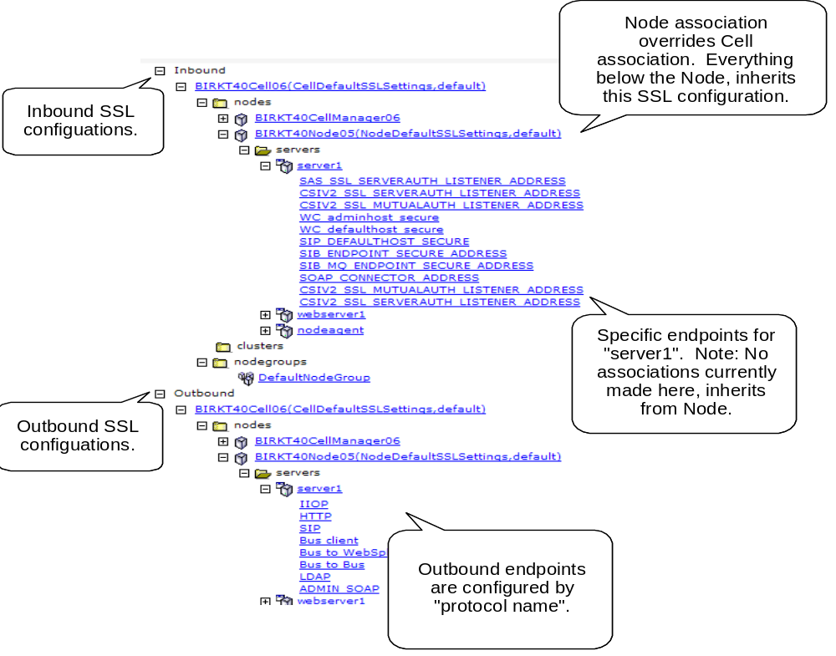
SSL Configurations Scoped by Topology
Notes:
Topology view is for the Centrally Managed option. Endpoints can configure themselves as either Centrally Managed (default in v6.1) or Direct Selection (default when migrated).
Topology view is how to scope the visibility of SSL, keystore, keyset, etc. configurations to a specific Node, NodeGroup, Cluster, Server, or EndPoint. When associated with one of these management scopes, visibility is limited to that scope and below.
Be aware, a configuration created a Node A will not show up in the list for Node B or Cell scopes, etc. This may cause some confusion at first, but is working as designed.
The SSL configuration chosen is the one defined at the lowest scope for the EndPoint requesting the SSL configuration.

Slide 14
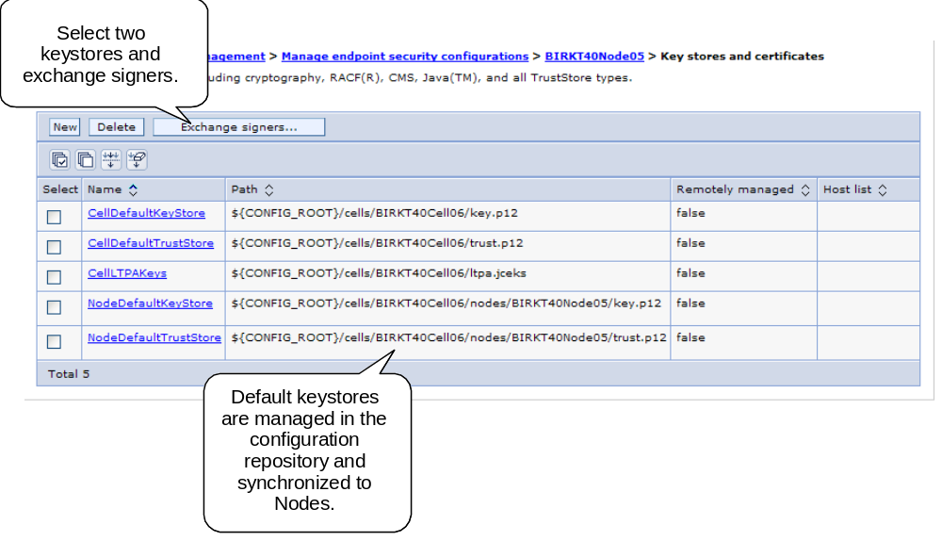
Panel: Keystore Collection

Slide 15
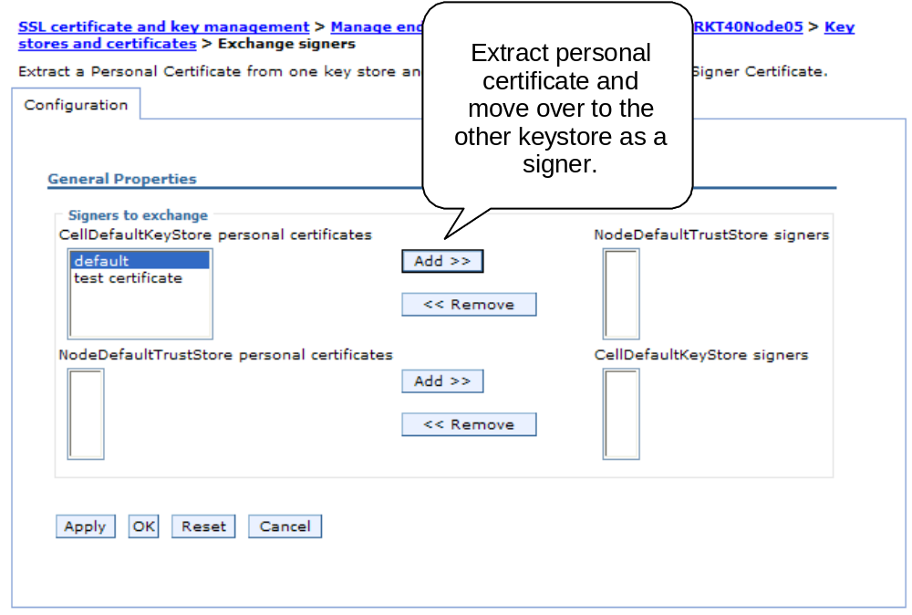
Exchange Signers

Slide 16
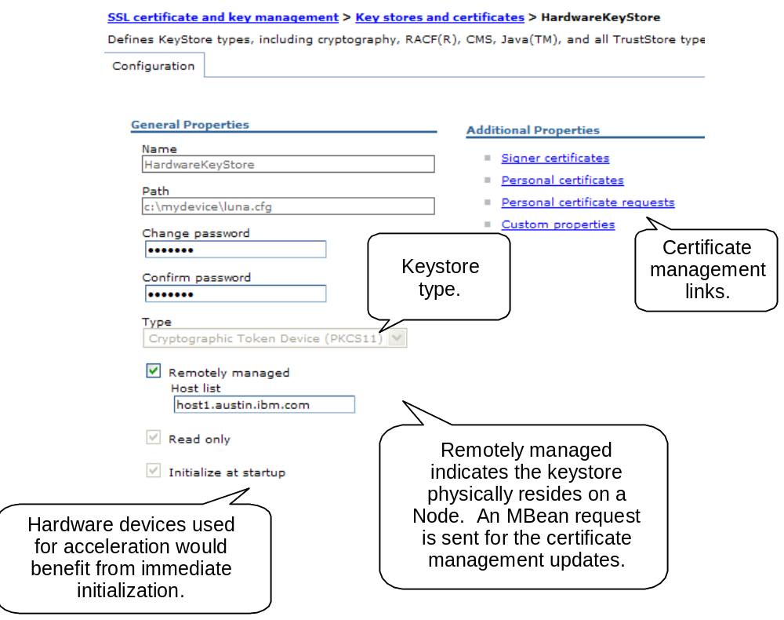
KeyStore (Managed on the Node)
Notes:
Similar certificate management capabilities of IKeyMan utility plus more advanced functions including signer exchange, self-signed replacement, expiration monitoring, etc.
Keystore type list is generated from java.security provider list based on “KeyStore” algorithm types. This can be extended by adding a custom algorithm/provider.
Read-only flag indicates the keystore cannot be written to. This typically includes RACF keystores and some hardware keystores.
ND keystore objects contain remotely managed flag to allow a keystore to reside on a system with a Node Agent and allow updates from the AdminConsole or AdminTask. Note: This allows configuration of multiple hosts per keystore configuration, but it’s recommended to only have one host per keystore as we don’t guarantee atomic updates in cases where one of the hosts is not available.
Note: zSeries does not have writable keystores so we cannot create certificates into them. We can monitor expirations and view the certificates (unless zSeries is configured with the family security option to utilize the writable keystores that distributed uses).

Slide 17
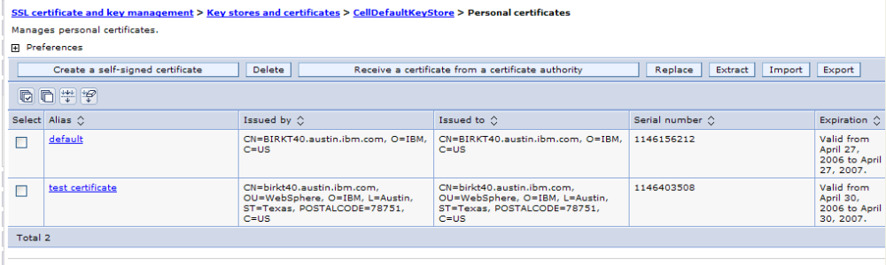
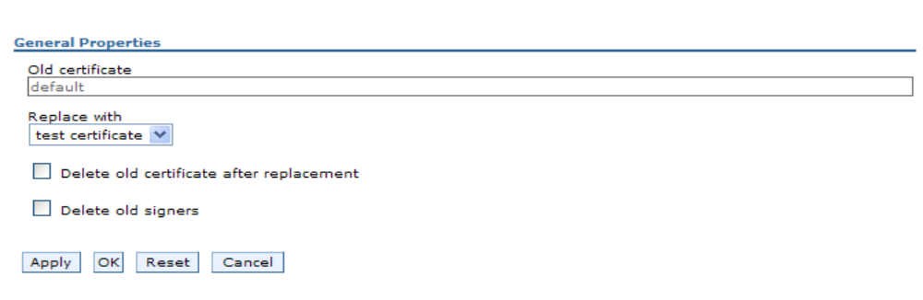
Personal Certificate Collection
Same IKeyMan-like function except for the advanced “Replace” function. This will allow the selection of certificate to replace with a new one. It replaces all old signers. This is the same function used by the certificate expiration monitor to replace an expiring certificate.

Slide 18
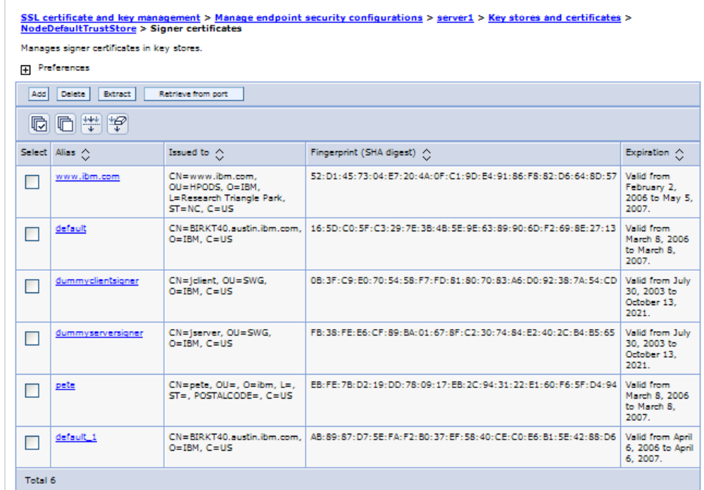
Signer Certificate Collection

Slide 19
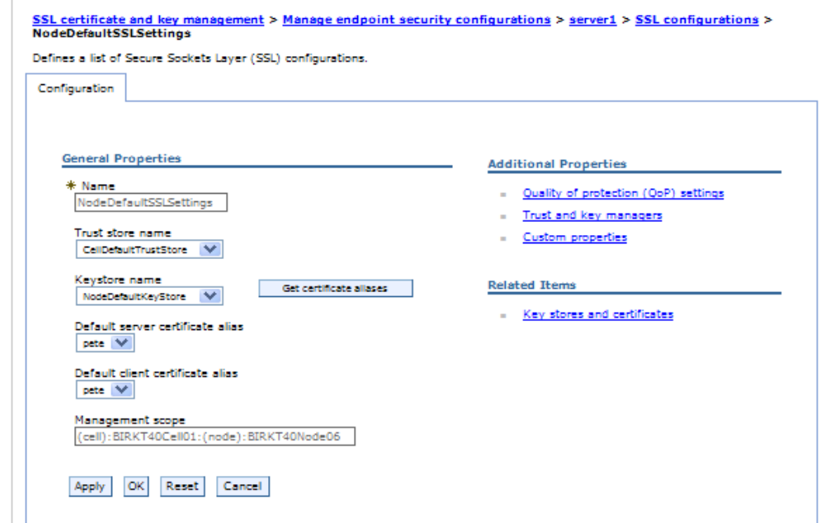
Panel: Scoped SSL Configuration
Notes:
Keystore and truststore references with ability to choose alias from keystore for client and server identity. When you choose a different keystore, you must refresh the alias lists by clicking on “Get certificate aliases” push button.
Pluggable trust and key managers.
Configurable IbmPKIX trust manager provides CRL validation when certificates have a CRL distribution point extension (common for most CAs).
Management scope shown for SSL configurations. This determines visibility based on topological inheritance.

Slide 20
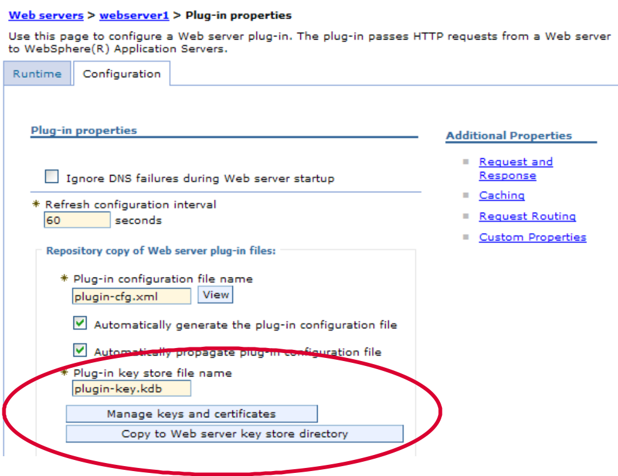
WebServer Plugin SSL Configuration
Notes:
Plugin-key.kdb is generated during web server creation using the same self-signed from the profile. This enables trust on both sides of the connection between plugin and application server, out of the box.
Can link to the same certificate management panels to modify the KDB file and then propagate to the WebServer similar to how the WebServer configuration file is propagated.
iSeries has hard link to internal password (no .sth file) so once KDB is propagated, the password needs to be reset to establish the link.
zSeries does not have writeable keystores, so we cannot add the signer from the self-signed in the KDB back into the RACF keystores. However we can extract the RACF signer into the KDB so that server authentication succeeds (which is the default setup).

Slide 21
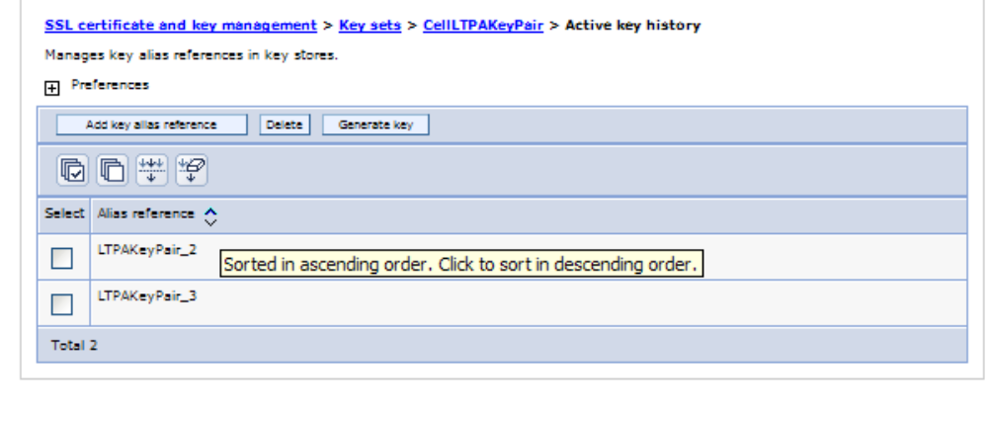
Key Lifecycle Management – Active Key History
This shows the current key aliases that are tracked by a specific KeySet.
The aliases can be generated dynamically (when keys are generated dynamically) or they can be references to already existing aliases in the KeyStore.

Slide 22
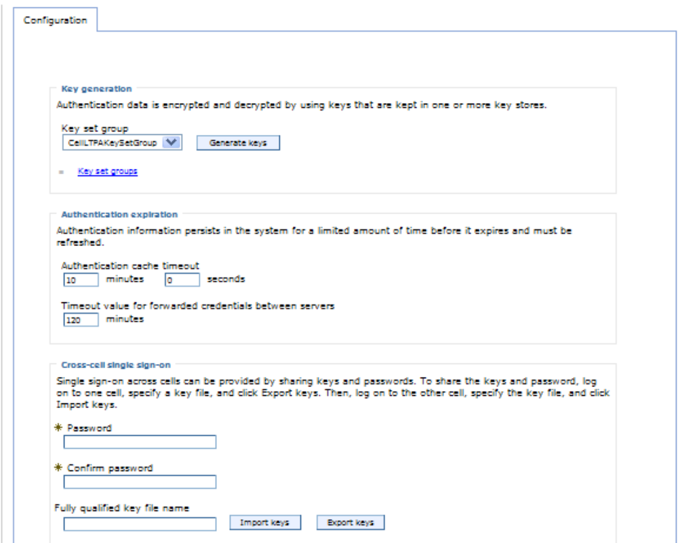
LTPA Use of KeySetGroup for Key Management
Notes:
LTPA uses this new technology for key lifecycle management to ensure keys are changed frequently enough.
By default, two versions of keys tracked (the latest is used to generate/validate recent keys, the oldest is used to validate older tokens).
Dynamic generation has implications to cross-cell SSO. When importing a key from another Cell, it becomes the default key for both Cells (last keys imported/generated are the ones used for token generation). If you don’t want to lose these keys due to wrapping, either increase the “maximum number of keys referenced” (could cause performance degradation) or disable dynamic generation to keep the list static.
Since keys have moved into keystores, it’s highly recommended to remove scripting that updates the old LTPA key location in security.xml. This effectively disables the new function.
Password no longer required for LTPA keys explicitly, except when importing/exporting keys (required for KeyStore though).

Slide 23
z/OS Specific Changes
CSIv2 implementation for IIOP security now mostly common-code with distributed (Java-based).
Support for HW Crypto exploitation for LTPA and web services security for soft non hw managed keys.
Enhanced Sync-to-thread to move the enablement decision into SAF.
Added support to optionally utilized the new RACF mixed case password.
All but the LSD daemon SSL has moved to JSSE.
Notes:
The IIOP SSL listerner for LSD is still in a separate address space that doesn’t contain any java

Slide 24
Agenda
Security Enabled by Default and WebSphere Member Registry
SSL, KeyStore, Certificate, and Key Management Enhancements
Windows Single Sign-On (SSO) using the SPNEGO TAI
Fine-Grained Admin Security
Portlet URL Security
Security Integration Options

Slide 25
Single sign-on (SSO) for HTTP using SPNEGO TAI
WebSphere Application Server provides a trust association interceptor (TAI) that uses the Simple and Protected GSS-API Negotiation Mechanism (SPNEGO) to securely negotiate and authenticate HTTP requests for protected resources in WebSphere Application Server.
With SPNEGO TAI support, after a user login to the MS domain controller, the Web browser client does not have to provide a user ID and password again to access protected resources in WebSphere Application Server.
A JAAS custom login module is used to map the client Kerberos principal name to the WebSphere user name.
Support for all User Registries and platforms that are supported by WebSphere Application Server.
Support web browsers:
  Microsoft Internet Explorer V6.0 SP1
  Mozilla V1.7.8
  Firefox V1.5
Support one or more Microsoft (MS) domain controllers within the same forest.

Slide 26
TAI Basics (A Brief Digression)
Normal WAS Authentication Process
  User Authenticates with WAS
  WAS Issues Credentials to User
  Application Request(s) are Processed
WAS Authentication Process with TAI
  User Authenticates with Third Party Security Server
  Request Flows to WAS (with Security Server credentials)
  Custom TAI Authenticates Request to ensure it is trusted
  WAS Issues Credentials
  Application Request(s) are Processed Based

Slide 27
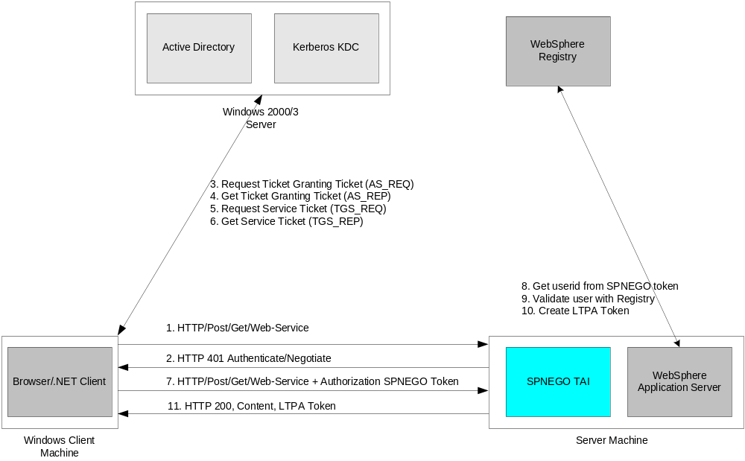
Challenge-responses process between web browser and SPNEGO TAI

Slide 28
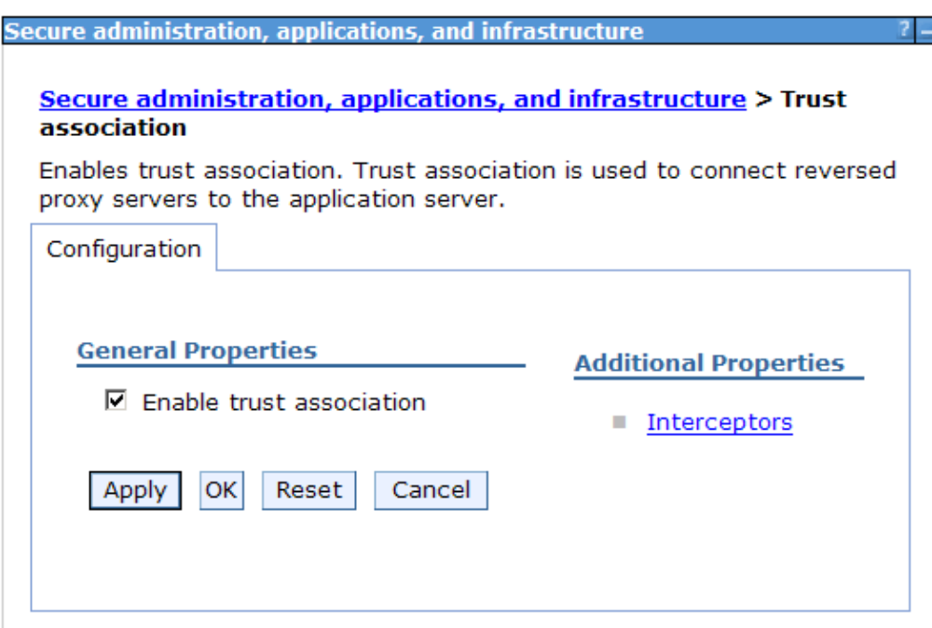
SPNEGO TAI Configuration in WebSphere Application Server
Panel: Enable Trust Association

Slide 29
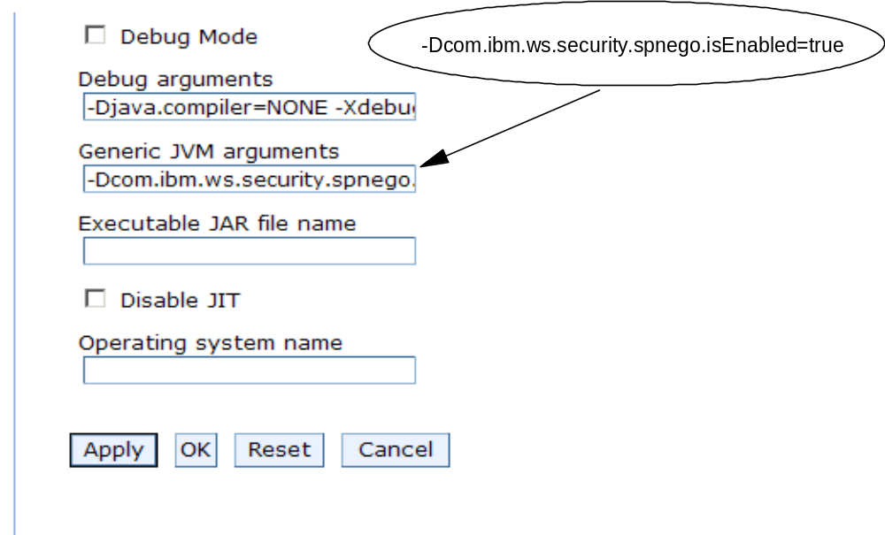
SPNEGO TAI Configuration in WebSphere Application Server
Enable SPNEGO TAI through JVM system property
  Application servers > server1 > Process Definition > Java Virtual Machine

Slide 30
Agenda
Security Enabled by Default and WebSphere Member Registry
SSL, KeyStore, Certificate, and Key Management Enhancements
Windows Single Sign-On (SSO) using the SPNEGO TAI
Fine-Grained Admin Security
Portlet URL Security
Security Integration Options

Slide 31
Fine-Grained Admin Access Control
Configurable by scripting only.
Authorization groups setup to group resources.
Group Resources
  Cell, Node, ServerCluster, Server, Application, or NodeGroup.
  Cell authorization group available by default
    Provides backwards compatibility.
A resource can only belong to a single authorization group.
Users/groups assigned to roles and authorization groups.
Restrictions
  WebSphere Application Servers lower than V6.1 cannot enforce fine-grained administrative security
  SIB resources cannot be managed as part of fine-grained administration
Notes:
A resource instance must be part of a V6.1 node or higher to be added to an authorization group
Only applications that are targeted on V6.1 servers or higher can be part of an authorization group
If a cluster spans nodes of multiple releases, neither the node or its members can be part of an authorization group
An application targeted on a cluster spanning multiple releases cannot be part of an authorization group

Slide 32
Scripting Operations to Setup Fine-Grained Admin Authz
Create a new authorization group
Deleting an authorization group
Add resources to an authorization group
Remove resources from an authorization group
Add user IDs to roles in an authorization group
Add group IDs to roles in an authorization group
Remove user IDs from roles in an authorization group
Remove group IDs from roles in an authorization group

Slide 33
New Deployer Role
The Deployer role is for users who need to manage applications
  The Deployer role is a subset of the Configurator and Operator roles
  Only provides the ability to manage applications
Users within the Deployer role can configure and perform runtime operations on applications
  No abilities on other resources (server, node, cluster)
This role is only available for wsadmin users.
Administrator
Configurator
Deployer
Operator
Monitor
Notes:
New role called Deployer role is introduced in was 6.1 to manage the Applications
Deployer role can be considered as combination of Configurator, a user that is granted a deployer role can perform all of the configuration and runtime operations on an application. A deployer role can be subsets of both configurator and operator roles. However, a user granted a deployer role cannot configure or operate any other resources (like server, node)
MonitorAn individual or group that uses the monitor role has the least amount of privileges. A monitor can complete the following tasks:
View the WebSphere Application Server configuration.
View the current state of the Application Server.
ConfiguratorAn individual or group that uses the configurator role has the monitor privilege plus the ability to change the WebSphere Application Server configuration. The configurator can perform all the day-to-day configuration tasks. For example, a configurator can complete the following tasks:
Create a resource.
Map an application server.
Install and uninstall an application.
Deploy an application.
Assign users and groups-to-role mapping for applications.
Set up Java 2 security permissions for applications.
Customize the Common Secure Interoperability Version 2 (CSIv2), Security Authentication Service (SAS), and Secure Sockets Layer (SSL) configurations. Important: SAS is supported only between Version 6.0.x and previous version servers that have been federated in a Version 6.1 cell.
OperatorAn individual or group that uses the operator role has monitor privileges plus ability to change the runtime state. For example, an operator can complete the following tasks:
Stop and start the server.
Monitor the server status in the administrative console.
AdministratorAn individual or group that uses the administrator role has the operator and configurator privileges plus additional privileges that are granted solely to the administrator role. For example, an administrator can complete the following tasks:
Modify the server user ID and password.
Configure authentication and authorization mechanisms.
Enable or disable administrative security.
Enable or disable Java 2 security.
Change the Lightweight Third Party Authentication (LTPA) password and generate keys.
Create, update, or delete users in the federated repositories configuration.
Create, update, or delete groups in the federated repositories configuration.
Note: An administrator cannot map users and groups to the administrator roles.iscadminsThis role is only available for administrative console users, not for wsadmin users. Users who are granted this role have administrator privileges for managing users and groups in the federated repositories. For example, a user of the iscadmins role can complete the following tasks:
Create, update, or delete users in the federated repositories configuration.
Create, update, or delete groups in the federated repositories configuration.
DeployerThis role is only available for wsadmin users, not for administrative console users. Users granted this role can perform both configuration actions and runtime operations on applications. See the Deployer role section for more details.AdminSecurityManagerThis role is only available for wsadmin users, not for administrative console users. When using wsadmin, users granted this role can map users to administrative roles. Also, when fine grained admin security is used, users granted this role can manage authorization groups. See the AdminSecurityManager role section for more details.

Slide 34
Deployer Role
Operation | Required Role(s)
Install Application | Cell Configurator, target-deployer
Uninstall Application | Cell Configurator, application deployer
List Applications | Cell monitor, application monitor
Edit, update and redeploy application | Cell configurator, application deployer
Export application | Cell monitor, application monitor
Start—stop application | Cell operator, applcation deployer
Notes:
Cell-configurator
is the configurator role at cell level.
Application-deployer
is the deployer role for the application that is being managed.
Target-deployer
is the deployer role for all servers or clusters for which an application is targeted. If you have a target-deployer role, you can install a new application on the target. However, to edit or update the installed application, you must be included in the authorization group of the installed application-deployer. The target-deployer can not explicitly start or stop a new application. However, when a target-deployer starts a server on a target, all of the applications that have their auto-start attribute set to yes are started when the server starts.
It is recommended that the application-deployer set this attribute to true if the application-deployer does not want the application to be started by the target-deployer.

Slide 35
New AdminstrativeSecurityManager Role
AdministrativeSecurityManager
  Separates fine-grained administrative security and application administration
  When fine-grained administrative security is used, only users granted this role can manage the authorization groups
  Only users granted this role can map users to administrative roles
    Note that the administrator role does not correlate to the adminsecuritymanager role
  By default, the serverId(SystemId) is assigned to this role in the cell level authorization table

Slide 36
Agenda
Security Enabled by Default and WebSphere Member Registry
SSL, KeyStore, Certificate, and Key Management Enhancements
Windows Single Sign-On (SSO) using the SPNEGO TAI
Fine-Grained Admin Security
Portlet URL Security
Security Integration Options

Slide 37
Portlet URL security
WAS 6.1 has an embedded JSR168 Portlet Container.
One can directly request a portlet through a URL to display its contents without portal aggregation.
Similar to servlets one can invoke a portlet by its context root with the URL mapping /<portlet-name> that is created for each portlet.
Portlets can be protected just like servlets when accessed using the URL.
The information in the portlet.xml like the user-data-constraint and security-role-ref will be combined with the information in the web.xml for that portlet which can be explicitly defined or implied through an url-pattern.

Slide 38
Agenda
Security Enabled by Default and WebSphere Member Registry
SSL, KeyStore, Certificate, and Key Management Enhancements
Windows Single Sign-On (SSO) using the SPNEGO TAI
Fine-Grained Admin Security
Portlet URL Security
Security Integration Options

Slide 39
Security Integration Options (1/4)
TAM Authentication Integration with WAS
  Web SSO integration
    WebSEAL/TAM authenticates web browser user and passes that information on to WAS
      Leverages standard WAS TAI function
      WAS ships with WebSEAL/TAM TAI
        Configure via admin console, under LTPA section
    Access Manager can directly issue LTPA tokens - deprecated
      Have to export WAS LTPA encryption key to TAM and keep two copies in sync

Slide 40
Security Integration Options (2/4)
Trusted Association
  WAS can be told to "trust" web proxy authentication systems via a Trusted Association
    Write custom plug-in Java code that WAS calls when identifying user web request. WAS will trust your code to identify user.
    Can provide to WAS
      Userid
      Group membership information
      Optional attributes to place in Subject. E.g., any serializable Java object.
    WAS will still obtain some information from registry (LDAP or custom)
    Only works with web based authentication. Won't help with other SSO systems
Login Module
  Customize authentication process for web and IIOP
  Similar to TAI

Slide 41
Security Integration Options (3/4)
Custom Registry
  Customized registry access
JACC = Java Authorization Contract for Containers
  Customized authorization
  When WAS needs to make an authorization decision, it will ask JACC provider
Direct LTPA Integration
  Domino has support for recognizing LTPA tokens
  Multiple WAS cells can communicate securely if
    They share common LTPA encryption keys - export LTPA keys using Security Center and import into peer domains
    Share a common registry
    Share compatible SSL keyrings – E.g., the caller has to have the signing certificate that corresponds to the server being called. Just the usual SSL stuff.

Slide 42
Security Integration Options (4/4)
Which Option Should I Use?
  Use the one with the closest semantic match to your goal
Direct LTPA integration should be used with Domino, not TAM
    TAI integration preferred with TAM/WebSEAL
TAIs and login modules are for recognizing an existing authentication
    Allow for dynamic information in Subject during login process
    Doesn’t even require that same data be in registry
CURs are for getting data from a non-standard source statically
    Tend to break interoperability since generally require common registry
    Triggers need for custom registry in Portal as well
Prefer TAIs and login modules over CURs when possible
JACC – probably shouldn’t use at all

Slide 43
Backup

Slide 44
Migration/Mixed Version/Mixed Platform Issues
Migration will preserve keystores in entirety. If v6.02 is migrated to v6.1 and it used the Dummy certificates, these will be preserved. It’s difficult to determine if some customization has occurred to all or part of an SSL configuration and safer to migration this way. These can more easily be converted to self-signed certificates in the new certificate management panels.
Migrating the existing keystores allows a mixed version Cell to work properly as back-level servers do not have the advanced functions to handle signer exchange. Default certificates can more easily be replaced using the new certificate management panels.
Back-level clients will have difficulty communicating with a v6.1 server (using self-signed certs). The client will need to be reconfigured to use the v6.1 key/trust stores or add the necessary signers using IKeyMan.
When Dmgr is z/OS (using RACF keystores) and Node is distributed (using self-signed cert inside PKCS12 keystores), a manual signer exchange should occur prior to performing an addNode.
When performing an addNode from a v6.02 Node to a v6.1 Dmgr, the v6.02 Node needs to exchange signers with the v6.1 Dmgr prior to being able to federate.
Migration disables “Web inbound attribute propagation” whenever a v5.1 or prior Node is part of a mixed-version Cell due to problems interoperating with LtpaToken2 (new version of LtpaToken introduced in v5.1.1).

Slide 45
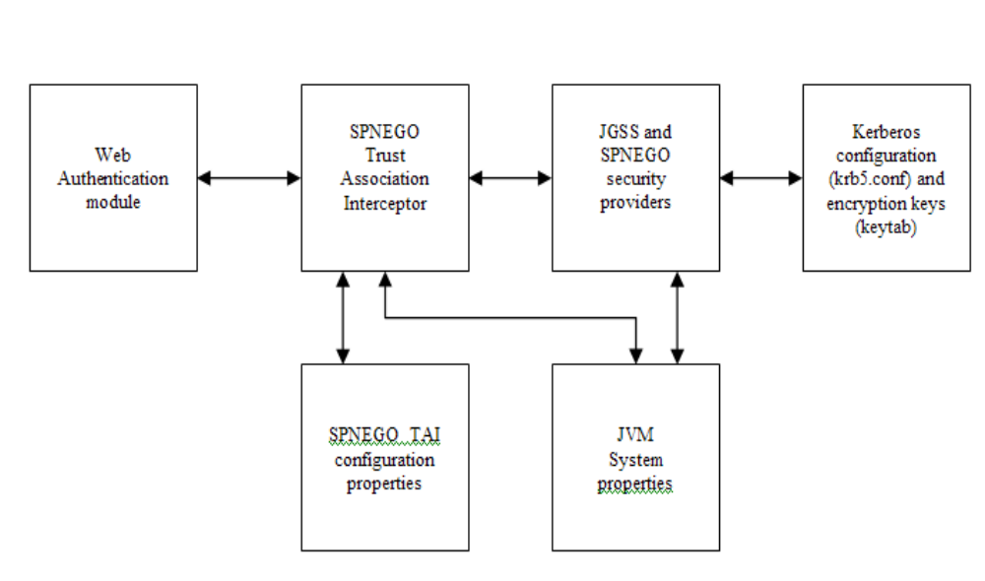
SPNEGO TAI configuration elements

Slide 46
SPNEGO TAI Configuration for WebSphere Application Server
Create a Kerberos key tab file from the Active Directory (AD) machine
  Create a user name w2003secdev in AD and check the option Use DES encryptions types for this account.
  Use MS setspn tool to map the user name to the SPN format HTTP/<hostname>
    C:\MS SDK>setspn -a HTTP/w2003secdev.austin.ibm.com w2003secdev
  Use MS ktpass tool to generate the Kerberos keytab file krb5.keytab for the SPN
    ktpass -out c:\temp\krb5.keytab -princ HTTP/w2003secdev.austin.ibm.com@WSSEC.AUSTIN.IBM.COM -mapUser w2003secdev -mapOp set -pass security -crypto DES-CBC-MD5 +DesOnly
Copy the krb5.keytab file to the WebSphere Application Server machine at the location which specify in the Kerberos configuration file (krb5.ini or krb5.conf).
Note: The Windows 2003 server ktpass support both DES and RC4-HMAC

Slide 47
Configure MS IE browser to use SPNEGO authentication
Make sure the client machine is part of a domain for which SSO has been defined. In the following example, the machine w2003secdev.austin.ibm.com is a member of the domain controller wssec.austin.ibm.com. Log on to the Windows Desktop with a user name from the domain.
  Open the browser, go to menu bar Tools -> Internet Options
  Select the Security tab.
  Select Local intranet icon.
  Click Sites.
  Click Advanced.
  Add the URL for the host name that SSO should be enabled for, to the list. For example: http://w2003secdev.austin.ibm.com
  Click OK.
  Click OK.
  Select the Advanced tab.
  Scroll down to security section and ensure that Enable integrated Windows Authentication(requires restart) is checked.
  Close the browser.
  Start the browser.

Slide 48
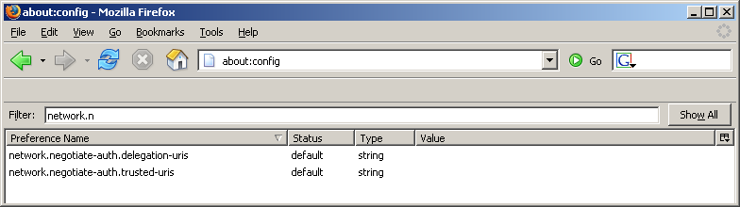
Configure Mozilla or FireFox browser to use SPNEGO authentication
  Open the browser.
  At the address field, type about:config
  In the filter, type network.n
  Double click on network.negotiate-auth.trusted-uris. This preference lists the sites that are permitted to engage in SPNEGO Authentication with the browser
  Enter a comma delimited list of trusted domains or URLs. For example: http://w2003secdev.austin.ibm.com
  Close the browser.
  Start the browser.

Slide 49
Scripting Operations to Setup Fine-Grained Admin Authz
Create a new authorization group: $AdminTask createAuthorizationGroup {-authorizationGroupName authGroup1}
Deleting an authorization group: $AdminTask deleteAuthorizationGroup {-authorizationGroupName groupName}
Add resources to an authorization group: $AdminTask addResourceToAuthorizationGroup {-authorizationGroupName groupName -resourceName Application=app1}
Remove resources from an authorization group: $AdminTask removeResourceFromAuthorizationGroup {-authorizationGroupName groupName -resourceName Application=app1}
Add user IDs to roles in an authorization group: $AdminTask mapUsersToAdminRole {-authorizationGroupName groupName -roleName administrator -userids user1}
Add group IDs to roles in an authorization group: $AdminTask mapGroupsToAdminRole {-authorizationGroupName groupName -roleName administrator -groupids group1}
Remove user IDs from roles in an authorization group: $AdminTask removeUsersFromAdminRole {-authorizationGroupName groupName -roleName administrator -userids user1}
Remove group IDs from roles in an authorization group: $AdminTask removeGroupsFromAdminRole {-authorizationGroupName groupName -roleName administrator -groupids group1}

Slide 50
Portlet URL Security Example
Portlet relevant Security Constraints in web.xml
---------------------------------------------------------------
<security-constraint id="SecurityConstraint_1">
<web-resource-collection id="WebResourceCollection_1">
<web-resource-name>Protected Area</web-resource-name>
<url-pattern>/MyPortlet1/*</url-pattern>
<url-pattern>/MyPortlet2/*</url-pattern>
</web-resource-collection>
<auth-constraint id="AuthConstraint_1">
<role-name>Employee</role-name>
</auth-constraint>
</security-constraint>
Security Constraints in Portlet.xml
---------------------------------------------
<security-constraint>
<display-name>Secure Portlets</display-name>
<portlet-collection>
<portlet-name>MyPortlet1</portlet-name>
<portlet-name>MyPortlet3</portlet-name>
</portlet-collection>
<user-data-constraint>
<transport-guarantee>CONFIDENTIAL</transport-guarantee>
</user-data-constraint>
</security-constraint>

Slide 51
Portlet URL Protection based on above constraints
URL | Transportation Protection | User Authentication | Authorization
MyPortlet1/* | HTTPS | Yes | Yes (Employee)
MyPortlet2/* | None | Yes | Yes (Employee)
MyPortlet3/* | HTTPS | None | None
MyPortlet4/* | None | None | None

