Slide 1
WebSphere Application Server 6.1
competitive positioning
Roman Kharkovski, WW WebSphere Technical Sales Team, kharkovski@us.ibm.com
Microsoft and SAP sections contributed by SWG CPO
Notes:
DISCLAIMERS
Information included in this document is believed to be current as of this writing and was obtained from publicly available sources such as BEA Web pages, Usenet forums, discussion groups, BEA-sponsored seminars and classes, and externally published collateral. Additional information was obtained from hands-on testing of WebLogic in an internal IBM test environment. Competitive information changes on a daily basis with new features of products, fix packs, partner offerings, etc. This document is accurate to the best IBM knowledge of both product families. IBM is a registered trademark of International Business Machines Corporation. BEA is a registered trademark of BEA Systems, Inc. All other trademarks or registered trademarks are registered to their respective owners. References to products or offerings do not necessarily imply that IBM intends to make these products or offerings available to every country in the world.
The information in this document concerning non-IBM products and services was obtained from the suppliers of those products and services. IBM has not tested such products and services and cannot confirm the accuracy of the performance, compatibility or any other claims related to non-IBM products and services. Questions about the capabilities of non-IBM products and services should be addressed to the suppliers of those products and services.
Prices are current as of the date on the title page, exclude applicable taxes, and are subject to change by IBM without notice. Suggested retail prices used, dealer prices may vary.
Performance data contained in this publication was obtained in the specific operating environment and under the conditions described in this document and/or at http://www.spec.org and is presented as an illustration. Performance obtained in other operating environments may vary and customers should conduct their own testing.

Slide 2
IBM Industry Leadership
Scope of Offerings - CE to WAS for z/OS to XD
Open Standards and Open Source Leadership
Complex / High-End Solutions
Complete & Best in Class Middleware Stack
Breadth of Platform Support
Vender Viability

Slide 3
Technical differentiators for Application Servers
None – no support, or need 3rd party
Limited – some rudimentary features
Good – decent working implementation
Best – best in class implementation
 | IBM | BEA | JBoss | Oracle | SAP | MSFT
Manageability | Best | Best | Limited | Limited | Limited | Best
Ease of use | Good | Good | Good | Limited | Limited | Best
Product reliability and maturity | Best | Best | Limited | Limited | Limited | Good
Development tools | Best | Limited | Limited | Good | Limited | Best
Performance | Best | Best | Limited | Good | Limited | Good
Scalability | Best | Best | Limited | Good | Limited | Limited
Security | Best | Best | Limited | Good | Good | Limited
Web services and SOA standards | Best | Good | Limited | Good | Limited | Best
High end OLTP capabilities | Best | Limited | None | None | None | None
Programming model extensions | Good | Limited | Limited | Limited | Limited | N/A
Quality up-to-date documentation | Good | Best | Limited | Good | Limited | Best
Hardware, OS and DBMS support | Best | Good | Good | Limited | Limited | Limited
Integration with Tivoli | Best | Good | None | None | None | Limited
Integration with 3rd party software | Best | Best | Good | Limited | Limited | Best
Timely Java and J2EE support | Best | Best | Best | Good | Limited | None
.NET runtime support | None | None | None | None | None | Best

Slide 4
Business Differentiators
None – not provided
Limited – partial or immature
Good – considerable capability
Best – best in class
 | IBM | BEA | JBoss | Oracle | SAP | MSFT
Free J2EE runtime | Good | None | Best | None | Limited | None
Acquisition cost for add-on components | Good | Good | Limited | Good | Limited | Good
Lowest integration cost | Good | Good | Limited | Limited | Limited | Good
Hardware cost (price/performance) | Best | Best | Limited | Good | Limited | Good
Development cost (time to market) | Best | Best | Limited | Good | Limited | Best
Lowest implementation risk | Best | Best | Limited | Limited | Limited | Good
Vendor track record in middleware | Best | Best | Limited | Good | Limited | Good
Community and intellectual capital | Best | Good | Good | Limited | Limited | Best
ISV community for vendor runtime | Good | Good | Good | Limited | None | Best
COTS software available for the product | Best | Good | Good | Limited | None | Best
Vendor viability | Best | Good | Limited | Best | Best | Best
Product viability | Best | Best | Best | Good | Good | Best
WW presence and product support | Best | Good | Limited | Best | Good | Best
Mission critical high volume references | Best | Best | Limited | Limited | Limited | Limited
Protect against potential legal issues | Best | Best | Limited | Best | Best | Best
Product packaging | Best | Good | Good | Good | Limited | N/A
Availability of add-on SOA components (Portal, Integration, Commerce, etc.) | Best | Good | Limited | Good | Limited | Good

Slide 5
All competitors

Slide 6
IBM offers the most 1) advanced and 2) flexible scope
WebSphere Extended
Deployment 6.01
Same programming model, different qualities of services
WAS 6.1 for z/OS
Scale Up / SMP Computing
WAS Network Deployment 6.1
Oracle, SAP, BEA and Microsoft do not have these offerings
WAS 6.1
WAS Express 6.1
WAS Community Edition 1.0
JBoss does not have these offerings
Scale Out / Distributed Computing
Notes:
this drawing is not to the scale

Slide 7
IBM has the most sophisticated Application Server runtime
 | IBM | BEA | JBoss | Oracle | SAP | MSFT
Installation factory
Automation toolkit for the admin
Portlet API (JSR 168) |  |  |  |  |  | n/a
JSF widget library
Common criteria level 4 certified
Session Initiation Protocol (SIP)
SPNEGO
Console command assistant
J2SE 5.0 |  |  |  |  |  | n/a
Complete WS* stack
Ability to federate user repositories |  |  |  |  |  | ?
Development tool included
J2EE 1.4 certified |  |  |  |  | 1.3 | n/a
First to be J2EE 1.3 and 1.4 certified |  |  |  |  |  | n/a
Java EE 1.5 support |  | * | * | * |  | n/a
JDK 1.4 |  |  |  |  |  | n/a
Mature and proven code base
Scripted administration
SDO |  |  |  |  |  | n/a
IPv6
WAS 6.1 new items
- limited
- full support
- no support
* - EJB3 preview
Notes:
Programming Model Enhancements
Dynamic Application Profiles, Dynamic EJBQL w/ extensions, Active Server features like Work Manager and Timers, Dynamic EJBQL, Business Rules Engine, Compensation, etc.
Better problem determination infrastructure
First Failure Data Capture, Tivoli Performance Viewer, Performance Advisors, flexible tracing and logging facilities, request metrics (request-to-response timing details), CEI
Better performance optimization options
Akamai integration, Edge replication, Dynacache, EdgeComputing features
On/Off Capacity On Demand
Enables customers to only pay for temporary usage of software to accommodate demand peaks and valleys (per-day charges available for zSeries, iSeries, and pSeries)
Better autonomic support
WebSphere Extended Deployment enables customers to monitor Service Level Agreements (SLA) and optimize hardware usage to make sure all SLAs are met
Native and current z/OS (OS/390) support
Best in class development and monitoring tools

Slide 8
IBM has the most sophisticated Application Server runtime
 | IBM | BEA | JBoss | Oracle | SAP | MSFT
SPECjAppServer2004 leader |  |  |  |  |  | n/a
Manage mixed runtime versions in a single cell
Robust messaging provider with auto failover |  |  |  |  |  | ?
Fine grained application updates |  |  |  |  | ?
Best OS and HW platforms support
Best heterogeneous DBMS support w/ XA
Spring, Hibernate, Struts compatibility |  |  |  |  |  | n/a
Vendor support for Spring and Hibernate |  |  |  |  |  | n/a
Server templates |  |  |  |  | ? | ?
99.999% availability architecture
Native integration with WSMQ
Annotations in source code
Last participant transaction support |  |  |  |  | ? | ?
Parallel Processing Beans |  |  |  |  |  | n/a
Shared Work Area Service |  |  |  |  |  | n/a
Automatic Backup Clusters |  |  |  |  |  | ?
Node agent to manage JVMs on the node |  |  |  |  | ? | n/a
JSF |  |  |  |  |  | n/a
SSO with 3rd party systems |  |  |  |  | ?
Dynamic EJBQL with extensions |  |  |  |  |  | n/a
- limited
- full support
- no support
? - to be determined

Slide 9
IBM has the most sophisticated Application Server runtime
 | IBM | BEA | JBoss | Oracle | SAP | MSFT
Dynamic Application Profile optimization
i18n Service
Activity session service
Manage HTTP server from admin GUI
Web services caching & edgefication |  |  |  |  |  | ?
Akamai EdgeComputing integration
Partitioning for state replication (scalability) |  |  |  |  |  | ?
Page fragment cache with replication
Production grade HTTP server included
Database for session persistence included
Edge components included |  |  |  | Some
Production LDAP server included
Java based embedded LDAP server |  |  |  |  |  | n/a
On/Off capacity on Demand pricing |  |  |  |  |  | ?
Shared binaries for multiple installs
Version to version migration tool |  |  |  |  | ?
Extensible Admin console
User lockout |  |  |  |  | ? | ?
SNMP |  |  |  |  | ?
Split HTTPSession into multiple rows in the DB |  |  |  |  |  | n/a
- limited
- full support
- no support
? - to be determined

Slide 10
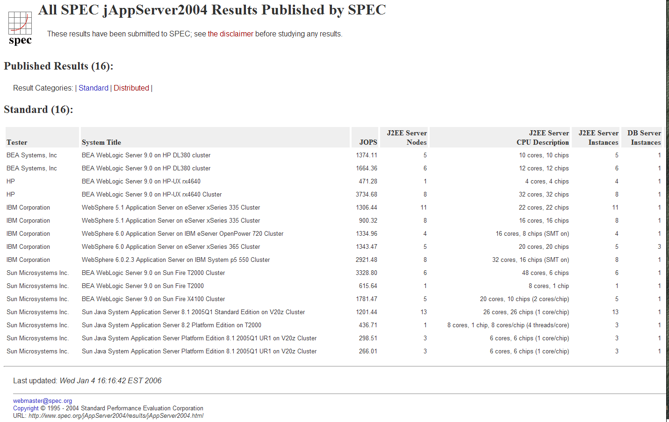
IBM is the Company of Benchmark Publication “ONES”
X
IBM
FIRST to publish on SPECj2001
FIRST to publish on SPECj2002
FIRST and ONLY company to publish SPECj2002 Distributed
FIRST to publish SPECj2004
  Held #1 position for over 13 months
IBM has new #1 result that beats BEA by 30% (publishing it now)
BEA
Was 13 months late to publish
Oracle, JBoss, SAP
Never published
2. Took BEA 13 months to catch up
1. IBM – is FIRST to publish in June 2004
4. BEA caught up shortly
3. IBM beats BEA by 67% and was again #1
Notes:
IBM beats BEA in SPEC jAppServer2002 Distributed
On price and on performance (BEA has no submissions)
Leapfrogging each other IBM and BEA in SPEC jAppServer2002 Multiple Node (see latest results here http://www.spec.org/jAppServer2002)
IBM was first to publish (submitted 12/12/02)
IBM is using real world configuration despite added cost (WAS ND)
BEA uses benchmark specials to trick the public and get higher performance – that configuration is not applicable for real world configurations
BEA uses non-clustered version (e.g. WL Advantage Edition with $10,000/CPU) and DNS Round Robin used instead of real WLM (e.g. WL Premium Edition for $17,000/CPU)– not realistic (e.g. no fast failover). What if DNS fails? Cached DNS entry will be sending requests to dead machine… or need to resolve DNS on each request!
BEA uses proprietary T3 instead of RMI-IIOP (IBM uses RMI-IIOP)
IBM beats BEA in SPEC jAppServer2001- http://www.spec.org/jAppServer2001
IBM was first to publish
Best vertical scalability (WAS 4.03 - SPECJ2001 - 32 CPUs, 1 JVM on iSeries)
BEA does not have SPEC jAppServer2001 submissions – BEA WebLogic EJB 1.1 can’t handle correct isolation levels
IBM beats BEA in ECperf (http://ecperf.theserverside.com/ecperf)
On price and on performance
IBM published results with the largest cluster (12 node)
IBM was using real world configuration despite added cost
Competitors used proprietary features and benchmark tricks - DNS round robin, term license, “non-clustered” version of the product, T3 instead of RMI-IIOP, etc.
PC Magazine’s Editors' Choice (5/3/01): WebSphere has achieved highest rating
"IBM's WebSphere Application Server, Advanced Edition 3.5 was by far the fastest and most scalable server on the scenario test. At its peak, it maintained 4,000 virtual users at 177 pages per second… "Because of its sophisticated dynamic page-caching algorithms, WebSphere was also the clear winner on the title search test. It also had the best average response time at peak performance on nearly all of the tests… "If your business is looking for a complete scalable and high performance environment for Web applications, WebSphere Application Server is ready… Beats iPlanet, Sybase, Borland, and Microsoft. BEA and Oracle were no-shows and declined, citing lack of resources to support or unwillingness to undergo performance testing.”

Slide 11
Application and Integration Server Monitoring Capabilities
 | WAS | WLS | JBoss | OAS | SAP | MSFT
Application performance monitoring |  |  | *
J2EE monitoring tool integrated with admin GUI
OASIS CBE 1.1 (draft) support
Graphical historical display of performance data
Smart performance analyzers and advisors
View of transaction across all tiers (HTTP-JSP-EJB-DBMS) |  | Limited |  | Limited | Limited
Log analyzer
Collector tool
First Failure Data Capture
Notes:
* - with paid subscription only

Slide 12
WAS ND v6: Mixed Version Cells
None of IBM competitors have this capability
WebSphere Application Server 6.0 supports a cell composed of multiple WebSphere nodes at different version levels
Server 1
Node 5.x
J2EE 1.3
Capabilities
Server 2
Cell 6.x
The cell can operate in this mode for indeterminate amounts of time
Supported node versions include:
WAS 5.0.x Distributed
WAS 5.1.x Distributed
WAS 6.x (Distributed and z/OS)
Server 3
Node 6.x
J2EE 1.4
Capabilities
Server 4
Notes:
What’s new?
Individual nodes within a V5 cell can be upgraded to V6 without requiring the entire cell to be upgraded. The deployment manager node has to be the first one upgraded. But after that, the cell upgrade can be done one node at a time.
What used to happen?
Customers used to have to upgrade the entire domain to the next major release level at once.
Why does the customer care?
By keeping some number of nodes at the V5 release level, the product upgrade process is more incremental - allowing the customer to validate that their applications continue to function in a V6 cell without forcing them into an all-or-nothing choice about upgrading.
Top 3 points of this slide?
1. Incrementally upgrade the cell, one node at a time.
2. DManager must be at the newest level and should be upgraded first
3. Adapt-A-View for console and wsadmin
Distributed and Z/0S <<<===
Distributed only
Z/OS only
Additional Notes…
- Deployment Manager must be at the version of the newest node in the cell.
- If there is a V6 node, then the DMgr must be at the V6 level
- The console and wsadmin tools will do filtering based on the capabilities of the node being configured
- V6 fields will not be shown for a V5 server
- There will be some limitations on what can be done with V5 nodes once the upgrade process to V6 has been started.

Slide 13
Web Services Support (1/2)
 |  | IBM | JBoss | OAS | BEA | SAP | MSFT
Metadata | WSDL 1.1
 | WSXL 2.0
 | WS-MetadataExchange
 | WS-ResourceFramework |  |  |  |  |  | ?
Discovery | UDDI 2.0 |  |  |  |  | ?
 | UDDI 3.0 |  |  |  |  | ?
 | WSIL
Messaging | SOAP 1.1
 | SOAP 1.2
 | WS-Addressing
 | WS-ReliableMessaging | coming |  | beta
 | WS-Notification
 | MTOM
Encoding | Document Literal
 | RPC Literal
 | RPC SOAP Encoded
Notes:
Most of the specs that are supported by ETTK today will be in coming releases of WAS and other products
Metadata
Web Services Description Language (WSDL 1.1, 1.2 draft)
w3c, March 2001, http://www.w3.org/TR/wsdl
WSDL is an XML format for describing network services as a set of endpoints operating on messages containing either document-oriented or procedure-oriented information. The operations and messages are described abstractly, and then bound to a concrete network protocol and message format to define an endpoint. Related concrete endpoints are combined into abstract endpoints (services). WSDL is extensible to allow description of endpoints and their messages regardless of what message formats or network protocols are used to communicate, however, the only bindings described in WSDL 1.1 spec describe how to use WSDL in conjunction with SOAP 1.1, HTTP GET/POST, and MIME.
WS-Policy
(May 2003) http://www-106.ibm.com/developerworks/library/ws-polfram
The Web service specifications (WS*) are designed to be composed with each other to provide a rich set of tools to provide security in the Web Services environment. WSPolicy by itself does not provide a negotiation solution for Web services. WS-Policy is a building block that is used in conjunction with other Web service and application-specific protocols to accommodate a wide variety of policy exchange models.
WS Experience Language (WSXL 2.0)
April 2002, http://www-106.ibm.com/developerworks/library/ws-wsxl/
WSXL (Web Services Experience Language) is a Web services centric component model for interactive Web applications, that is, for applications that provide a user experience across the Internet. WSXL is designed to achieve two main goals: enable businesses to deliver interactive Web applications through multiple distribution channels and enable new services or applications to be created by leveraging other interactive applications across the Web. To accomplish these goals, all WSXL component services implement a set of base operations for life cycle management, accepting user input, and producing presentation markup. More sophisticated WSXL component services may be specialized to represent data, presentation, and control. WSXL also introduces a new description language to guide the adaptation of user experience to new distribution channels. User experiences that are implemented using WSXL can be delivered to end users through a diversity of distribution channels - for example, directly to a browser, indirectly through a portal, or by embedding into a third party interactive Web application. In addition, WSXL user experiences can easily be modified, adapted, aggregated, coordinated, synchronized or integrated, often by simple declarative means. New applications can be created by seamlessly combining WSXL applications and adapting them to new uses, to ultimately leverage a worldwide pallet of WSXL component services. WSXL is built on widely accepted established and emerging open standards, and is designed to be independent of execution platform, browser, and presentation markup.
Web Services Metadata Exchange (WS-MetadataExchange) proposal
http://www-106.ibm.com/developerworks/library/specification/ws-mex/
To bootstrap communication with a Web service, this specification defines three request-response message pairs to retrieve these three types of metadata: one retrieves the WS-Policy associated with the receiving endpoint or with a given target namespace, another retrieves either the WSDL associated with the receiving endpoint or with a given target namespace, and a third retrieves the XML Schema with a given target namespace. Together these messages allow efficient, incremental retrieval of a Web service’s metadata.
Web Services Resource Framework (proposal)
http://www-106.ibm.com/developerworks/library/ws-resource/
The Web Services Resource Framework defines a family of specifications for accessing stateful resources using Web services. It includes the WS-ResourceProperties, WS-ResourceLifetime, WS-BaseFaults, and WS-ServiceGroup specifications. The motivation for these new specifications is that while Web service implementations typically do not maintain state information during their interactions, their interfaces must frequently allow for the manipulation of state, that is, data values that persist across and evolve as a result of Web service interactions. For example, an online airline reservation system must maintain state concerning flight status, reservations made by specific customers, and the system itself: its current location, load, and performance. Web service interfaces that allow requestors to query flight status, make reservations, change reservation status, and manage the reservation system must necessarily provide access to this state. In the Web Services Resource Framework we model state as stateful resources and codify the relationship between Web services in terms of an implied resource pattern. WS-Resource Properties defines how the data associated with a stateful resource can be queried and changed using Web services technologies. This allows a standard means by which data associated with a WS-Resource can be accessed by clients. The declaration of the WS-Resource’s properties represents a projection of or a view on the WS-Resource’s state. This projection represents an implied resource type which serves to define a basis for access to the resource properties through Web service interfaces. WS-Resource Lifetime defines two ways of destroying a WS-Resource: immediate and scheduled. This allows designers flexibility to design how their Web services applications can clean up resources no longer needed. WS-BaseFaults defines an XML Schema type for a base fault, along with rules for how this fault type is used by Web services. A designer of a Web services application often uses interfaces defined by others. Managing faults in such an application is more difficult when each interface uses a different convention for representing common information in fault messages. Support for problem determination and fault management can be enhanced by specifying Web services fault messages in a common way. When the information available in faults from various interfaces is consistent, it is easier for requestors to understand faults. It is also more likely that common tooling can be created to assist in the handling of faults. WS-ServiceGroup defines a means by which Web services and WS-Resources can be aggregated or grouped together for a domain specific purpose. In order for requestors to form meaningful queries against the contents of the ServiceGroup, membership in the group must be constrained in some fashion. The constraints for membership are expressed by intension using a classification mechanism. Further, the members of each intension must share a common set of information over which queries can be expressed.
Publishing & Discovery
Universal Description, Discovery and Integration (UDDI 3.0 draft)
OASIS, August 2003: http://uddi.org/pubs/uddi_v3.htm
Web services are meaningful only if potential users may find information sufficient to permit their execution. The focus of Universal Description Discovery & Integration (UDDI) is the definition of a set of services supporting the description and discovery of (1) businesses, organizations, and other Web services providers, (2) the Web services they make available, and (3) the technical interfaces which may be used to access those services. Based on a common set of industry standards, including HTTP, XML, XML Schema, and SOAP, UDDI provides an interoperable, foundational infrastructure for a Web services-based software environment for both publicly available services and services only exposed internally within an organization.
Web Services Inspection Language (WSIL)
November 2001, http://www-106.ibm.com/developerworks/webservices/library/ws-wsilspec.html
The WS-Inspection specification provides an XML format for assisting in the inspection of a site for available services and a set of rules for how inspection related information should be made available for consumption. A WS-Inspection document provides a means for aggregating references to pre-existing service description documents which have been authored in any number of formats. These inspection documents are then made available at the point-of-offering for the service as well as through references which may be placed within a content medium such as HTML.
Specifications have been proposed to describe Web Services at different levels and from various perspectives. It is the goal of the proposed Web Services Description Language (WSDL) [1] to describe services at a functional level. The Universal Description, Discovery, and Integration (UDDI) [2] schema aims at providing a more business-centric perspective. What has not yet been provided by these proposed standards is the ability to tie together, at the point of offering for a service, these various sources of information in a manner which is both simple to create and use. the WS-Inspection specification addresses this need by defining an XML grammar which facilitates the aggregation of references to different types of service description documents, and then provides a well defined pattern of usage for instances of this grammar. By doing this, the WS-Inspection specification provides a means by which to inspect sites for service offerings. Repositories already exist where descriptive information about Web services has been gathered together. The WS-Inspection specification provides mechanisms with which these existing repositories can be referenced and utilized, so that the information contained in them need not be duplicated if such a duplication is not desired.
Query
XML Path Language (XPath 1.0)
w3c, November 1999, http://www.w3.org/TR/xpath
XPath is a language for addressing parts of an XML document, designed to be used by both XSLT and XPointer. The primary purpose of XPath is to address parts of an XML [XML] document. In support of this primary purpose, it also provides basic facilities for manipulation of strings, numbers and booleans. XPath uses a compact, non-XML syntax to facilitate use of XPath within URIs and XML attribute values. XPath operates on the abstract, logical structure of an XML document, rather than its surface syntax. XPath gets its name from its use of a path notation as in URLs for navigating through the hierarchical structure of an XML document.
XML Query (XQuery 1.0 draft)
w3c, November 2003, http://www.w3.org/TR/xquery/
XQuery is designed to meet the requirements identified by the W3C XML Query Working Group [XML Query 1.0 Requirements] and the use cases in [XML Query Use Cases]. It is designed to be a language in which queries are concise and easily understood. It is also flexible enough to query a broad spectrum of XML information sources, including both databases and documents. The Query Working Group has identified a requirement for both a human-readable query syntax and an XML-based query syntax. XQuery is designed to meet the first of these requirements. XQuery is derived from an XML query language called Quilt [Quilt], which in turn borrowed features from several other languages, including XPath 1.0 [XPath 1.0], XQL [XQL], XML-QL [XML-QL], SQL [SQL], and OQL [ODMG].
XQuery Version 1.0 is an extension of XPath Version 2.0. Any expression that is syntactically valid and executes successfully in both XPath 2.0 and XQuery 1.0 will return the same result in both languages. Since these languages are so closely related, their grammars and language descriptions are generated from a common source to ensure consistency, and the editors of these specifications work together closely.
Transactions
WS-AtomicTransaction
September 2003, http://www-106.ibm.com/developerworks/library/ws-atomtran
This specification provides the definition of the atomic transaction coordination type that is to be used with the extensible coordination framework described in the WSCoordination specification. The specification defines three specific agreement coordination protocols for the atomic transaction coordination type: completion, volatile two-phase commit, and durable two-phase commit. Developers can use any or all of these protocols when building applications that require consistent agreement on the outcome of short-lived distributed activities that have the all-or-nothing property. WS-AtomicTransaction replaces Part I of the WS-Transaction specification released August 2002. A specification titled WS-BusinessActivity that replaces Part II of WSTransaction will be released separately.
WS-Coordination
September 2003, http://www-106.ibm.com/developerworks/library/ws-coor/
This specification (WS-Coordination) describes an extensible framework for providing protocols that coordinate the actions of distributed applications. Such coordination protocols are used to support a number of applications, including those that need to reach consistent agreement on the outcome of distributed activities. The framework defined in this specification enables an application service to create a context needed to propagate an activity to other services and to register for coordination protocols. The framework enables existing transaction processing, workflow, and other systems for coordination to hide their proprietary protocols and to operate in a heterogeneous environment. Additionally this specification describes a definition of the structure of context and the requirements for propagating context between cooperating services.
WS-BusinessActivity
January 2004, http://www-106.ibm.com/developerworks/webservices/library/ws-busact/
This specification provides the definition of the business activity coordination type that is to be used with the extensible coordination framework described in the WS-Coordination specification. The specification defines two specific agreement coordination protocols for the business activity coordination type: BusinessAgreementWithParticipantCompletion and BusinessAgreementWithCoordinatorCompletion. Developers can use any or all of these protocols when building applications that require consistent agreement on the outcome of long-running distributed activities.
Protocols & Messaging
Simple Object Access Protocol (SOAP 1.2)
w3c, June 2003, http://www.w3.org/TR/soap12-part1/
SOAP Version 1.2 (SOAP) is a lightweight protocol intended for exchanging structured information in a decentralized, distributed environment. It uses XML technologies to define an extensible messaging framework providing a message construct that can be exchanged over a variety of underlying protocols. The framework has been designed to be independent of any particular programming model and other implementation specific semantics.
WS-Addressing
March 2003, http://www-106.ibm.com/developerworks/library/specification/ws-add/
WS-Addressing provides transport-neutral mechanisms to address Web services and messages. Specifically, this specification defines XML elements to identify Web service endpoints and to secure end-to-end endpoint identification in messages. This specification enables messaging systems to support message transmission in a transport-neutral manner through networks that include processing nodes such as endpoint managers, firewalls, and gateways. A Web services endpoint is a (referenceable) entity, processor, or resource where Web services messages can be targeted. Endpoint references convey the information needed to identify/reference a Web services endpoint, and may be used in several different ways: endpoint references are suitable for conveying the information needed to access a Web services endpoint, but are also used to provide addresses for individual messages sent to and from Web services. To deal with this last usage case, this specification defines a family of message information headers that allows uniform addressing of messages independent of underlying transport. These message information headers convey end-to-end message characteristics including addressing for source and destination endpoints as well as message identity.
WS-MessageDelivery (submission)
w3c, April 2004, http://www.w3.org/Submission/2004/SUBM-ws-messagedelivery-20040426/
WS-MessageDelivery specification defines a mechanism to reference Web services (WSRef), essential abstract message delivery properties (AMDP), a SOAP binding for those properties, and the relationship of those properties to WSDL definitions and message exchange patterns. These properties enable SOAP messages to be transport independent - extending messaging capability to use separate transport protocol sessions or even using different transport protocols within the context of a message exchange pattern (MEP). Message delivery details are surfaced to the application layer, extending SOAP processors to use a wider range of message patterns and transport protocols to accomplish a Web service interaction. The abstract message delivery properties include web service references, message identification and message references. This specification outlines in detail how to build message exchange patterns consistent with WSDL 1.1 or WSDL 2.0 using the definitions in the specification. The semantics and mapping for the Callback Pattern, a commonly used message exchange pattern as a composite pattern, is defined. The Web service References (WSRef), Abstract Message Delivery Properties and a SOAP binding are designed for interoperability and extensibility.
WS-ReliableMessaging
March 2003, http://www-106.ibm.com/developerworks/webservices/library/ws-rm/
This specification (WS-ReliableMessaging) describes a protocol that allows messages to be delivered reliably between distributed applications in the presence of software component, system, or network failures. The protocol is described in this specification in an independent manner allowing it to be implemented using different network transport technologies. To support interoperable Web services, a SOAP binding is defined within this specification.
WS-Reliability
OASIS, http://www.oasis-open.org/committees/download.php/7370/WS-Reliability-2004-06-21.pdf
WS-Reliability is a SOAP Module (as defined by [SOAP 1.2]), which fulfills reliable messaging requirements that are critical in some applications of Web Services. SOAP ([SOAP 1.1] and [SOAP 1.2]) over HTTP [RFC2616] are not sufficient when an application-level messaging protocol must also guarantee some level of reliability and security. This specification defines reliability in the context of current Web Services standards. This specification has been designed to be used in combination with other complementary protocols (see Section 1.4), and has built upon previous experiences (e.g., ebXML Message Service [ebMS].)
WS Notification
March 2004, http://www-106.ibm.com/developerworks/library/specification/ws-notification/
The Event-driven, or Notification-based, interaction pattern is a commonly used pattern for inter-object communications. Examples exist in many domains, for example in publish/subscribe systems provided by Message Oriented Middleware vendors, or in system and device management domains. This notification pattern is increasingly being used in a Web services context. WS-Notification is a family of related white papers and specifications that define a standard Web services approach to notification using a topic-based publish/subscribe pattern. It includes:
Standard message exchanges to be implemented by service providers that wish to participate in Notifications
Standard message exchanges for a notification broker service provider (allowing publication of messages from entities that are not themselves service providers)
Operational requirements expected of service providers and requestors that participate in notifications
An XML model that describes topics.
WS-Eventing
Microsoft spec, http://msdn.microsoft.com/webservices/understanding/specs/default.aspx?pull=/library/en-us/dnglobspec/html/ws-eventing.asp
This specification describes a protocol that allows Web services to subscribe to or accept subscriptions for event notification messages.
Message Transmission Optimization Mechanism (MTOM draft)
w3c, June 2004, http://www.w3.org/TR/soap12-mtom/
MTOM describes a mechanism for optimizing the transmission and/or wire format of a SOAP message by selectively re-encoding portions of the message while still presenting an XML Infoset to the SOAP application. MTOM also describes an Inclusion Mechanism that operates in a binding-independent way, plus a specific binding for HTTP.
Security
XML Digital Signature & Encryption
w3, http://www.w3.org/TR/xmldsig-requirements
The XML 1.0 Recommendation [XML] describes the syntax of a class of data objects called XML documents. The mission of this working group is to develop a XML syntax used for representing signatures on digital content and procedures for computing and verifying such signatures. Signatures will provide data integrity, authentication, and/or non-repudiatability.
WS-Security
OASIS, April 2002, http://www-106.ibm.com/developerworks/webservices/library/ws-secure/
WS-Security describes enhancements to SOAP messaging to provide quality of protection through message integrity, message confidentiality, and single message authentication. These mechanisms can be used to accommodate a wide variety of security models and encryption technologies. WS-Security also provides a general-purpose mechanism for associating security tokens with messages. No specific type of security token is required by WS-Security. It is designed to be extensible (e.g. support multiple security token formats). For example, a client might provide proof of identity and proof that they have a particular business certification. Additionally, WS-Security describes how to encode binary security tokens. Specifically, the specification describes how to encode X.509 certificates and Kerberos tickets as well as how to include opaque encrypted keys. It also includes extensibility mechanisms that can be used to further describe the characteristics of the credentials that are included with a message.
WS-SecurityPolicy
December 2002, http://www-106.ibm.com/developerworks/library/ws-secpol/
By using the XML, SOAP and WSDL extensibility models, the WS* specifications are designed to be composed with each other to provide a rich Web services environment. WS-SecurityPolicy by itself does not provide a complete security solution for Web services. WS-SecurityPolicy is a building block that is used in conjunction with other Web service and application-specific protocols to accommodate a wide variety of security models. Most Web service specifications indicate their associated policy assertions for use with [WS-Policy]. However, because [WS-Security] was published prior to [WS-Policy], this addendum identifies these assertions.
WS-Trust
May 2004, http://www-106.ibm.com/developerworks/library/specification/ws-trust/
The Web Services Trust Language (WS-Trust) uses the secure messaging mechanisms of WS-Security to define additional primitives and extensions for the issuance, exchange and validation of security tokens. WS-Trust also enables the issuance and dissemination of credentials within different trust domains. In order to secure a communication between two parties, the two parties must exchange security credentials (either directly or indirectly). However, each party needs to determine if they can "trust" the asserted credentials of the other party. This specification defines extensions to WS-Security for issuing and exchanging security tokens and ways to establish and access the presence of trust relationships. Using these extensions, applications can engage in secure communication designed to work with the general Web Services framework, including WSDL service descriptions, UDDI businessServices and bindingTemplates, and SOAP messages.
WS-SecureConversation
May 2004, http://www-106.ibm.com/developerworks/library/specification/ws-secon/
The Web Services Secure Conversation Language (WS-SecureConversation) is built on top of the WS-Security and WS-Policy models to provide secure communication between services. WS-Security focuses on the message authentication model but not a security context, and thus is subject several forms of security attacks. This specification defines mechanisms for establishing and sharing security contexts, and deriving keys from security contexts, to enable a secure conversation. By using the SOAP extensibility model, modular SOAP-based specifications are designed to be composed with each other to provide a rich messaging environment. As such, WS-SecureConversation by itself does not provide a complete security solution. WS-SecureConversation is a building block that is used in conjunction with other Web service and application-specific protocols (for example, WS-Security) to accommodate a wide variety of security models and technologies.
Security Assertion Markup Language (SAML 2.0)
OASIS, http://www.oasis-open.org/committees/tc_home.php?wg_abbrev=security
The Security Assertion Markup Language (SAML) standard defines a framework for exchanging security information between online business partners.
WS-Federation (draft)
July 2003, http://www-106.ibm.com/developerworks/webservices/library/ws-fed/
This specification defines mechanisms to allow different security realms to federate using different or like mechanisms by allowing and brokering trust of identities, attributes, authentication between participating Web services. The mechanisms defined in this specification can be used by passive and active requestors. The Web service requestors are assumed to understand the new security mechanisms and be capable of interacting with Web service providers.
Management
WS-Provisioning (draft)
OASIS, October 2003, http://www-106.ibm.com/developerworks/library/ws-provis/
WS-Provisioning describes the APIs and schemas necessary to facilitate interoperability between provisioning systems and to allow software vendors to provide provisioning facilities in a consistent way. The specification addresses many of the problems faced by provisioning vendors in their use of existing protocols, commonly based on directory concepts, and confronts the challenges involved in provisioning Web Services described using WSDL and XML Schema. The specification defines a model for the primary entities and operations common to provisioning systems including the provisioning and de-provisioning of resources, retrieval of target data and target schema information, and provides a mechanism to describe and control the lifecycle of provisioned state.
WS-Manageability
September 2003, http://www-106.ibm.com/developerworks/webservices/library/ws-manage/
The WS-Manageability - Specification begins by introducing the general concepts of a manageability model in terms of manageability topics, (identification, configuration, state, metrics, and relationships) and the aspects (properties, operations and events) used to define them. These abstract concepts apply to understanding and describing the manageability information and behavior of any IT resource, not just Web services. We use these concepts to organize our approach to Web services manageability. The manageability model for Web services endpoint is defined as concrete models in UML using the topics and aspects concepts, without implying any particular implementation or locus of implementation. Appropriate manageability interfaces are defined based on the UML manageability models. While some parts of this model may be useful for modeling the manageability of any IT resource, this specification is focused exclusively on the requirements of Web service endpoints and does not propose a complete generic resource manageability model. The WSDM "Management Using Web Services" specification may incorporate these more generic models. This document is provided as a submission to the OASIS Web Services Distributed Management Technical Committee and to the Web service community in general.
Business Process
Business Process Execution Language (BPEL 1.1)
OASIS, August 2002, http://www-106.ibm.com/developerworks/library/ws-bpel/
BPEL4WS provides a language for the formal specification of business processes and business interaction protocols. By doing so, it extends the Web Services interaction model and enables it to support business transactions. BPEL4WS defines an interoperable integration model that should facilitate the expansion of automated process integration in both the intra-corporate and the business-to-business spaces.
Compatibility profiles
WS-I Basic Profile
ws-i.org, http://ws-i.org/Profiles/BasicProfile-1.0-2004-04-16.html
WS-I Basic Security Profile
ws-i.org, May 2004, http://ws-i.org/Profiles/BasicSecurityProfile-1.0-2004-05-12.html

Slide 14
Web Services Support (2/2)
 |  | IBM | JBoss | OAS | BEA | SAP | MSFT
Security | WS-Security 1.0 |  | WSS4J
 | XML Digital Sig & Encryption |  | WSS4J
 | WS-Trust
 | WS-SecureConversation
 | SAML 2.0
 | WS-Federation
Transactions | WS-Coordination
 | WS-AtomicTransaction
 | WS-BusinessActivity
Interoperability | WS-I Basic Profile 1.1 | 1.1 | 1.0 | 1.0 | 1.0 | 1.0 | 1.0
 | WS-I Attachments Profile 1.1 | 1.1 | 1.0 | ? | 1.0 | 1.0 | 1.0
 | WS-I Security Profile 1.0 | 1.0 | ? | ? | ? | ? | 1.0
 | Reliable Asynch Message Profile
Management | WSDM
 | WS-Management
Notes:
WSXL SDK is provided as part of IBM's Emerging Technologies Toolkit (ETTK) on alphaWorks: http://www.alphaworks.ibm.com/tech/ettk
http://www.alphaworks.ibm.com/tech/wsxlsdk
What are the specific contents of Emerging Technologies Toolkit?
The ETTK contains the following:
Autonomic and web services infrastructure, samples, and documentation for programmers creating their own autonomic programs
Pre-installed environment (embedded version of WebSphere Application Server - Express and JDK)
Client-side APIs for interfacing with a WSDL document or a UDDI registry; and APIs for publishing and binding Web services
IBM Grid Toolbox infrastructure and demos
Prototype implementations of recently-announced Web Services specifications
Demonstrations that can be used to test Emerging Technologies Toolkit: Publish a service and then use a client that communicates with the UDDI registry to find the Web service and invoke it.
A set of utility Web services: User Profile, Metering, Accounting, Contract, and Notification. Provided is a composite demonstration, which makes use of these utility services and makes use of Web Service Level Agreement (WSLA), Web Services Management Middleware, and Service Domain technologies.
Technology previews of security functions such as WS-Security, systems management, and SOAP technologies
Documentation about the Web Services Architecture, WS-Inspection, and WSDL specifications
A tutorial on developing Web services

Slide 15
WebSphere Edge Server (included in WAS ND)
Only Oracle has similar function to Edge Server Caching, but lacks some other capabilities of Edge Server
Sophisticated Load Balancer
  Scalability and availability through server clustering and failover
Enhanced Caching Proxy
  Enhance user response time by caching recurring static and dynamic content for quick retrieval
Access Control Security
  Integrated, authorization security
Transactional Quality of Service
  Enhance web experience via differentiated services, enabling priority services to preferred users
Notes:
Deutsche Telekom - "The deployment of the WebSphere Edge Server as part of the Deutsche Telekom IP-Network infrastructure helped us lower network costs and deliver content faster to our clients. The open-standards technology of the WebSphere platform enabled us to easily - and quickly - create new exciting services that meet our customers growing e-business needs." Klaus Breitbach, Head of Technical Product Management, Deutsche Telekom
Wimbledon - " WebSphere Edge Server's sophisticated load balancing capabilities enabled us to support 3.2 million unique users and 208 million page views at The Championships, Wimbledon in 2001. The openness and speed of the WebSphere platform was a tremendous asset for us throughout the two weeks." Jeff Lucas, IT Director, The All England Lawn Tennis Club
More on Performance:
The precise performance data points for Edge are as follows (based on controlled tests performed in the Raleigh lab where WAS and Edge were running on RS/6000 43P 140 boxes):
DYNACACHING FEATURE
WAS performance with dynacache: 93.96 transactions per second (TPS).
Edge Server (dynacaching - with WAS): 170.88 TPS.
Dynacache Results Analysis: WAS performance increases by 76.92 TPS when used with the Edge Server dynacaching feature, which is an 82% increase.
DYNACACHING WITH SSL FEATURE
WAS performance with dynacaching, with SSL from Web clients to WAS: 8.63 TPS.
Edge Server (with dynacaching with SSL both from the Web clients to the Edge Server, and from the Edge Server to WAS: 31.01 TPS (without accelerator cards).
Dynacache with SSL Results Analysis: WAS SSL performance increases by 22.38 TPS when used with the Edge Server dynacaching feature with SSL, which is a 259% increase.
The specific results that are listed above can be attributed to the fact that very simple Java Server Pages were being used.
Some Other Notes:
The Edge technology already integrates tightly with Tivoli Policy Director in terms of security.
We'll be seeing some blurring of the lines between software and hardware as we continue to move forward with our "edge of network" strategy. Be on the lookout for various hardware appliances that are preloaded with WebSphere software technology in order to address certain customer segments in the edge of network marketplace.

Slide 16
BEA
Complete document can be found here:
http://w3-104.ibm.com/wwreuse_b1.nsf/65b2d99810a29a8985256c93007b8a39/82f6a16dd2c0ebab852571010053eea2?OpenDocument

Slide 17
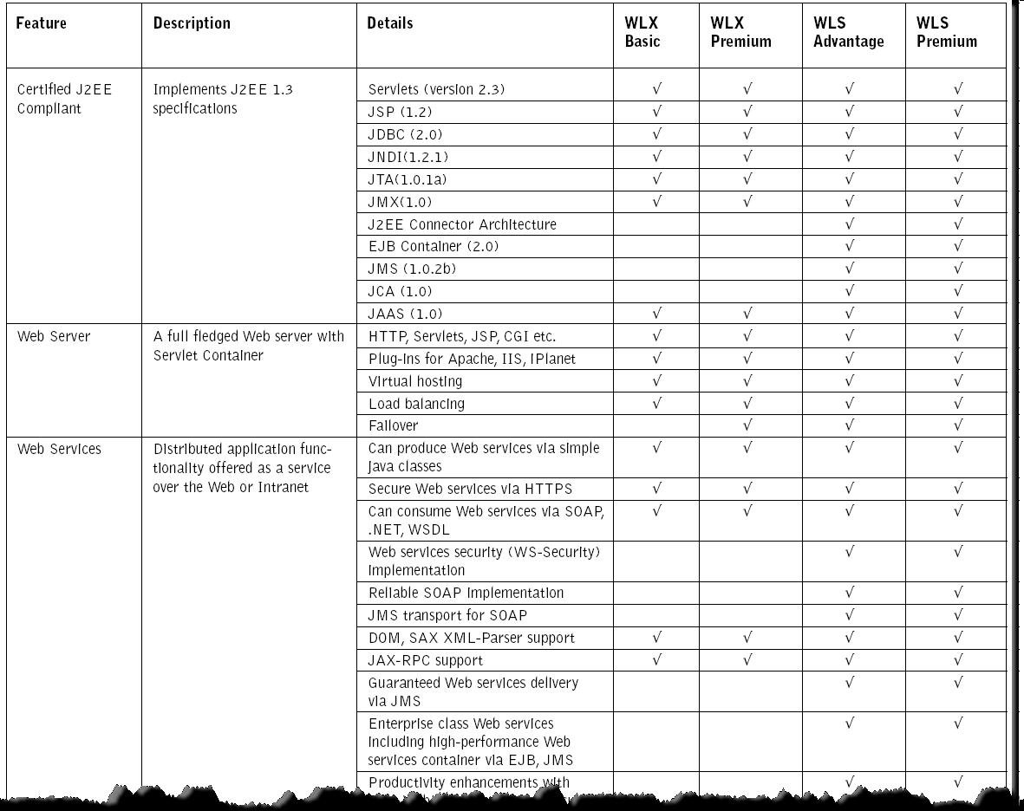
WebLogic packaging forces programming model on customers
Unlike IBM, BEA does not offer consistent programming model between packages and limits design decisions and API usage
More examples of similar limitations at http://dev2dev.bea.com/wlexpress/wlx_matrix81.html
Notes:
More details here: http://dev2dev.bea.com/wlexpress/wlx_matrix81.html

Slide 18
WebLogic Server v9 (WebSphere features in red)
J2EE 1.4 support - WAS had this 9 months earlier
J2SE 1.5 support – supported in WAS 6.1
Disruption-free application upgrades - only subset of WSXD app versioning
Open diagnostic framework, out-of-box visualization and alerts service – WSXD has better tooling
New portal-based administration console – WAS Console is also Portal-like
  Portal becomes common admin console for all WebLogic Platform components – for some reason AquaLogic Service Bus and WebLogic Integration still have separate consoles. IBM’s forthcoming ISC in v7 (Integrated Solutions Console) will be a big step forward to combat this
  Console can be embedded or re-branded for ISV usage – not in WAS
  Configuration-change audits - not in WAS
  Administrator early warning system for deprecated interfaces - not in WAS
Rewritten admin infrastructure – now even more similar to WAS v6
Additional WS-* support
  WS-SecurityPolicy (not in WAS), WS-Addressing (in WAS) , WS-Reliable Messaging (tentatively 2H 2006 for WAS 6.1.x refresh)
Notes:
WLS v9 shipped in August 2005

Slide 19
WebLogic Server v9 (WebSphere features in red)
SDO and XML Data Services (XDS) support (WAS already supports SDO)
  SDO support in WLS is not exposed- this is only for AquaLogic Data Service Platform
XSD-based config repository for offline validation via any XML tool (not in WAS)
XMLBeans 2.0 with XML data binding framework, partial binding to schema elements (not in WAS)
  High-fidelity: maintains whole document fidelity
  Fast-track: supports standard JAX-RPC functionality (loses fidelity, but very high performance)
Messaging
  Store-and-Forward Service for Highly Available Messaging (already in WAS), new admin facilities for JMS such as stop and restart queue and more (some of it is in WAS, but not all), C access to JMS (WAS XMS), message ordering (also in WAS), DOM for XML messages (???)
Other features
  Work context (shared work areas), System-Wide Default Persistent Store (WAS uses Cloudscape, not sure what performance implications are), scripting tool (wsadmin), standardized logging (CBE, but BEA is proprietary), event capture (request metrics), CommonJ Timer and Work Manager (Asynch Beans), asynch flush of HTTPSession state into DB (time based write), self tuning for thread pool (we do a lot more in XD), JSR 77 (yes), JSR 88 (yes), improved EJB caching and pooling (yes), JACC (yes), SSO with SAML (no) and SPNEGO (yes), etc.
Notes:
WLS v9 shipped in August 2005

Slide 20
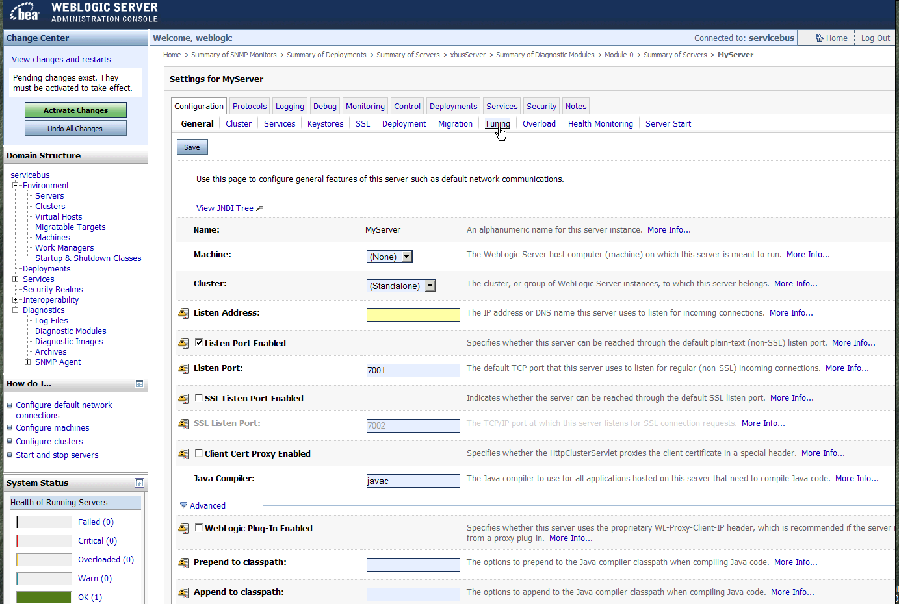
WebLogic Server v9 – Admin GUI

Slide 21
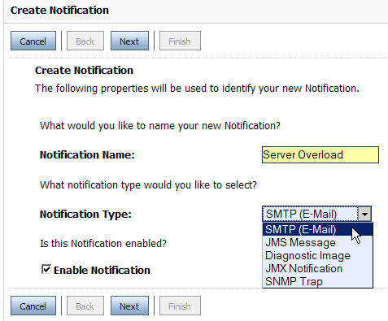
WebLogic Server v9 (WebSphere features in red)
Jython based WebLogic Scripting Tool (supported in WAS)
  WLS generates Jython WLST scripts as user makes changes in Admin GUI (yes)
  Eclipse plug-in for building Jython WLST scripts (yes)
  Export full server configuration as WLST script to recreate it on another server (???)
Administrative notifications can be sent from WLS
via SNMP, SMTP, JMX, JMS, diagnostic image
(this can be done with custom JMX coding in WAS)
Admin Console allows one administrator lock and edit
configuration to prevent conflicts (not in WAS)
  Audit log has information on who edited what and when
Mgmt server keeps track of config changes and can roll back (WSXD has this and more). Versions of EAR files are not kept and not rolled back
WebLogic Server Console allows management of Tomcat (not in WAS)
  BEA also sells support for Apache Tomcat (IBM sells Tomcat support with WAS CE)

Slide 22
Dynamic non-disruptive application deployment
WebLogic supports non-disruptive application deployments
  Revised version of a production application can be deployed alongside the older version of the application without affecting existing clients to the application, and without interrupting the availability of the application to new client requests
  Group rollout and validation mode are supported, but only for the pair of old and new version and for limited time
WSXD provides more features that are not in WLS v9
  Many versions of the same application can run concurrently forever and routing is defined by rules setup by administrator (based on cookies, user ID, client IP, etc.)
  WebLogic only supports two versions. Once the rollout is complete (after the last HTTPSession in the old application expires) the old version is automatically removed and there is no going back to it, like we can do it in WSXD
  WLS does not support Atomic rollout, has no routing rules, can’t roll back to old version after the deployment and switch-over are complete
WebSphere Application Server ND v6 does not support this out of the box
  But patterns and best practices exist that allow to accomplish this task
Notes:
WAS ND v6 today can do this today (it is not exactly the same as BEA WLS v9 does it)
While it is true we do not support exact same feature out of the box, there are several patterns that show how to implement this. With proper preparation and administrative scripts in place (only has to be done once in a lifetime) we can make this almost as easy with WAS ND v6 as it is in WLS v9. Here is an example of how we can make this work: "IBM WebSphere Developer Technical Journal: Maintain continuous availability while updating WebSphere Application Server enterprise applications" http://www-128.ibm.com/developerworks/websphere/techjournal/0412_vansickel/0412_vansickel.html
WAS v7 will have some of this functionality moved down from WS XD.

Slide 23
Web Services Reliable Messaging
BEA supports WSRM in WLS v9
  WS-RM is built on top of WebLogic JMS Store And Forward, with some limitations
    Can’t interoperate with prior releases of WebLogic Server
    Only WLS server can utilize WSRM (because SAF has no client-side store-and-forward)
    BEA seems to be back level on WS-I.org profiles and this limits interoperability options
IBM WAS v6 does not yet support WSRM
  For reliable delivery of messages today we offer several options
    WSMQ
    WAS JMS
    SOAP-JMS binding
  WS-RM is expected later in 2006 with WAS v6.1.x refresh
There is no WS-RM interoperability profile yet, so making this work could be challenging
  IBM is developing Reliable Asynchronous Message Profile
Notes:
BEA
JWS is now deprecated. Metadata in WLS v9 is JSR 175 based – no upgrade tool for migration
WS-Policy is supported with 3 files out of the box (x.509, SAML, ?)
Tags are provided for policy (@policy)
WS-Addressing is supported via annotations in source code
WS-RM is supported and is using SAF – thus all of the limitations of SAF are true for WS-RM (see other page on this – only WLS v9 to v9 JMS)

Slide 24

IBM Offers Broader & More Current Linux Support
 |  | WAS | WLS |  | WPS | WLI |  | WSESB | ALSB
xSeries | Red Hat Enterprise Linux 3
 | Red Hat Enterprise Linux 4
 | Red Hat 3, 4 (64 bit)
 | RedFlag AS 4.1
 | SuSe Linux Enterprise Server 8, 9
 | SuSe LES 9 (64 bit)
pSeries | Red Hat Enterprise Linux 3, 4
 | SuSe Linux Enterprise Server 8, 9
 | SuSe LES 9 (64 bit)
 | Red Hat 3, 4 (64 bit)
zSeries | Red Hat Enterprise Linux 3
 | Red Hat Enterprise Linux 4
 | SuSE Linux Enterprise Server 8
 | SuSE Linux Enterprise Server 9
- supported with significant delay
Notes:
All Linux distributions powered by UnitedLinux 1.0 for xSeries, zSeries, pSeries and iSeries are supported by WAS & WBISF
See complete listing of IBM products that support Linux here (VERY COOL list): http://lic.austin.ibm.com/Whitepapers/linuxmatrix.html
Complete list of platforms supported can be found here:
WSMQ: http://www-306.ibm.com/software/integration/websphere/mqplatforms/
WAS: http://www-306.ibm.com/software/webservers/appserv/doc/v50/prereqs/was_v51.htm
WBISF: http://www-306.ibm.com/software/integration/wbisf/requirements/

Slide 25
Platforms Support – Important Factor for ESB & J2EE server
 |  | WAS* | WLS |  | WPS* | WLI |  | WSESB* | ALSB
Unix | AIX (32 and 64 bit)
 | HPUX RISC (32 bit)
 | HPUX RISC (64 bit)
 | HP-UX on Itanium
 | Solaris (SPARC)
Microsoft | Win XP/2000/2003
 | Windows 2003 (64 bit)
Other | z/OS
 | OS/400
* - 64 bit is tolerated, but not exploited on all platforms
- supported with significant delay

Slide 26
Database support and certifications
 | WAS | WLS |  | WPS | WLI |  | WSESB | ALSB
Oracle 9i
Oracle 10g
Microsoft SQL 2000
Sybase 12
IBM DB2 UDB EE 8.x
IBM DB2 UDB WE 8.x
IBM WS II Advanced 8.1
IBM Informix DS 9.4
IBM IMS on z/OS
IBM Cloudscape 5.1
Derby10.x
IBM DB2 Connect 8.x
PointBase 5.1
MySQL 4

Slide 27
Dynamic Caches on WebSphere
Application Server
Edge Server
X
Distributed Map
Application Server
X
X
Static HTML cache
X
HTTP Server
Distributed Map
Akamai ESI support
X
Static HTML cache
X
X
X
Dynamic Page Fragment Cache
Dynamic Page Fragment Cache
X
X
X
X
Akamai Edge Suite
Dynamic Page Fragment Cache*
X
X
Web services cache
X
Web services cache
X
X
BEA has no support for such capability
BEA has limited support
Notes:
this chart has no animation

Slide 28
Summary: IBM vs. BEA
Overall WAS ND and WLS Premium are similarly robust and mature products
  This can’t be said about any other J2EE competitors
IBM WAS supports more latest standards quicker compared to BEA
IBM has the most flexible packaging for app server
  From free WAS CE to high end WSXD
WAS supports more OSs and DBMSs than any other server on the market
IBM Rational Application Developer is more mature and capable Eclipse based development tool compared to BEA WebLogic Workshop (non-Eclipse)
IBM and BEA leapfrog each other in SPECjAppServer2004 performance
IBM leads in autonomic computing and administrative capabilities
IBM leads in high end OLTP and caching capabilities
IBM bundles more software with WAS ND than BEA does with WLS Premium
WAS ND is $12K/CPU while BEA WLS Premium is $17K/CPU
IBM support price is based on discounted value, while BEA’s on list prices
IBM has more complete middleware platform than BEA does
Number of customers are migrating from WebLogic to WebSphere
  IBM migration services team is overbooked for the past 18 months
  Number of customers have migrated from WLS to WAS

Slide 29
JBoss
Complete document can be found here:
http://w3-104.ibm.com/wwreuse_b1.nsf/65b2d99810a29a8985256c93007b8a39/b7cafa35afafe56385256fa40076f041?OpenDocument

Slide 30
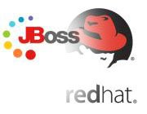
Red Hat Acquisition of JBoss
Why did Red Hat acquire JBoss?
  The only growth path Red Hat has is up the stack
  Availability (JBoss was for sale)
  Fit (both are Open Source companies)
Obstacles
  Red Hat has poor track record at moving beyond the operating system and up selling Java
  Lack of deep sales and marketing support
  Possible talent retention issues
  Increased channel conflict and competition
  Heighten Profit Concerns
Notes:
Why did Red Hat need to buy JBoss?
The only growth path Red Hat has is up the stack: Over the past 2 years, Red Hat has made several, albeit nominal, attempts to move up the stack and grow beyond operating systems with products such as content management, Portals, and application servers. These attempts have not proven to be as successful as Red Hat would have liked. The acquisition of JBoss is a major attempt by Red Hat to position themselves as more than an operating system company. JBoss has been attempting to build an open source middleware infrastructure JEMS (JBoss Enterprise Middleware Software). JBoss would like to position JEMS as an SOA platform, a point covered in the JBoss & Red Hat announcement. However, this should be viewed as JBoss overselling its capabilities and Red Hat attempting to align with an industry movement that isn't just about operating systems.
JBoss was available: After the rumored deal with Oracle didn't close, (and the exclusivity term expired), JBoss went shopping again. We believe Red Hat paid too much (reportedly $100m more up-front than Oracle), and while this is great news for JBoss employees and investors, Red Hat has invested such a large amount that they'll struggle to recoup their investment. JBoss cashed in: We believe JBoss rushed to accept the acquisition offer from Red Hat in an effort to cash out their market position before IBM WebSphere and the Apache Geronimo community marginalized
Red Hat – The low-cost on-ramp to SOA
The adoption cycle for new technologies is littered with early adopters, who spent millions of dollars subsidizing "new" platform software that never lived-up to the hype. JBoss was starting to change that model by providing standards-based middleware solutions at a low cost, to enable mainstream customers to develop and deploy next-generation, service-enabled applications much sooner than previously expected. According to Gartner, Inc., the Application Integration and Middleware and Portal (AIM) markets for license revenue is preliminarily estimated to more than $6.5 billion in 2006. Paired with Red Hat's proven portfolio of enterprise solutions, Red Hat believes the combination, once consummated, will help accelerate the shift to SOA by making innovative, powerful solutions available to developers and customers that seek to lower development and deployment costs.
Red Hat – claim a nice open source culture fit, helps retain skills etcThe Common Bond of Open Source
With each committed to advancing open source software and its collaborative development model, Red Hat and JBoss see themselves as the open source leaders. The large and vibrant communities around Linux and JBoss prove that the open source development model creates innovative, quality software, while providing a flexible and low cost model for customers. This acquisition is may accelerate enterprise adoption of open source infrastructure, and broaden the entire market opportunity for existing and new Red Hat and JBoss partners who are building value-added enterprise solutions.
A complete fit - business model, channels, service delivery, and culture
JBoss has modeled it's business after Red Hat's subscription model - services and support, delivered through an online network. Red Hat provides some channels and global service delivery capability begin to get some enterprise acceptance. JBoss adds middleware technology, solid community, and a strong developer brand to Red Hat - a tight fit of business model and service delivery model. JBoss management claims to have selected Red Hat because it aligns to the vision of JBoss - delivering customer value by simplifying development, reducing cost barriers for adoption, and making it safer for use in mission-critical deployments by providing expert support services and advanced management tools.
"The union of these two companies will demonstrate the benefits of a pure open source play," said Marc Fleury, CEO of JBoss. "Our customers are increasingly standardizing their infrastructures on open source technologies and want a stable and trusted global open source vendor to support them. By joining forces with Red Hat, we expect to be able to provide enterprises the largest offering of open source solutions, a global services network staffed by technology experts, and a large and vibrant eco-system of certified products and services. This is a winning combination that we believe will further expedite the proliferation of open source in the enterprise, which has been our mission since day one."

Slide 31
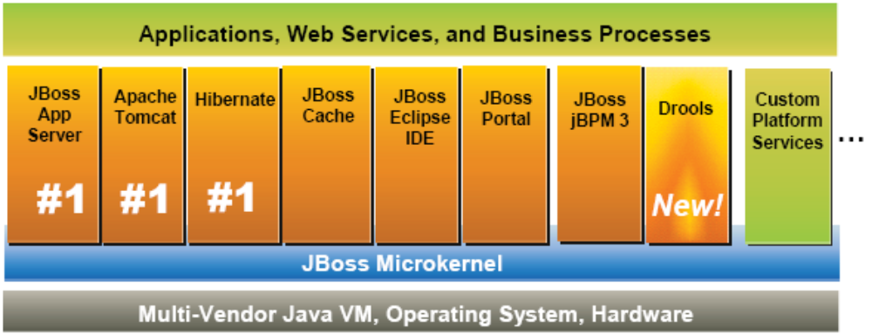
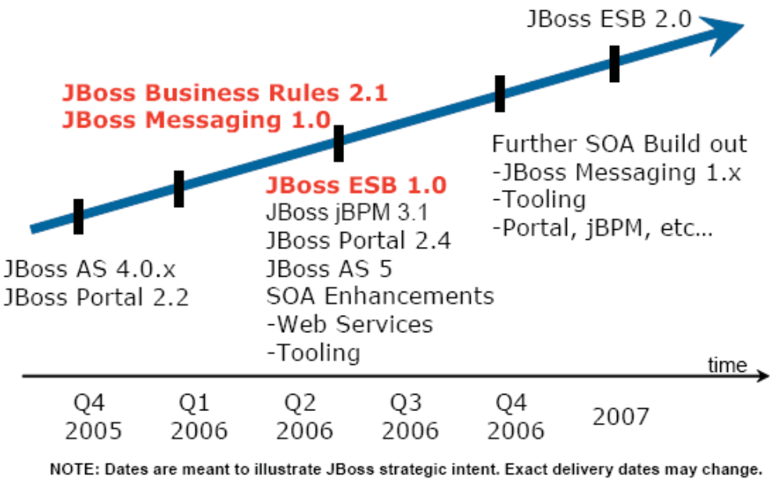
JEMS – Open Source Platform for SOA
JBoss Application Server
Apache Tomcat
JBoss Portal
JBoss Eclipse IDE
Hibernate
  ORM tool
jBPM
  Service Choreography
JBoss Transactions
  formerly Arjuna
JBoss Cache
JBoss Rules
  future - business rules
JBoss ESB
  future - JSR-208 implementation
JBoss Messaging
  future - will replace JBossMQ
Notes:
Quote from JBoss website: “All of these projects have one important thing in common. They are all apart of the JBoss Enterprise Middleware System. This means that all projects can operate stand-alone, within other J2EE platforms, or tightly integrated together in a comprehensive JBoss Enterprise Middleware System. It also means that they are all available with business-friendly open source licenses. And, perhaps most importantly, they are all supported by JBoss”
JBoss Application Server
Apache Tomcat
JBoss Portal
JBoss Eclipse IDE
Hibernate (ORM tool)
jBPM (Service Choreography)
JBoss Transactions (formerly Arjuna)
JBoss Rules (business rules - future)
JBoss ESB (pre-announced - future)
JBoss Cache

Slide 32
How Open Source Maps to BI Reference Architecture?
Development Services
Business Innovation & Optimization Services
IT Service
Management
SlickEdit
Web Tools
Eclipse
Interaction Services
Process Services
Information Services
MyEclipse
Altova
JOSSO
BPWS4J
Apache Pluto
OpenWFE
Apache Tuscany
small projects only
RedHat Portal
WebMesh
JBoss jBPM
Apache Jetspeed
Tiles
small projects only
Active BPEL
BPWS4J
Wiki
JBoss Portal
MX4J
LifeRay
Agila
ActiveMQ
ServiceMix
ESB
Instantiations
Apache Agila
ObjectWeb ESB
Mule
JBoss ESB (coming)
XDoclet
eXo
IONA Celtix
OpenESB
Partner Services
Business App Services
Access Services
Orbeon
AspectJ
Spring
MantaRay
Presumo
Sun NetBeans
JBoss
Lucene
Resin
Librados
SourceForge.net
MC4J
Torque
Struts
JBoss plugin
Brunswick BIE
Tomcat
xmlhack
JOnAS
OpenSSL
Beehive
Slide
inttek
OpenCMS
FreeHost3270
XMOJO
h3270
HSQL
EDI4J
Hibernate
MySQL
James
OpenLDAP
Infrastructure Services
Linux
Qlusters
SendMail
OS2cache
Derby
OpenSAML
OpenJMS
Linux
Solaris
These are just few examples. Many more Open Source projects exist in each area

Slide 33
Competing styles of development (outside of Microsoft)
LAMP
  Linux, Apache, MySQL, PHP, Perl, and Python - collectively known as LAMP. Some sources suggest these comprise more than two-thirds of the servers, databases, and scripting languages on the web today. LAMP systems are known to be very simple and easy to deal with, but they lack enterprise qualities of services
POJO
  Plain Old Java Object – POJO is development approach that is “pure” OO and strives for simplicity in design and lightweight development environment and runtime, albeit at the cost of non-standard APIs and smaller set of features compared to full J2EE
J2EE
  Full blown J2EE programming model that requires application server runtime. Some claim that this comes at too much of a price in terms of complexity of infrastructure, cost of software licenses and overly complex J2EE programming model
Notes:
LAMP
Linux, Apache, MySQL, PHP, Perl, and Python - collectively known as LAMP. Some sources suggest these comprise more than two-thirds of the servers, databases, and scripting languages on the web today. These do not have to be used all together. LAMP systems are known to be very simple and easy to deal with, but they lack enterprise qualities of services
LAMP developer uses scripting languages (Perl or PHP) and does not care about the Object Orientation (OO) and J2EE. Systems built with LAMP are usually “one off” or “ad-hoc” simple projects, but some complex systems exist. Seasoned enterprise developers usually do not like LAMP for the P part of it and lack of OO
POJO
Plain Old Java Object – POJO is development approach that is “pure” OO and strives for simplicity in design and lightweight development environment and runtime. Proponents of it claim speed and simplicity of development to be the main argument to POJO. Very popular Open Source frameworks, such as Spring run on top of any J2EE runtime and provide simple programming model, albeit at the cost of non-standard APIs and smaller set of features compared to full J2EE
J2EE
This is what typical WebSphere Application Server customers are using. Java as programming language, EJB, Servlets/JSPs, JDBC, full blown application server with transactions, WLM and other high quality of services
Some claim that this comes at too much of a price in terms of complexity of infrastructure, cost of software licenses and over-complex J2EE programming model

Slide 34
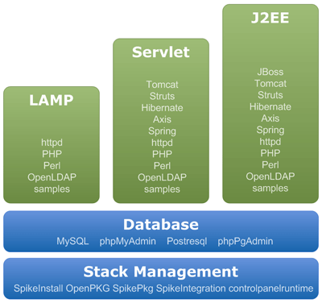
An example: The SpikeSource Core Stack
  POJO
  LAMP = Linux + Apache + MySql + PHP or Perl
SourceLabs offers similar stacks and services
RedHat announced similar offerings
ISVs and Customers are looking for partners and solution providers who can deliver Open Source Stack
  not just single Open Source product
Notes:
RED HAT ENTERS OPEN SOURCE STACK MARKET. Red Hat announces its plans to release three certified open source software stacks for Red Hat Enterprise Linux customers. These stacks will be certified and supported by Red Hat beginning in the first quarter of 2006.
http://www.eosj.com/ccount/click.php?id=1326

Slide 35

Choices, choices…
WSXD
WAS ND
WAS
WAS Express
WAS CE
Apache Geronimo
JBoss
LAMP stack

Slide 36
Approximate answers
Complexity and size of the project
 | Small | Medium | Large
LAMP
POJO
J2EE
LAMP
JBoss
Tomcat,
Jetty
Geronimo,
WAS CE
Programming style preference
WAS ND
WSXD
Notes:
Need to talk about the skills, hardware cost, server consolidation, cost of licenses, number of total CPUs to be deployed, ISVs, etc.

Slide 37
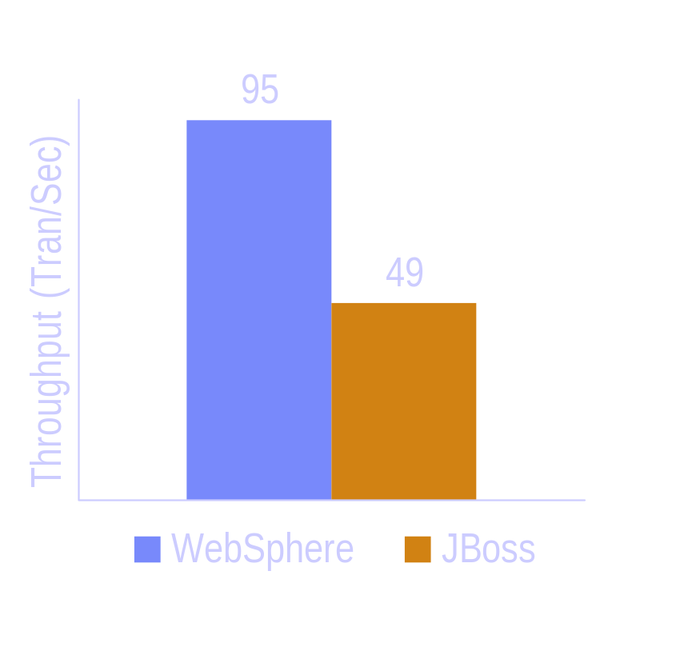
Example of how WebSphere can reduce TCO: Better Performance and Lower Hardware Costs
Hardware
  IBM x360 Server 8x 900Mhz Intel + 8GB Memory (application server plus web server)
  IBM x370 Server 8X 900Mhz Intel + 8GB Memory (database machine, on a raid 0)
  1GB dedicated network
Software
  JBOSS 4.0.3 SP1, Windows 2003, Tomcat 5.0, JDK ?
  WebSphere v6.0.2.3
  DB2 UDB EE 8.1 on Windows 2000
Transaction = completing all the steps of the SilkPerformer script
  Friendly bank benchmark: Login, Check Accounts, Withdraw, Deposit, Logout
Extra hardware costs with JBoss
Split tier configuration
Source: IBM Competitive Technology Lab, April 2006
Notes:
Original report can be found here: http://w3-03.ibm.com/sales/competition/compdlib.nsf/41b3dc2211cc2f6ac12566a200259ba4/ed196d859f4d957487256faa0070b30a?OpenDocument

Slide 38
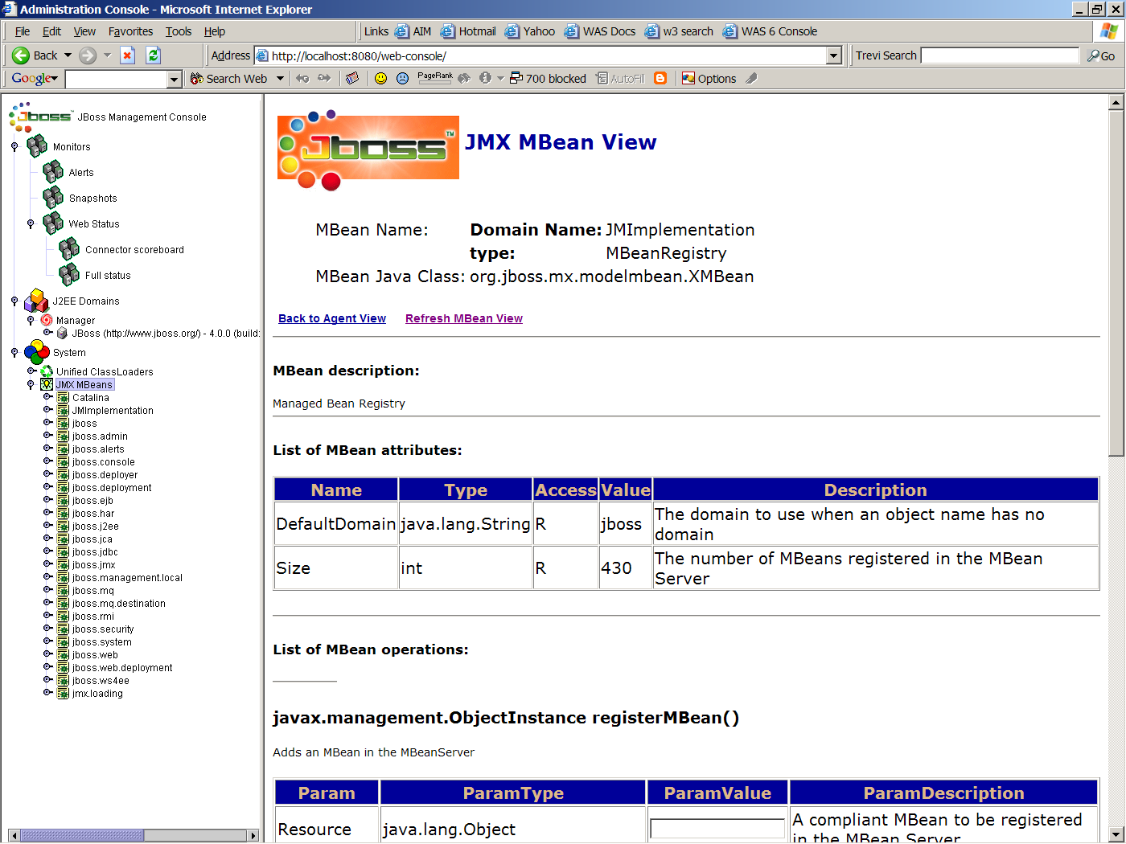
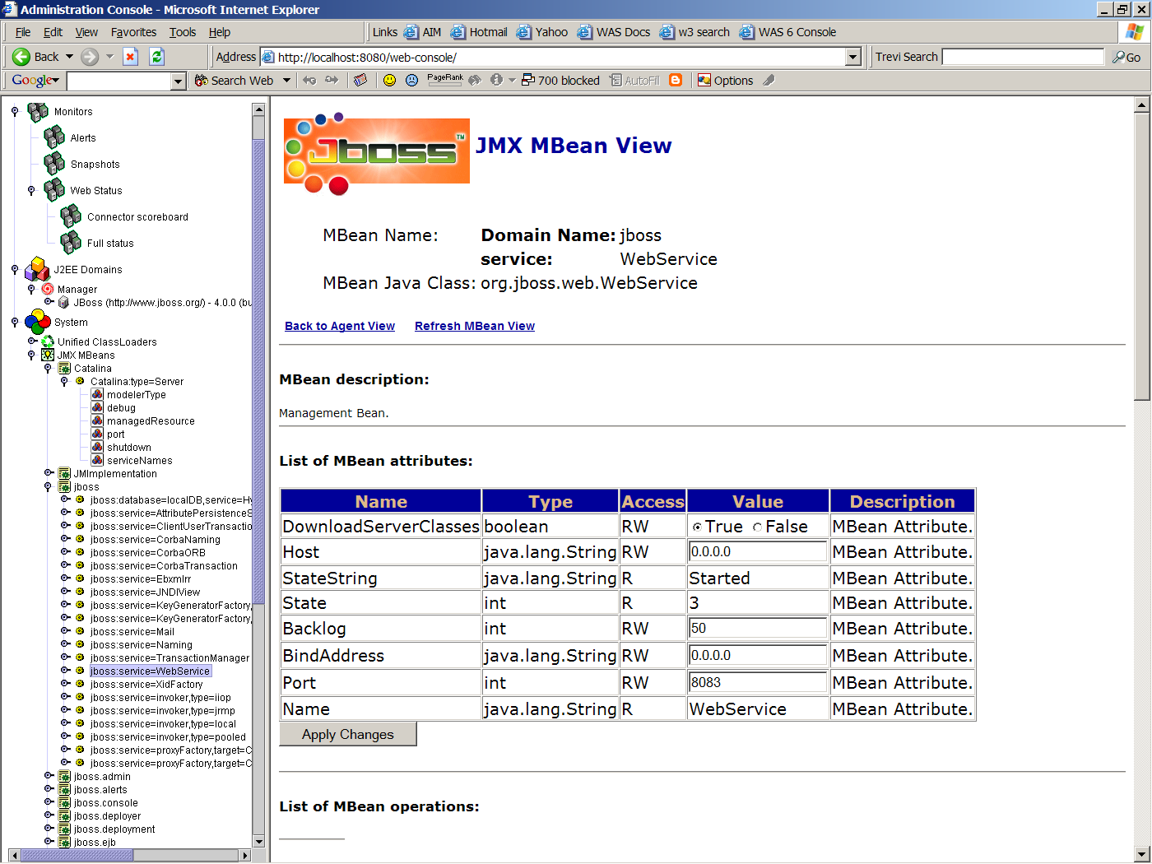
Open Source
JBoss Admin Console (available with free product download) is poorly documented, is hard to understand and may lead to administrative errors and thus potential downtime. This may dramatically increase TCO

Slide 39
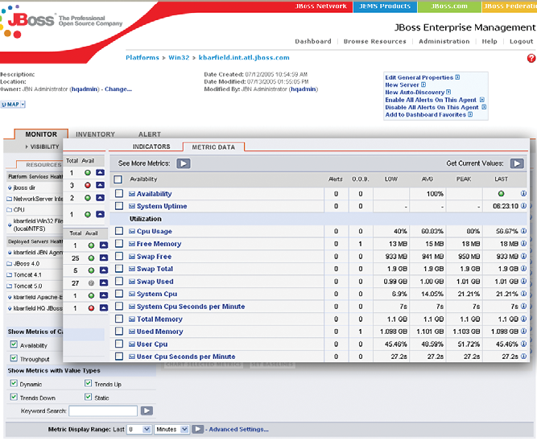
JBoss Enterprise Manager
Proprietary JBoss code.
Not Open Source
Inventory
  Allows you to catalog IT assets spanning OS platforms, servers (Apache Web Server, Apache Tomcat, JBoss AS), and services (EJB, Message Driven Beans, data sources). Assets can be added manually or auto-discovered
Administration
  Provides a single location for performing key control functions such as start, stop, and re-start across the entire JEMS platform. Operations can also be scheduled for later dates on-demand or on a recurring basis
Updates (plan for Q1’06)
  In many respects, this module will be similar to a Windows Update service for JEMS software. Updates can be reviewed, rejected, or applied
Provisioning (plan for Q1’06)
  Provides you the ability to create and replicate environments. It will also allow you to easily compare and synchronize environments and provide you the ability to roll-back to previous states
Monitoring (see next page)
JBoss Enterprise Manager is only available for paid JBoss Subscription service customers and has limited capabilities (available since mid-2005).
Notes:
Inventory Module
The inventory module allows you to catalog IT assets spanning platforms (Linux, HP/UX, Solaris, Windows, AIX), servers (Apache Web Server, Apache Tomcat, JBoss AS), and services (EJB, Message Driven Beans, data sources). Assets can be added manually or auto-discovered providing enhanced visibility over your critical business applications including their versions and dependencies.
Administration Module
The Administration Module provides a single location for performing key control functions such as start, stop, and re-start across the entire JEMS platform. Administration functions can be applied to a single application or across an enterprise cluster. Operations can also be scheduled for later dates on-demand or on a recurring basis. This module also allows you to roll-back to previous versions if necessary.
Monitoring Module (optional)
The Monitoring Module is an optional component of the JBoss Network Enterprise Manager. Once purchased, all monitoring capabilities are fully integrated and accessible from the JBoss Network Enterprise Manager console.
Update Module (Beta Q4 2005, Release Q1 2006)
Because updates and upgrades are always a difficult challenge to manage for enterprise software deployments, JBoss is building out a Patch and Software distribution management system that will be available through the JBoss Network Enterprise Manager. In many respects, this module will be similar to a Windows Update service for JEMS software. Updates can be reviewed, rejected, or applied. They can be applied to individual environments in a controlled fashion allowing you to move applications from development to QA and test to production. Software updates are a schedulable task and can be done in a rolling fashion or all at once.
Provisioning Module (Q1 2006)
The Provisioning Module will help you to configure new environments and recreate existing environments quickly. The latter is especially useful for cases when you need to mirror your production environment in QA, a common requirement for many IT shops. This requirement is usually a challenge as is keeping environments synchronized. The Provisioning Module will provide you the ability to create and replicate environments. It will also allow you to easily compare and synchronize environments and provide you the ability to roll-back to previous states. An audit trail will also be provided, along with integrations into popular ticketing systems.

Slide 40
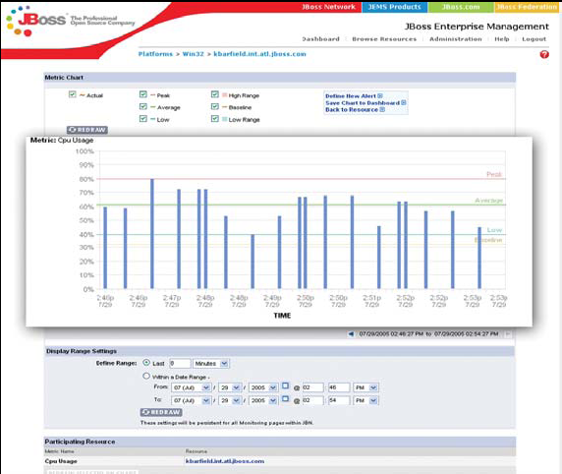
JBoss Network Monitoring
Proprietary JBoss code.
Not Open Source
Pre-selected, configurable, and custom statistics
SMTP/e-mail alerts
Initiate control actions on alerts
Dampering (cap alert maximum)
Baseline measurements and problem detection
Graphing and charting
Trend analysis
Full alert audit trail
Agents for JEMS products
Agents for all major OSs
Agents for Apache Web Server
Agents for Apache Tomcat
Port monitoring
File system and directory monitoring
Nagios/scripting plug-in
Plug-in developer’s kit
JBoss Network Monitoring is optional add-on for paid JBoss Subscription service. The price of this option is not known. Has limited capabilities (only available since mid-2005)

Slide 41
Examples of competitive wins and migrations from JBoss to WebSphere Application Server (2005)
One of the largest hotel chains in the world
  Replaced all JBoss use with WAS. JBoss JMS did not work. TCO was lower with WAS compared to JBoss + WSMQ. Porting was easy
Mobile phone service chain in UK
  Decided to replace JBoss for their existing J2EE based applications running on JBOSS/Tomcat for Warranty Registration, Phone Activation, Locate Nearest Repair Center
  Liked IBM development tools, WAS availability and performance, cost
Speech recognition solutions (ISV)
  Migrated from JBoss to WAS because needed WebSphere Voice Server and wanted to leverage IBM product stack
Market leader in Web-based corporate cash management (ISV)
  Attempted port to JBoss from WAS, but decided to stay with WAS strategically due to lack of JBoss security features, issues with SSO support, etc.

Slide 42
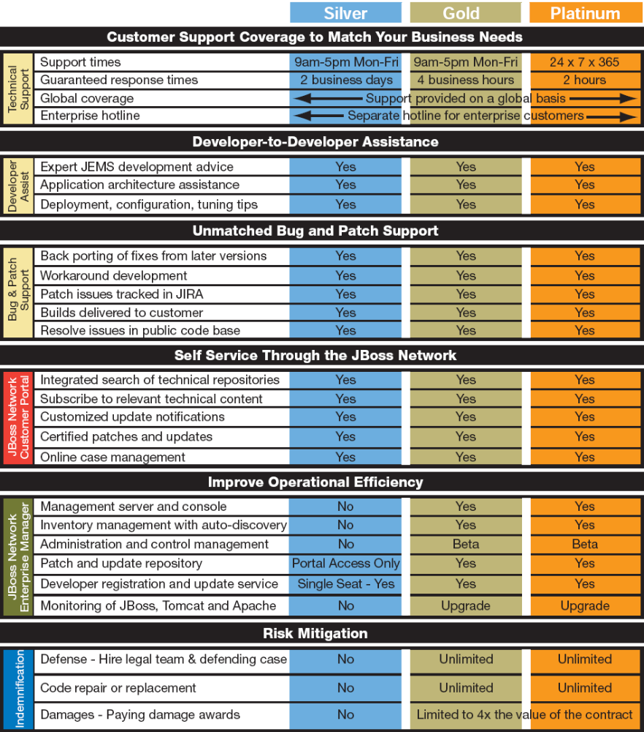
JBoss Subscription support offerings
Support is flat fee per year as shown below:
1 to 32 CPUs
  Silver: $10,000
  Gold: $15,000
  Platinum: $20,00
33 to 64 CPUs
  Silver: $20,000
  Gold: $30,000
  Platinum: $40,000
Over 65 CPUs
  Custom pricing
Separate subscriptions may be required for different JEMS products
Single JEMS subscription is also available (cost is not known)
Notes:
Source: http://www.jboss.com/services/profsupportdetails

Slide 43
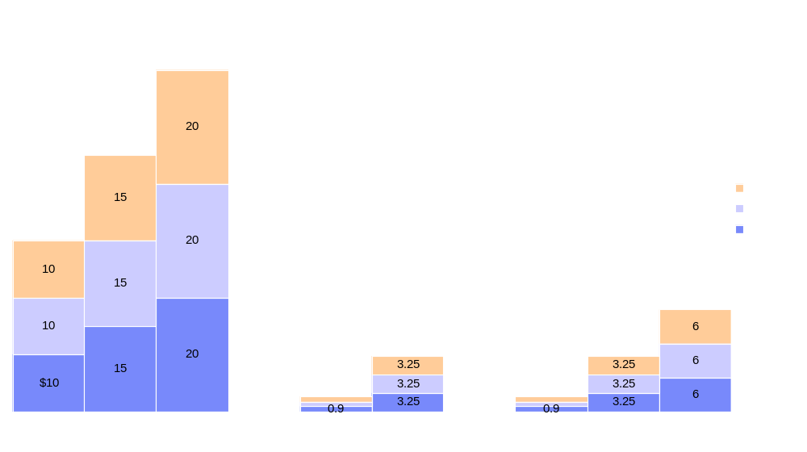
Single server TCO for 3 years: JBoss vs. IBM support *
$60K
$45K
Software license is free for all compared products
$30K
$18K
$9.75K
$9.75K
$2.7K
$2.7K
JBoss
IBM Support for Apache Geronimo
IBM Support for WebSphere Application Server Community Edition
* - This TCO is based on a single 4 CPU server scenario
Notes:
Estimated JBoss Pricing:
1 to 32 CPUs
Silver: $10,000
Gold: $15,000
Platinum: $20,00
33 to 64 CPUs
Silver: $20,000
Gold: $30,000
Platinum: $40,000
IBM Support offerings priced per Server (up to 4 CPUs per server):
Entry: $900
Enhanced: $3,250
Elite: $6,000

Slide 44
Summary: IBM vs. JBoss
WAS ND 6.0 is by far more robust and mature product than JBoss
IBM WAS supports more latest standards quicker compared to JBoss
  WS*, J2EE, grid, OASIS, etc.
WAS supports more OSs and DBMSs than any other server on the market
  JBoss does not even have an official list of supported platforms
IBM Rational Application Developer is much more robust than JBoss Eclipse plug-in
While IBM leads SPECjAppServer2004, JBoss is fishily quiet
  What you save on license cost you may spend on hardware and administration
JBoss administrative capabilities are rudimentary
  JBoss Admin and Monitoring are 9 months old, are not open source and only available top paid customers
IBM leads in security and autonomic computing capabilities
IBM leads in high end OLTP and caching capabilities
Only Hibernate and JBoss are credible parts of JEMS, all other elements are years behind the industry
Industry needs TCO studies on using JBoss vs. commercial products
  Both have their niches, but often JBoss claims are greatly exaggerated

Slide 45
Oracle
Complete document can be found here:
http://w3-104.ibm.com/wwreuse_b1.nsf/65b2d99810a29a8985256c93007b8a39/1da7008923f44ee185257101005343fc?OpenDocument

Slide 46
Oracle Application Server – a History of Fumbling
1998 – Oracle ships 3 different application server runtimes
  (1) Oracle Application server (OAS) product
  (2) Oracle Developer Server (runtime for Oracle Developer Apps)
  (3) Oracle WebDB
1999 – Oracle ships yet another Java application server runtime
  (4) Oracle 8i JServer is embedded into the Oracle 8i database
  all of the above are separate code base and separate labs
May 2001 – Oracle kills old and ships new application server
  Oracle abandons all previous attempts (and code bases) and licenses Orion Application Server from IronFlare company (Sweden). Oracle packages MANY separate products into single “product” called (5) Oracle 9iAS (Application Server), which includes OC4J (Orion based)
Notes:
IronFlare (small company in Sweden – formerly Evermind)
“Oracle Containers for Java” (OC4J)

Slide 47
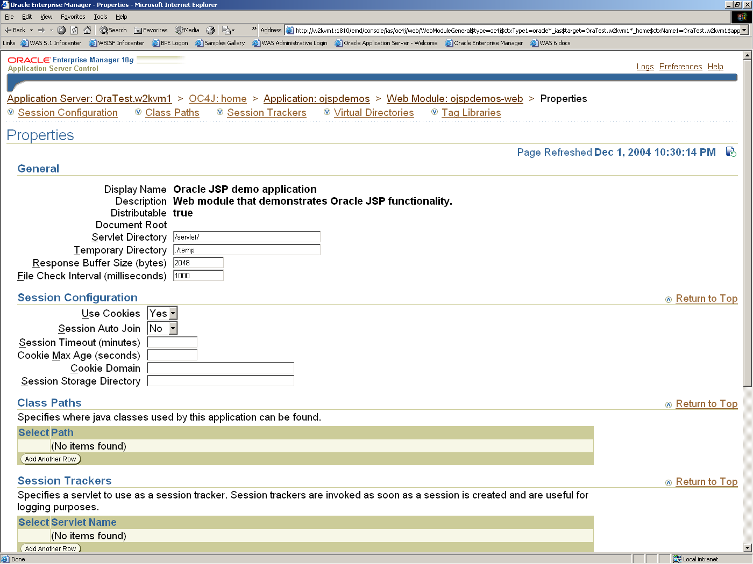
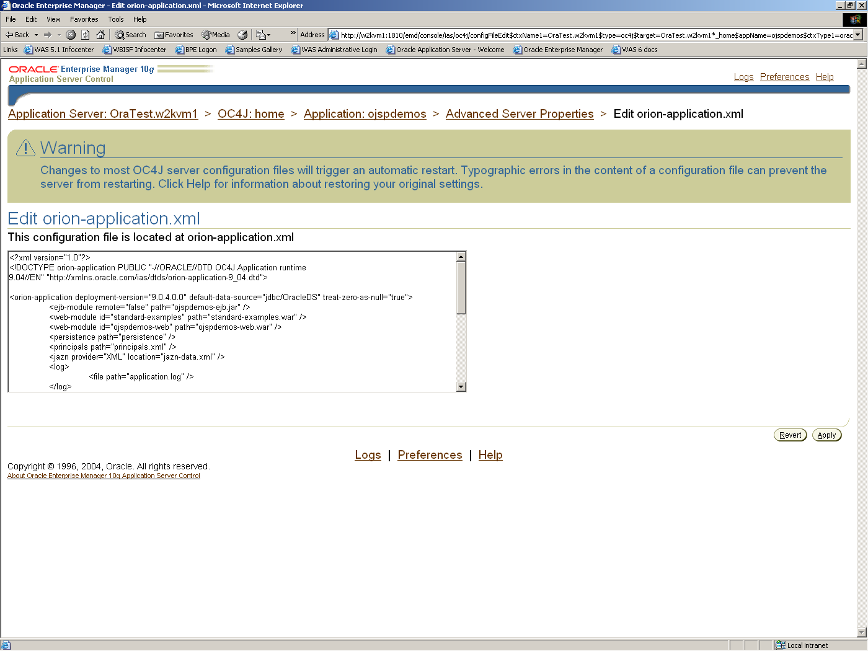
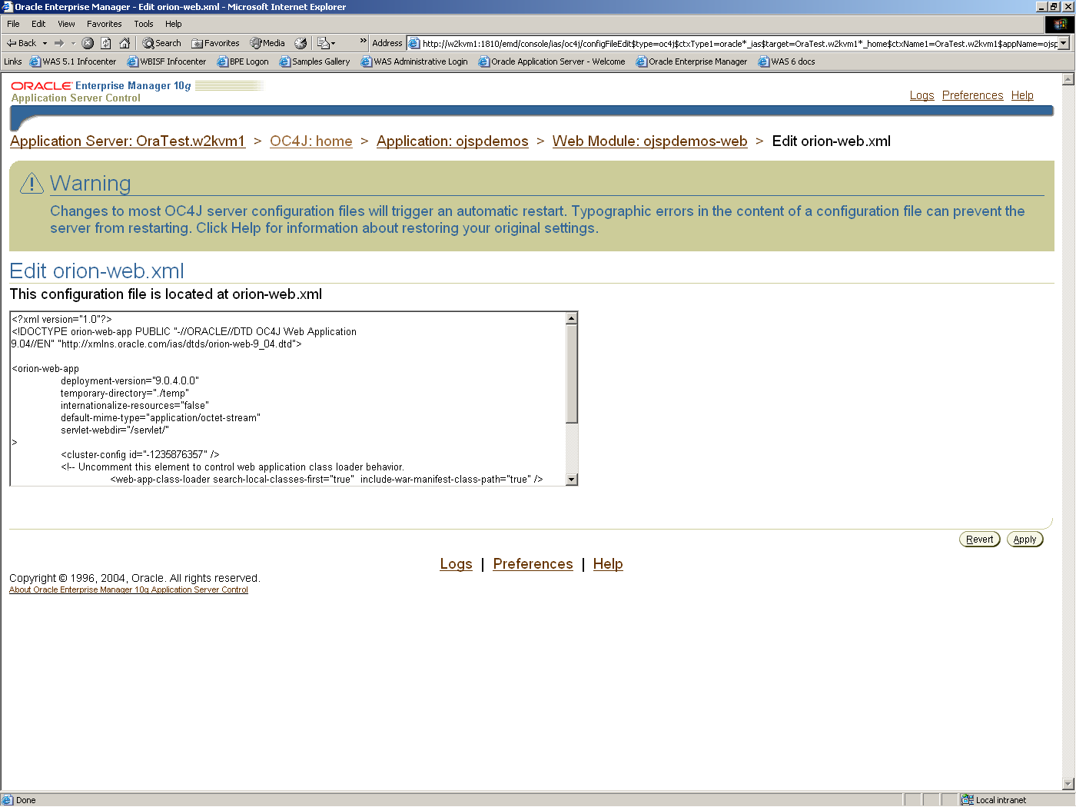
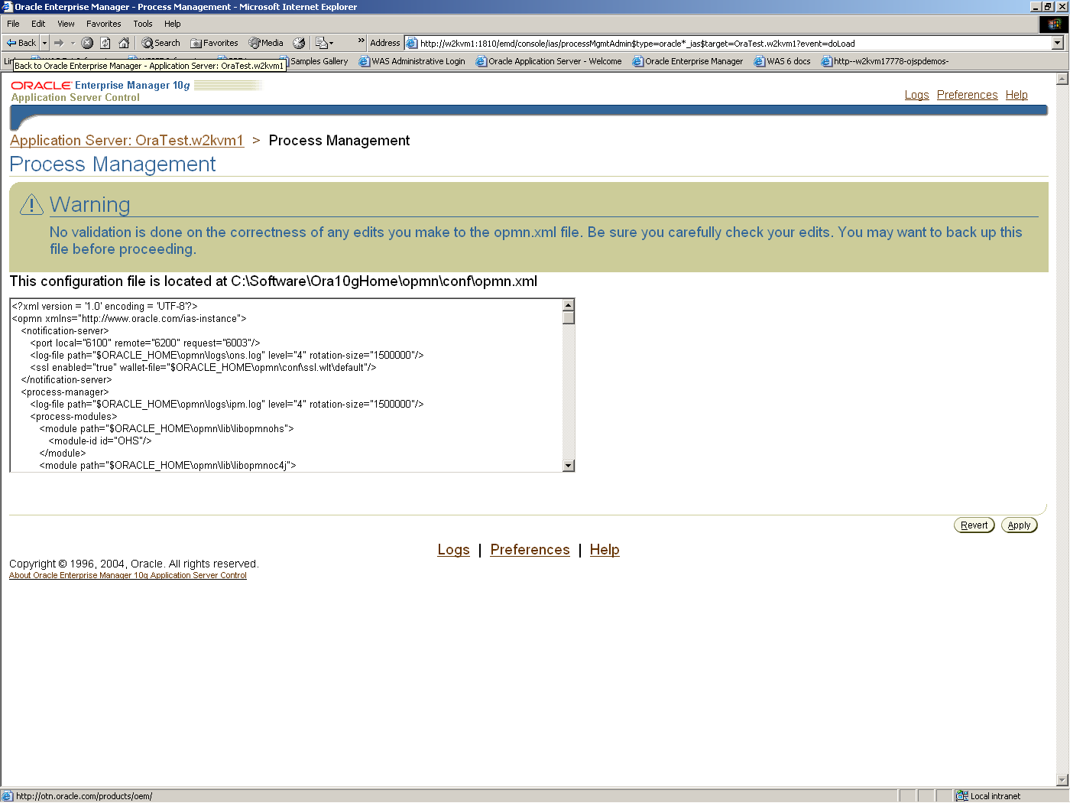
Administration
Oracle Application Server 10g is done via Oracle 10g Enterprise Manager
  Immature
  Extremely limited capabilities
  See for yourself…
Oracle 10g Application Server Admin Console is poorly designed, is hard to understand and may lead to administrative errors and thus potential downtime. This may dramatically increase TCO

Slide 48
WAS vs. OC4J HTTP session failover
Note: HTTP Session Failover Enabled
 | WAS ND 6 | OC4J 10.1.2
App Server 2 Network Failure | PASS | FAIL | WebSphere: System behaved as expected OC4J: Same as 1.1. In addition, the user was occasionally presented with Error 500 – Internal Server Error when finally being re-routed to available cluster member. This was corrected by simply refreshing the user’s browser. This occurred in half of all test runs and is likely attributed to mod_oc4j plug-in. Average re-route time: 8 minutes
App Server 2 System Failure | PASS | PASS | WebSphere: System behaved as expected OC4J: System behaved as expected
App Server 1 Network Failure | PASS | FAIL | WebSphere: System behaved as expected OC4J: Same as 2.1. Average re-route time: 13 minutes
App Server 1 System Failure | PASS | PASS | WebSphere: System behaved as expected OC4J: System behaved as expected
Source: “Oracle Application Server 10g R2 (10.1.2.0.2) Failover Test Results”, December 2005, Justin Tyberg, SWG CPO

Slide 49
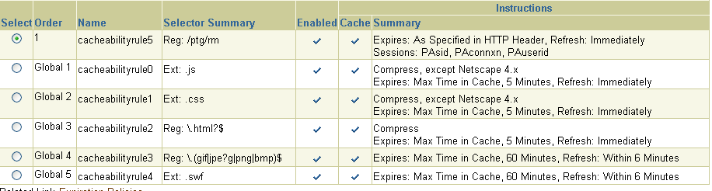
Oracle Web Cache
Pros
  Automatic content compression
  Full and fragment static and dynamic page caching
  Edge Side Includes support and assembly (ESI)
  Cache invalidation and expiration
  Workload management
  Cache clustering
    With partitioning and replication
  3rd party ESI compliant Application Server support
  All of the above is also supported by WebSphere
Cons
  Pages must be explicitly designed for fragment caching with ESI. Why your artists and page designers need to know about caching and ESI tags?
  How do you put ESI tag inside of a Servlet?
  What if you need to change caching. Do you need to rebuild, repackage and redeploy the entire project?
  These limitations do not exist in WebSphere
Notes:
WebSphere page fragment cache does not require re-design of pages and use of ESI tags

Slide 50
IBM Offers Broader & More Current Linux Support
 |  | WAS | OAS
xSeries | Red Hat Enterprise Linux 3, 4
 | Red Hat 4 (64 bit)
 | Red Hat 3 (64 bit)
 | RedFlag AS 4.1
 | SuSe Linux Enterprise Server 8
 | SuSe Linux Enterprise Server 9
 | SuSe LES 9 (64 bit)
pSeries | Red Hat Enterprise Linux 3, 4
 | SuSe Linux Enterprise Server 8, 9
 | SuSe LES 9 (64 bit)
 | Red Hat 3, 4 (64 bit)
zSeries | Red Hat Enterprise Linux 3, 4
 | SuSE Linux Enterprise Server 8, 9
- supported with significant delay after main platforms

Slide 51
Server OS support
 |  | WAS | OAS*
Unix | AIX
 | HP-UX on PA-RISC
 | HP-UX (64 bit)
 | Solaris
Microsoft | Windows 2000
 | Windows 2003
 | Windows 2003 (64 bit)
Other | z/OS
 | OS/400
- supported with some delay after main platforms
* - OAS – not all components supported on all platforms

Slide 52
Database support and certifications
 | WAS | OAS |  | WPS | OBPM |  | WSESB | n/a
Oracle 9i
Oracle 10g
Microsoft SQL 2000 |  | no XA
Sybase 12 |  | no XA
IBM DB2 UDB EE 8.x |  | no XA
IBM DB2 UDB WE 8.x |  | no XA
IBM WS II Advanced 8.1
IBM Informix DS 9.4 |  | no XA
IBM IMS on z/OS
IBM Cloudscape 5.1
Derby10.x
IBM DB2 Connect 8.x
PointBase 5.1
MySQL 4

Slide 53
Summary: IBM vs. Oracle
WAS ND 6.0 is by far more robust and mature product than OC4J 10.1.3
IBM WAS supports more latest standards quicker compared to Oracle
  Oracle even lags behind BEA
IBM has the most flexible packaging for app server
  From free WAS CE to high end WSXD
WAS supports more OSs and DBMSs than any other server on the market
  OC4J is one of the most proprietary servers on the market
IBM Rational Application Developer is more mature and capable Eclipse based development tool compared to Oracle JDeveloper (non Eclipse)
While IBM leads SPECjAppServer2004, Oracle is fishily quiet
Oracle administrative capabilities are rudimentary
  Oracle Enterprise Manager is a joke when it comes to managing J2EE runtime
IBM leads in autonomic computing capabilities – Oracle grid is slideware
IBM leads in high end OLTP and caching capabilities
IBM support price is based on discounted value, while Oracle’s on list prices
IBM has more complete middleware platform than Oracle does

Slide 54
SAP
Complete document can be found here:
https://w3-03.ibm.com/sales/competition/compdlib.nsf/pages/websphere

Slide 55
IBM Provides a Single Integration Platform, but
NetWeaver Mixes ABAP and Java
IBM
SAP NetWeaver
Human Workflow
Process Engine
Broker
Application Server
Collaboration
Portal
Business Process Integration
Application Server
Collaboration
Portal
Mapping
Application Server
Java
ABAP
Java

Slide 56
NetWeaver’s Two Programming Models Complicate Application Development
Different development and debugging tools
Different deployment techniques
Different security models increases risk of security exposures
Performance degradation due to switching between programming models at runtime
Multiple development skills
Multiple system administration skills
Greater time to value!

Slide 57
Administrative Tools for NetWeaver
Application Server are Fragmented
NetWeaver Administrator
(Web Client, Incomplete,
No Predicted Completion Date )
Multiple, disparate tools required to administer just the SAP Web Application Server (J2EE)
  Many tools have overlapping
  functionality
Multiple, inconsistent user interface technologies used throughout
  Different user IDs and passwords required
Administration requires installation of a separate database for configuration information
Some tools only run locally on servers
Most tools operate on one server
at a time
Visual Administrator
(Java Thick Client,
Proprietary P4 Protocol)
Config Tool
(Java Thick Client,
Proprietary DB Access APIs)
SAP management Console
(Microsoft MMC Client,
Proprietary MS Protocols)
Web Dispatcher Admin
(Web Client,
Different ID/Password System)
Remote Log Viewer
(Java Thick Client,
Special Server Components)
Central Monitoring
(SAP GUI to special purpose
ABAP Server)
SLD Admin
(Web Client, needs some
setup via Visual Admin)
Source: IBM SWG CPO Research, 2005

Slide 58
NetWeaver Detection, Isolation and Problem Resolution Capabilities are Weak
Tools are Not Unified
  Requires multiple tools, windows, logins and administrator effort to create a complete view of a problem situation
Documentation and help information are ineffective
  Poor indexing
  Relevance of documentation to deployed options is not clear
  Information needed to complete routine tasks is scattered
J2EE Tools do not consolidate the domain
  Servers must be addressed one at a time to complete most tasks
Management infrastructure
  The most mature and capable components require ABAP
  Many manual setup steps are required for a pure J2EE domain
Source: IBM SWG CPO Research, 2005

Slide 59
IBM Has Stronger Support for Standards
IBM internal Use Only
Important Middleware Standards
IBM WebSphere
NetWeaver 2005
Impact
Application
Server
  J2EE v1.3 – JSR58
  JMS v1.0.2, JCA v1.0
  Specification - Sep 2001
  Dec 2001 – WAS V5.0 TD
  Nov 2002 – WAS V5.0
Q1 2003 –
web AS v6.30
2 year delay for ISV’s and customers to start writing apps on SAP WebAS
  Web Services V1.0 – JSR109
  Specification – April 2002
  Jul 2003 – WAS V5.0.2
  Not fully
  supported yet
Some basic Web Services capabilities not available
Standards
Adherence
  J2EE v1.4 – JSR58
  JMS v1.1, JCA v1.5
  WS v1.1, JAX-RPC v1.1
  SAAJ v1.2, UDDI V2.0, V3.0
  Spec - Nov 2003, Mar 2004 up
  Dec 2003 – WAS V6.0 TD
  Nov 2004 – WAS V6.0
  Not
  announced yet
  UDDI V2/3 supported
Latest Industry JMS1.1 JCA1.5 Adapters cannot be used.
Web Services extensions in WS1.1 not useable
  Java Server Faces – JSR 127
  Specification – May 2004
  Mid 2004 – WSAD v5.1.2
  Nov 2004 – WAS V6.0
  No announce
Additional UI programming Forms increase productivity
Web Service Remote Portlets Specification – Aug 2003
  Jan 2004 – Portal V5.0
  No announce
Inability to invoke SAP Portlet via external Web Services call ie Web App
Portal
  JSR-168 Industry Portlets
  Specification – Oct 2003
  1Q – Portal V5.0 TD
  Dec 2004 Portal V5.1
  No announce
SAP developed Portlets cannot run on other Portal
JSR-170 - Content mgmt Specification – June 2005
  Dec 2004 – Portal V5.1 TD
  No announce
ERP and ECM apps use Open shared databases
App Server
Implemented using a
J2EE engine
  Fully Java based
Mixed Java &
proprietary ABAP
Performance issues with Java/ABAP transitions
Reliance
On
Proprietary
Technologies
  JSR 168 Portlets supported
  SAP iViews are proprietary
Portal
Supplier lock in on Portal technology
Tools
Standards based web
application development
  Eclipse tools
  Web Dynpro is proprietary
Additional investment in skills since multiple SAP tools are very different
Eclipse based integration
tools
  WBI tools eclipse based
XI tools
not Eclipse
Additional investment in skills since multiple SAP tools are very different
Business
Integration
Java Integration and business
process engines
  WBI / WPS runs in Java
  XI software runs in ABAP
Performance issues with Java/ABAP transitions

Slide 60
SAP Web Application Server for Java is Much Less Reliable than WebSphere
Single Points of Failure - All J2EE Engines within SAP Web AS Java cluster require communication with Central Services (new as of version 6.30)
  Central Services components (Message Service, Enqueue Service) are single points of failure (SPOF)
  SAP Web Dispatcher requires information from the Message Service while load balancing - if Message Service is unavailable, users cannot login or logout of applications
Inability to Recover Gracefully from Outages
  J2EE Engine unable to gracefully recover from network outage and performs restart after being reconnected
  J2EE Engine restarts if communications with other cluster elements exceed timeout
  Leads to periods when applications are completely unavailable to end users
Source: IBM SWG CPO Research, 2005

Slide 61
Clustered Application Availability Tests
Testcase | WebSphere ND |  | NetWeaver
 | HTTP Failover Enabled | HTTP Failover Enabled | HTTP Failover Disabled | HTTP Failover Enabled
App Server 2 Network Failure | PASS | PASS | FAIL | FAIL
App Server 2 System Failure | PASS | PASS | PASS | PASS
App Server 1 Network Failure | PASS | PASS | FAIL | FAIL
App Server 1 System Failure | PASS | PASS | FAIL | FAIL
Configuration Database Availability Failure | n/a | n/a | PASS | PASS
Source: IBM SWG CPO Research, 2005

Slide 62
IBM Has Stronger Infrastructure
Easier to Install
  Better documentation
  Smaller Footprint
Standards
Increased administrator productivity
  Web-based administration console
  Configuration data stored in files, not a database
  WebSphere Rapid Deployment
High Availability
More productive tools
  Compete life-cycle support
XD for high availability systems
Integrated monitoring and tooling to speed problem resolution
Dynamic Provisioning to improve utilization
Performance
zSeries support

Slide 63
Web Application Server Summary: IBM vs. SAP
IBM is a market leader in Web Application Servers with years of experience whereas SAP is new entrant and must overcome numerous hurdles to deliver competitive product
  SAP’s mix of ABAP/Java code bases sub-optimizes performance and requires additional coding skills
  Administrative tools are fragmented
  Immature or non-existent detection, isoliation, problem resolution capabilities
  Lacks high performance environment
IBM has the most flexible packaging for app server
  From free WAS CE to high end WSXD
IBM WAS supports more OSs and DBMSs than any other server on the market
IBM continues to set SPECjAppServer2004 performance benchmarks
  No performance benchmarks available for SAP
IBM leads in high end OLTP and caching capabilities
IBM has more complete middleware platform than SAP
IBM continues to adhere to leading open standards
  SAP is significantly behind on key standards for J2EE and web services

Slide 64
Microsoft
Complete document can be found here:
https://w3-03.ibm.com/sales/competition/compdlib.nsf/pages/websphere

Slide 65
IBM Advantages Over Microsoft
Complete Enterprise IT Environment
Superior SOA Support
Better developer productivity
Based on open standards
Flexible, portable, deployments
Software investment protection
Consistent execution environment
Notes:
Show roadmap for investment protection

Slide 66
Developer Productivity Study –
Top 10 Productivity Lessons
IBM developer environment is much more productive – even compared to VS 2005!
1. The IBM tools were more productive in 7 out of 8 applications built
2. Almost twice as many Microsoft tools and support software was required to build the
8 applications
3. The IBM tools met all of the application requirements; Microsoft tools only met 4 out of 8
4. Microsoft had 3X the number of lines of code that were manually generated by hand
5. IBM provided wizards to build all the applications. Microsoft provided wizards in
4 of the 8 applications.
6. IBM provided built in test environments in all 8 applications. Microsoft had to build test
harness and forms in 6 of the eight applications.
7. Microsoft was unable to build a robust human workflow application
8. Microsoft was unable to simulate and do cost analysis of workflows
9. Microsoft was unable to easily build multiple related pages in a portlet
10. Microsoft was unable to build a UML sequence diagram from existing code. Also unable to
synchronize UML code with C# code
Source: Branham Group Inc.

Slide 67
Microsoft Claims .NET is Open. . .
Designed around web services and conforms to open web services standards
Co-founded WS-I with IBM
CLI and C# standards approved by ECMA
  CLI is a subset of the .NET Common Language Runtime
MSIL can be executed anywhere

Slide 68
. . .But .NET is Proprietary
Microsoft applied for patent on .NET APIs.
.NET Framework 2.0 has more than 100 changes that breaks code written for Version 1.1
  http://www.gotdotnet.com/team/changeinfo/Backwards1.1to2.0/default.aspx
.NET Framework 1.1 has more that 80 changes that breaks code written for Version 1.0
Proprietary type system and object model
Visual Basic .NET dramatically different from Visual Basic 6 to conform to CLR.
  116 differences listed at http://www.mvps.org/vb/index2.html?rants/vfred.htm
  Gartner estimates that 60% of VB code will have to be modified for .NET
Windows Vista will also mean change

Slide 69
Portability:
WebSphere Enables Platform Portability
Rational
Application
Developer
Open standards make it possible to develop application once, deploy on multiple platforms
J2EE Application
WebSphere Application Server
WebSphere Application Server
WebSphere Application Server
WebSphere Application Server
WebSphere Application Server
Windows
Linux
UNIX
(AIX, HP-UX, Solaris)
OS/400
zOS

Slide 70
Why is Portability Important?
Flexibility to choose server platform
  Re-use old servers
  Scale up to more powerful server
  Improve reliability by moving to IBM zSeries Servers
Consolidate workloads to fewer servers and reduce IT costs
Integrate systems from business acquisitions
Software vendors can sell their solutions into more customer environments
Avoid vendor lock-in
Make it a strategic decision in your enterprise
Never develop a non-portable application again!

Slide 71
Microsoft Roadmap
Three Major Technology Transitions Mean Rework
Native COM Native .NET Native Longhorn
Windows Client
Win XP
Windows
Vista Client
Office 2003 +VS Tools
VS Tools
for Office 2005
Office Suite
Office XP
Office 12
Windows
Vista Server
Windows Server
W2k
WS2003
WS2003 R2
SQL Server
SQL 2000
SQL Server 2005 (Yukon)
Exchange Server
Exchange 2000
Exchange
2003
Exchange 12
SharePoint Portal
SPPS 2001
SPPS 2003
SharePoint V3
BizTalk
BizTalk 2000
BizTalk 2002
BizTalk 2004
BizTalk 2006
Visual Studio
VS 6.0
VS .NET
VS .NET 2003
VS 2005
VS
“Orcas”
2000
2001
2002
2003
2004
2005
2006
2007
Notes:
Blackcomb is codename for Longhorn server release.

Slide 72
Platform Maturity
IBM middleware is delivered as an integrated set of solution components, all running on the J2EE model
  Portal, messaging, collaboration, business integration, commerce, etc.
Microsoft middleware is still implemented in legacy COM code
  Only exception is BizTalk 2004 which is implemented in .NET
Microsoft is still re-engineering .NET!
  New web services model coming
  New web part framework incompatible with SharePoint Portal Server 2003
Microsoft customers will face significant migrations
Notes:
Take out

Slide 73
1 Programming Model is Better Than 2
IBM
Microsoft
J2EE
.NET
+
COM
WebSphere-based applications require exactly one open
programming model – J2EE
Most .NET applications will require two proprietary
programming models - .NET and COM
Notes:
Point out COM will never go away

Slide 74
Consequences of Building Solutions Using Two Different Programming Models
Different development and debugging tools
Different deployment techniques
Different security models increases risk of security exposures
Performance degradation due to switching between programming models at runtime
Multiple development skills
Multiple system administration skills
It’s harder and more complicated!

Slide 75
Microsoft Has 2 Inconsistent Security Models
COM+ role-based access control model is declarative
.NET role-based access control is specified in source code
  [PrincipalPermission(SecurityAction.Demand,Role=“Teller”)] public void CreateAccount(){….}
The two models have different class hierarchies and define roles differently
  This means that serviced components (COM+) have a different security model than pure .NET components
Inconsistent models tend to provide looser security
  Increased chance of mistakes, oversight, conflicts
Notes:
Access Control for COM+ is Declarative. COM+ model was pretty good.
In the .NET case, you have to specify it in source code. Must recompile to change roles.
More importantly, the two security models are implemented using two class hierarchies. In addition, a Role in COM+ is an application-specific Role (as is the case with J2EE), but a Role in .NET is a Windows user group
So have mixed security model, and sharepoint doesn’t use either one. Multiple models tend to have holes.
Look into SharePoint groups vs. roles.

