Slide 1
WebSphere Application Server v6.1
Futures

Slide 2
From the public WAS v6.1 announcement letter
IBM currently intends to release an enhanced Web services solution focused on improving consumability of Web services and providing business value in the Reliable Messaging space, focusing on a solution supporting the Reliable Asynchronous Messaging Profile (RAMP). This capability would be provided as a "plug-in" for customers.
As part of this Web services "plug-in," IBM plans to release a fully supported Web services Reliable Messaging solution.
IBM United States Software Announcement 206-076
April 11, 2006

Slide 3
WAS Feature Pack Concept
  Delivery vehicle to ship critical new function outside WAS release stream
  Function optionally installed on top of a specific required existing WAS release
  Theme with carefully controlled content
  Extension of base WAS function
  Delivery plan may begin with pre-GA (Early Program) code, but concludes with GA code
  Feature Packs support same configurations as prereq WAS release at GA
  Content is either available in next major WAS release OR
  Feature Pack is rebased on next major WAS release and available concurrently
  Includes Tooling support, as applicable

Slide 4
WebSphere Web Services Feature Pack
Features
  Web Services Standards
  WS-I Reliable Secure Profile (RAMP Profile)
    WS-ReliableMessaging
    WS-SecureConversation
    WS-Addressing
    WS-I Basic Security Profile
    WS-I Basic Profile 1.0
    SOAP 1.2, MTOM / XOP
  JCP-based programming model
    JAX-WS 2.0
    JAXB 2.0
    SAAJ 1.3
    StAX 1.0
Benefits
  Standards-based Interoperability w/other vendors implementations
    Securely
    Reliably
    Asynchronously
  Standardized (and portable) application programming model
    Simple annotation based
    Fast pull parser based
    Asynchronous programming model
Available here: https://www14.software.ibm.com/iwm/web/cc/earlyprograms/websphere/wsvwas61/

Slide 5
WebSphere Integration
Provide integration for consumability for profiles (PolicySets)
  Have predefined templates:
    RAMP
    Secured and High Performance
    Basic Security Profile (WS-I BSP 1.0)
    Basic Profile (WS-I BP 1.0)
    Custom: shows every single options
  Templates are created based on “capabilities”
  Options show on the UI are based on the type of template selected to create policy set

Slide 6
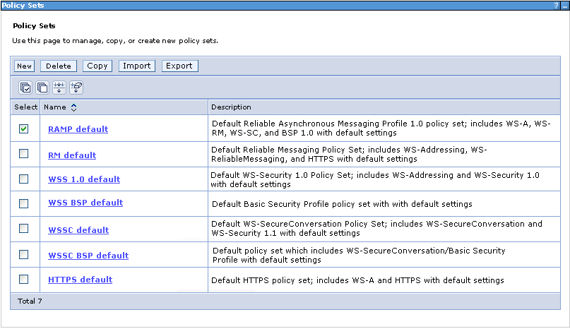
Policy Sets

Slide 7
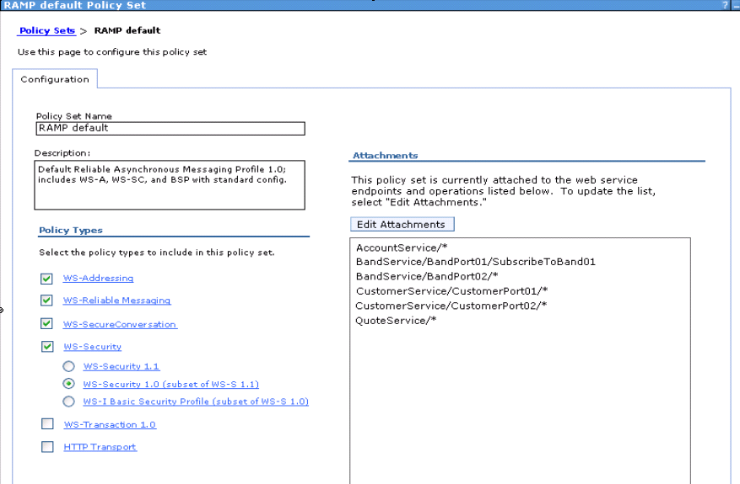
Policy Sets

Slide 8
SOA Feature Pack
Initial Alpha release available
Supported platforms for the Alpha release are Windows® and Linux® x86.
Features:
  SCA 0.9
  SDO 2.0
  Relational Database Data Access Service (DAS)
Leverages the Apache Tuscany open source technology
https://www14.software.ibm.com/iwm/web/cc/earlyprograms/websphere/soawas61/

Slide 9
Terms and Technology
SOA – Service Oriented Architecture
SCA – Service Component Architecture, one aspect of the SOA programming model.
SDO – Service Data object, one aspect of the SOA programming model.
Tuscany – apache open source project that implementation of SOA
Maven – Apache open source build tool for Tuscany to build application
Subversion – repository management for Tuscany project and a lot other open source projects

Slide 10
Service Component Architecture
A model for building loosely-coupled systems based on a Service Oriented Architecture.
  Language neutral
  Technology neutral
  Vendor neutral
Specification produced through collaboration of many industry leaders including BEA, IBM, Oracle and SAP.
Aims to make manageable the complexity associated with large-scale systems and enterprise applications.
Open Source implementation by Apache Tuscany project.

Slide 11
Additional links
2006 WebSphere Services Technical Conference in Las Vegas
  Recordings of this conference are available internally
  http://ausgsa.ibm.com/gsa/ausgsa/home/w/s/wstc/web/public/WSTCRecordings.html
  Of special interest (most are IBM Confidential)
    W01 : WAS v6.1/7 Roadmap and Futures
    W18 : AST Overview and Demo
    A12 : WebSphere Web Services Strategy and Roadmap
    D31 : Apache Tuscany

Slide 12
Application Server Toolkit 6.1 - Availability and versions
AST 6.1 is available with WAS 6.1
    Built on Eclipse 3.1 & WTP 1.0
RAD 7.0 (supporting WAS 6.1) will follow
  Scheduled for 3Q, 2006
    RAD 7.0 is built on Eclipse 3.2 & WTP 1.5
A refresh of AST is scheduled with RAD 7.0
    Will bring AST up to Eclipse 3.2 & WTP 1.5

Slide 13
What about J2EE 1.5 and EJB 3 ???
Class discussion

