Slide 1

ISRC Technology Briefing
October 26, 2006
Henry Yan
Business Intelligence

Slide 2
Agenda
What is business intelligence (BI)
Current status of BI
Future of BI
Conclusions
Q & A

Slide 3
Definition
The process of gathering information in the field of business. It can be described as the process of enhancing data into information and then into knowledge. Business intelligence is carried out to gain sustainable competitive advantage, and is a valuable core competence in some instances.
en.wikipedia.org/wiki/Business_intelligence

Slide 4
Elements of BI
Users
Tools
Warehouse
Extract
Data Sources

Slide 5
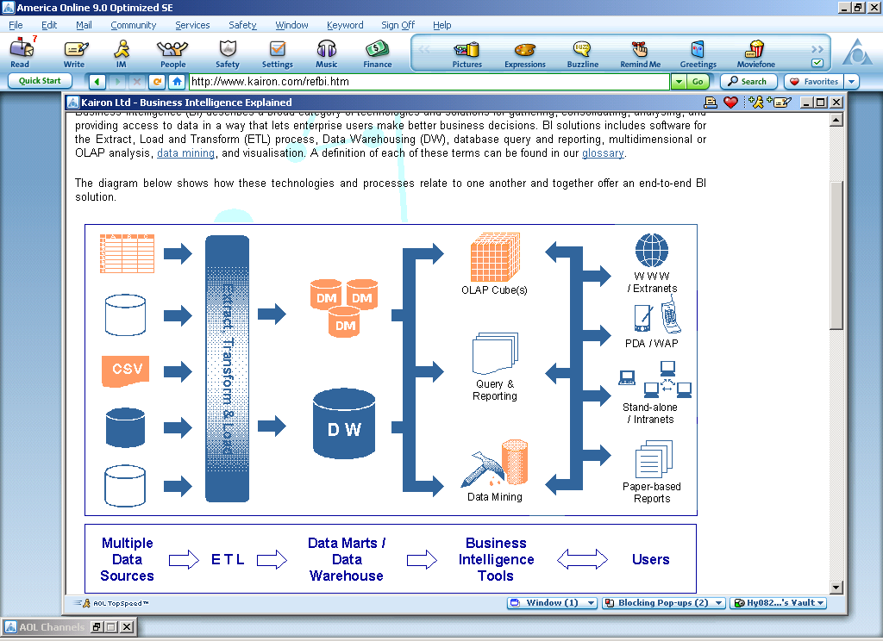
Source: www.kairon.com

Slide 6
A Failure of Business Intelligence
An energy company’s BI system:
  Oracle data warehouse & ETL, Hyperion Brio
Natural Gas price skyrocketed during Katrina & Rita, resulting in loss of millions because
  Historic data from DW fail to reveal the change
  Let alone generate alerts to analyst & management
  Small BI audience limits information dissemination
Moral of the case:
  Current BI may not be up to the task for time-sensitive analysis and decision-making

Slide 7
BI Can Fail Because it is Often…
Reliant on non Real-time data
Reactive rather than proactive
  Summarizing past rather than looking forward
Esoteric
  Employees with necessary business and technical skills are rare

Slide 8
Future BI’s will be increasingly…
Real-time
Proactive
Pervasive

Slide 9
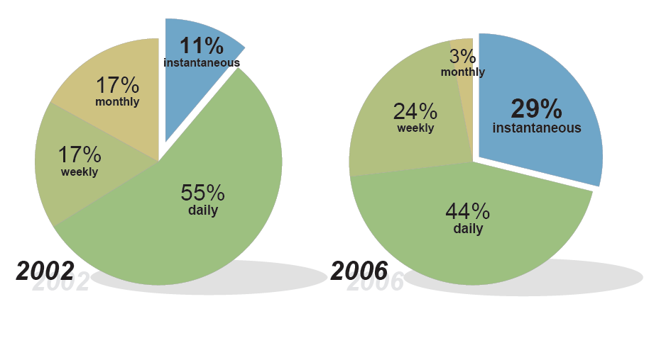
BI will be Real-time or Near Real-time
Source: Gartner Survey of 540 organizations

Slide 10

For Example
Wisconsin-based energy services provider
Serving 1.5 million customers in the Mid-West
Source: Computerworld, September 18, 2006 and www.alliantenergy.com

Slide 11
For Example
BI system generates financial reports in an hour
Previously took up to 3 days
Faster access allowed officials to quickly spot accounts receivable problems
Source: Computerworld, September 18, 2006 and www.alliantenergy.com

Slide 12
Making BI Real-time by…
Bypassing historic repository for time-sensitive analysis
Source: Stephen Swoyer, Athens, GA

Slide 13

Making BI Real-time by…
64-bit in-memory processing
  stores time-sensitive data in the server’s RAM rather than a data warehouse
Source: Stephen Swoyer, Athens, GA

Slide 14
Making BI Real-time by…
Grid computing
  Multiple SAS instances running in parallel to process terabytes of data.
  Execution time down 95%
Source: Stephen Swoyer, Athens, GA

Slide 15

BI Will be Proactive
Blue Cross Blue Shield provider uses its SAS BI to detect health insurance fraud.
Recovered millions of dollars through extensive litigation procedures.
Source: https://www.highmark.com

Slide 16
BI Will be Proactive
Planned BI will detect insurance abuse earlier
“… identify abnormalities prior to the money going out the door …"
Source: https://www.highmark.com

Slide 17
Making BI Proactive by Analogy
E.g., Intelligence in DBMS
  Push messages to Database Administrator (DBA)
    BI: push + escalation alert people to issues early
  Dynamically reconfigure resources based on loads
    BI: eliminate issues before damage done

Slide 18
Making BI Proactive by Analogy
E.g., Intelligent agents on Internet
  Track and learn viewers’ browsing patterns and later automatically suggest potential interests
    BI: machine learning liberates analysts from repetitive work and focus them on critical issues

Slide 19


BI Will be Pervasive
Outdoor specialty retailer in NH
BI provides common view to everyone
From CEO to store managers
Source: http://www.ems.com/
and computerworld, september 18, 2006

Slide 20
BI Will be Pervasive
Pervasive access has enabled them to identify locally successful sales tactics and formulate company-wide operation strategy
It has recently reported 73% increase of sales thanks to its pervasive BI system
Source: http://www.ems.com/
and computerworld, september 18, 2006

Slide 21
Making BI Pervasive by
Pervasiveness of use interface
  Mobile device
  Large-scale deployment in office
  Web-based, Service-oriented architecture
  Open-source to cut cost
  Piggyback on office productivity software
  Data Visualization

Slide 22
Conclusions
BI anticipated to be a top IT spending priority due to CEOs’ desire to gain competitive advantage.
Spending can be justified if BI provides compelling returns via
  real-time or near real-time
  proactive
  pervasive

Slide 23
Questions
Comments
Observations

