Slide 1
Measures of Economic Performance

Slide 2
Measures of Economic Performance
Economic Measures:
  Inflation
  Unemployment
  Growth (GDP)
  Balance of Payments
  Exchange Rate
Non-Economic Measures:
  Quality of Life
  Environment
  Health
  Education

Slide 3
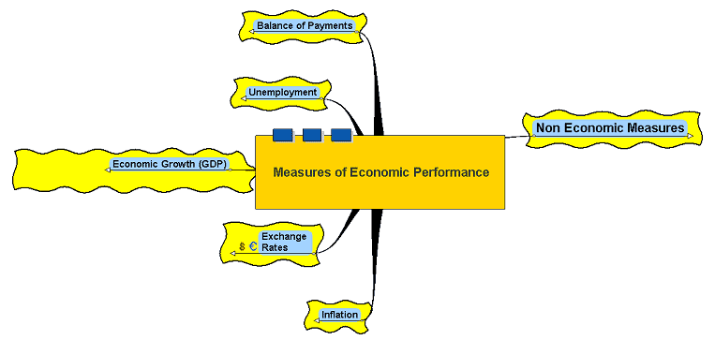
Measures of Economic Performance

Slide 4
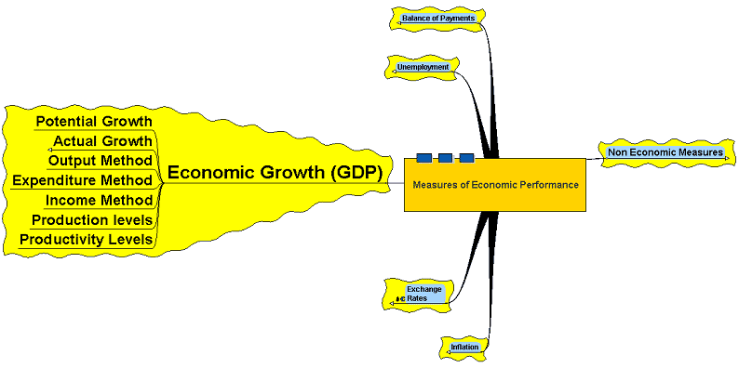
Economic Growth (GDP)

Slide 5
Economic Growth (GDP)
Gross Domestic Product:
  The value of output of goods and services produced in the UK during one year
  Primary, secondary and tertiary sectors
  Real versus nominal output
  Can be viewed as being national income, national output or aggregate demand (AD)
  GDP per capita – GDP divided by the population (GDP per head)

Slide 6
Economic Growth (GDP)
Potential Growth – the overall capacity of the economy (i.e. what the economy could produce
if it used all its resources)
Actual Growth – the annual percentage increase in output
Nominal Growth – the growth in output not including any adjustment for price changes expressed as ‘current prices’ (the price reigning at the time of the measurement)
Real Growth – growth in GDP adjusted to take account of changes in the price level – expressed
as ‘constant prices’

Slide 7
The Business Cycle
Growth (NY)
Potential Growth
Actual Growth
Boom/Overheating
Growth/Upturn
Decline/slowdown
Recession/Slump
Time

Slide 8
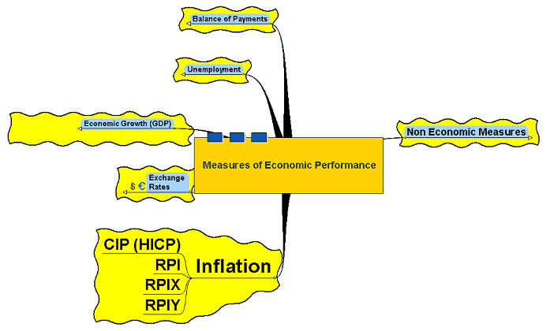
Inflation

Slide 9
Inflation
A persistent rise in prices in an economy over a period of time
Now measured by the HICP (CPI)
Inflation does not fall – it slows down or speeds up! (If inflation in 2003 was 3% and in 2004 is 2% it still means prices have risen by an average of 2% over the last year!)
A fall in the price level is termed ‘deflation’

Slide 10
Inflation
Anticipated and Unanticipated inflation:
  affects the outcome of economic decision making – if anticipated, changes in prices can be accommodated, if unanticipated can cause shocks and problems to arise

Slide 11
Inflation
Causes of Inflation:
Demand-Pull – where aggregate demand (AD) rises at a faster rate than aggregate supply (AS)
Cost-Push – increases in costs (labour, raw materials, imported costs, etc.) that cause a leftward shift in AS

Slide 12
Inflation
The effects of inflation:
Seriousness of the effect depends on the extent
to which the inflation is anticipated
  Menu costs – the cost of having to change prices – vending machines, labels, etc.
  Wealth costs – inflation affects those on fixed incomes and redirects wealth to those in strong bargaining positions or with physical assets
  Planning costs – businesses uncertain about future price changes may be reluctant to invest – hits economic growth
  Competitiveness – inflation at a higher rate in the UK than elsewhere hits domestic competitiveness and affects the balance of payments
  Social stability - At very high rates, confidence in the currency is eroded and production and exchange can be stifled – can lead to food riots, looting and violence

Slide 13
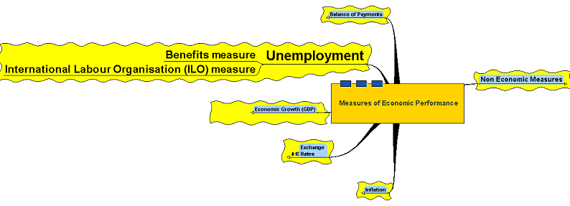
Unemployment

Slide 14
Unemployment
Various definitions:
  The number of people of working age who are without a job
  The Claimant Count – those actively seeking work and claiming benefit
  ILO (International Labour Organisation) measure– the number of people available for work and actively seeking employment

Slide 15
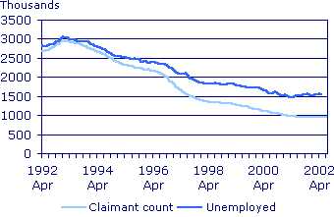
Unemployment
UK Unemployment and the claimant count, 1992-2002
Source: Office for National Statistics (http://www.statistics.gov.uk/cci/nugget.asp?id=165) (Crown copyright material is reproduced with the permission of the Controller of HMSO and the Queen's Printer for Scotland.)

Slide 16
Unemployment
Causes of unemployment:
  Frictional Unemployment – where people become unemployed between jobs
  Demand Deficient Unemployment – where AD is less than AS
  Technological Unemployment – caused where people are put out of work by changes in technology
  Seasonal Unemployment – caused by the seasonal nature of some types of employment – e.g. holiday resorts
  Real Wage or Classical Unemployment – caused by wage rates being held above market clearing levels
  Structural Unemployment – caused by changes to the structure of industry in the economy – e.g. the decline of the coal, iron and steel industries

Slide 17
Unemployment
Costs of unemployment to the economy:
  Lower tax revenues
  Higher benefit payments
  Social costs: crime, vandalism, family breakdowns and social welfare support, regional decay
  Opportunity cost of lost potential output

Slide 18
Unemployment
Costs of unemployment to the individual:
De-skilling
Loss of self-esteem
Lower income – reduced purchasing power and lower standard of living
Effects on the family unit
Increase in likelihood of stress related illnesses and mental breakdown

Slide 19
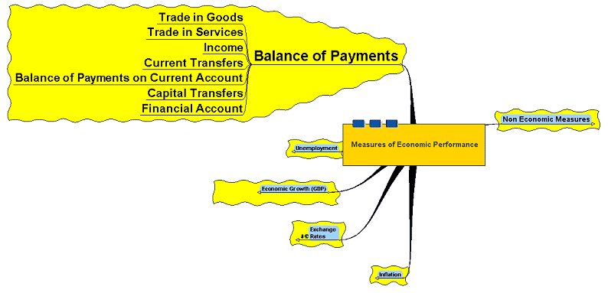
Balance of Payments

Slide 20
Balance of Payments
Measures economic transactions between UK residents and the rest of the world:
  Trade in goods
  Trade in services
  Income flows from investments
  Financial flows – shares, loans
  Foreign aid

Slide 21
Balance of Payments
Current Account:
  The trade in goods
  The trade in services
  Income flows
  Current transfers
Capital Account:
  Sale and purchase of capital assets and non-produced or non-financial assets
Financial Account:
  Trade in financial assets

Slide 22
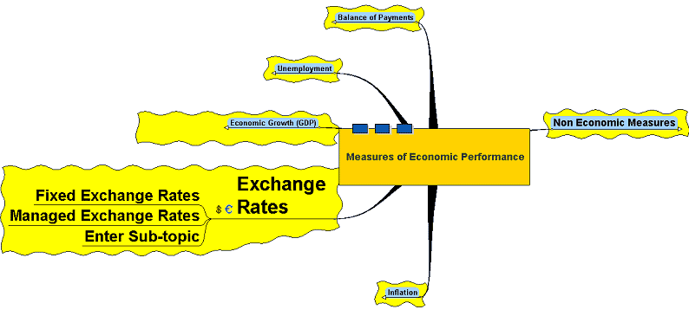
Exchange Rates

Slide 23
Exchange Rates
The price of one currency in terms
of another – the amount of one currency that has to be given up to purchase another currency
Exchange rates determined by the demand and supply of a currency
on foreign exchange markets
Demand determined by the purchase
of exports, supply by the purchase
of imports

Slide 24
Exchange Rates
Floating Exchange Rates:
  Where the rate is determined by the interaction of supply and demand of the currency with no intervention by government or other agencies in the market
‘Dirty’ or ‘Managed’ Floating:
  Where the exchange rate is allowed to float freely but intervention by governments or other agencies is carried out to manipulate the rate within some desired band

Slide 25
Exchange Rates
Fixed Exchange Rates:
  Where the rate is fixed or pegged
  to another currency or asset (such
  as gold – the ‘Gold Standard’) – intervention may be necessary to maintain the rate or economic policies to influence the strength of economic growth

Slide 26
Exchange Rates
Adjustable Peg System
  A managed exchange rate – rate fixed in the short term but has
  the possibility of devaluation
  or revaluation if necessary

Slide 27
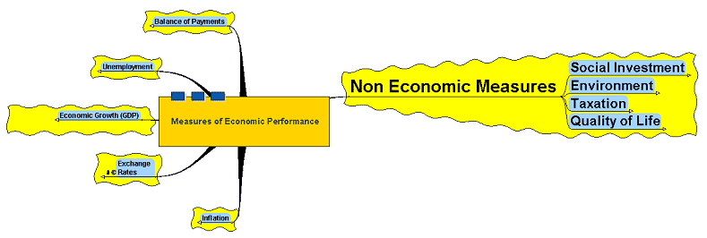
Non Economic Measures

Slide 28
Social Investment
Infrastructure – roads, communication networks, bridges, railways, airports, ports
Education – schools, colleges and universities
Hospitals/Health – primary and secondary care, health education, disease and accident prevention, number of doctors per head, access to health care
Water/Sewerage
Housing – affordable and accessible housing to meet the needs of those in search of homes and employment

Slide 29
Environment
Pollution – land, air, sea and noise
Waste – waste disposal and waste management
Nature – areas of outstanding beauty, national parks, wildlife, ecology, sites
of special scientific interest
Land Use – planning regulations, building regulations

Slide 30
Taxation
Tax Burden – the amount of tax paid by the population – direct
and indirect taxation
Incentives – aimed at encouraging enterprise, business development and creativity

Slide 31
Quality of Life
Material Wealth – telephones, fridges, computers, cars, etc.
Mental State
Stress – caused by employment, unemployment, travel, etc.
Crime – crime prevention, crime reduction, monitoring of crime
and perceptions of crime

