Slide 1
Java's Collection Framework
Naveen Kumar K.S

Slide 2
Collection Framework
  A collections framework is a unified architecture for representing and manipulating collections. It has:
    Interfaces: abstract data types representing collections
    Implementations: concrete implementations of the collection interfaces
    Algorithms: methods that perform useful computations, such as searching and sorting
      These algorithms are said to be polymorphic: the same method can be used on different implementations

Slide 3
Interfaces
  An interface describes a set of methods:
    no constructors or instance variables
  Interfaces must be implemented by classes
    646 java classes implement >= 1 interfaces (‘02)
  2 or more classes implement an interface
    Classes guaranteed to have the same methods
    Objects can be treated as the same type
    Can use different algorithms / instance variables

Slide 4
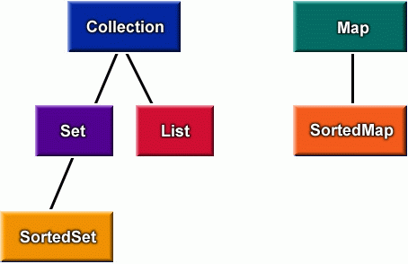
Collection interfaces
Queue
since Java 5

Slide 5
Implementations
  A collection class
    implements all methods of the interface
    selects appropriate instance variables
    can be instantiated
  Java implements interfaces with
    List: ArrayList, LinkedList, Vector
    Map: HashMap, TreeMap
    Set: TreeSet, HashSet

Slide 6
Algorithms
  Java has polymorphic algorithms to provide functionality for different types of collections
    Sorting (e.g. sort)
    Searching (e.g. binarySearch)
    Finding Extreme Values (e.g. max)

Slide 7
Two Useful ADTs
  List: a collection with a first element, a last element, distinct predecessors and successors
    duplicates that "equals" each other are allowed
  Map: maps keys to values
    Maps cannot contain duplicate keys
    Each key maps at most one value

Slide 8
List
  A list is
    a collection of elements (numbers, strings, accounts, pictures,…)
    ordered (a sequence): there is a first, and a last element
      lists can be empty – no elements
    elements with a unique predecessor and successor
    also known as a sequence

Slide 9
ArrayList A Java Collection Class that Implements List
  ArrayList
    stores a collection of any type of object
    can be all the same type, or different types
    similar functionality to an array, but does not use subscripts is an indexed collection

Slide 10
List implemented by 3 classes
// Interface name: List
// Three classes that implement the List interface:
List<String> bigList = new ArrayList<String>();
List<String> littleList = new LinkedList<String>();
List<String> sharedList = new Vector<String>();
// All three have an add method
bigList.add("in array list");
littleList.add("in linked list");
sharedList.add("in vector");

Slide 11
Generics
  A List can be made to store only one type
List<BankAccount> accountList =
new ArrayList<BankAccount>();
accountList.add(new BankAccount("One", 111.11));
accountList.add(new BankAccount("Two", 222.22));
accountList.add(new BankAccount("Three", 333.33));
accountList.add(new BankAccount("Four", 444.44));

Slide 12
Iterators
  Iterators provide a general way to traverse all elements in a collection
ArrayList<String> list = new ArrayList<String>();
list.add("1-FiRsT");
list.add("2-SeCoND");
list.add("3-ThIrD");
Iterator<String> itr = list.iterator();
while (itr.hasNext()) {
System.out.println(itr.next().toLowerCase());
}
Output
1-first
2-second
3-third

Slide 13
Enhanced for loop
  If a class extends Iterable<E> (like you did with your Set<E> class), you can use Java's enhanced for loop of this general form
    for (E refVar : collection<E> ) {
    refVar refers to each element in collection<E>
    }
    example
ArrayList<String> list = new ArrayList<String>();
list.add("first");
for (String s : list)
System.out.println(s.toLowerCase());

Slide 14
Hash Map
Set set = hm.entrySet();
Iterator i = set.iterator();
Note: An iterator for an map should by casted with set

Slide 15
Looping Map
while(i.hasNext()){
Map.Entry me = (Entry) i.next();
System.out.println(me.getKey() + " : " + me.getValue());
}

Slide 16
get and put with Map
double balance = ((Double) hm.get("Naveen")).doubleValue();
hm.put("Naveen", new Double(balance + 1000));
System.out.println("New Balance of Naveen is " + hm.get("Naveen"));

