Slide 1
Title:>Test Data Presentation
Author:> DAISY DUCK
Scope:> user story
ID:> ID04212026

Slide 2
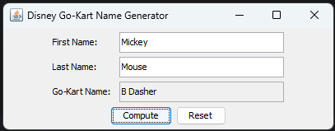
Intro:> Develop a Disney Go-Kart Lookup GUI.
NOTE:> THIS IS TEST DATA ONLY. THIS POWERPOINT FILE IS USED AS SAMPLE INPUT FOR THE DECKNOTE APPLICATION.
Text:> Create a sample GUI application concept that looks up go-kart assignments for Disney Adventure drivers. When completed, the sample application should look like this:

Slide 3
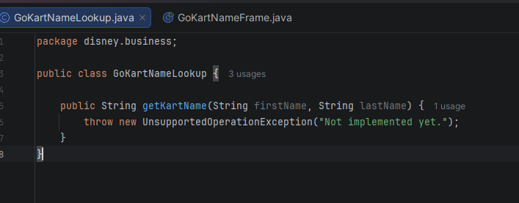
Title:> Review the existing code
Sequence:> 1 of 2
Steps:>
Open the project that contains the Disney go-kart lookup application starter code.
Open the GoKartNameLookup class in the disney.business package and review the existing method. Note that the getKartName() method is currently a stub and throws a "Not implemented yet" exception.
Open the GoKartNameFrame class in the disney.ui package and review the existing code. Note that:
the class extends JFrame
the constructor calls the initComponents() method
the initComponents() method currently creates only an empty frame with a title and size
the computeButtonClicked() and resetButtonClicked() methods are currently stubs
the main() method creates and displays the frame
Run the application. This should display an empty frame titled Disney Go-Kart Name Generator.
Resize the frame if needed and confirm that it contains no input fields, labels, or buttons yet.

Slide 4
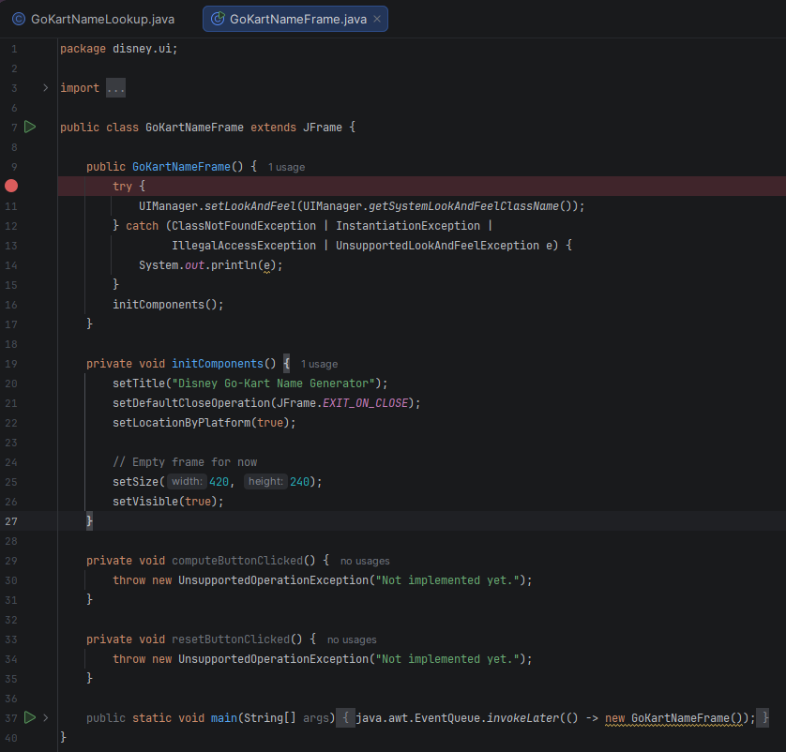
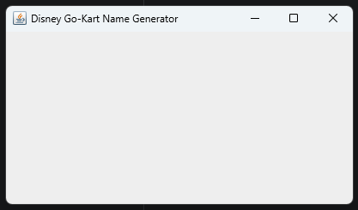
Sequence :> 2 of 2

Slide 5
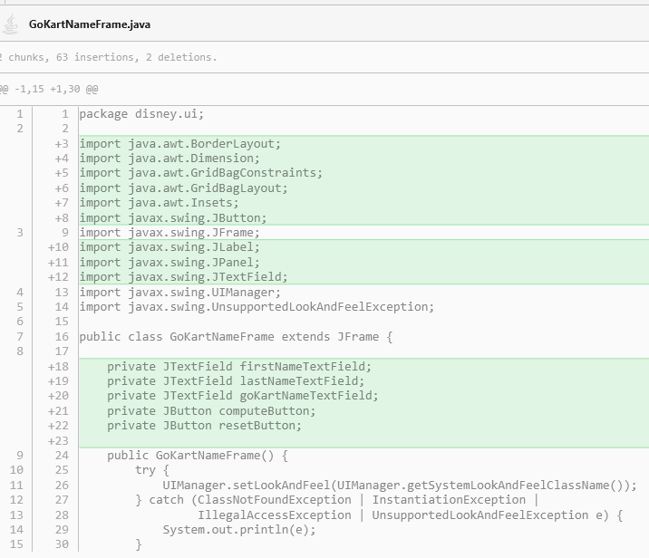
Title:> Add the components to the frame
Sequence :> 1 of 2
Steps:>
Open the GoKartNameFrame class in the disney.ui package.
Add instance variables for the three text fields and two buttons: - firstNameTextField - lastNameTextField - goKartNameTextField - computeButton - resetButton
Add code to the initComponents() method to build the user interface. This method should: - create the three text fields - make the Go-Kart Name text field non-editable - set the minimum and preferred size for all three text fields - create the Compute and Reset buttons - attach action listeners to both buttons - create a panel that uses the GridBagLayout manager - add the labels and text fields to the panel - create a button panel and add the two buttons - add both panels to the frame - pack the frame to set its size
Add the getConstraints() helper method so the labels and text fields can be positioned correctly in the GridBagLayout.
Run the application. This should display a frame with the First Name, Last Name, and Go-Kart Name fields, along with the Compute and Reset buttons. However, the button-click methods should still be unfinished at this stage.

Slide 6
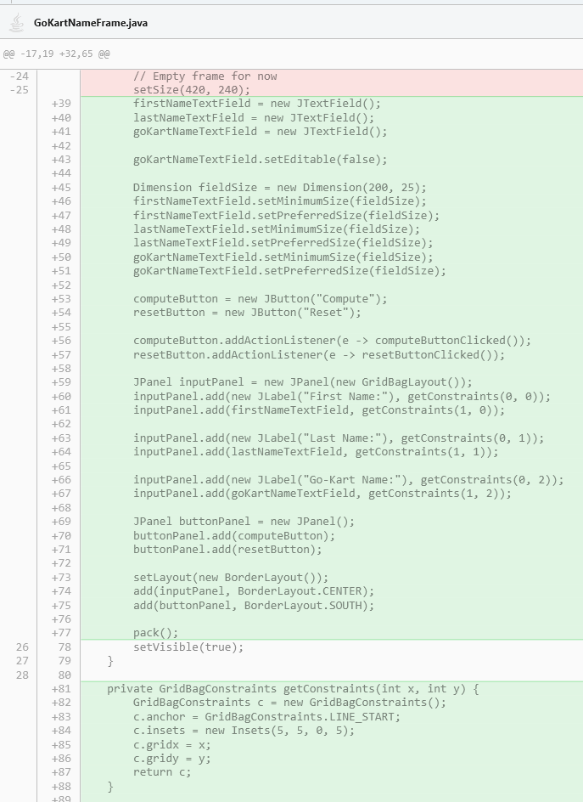
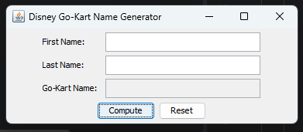
Sequence :> 2 of 2

Slide 7
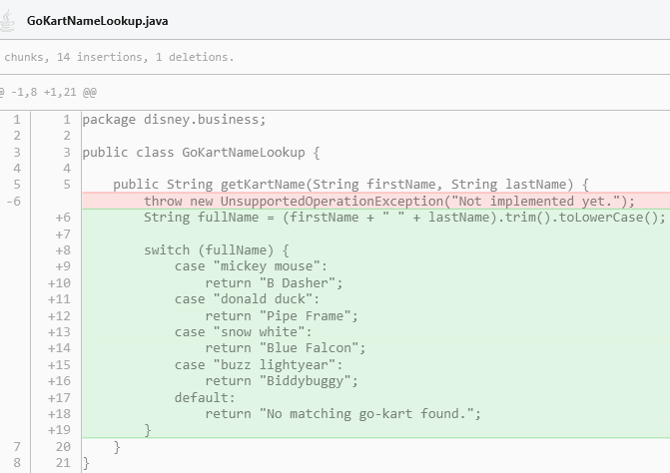
Title:> Handle the button events and add lookup logic
Sequence :> 1 of 2
Steps:>
Open the GoKartNameLookup class in the disney.business package.
Implement the getKartName() method so it returns the correct go-kart name for each supported Disney driver: - Mickey Mouse -> B Dasher - Donald Duck -> Pipe Frame - Snow White -> Blue Falcon - Buzz Lightyear -> Biddybuggy
Open the GoKartNameFrame class in the disney.ui package.
Implement the computeButtonClicked() method. This method should: - get the First Name and Last Name values from the text fields - validate that both fields contain input - display an error dialog if either field is missing - call the GoKartNameLookup class to retrieve the correct go-kart name - display the result in the Go-Kart Name text field
Implement the resetButtonClicked() method. This method should: - clear the First Name, Last Name, and Go-Kart Name text fields - place the cursor back in the First Name field
Run the application and test the lookup using the supported sample inputs. Confirm that each supported name pair displays the correct go-kart name.
Test the Reset button and confirm that it clears all fields correctly.

Slide 8
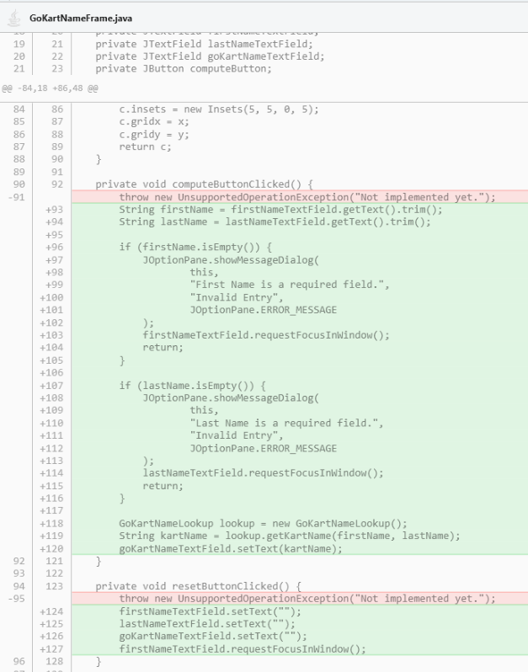
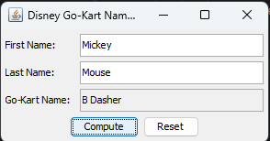
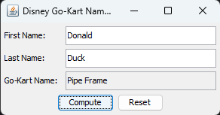
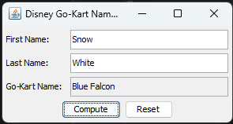
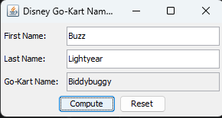
Sequence :> 2 of 2
Test:> “Reset” button tested and works!

