Slide 1
A developmental math textbook:
Modeling, Functions, and Graphs: Algebra for College Students (5th)
Katherine Yoshiwara

Slide 2
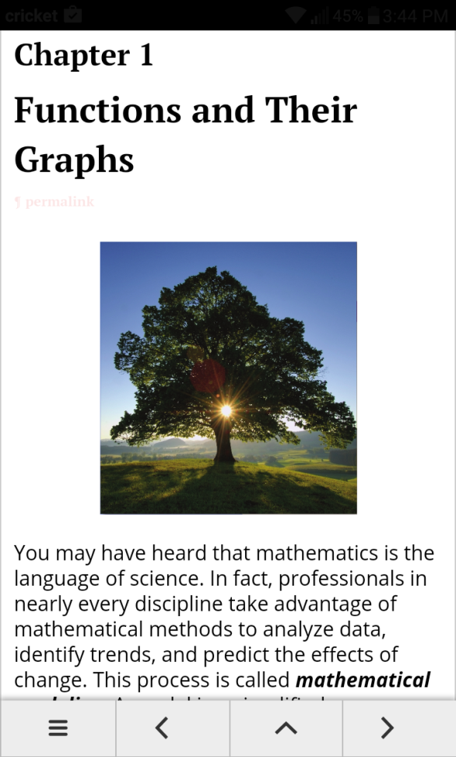
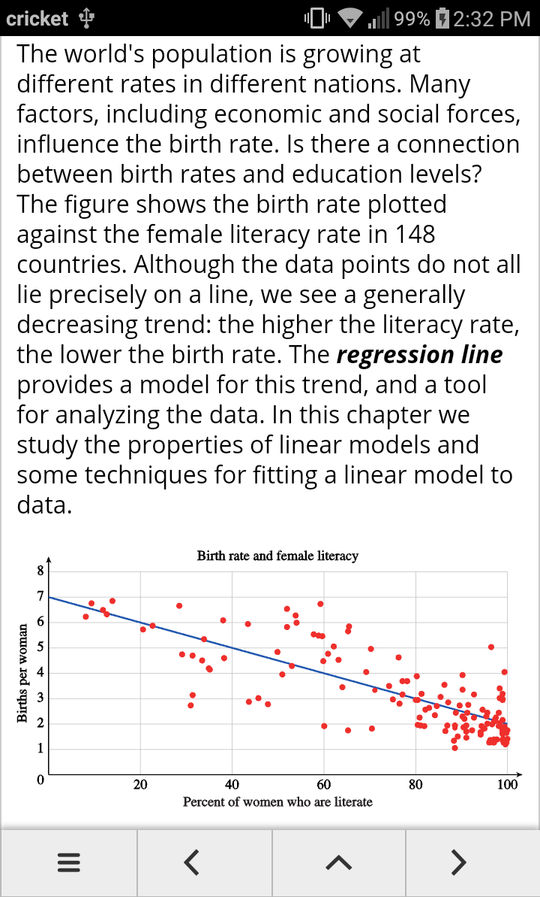

Modeling, Functions, and Graphs: Algebra for College Students (5th) Katherine Yoshiwara
https://rawgit.com/byoshiwara/mfg/master/chap1.html
http://bit.ly/2i1b1zB

Slide 3
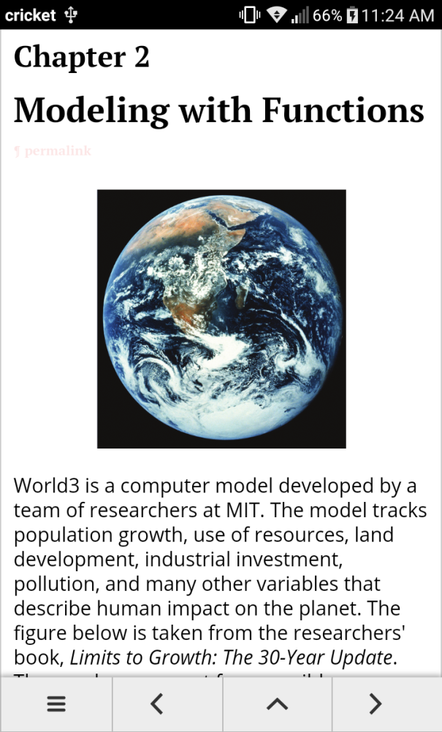
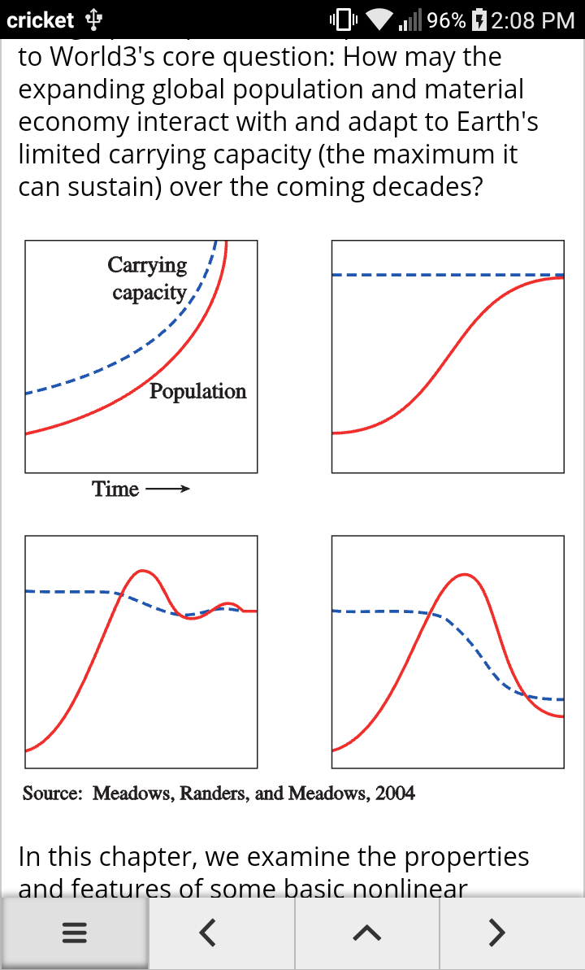
Modeling, Functions, and Graphs: Algebra for College Students (5th), Katherine Yoshiwara
Each chapter opens with a problem of historical or contemporary significance to introduce the material in the chapter. These scenarios encourage students to look for ways that real life can be described or predicted mathematically.

Slide 4
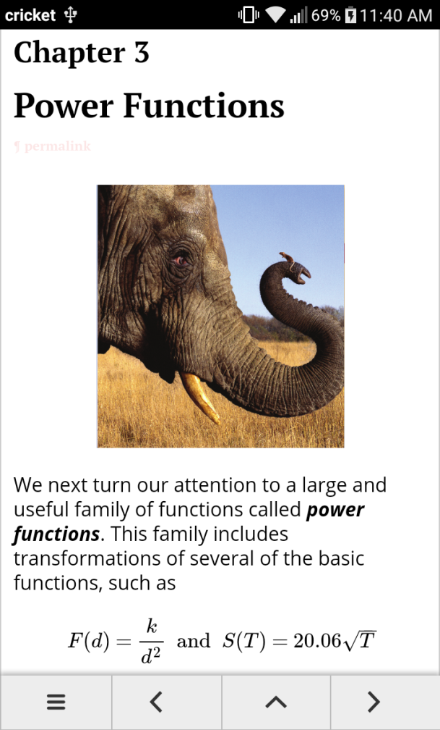
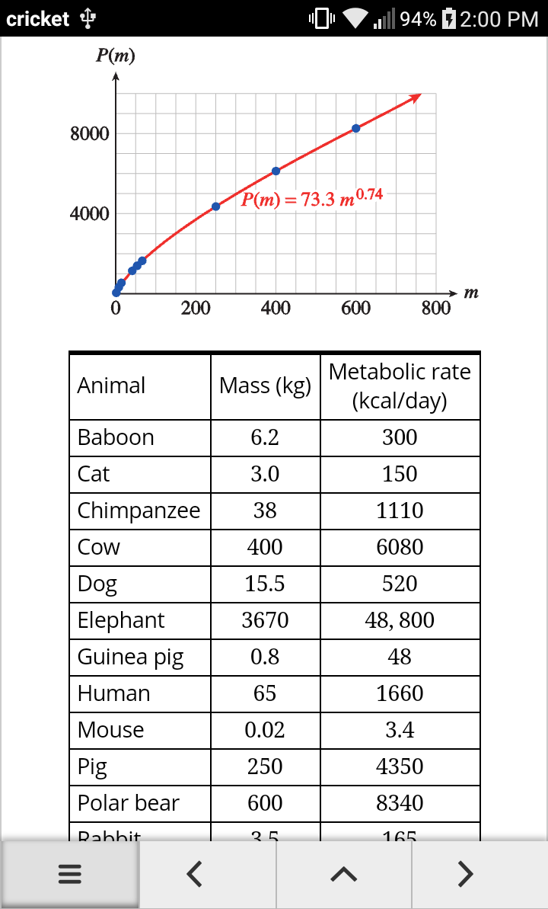
Modeling, Functions, and Graphs: Algebra for College Students (5th), Katherine Yoshiwara
The ability to model problems or phenomena by algebraic expressions and equations is the
ultimate goal of any algebra course. Through a variety of applications, we motivate students to develop the skills and techniques of algebra.

Slide 5
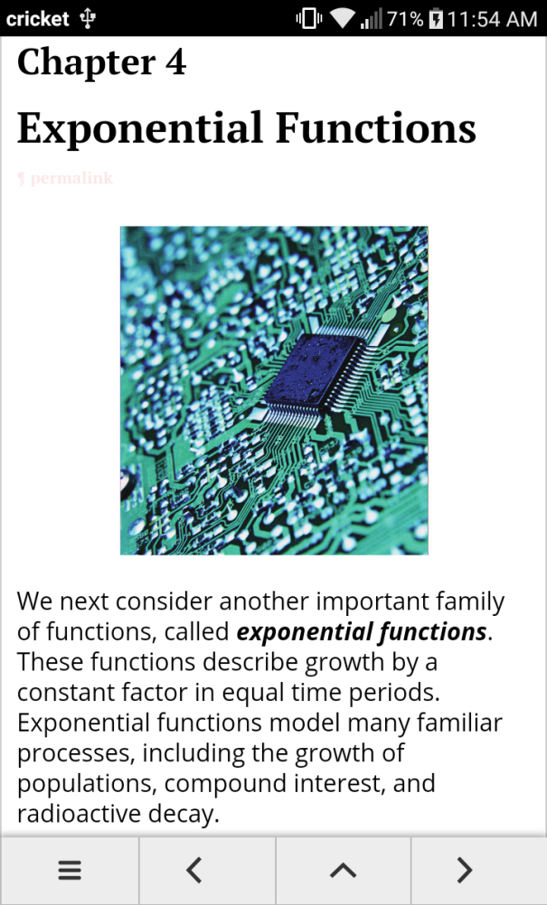
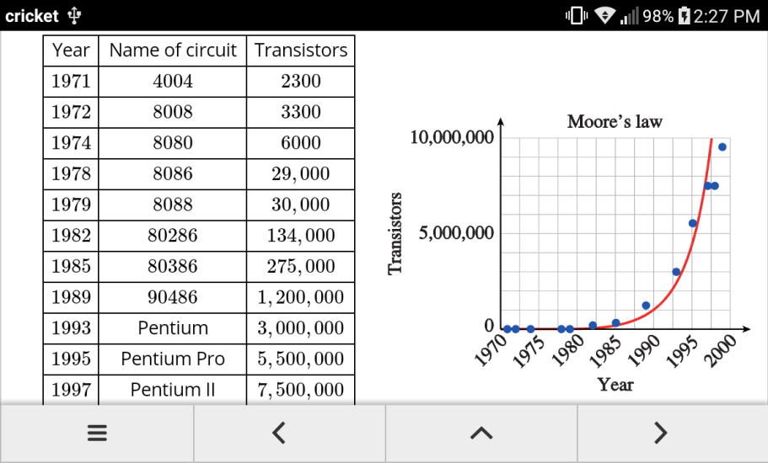
Modeling, Functions, and Graphs: Algebra for College Students (5th) Katherine Yoshiwara
In all our work with functions and modeling we employ the “Rule of Four,” that all problems should be considered using algebraic, numerical, graphical, and verbal methods.

Slide 6
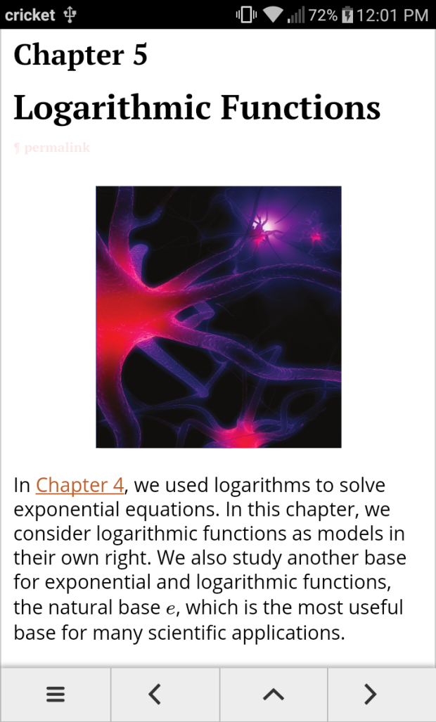
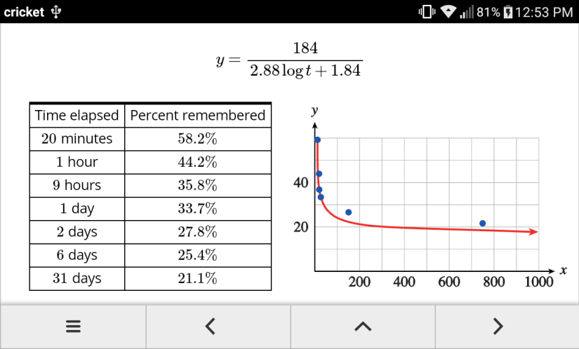
Modeling, Functions, and Graphs: Algebra for College Students (5th) Katherine Yoshiwara
Many students have trouble progressing from a point-wise understanding of graphs to a more global view. By taking advantage of graphing utilities, we examine a large number of examples and study them in more detail than is possible when every graph is plotted by hand.

Slide 7
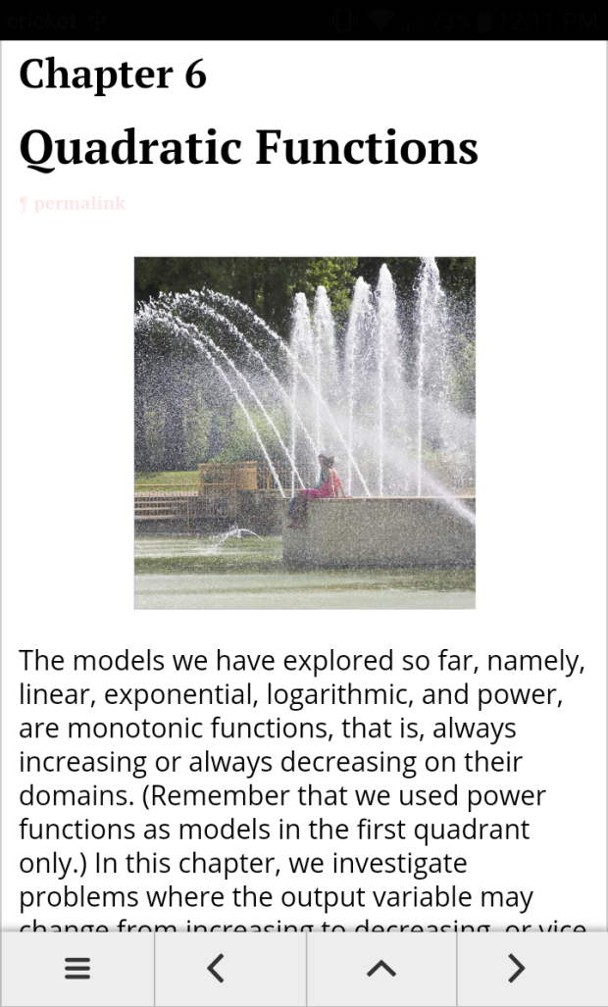
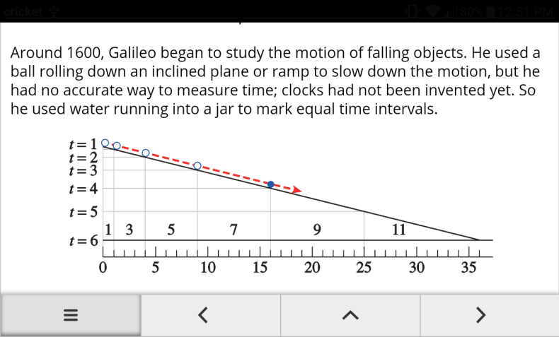
Modeling, Functions, and Graphs: Algebra for College Students (5th) Katherine Yoshiwara
We have provided a wide range of open-ended problems that emphasize mathematical modeling using tables of values, algebraic expressions, and graphs. We have
also included practice exercises for each new skill, so that instructors
may decide how much drill or manipulation is appropriate for their classes.

Slide 8
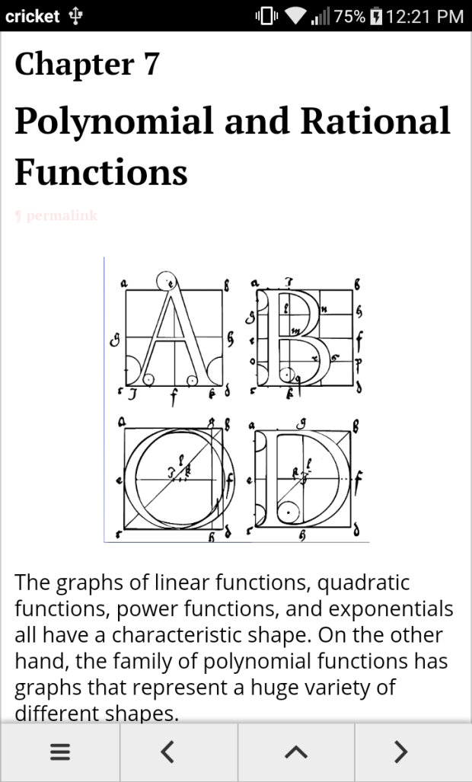
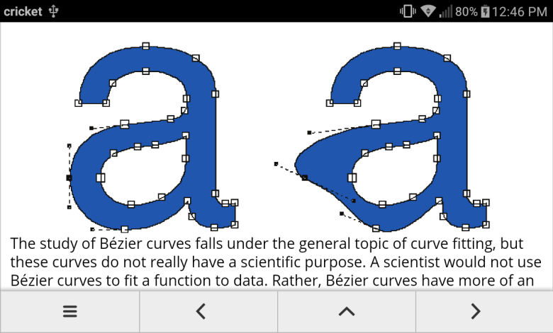
Modeling, Functions, and Graphs: Algebra for College Students (5th) Katherine Yoshiwara
This 5th edition is being prepared using Mathbook xml.
Thus it will be available in html and LaTeX (and hence pdf) formats.

Slide 9
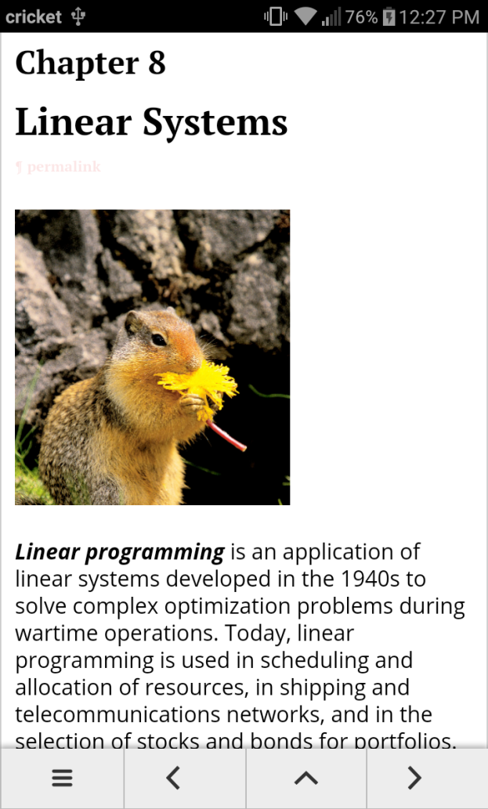
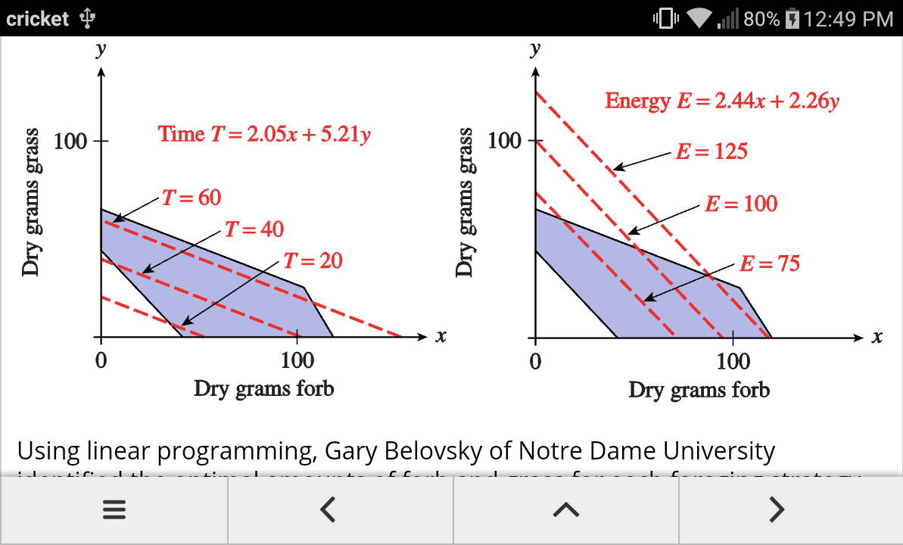
Modeling, Functions, and Graphs: Algebra for College Students (5th) Katherine Yoshiwara
Anticipated availability: Summer 2017

