Slide 1
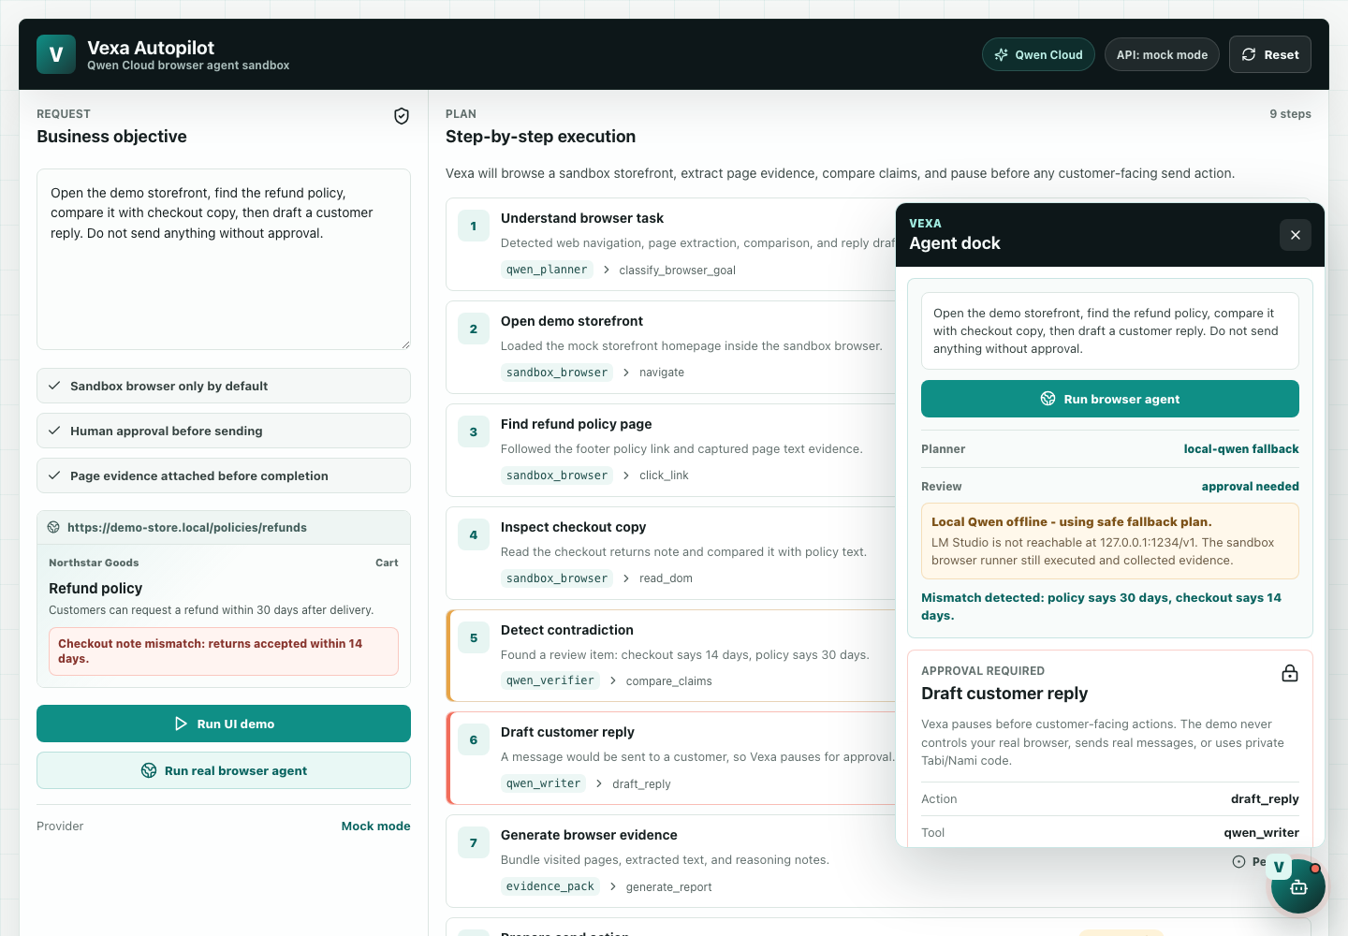
Vexa Autopilot
Qwen browser-agent sandbox with evidence and approval gates
Track 4: Autopilot Agent
Public repo: github.com/bypinkland-mi/vexa-autopilot
Vexa Autopilot / Qwen Cloud Hackathon
01

Slide 2
Why this agent matters
Browser automation is only useful if it can explain what it saw and stop before risky actions.
30 vs 14
6
0
MIT
Policy mismatch detected between refund page and checkout copy.
Sandbox browser steps: navigate, click, extract, compare, pause.
Real customer messages sent automatically.
Open-source repo ready for Devpost judging.
Vexa Autopilot / Qwen Cloud Hackathon
02

Slide 3
Autopilot workflow
A narrow business task runs through model planning, deterministic browser execution, evidence capture, and human approval.
01
Business objective
02
Qwen plan
03
Sandbox runner
Reviewer asks Vexa to inspect a storefront refund policy and checkout copy.
Qwen Cloud or local Qwen returns a JSON browser plan. Fallback is visible.
Playwright executes only allowlisted local sandbox pages and actions.
04
Evidence report
05
Approval gate
DOM extracts are attached to the result for auditability.
Draft reply pauses before any customer-facing send action.
Vexa Autopilot / Qwen Cloud Hackathon
03

Slide 4
Architecture
The model plans; deterministic code enforces boundaries and collects evidence.
React UI
Express API
Qwen adapter
Playwright runner
>
>
>
Objective, trace, evidence, approval panel
/api/health, /api/browser-agent/run, /sandbox/*
DashScope-compatible API or local Qwen endpoint
Allowed sandbox navigation and DOM extraction
evidence + pause
Approval result
Human review required before customer reply
Vexa Autopilot / Qwen Cloud Hackathon
04

Slide 5
What the demo shows
The floating V agent dock gives a browser-agent entry point without using private Tabi/Nami code.
- Planner status is visible: Qwen, local Qwen, or safe fallback.
- Trace and evidence are shown before completion.
- Customer reply is drafted but not sent.
- Sandbox-only runner protects real browser profiles and data.
Public-safe demo, not a Tabi source-code fork.
Vexa Autopilot / Qwen Cloud Hackathon
05

Slide 6
Safety model
Vexa is intentionally narrow: enough to prove the agent pattern, without exposing private product code or customer data.
No real browser profile
Sandbox pages only; no cookies, customer files, or logged-in sessions.
No unattended send
The reply action ends in waiting_for_human.
Visible fallback
Provider errors are surfaced instead of pretending a Qwen call succeeded.
Open boundary
Public repo excludes private Tabi desktop and Nami core source.
Vexa Autopilot / Qwen Cloud Hackathon
06

Slide 7
Submission evidence
The public package is verifiable before cloud deployment.
Repo
License
CI
Docker
Public GitHub repository published
MIT detected on GitHub
Submission checks passing
Container smoke passed
Code proof
github.com/bypinkland-mi/vexa-autopilot/blob/main/server/qwen-cloud.mjs
Vexa Autopilot / Qwen Cloud Hackathon
07

Slide 8
Remaining external gates
The repo is ready. Final eligibility needs Alibaba Cloud and media submission evidence.
01
Configure Alibaba Cloud
02
Deploy backend
Create ~/.aliyun/config.json or deploy through console with the documented env vars.
Run the Docker image on Alibaba Cloud and keep the URL online for judging.
03
Verify URL
04
Submit Devpost
Run npm run verify:cloud -- <cloud-url> and capture /api/health plus agent trace.
Upload demo video, deck, code proof link, architecture, and Track 4 description.
Vexa Autopilot / Qwen Cloud Hackathon
08

